Slide 1

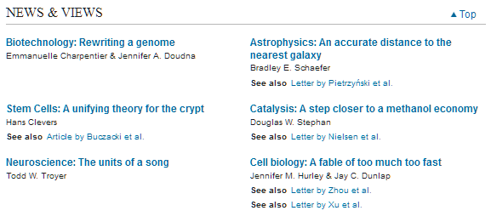
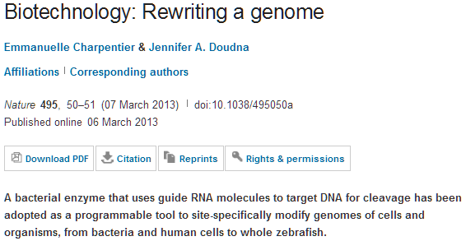
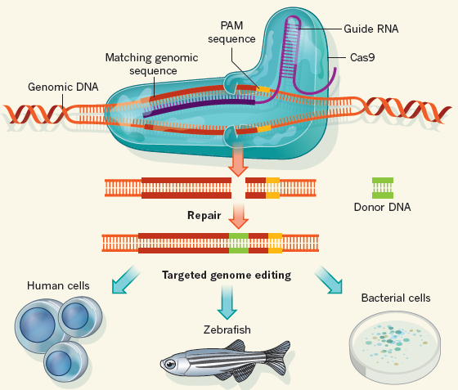

Slide 2
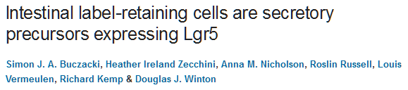
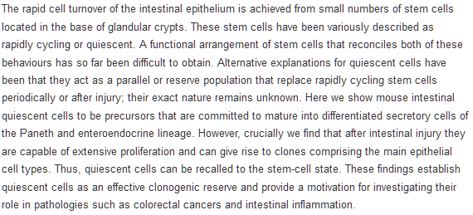
Stem Cells: A unifying theory for the crypt
Hans Clevers
A long-standing ambiguity has been whether quiescent cells located in intestinal crypt structures are stem cells. The answer seems to be yes and no, depending on how one defines the term stem cell.

Slide 3
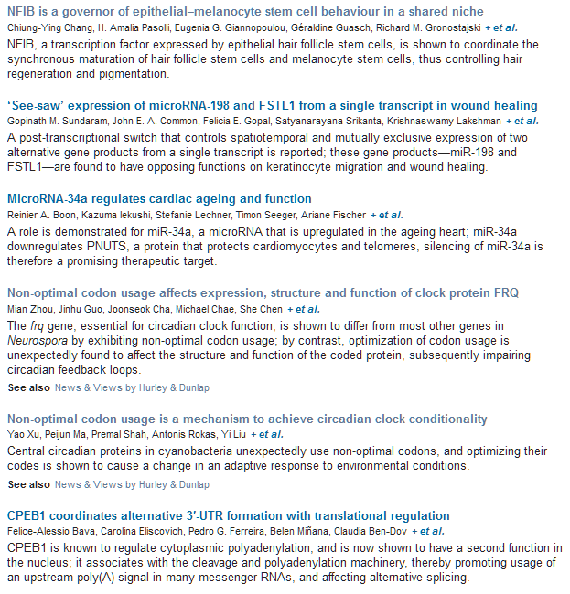

Slide 4

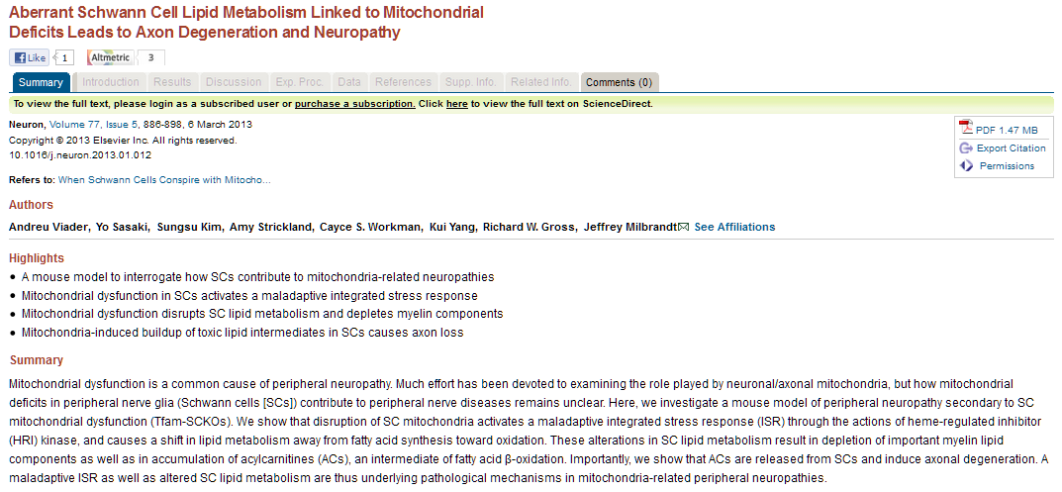

Slide 5

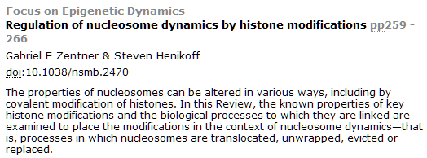
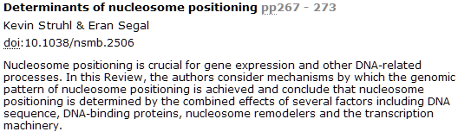
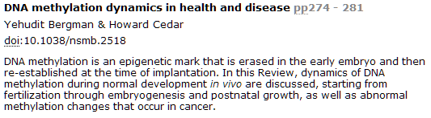

Slide 6
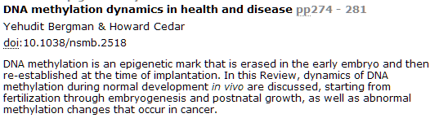
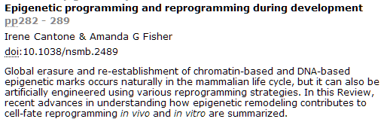
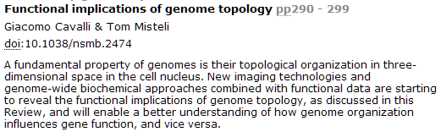
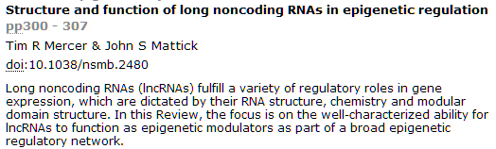

Slide 7
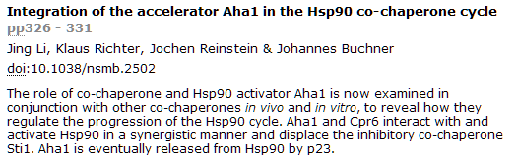
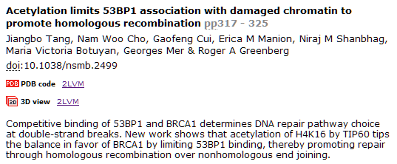
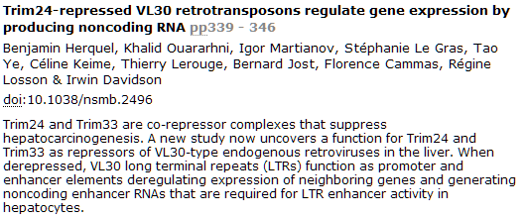

Slide 8

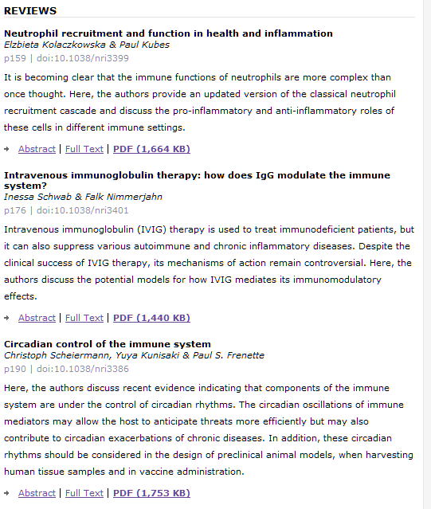

Slide 9

Darkness Alters Maturation of Visual Cortex and Promotes Fast Recovery from Monocular Deprivation p382Kevin R. Duffy, Donald E. Mitchell
Summary | Full Text | PDF (611 kb)
Source Memory in the Rat
p387Jonathon D. Crystal, Wesley T. Alford, Wenyi Zhou, Andrea G. Hohmann
Summary | Full Text | PDF (278 kb)
Molecular Timetrees Reveal a Cambrian Colonization of Land and a New Scenario for Ecdysozoan Evolution
p392Omar Rota-Stabelli, Allison C. Daley, Davide Pisani
Summary | Full Text | PDF (661 kb)
Traces of Experience in the Lateral Entorhinal Cortex
p399Albert Tsao, May-Britt Moser, Edvard I. Moser
Summary | Full Text | PDF (1764 kb)
Social Modulation of Peripersonal Space Boundaries
p406Chiara Teneggi, Elisa Canzoneri, Giuseppe di Pellegrino, Andrea Serino
Summary | Full Text | PDF (428 kb)
Retinoid Acid Specifies Neuronal Identity through Graded Expression of Ascl1
p412John Jacob, Jennifer Kong, Steven Moore, Christopher Milton, Noriaki Sasai, Rosa Gonzalez-Quevedo, Javier Terriente, Itaru Imayoshi, Ryoichoro Kageyama, David G. Wilkinson, Bennett G. Novitch, James Briscoe
Summary | Full Text | PDF (1286 kb)

Slide 10
Coldness Triggers Northward Flight in Remigrant Monarch Butterflies
p419Patrick A. Guerra, Steven M. Reppert
Summary | Full Text | PDF (1106 kb)
Calcium Flashes Orchestrate the Wound Inflammatory Response through DUOX Activation and Hydrogen Peroxide Release
p424William Razzell, Iwan Robert Evans, Paul Martin, Will Wood
Summary | Full Text | PDF (925 kb)
Cellular Mechanotransduction Relies on Tension-Induced and Chaperone-Assisted Autophagy
p430Anna Ulbricht, Felix J. Eppler, Victor E. Tapia, Peter F.M. van der Ven, Nico Hampe, Nils Hersch, Padmanabhan Vakeel, Daniela Stadel, Albert Haas, Paul Saftig, Christian Behrends, Dieter O. Fürst, Rudolf Volkmer, Bernd Hoffmann, Waldemar Kolanus, Jörg Höhfeld
Summary | Full Text | PDF (1035 kb)
Tremor Suppression by Rhythmic Transcranial Current Stimulation
p436John-Stuart Brittain, Penny Probert-Smith, Tipu Z. Aziz, Peter Brown
Summary | Full Text | PDF (979 kb)

Slide 11
Darkness Alters Maturation of Visual Cortex and Promotes Fast Recovery from Monocular Deprivation p382Kevin R. Duffy, Donald E. Mitchell
Summary | Full Text | PDF (611 kb)
Source Memory in the Rat
p387Jonathon D. Crystal, Wesley T. Alford, Wenyi Zhou, Andrea G. Hohmann
Summary | Full Text | PDF (278 kb)
Molecular Timetrees Reveal a Cambrian Colonization of Land and a New Scenario for Ecdysozoan Evolution
p392Omar Rota-Stabelli, Allison C. Daley, Davide Pisani
Summary | Full Text | PDF (661 kb)
Traces of Experience in the Lateral Entorhinal Cortex
p399Albert Tsao, May-Britt Moser, Edvard I. Moser
Summary | Full Text | PDF (1764 kb)
Social Modulation of Peripersonal Space Boundaries
p406Chiara Teneggi, Elisa Canzoneri, Giuseppe di Pellegrino, Andrea Serino
Summary | Full Text | PDF (428 kb)
Retinoid Acid Specifies Neuronal Identity through Graded Expression of Ascl1
p412John Jacob, Jennifer Kong, Steven Moore, Christopher Milton, Noriaki Sasai, Rosa Gonzalez-Quevedo, Javier Terriente, Itaru Imayoshi, Ryoichoro Kageyama, David G. Wilkinson, Bennett G. Novitch, James Briscoe
Summary | Full Text | PDF (1286 kb)

Slide 12
Coldness Triggers Northward Flight in Remigrant Monarch Butterflies
p419Patrick A. Guerra, Steven M. Reppert
Summary | Full Text | PDF (1106 kb)
Calcium Flashes Orchestrate the Wound Inflammatory Response through DUOX Activation and Hydrogen Peroxide Release
p424William Razzell, Iwan Robert Evans, Paul Martin, Will Wood
Summary | Full Text | PDF (925 kb)
Cellular Mechanotransduction Relies on Tension-Induced and Chaperone-Assisted Autophagy
p430Anna Ulbricht, Felix J. Eppler, Victor E. Tapia, Peter F.M. van der Ven, Nico Hampe, Nils Hersch, Padmanabhan Vakeel, Daniela Stadel, Albert Haas, Paul Saftig, Christian Behrends, Dieter O. Fürst, Rudolf Volkmer, Bernd Hoffmann, Waldemar Kolanus, Jörg Höhfeld
Summary | Full Text | PDF (1035 kb)
Tremor Suppression by Rhythmic Transcranial Current Stimulation
p436John-Stuart Brittain, Penny Probert-Smith, Tipu Z. Aziz, Peter Brown
Summary | Full Text | PDF (979 kb)

Slide 13

Scientific Reports

Slide 14
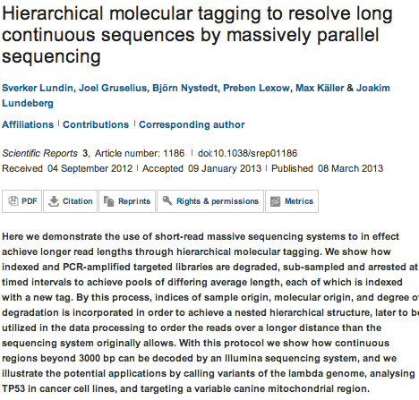

Slide 15
ONCOGENE
Aberrant IKKα and IKKβ cooperatively activate NF-κB and induce EGFR/AP1 signaling to promote survival and migration of head and neck cancer.
Nottingham LK, Yan CH, Yang X, Si H, Coupar J, Bian Y, Cheng TF, Allen C, Arun P, Gius D, Dang L, Van Waes C,Chen Z.
Tumor Biology Section, Head and Neck Surgery Branch, National Institute on Deafness and Other Communication Disorders, NIH, Bethesda, MD, USA.
The inhibitor-κB kinase-nuclear factor-κB (IKK-NF-κB) and epidermal growth factor receptor-activator protein-1 (EGFR-AP1) pathways are often co-activated and promote malignant behavior, but the underlying basis for this relationship is unclear. Resistance to inhibitors of IKKβ or EGFR is observed in head and neck squamous cell carcinomas (HNSCC). Here, we reveal that both IKKα and β contribute to nuclear activation of canonical and alternate NF-κB/REL family transcription factors, and overexpression of signal components that enhance co-activation of the EGFR-AP1 pathway. We observed that IKKα and IKKβ exhibit increased protein expression, nuclear localization, and phosphorylation in HNSCC tissues and cell lines. Individually, IKK activity varied among different cell lines, but overexpression of both IKKs induced the strongest NF-κB activation. Conversely, siRNA knock down of both IKKs significantly decreased nuclear localization and phosphorylation of canonical RELA and IκBα and alternative p52 and RELB subunits. Knock down of both IKKs more effectively inhibited NF-κB activation, broadly modulated gene expression and suppressed cell proliferation and migration. Global expression profiling revealed that NF-κB, cytokine, inflammatory response and growth factor signaling are among the top pathways and networks regulated by IKKs. Importantly, IKKα and IKKβ together promoted the expression and activity of transforming growth factor α, EGFR and AP1 transcription factors cJun, JunB and Fra1. Knock down of AP1 subunits individually decreased 8/15 (53%) of IKK-targeted genes sampled and similarly inhibited cell proliferation and migration. Mutations of NF-κB and AP1-binding sites abolished or decreased IKK-induced interleukin-8 (IL-8) promoter activity. Compounds such as wedelactone with dual IKK inhibitory activity and geldanomycins that block IKKα/β and EGFR pathways were more active than IKKβ-specific inhibitors in suppressing NF-κB activation and proliferation and inducing cell death. We conclude that IKKα and IKKβ cooperatively activate NF-κB and EGFR/AP1 networks of signaling pathways and contribute to the malignant phenotype and the intrinsic or acquired therapeutic resistance of HNSCC.

Slide 16
MicroRNAs regulate both epithelial-to-mesenchymal transition and cancer stem cells.
Ceppi P, Peter ME.
Source
Feinberg School of Medicine, Northwestern University, Chicago, IL, USA.
ONCOGENE
Interaction between PARP-1 and HIF-2α in the hypoxic response.
Gonzalez-Flores A, Aguilar-Quesada R, Siles E, Pozo S, Rodríguez-Lara MI, López-Jiménez L, López-Rodríguez M,Peralta-Leal A, Villar D, Martín-Oliva D, Del Peso L, Berra E, Oliver FJ.
Source
Institute of Parasitology and Biomedicine López-Neyra, CSIC, Granada, Spain.
Roles of microRNAs during prostatic tumorigenesis and tumor progression.
Fang YX, Gao WQ.
Source
State Key Laboratory of Oncogenes and Related Genes, Stem Cell Research Center, Renji Hospital, Shanghai Jiaotong University School of Medicine, Shanghai, PR China.
Constitutively active TrkB confers an aggressive transformed phenotype to a neural crest-derived cell line.
Dewitt J, Ochoa V, Urschitz J, Elston M, Moisyadi S, Nishi R.
Source
Department of Anatomy and Neurobiology and Neuroscience Graduate Program, University of Vermont, Burlington, VT, USA.
Regulation of protein translation and c-Jun expression by prostate tumor overexpressed 1.
Marqués N, Sesé M, Cánovas V, Valente F, Bermudo R, de Torres I, Fernández Y, Abasolo I, Fernández PL, Contreras H, Castellón E, Celià-Terrassa T, Méndez R, Ramón Y Cajal S, Thomson TM, Paciucci R.
Source
Research Unit in Biomedicine, Translational and Pediatrics Oncology, Vall d'Hebron Institute of Research, Universidad Autónoma, Barcelona, Spain.
Activation of PDK-1 maintains mouse embryonic stem cell self-renewal in a PKB-dependent manner.
Ling LS, Voskas D, Woodgett JR.
Source
1] Department of Medical Biophysics, University of Toronto, Toronto, Ontario, Canada [2] Samuel Lunenfeld Research Institute, Mount Sinai Hospital, Toronto, Ontario, Canada.
Mutant B-RAF-Mcl-1 survival signaling depends on the STAT3 transcription factor.
Becker TM, Boyd SC, Mijatov B, Gowrishankar K, Snoyman S, Pupo GM, Scolyer RA, Mann GJ, Kefford RF, Zhang XD,Rizos H.
Source
Westmead Institute for Cancer Research, University of Sydney at Westmead Millennium Institute, Westmead Hospital, Sydney, New South Wales, Australia.
K63-Ubiquitylation of VHL by SOCS1 mediates DNA double-strand break repair.
Metcalf JL, Bradshaw PS, Komosa M, Greer SN, Stephen Meyn M, Ohh M.
Source
Department of Laboratory Medicine and Pathobiology, University of Toronto, Toronto, Ontario, Canada.

Slide 17

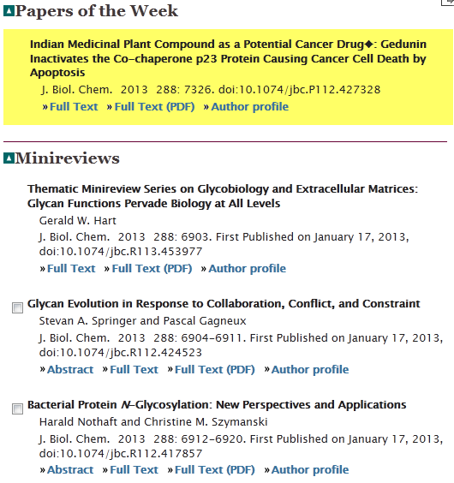
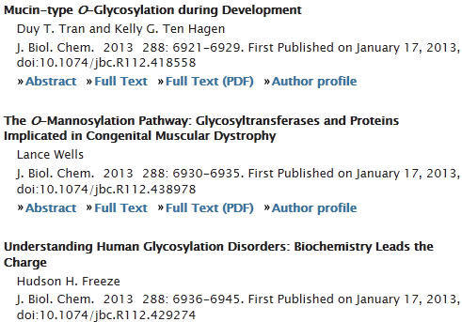

Slide 18
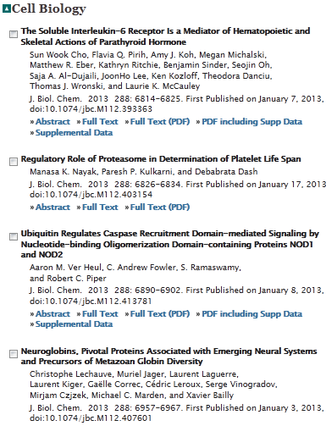
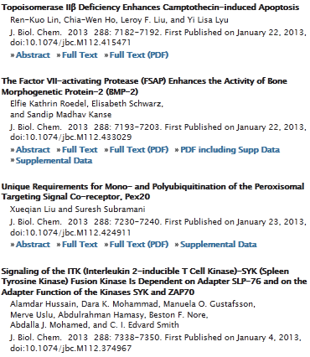

Slide 19
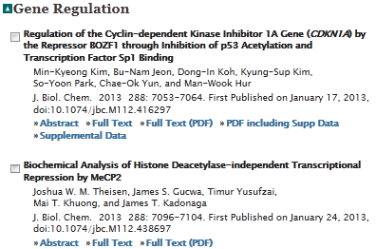
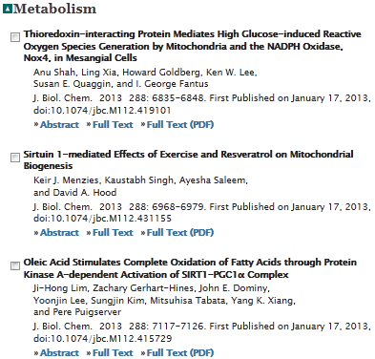


Slide 20
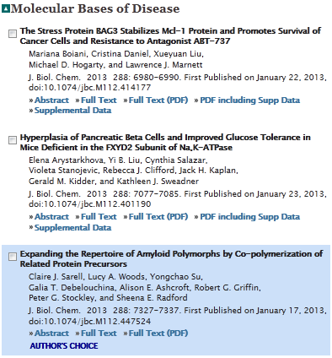
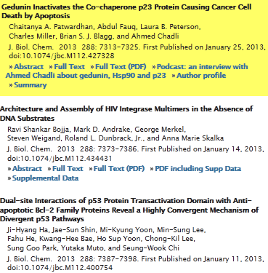

Slide 21
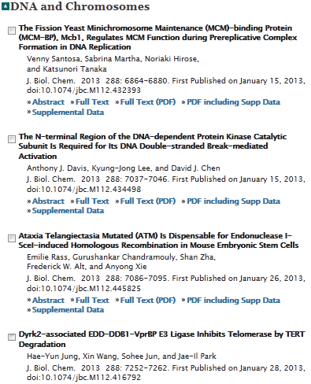

Slide 22
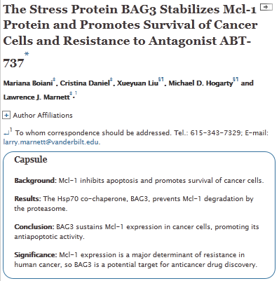

Slide 23
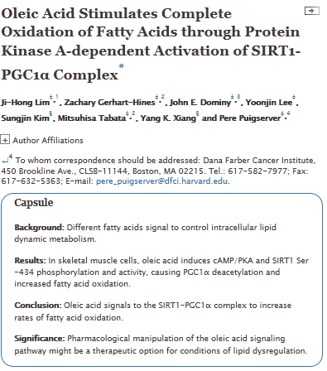

Slide 24
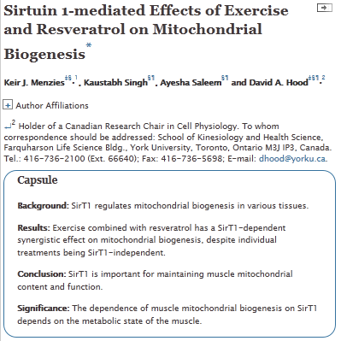

Slide 25
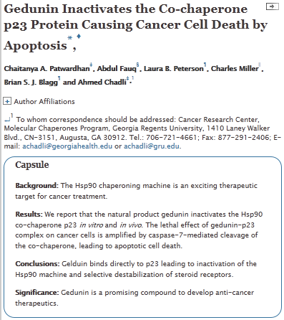

Slide 26
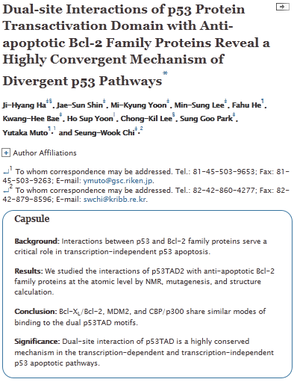

Slide 27
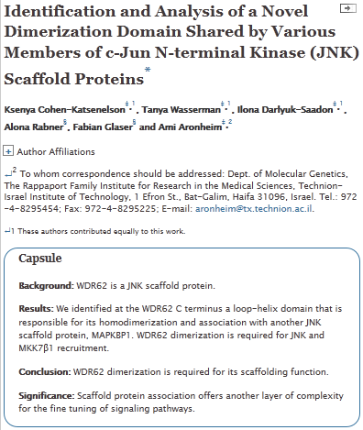

Slide 28

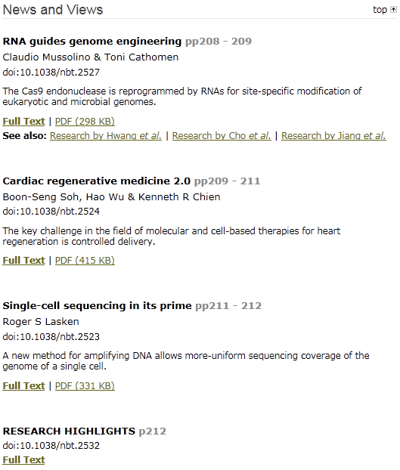

Slide 29


