Slide 1
[Science] 8 March 2013 vol 339, issue 6124, pages 1113-1244
EW
Perspectives-Medicine
(De)Personalized Medicine
Ralph I. Horwitz, Mark R. Cullen, Jill Abell, and Jennifer B. Christian
Science 8 March 2013: 1155-1156.[DOI:10.1126/science.1234106]
Integration of clinical, social, and environmental data with genomic and molecular information is needed to develop a personalized approach to medicine.
Perspectives-Neuroscience
Caffeine Boosts Bees' Memories
Lars Chittka and Fei Peng
Caffeine in floral nectar enhances the memory of bees for the flowers' scent by altering response properties of neurons in the bee brain.
Science. 2013 Mar 8;339(6124):1202-4. doi: 10.1126/science.1228806.
Caffeine in floral nectar enhances a pollinator's memory of reward.
Wright GA, Baker DD, Palmer MJ, Stabler D, Mustard JA, Power EF, Borland AM, Stevenson PC.
Centre for Behaviour and Evolution, Institute of Neuroscience, Newcastle University, Newcastle upon Tyne NE1 7RU, UK. jeri.wright@ncl.ac.uk
Plant defense compounds occur in floral nectar, but their ecological role is not well understood. We provide evidence that plant compounds pharmacologically alter pollinator behavior by enhancing their memory of reward. Honeybees rewarded with caffeine, which occurs naturally innectar of Coffea and Citrus species, were three times as likely to remember a learned floral scent as were honeybees rewarded with sucrose alone. Caffeine potentiated responses of mushroom body neurons involved in olfactory learning and memory by acting as an adenosine receptor antagonist. Caffeine concentrations in nectar did not exceed the bees' bitter taste threshold, implying that pollinators impose selection for nectar that is pharmacologically active but not repellent. By using a drug to enhance memories of reward, plants secure pollinator fidelity and improve reproductive success.

Slide 2
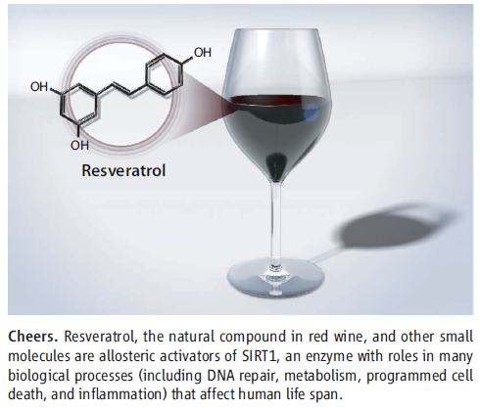
[Science] 8 March 2013 vol 339, issue 6124, pages 1113-1244
Science. 2013 Mar 8;339(6124):1216-9. doi: 10.1126/science.1231097.
Evidence for a common mechanism of SIRT1 regulation by allosteric activators.
Hubbard BP, Gomes AP, Dai H, Li J, Case AW, Considine T, Riera TV, Lee JE, E SY, Lamming DW, Pentelute BL, Schuman ER, Stevens LA, Ling AJ,Armour SM, Michan S, Zhao H, Jiang Y, Sweitzer SM, Blum CA, Disch JS, Ng PY, Howitz KT, Rolo AP, Hamuro Y, Moss J, Perni RB, Ellis JL, Vlasuk GP,Sinclair DA.
Department of Genetics, Harvard Medical School, Boston, MA 02115, USA.
A molecule that treats multiple age-related diseases would have a major impact on global health and economics. The SIRT1 deacetylase has drawn attention in this regard as a target for drug design. Yet controversy exists around the mechanism of sirtuin-activating compounds (STACs). We found that specific hydrophobic motifs found in SIRT1 substrates such as PGC-1α and FOXO3a facilitate SIRT1 activation by STACs. A single amino acid in SIRT1, Glu(230), located in a structured N-terminal domain, was critical for activation by all previously reported STAC scaffolds and a new class of chemically distinct activators. In primary cells reconstituted with activation-defective SIRT1, the metabolic effects of STACs were blocked. Thus, SIRT1 can be directly activated through an allosteric mechanism common to chemically diverse STACs.
Editor's Summary
It's a SIRT
Intense attention has focused on the SIRT1 deacetylase as a possible target for anti-aging drugs. But unexpected complications in assays of SIRT1 activity have made it unclear whether compounds thought to be sirtuin-activating compounds (STACs) are really direct regulators of the enzyme. Further exploration of these effects by Hubbard et al. (p. 1216; see the Perspective by Yuan and Marmorstein) revealed that interaction of SIRT1 with certain substrates allows activation of SIRT1 by STACs and identified critical amino acids in SIRT1 required for these effects. Mouse myoblasts reconstituted with SIRT1 mutated at this amino acid lost their responsiveness to STACs.
Perspectives-Biochemistry
Red Wine, Toast of the Town (Again)
Hua Yuan and Ronen Marmorstein
Science 8 March 2013: 1156-1157.[DOI:10.1126/science.1236463]
The debate may be over on whether resveratrol and
other small molecules directly activate an enzyme implicated in longevity.

Slide 3
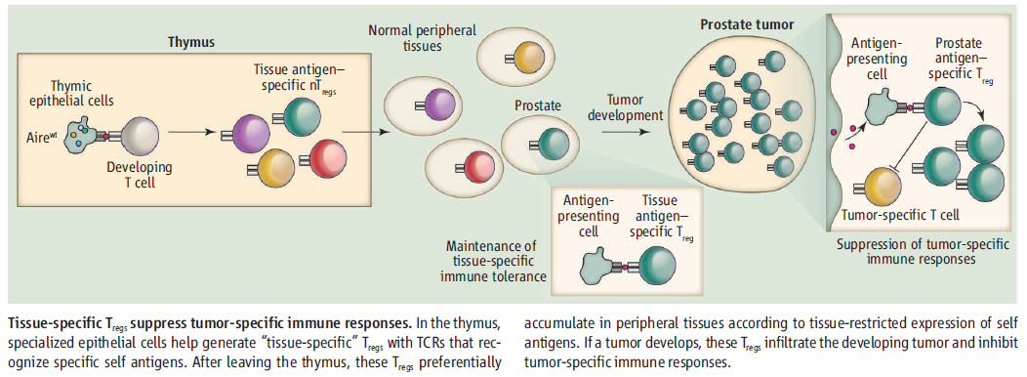
[Science] 8 March 2013 vol 339, issue 6124, pages 1113-1244
Perspectives-Immunology
Guilty by Association
Nikhil S. Joshi and Tyler Jacks
Science 8 March 2013: 1160-1161.[DOI:10.1126/science.1235528]
Fingerprinting regulatory T cells in tumors reveals that they are specific for organ-expressed antigens.
Science. 2013 Mar 8;339(6124):1219-24. doi: 10.1126/science.1233913.
Aire-dependent thymic development of tumor-associated regulatory T cells.
Malchow S, Leventhal DS, Nishi S, Fischer BI, Shen L, Paner GP, Amit AS, Kang C, Geddes JE, Allison JP, Socci ND, Savage PA.
Department of Pathology, University of Chicago, Chicago, IL 60637, USA.
Despite considerable interest in the modulation of tumor-associated Foxp3(+) regulatory T cells (T(regs)) for therapeutic benefit, little is known about the developmental origins of these cells and the nature of the antigens that they recognize. We identified an endogenous population of antigen-specific T(regs) (termed MJ23 T(regs)) found recurrently enriched in the tumors of mice with oncogene-driven prostate cancer. MJ23T(regs) were not reactive to a tumor-specific antigen but instead recognized a prostate-associated antigen that was present in tumor-free mice. MJ23 T(regs) underwent autoimmune regulator (Aire)-dependent thymic development in both male and female mice. Thus, Aire-mediated expression of peripheral tissue antigens drives the thymic development of a subset of organ-specific T(regs), which are likely coopted by tumors developing within the associated organ.

Slide 4
[Science] 8 March 2013 vol 339, issue 6124, pages 1113-1244
Science. 2013 Mar 8;339(6124):1210-3. doi: 10.1126/science.1232751.
Cell death from antibiotics without the involvement of reactive oxygen species.
Liu Y, Imlay JA.
Department of Microbiology, University of Illinois, Urbana, IL 61801, USA.
Recent observations have suggested that classic antibiotics kill bacteria by stimulating the formation of reactive oxygen species (ROS). If true, this notion might guide new strategies to improve antibiotic efficacy. In this study, the model was directly tested. Contrary to the hypothesis, antibiotic treatment did not accelerate the formation of hydrogen peroxide in Escherichia coli and did not elevate intracellular free iron, an essential reactant for the production of lethal damage. Lethality persisted in the absence of oxygen, and DNA repair mutants were not hypersensitive, undermining the idea that toxicity arose from oxidative DNA lesions. We conclude that these antibiotic exposures did not produce ROS and that lethality more likely resulted from the direct inhibition of cell-wall assembly, protein synthesis, and DNA replication.
Killing by Bactericidal Antibiotics Does Not Depend on Reactive Oxygen Species
Iris Keren, Yanxia Wu, Julio Inocencio, Lawrence R. Mulcahy, and Kim Lewis
Science 8 March 2013: 1213-1216.[DOI:10.1126/science.1232688]
Tests of the oxidative damage mechanism for antibiotic killing do not support the generality of the hypothesis.
Gene Transfer from Bacteria and Archaea Facilitated Evolution of an Extremophilic Eukaryote
Gerald Schönknecht, Wei-Hua Chen, Chad M. Ternes, Guillaume G. Barbier, Roshan P. Shrestha, Mario Stanke, Andrea Bräutigam, Brett J. Baker,
Jillian F. Banfield, R. Michael Garavito, Kevin Carr, Curtis Wilkerson, Stefan A. Rensing, David Gagneul, Nicholas E. Dickenson, Christine Oesterhelt,
Martin J. Lercher, and Andreas P. M. Weber
Science 8 March 2013: 1207-1210.[DOI:10.1126/science.1231707]
A mosaic of genes acquired from various phyla enable a red alga to grow abundantly in hot, acidic, and toxic niches.

Slide 5
[Science Sig]
Sci Signal. 2013 Mar 5;6(265):ra14. doi: 10.1126/scisignal.2003398.
The Small GTPase ARF6 Stimulates β-Catenin Transcriptional Activity During WNT5A-MediatedMelanoma Invasion and Metastasis.
Grossmann AH, Yoo JH, Clancy J, Sorensen LK, Sedgwick A, Tong Z, Ostanin K, Rogers A, Grossmann KF, Tripp SR, Thomas KR, D'Souza-Schorey C,Odelberg SJ, Li DY.
1Department of Pathology, University of Utah, Salt Lake City, UT 84112, USA.
β-Catenin has a dual function in cells: fortifying cadherin-based adhesion at the plasma membrane and activating transcription in the nucleus. We found that in melanoma cells, WNT5A stimulated the disruption of N-cadherin and β-catenin complexes by activating the guanosine triphosphatase adenosine diphosphate ribosylation factor 6 (ARF6). Binding of WNT5A to the Frizzled 4-LRP6 (low-density lipoprotein receptor-related protein 6) receptor complex activated ARF6, which liberated β-catenin from N-cadherin, thus increasing the pool of free β-catenin, enhancing β-catenin-mediated transcription, and stimulating invasion. In contrast to WNT5A, the guidance cue SLIT2 and its receptor ROBO1 inhibited ARF6 activation and, accordingly, stabilized the interaction of N-cadherin with β-catenin and reduced transcription and invasion. Thus,ARF6 integrated competing signals in melanoma cells, thereby enabling plasticity in the response to external cues. Moreover, small-molecule inhibition of ARF6 stabilized adherens junctions, blocked β-catenin signaling and invasiveness of melanoma cells in culture, and reduced spontaneous pulmonary metastasis in mice, suggesting that targeting ARF6 may provide a means of inhibiting WNT/β-catenin signaling in cancer.
Sci Signal. 2013 Mar 5;6(265):ra15. doi: 10.1126/scisignal.2003661.
Akt and PP2A Reciprocally Regulate the Guanine Nucleotide Exchange Factor Dock6 to Control AxonGrowth of Sensory Neurons.
Miyamoto Y, Torii T, Yamamori N, Ogata T, Tanoue A, Yamauchi J.
1Department of Pharmacology, National Research Institute for Child Health and Development, Setagaya, Tokyo 157-8535, Japan.
During neuronal development, axons navigate long distances, eventually forming precise connections with such targets as peripheral tissues.Dock6 is a guanine nucleotide exchange factor (GEF) that activates the Rho family guanosine triphosphatases Rac1 and Cdc42 to regulate the actin cytoskeleton. We found that phosphorylation of Ser in Dock6 inhibited its GEF activity and suppressed axonal growth of embryonic sensoryneurons and axon regeneration of postnatal sensory neurons in vitro and in vivo. At early developmental stages, when axons are growing, the protein phosphatase PP2A interacted with and dephosphorylated Dock6, thereby increasing the activity of Dock6. At later developmental stages, the abundance of the kinase Akt increased, resulting in the binding of Akt to Dock6 and the phosphorylation of Dock6 at Ser. In dorsal root ganglion neurons from mice lacking Dock6, reintroduction of Dock6 with a nonphosphorylatable S1194A mutation rescued axon extension but not branch number, whereas reintroduction of Dock6 with a phosphomimetic S1194E mutation resulted in premature branching. Thus, the phosphorylation status of Dock6 at Ser determines whether it promotes axon extension or branching in sensory neurons, revealing interplay between kinase and phosphatase action on a Rho-GEF during axon growth.

Slide 6

KJ
Calpain-2-Mediated PTEN Degradation Contributes to BDNF-Induced Stimulation of Dendritic Protein Synthesis
Victor Briz1,*, Yu-Tien Hsu3,*, Yi Li1, Erin Lee3, Xiaoning Bi2, and Michel Baudry1,3
Abstract
Memory consolidation has been suggested to be protein synthesis dependent. Previous data indicate that BDNF-induced dendritic protein synthesis is a key event in memory formation through activation of the mammalian target of rapamycin (mTOR) pathway. BDNF also activates calpain, a calcium-dependent cysteine protease, which has been shown to play a critical role in learning and memory. This study was therefore directed at testing the hypothesis that calpain activity is required for BDNF-stimulated local protein synthesis, and at identifying the underlying molecular mechanism. In rat hippocampal slices, cortical synaptoneurosomes, and cultured neurons, BDNF-induced mTOR pathway activation and protein translation were blocked by calpain inhibition. BDNF treatment rapidly reduced levels of hamartin and tuberin, negative regulators of mTOR, in a calpain-dependent manner. Treatment of brain homogenates with purified calpain-1 and calpain-2 truncated both proteins. BDNF treatment increased phosphorylation of both Akt and ERK, but only the effect on Akt was blocked by calpain inhibition. Levels of phosphatase and tensin homolog deleted on chromosome 10 (PTEN), a phosphatase that inactivates Akt, were decreased following BDNF treatment, and calpain inhibition reversed this effect. Calpain-2, but not calpain-1, treatment of brain homogenates resulted in PTEN degradation. In cultured cortical neurons, knockdown of calpain-2, but not calpain-1, by small interfering RNA completely suppressed the effect of BDNF on mTOR activation. Our results reveal a critical role for calpain-2 in BDNF-induced mTOR signaling and dendritic protein synthesis via PTEN, hamartin, and tuberin degradation. This mechanism therefore provides a link between proteolysis and protein synthesis that might contribute to synaptic plasticity.

Slide 7


KJ

Slide 8


KJ

Slide 9
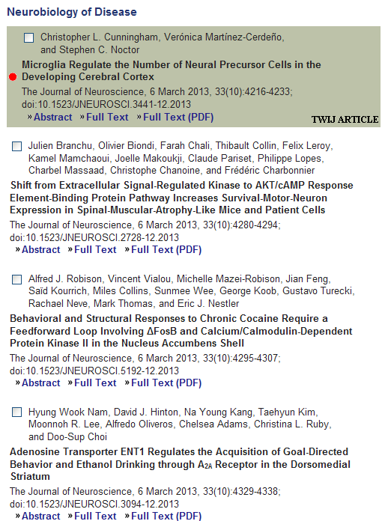
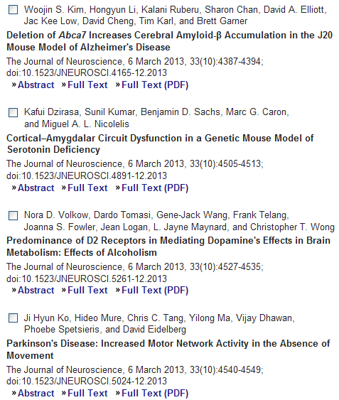
KJ

Slide 10

MH
Research Article
Hypoxia Antagonizes Glucose Deprivation on Interleukin 6 Expression in an Akt Dependent, but HIF-1/2α Independent Manner
Affiliation: Laboratory of Genome to Drug Medicine, Joint Center for Biosciences, Incheon, Korea
Received: September 19, 2012; Accepted: February 7, 2013; Published: March 8, 2013
Abstract
Although both glucose deprivation and hypoxia have been reported to promote cascades of biological alterations that lead to induction of inflammatory mediators, we hypothesized that glucose deprivation and hypoxia might show neutral, synergistic or antagonistic effects to each other on gene expression of inflammatory mediators depending on the regulatory components in their promoters. Gene expression of interleukin 6 (IL-6) was analyzed by real-time PCR, ELISA, or Western blot. Effects of glucose deprivation and/or hypoxia on activation of signaling pathways were analyzed by time-dependent phosphorylation patterns of signaling molecules. We demonstrate that hypoxia antagonized the effects of glucose deprivation on induction of IL-6 gene expression in microglia, macrophages, and monocytes. Hypoxia also antagonized thapsigargin-induced IL-6 gene expression. Hypoxia enhanced phosphorylation of Akt, and inhibition of Akt was able to reverse the effects of hypoxia on IL-6 gene expression. However, inhibition of HIF-1/2α did not reverse the effects of hypoxia on IL-6 gene expression. In addition, phosphorylation of p38, but not JNK, was responsible for the effects of glucose deprivation on IL-6 gene expression.

Slide 11
Research Article
Protein Kinase C Delta Negatively Modulates Canonical Wnt Pathway and Cell Proliferation in Colon Tumor Cell Lines
Affiliation: Department of Biochemistry, Faculty of Medicine, Universidad Nacional Autónoma de México (UNAM), Mexico City, Mexico
Received: July 23, 2012; Accepted: February 7, 2013; Published: March 8, 2013
Abstract
The tumor suppressor Adenomatous Polyposis coli (APC) gene is mutated or lost in most colon cancers. Alterations in Protein kinase C (PKC) isozyme expression and aberrant regulation also comprise early events in intestinal carcinomas. Here we show that PKCδ expression levels are decreased in colon tumor cell lines with respect to non-malignant cells. Reciprocal co-immunoprecipitation and immunofluorescence studies revealed that PKCδ interacts specifically with both full-length (from non-malignant cells) and truncated APC protein (from cancerous cells) at the cytoplasm and at the cell nucleus. Selective inhibition of PKCδ in cancer SW480 cells, which do not possess a functional β-catenin destruction complex, did not affect β-catenin-mediated transcriptional activity. However, in human colon carcinoma RKO cells, which have a normal β-catenin destruction complex, negatively affected β-catenin-mediated transcriptional activity, cell proliferation, and the expression of Wnt target genes C-MYC and CYCLIN D1. These negative effects were confirmed by siRNA-mediated knockdown of PKCδ and by the expression of a dominant negative form of PKCδ in RKO cells. Remarkably, the PKCδ stably depleted cells exhibited augmented tumorigenic activity in grafted mice. We show that PKCδ functions in a mechanism that involves regulation of β-catenin degradation, because PKCδ inhibition induces β-catenin stabilization at the cytoplasm and its nuclear presence at the C-MYC enhancer even without Wnt3a stimulation. In addition, expression of a dominant form of PKCδ diminished APC phosphorylation in intact cells, suggesting that PKCδ may modulate canonical Wnt activation negatively through APC phosphorylation.

Slide 12
The Polo-Like Kinase 1 (PLK1) Inhibitor NMS-P937 Is Effective in a New Model of Disseminated Primary CD56⁺ Acute Monoblastic Leukaemia Alessia Casolaro, Josee Golay, Clara Albanese, Roberta Ceruti, Veronica Patton, Sabrina Cribioli, Alice Pezzoni, Marco Losa, Gemma Texido, Ursula Giussani, Francesco Marchesi, Nadia Amboldi, Barbara Valsasina, Silvia Bungaro, Gianni Cazzaniga, Alessandro Rambaldi, Martino Introna, Enrico Pesenti, Rachele Alzani Research Article | published 08 Mar 2013 | PLOS ONE 10.1371/journal.pone.0058424 Views: 56 • Citations: None • Bookmarks: None
The Impact of Healthcare-Associated Infection on Mortality: Failure in Clinical Recognition Is Related with Inadequate Antibiotic Therapy Teresa Cardoso, Orquídea Ribeiro, Irene Aragão, Altamiro Costa-Pereira, António Sarmento Research Article | published 08 Mar 2013 | PLOS ONE 10.1371/journal.pone.0058418 Views: 62 • Citations: None • Bookmarks:
Magnesium and the Risk of Cardiovascular Events: A Meta-Analysis of Prospective Cohort Studies Xinhua Qu, Fangchun Jin, Yongqiang Hao, Huiwu Li, Tingting Tang, Hao Wang, Weili Yan, Kerong Dai Research Article | published 08 Mar 2013 | PLOS ONE 10.1371/journal.pone.0057720 Views: 49 • Citations: None • Bookmarks: None
N-Cadherin Expression Is Associated with Acquisition of EMT Phenotype and with Enhanced Invasion in Erlotinib-Resistant Lung Cancer Cell Lines Xiaoju Zhang, Guangzhi Liu, Yi Kang, Zhaogang Dong, Qiyu Qian, Xitao Ma Research Article | published 08 Mar 2013 | PLOS ONE 10.1371/journal.pone.0057692 Views: 52 • Citations: None • Bookmarks: None
None
Maintaining mRNA Integrity during Decalcification of Mineralized Tissues Daniele Belluoccio, Lynn Rowley, Christopher B. Little, John F. Bateman Research Article | published 07 Mar 2013 | PLOS ONE 10.1371/journal.pone.0058154 Views: 89 • Citations: None • Bookmarks: None
Signaling Specificity Provided by the Arabidopsis thaliana Heterotrimeric G-Protein γ Subunits AGG1 and AGG2 Is Partially but Not Exclusively Provided through Transcriptional Regulation Leena Thung, David Chakravorty, Yuri Trusov, Alan M. Jones, José Ramón Botella Research Article | published 08 Mar 2013 | PLOS ONE 10.1371/journal.pone.0058503 Views: 124 • Citations: None • Bookmarks: None
Prolonged Restraint Stress Increases IL-6, Reduces IL-10, and Causes Persistent Depressive-Like Behavior That Is Reversed by Recombinant IL-10 Jeffrey L. Voorhees, Andrew J. Tarr, Eric S. Wohleb, Jonathan P. Godbout, Xiaokui Mo, John F. Sheridan, Timothy D. Eubank, Clay B. Marsh Research Article | published 08 Mar 2013 | PLOS ONE 10.1371/journal.pone.0058488 Views: 137 • Citations: None • Bookmarks: None
Cell Cycle-Regulated Protein Abundance Changes in Synchronously Proliferating HeLa Cells Include Regulation of Pre-mRNA Splicing Proteins Karen R. Lane, Yanbao Yu, Patrick E. Lackey, Xian Chen, William F. Marzluff, Jeanette Gowen Cook Research Article | published 08 Mar 2013 | PLOS ONE 10.1371/journal.pone.0058456 Views: 48 • Citations: None • Bookmarks: None
Insulin Regulates Glut4 Confinement in Plasma Membrane Clusters in Adipose Cells Vladimir A. Lizunov, Karin Stenkula, Aaron Troy, Samuel W. Cushman, Joshua Zimmerberg Research Article | published 08 Mar 2013 | PLOS ONE 10.1371/journal.pone.0057559 Views: 60 • Citations: None • Bookmarks: None
SIRT1 Polymorphism, Long-Term Survival and Glucose Tolerance in the General Population Sylwia M. Figarska, Judith M. Vonk, H. Marike Boezen Research Article | published 07 Mar 2013 | PLOS ONE 10.1371/journal.pone.0058636 Views: 68 • Citations: None • Bookmarks: None

Slide 13


HSY

Slide 14
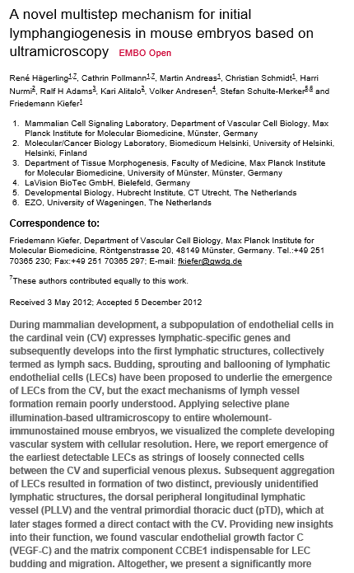

Slide 15
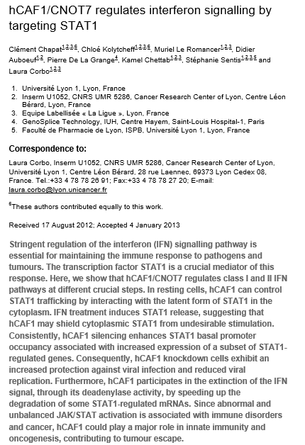

Slide 16
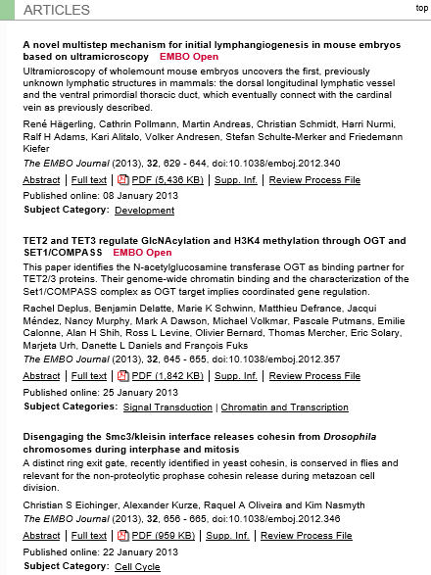


Slide 17




