Slide 1

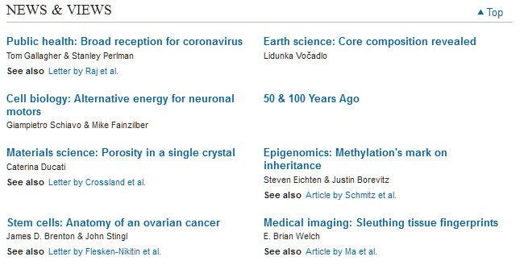

Slide 2
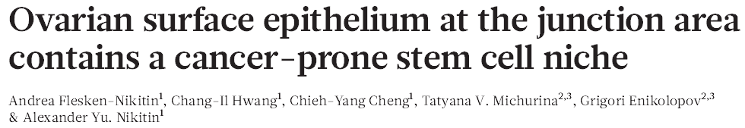
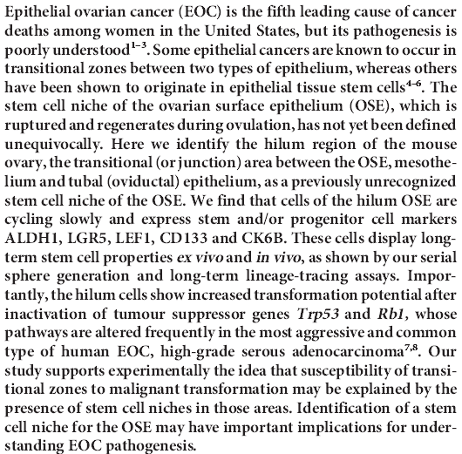
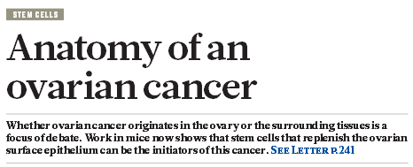
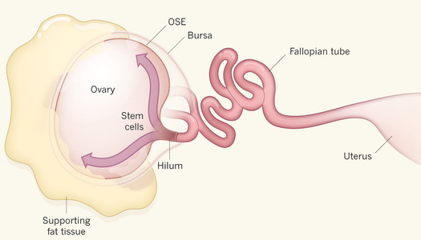

Slide 3
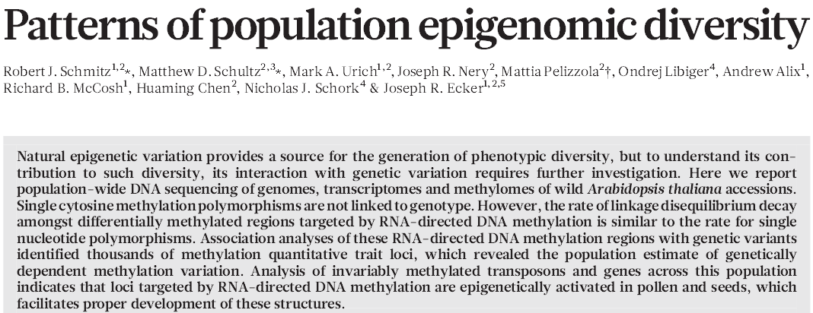
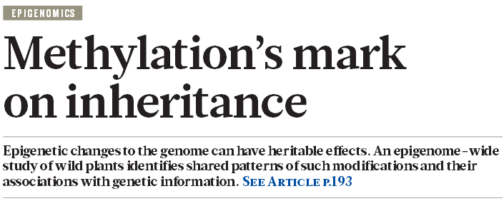

Slide 4
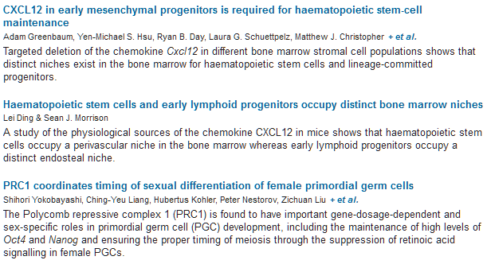


Slide 5
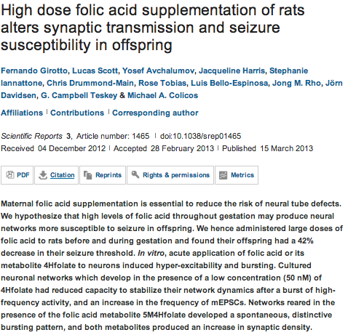
Scientific Reports

Slide 6
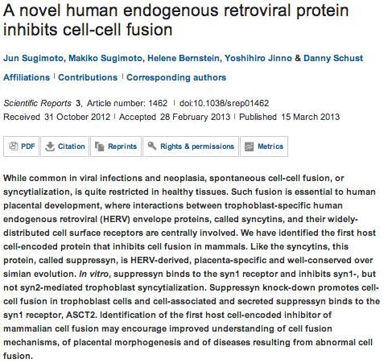

Slide 7
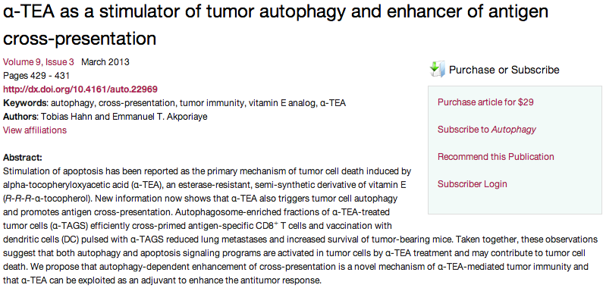
Autophagy

Slide 8
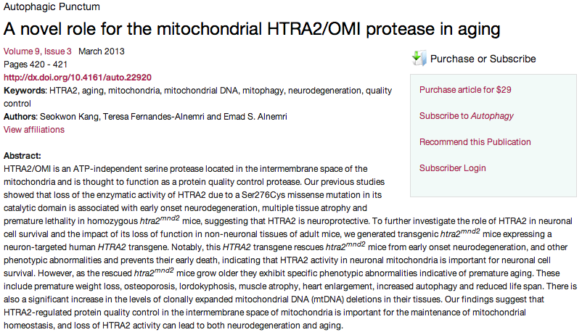

Slide 9

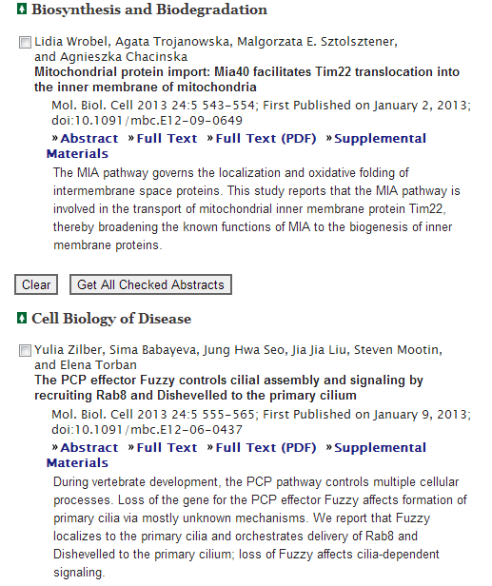
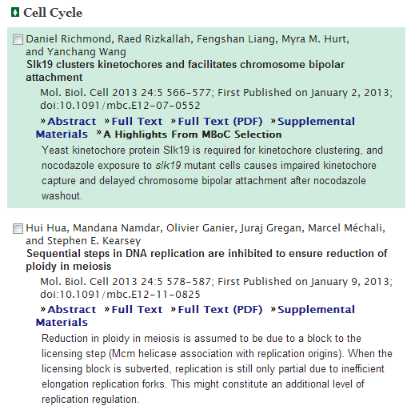

Slide 10
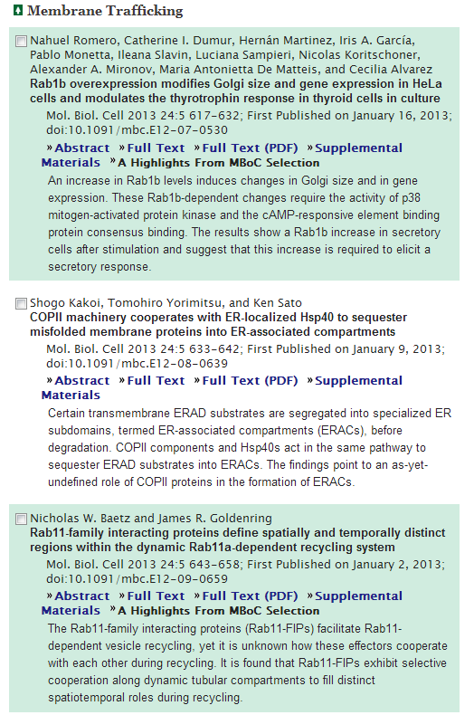
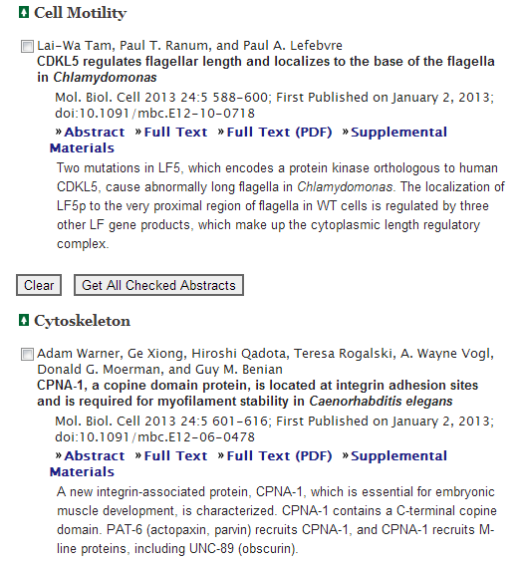

Slide 11

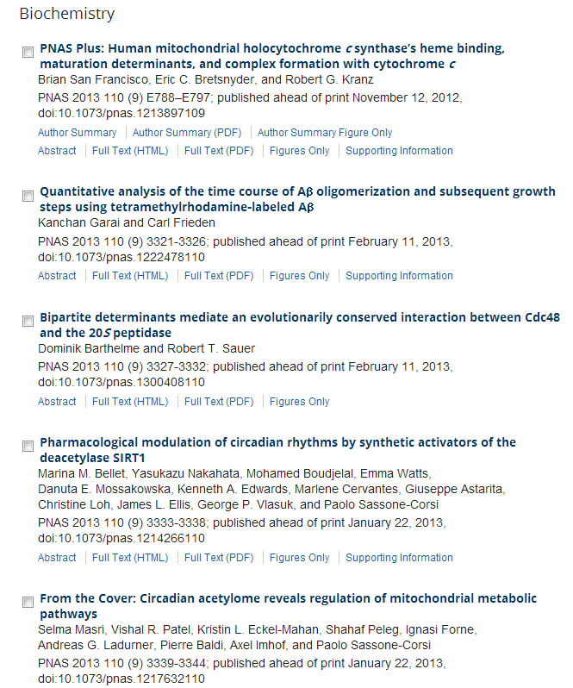
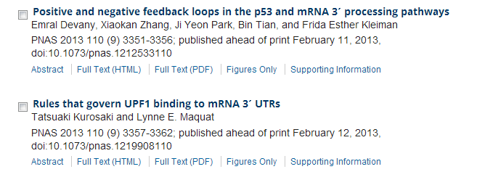

Slide 12
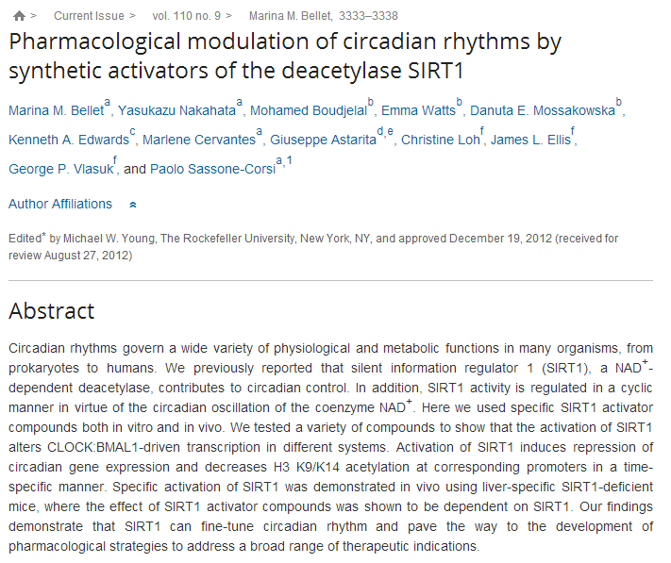

Slide 13
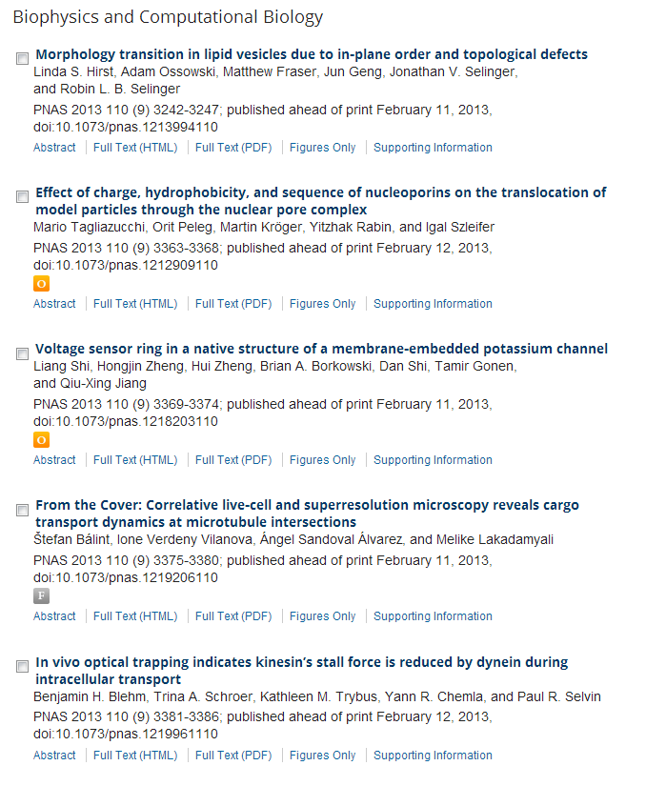

Slide 14
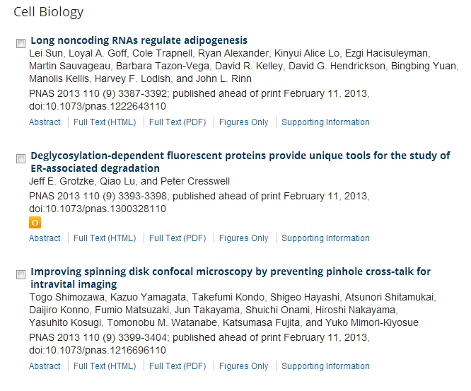
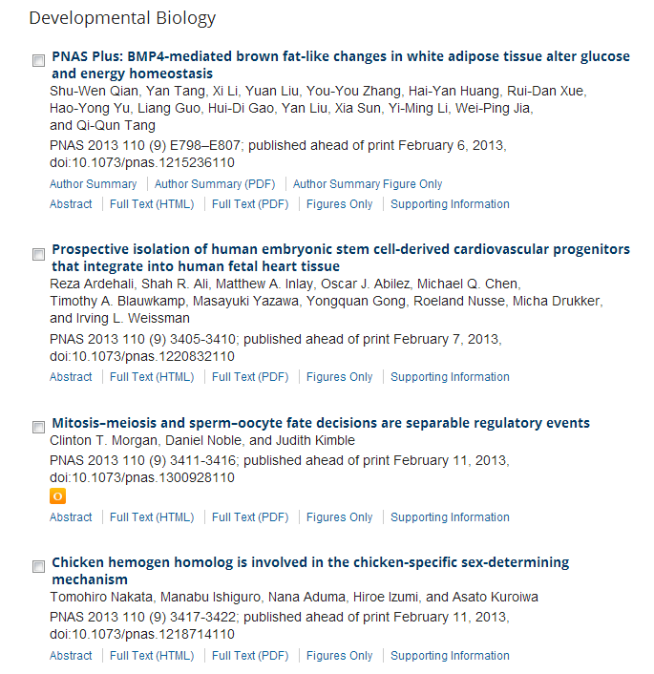

Slide 15
Regulation of cell migration, invasion and metastasis by IAP proteins and their antagonists.
Fulda S.
Source
Institute for Experimental Cancer Research in Pediatrics, Goethe-University, Frankfurt, Germany.
Abstract
Inhibitor of apoptosis (IAP) proteins are a family comprised of a total of eight mammalian members that were initially described to act as endogenous inhibitors of caspases. In addition, extensive evidence has been accumulated over the last years showing that IAP proteins can regulate various signal transduction pathways, thereby exerting non-apoptotic functions beyond the inhibition of apoptosis. For example, IAP proteins have been implied in the control of cell motility, migration, invasion and metastasis. However, currently the question is controversially discussed whether or not they positively or negatively control these processes. As small-molecule inhibitors of IAP proteins have entered the stage of clinical evaluation as experimental cancer therapeutics, a better understanding of their various cellular effects will be critical for their rational use in the treatment of human diseases.

Slide 16
Canonical and non-canonical NF-κB signaling promotes breast cancer tumor-initiating cells.
Kendellen MF, Bradford JW, Lawrence CL, Clark KS, Baldwin AS.
Source
Lineberger Comprehensive Cancer Center, University of North Carolina School of Medicine, Chapel Hill, NC, USA.
Abstract
Tumor-initiating cells (TICs) are a sub-population of cells that exhibit a robust ability to self-renew and contribute to the formation of primary tumors, the relapse of previously treated tumors and the development of metastases. TICs have been identified in various tumors including those of the breast, and are particularly enriched in the basal-like and claudin-low subtypes of breast cancer. The signaling pathways that contribute to the function and maintenance of TICs are under intense study. We explored the potential involvement of the nuclear factor-κB (NF-κB) family of transcription factors in TICs in cell lines that are representative of basal-like and claudin-low breast cancer. NF-κB was found to be activated in breast cancer cells that form tumorspheres efficiently. Moreover, both canonical and non-canonical NF-κB signaling is required for these cells to self-renew in vitro and to form xenograft tumors efficiently in vivo using limiting dilutions of cells. Consistent with this fact, canonical and non-canonical NF-κB signaling is activated in TICs isolated from breast cancer cell lines. Experimental results indicate that NF-κB promotes the function of TICs by stimulating epithelial-to-mesenchymal transition and by upregulating the expression of the inflammatory cytokines interleukin-1β and interleukin-6. The results suggest the use of NF-κB inhibitors for clinical therapy of certain breast cancers.

Slide 17
Protein kinase Cδ is required for ErbB2-driven mammary gland tumorigenesis and negatively correlates with prognosis in human breast cancer.
Allen-Petersen BL, Carter CJ, Ohm AM, Reyland ME.
Source
Program in Cell Biology, Stem Cells and Development, School of Medicine, University of Colorado, Anschutz Medical Campus, Aurora, CO, USA.
Downregulation of miR-486-5p contributes to tumor progression and metastasis by targeting protumorigenic ARHGAP5 in lung cancer.
Wang J, Tian X, Han R, Zhang X, Wang X, Shen H, Xue L, Liu Y, Yan X, Shen J, Mannoor K, Deepak J, Donahue JM,Stass SA, Xing L, Jiang F.
Source
Department of Pathology, Hebei Medical University, Shijiazhuang, China.
Targeting HPV16 E6-p300 interaction reactivates p53 and inhibits the tumorigenicity of HPV-positive head and neck squamous cell carcinoma.
Xie X, Piao L, Bullock BN, Smith A, Su T, Zhang M, Teknos TN, Arora PS, Pan Q.
Source
1] Department of Otolaryngology-Head and Neck Surgery, The Ohio State University Wexner Medical Center, Columbus, OH, USA [2] Arthur G. James Cancer Hospital and Richard J. Solove Research Institute, The Ohio State University Comprehensive Cancer Center, Columbus, OH, USA.
Regulation of cell migration, invasion and metastasis by IAP proteins and their antagonists.
Fulda S.
Source
Institute for Experimental Cancer Research in Pediatrics, Goethe-University, Frankfurt, Germany.
AXL induces epithelial-to-mesenchymal transition and regulates the function of breast cancer stem cells.
Asiedu MK, Beauchamp-Perez FD, Ingle JN, Behrens MD, Radisky DC, Knutson KL.
Source
Department of Immunology, College of Medicine, Mayo Clinic, Rochester, MN, USA.
Mdm4 loss in mice expressing a p53 hypomorph alters tumor spectrum without improving survival.
Fang M, Simeonova I, Bardot B, Lejour V, Jaber S, Bouarich-Bourimi R, Morin A, Toledo F.
Source
1] Institut Curie, Centre de recherche, Genetics of Tumor Suppression, Paris, France [2] UPMC Univ Paris 06, Paris, France [3] Genetics of Tumor Suppression, CNRS UMR 3244, Paris, France.
Aberrant Mer receptor tyrosine kinase expression contributes to leukemogenesis in acute myeloid leukemia.
Lee-Sherick AB, Eisenman KM, Sather S, McGranahan A, Armistead PM, McGary CS, Hunsucker SA, Schlegel J,Martinson H, Cannon C, Keating AK, Earp HS, Liang X, Deryckere D, Graham DK.
Source
Department of Pediatrics, Division of Hematology, Oncology, and Bone Marrow Transplantation, Aurora, CO, USA.
Identification of novel determinants of resistance to lapatinib in ERBB2-amplified cancers.
Wetterskog D, Shiu KK, Chong I, Meijer T, Mackay A, Lambros M, Cunningham D, Reis-Filho JS, Lord CJ, Ashworth A.
Source
The Breakthrough Breast Cancer Research Centre, The Institute of Cancer Research, London, UK.

Slide 18
An endogenous inhibitor of angiogenesis inversely correlates with side population phenotype and function in human lung cancer cells.
Han H, Bourboulia D, Jensen-Taubman S, Isaac B, Wei B, Stetler-Stevenson WG.
Source
Radiation Oncology Branch, Center for Cancer Research, National Cancer Institute, the National Institutes of Health, Advanced Technology Center, Bethesda, MD, USA.
Loss of the polycomb protein Mel-18 enhances the epithelial-mesenchymal transition by ZEB1 and ZEB2 expression through the downregulation of miR-205 in breast cancer.
Lee JY, Park MK, Park JH, Lee HJ, Shin DH, Kang Y, Lee CH, Kong G.
Source
Institute for Bioengineering and Biopharmaceutical Research (IBBR), Hanyang University, Seoul, Korea.
Suppression of MIM by microRNA-182 activates RhoA and promotes breast cancer metastasis.
Lei R, Tang J, Zhuang X, Deng R, Li G, Yu J, Liang Y, Xiao J, Wang HY, Yang Q, Hu G.
Source
Key Laboratory of Stem Cell Biology, Institute of Health Sciences, Shanghai Institutes for Biological Sciences, Chinese Academy of Sciences and Shanghai Jiao Tong University School of Medicine, Shanghai, China.

Slide 19
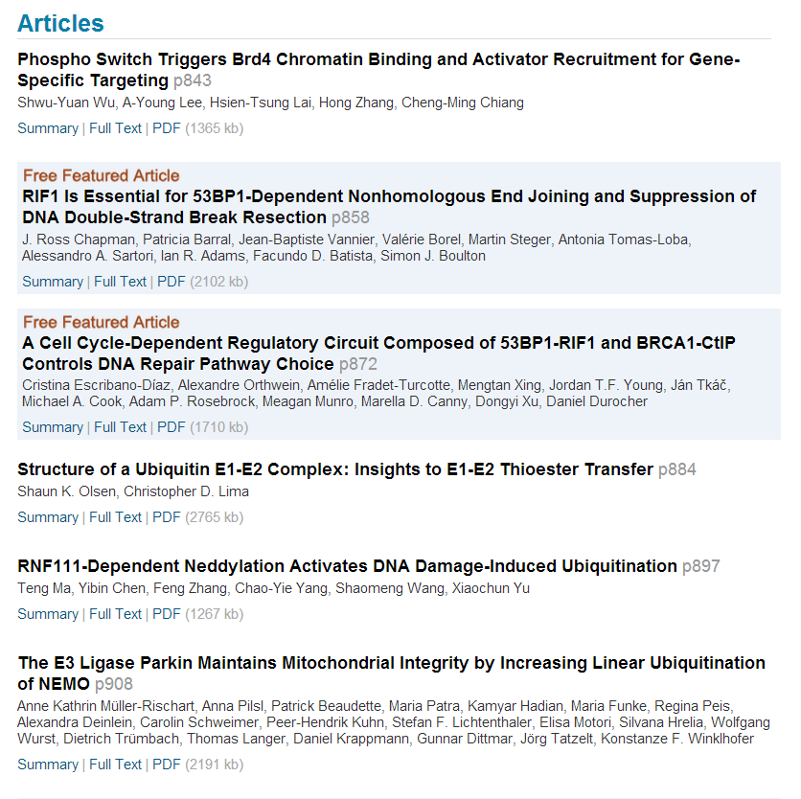


Slide 20
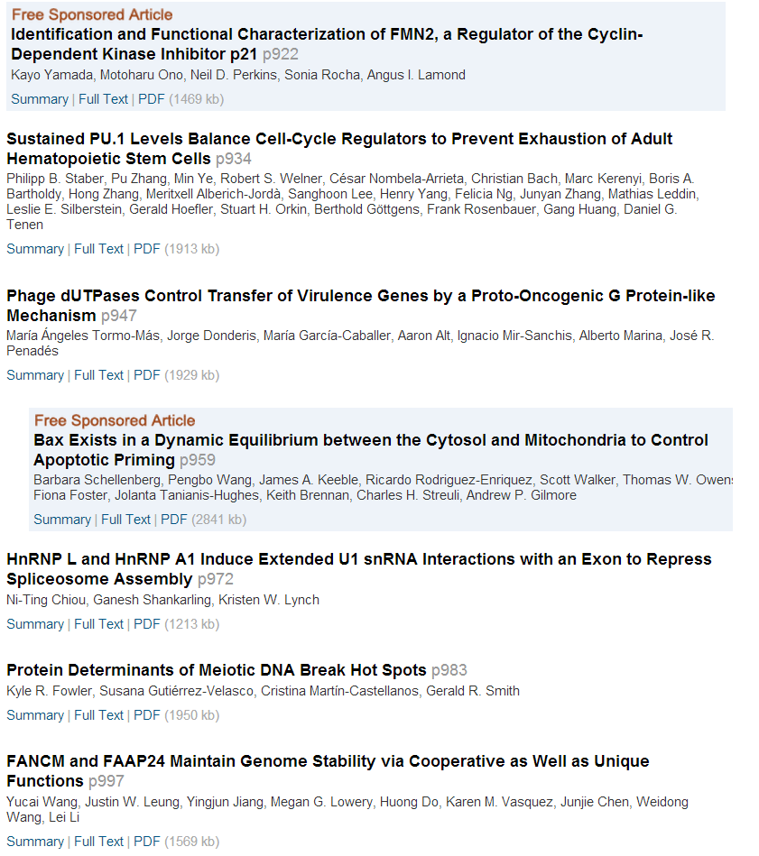

Slide 21
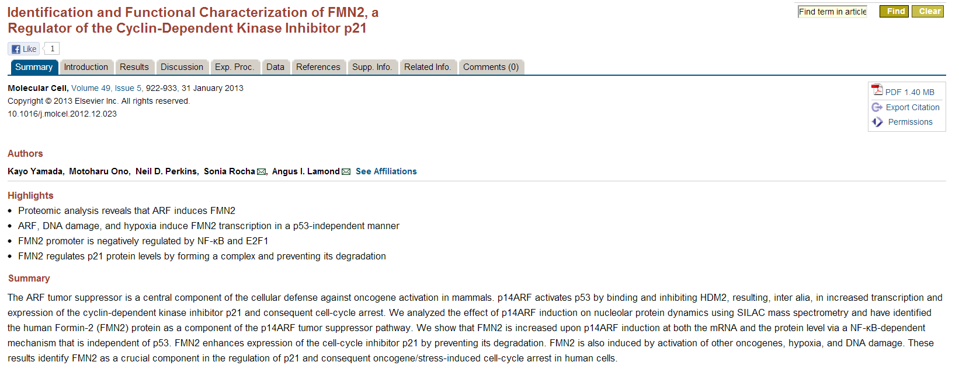

Slide 22


