Slide 1

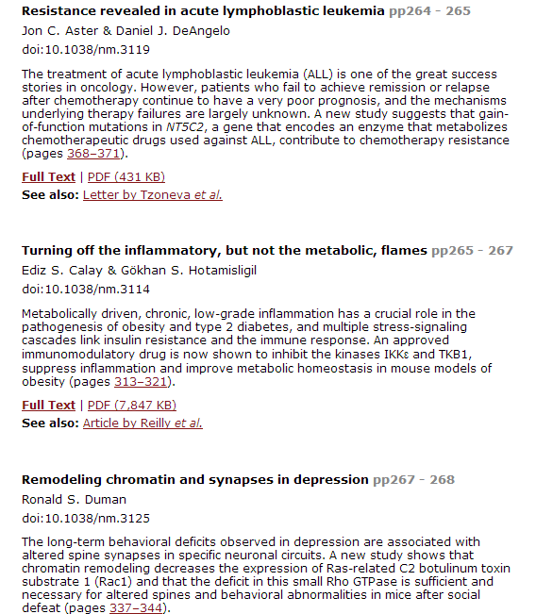
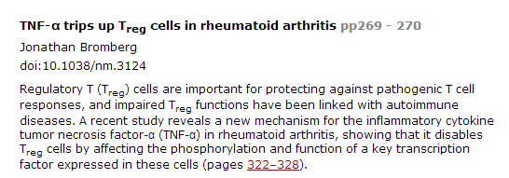

Slide 2
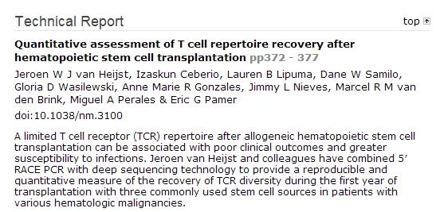

Slide 3
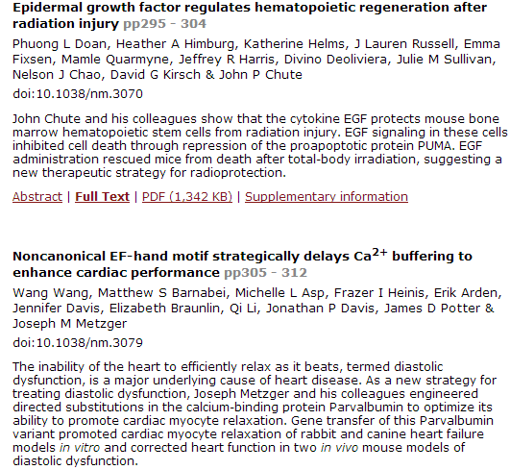

Slide 4
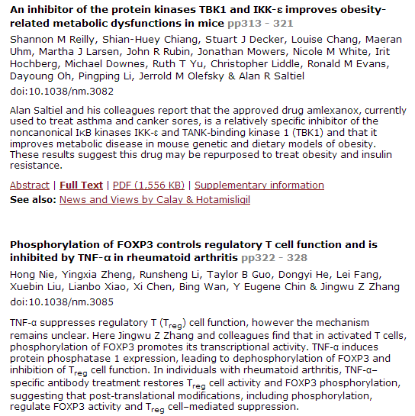

Slide 5
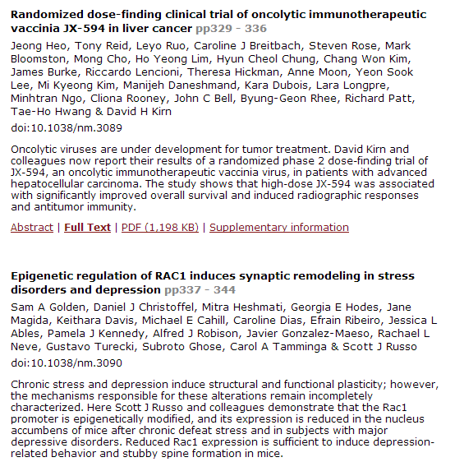

Slide 6
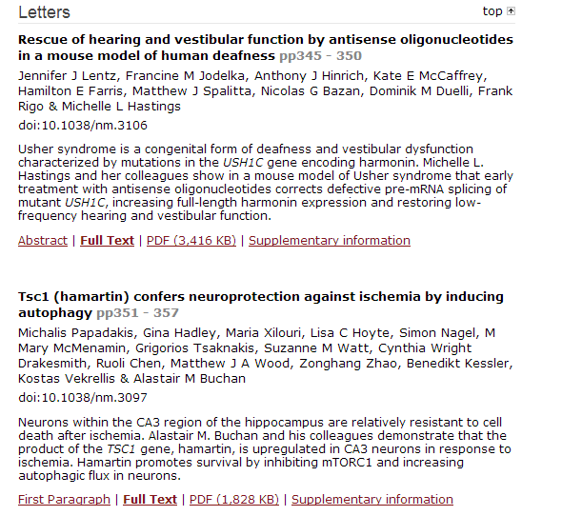

Slide 7
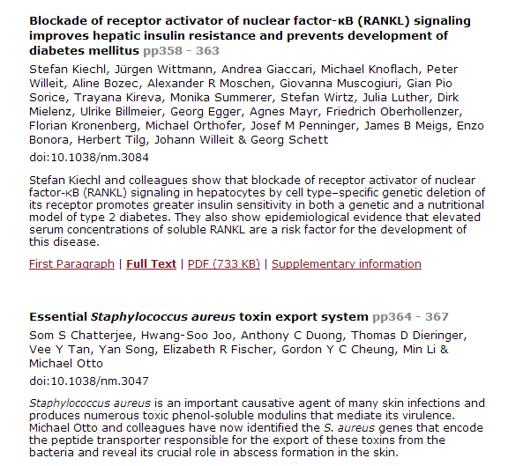

Slide 8
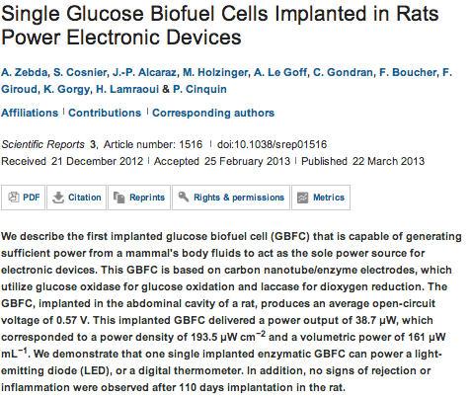
Scientific Reports

Slide 9
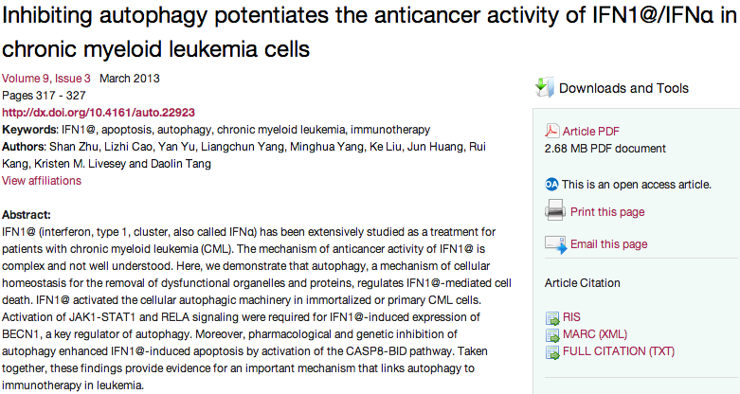
Autophagy

Slide 10
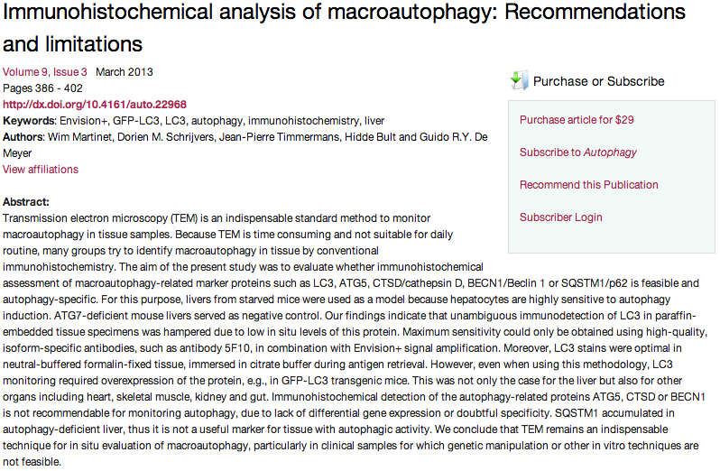

Slide 11
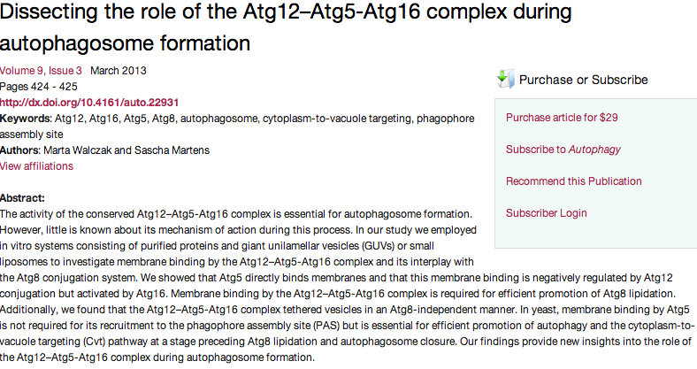

Slide 12
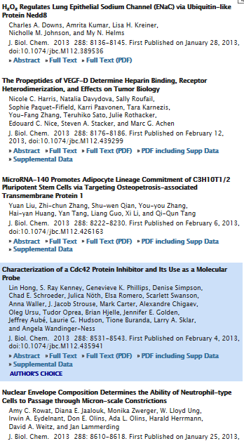

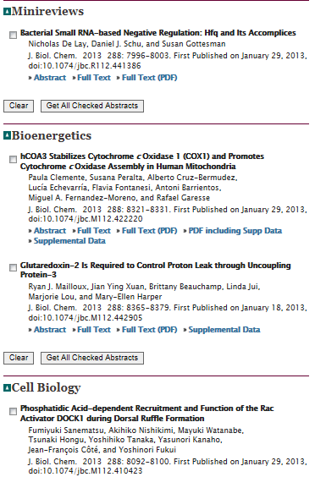

Slide 13
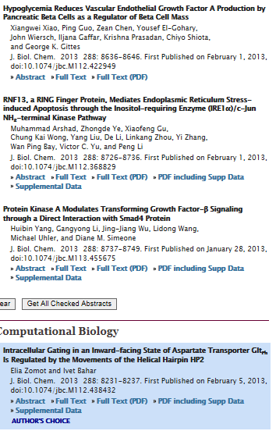
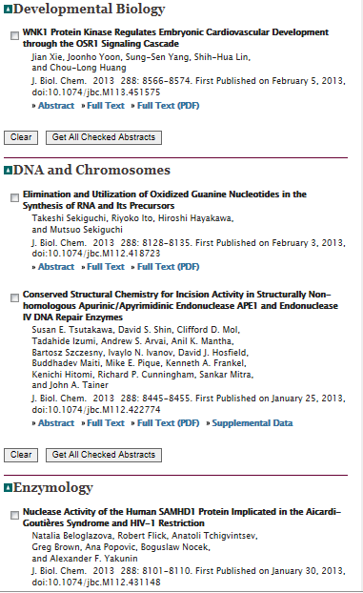

Slide 14
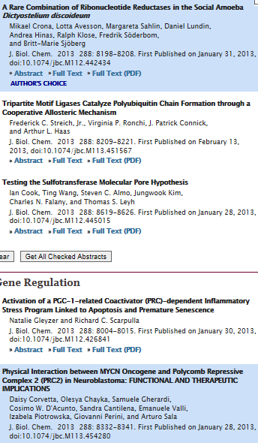
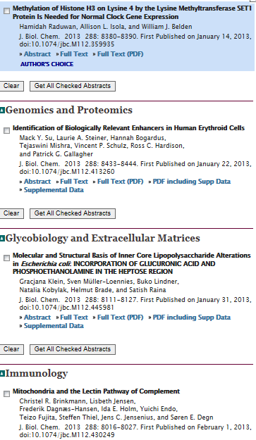

Slide 15
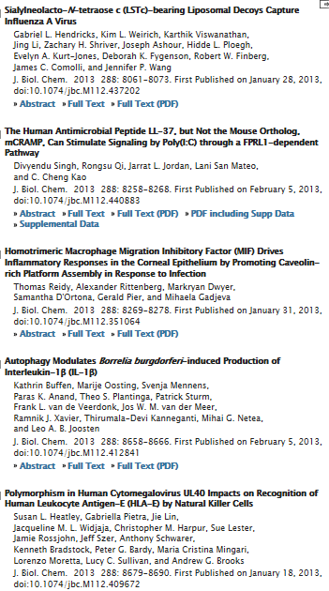
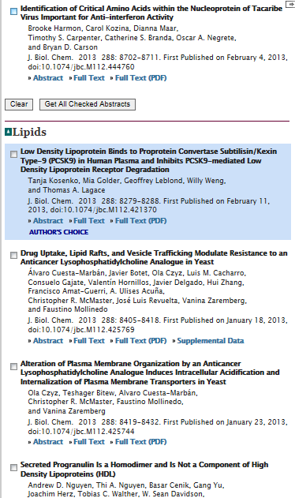

Slide 16
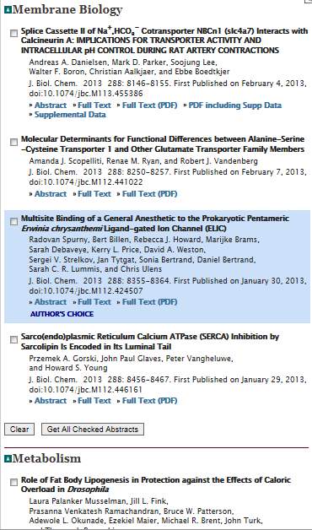
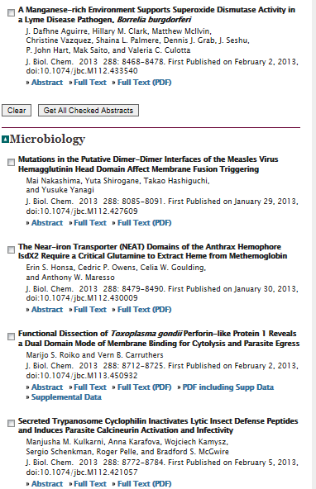

Slide 17
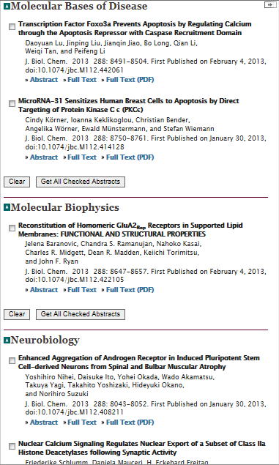
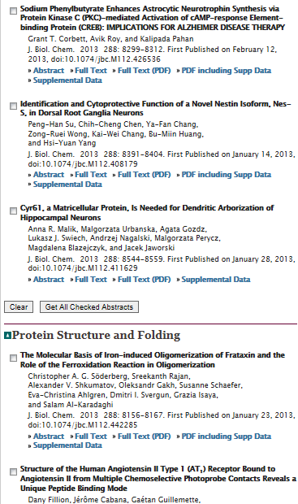

Slide 18
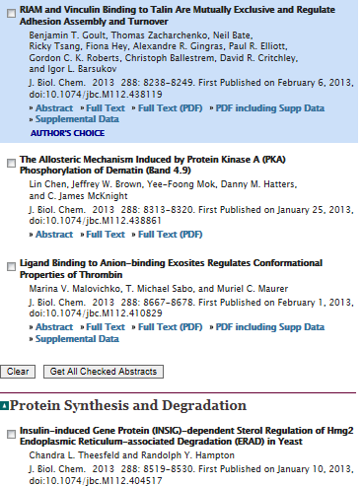
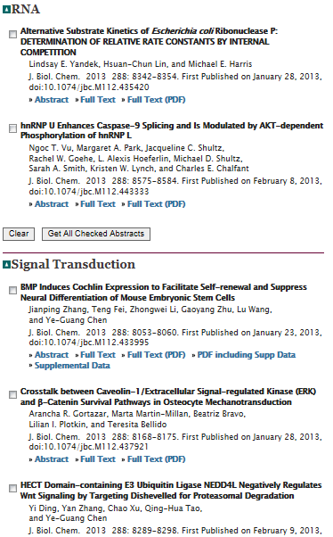

Slide 19
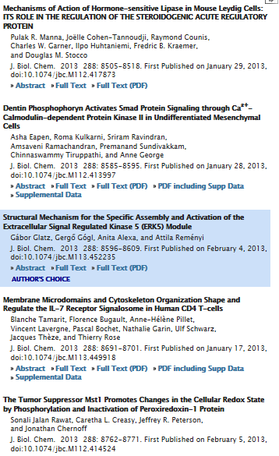

Slide 20
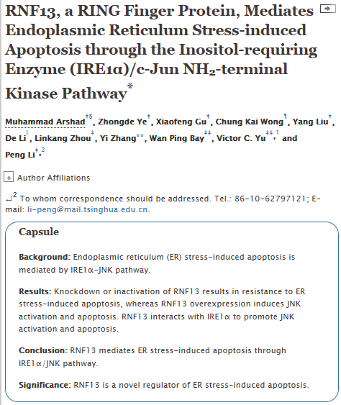

Slide 21
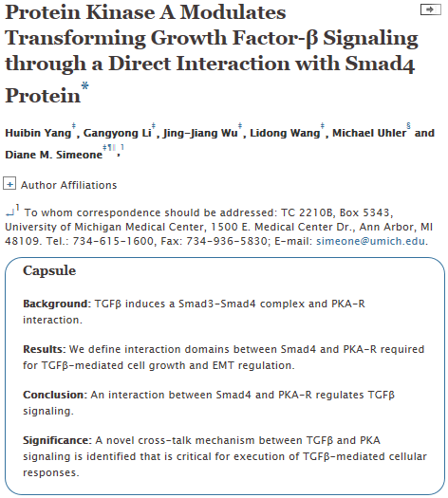

Slide 22
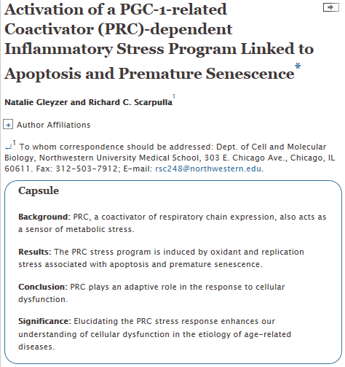

Slide 23
Oncogene
Context-specific regulation of cancer epigenomes by histone and transcription factor methylation.
Sarris M, Nikolaou K, Talianidis I.
Source
Biomedical Sciences Research Center Alexander Fleming, Vari, Greece.
Abstract
Altered expression or activity of histone lysine methylases and demethylases in cancer lead to aberrant chromatin modification patterns, which contribute to uncontrolled cell proliferation via cancer-specific deregulation of gene expression programs or the induction of genome instability. Several transcription factors that regulate growth-associated genes undergo lysine methylation, expanding the repertoire of regulatory targets modulated by histone-methylating enzymes during tumorigenesis. In certain specific tumor types or specific physiological conditions, these enzymes may trigger chromatin structure and/or transcription factor activity changes that result in opposite effects on cancer initiation or progression. The mechanisms of such context-specific dual functions and those involved in the crosstalk between factor and histone modifications are subject to extensive research, which is beginning to shed light into this novel level of complexity of cancer-related epigenetic pathways.

Slide 24
Oncogene
The regulatory roles of phosphatases in cancer.
Stebbing J, Lit LC, Zhang H, Darrington RS, Melaiu O, Rudraraju B, Giamas G.
Source
Division of Cancer, Department of Surgery and Cancer, Imperial College London, London, UK.
Abstract
The relevance of potentially reversible post-translational modifications required for controlling cellular processes in cancer is one of the most thriving arenas of cellular and molecular biology. Any alteration in the balanced equilibrium between kinases and phosphatases may result in development and progression of various diseases, including different types of cancer, though phosphatases are relatively under-studied. Loss of phosphatases such as PTEN (phosphatase and tensin homologue deleted on chromosome 10), a known tumour suppressor, across tumour types lends credence to the development of phosphatidylinositol 3--kinase inhibitors alongside the use of phosphatase expression as a biomarker, though phase 3 trial data are lacking. In this review, we give an updated report on phosphatase dysregulation linked to organ-specific malignancies.

Slide 25
A novel splice variant of calcium and integrin-binding protein 1 mediates protein kinase D2-stimulated tumour growth by regulating angiogenesis.
Armacki M, Joodi G, Nimmagadda SC, de Kimpe L, Pusapati GV, Vandoninck S, Van Lint J, Illing A, Seufferlein T.
Source
1] Department of Internal Medicine I, University of Ulm, Ulm, Baden-Wuerttemberg, Germany [2] Department of Internal Medicine I, Martin-Luther-University Halle-Wittenberg, Halle(Saale), Germany.
Oncogene
DNA damage emergency: cellular garbage disposal to the rescue?
Stone HR, Morris JR.
Source
School of Cancer Sciences, College of Medical and Dental Sciences, University of Birmingham, Edgbaston, Birmingham, UK.
Regulation of several androgen-induced genes through the repression of the miR-99a/let-7c/miR-125b-2 miRNA cluster in prostate cancer cells.
Sun D, Layer R, Mueller AC, Cichewicz MA, Negishi M, Paschal BM, Dutta A.
Source
Department of Biochemistry and Molecular Genetics, University of Virginia Health Sciences Center, Charlottesville, VA, USA.
Coxsackie and adenovirus receptor is a critical regulator for the survival and growth of oral squamous carcinoma cells.
Saito K, Sakaguchi M, Iioka H, Matsui M, Nakanishi H, Huh NH, Kondo E.
Source
Division of Oncological Pathology, Aichi Cancer Center Research Institute, Nagoya, Japan.
Radiation-induced angiogenic signaling pathway in endothelial cells obtained from normal and cancer tissue of human breast.
Oh ET, Park MT, Song MJ, Lee H, Cho YU, Kim SJ, Chu YC, Choi EK, Park HJ.
Source
Department of Microbiology, Center for Advanced Medical Education by BK21 Project, College of Medicine, Inha University, Incheon, Republic of Korea.
Epstein-Barr virus maintains lymphomas via its miRNAs.
Vereide DT, Seto E, Chiu YF, Hayes M, Tagawa T, Grundhoff A, Hammerschmidt W, Sugden B.
Source
McArdle Laboratory for Cancer Research, University of Wisconsin-Madison, Madison, WI, USA.

Slide 26

Versican 3′-untranslated region (3′-UTR) functions as a ceRNA in inducing the development of hepatocellular carcinoma by regulating miRNA activity
Ling Fang, William W. Du, Xiangling Yang, Kui Chen, Anand Ghanekar, Gary Levy, Weining Yang, Albert J. Yee, Wei-Yang Lu,
Jim W. Xuan, Zhongli Gao, Feng Xie, Chengyan He, Zhaoqun Deng, and Burton B. Yang
Source
FASEB J March 2013 27:907-919; published ahead of print November 24, 2012, doi:10.1096/fj.12-220905
Versican 3′-untranslated region (3′-UTR) functions as a ceRNA in inducing the development of hepatocellular carcinoma by regulating miRNA activity
Ling Fang, William W. Du, Xiangling Yang, Kui Chen, Anand Ghanekar, Gary Levy, Weining Yang, Albert J. Yee, Wei-Yang Lu,
Jim W. Xuan, Zhongli Gao, Feng Xie, Chengyan He, Zhaoqun Deng, and Burton B. Yang
Source
FASEB J March 2013 27:907-919; published ahead of print November 24, 2012, doi:10.1096/fj.12-220905
miR148b is a major coordinator of breast cancer progression in a relapse-associated microRNA signature by targeting ITGA5, ROCK1, PIK3CA, NRAS, and CSF1
Daniela Cimino, Cristiano De Pittà, Francesca Orso, Matteo Zampini, Silvia Casara, Elisa Penna, Elena Quaglino, Marco Forni,
Christian Damasco, and Daniela Taverna
Source
FASEB J March 2013 27:1223-1235; published ahead of print December 11, 2012, doi:10.1096/fj.12-214692
Class IIa HDACs repressive activities on MEF2-depedent transcription are associated with poor prognosis of ER⁺ breast tumors
Andrea Clocchiatti, Eros Di Giorgio, Sabrina Ingrao, Franz-Josef Meyer-Almes, Claudio Tripodo, and Claudio Brancolini
Source
FASEB J March 2013 27:942-954; published ahead of print November 16, 2012, doi:10.1096/fj.12-209346
Class IIa HDACs repressive activities on MEF2-depedent transcription are associated with poor prognosis of ER⁺ breast tumors
Andrea Clocchiatti, Eros Di Giorgio, Sabrina Ingrao, Franz-Josef Meyer-Almes, Claudio Tripodo, and Claudio Brancolini
Source
FASEB J March 2013 27:942-954; published ahead of print November 16, 2012, doi:10.1096/fj.12-209346

Slide 27

Editor's choice: Editor's choice: FoxO1 is crucial for sustaining cardiomyocyte metabolism and cell survival
Prasanth Puthanveetil, Andrea Wan, and Brian Rodrigues
Source
Cardiovasc Res (2013) 97(3): 393-403 first published online December 21, 2012 doi:10.1093/cvr/cvs426
Matrix metalloproteinase-9 deletion attenuates myocardial fibrosis and diastolic dysfunction in ageing mice
Ying Ann Chiao, Trevi A. Ramirez, Rogelio Zamilpa, S. Michelle Okoronkwo, Qiuxia Dai, Jianhua Zhang, Yu-Fang Jin,
and Merry L. Lindsey
Source
Cardiovasc Res (2012) 96(3): 444-455 first published online August 22, 2012 doi:10.1093/cvr/cvs275
Extracellular matrix protein CCN1 regulates cardiomyocyte apoptosis in mice with stress-induced cardiac injury
Pei-Ling Hsu, Bor-Chyuan Su, Qian-Yu Kuok, and Fan-E Mo
Source
Cardiovasc Res (2013) 98(1): 64-72 first published online January 16, 2013 doi:10.1093/cvr/cvt001
Editor's choice: Protective role of vascular smooth muscle cell PPARγ in angiotensin II-induced vascular disease
Chiara Marchesi, Asia Rehman, Yohann Rautureau, Daniel A. Kasal, Marie Briet, Avshalom Leibowitz, Stefania M.C. Simeone,
Talin Ebrahimian, Mario F. Neves, Stefan Offermanns, Frank J. Gonzalez, Pierre Paradis, and Ernesto L. Schiffrin
Source
Cardiovasc Res (2013) 97(3): 562-570 first published online December 17, 2012 doi:10.1093/cvr/cvs362
Activation of PPARδ prevents endothelial dysfunction induced by overexpression of amyloid-β precursor protein
Livius V. d'Uscio, Pritam Das, Anantha V.R. Santhanam, Tongrong He, Steven G. Younkin, and Zvonimir S. Katusic
Source
Cardiovasc Res (2012) 96(3): 504-512 first published online August 10, 2012 doi:10.1093/cvr/cvs266

Slide 28
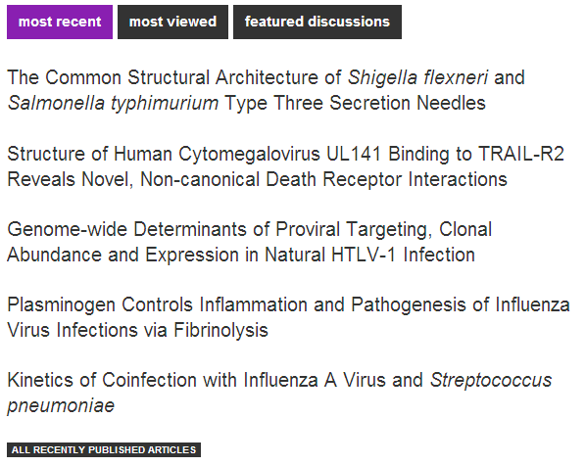


Slide 29


