Slide 1


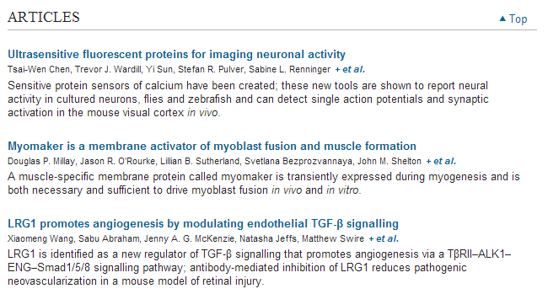

Slide 2

Ptpn11 deletion in a novel progenitor causes metachondromatosis
by inducing hedgehog signalling
The tyrosine phosphatase SHP2, encoded by PTPN11, is required for the survival, proliferation and differentiation of various cell types^{1, 2}. Germline activating mutations inPTPN11 cause Noonan syndrome, whereas somatic PTPN11 mutations cause childhood myeloproliferative disease and contribute to some solid tumours. Recently, heterozygous inactivating mutations in PTPN11 were found in metachondromatosis, a rare inherited disorder featuring multiple exostoses, enchondromas, joint destruction and bony deformities^{3, 4}. The detailed pathogenesis of this disorder has remained unclear. Here we use a conditional knockout (floxed) Ptpn11 allele (Ptpn11^{fl}) and Cre recombinase transgenic mice to delete Ptpn11 specifically in monocytes, macrophages and osteoclasts (lysozyme M-Cre; LysMCre) or in cathepsin K (Ctsk)-expressing cells, previously thought to be osteoclasts. LysMCre;Ptpn11^{fl/fl} mice had mild osteopetrosis. Notably, however,CtskCre;Ptpn11^{fl/fl} mice developed features very similar to metachondromatosis. Lineage tracing revealed a novel population of CtskCre-expressing cells in the perichondrial groove of Ranvier that display markers and functional properties consistent with mesenchymal progenitors. Chondroid neoplasms arise from these cells and show decreased extracellular signal-regulated kinase (ERK) pathway activation, increased Indian hedgehog (Ihh) and parathyroid hormone-related protein (Pthrp, also known as Pthlh) expression and excessive proliferation. Shp2-deficient chondroprogenitors had decreased fibroblast growth factor-evoked ERK activation and enhanced Ihh and Pthrpexpression, whereas fibroblast growth factor receptor (FGFR) or mitogen-activated protein kinase kinase (MEK) inhibitor treatment of chondroid cells increased Ihh andPthrp expression. Importantly, smoothened inhibitor treatment ameliorated metachondromatosis features in CtskCre;Ptpn11^{fl/fl} mice. Thus, in contrast to its pro-oncogenic role in haematopoietic and epithelial cells, Ptpn11 is a tumour suppressor in cartilage, acting through a FGFR/MEK/ERK-dependent pathway in a novel progenitor cell population to prevent excessive Ihh production

Slide 3
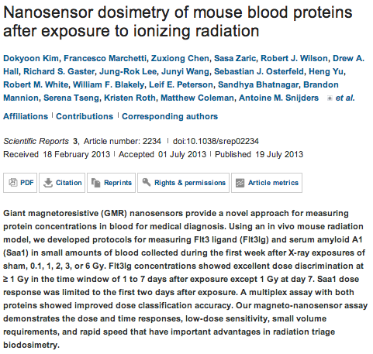
Scientific Reports

Slide 4
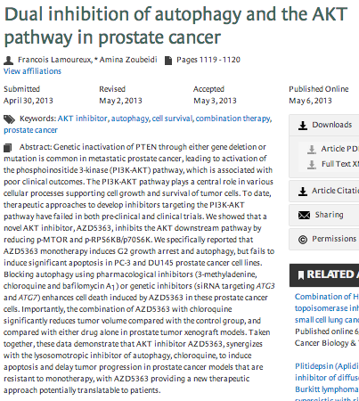
Autophagy

Slide 5
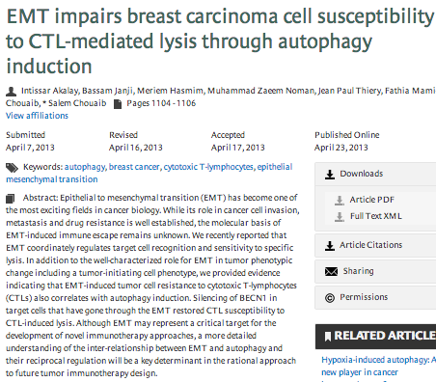

Slide 6
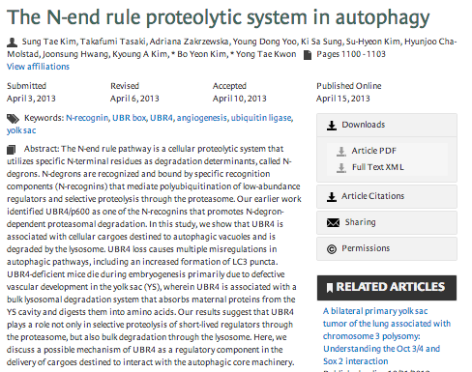

Slide 7
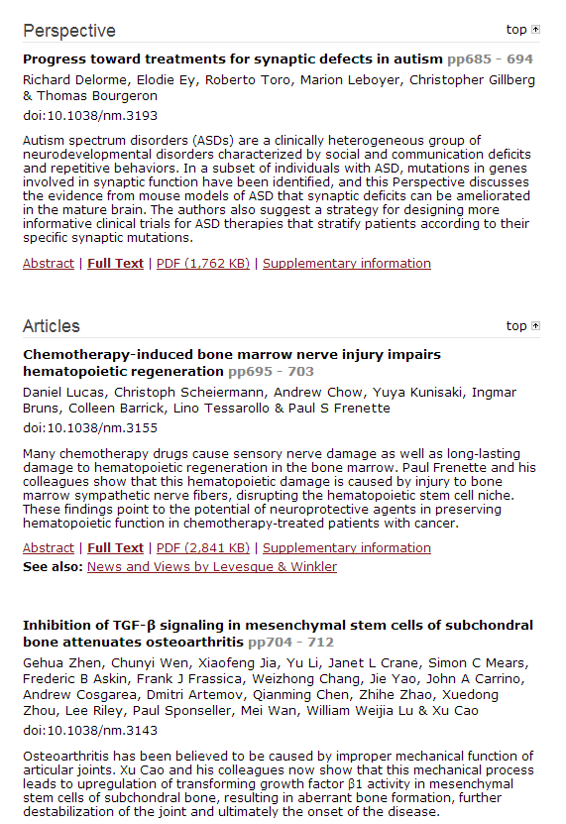


Slide 8
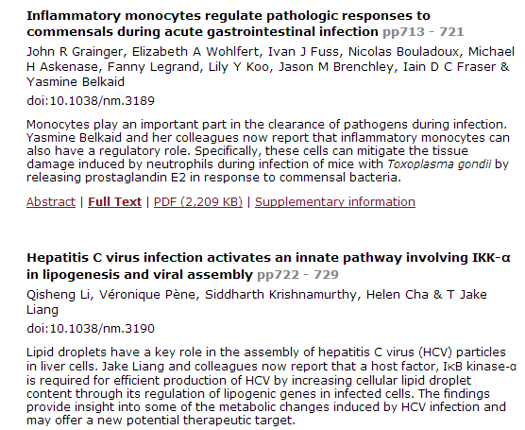
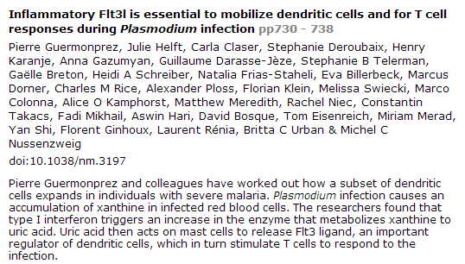

Slide 9
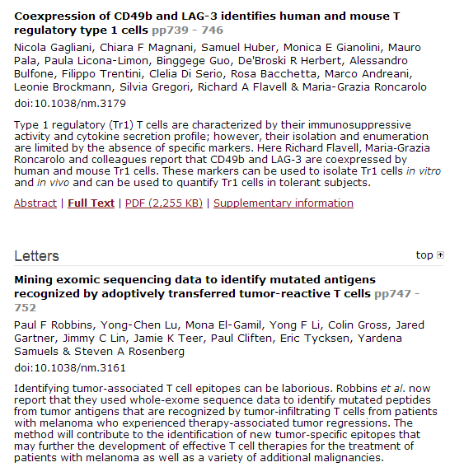

Slide 10
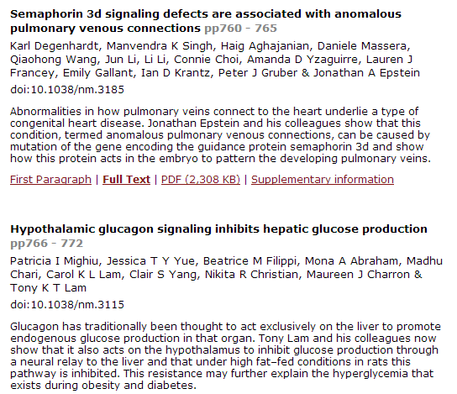

Slide 11
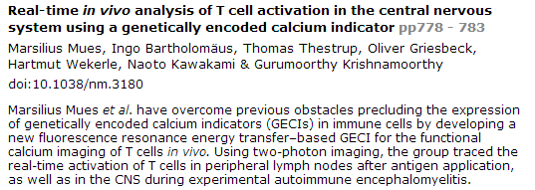
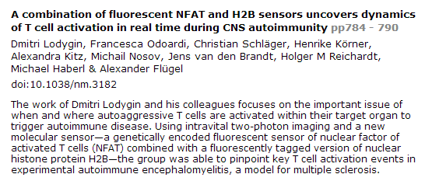

Slide 12
Oncogene
RUNX3 interacts with MYCN and facilitates protein degradation in neuroblastoma.
Yu F, Gao W, Yokochi T, Suenaga Y, Ando K, Ohira M, Nakamura Y, Nakagawara A.
1] Division of Biochemistry and Innovative Cancer Therapeutics, Chiba Cancer Center Research Institute, Chiba, Japan [2] Department of Molecular Biology and Oncology, Chiba University Graduate School of Medicine, Chiba, Japan [3] Department of Thoracic Surgery, Forth Hospital of Hebei Medical University, Hebei, PRC.
RUNX3, a runt-related transcription factor, has a crucial role in dorsal root ganglion neurogenesis. Recent studies have suggested that RUNX3 acts as a tumor suppressor in stomach, colon and breast cancer. However, the biological role of RUNX3 in neuroblastoma remains elusive. Here we report that high levels of RUNX3 expression contribute to the favorable outcome in patients with neuroblastoma, whereas low levels of RUNX3 expression result in poor outcome. Array-based analysis suggested that the allelic loss at chromosome 1p36 is one of the reasons why expression of RUNX3 is downregulated in advanced neuroblastomas. Interestingly, the several patients survived from neuroblastoma with both high mRNA expressions of MYCN and RUNX3, suggesting that RUNX3 high expression might overcome the aggressive behavior of MYCN. Exogenous expression of RUNX3 strongly inhibits cell proliferation and migration in neuroblastoma cell lines. Furthermore, RUNX3 reduces the stability of MYCN protein in MYCN-amplified neuroblastoma cell lines, and this RUNX3-mediated MYCN degradation may depend on the physical interaction between RUNX3 and MYCN. Thus, our findings provide a tumor-suppressing mechanism by which RUNX3 inhibits the MYCN activity in neuroblastoma.

Slide 13
GSK3β controls epithelial-mesenchymal transition and tumor metastasis by CHIP-mediated degradation of Slug.
Kao SH, Wang WL, Chen CY, Chang YL, Wu YY, Wang YT, Wang SP, Nesvizhskii AI, Chen YJ, Hong TM, Yang PC.
Source
Institute of Molecular Medicine, National Taiwan University, Taipei, Taiwan.
Abstract
Glycogen synthase kinase 3 beta (GSK3β) is highly inactivated in epithelial cancers and is known to inhibit tumor migration and invasion. The zinc-finger-containing transcriptional repressor, Slug, represses E-cadherin transcription and enhances epithelial-mesenchymal transition (EMT). In this study, we find that the GSK3β-pSer9 level is associated with the expression of Slug in non-small cell lung cancer. GSK3β-mediated phosphorylation of Slug facilitates Slug protein turnover. Proteomic analysis reveals that the carboxyl terminus of Hsc70-interacting protein (CHIP) interacts with wild-type Slug (wtSlug). Knockdown of CHIP stabilizes the wtSlug protein and reduces Slug ubiquitylation and degradation. In contrast, nonphosphorylatable Slug-4SA is not degraded by CHIP. The accumulation of nondegradable Slug may further lead to the repression of E-cadherin expression and promote cancer cell migration, invasion and metastasis. Our findings provide evidence of a de novo GSK3β-CHIP-Slug pathway that may be involved in the progression of metastasis in lung cancer.

Slide 14
ATM signalling and cancer.
Cremona CA, Behrens A.
Source
Mammalian Genetics Lab, Cancer Research UK London Research Institute, London, UK.
Abstract
ATM, the protein kinase mutated in the rare human disease ataxia telangiectasia (A-T), has been the focus of intense scrutiny over the past two decades. Initially this was because of the unusual radiosensitive phenotype of cells from A-T patients, and latterly because investigating ATM signalling has yielded valuable insights into the DNA damage response, redox signalling and cancer. With the recent explosion in genomic data, ATM alterations have been revealed both in the germline as a predisposing factor for cancer and as somatic changes in tumours themselves. Here we review these findings, as well as advances in the understanding of ATM signalling mechanisms in cancer and ATM inhibition as a strategy for cancer treatment.

Slide 15
Mechanisms of the androgen receptor splicing in prostate cancer cells.
Liu LL, Xie N, Sun S, Plymate S, Mostaghel E, Dong X.
Source
Department of Urologic Sciences, Vancouver Prostate Centre, University of British Columbia, Vancouver, British Columbia, Canada
GATA3 cooperates with PARP1 to regulate CCND1 transcription through modulating histone H1 incorporation.
Shan L, Li X, Liu L, Ding X, Wang Q, Zheng Y, Duan Y, Xuan C, Wang Y, Yang F, Shang Y, Shi L.
Source
Tianjin Key Laboratory of Medical Epigenetics, Department of Biochemistry and Molecular Biology, Tianjin Medical University, Tianjin, China.
MicroRNA-30a suppresses breast tumor growth and metastasis by targeting metadherin.
Zhang N, Wang X, Huo Q, Sun M, Cai C, Liu Z, Hu G, Yang Q.
Source
Department of Breast Surgery, Qilu Hospital, Shandong University, Jinan, China.
The nuclear coactivator amplified in breast cancer 1 maintains tumor-initiating cells during development of ductal carcinoma in situ.
Ory V, Tassi E, Cavalli LR, Sharif GM, Saenz F, Baker T, Schmidt MO, Mueller SC, Furth PA, Wellstein A, Riegel AT.
Source
Department of Oncology, Lombardi Comprehensive Cancer Center, Georgetown University, Washington, DC, USA.
The anti-metastatic activity of collagenase-2 in breast cancer cells is mediated by a signaling pathway involving decorin and miR-21.
Soria-Valles C, Gutiérrez-Fernández A, Guiu M, Mari B, Fueyo A, Gomis RR, López-Otín C.
Source
Departamento de Bioquímica y Biología Molecular, Facultad de Medicina, Instituto Universitario de Oncología (IUOPA), Universidad de Oviedo, Oviedo, Spain.
Autocrine/paracrine mechanism of interleukin-17B receptor promotes breast tumorigenesis through NF-κB-mediated antiapoptotic pathway.
Huang CK, Yang CY, Jeng YM, Chen CL, Wu HH, Chang YC, Ma C, Kuo WH, Chang KJ, Shew JY, Lee WH.
Source
1] Institute of Biochemistry and Molecular Biology, College of Medicine, National Taiwan University, Taipei, Taiwan [2] Genomics Research Center, Academia Sinica, Taipei, Taiwan.
Inflammatory chemokines and metastasis-tracing the accessory.
Borsig L, Wolf MJ, Roblek M, Lorentzen A, Heikenwalder M.
Source
Institute of Physiology, University of Zurich and Zurich Center for Integrative Human Physiology, Zurich, Switzerland.
Tsc1-Tp53 loss induces mesothelioma in mice, and evidence for this mechanism in human mesothelioma.
Guo Y, Chirieac LR, Bueno R, Pass H, Wu W, Malinowska IA, Kwiatkowski DJ.
Source
Division of Translational Medicine, Department of Medicine, Brigham and Women's Hospital and Harvard Medical School, Boston, MA, USA.

Slide 16
Loss of IGFBP7 expression and persistent AKT activation contribute to SMARCB1/Snf5-mediated tumorigenesis.
Darr J, Klochendler A, Isaac S, Eden A.
Source
Department of Cell and Developmental Biology, The Alexander Silberman Institute of Life Sciences, The Hebrew University of Jerusalem, Jerusalem, Israel.
The FoxO-BNIP3 axis exerts a unique regulation of mTORC1 and cell survival under energy stress.
Lin A, Yao J, Zhuang L, Wang D, Han J, Lam EW; TCGA Research Network, Gan B.
Source
Department of Experimental Radiation Oncology, The University of Texas MD Anderson Cancer Center, Houston, TX, USA
GRIM-19 mutations fail to inhibit v-Src-induced oncogenesis.
Kalakonda S, Nallar SC, Lindner DJ, Sun P, Lorenz RR, Lamarre E, Reddy SP, Kalvakolanu DV.
Source
Department of Microbiology & Immunology, Program in Oncology, Greenebaum Cancer Center, University of Maryland School of Medicine, Baltimore, MD, USA.
Identification of G-protein-coupled receptor 120 as a tumor-promoting receptor that induces angiogenesis and migration in human colorectal carcinoma.
Wu Q, Wang H, Zhao X, Shi Y, Jin M, Wan B, Xu H, Cheng Y, Ge H, Zhang Y.
Source
Key Laboratory of Stem Cell Biology, Institute of Health Sciences, Shanghai Institutes for Biological Sciences, Chinese Academy of Sciences & Shanghai Jiao Tong University School of Medicine (SJTUSM) and Shanghai Institute of Immunology, Institutes of Medical Sciences, SJTUSM, Shanghai, China.
A dosage-dependent pleiotropic role of Dicer in prostate cancer growth and metastasis.
Zhang B, Chen H, Zhang L, Dakhova O, Zhang Y, Lewis MT, Creighton CJ, Ittmann MM, Xin L.
Source
Department of Molecular and Cellular Biology, Baylor College of Medicine, Houston, TX, USA.
Cytoplasmic interaction of the tumour suppressor protein hSNF5 with dynamin-2 controls endocytosis.
Alfonso-Pérez T, Domínguez-Sánchez MS, García-Domínguez M, Reyes JC.
Source
Molecular Biology Department, Centro Andaluz de Biología Molecular y Medicina Regenerativa (CABIMER), Consejo Superior de Investigaciones Científicas (CSIC), Seville, Spain.
The immune network in pancreatic cancer development and progression.
Wörmann SM, Diakopoulos KN, Lesina M, Algül H.
Source
Medizinische Klinik, Klinikum rechts der Isar, Technische Universität München, Munich, Germany.

Slide 17

Public accessibility of biomedical articles from PubMed Central reduces journal readership—retrospective cohort analysis
Philip M. Davis
Source
FASEB J July 2013 27:2536-2541; published ahead of print April 3, 2013, doi:10.1096/fj.13-229922
Signaling mechanism of tumor cell-induced up-regulation of E3 ubiquitin ligase UBR2
hua Zhang, Ren-Kuo Lin, Yong Tae Kwon, and Yi-Ping Li
Source
FASEB J July 2013 27:2893-2901; published ahead of print April 8, 2013, doi:10.1096/fj.12-222711
Signal transducer and activator of transcription-3 (Stat3) plays a critical role in implantation via progesterone receptor in uterus
Jae Hee Lee, Tae Hoon Kim, Seo Jin Oh, Jung-Yoon Yoo,
Shizuo Akira, Bon Jeong Ku, John P. Lydon, and Jae-Wook Jeong
Source
FASEB J June 2013 27:2484-2495; published ahead of print March 4, 2013, doi:10.1096/fj.12-224170
Diaphragm and ventilatory dysfunction during cancer cachexia
Brandon M. Roberts, Bumsoo Ahn, Ashley J. Smuder, Monsour Al-Rajhi, Luther C. Gill, Adam W. Beharry, Scott K. Powers, David D. Fuller, Leonardo F. Ferreira, and Andrew R. Judge
Source
FASEB J July 2013 27:2600-2610; published ahead of print March 20, 2013, doi:10.1096/fj.12-222844
SCF E3 ligase F-box protein complex SCF^{FBXL19} regulates cell migration by mediating Rac1 ubiquitination and degradation
Jing Zhao, Rachel K. Mialki, Jianxin Wei, Tiffany A. Coon, Chunbin Zou, Bill B. Chen, Rama K. Mallampalli, and Yutong Zhao
Source
FASEB J July 2013 27:2611-2619; published ahead of print March 19, 2013, doi:10.1096/fj.12-223099
Signal transducer and activator of transcription-3 (Stat3) plays a critical role in implantation via progesterone receptor in uterus
Jae Hee Lee, Tae Hoon Kim, Seo Jin Oh, Jung-Yoon Yoo,
Shizuo Akira, Bon Jeong Ku, John P. Lydon, and Jae-Wook Jeong
Source
FASEB J July 2013 27:2553-2563; published ahead of print March 26, 2013, doi:10.1096/fj.12-225664

Slide 18
SCF E3 ligase F-box protein complex SCF^{FBXL19} regulates cell migration by mediating Rac1 ubiquitination and degradation
Jing Zhao, Rachel K. Mialki, Jianxin Wei, Tiffany A. Coon, Chunbin Zou, Bill B. Chen, Rama K. Mallampalli, and Yutong Zhao
Abstract
Rac1, a member of the Rho family of GTPases, regulates diverse cellular functions, including cytoskeleton reorganization and cell migration. F-box proteins are major subunits within the Skp1-Cul1-F-box (SCF) E3 ubiquitin ligases that recognize specific substrates for ubiquitination. The role of F-box proteins in regulating Rac1 stability has not been studied. Mouse lung epithelial (MLE12) cells were used to investigate Rac1 stability and cell migration. Screening of an F-box protein library and in vitro ubiquitination assays identified FBXL19, a relatively new member of the F-box protein family that targets Rac1 for its polyubiquitination and proteasomal degradation. Overexpression of FBXL19 decreased both Rac1 active and inactive forms and significantly reduced cellular migration. Protein kinase AKT-mediated phosphorylation of Rac1 at serine⁷¹ was essential for FBXL19-mediated Rac1 ubiquitination and depletion. Lysine¹⁶⁶ within Rac1 was identified as a polyubiquitination acceptor site. Rac1^{S71A} and Rac1^{K166R} mutant proteins were resistant to FBXL19-mediated ubiquitination and degradation. Further, ectopically expressed FBXL19 reduced cell migration in Rac1-overexpressing cells (P<0.01, Rac1 cells vs. FBXL19+Rac1 cells), but not in Rac1 lysine¹⁶⁶ mutant-overexpressing cells. FBXL19 diminished formation of the migratory leading edge. Thus, SCF^{FBXL19} targets Rac1 for its disposal, a process regulated by AKT. These findings provide the first evidence of an F-box protein targeting a small G protein for ubiquitination and degradation to modulate cell migration.

Slide 19

Up-regulation of sarcoplasmic reticulum Ca²⁺ uptake leads to cardiac hypertrophy, contractile dysfunction and early mortality in mice deficient in CASQ2
Anuradha Kalyanasundaram, Véronique A. Lacombe, Andriy E. Belevych, Lucia Brunello, Cynthia A. Carnes, Paul M.L. Janssen,
Bjørn C. Knollmann, Muthu Periasamy, and Sandor Gyørke
Source
Cardiovasc Res (2013) 98(2): 297-306 first published online November 6, 2012 doi:10.1093/cvr/cvs334
Over-expression of calpastatin aggravates cardiotoxicity induced by doxorubicin
Yanpeng Wang, Dong Zheng, Meng Wei, Jian Ma, Yong Yu,
Ruizhen Chen, James C. Lacefield, Huaxi Xu, and Tianqing Peng
Source
Cardiovasc Res (2013) 98(3): 381-390 first published online March 1, 2013 doi:10.1093/cvr/cvt048
Extracellular matrix protein CCN1 regulates cardiomyocyte apoptosis in mice with stress-induced cardiac injury
Pei-Ling Hsu, Bor-Chyuan Su, Qian-Yu Kuok, and Fan-E Mo
Source
Cardiovasc Res (2013) 98(1): 64-72 first published online January 16, 2013 doi:10.1093/cvr/cvt001
Editor's choice: Protective role of vascular smooth muscle cell PPARγ in angiotensin II-induced vascular disease
Chiara Marchesi, Asia Rehman, Yohann Rautureau, Daniel A. Kasal, Marie Briet, Avshalom Leibowitz, Stefania M.C. Simeone,
Talin Ebrahimian, Mario F. Neves, Stefan Offermanns, Frank J. Gonzalez, Pierre Paradis, and Ernesto L. Schiffrin
Source
Cardiovasc Res (2013) 97(3): 562-570 first published online December 17, 2012 doi:10.1093/cvr/cvs362
AICAR inhibits PPARγ during monocyte differentiation to attenuate inflammatory responses to atherogenic lipids
Dmitry Namgaladze, Marina Kemmerer, Andreas von Knethen,
and Bernhard Brüne
Source
Cardiovasc Res (2013) 98(3): 479-487 first published online March 25, 2013 doi:10.1093/cvr/cvt073
Extracellular HSP60 induces inflammation through activating and up-regulating TLRs in cardiomyocytes
Jing Tian, Xin Guo, Xue-Mei Liu, Li Liu, Qi-Fang Weng, Shu-Juan Dong, Anne A. Knowlton, Wen-Jun Yuan, and Li Lin
Source
Cardiovasc Res (2013) 98(3): 391-401 first published online February 27, 2013 doi:10.1093/cvr/cvt047

Slide 20

IL-1β Production through the NLRP3 Inflammasome by Hepatic Macrophages Links Hepatitis C Virus Infection with Liver Inflammation and Disease
Amina A. Negash, Hilario J. Ramos, Nanette Crochet, Daryl T. Y. Lau, Brian Doehle, Neven Papic, Don A. Delker, Juandy Jo, Antonio Bertoletti, Curt H. Hagedorn, Michael Gale Jr
Source
published 25 Apr 2013 | info:doi/10.1371/journal.ppat.1003330
CYLD Enhances Severe Listeriosis by Impairing IL-6/STAT3-Dependent Fibrin Production
Gopala Nishanth, Martina Deckert, Katharina Wex, Ramin Massoumi, Katrin Schweitzer, Michael Naumann, Dirk Schlüter
Source
published 27 Jun 2013 | info:doi/10.1371/journal.ppat.1003455
Shigella IpaH0722 E3 Ubiquitin Ligase Effector Targets TRAF2 to Inhibit PKC–NF-κB Activity in Invaded Epithelial Cells
Hiroshi Ashida, Hiroyasu Nakano, Chihiro Sasakawa
Source
published 06 Jun 2013 | info:doi/10.1371/journal.ppat.1003409
The Serine Phosphatase SerB of Porphyromonas gingivalis Suppresses IL-8 Production by Dephosphorylation of NF-κB RelA/p65
Hiroki Takeuchi, Takanori Hirano, Sarah E. Whitmore, Ichijiro Morisaki, Atsuo Amano, Richard J. Lamont
Source
published 18 Apr 2013 | info:doi/10.1371/journal.ppat.1003326
The JAK-STAT Transcriptional Regulator, STAT-5, Activates the ATM DNA Damage Pathway to Induce HPV 31 Genome Amplification upon Epithelial Differentiation
Shiyuan Hong, Laimonis A. Laimins
Source
published 04 Apr 2013 | info:doi/10.1371/journal.ppat.1003295
Cell Death Control: The Interplay of Apoptosis and Autophagy in the Pathogenicity of Sclerotinia sclerotiorum
Mehdi Kabbage, Brett Williams, Martin B. Dickman
Source
published 11 Apr 2013 | info:doi/10.1371/journal.ppat.1003287

Slide 21

Understanding, recognizing, and managing toxicities of targeted anticancer therapies
Grace K. Dy and Alex A. Adjei
Source
Article first published online: 28 MAY 2013 | DOI: 10.3322/caac.21184
Recent developments in esophageal adenocarcinoma
  Jesper Lagergren and Pernilla Lagergren
Grace K. Dy and Alex A. Adjei
Source
Article first published online: 1 JUL 2013 | DOI: 10.3322/caac.21185
Strategies for expanding colorectal cancer screening at community health centers
Mona Sarfaty, Mary Doroshenk, James Hotz, Durado Brooks, Seiji Hayashi, Terry C. Davis, Djenaba Joseph, David Stevens, Donald L. Weaver, Michael B. Potter and Richard Wender
Source
Article first published online: 1 JUL 2013 | DOI: 10.3322/caac.21191

Slide 22

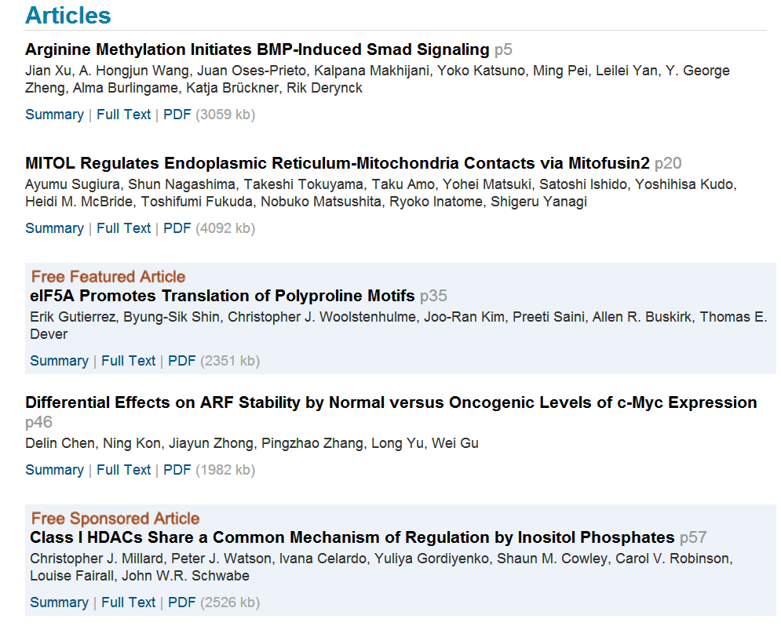

Slide 23
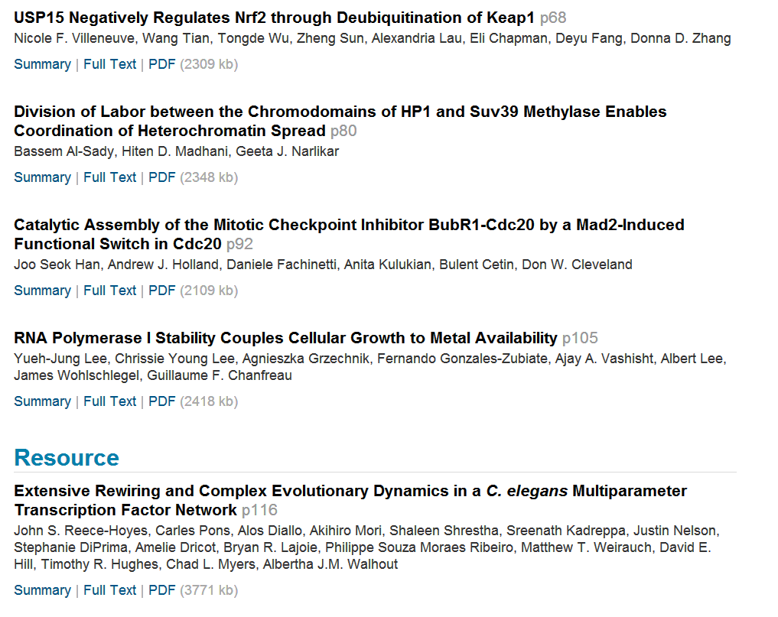

Slide 24
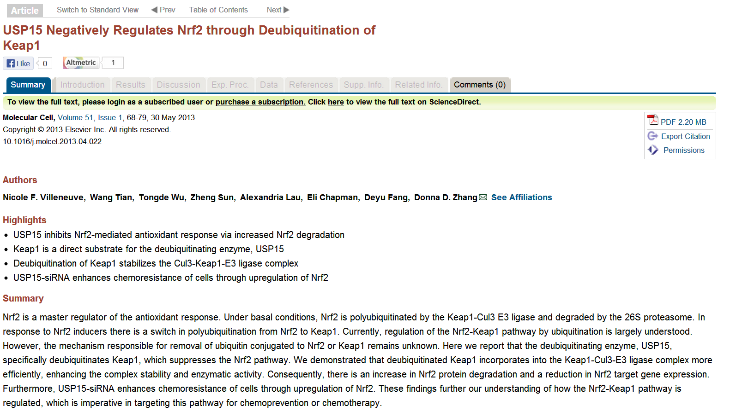

Slide 25
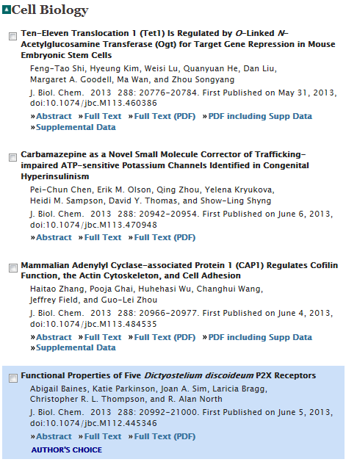
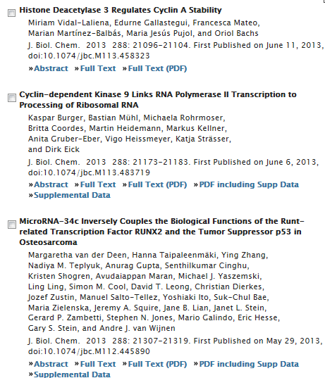

Slide 26
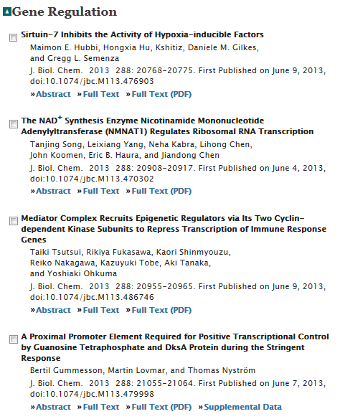
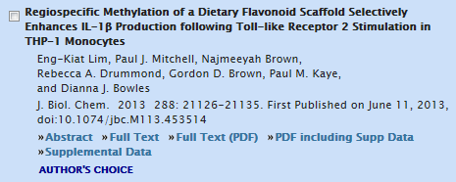
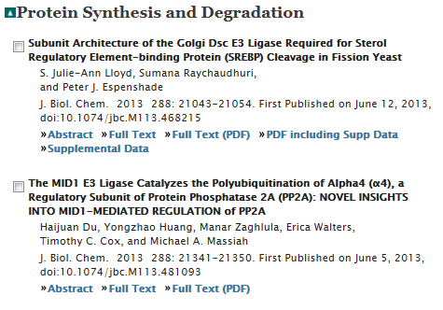

Slide 27
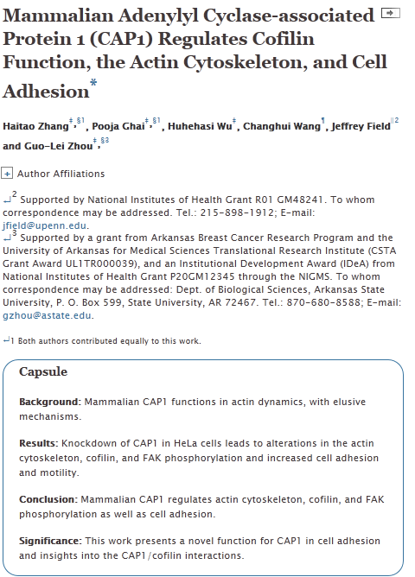

Slide 28


