Slide 1
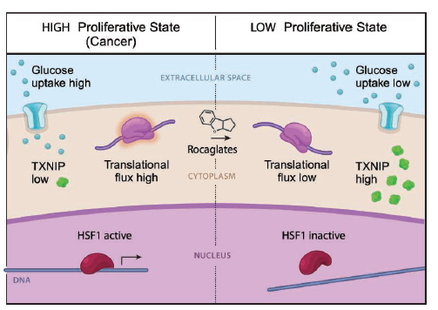
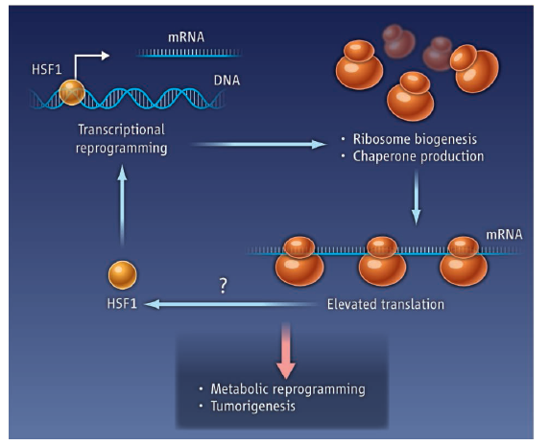
[Science] 19 JULY 2013 VOL 341, ISSUE 6143, PAGES 209-308
Tight Coordination of Protein Translation and HSF1 Activation Supports the Anabolic Malignant State
Sandro Santagata1,2,3,*, Marc L. Mendillo3,4,*, Yun-chi Tang4,5,†, Aravind Subramanian6, Casey C. Perley3,4, Stéphane P. Roche7, Bang Wong6, Rajiv Narayan6, Hyoungtae Kwon3,4, Martina Koeva3,4, Angelika Amon4,5, Todd R. Golub6, John A. Porco Jr.7, Luke Whitesell3,‡, Susan Lindquist3,4,‡
3Whitehead Institute for Biomedical Research (WIBR), Cambridge, MA 02142, USA.
4Howard Hughes Medical Institute, Department of Biology, Massachusetts Institute of Technology (MIT), Cambridge, MA 02142, USA.
The ribosome is centrally situated to sense metabolic states, but whether its activity, in turn, coherently rewires transcriptional responses is unknown. Here, through integrated chemical-genetic analyses, we found that a dominant transcriptional effect of blocking protein translation in cancer cells was inactivation of heat shock factor 1 (HSF1), a multifaceted transcriptional regulator of the heat-shock response and many other cellular processes essential for anabolic metabolism, cellular proliferation, and tumorigenesis. These analyses linked translational flux to the regulation of HSF1 transcriptional activity and to the modulation of energy metabolism. Targeting this link with translation initiation inhibitors such as rocaglates deprived cancer cells of their energy and chaperone armamentarium and selectively impaired the proliferation of both malignant and premalignant cells with early-stage oncogenic lesions.
Perspectives - CELL BIOLOGY
Trans-HSF1 Express
Valentina Gandin and Ivan Topisirovic
Ribosome activity is linked to the activity of a transcription factor in cancer cells.

Slide 2
[Science] 19 JULY 2013 VOL 341, ISSUE 6143, PAGES 209-308
REPORT
Loss of Function of the Melanocortin 2 Receptor Accessory Protein 2 Is Associated with Mammalian Obesity
Masato Asai1,2, Shwetha Ramachandrappa3, Maria Joachim1, Yuan Shen1, Rong Zhang1, Nikhil Nuthalapati1, Visali Ramanathan1, David E. Strochlic1, Peter Ferket4, Kirsten Linhart1,*, Caroline Ho1, Tatiana V. Novoselova5, Sumedha Garg3, Martin Ridderstråle6, Claude Marcus7, Joel N. Hirschhorn1,8, Julia M. Keogh3, Stephen O’Rahilly3, Li F. Chan5, Adrian J. Clark5, I. Sadaf Farooqi3,†, Joseph A. Majzoub1,†
1Division of Endocrinology, Department of Medicine, Boston Children’s Hospital, Harvard Medical School, 300 Longwood Avenue, Boston, MA 02115, USA.
Melanocortin receptor accessory proteins (MRAPs) modulate signaling of melanocortin receptors in vitro. To investigate the physiological role of brain-expressed melanocortin 2 receptor accessory protein 2 (MRAP2), we characterized mice with whole-body and brain-specific targeted deletion of Mrap2, both of which develop severe obesity at a young age. Mrap2 interacts directly with melanocortin 4 receptor (Mc4r), a protein previously implicated in mammalian obesity, and it enhances Mc4r-mediated generation of the second messenger cyclic adenosine monophosphate, suggesting that alterations in Mc4r signaling may be one mechanism underlying the association between Mrap2 disruption and obesity. In a study of humans with severe, early-onset obesity, we found four rare, potentially pathogenic genetic variants in MRAP2, suggesting that the gene may also contribute to body weight regulation in humans.
REPORT
Developmental Control of the Melanocortin-4 Receptor by MRAP2 Proteins in Zebrafish
Julien A. Sebag1,*, Chao Zhang1,*, Patricia M. Hinkle2, Amanda M. Bradshaw1, Roger D. Cone1,†
1Department of Molecular Physiology and Biophysics, Vanderbilt University School of Medicine, Nashville, TN 37232, USA.
The melanocortin-4 receptor (MC4R) is essential for control of energy homeostasis in vertebrates. MC4R interacts with melanocortin receptor accessory protein 2 (MRAP2) in vitro, but its functions in vivo are unknown. We found that MRAP2a, a larval form, stimulates growth of zebrafish by specifically blocking the action of MC4R. In cell culture, this protein binds MC4R and reduces the ability of the receptor to bind its ligand, α–melanocyte-stimulating hormone (α-MSH). A paralog, MRAP2b, expressed later in development, also binds MC4R but increases ligand sensitivity. Thus, MRAP2 proteins allow for developmental control of MC4R activity, with MRAP2a blocking its function and stimulating growth during larval development, whereas MRAP2b enhances responsiveness to α-MSH once the zebrafish begins feeding, thus increasing the capacity for regulated feeding and growth.

Slide 3
[Science] 19 JULY 2013 VOL 341, ISSUE 6143, PAGES 209-308
REPORT
Sept4/ARTS Regulates Stem Cell Apoptosis and Skin Regeneration
Yaron Fuchs1, Samara Brown1, Travis Gorenc1, Joe Rodriguez1, Elaine Fuchs2,*, Hermann Steller1,*
1Strang Laboratory of Apoptosis and Cancer Biology, Howard Hughes Medical Institute, The Rockefeller University, New York, NY 10065, USA.
Adult stem cells are essential for tissue homeostasis and wound repair. Their proliferative capacity must be tightly regulated to prevent the emergence of unwanted and potentially dangerous cells, such as cancer cells. We found that mice deficient for the proapoptotic Sept4/ARTS gene have elevated numbers of hair follicle stem cells (HFSCs) that are protected against apoptosis. Sept4/ARTS−/− mice display marked improvement in wound healing and regeneration of hair follicles. These phenotypes depend on HFSCs, as indicated by lineage tracing. Inactivation of XIAP, a direct target of ARTS, abrogated these phenotypes and impaired wound healing. Our results indicate that apoptosis plays an important role in regulating stem cell–dependent regeneration and suggest that this pathway may be a target for regenerative medicine.

Slide 4
[Science Sig] 16 JULY 2013 VOL 6, ISSUE 284
Sci Signal. 2013 Jul 16;6(284):ra58. doi: 10.1126/scisignal.2003994.
Receptor tyrosine kinases fall into distinct classes based on their inferred signaling networks.
Wagner JP, Wolf-Yadlin A, Sevecka M, Grenier JK, Root DE, Lauffenburger DA, Macbeath G.
1Department of Biological Engineering, Massachusetts Institute of Technology, 77 Massachusetts Avenue, Cambridge, MA 02139, USA.
Although many anticancer drugs that target receptor tyrosine kinases (RTKs) provide clinical benefit, their long-term use is limited by resistance that is often attributed to increased abundance or activation of another RTK that compensates for the inhibited receptor. To uncover common and unique features in the signaling networks of RTKs, we measured time-dependent signaling in six isogenic cell lines, each expressing a different RTK as downstream proteins were systematically perturbed by RNA interference. Network models inferred from the data revealed a conserved set of signaling pathways and RTK-specific features that grouped the RTKs into three distinct classes: (i) an EGFR/FGFR1/c-Met class constituting epidermal growth factor receptor, fibroblast growth factor receptor 1, and the hepatocyte growth factor receptor c-Met; (ii) an IGF-1R/NTRK2 class constituting insulin-like growth factor 1 receptor and neurotrophic tyrosine receptor kinase 2; and (iii) a PDGFRβ class constituting platelet-derived growth factor receptor β. Analysis of cancer cell line data showed that many RTKs of the same class were coexpressed and that increased abundance of an RTK or its cognate ligand frequently correlated with resistance to a drug targeting another RTK of the same class. In contrast, abundance of an RTK or ligand of one class generally did not affect sensitivity to a drug targeting an RTK of a different class. Thus, classifying RTKs by their inferred networks and then therapeutically targeting multiple receptors within a class may delay or prevent the onset of resistance.
CCAAT/Enhancer Binding Protein {delta} in Macrophages Contributes to Immunosuppression and Inhibits Phagocytosis in Nasopharyngeal Carcinoma
Yu-Wei Hsiao, Chien-Feng Li, Jhih-Ying Chi, Joseph T. Tseng, Yao Chang, Li-Jin Hsu, Chien-Hsun Lee, Tsung-Hao Chang, Shao-Ming Wang, Dennis Ding Hwa Wang, Hung-Chi Cheng, and Ju-Ming Wang
The transcription factor C/EBP{delta} makes tumor-associated macrophages produce signals that aid the tumor.
Release of Nonmuscle Myosin II from the Cytosolic Domain of Tumor Necrosis Factor Receptor 2 Is Required for Target Gene Expression
Unni M. Chandrasekharan, Lisa Dechert, Uchechukwu I. Davidson, Matthew Waitkus, Lori Mavrakis, Katherine Lyons, Jordan R. Beach, Xiaoxia Li, Thomas T. Egelhoff, Paul L. Fox, and Paul E. DiCorleto
By binding to tumor necrosis factor receptor 2, myosin limits signaling by TNF-α.

