Slide 1


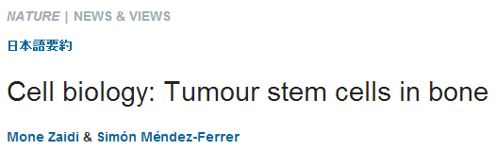


Slide 2

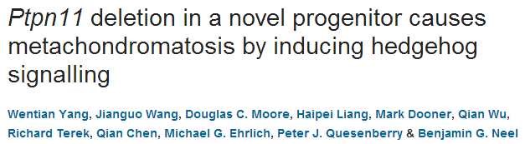
The tyrosine phosphatase SHP2, encoded by PTPN11, is required for the survival, proliferation and differentiation of various cell types^{1, 2}. Germline activating mutations inPTPN11 cause Noonan syndrome, whereas somatic PTPN11 mutations cause childhood myeloproliferative disease and contribute to some solid tumours. Recently, heterozygous inactivating mutations in PTPN11 were found in metachondromatosis, a rare inherited disorder featuring multiple exostoses, enchondromas, joint destruction and bony deformities^{3, 4}. The detailed pathogenesis of this disorder has remained unclear. Here we use a conditional knockout (floxed) Ptpn11 allele (Ptpn11^{fl}) and Cre recombinase transgenic mice to delete Ptpn11 specifically in monocytes, macrophages and osteoclasts (lysozyme M-Cre; LysMCre) or in cathepsin K (Ctsk)-expressing cells, previously thought to be osteoclasts. LysMCre;Ptpn11^{fl/fl} mice had mild osteopetrosis. Notably, however,CtskCre;Ptpn11^{fl/fl} mice developed features very similar to metachondromatosis. Lineage tracing revealed a novel population of CtskCre-expressing cells in the perichondrial groove of Ranvier that display markers and functional properties consistent with mesenchymal progenitors. Chondroid neoplasms arise from these cells and show decreased extracellular signal-regulated kinase (ERK) pathway activation, increased Indian hedgehog (Ihh) and parathyroid hormone-related protein (Pthrp, also known as Pthlh) expression and excessive proliferation. Shp2-deficient chondroprogenitors had decreased fibroblast growth factor-evoked ERK activation and enhanced Ihh and Pthrpexpression, whereas fibroblast growth factor receptor (FGFR) or mitogen-activated protein kinase kinase (MEK) inhibitor treatment of chondroid cells increased Ihh andPthrp expression. Importantly, smoothened inhibitor treatment ameliorated metachondromatosis features in CtskCre;Ptpn11^{fl/fl} mice. Thus, in contrast to its pro-oncogenic role in haematopoietic and epithelial cells, Ptpn11 is a tumour suppressor in cartilage, acting through a FGFR/MEK/ERK-dependent pathway in a novel progenitor cell population to prevent excessive Ihh production.

Slide 3

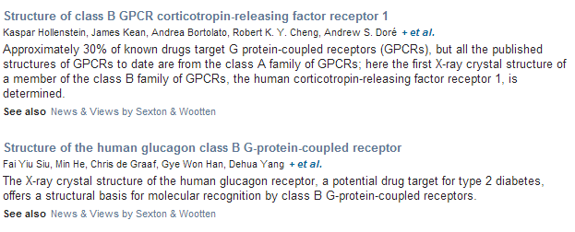

Slide 4
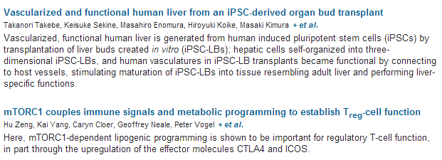

Slide 5

REVIEWS
Newly described pattern recognition receptors team up against intracellular pathogens
Petr Broz & Denise M. Monack
p551 | doi:10.1038/nri3479
This Review provides a comprehensive overview of very recent progress in our understanding of the role of pattern recognition receptors, including Toll-like receptors, cytosolic nucleic acid receptors and NOD-like receptors that assemble inflammasomes, in the detection of and in the defence against intracellular pathogens.
The role of dendritic cells in autoimmunity
Dipyaman Ganguly, Stefan Haak, Vanja Sisirak & Boris Reizis
p566 | doi:10.1038/nri3477
Dendritic cells (DCs) can promote both tolerogenic and pro-inflammatory immune responses and have been associated with various autoimmune diseases. However, it still remains unclear whether these cells have beneficial or detrimental functions in these settings. In this Review, the authors discuss the current understanding of the roles of distinct DC subsets in autoimmunity.
New insights into pre-BCR and BCR signalling with relevance to B cell malignancies
Robert C. Rickert
p578 | doi:10.1038/nri3487
In this Review, the key signalling pathways that lie downstream of the pre-B cell receptor (BCR) and the BCR are discussed in terms of their contribution to B cell homeostasis and neoplasia, with a focus on the emerging distinctions between tonic and chronic active signalling.
Applications of nanotechnology for immunology
Douglas M. Smith, Jakub K. Simon & James R. Baker Jr
p592 | doi:10.1038/nri3488
This Review describes the different types of nanotechnologies that can be used to target the immune system. The authors explain how the unique properties of different nanostructures can be used to either enhance or to suppress immune responses, and they discuss the promise of these strategies for developing more effective immunotherapies.

Slide 6
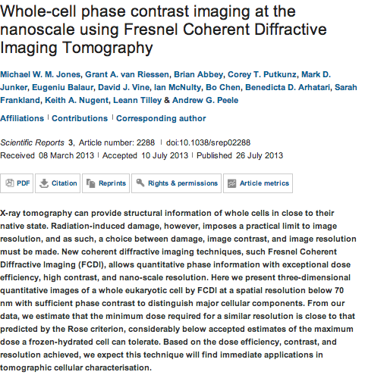
Scientific Reports

Slide 7
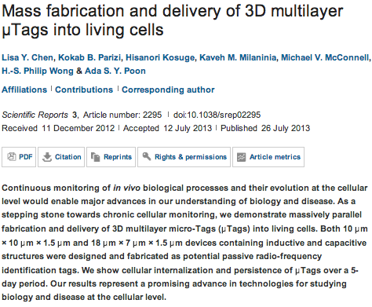
Scientific Reports

Slide 8
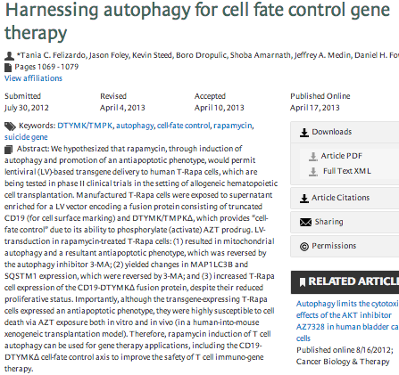
Autophagy

Slide 9

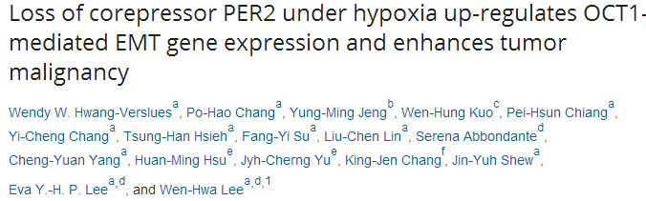
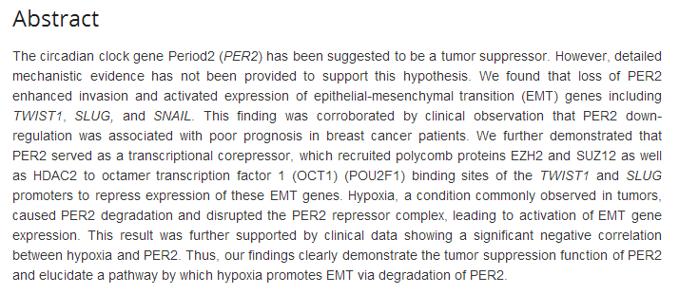

Slide 10
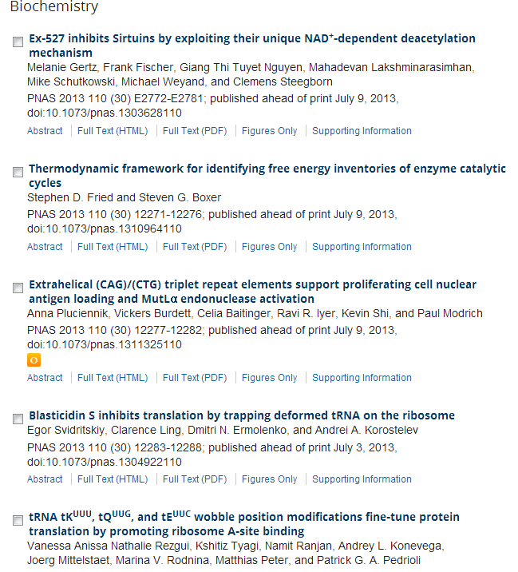

Slide 11
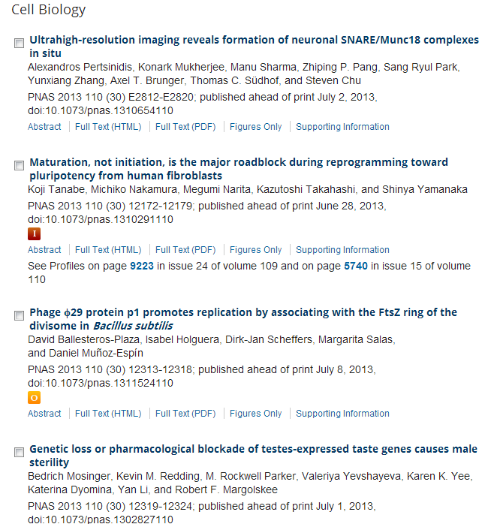

Slide 12
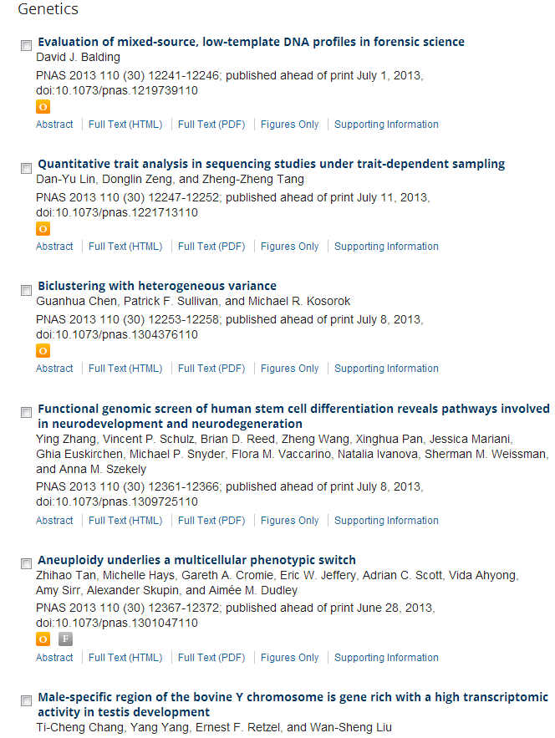

Slide 13
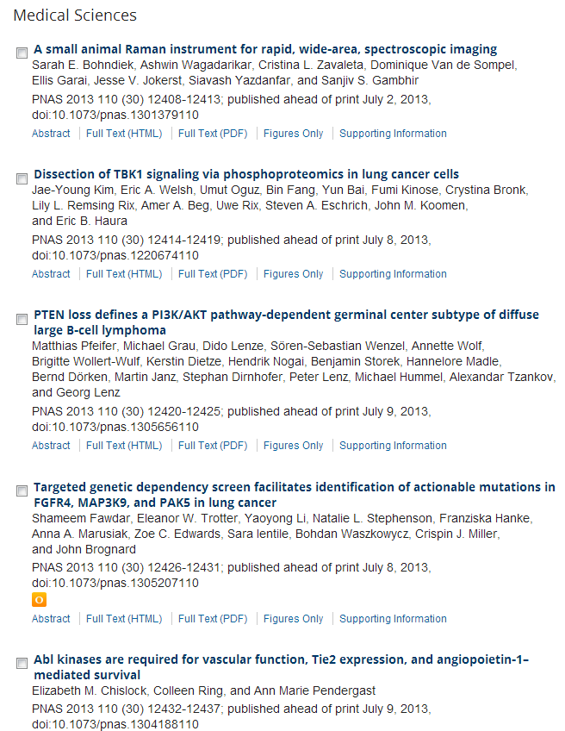

Slide 14

Marine Biology: New Light on Growth in the Cold pR609David K.A. Barnes
Summary | Full Text | PDF (430 kb)
Animal Vision: Rats Watch the Sky pR611Michael F. Land
Summary | Full Text | PDF (445 kb)
Neuron Survival: Say It with Flowers pR613Franck Pichaud
Summary | Full Text | PDF (376 kb)
Ecology: The Lunch of a Lifetime pR615Richard Shine
Summary | Full Text | PDF (492 kb)
Microtubule Motors: A New Hope for Kinesin-5 Inhibitors? pR617Aaron Groen
Summary | Full Text | PDF (499 kb)
Cardiovascular Biology: Play It Again, Gata4 pR619Grant I. Miura, Deborah Yelon
Summary | Full Text | PDF (161 kb)
Animal Behavior: Shifting Neural Circuits with Sex Hormones pR621David M. Ferrero, Stephen D. Liberles
Summary | Full Text | PDF (421 kb)
Intracellular Transport: The Causes for Pauses pR623Kathleen M. Trybus
Summary | Full Text | PDF (117 kb)

Slide 15
Changes in Cell Morphology Are Coordinated with Cell Growth through the TORC1 Pathway p1269Alexi I. Goranov, Amneet Gulati, Noah Dephoure, Terunao Takahara, Tatsuya Maeda, Steven P. Gygi, Scott Manalis, Angelika Amon
Summary | Full Text | PDF (1836 kb)
Kinesin-12 Differentially Affects Spindle Assembly Depending on Its Microtubule Substrate p1280Emma G. Sturgill, Ryoma Ohi
Summary | Full Text | PDF (3707 kb)
ontext-Specific Reweighting of Auditory Spatial Cues following Altered Experience during Development p1291Peter Keating, Johannes C. Dahmen, Andrew J. King
Summary | Full Text | PDF (1636 kb)
“Fitness Fingerprints” Mediate Physiological Culling of Unwanted Neurons in Drosophilap1300Marisa M. Merino, Christa Rhiner, Marta Portela, Eduardo Moreno
Summary | Full Text | PDF (5090 kb)
Spindle Pole Body History Intrinsically Links Pole Identity with Asymmetric Fate in Budding Yeast p1310M. Angeles Juanes, Hanlu Twyman, Edward Tunnacliffe, Zhiang Guo, Rogier ten Hoopen, Marisa Segal
Summary | Full Text | PDF (3366 kb)
Phenotypic Resonance from a Single Meal in an Insectivorous Lizard p1320Manuel Massot, Pedro Aragón
Summary | Full Text | PDF (105 kb)
VAL- and AtBMI1-Mediated H2Aub Initiate the Switch from Embryonic to Postgerminative Growth in Arabidopsis p1324Chao Yang, Fabian Bratzel, Nora Hohmann, Marcus Koch, Franziska Turck, Myriam Calonje
Summary | Full Text | PDF (1660 kb)

Slide 16
Reports
Cell-Fibronectin Interactions Propel Vertebrate Trunk Elongation via Tissue Mechanicsp1335Nicolas Dray, Andrew Lawton, Amitabha Nandi, Dörthe Jülich, Thierry Emonet, Scott A. Holley
Summary | Full Text | PDF (2568 kb)
Evolving Tip Structures Can Explain Age-Dependent Microtubule Catastrophe p1342Courtney E. Coombes, Ami Yamamoto, Madeline R. Kenzie, David J. Odde, Melissa K. Gardner
Summary | Full Text | PDF (1497 kb)
DLin-7 Is Required in Postsynaptic Lamina Neurons to Prevent Light-Induced Photoreceptor Degeneration in Drosophila p1349Sandra-Fausia Soukup, Shirin Meher Pocha, Michaela Yuan, Elisabeth Knust
Summary | Full Text | PDF (2766 kb)
Evolutionary History and Ecological Processes Shape a Local Multilevel Antagonistic Network p1355Marianne Elias, Colin Fontaine, F.J. Frank van Veen
Summary | Full Text | PDF (321 kb)
CEP120 and SPICE1 Cooperate with CPAP in Centriole Elongation p1360David Comartin, Gagan D. Gupta, Eden Fussner, Étienne Coyaud, Monica Hasegan, Marco Archinti, Sally W.T. Cheung, Deborah Pinchev, Steffen Lawo, Brian Raught, David P. Bazett-Jones, Jens Lüders, Laurence Pelletier
Summary | Full Text | PDF (2010 kb)
Mental Imagery Changes Multisensory Perception p1367Christopher C. Berger, H. Henrik Ehrsson
Summary | Full Text | PDF (553 kb)
The Formin Daam1 and Fascin Directly Collaborate to Promote Filopodia Formation p1373Richa Jaiswal, Dennis Breitsprecher, Agnieszka Collins, Ivan R. Corrêa, Ming-Qun Xu, Bruce L. Goode
Summary | Full Text | PDF (2549 kb)

Slide 17
Functions of TAp63 and p53 in restraining the development of metastatic cancer.
Tan EH, Morton JP, Timpson P, Tucci P, Melino G, Flores ER, Sansom OJ, Vousden KH, Muller PA.
Cancer Research UK Beatson Institute, Glasgow, UK.
Many tumours harbour mutations in the p53 tumour-suppressor gene that result in the expression of a mutant p53 protein. This mutant p53 protein has, in most cases, lost wild-type transcriptional activity and can also acquire novel functions in promoting invasion and metastasis. One of the mechanisms underlying these novel functions involves the ability of the mutant p53 to interfere with other transcription factors, including the p53 family protein TAp63. To investigate whether simultaneous depletion of both p53 and TAp63 can recapitulate the effect of mutant p53 expression in vivo, we used a mouse model of pancreatic cancer in which the expression of mutant p53 resulted in the rapid appearance of primary tumours and metastases. As shown previously, loss of one allele of wild-type (WT) p53 accelerated tumour development. A change of one WT p53 allele into mutant p53 did not further accelerate tumour development, but did promote the formation of metastasis. By contrast, loss of TAp63 did not significantly accelerate tumour development or metastasis. However, simultaneous depletion of p53 and TAp63 led to both rapid tumour development and metastatic potential, although the incidence of metastases remained lower than that seen in mutant p53-expressing tumours. TAp63/p53-null cells derived from these mice also showed an enhanced ability to scatter and invade in tissue culture as was observed in mutant p53 cells. These data suggest that depletion of TAp63 in a p53-null tumour can promote metastasis and recapitulate-to some extent-the consequences of mutant p53 expression.
Oncogene

Slide 18
Prdm5 suppresses ApcMin-driven intestinal adenomas and regulates monoacylglycerol lipase expression.
Galli GG, Multhaupt HA, Carrara M, de Lichtenberg KH, Christensen IB, Linnemann D, Santoni-Rugiu E, Calogero RA,Lund AH.
Biotech Research and Innovation Centre, Centre for Epigenetics, University of Copenhagen, Copenhagen, Denmark.
PRDM proteins are tissue-specific transcription factors often deregulated in diseases, particularly in cancer where different members have been found to act as oncogenes or tumor suppressors. PRDM5 is a poorly characterized member of the PRDM family for which several studies have reported a high frequency of promoter hypermethylation in cancer types of gastrointestinal origin. We report here the characterization of Prdm5 knockout mice in the context of intestinal carcinogenesis. We demonstrate that loss of Prdm5 increases the number of adenomas throughout the murine small intestine on an Apc^{Min} background. By using the genome-wide ChIP-seq (chromatin immunoprecipitation (ChIP) followed by DNA sequencing) and transcriptome analyses we identify loci encoding proteins involved in metabolic processes as prominent PRDM5 targets and characterize monoacylglycerol lipase (Mgll) as a direct PRDM5 target in human colon cancer cells and in Prdm5 mutant mouse intestines. Moreover, we report the downregulation of PRDM5 protein expression in human colon neoplastic lesions. In summary, our data provide the first causal link between Prdm5 loss and intestinal carcinogenesis, and uncover an extensive and novel PRDM5 target repertoire likely facilitating the tumor-suppressive functions of PRDM5.
Oncogene

Slide 19
Sphingosine kinase 1 enables communication between melanoma cells and fibroblasts that provides a new link to metastasis.
Pyne NJ, Pyne S.
Source
Cell Biology Group, Strathclyde Institute of Pharmacy and Biomedical Science, University of Strathclyde, Glasgow, UK.
Oncogene
Prolactin cooperates with loss of p53 to promote claudin-low mammary carcinomas.
O'Leary KA, Rugowski DE, Sullivan R, Schuler LA.
Source
Department of Comparative Biosciences, University of Wisconsin-Madison, Madison, WI, USA.
Mutations that disrupt PHOXB interaction with the neuronal calcium sensor HPCAL1 impede cellular differentiation in neuroblastoma.
Wang W, Zhong Q, Teng L, Bhatnagar N, Sharma B, Zhang X, Luther W 2nd, Haynes LP, Burgoyne RD, Vidal M,Volchenboum S, Hill DE, George RE.
Source
Department of Pediatric Oncology, Dana-Farber Cancer Institute, Harvard Medical School, Boston, MA, USA.
Fbw7-dependent cyclin E regulation ensures terminal maturation of bone marrow erythroid cells by restraining oxidative metabolism.
Xu Y, Swartz KL, Siu KT, Bhattacharyya M, Minella AC.
Source
Division of Hematology/Oncology, Department of Medicine, Northwestern University Feinberg School of Medicine, Chicago, IL, USA
Androgen receptor (AR) differential roles in hormone-related tumors including prostate, bladder, kidney, lung, breast and liver.
Chang C, Lee SO, Yeh S, Chang TM.
Source
1] George Whipple Lab for Cancer Research, Departments of Pathology, Urology, Radiation Oncology, and the Wilmot Cancer Center, University of Rochester Medical Center, Rochester, NY, USA [2] Sex Hormone Research Center, China Medical University/Hospital, Taichung, Taiwan.
Testican-1-mediated epithelial-mesenchymal transition signaling confers acquired resistance to lapatinib in HER2-positive gastric cancer.
Kim HP, Han SW, Song SH, Jeong EG, Lee MY, Hwang D, Im SA, Bang YJ, Kim TY.
Source
Cancer Research Institute, Seoul National University College of Medicine, Seoul, Republic of Korea.
Mechanisms of the androgen receptor splicing in prostate cancer cells.
Liu LL, Xie N, Sun S, Plymate S, Mostaghel E, Dong X.
Source
Department of Urologic Sciences, Vancouver Prostate Centre, University of British Columbia, Vancouver, British Columbia, Canada
CD82/KAI expression prevents IL-8-mediated endothelial gap formation in late-stage melanomas.
Khanna P, Chung CY, Neves RI, Robertson GP, Dong C.
Source
Department of Bioengineering, The Pennsylvania State University, University Park, PA, USA.

Slide 20

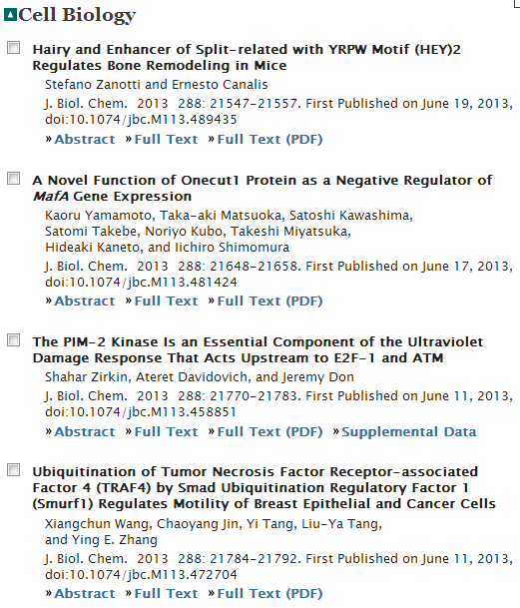
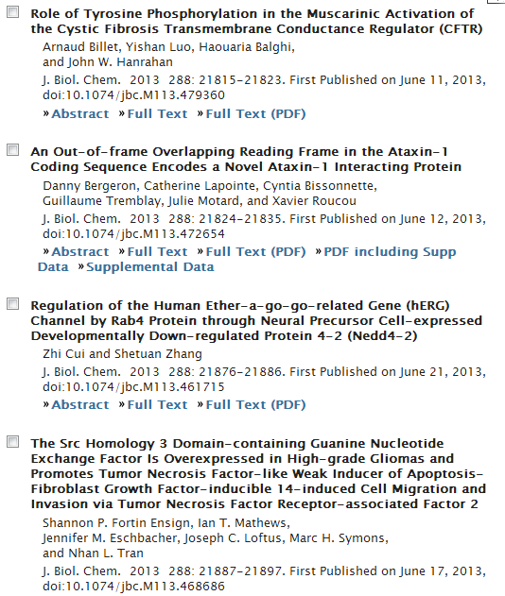

Slide 21
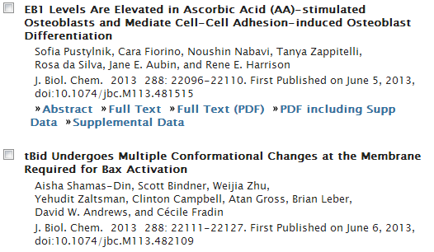
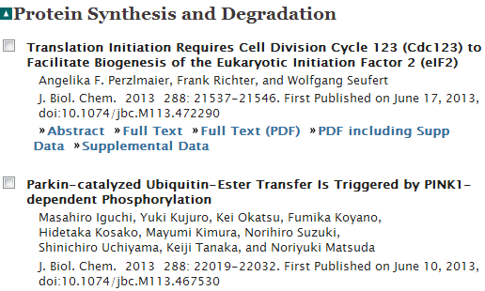
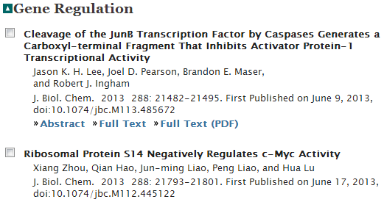

Slide 22
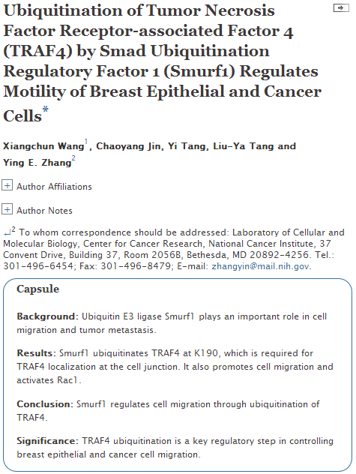
Notes:
Smad ubiquitin regulatory factors (Smurfs) are HECT-domain ubiquitin E3 ligases that regulate diverse cellular processes, including normal and tumor cell migration. However, the underlying mechanism of the Smurfs' role in cell migration is not fully understood. Here we show that Smurf1 induces ubiquitination of tumor necrosis factor receptor-associated factor 4 (TRAF4) at K190. Using the K190R mutant of TRAF4, we demonstrate that Smurf1-induced ubiquitination is required for proper localization of TRAF4 to tight junctions in confluent epithelial cells. We further show that TRAF4 is essential for the migration of both normal mammary epithelial and breast cancer cells. The ability of TRAF4 to promote cell migration is also dependent on Smurf1-mediated ubiquitination, which is associated with Rac1 activation by TRAF4. These results reveal a new regulatory circuit for cell migration, consisting of Smurf1-mediated ubiquitination of TRAF4 and Rac1 activation.

Slide 23
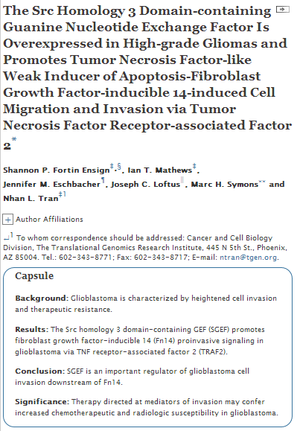
Notes:
Glioblastoma (GB) is the highest grade of primary adult brain tumors, characterized by a poorly defined and highly invasive cell population. Importantly, these invading cells are attributed with having a decreased sensitivity to radiation and chemotherapy. TNF-like weak inducer of apoptosis (TWEAK)-Fn14 ligand-receptor signaling is one mechanism in GB that promotes cell invasiveness and survival and is dependent upon the activity of multiple Rho GTPases, including Rac1. Here we report that Src homology 3 domain-containing guanine nucleotide exchange factor (SGEF), a RhoG-specific guanine nucleotide exchange factor, is overexpressed in GB tumors and promotes TWEAK-Fn14-mediated glioma invasion. Importantly, levels of SGEF expression in GB tumors inversely correlate with patient survival. SGEF mRNA expression is increased in GB cells at the invasive rim relative to those in the tumor core, and knockdown of SGEF expression by shRNA decreases glioma cell migration in vitro and invasion ex vivo. Furthermore, we showed that, upon TWEAK stimulation, SGEF is recruited to the Fn14 cytoplasmic tail via TRAF2. Mutation of the Fn14-TRAF domain site or depletion of TNF receptor-associated factor 2 (TRAF2) expression by siRNA oligonucleotides blocked SGEF recruitment to Fn14 and inhibited SGEF activity and subsequent GB cell migration. We also showed that knockdown of either SGEF or RhoG diminished TWEAK activation of Rac1 and subsequent lamellipodia formation. Together, these results indicate that SGEF-RhoG is an important downstream regulator of TWEAK-Fn14-driven GB cell migration and invasion.

Slide 24
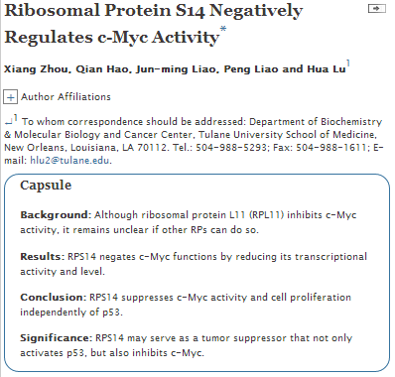
Notes:
The ribosomal gene RPS14 is associated with the cancer-prone 5q-syndrome, which is caused by an interstitial deletion of the long arm of human chromosome 5. Previously, we found that ribosomal protein S14 (RPS14) binds to and inactivates MDM2, consequently leading to p53-dependent cell-cycle arrest and growth inhibition. However, it remains elusive whether RPS14 regulates cell proliferation in a p53-independent manner. Here, we show that RPS14 interacts with the Myc homology box II (MBII) and the C-terminal basic helix-loop-helix leucine zipper (bHLH-LZ) domains of the oncoprotein c-Myc. Further, RPS14 inhibited c-Myc transcriptional activity by preventing the recruitment of c-Myc and its cofactor, TRRAP, to the target gene promoters, as thus suppressing c-Myc-induced cell proliferation. Also, siRNA-mediated RPS14 depletion elevated c-Myc transcriptional activity determined by its target gene, Nucleolin, expression. Interestingly, RPS14 depletion also resulted in the induction of c-Myc mRNA and subsequent protein levels. Consistent with this, RPS14 promoted c-Myc mRNA turnover through an Argonaute 2 (Ago2)- and microRNA-mediated pathway. Taken together, our study demonstrates that RPS14 negates c-Myc functions by directly inhibiting its transcriptional activity and mediating its mRNA degradation via miRNA.

Slide 25

Hypermethylation reduces expression of tumor-suppressor PLZF and regulates proliferation and apoptosis in non-small-cell lung cancers
Xiaotian Wang, Lei Wang, Shicheng Guo, Yang Bao, Yanyun Ma,
Fengyang Yan, Kuan Xu, Zhiyun Xu, Li Jin, Daru Lu, Jibin Xu,
and Jiu-Cun Wang
Source
FASEB J fj.13-229070; published ahead of print June 26, 2013, doi:10.1096/fj.13-229070
Signaling mechanism of tumor cell-induced up-regulation of E3 ubiquitin ligase UBR2
hua Zhang, Ren-Kuo Lin, Yong Tae Kwon, and Yi-Ping Li
Source
FASEB J July 2013 27:2893-2901; published ahead of print April 8, 2013, doi:10.1096/fj.12-222711
Autophagy is required for exercise training-induced skeletal muscle adaptation and improvement of physical performance
Vitor A. Lira, Mitsuharu Okutsu, Mei Zhang, Nicholas P. Greene,
Rhianna C. Laker, David S. Breen, Kyle L. Hoehn, and Zhen Yan
Source
FASEB J fj.13-228486; published ahead of print June 27, 2013, doi:10.1096/fj.13-228486
Apoptosis and angiogenesis: an evolving mechanism for fibrosis
Brandon M. Roberts, Bumsoo Ahn, Ariel Johnson and Luisa Ann DiPietro
Source
FASEB J fj.12-214189; published ahead of print June 19, 2013, doi:10.1096/fj.12-214189
Lung endothelial HO-1 targeting in vivo using lentiviral miRNA regulates apoptosis and autophagy during oxidant injury
Yi Zhang, Ge Jiang, Maor Sauler, and Patty J. Lee
Source
FASEB J fj.13-231225; published ahead of print June 14, 2013, doi:10.1096/fj.13-231225
Hepatitis C virus/human interactome identifies SMURF2 and the viral protease as critical elements for the control of TGF-β signaling
Amandine Verga-Gérard, Marine Porcherot, Laurène Meyniel-Schicklin, Patrice André, Vincent Lotteau, and Laure Perrin-Cocon
Source
FASEB J fj.13-229187; published ahead of print June 18, 2013, doi:10.1096/fj.13-229187

Slide 26
Human telomerase reverse transcriptase regulates MMP expression independently of telomerase activity via NF-κB-dependent transcription
Deqiang Ding, Peng Xi, Junzhi Zhou, Miao Wang, and Yu-Sheng Cong
Abstract
Telomerase plays a pivotal role in the pathology of aging and cancer by controlling telomere length and integrity. However, accumulating evidence indicates that telomerase reverse transcriptase may have fundamental biological functions independent of its enzymatic activity in telomere maintenance. In this study, the ectopic expression of human telomerase reverse transcriptase (hTERT) and its catalytic mutant hTERT K626A induced cancer cell invasion accompanied by the up-regulation of the metalloproteinases (MMPs) MMP1, -3, -9, and -10. Both hTERT and hTERT K626A induced MMP9 mRNA expression and promoter activity in an NF-κB-dependent manner. hTERT and hTERT K626A also regulated the expression of several NF-κB target genes in cancer cell lines. Furthermore, both hTERT and hTERT K626A interacted with NF-κB p65 and increased NF-κB p65 nuclear accumulation and DNA binding. A mammalian 1-hybrid assay showed a functional interplay between hTERT and NF-κB p65 that may mediate NF-κB-dependent transcription activation in cells. Together, these data reveal a telomere-independent role for telomerase as a transcriptional modulator of the NF-κB signaling pathway and a possible contributor to cancer development and progression.

Slide 27

Macrophage migration inhibitory factor plays a permissive role in the maintenance of cardiac contractile function under starvation through regulation of autophagy
Xihui Xu, Benjamin D. Pacheco, Lin Leng, Richard Bucala,
and Jun Ren
Source
Cardiovasc Res (2013) 99 (3): 412-421 first published online May 13, 2013 doi:10.1093/cvr/cvt116
Nuclear accumulation of androgen receptor in gender difference of dilated cardiomyopathy due to lamin A/C mutations
Takuro Arimura, Kenji Onoue, Yumiko Takahashi-Tanaka,
Taisuke Ishikawa, Masayoshi Kuwahara, and Akinori Kimura
Source
Cardiovasc Res (2013) 99 (3): 382-394 first published online April 30, 2013 doi:10.1093/cvr/cvt106
Adiponectin protects against Toll-like receptor 4-mediated cardiac inflammation and injury
Alexander Jenke, Sabrina Wilk, Wolfgang Poller, Urs Eriksson,
Alan Valaperti, Bernhard Hermann Rauch, Andrea Stroux, Peter Liu, Heinz-Peter Schultheiss, Carmen Scheibenbogen,
and Carsten Skurk
Source
Cardiovasc Res (2013) 99 (3): 422-431 first published online May 13, 2013 doi:10.1093/cvr/cvt118
Deficiency of senescence marker protein 30 exacerbates angiotensin II-induced cardiac remodelling
Tomofumi Misaka, Satoshi Suzuki, Makiko Miyata, Atsushi Kobayashi, Tetsuro Shishido, Akihito Ishigami, Shu-ichi Saitoh,
Masamichi Hirose, Isao Kubota, and Yasuchika Takeishi
Source
Cardiovasc Res (2013) 99 (3): 461-470 first published online May 30, 2013 doi:10.1093/cvr/cvt122
AICAR inhibits PPARγ during monocyte differentiation to attenuate inflammatory responses to atherogenic lipids
Dmitry Namgaladze, Marina Kemmerer, Andreas von Knethen,
and Bernhard Brüne
Source
Cardiovasc Res (2013) 98(3): 479-487 first published online March 25, 2013 doi:10.1093/cvr/cvt073
Extracellular HSP60 induces inflammation through activating and up-regulating TLRs in cardiomyocytes
Jing Tian, Xin Guo, Xue-Mei Liu, Li Liu, Qi-Fang Weng, Shu-Juan Dong, Anne A. Knowlton, Wen-Jun Yuan, and Li Lin
Source
Cardiovasc Res (2013) 98(3): 391-401 first published online February 27, 2013 doi:10.1093/cvr/cvt047

Slide 28

IL-1β Production through the NLRP3 Inflammasome by Hepatic Macrophages Links Hepatitis C Virus Infection with Liver Inflammation and Disease
Amina A. Negash, Hilario J. Ramos, Nanette Crochet, Daryl T. Y. Lau, Brian Doehle, Neven Papic, Don A. Delker, Juandy Jo, Antonio Bertoletti, Curt H. Hagedorn, Michael Gale Jr
Source
published 25 Apr 2013 | info:doi/10.1371/journal.ppat.1003330
CYLD Enhances Severe Listeriosis by Impairing IL-6/STAT3-Dependent Fibrin Production
Gopala Nishanth, Martina Deckert, Katharina Wex, Ramin Massoumi, Katrin Schweitzer, Michael Naumann, Dirk Schlüter
Source
published 27 Jun 2013 | info:doi/10.1371/journal.ppat.1003455
Shigella IpaH0722 E3 Ubiquitin Ligase Effector Targets TRAF2 to Inhibit PKC–NF-κB Activity in Invaded Epithelial Cells
Hiroshi Ashida, Hiroyasu Nakano, Chihiro Sasakawa
Source
published 06 Jun 2013 | info:doi/10.1371/journal.ppat.1003409
HIF-1α Is Essential for Effective PMN Bacterial Killing, Antimicrobial Peptide Production and Apoptosis in Pseudomonas aeruginosa Keratitis
Elizabeth A. Berger, Sharon A. McClellan, Kerry S. Vistisen, Linda D. Hazlett
Source
published 18 Jul 2013 | info:doi/10.1371/journal.ppat.1003457
The JAK-STAT Transcriptional Regulator, STAT-5, Activates the ATM DNA Damage Pathway to Induce HPV 31 Genome Amplification upon Epithelial Differentiation
Shiyuan Hong, Laimonis A. Laimins
Source
published 04 Apr 2013 | info:doi/10.1371/journal.ppat.1003295
Cell Death Control: The Interplay of Apoptosis and Autophagy in the Pathogenicity of Sclerotinia sclerotiorum
Mehdi Kabbage, Brett Williams, Martin B. Dickman
Source
published 11 Apr 2013 | info:doi/10.1371/journal.ppat.1003287

