Slide 1
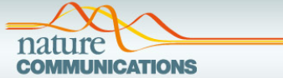
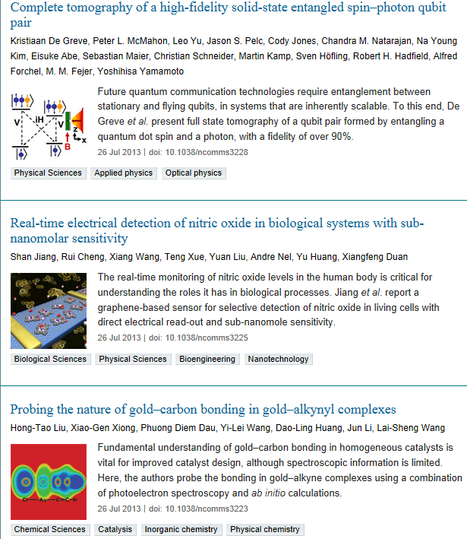

Slide 2
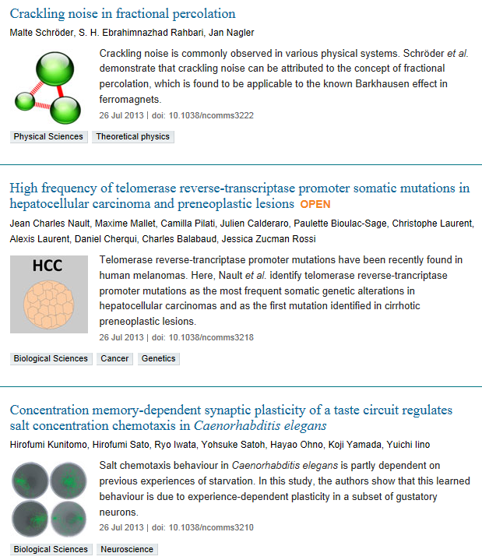

Slide 3
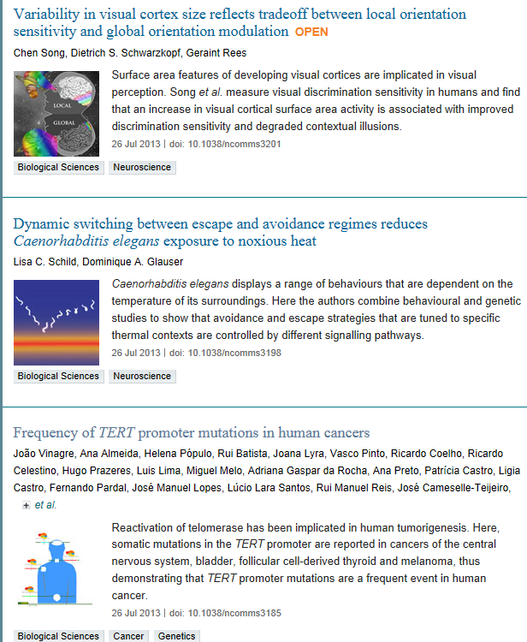

Slide 4
Frequency of TERT promoter mutations in human cancers
João Vinagre,^{1, 2, 16} Ana Almeida,^{1, 2, 16} Helena Pópulo,^{1, 16} Rui Batista,¹ Joana Lyra,^{1, 3}
Vasco Pinto,^{1, 3} Ricardo Coelho,^{1, 2} Ricardo Celestino,¹ Hugo Prazeres,^{1, 4} Luis Lima,^{2, 5, 6, 7} Miguel Melo,^{8, 9} Adriana Gaspar da Rocha,^{1, 3} Ana Preto,^{1, 10} Patrícia Castro,¹ Ligia Castro,^{3, 11} Fernando Pardal,¹² José Manuel Lopes,^{1, 3, 11} Lúcio Lara Santos,⁵ Rui Manuel Reis,^{13, 14} José Cameselle-Teijeiro,¹⁵ Manuel Sobrinho-Simões,^{1, 3, 11} Jorge Lima,^{1, 3} Valdemar Máximo^{1, 3} & Paula Soares^{1, 3}
Institute of Molecular Pathology and Immunology of the University of Porto (IPATIMUP), 4200-465
Reactivation of telomerase has been implicated in human tumorigenesis, but the underlying mechanisms remain poorly understood. Here we report the presence of recurrent somatic mutations in the TERT promoter in cancers of the central nervous system (43%), bladder (59%), thyroid (follicular cell-derived, 10%) and skin (melanoma, 29%). In thyroid cancers, the presence of TERT promoter mutations (when occurring together with BRAF mutations) is significantly associated with higher TERT mRNA expression, and in glioblastoma we find a trend for increased telomerase expression in cases harbouring TERT promoter mutations. Both in thyroid cancers and glioblastoma, TERT promoter mutations are significantly associated with older age of the patients. Our results show that TERT promoter mutations are relatively frequent in specific types of human cancers, where they lead to enhanced expression of telomerase.

Slide 5

Research Article
Regulation of the Tumor Suppressor PTEN through Exosomes: A Diagnostic Potential for Prostate Cancer
Affiliations: Division of Nephrology, Department of Medicine, McMaster University, Hamilton, Ontario, Canada, Hamilton Centre for Kidney Research (HCKR), St. Joseph’s Hospital, Hamilton, Ontario, Canada
Abstract
PTEN is a potent tumor-suppressor protein. Aggressive and metastatic prostate cancer (PC) is associated with a reduction or loss of PTEN expression. PTEN reduction often occurs without gene mutations, and its downregulation is not fully understood. Herein, we show that PTEN is incorporated in the cargo of exosomes derived from cancer cells. PTEN is not detected in exosomes derived from normal, noncancerous cells. We found that PTEN can be transferred to other cells through exosomes. In cells that have a reduction or complete loss of PTEN expression, the transferred PTEN is competent to confer tumor-suppression activity to acceptor cells. In PC patients, we show that PTEN is incorporated in the cargo of exosomes that circulate in their blood. Interestingly, normal subjects have no PTEN expression in their blood exosomes. Further, we found that the prostate-specific antigen (PSA) is incorporated in PC patients’ and normal subjects’ blood exosomes. These data suggest that exosomal PTEN can compensate for PTEN loss in PTEN deficient cells, and may have diagnostic value for prostate cancer.

Slide 6
The LDL Receptor-Related Protein 1 (LRP1) Regulates the PDGF Signaling Pathway by Binding the Protein Phosphatase SHP-2 and Modulating SHP-2- Mediated PDGF Signaling Events Julie Craig, Irina Mikhailenko, Nathaniel Noyes, Mary Migliorini, Dudley K. Strickland Research Article | published 26 Jul 2013 | PLOS ONE 10.1371/journal.pone.0070432
Telomere Length and Physical Performance at Older Ages: An Individual Participant Meta-Analysis Michael P. Gardner, Carmen Martin-Ruiz, Rachel Cooper, Rebecca Hardy, Avan Aihie Sayer, Cyrus Cooper, Ian J. Deary, John Gallacher, Sarah E. Harris, Paul G. Shiels, John M. Starr, Diana Kuh, Thomas von Zglinicki, Yoav Ben-Shlomo, the Halcyon study team Research Article | published 26 Jul 2013 | PLOS ONE 10.1371/journal.pone.0069526
E- and P-Selectins Are Essential for Repopulation of Chronic Myelogenous and Chronic Eosinophilic Leukemias in a Scid Mouse Xenograft Model Daniel Wicklein, Anna Schmidt, Vera Labitzky, Sebastian Ullrich, Peter Valent, Udo Schumacher Research Article | published 26 Jul 2013 | PLOS ONE 10.1371/journal.pone.0070139
Development of a Nuclear Morphometric Signature for Prostate Cancer Risk in Negative Biopsies Peter H. Gann, Ryan Deaton, Anup Amatya, Mahesh Mohnani, Erika Enk Rueter, Yirong Yang, Viju Ananthanarayanan Research Article | published 26 Jul 2013 | PLOS ONE 10.1371/journal.pone.0069457
Ursolic Acid Inhibits Adipogenesis in 3T3-L1 Adipocytes through LKB1/AMPK Pathway Yonghan He, Ying Li, Tiantian Zhao, Yanwen Wang, Changhao Sun Research Article | published 26 Jul 2013 | PLOS ONE 10.1371/journal.pone.0070135
ptor Proteins Intersectin 1 and 2 Bind Similar Proline-Rich Ligands but Are Differentially Recognized by SH2 Domain-Containing Proteins Olga Novokhatska, Mykola Dergai, Liudmyla Tsyba, Inessa Skrypkina, Valeriy Filonenko, Jacques Moreau, Alla Rynditch Research Article | published 25 Jul 2013 | PLOS ONE 10.1371/journal.pone.0070546
Progression of Kidney Disease in Non-Diabetic Patients with Coronary Artery Disease: Predictive Role of Circulating Matrix Metalloproteinase-2, -3, and -9 Ta-Wei Hsu, Ko-Lin Kuo, Szu-Chun Hung, Po-Hsun Huang, Jaw-Wen Chen, Der-Cherng Tarng Research Article | published 26 Jul 2013 | PLOS ONE 10.1371/journal.pone.0070132
Decrease of miR-202-3p Expression, a Novel Tumor Suppressor, in Gastric Cancer Yu Zhao, Chenglong Li, Ming Wang, Liping Su, Ying Qu, Jianfang Li, Beiqin Yu, Min Yan, Yingyan Yu, Bingya Liu, Zhenggang Zhu Research Article | published 25 Jul 2013 | PLOS ONE 10.1371/journal.pone.0069756
Crosstalk between Shh and TGF-β Signaling in Cyclosporine-Enhanced Cell Proliferation in Human Gingival Fibroblasts Yi Chung, Earl Fu Research Article | published 26 Jul 2013 | PLOS ONE 10.1371/journal.pone.0070128
The Peripheral Myeloid Expansion Driven by Murine Cancer Progression Is Reversed by Radiation Therapy of the Tumor Marka R. Crittenden, Talicia Savage, Benjamin Cottam, Keith S. Bahjat, William L. Redmond, Shelly Bambina, Melissa Kasiewicz, Pippa Newell, Andrew M. Jackson, Michael J. Gough Research Article | published 25 Jul 2013 | PLOS ONE 10.1371/journal.pone.0069527
SIRT1 is a Direct Coactivator of Thyroid Hormone Receptor β1 with Gene-Specific Actions Ji Ho Suh, Douglas H. Sieglaff, Aijun Zhang, Xuefeng Xia, Aleksandra Cvoro, Glenn E. Winnier, Paul Webb Research Article | published 26 Jul 2013 | PLOS ONE 10.1371/journal.pone.0070097

Slide 7
BRIEF REVIEWS
Antibody Polyreactivity in Health and Disease: Statu Variabilis
Jordan D. Dimitrov, Cyril Planchais, Lubka T. Roumenina, Tchavdar L. Vassilev, Srinivas V. Kaveri, and Sebastien Lacroix-Desmazes
J Immunol 2013 191:993-999; doi:10.4049/jimmunol.1300880
CUTTING EDGE
Cutting Edge: Heterosubtypic Influenza Infection Antagonizes Elicitation of Immunological Reactivity to Hemagglutinin
Jennifer L. Nayak, Shabnam Alam, and Andrea J. Sant
J Immunol 2013 191:1001-1005; published ahead of print June 21, 2013, doi:10.4049/jimmunol.1203520
Cutting Edge: The NLRP3 Inflammasome Links Complement-Mediated Inflammation and IL-1β Release
Federica Laudisi, Roberto Spreafico, Maximilien Evrard, Timothy R. Hughes, Barbara Mandriani, Matheswaran Kandasamy, B. Paul Morgan, Baalasubramanian Sivasankar, and Alessandra Mortellaro
J Immunol 2013 191:1006-1010; published ahead of print July 1, 2013, doi:10.4049/jimmunol.1300489
Cutting Edge: IL-12 and Type I IFN Differentially Program CD8 T Cells for Programmed Death 1 Re-expression Levels and Tumor Control
Michael Y. Gerner, Lynn M. Heltemes-Harris, Brian T. Fife, and Matthew F. Mescher
J Immunol 2013 191:1011-1015; published ahead of print June 26, 2013, doi:10.4049/jimmunol.1300652
Cutting Edge: Direct Recognition of Infected Cells by CD4 T Cells Is Required for Control of Intracellular Mycobacterium tuberculosis In Vivo
Smita Srivastava and Joel D. Ernst
J Immunol 2013 191:1016-1020; published ahead of print July 1, 2013, doi:10.4049/jimmunol.1301236
AUTOIMMUNITY
Macrophage Migration Inhibitory Factor Potentiates Autoimmune-Mediated Neuroinflammation
Gina Mavrikis Cox, Aaron P. Kithcart, David Pitt, Zhen Guan, Jessica Alexander, Jessica L. Williams, Todd Shawler, Nilesh M. Dagia, Phillip G. Popovich, Abhay R. Satoskar, and Caroline C. Whitacre
J Immunol 2013 191:1043-1054; published ahead of print June 24, 2013, doi:10.4049/jimmunol.1200485
Macrophage Scavenger Receptor 1 (Msr1, SR-A) Influences B Cell Autoimmunity by Regulating Soluble Autoantigen Concentration
Stefanie Haasken, Jennifer L. Auger, Justin J. Taylor, Patricia M. Hobday, Brian D. Goudy, Philip J. Titcombe, Daniel L. Mueller, and Bryce A. Binstadt
J Immunol 2013 191:1055-1062; published ahead of print June 21, 2013, doi:10.4049/jimmunol.1201680
Regulation of Adaptive Immunity by the Fractalkine Receptor during Autoimmune Inflammation
Jenny A. Garcia, Paula A. Pino, Makiko Mizutani, Sandra M. Cardona, Israel F. Charo, Richard M. Ransohoff, Thomas G. Forsthuber, and Astrid E. Cardona
J Immunol 2013 191:1063-1072; published ahead of print July 1, 2013, doi:10.4049/jimmunol.1300040
Myeloid-Derived Suppressor Cells Play Crucial Roles in the Regulation of Mouse Collagen-Induced Arthritis
Wataru Fujii, Eishi Ashihara, Hideyo Hirai, Hidetake Nagahara, Naoko Kajitani, Kazuki Fujioka, Ken Murakami, Takahiro Seno, Aihiro Yamamoto, Hidetaka Ishino, Masataka Kohno, Taira Maekawa, and Yutaka Kawahito
J Immunol 2013 191:1073-1081; published ahead of print June 26, 2013, doi:10.4049/jimmunol.1203535

Slide 8
Censoring of Self-Reactive B Cells by Follicular Dendritic Cell–Displayed Self-Antigen
Irene W. Yau, Matthew H. Cato, Julia Jellusova, Tatiana Hurtado de Mendoza, Robert Brink, and Robert C. Rickert
J Immunol 2013 191:1082-1090; published ahead of print July 1, 2013, doi:10.4049/jimmunol.1201569
The Encephalitogenic, Human Myelin Oligodendrocyte Glycoprotein–Induced Antibody Repertoire Is Directed toward Multiple Epitopes in C57BL/6-Immunized Mice
Pankaj Bansal, Tarique Khan, Uta Bussmeyer, Dilip K. Challa, Rafal Swiercz, Ramraj Velmurugan, Raimund J. Ober, and E. Sally Ward
J Immunol 2013 191:1091-1101; published ahead of print July 1, 2013, doi:10.4049/jimmunol.1300019
IMMUNE REGULATION
Distinct Chemokine Receptor Axes Regulate Th9 Cell Trafficking to Allergic and Autoimmune Inflammatory Sites
Ervin E. Kara, Iain Comerford, Cameron R. Bastow, Kevin A. Fenix, Wendel Litchfield, Tracy M. Handel, and Shaun R. McColl
J Immunol 2013 191:1110-1117; published ahead of print June 24, 2013, doi:10.4049/jimmunol.1203089
IL-23 Receptor Expression on γδ T Cells Correlates with Their Enhancing or Suppressive Effects on Autoreactive T Cells in Experimental Autoimmune Uveitis
Dongchun Liang, Aijun Zuo, Hui Shao, Willi K. Born, Rebecca L. O’Brien, Henry J. Kaplan, and Deming Sun
J Immunol 2013 191:1118-1125; published ahead of print June 24, 2013, doi:10.4049/jimmunol.1300626
Antigen-Free Adjuvant Assists Late Effector CD4 T Cells To Transit to Memory in Lymphopenic Hosts
F. Betul Guloglu, Jason S. Ellis, Xiaoxiao Wan, Mermagya Dhakal, Christine M. Hoeman, Jason A. Cascio, and Habib Zaghouani
J Immunol 2013 191:1126-1135; published ahead of print July 1, 2013, doi:10.4049/jimmunol.1202262
Comparison of Induced versus Natural Regulatory T Cells of the Same TCR Specificity for Induction of Tolerance to an Environmental Antigen
Hui Huang, Yanna Ma, Wojciech Dawicki, Xiaobei Zhang, and John R. Gordon
J Immunol 2013 191:1136-1143; published ahead of print July 1, 2013, doi:10.4049/jimmunol.1201899
Antiviral Vaccines License T Cell Responses by Suppressing Granzyme B Levels in Human Plasmacytoid Dendritic Cells
Dorit Fabricius, Benedikt Nußbaum, Daniel Busch, Verena Panitz, Birgit Mandel, Angelika Vollmer, Mike-Andrew Westhoff, Christof Kaltenmeier, Oleg Lunov, Kyrylo Tron, G. Ulrich Nienhaus, Bernd Jahrsdörfer, and Klaus-Michael Debatin
J Immunol 2013 191:1144-1153; published ahead of print June 19, 2013, doi:10.4049/jimmunol.1203479
BAFF- and APRIL-Dependent Maintenance of Antibody Titers after Immunization with T-Dependent Antigen and CD1d-Binding Ligand
Hemangi B. Shah, Sunil K. Joshi, Pragya Rampuria, T. Scott Devera, Gillian A. Lang, William Stohl, and Mark L. Lang
J Immunol 2013 191:1154-1163; published ahead of print June 24, 2013, doi:10.4049/jimmunol.1300263

Slide 9
The Role of JAK-3 in Regulating TLR-Mediated Inflammatory Cytokine Production in Innate Immune Cells
Huizhi Wang, Jonathan Brown, Shegan Gao, Shuang Liang, Ravi Jotwani, Huaxin Zhou, Jill Suttles, David A. Scott, and Richard J. Lamont
J Immunol 2013 191:1164-1174; published ahead of print June 24, 2013, doi:10.4049/jimmunol.1203084
Th17 Cells Induce Th1-Polarizing Monocyte-Derived Dendritic Cells
Matthew G. Davidson, Michael N. Alonso, Robert Yuan, Robert C. Axtell, Justin A. Kenkel, Megan M. Suhoski, Joseph C. González, Lawrence Steinman, and Edgar G. Engleman
J Immunol 2013 191:1175-1187; published ahead of print June 21, 2013, doi:10.4049/jimmunol.1203201
Dendritic Cells Regulate High-Speed Interstitial T Cell Migration in the Lymph Node via LFA-1/ICAM-1
Tomoya Katakai, Katsuyoshi Habiro, and Tatsuo Kinashi
J Immunol 2013 191:1188-1199; published ahead of print July 1, 2013, doi:10.4049/jimmunol.1300739
INFECTIOUS DISEASE AND HOST RESPONSE
T Cell–Dependent IgM Memory B Cells Generated during Bacterial Infection Are Required for IgG Responses to Antigen Challenge
Jennifer L. Yates, Rachael Racine, Kevin M. McBride, and Gary M. Winslow
J Immunol 2013 191:1240-1249; published ahead of print June 26, 2013, doi:10.4049/jimmunol.1300062
Depletion of Alveolar Macrophages during Influenza Infection Facilitates Bacterial Superinfections
Hazem E. Ghoneim, Paul G. Thomas, and Jonathan A. McCullers
J Immunol 2013 191:1250-1259; published ahead of print June 26, 2013, doi:10.4049/jimmunol.1300014
Common Tolerance Mechanisms, but Distinct Cross-Reactivities Associated with gp41 and Lipids, Limit Production of HIV-1 Broad Neutralizing Antibodies 2F5 and 4E10
Yao Chen, Jinsong Zhang, Kwan-Ki Hwang, Hilary Bouton-Verville, Shi-Mao Xia, Amanda Newman, Ying-Bin Ouyang, Barton F. Haynes, and Laurent Verkoczy
J Immunol 2013 191:1260-1275; published ahead of print July 3, 2013, doi:10.4049/jimmunol.1300770
Francisella tularensis SchuS4 and SchuS4 Lipids Inhibit IL-12p40 in Primary Human Dendritic Cells by Inhibition of IRF1 and IRF8
Robin Ireland, Rong Wang, Joshua B. Alinger, Pamela Small, and Catharine M. Bosio
J Immunol 2013 191:1276-1286; published ahead of print July 1, 2013, doi:10.4049/jimmunol.1300867
Corticosteroids Block Autophagy Protein Recruitment in Aspergillus fumigatus Phagosomes via Targeting Dectin-1/Syk Kinase Signaling
Irene Kyrmizi, Mark S. Gresnigt, Tonia Akoumianaki, George Samonis, Prodromos Sidiropoulos, Dimitrios Boumpas, Mihai G. Netea, Frank L. van de Veerdonk, Dimitrios P. Kontoyiannis, and Georgios Chamilos
J Immunol 2013 191:1287-1299; published ahead of print July 1, 2013, doi:10.4049/jimmunol.1300132

Slide 10
Differential Impact of Age and Cytomegalovirus Infection on the γδ T Cell Compartment
Antoine Roux, Gisèle Mourin, Martin Larsen, Solène Fastenackels, Alejandra Urrutia, Guy Gorochov, Brigitte Autran, Catherine Donner, Daniel Sidi, Joyce Sibony-Prat, Arnaud Marchant, Marc Stern, Delphine Sauce, and Victor Appay
J Immunol 2013 191:1300-1306; published ahead of print July 1, 2013, doi:10.4049/jimmunol.1202940
NKG2D Induces Mcl-1 Expression and Mediates Survival of CD8 Memory T Cell Precursors via Phosphatidylinositol 3-Kinase
Felix M. Wensveen, Maja Lenartić, Vedrana Jelenčić, Niels A. W. Lemmermann, Anja ten Brinke, Stipan Jonjić, and Bojan Polić
J Immunol 2013 191:1307-1315; published ahead of print June 26, 2013, doi:10.4049/jimmunol.1300670
INNATE IMMUNITY AND INFLAMMATION
Overexpression of CREMα in T Cells Aggravates Lipopolysaccharide-Induced Acute Lung Injury
Eva Verjans, Kim Ohl, Yin Yu, Ralph Lippe, Angela Schippers, Anastasia Wiener, Johannes Roth, Norbert Wagner, Stefan Uhlig, Klaus Tenbrock, and Christian Martin
J Immunol 2013 191:1316-1323; published ahead of print June 19, 2013, doi:10.4049/jimmunol.1203147
Ficolin-1–PTX3 Complex Formation Promotes Clearance of Altered Self-Cells and Modulates IL-8 Production
Ying Jie Ma, Andrea Doni, Luigina Romani, Henrik Jessen ürgensen, Niels Behrendt, Alberto Mantovani, and Peter Garred
J Immunol 2013 191:1324-1333; published ahead of print July 1, 2013, doi:10.4049/jimmunol.1300382
Co-Complexes of MASP-1 and MASP-2 Associated with the Soluble Pattern-Recognition Molecules Drive Lectin Pathway Activation in a Manner Inhibitable by MAp44
Søren E. Degn, Lisbeth Jensen, Tomasz Olszowski, Jens C. Jensenius, and Steffen Thiel
J Immunol 2013 191:1334-1345; published ahead of print June 19, 2013, doi:10.4049/jimmunol.1300780
Essential Requirements of Zoledronate-Induced Cytokine and γδ T Cell Proliferative Responses
Oliver Nussbaumer, Georg Gruenbacher, Hubert Gander, Juliana Komuczki, Andrea Rahm, and Martin Thurnher
J Immunol 2013 191:1346-1355; published ahead of print June 21, 2013, doi:10.4049/jimmunol.1300603
Adipocytes Modulate the Phenotype of Human Macrophages through Secreted Lipids
Inge R. Klein-Wieringa, Stefan N. Andersen, Joanneke C. Kwekkeboom, Martin Giera, Badelog J. E. de Lange-Brokaar, Gerjo J. V. M. van Osch, Anne-Marie Zuurmond, Vedrana Stojanovic-Susulic, Rob G. H. H. Nelissen, Hanno Pijl, Tom W. J. Huizinga, Margreet Kloppenburg, René E’. M. Toes, and Andreea Ioan-Facsinay
J Immunol 2013 191:1356-1363; published ahead of print July 1, 2013, doi:10.4049/jimmunol.1203074
Synovial Fibroblasts Directly Induce Th17 Pathogenicity via the Cyclooxygenase/Prostaglandin E₂ Pathway, Independent of IL-23
Sandra M. J. Paulissen, Jan Piet van Hamburg, Nadine Davelaar, Patrick S. Asmawidjaja, Johanna M. W. Hazes, and Erik Lubberts
J Immunol 2013 191:1364-1372; published ahead of print July 1, 2013, doi:10.4049/jimmunol.1300274

Slide 11
Histamine H₂ Receptor Signaling in the Pathogenesis of Sepsis: Studies in a Murine Diabetes Model
Daniela Carlos, Fernando Spiller, Fabrício O. Souto, Silvia C. Trevelin, Vanessa F. Borges, Andressa de Freitas, José C. Alves-Filho, João S. Silva, Bernhard Ryffel, and Fernando Q. Cunha
J Immunol 2013 191:1373-1382; published ahead of print July 1, 2013, doi:10.4049/jimmunol.1202907
Increased Saturated Fatty Acids in Obesity Alter Resolution of Inflammation in Part by Stimulating Prostaglandin Production
Jason Hellmann, Michael J. Zhang, Yunan Tang, Madhavi Rane, Aruni Bhatnagar, and Matthew Spite
J Immunol 2013 191:1383-1392; published ahead of print June 19, 2013, doi:10.4049/jimmunol.1203369
A Protective Hsp70–TLR4 Pathway in Lethal Oxidant Lung Injury
Yi Zhang, Xuchen Zhang, Peiying Shan, Clayton R. Hunt, Tej K. Pandita, and Patty J. Lee
J Immunol 2013 191:1393-1403; published ahead of print July 1, 2013, doi:10.4049/jimmunol.1300052
Mast Cell–Restricted, Tetramer-Forming Tryptases Induce Aggrecanolysis in Articular Cartilage by Activating Matrix Metalloproteinase-3 and -13 Zymogens
Natalia J. Magarinos, Katherine J. Bryant, Amanda J. Fosang, Roberto Adachi, Richard L. Stevens, and H. Patrick McNeil
J Immunol 2013 191:1404-1412; published ahead of print June 24, 2013, doi:10.4049/jimmunol.1300856
IL-16 Induces Intestinal Inflammation via PepT1 Upregulation in a Pufferfish Model: New Insights into the Molecular Mechanism of Inflammatory Bowel Disease
Ping Wang, Yi-qi Lu, Yi Wen, Dai-yong Yu, Liang Ge, Wei-ren Dong, Li-xin Xiang, and Jian-zhong Shao
J Immunol 2013 191:1413-1427; published ahead of print July 1, 2013, doi:10.4049/jimmunol.1202598
MOLECULAR AND STRUCTURAL IMMUNOLOGY
Antibody and Antigen Contact Residues Define Epitope and Paratope Size and Structure
James W. Stave and Klaus Lindpaintner
J Immunol 2013 191:1428-1435; published ahead of print June 24, 2013, doi:10.4049/jimmunol.1203198
Y14 Positively Regulates TNF-α–Induced NF-κB Transcriptional Activity via Interacting RIP1 and TRADD Beyond an Exon Junction Complex Protein
Sumihito Togi, Kaname Shiga, Ryuta Muromoto, Masaya Kato, Yuki Souma, Yuichi Sekine, Shigeyuki Kon, Kenji Oritani, and Tadashi Matsuda
J Immunol 2013 191:1436-1444; published ahead of print July 1, 2013, doi:10.4049/jimmunol.1300501
Active Caspase-3 Is Stored within Secretory Compartments of Viable Mast Cells
Gianni Garcia-Faroldi, Fabio R. Melo, Elin Rönnberg, Mirjana Grujic, and Gunnar Pejler
J Immunol 2013 191:1445-1452; published ahead of print July 1, 2013, doi:10.4049/jimmunol.1300216
TUMOR IMMUNOLOGY
Role of IRF4 in IFN-Stimulated Gene Induction and Maintenance of Kaposi Sarcoma–Associated Herpesvirus Latency in Primary Effusion Lymphoma Cells
Adriana Forero, Patrick S. Moore, and Saumendra N. Sarkar
J Immunol 2013 191:1476-1485; published ahead of print June 26, 2013, doi:10.4049/jimmunol.1202514

Slide 12
Tumor-Derived Lactate Modifies Antitumor Immune Response: Effect on Myeloid-Derived Suppressor Cells and NK Cells
Zaheed Husain, Yannu Huang, Pankaj Seth, and Vikas P. Sukhatme
J Immunol 2013 191:1486-1495; published ahead of print July 1, 2013, doi:10.4049/jimmunol.1202702
Chemokine Unresponsiveness of Chronic Lymphocytic Leukemia Cells Results from Impaired Endosomal Recycling of Rap1 and Is Associated with a Distinctive Type of Immunological Anergy
Derek S. Pye, Ignacio Rubio, Rico Pusch, Ke Lin, Andrew R. Pettitt, and Kathleen J. Till
J Immunol 2013 191:1496-1504; published ahead of print June 26, 2013, doi:10.4049/jimmunol.1203484

Slide 13
Y14 Positively Regulates TNF-α–Induced NF-κB Transcriptional Activity via Interacting RIP1 and TRADD Beyond an Exon Junction Complex Protein
Sumihito Togi*,1, Kaname Shiga*,1, Ryuta Muromoto*, Masaya Kato*, Yuki Souma*, Yuichi Sekine*, Shigeyuki Kon*, Kenji Oritani† and Tadashi Matsuda*
*Department of Immunology, Graduate School of Pharmaceutical Sciences, Hokkaido University, Sapporo 060-0812, Japan; and
†Department of Hematology and Oncology, Graduate School of Medicine, Osaka University, Suita, Osaka 565-0871, Japan
↵1 S.T. and K.S. contributed equally to this work.
Although Y14 is known to be a component of the exon junction complex, we previously reported that Y14 regulates IL-6–induced STAT3 activation. In this study, we showed that endogenous Y14 positively regulated TNF-α–induced IL-6 expression in HeLa cells. Small interfering RNA–mediated Y14-knockdown reduced TNF-α–induced and NF-κB–mediated transcriptional activity, phosphorylation/degradation of IκBα, and nuclear localization of NF-κB/p65. As in the case of IL-6 stimuli, Y14 enhanced TNF-α–induced STAT3 phosphorylation, which is important for its nuclear retention. However, our manipulation of Y14 expression indicated that it is involved in TNF-α–induced IL-6 expression via both STAT3-dependent and -independent mechanisms. We screened signaling molecules in the TNF-α–NF-κB pathway and found that Y14 endogenously associated with receptor-interacting protein 1 (RIP1) and TNFR-associated death domain (TRADD). Overexpression of RIP1, but not TRADD, restored TNF-α–induced NF-κB activation in Y14-knockdown cells, and Y14 overexpression restored TNF-α–induced NF-κB activation in TRADD-knockdown cells, but not in RIP1-knockdown cells, indicating that Y14 lies downstream of TRADD and upstream of RIP1. Of importance, Y14 significantly enhanced the binding between RIP1 and TRADD, and this is a possible new mechanism for Y14-mediated modification of TNF-α signals. Although Y14 associates with MAGOH in the exon junction complex, Y14’s actions in the TNF-α–NF-κB pathway are unlikely to require MAGOH. Therefore, Y14 positively regulates signals for TNF-α–induced IL-6 production at multiple steps beyond an exon junction complex protein.

Slide 14

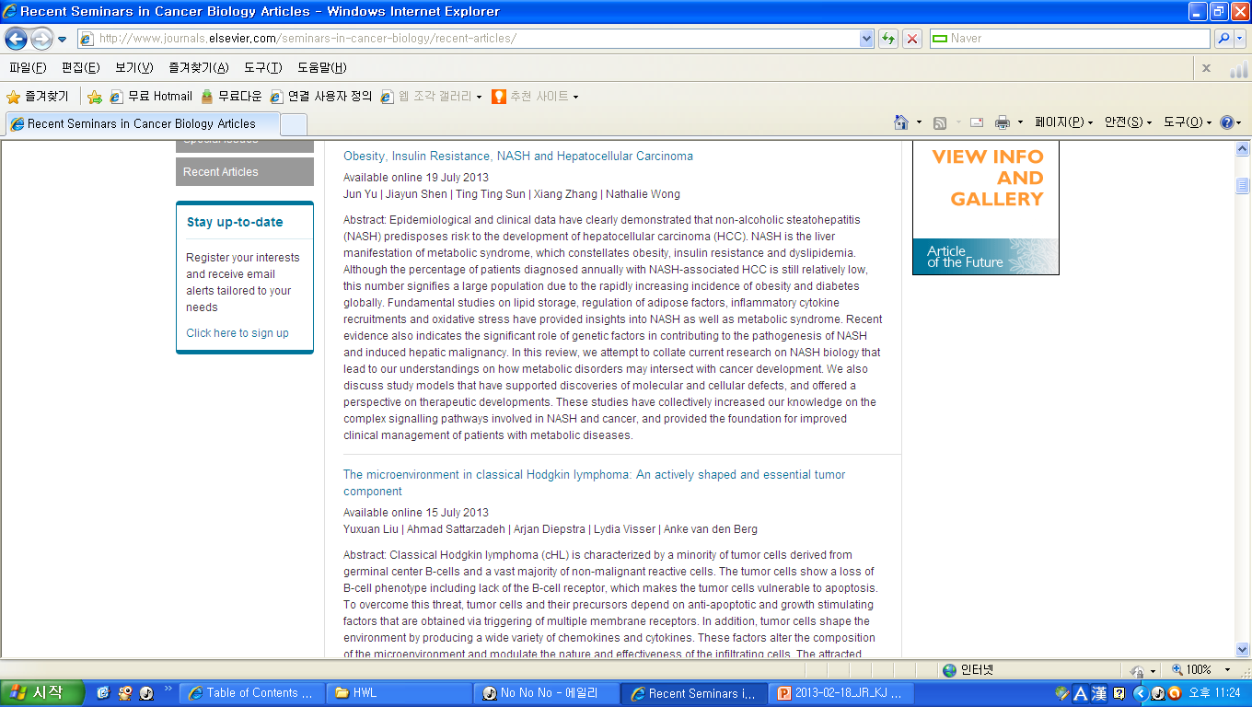
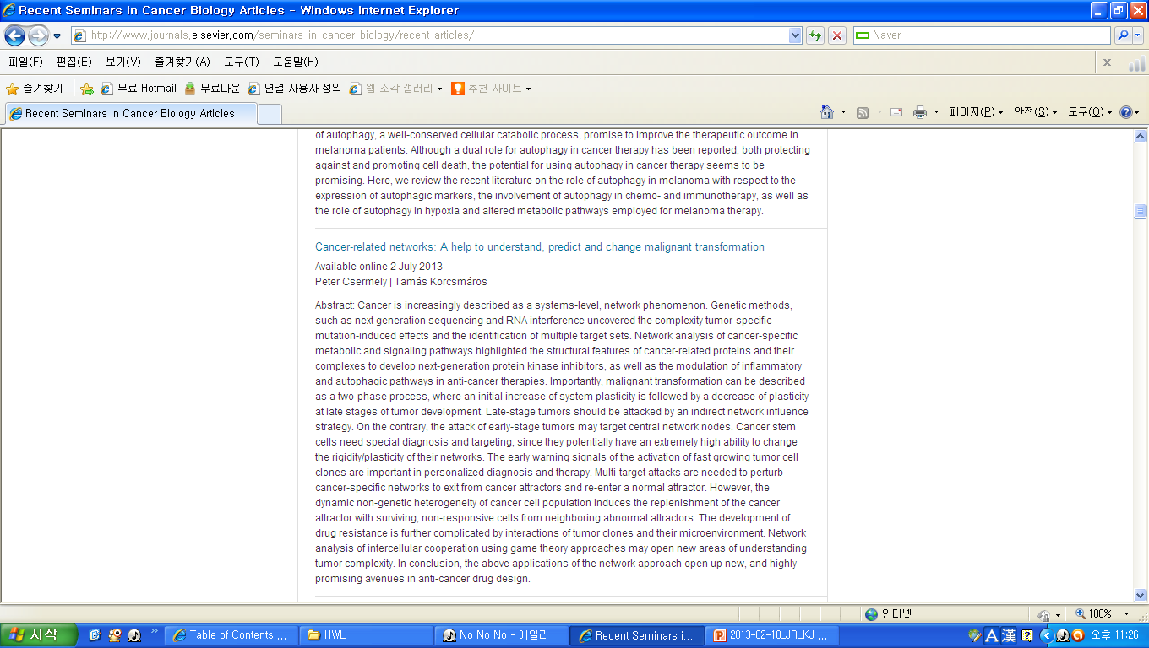
KJ

Slide 15
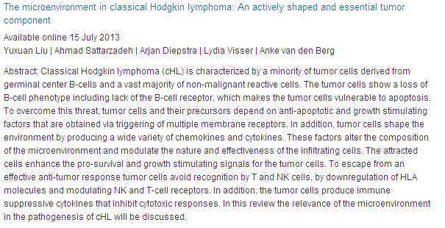
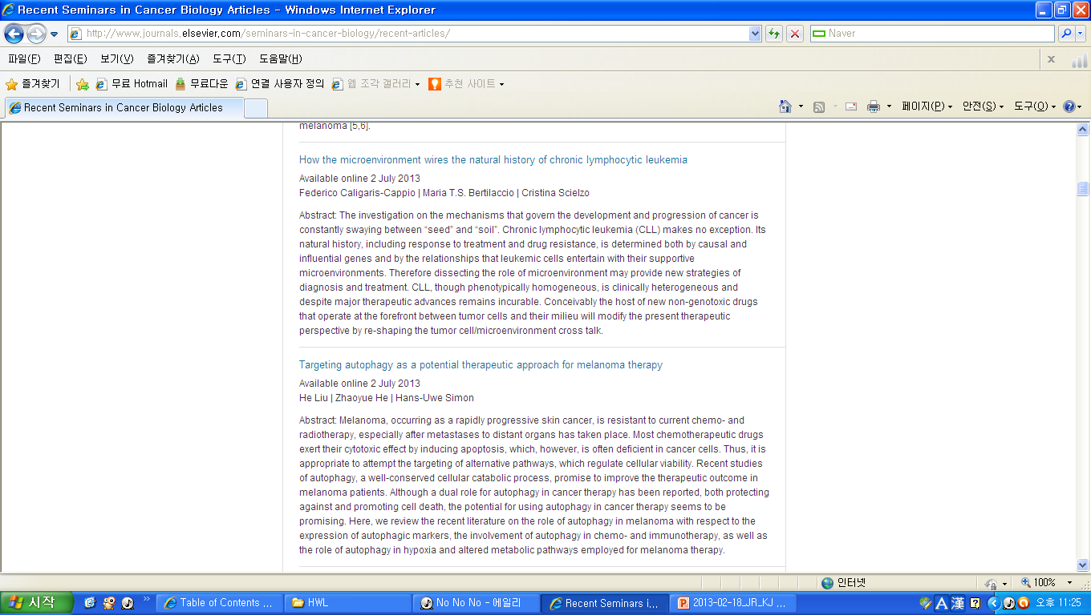
KJ

Slide 16
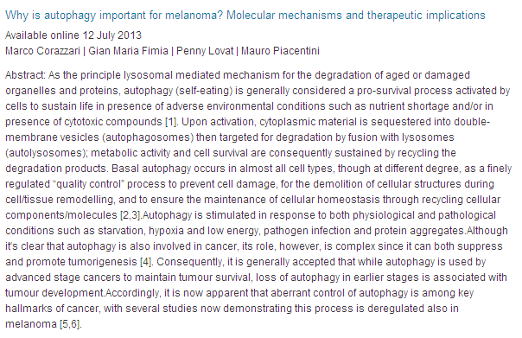
KJ

