Slide 1



Slide 2


Slide 3
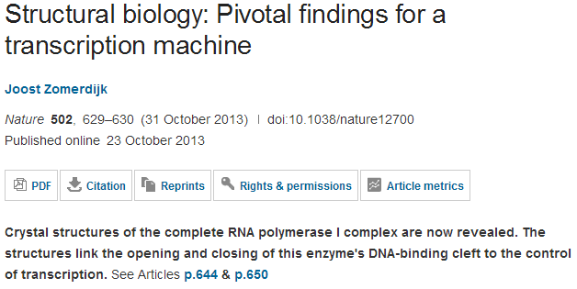
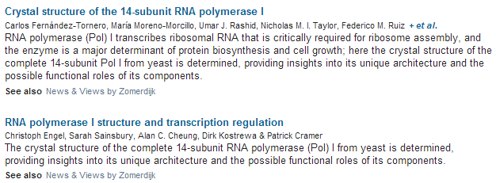

Slide 4
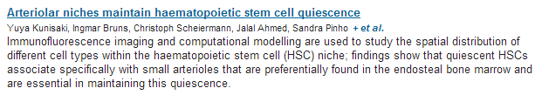
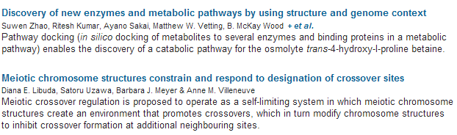

Slide 5
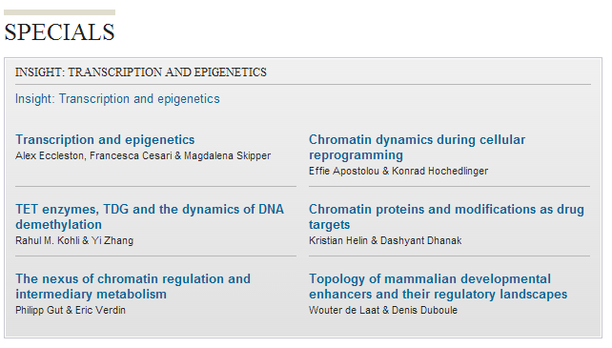

Slide 6
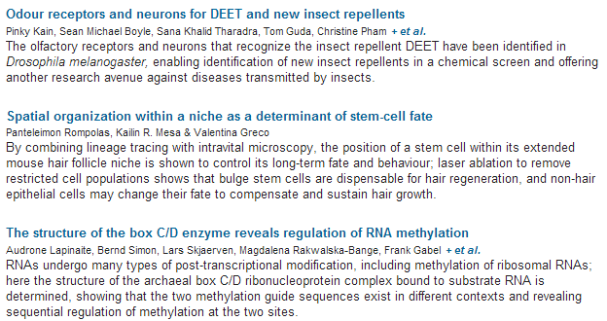

Slide 7


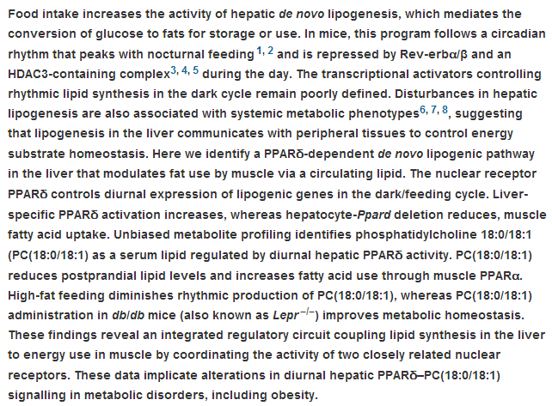

Slide 8

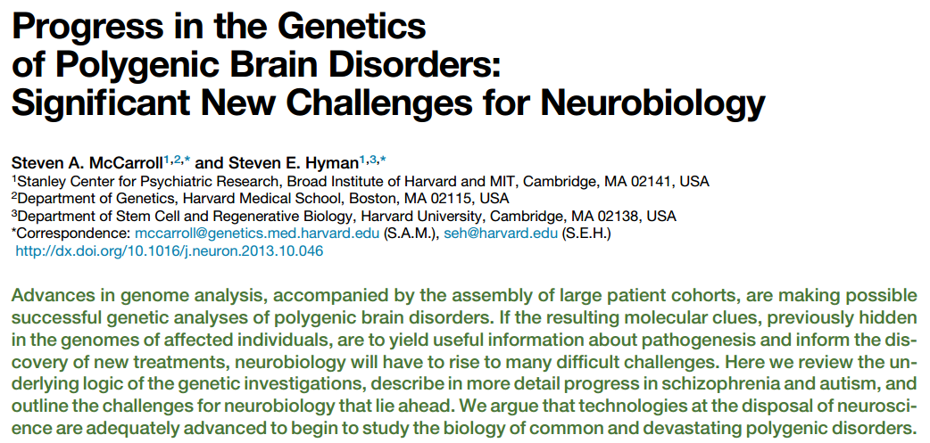

Slide 9
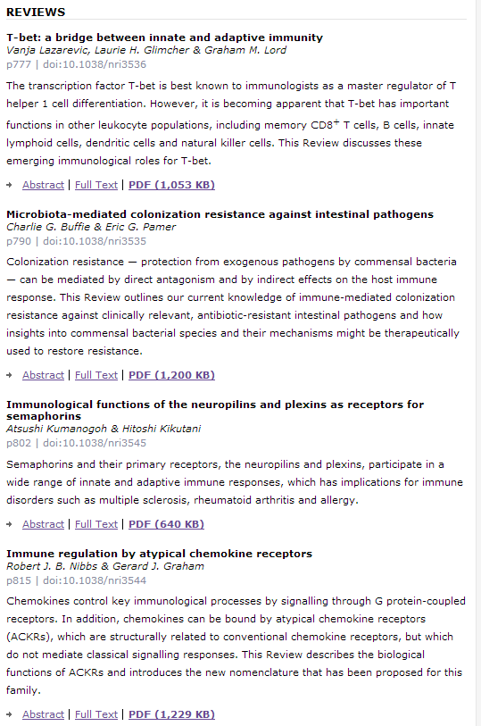


Slide 10

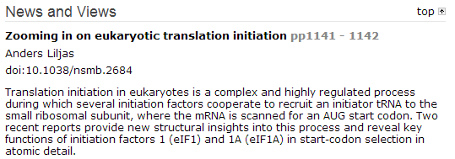
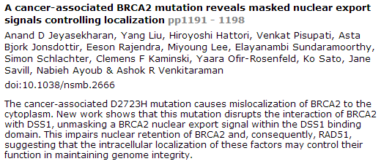
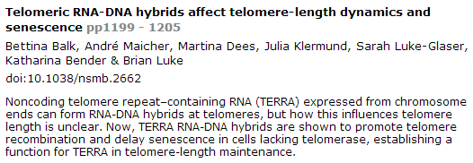

Slide 11
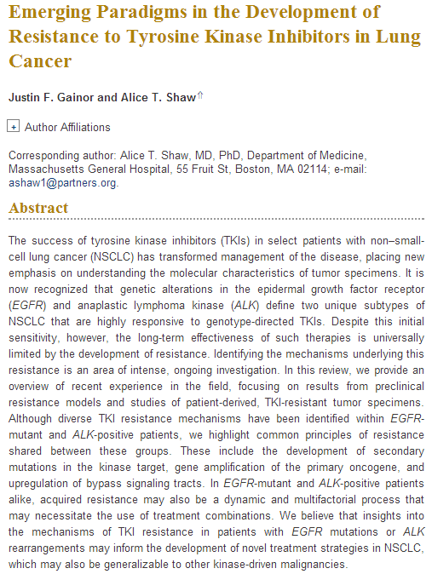


Slide 12
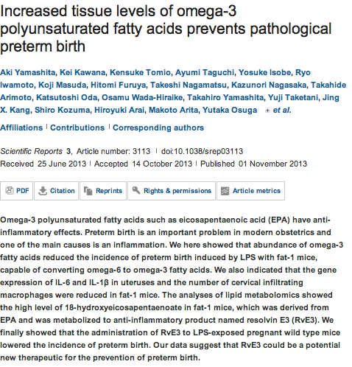
Scientific Reports

Slide 13
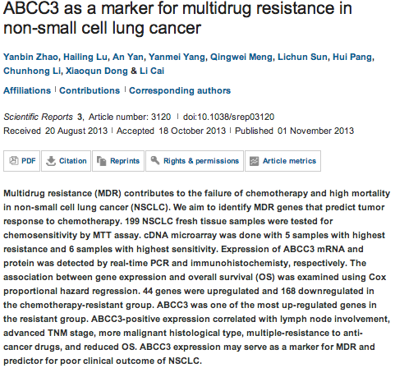

Slide 14
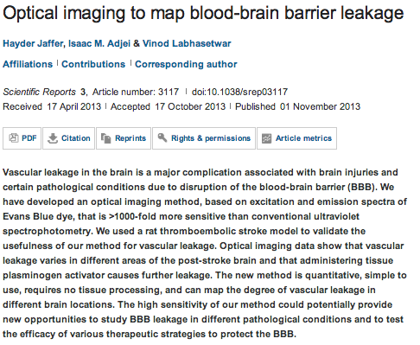

Slide 15
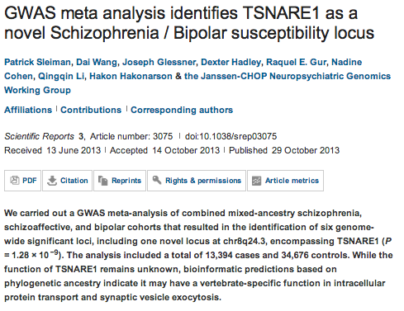

Slide 16
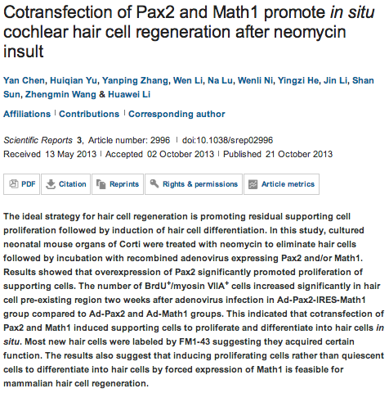

Slide 17

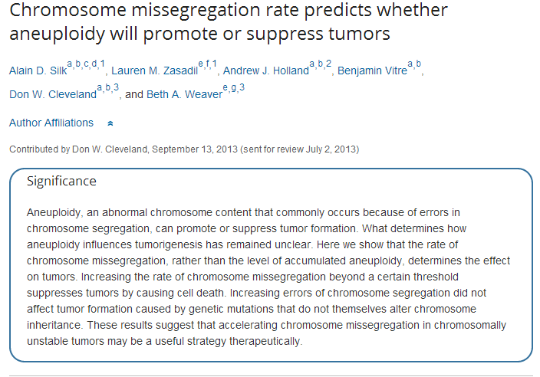

Slide 18
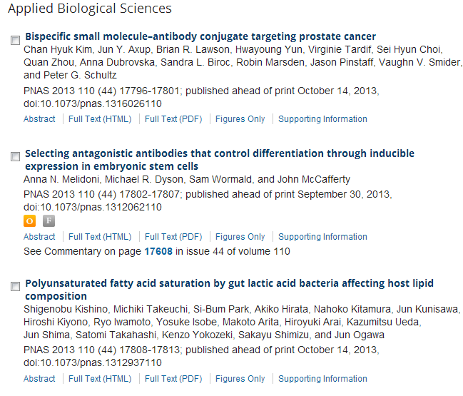

Slide 19
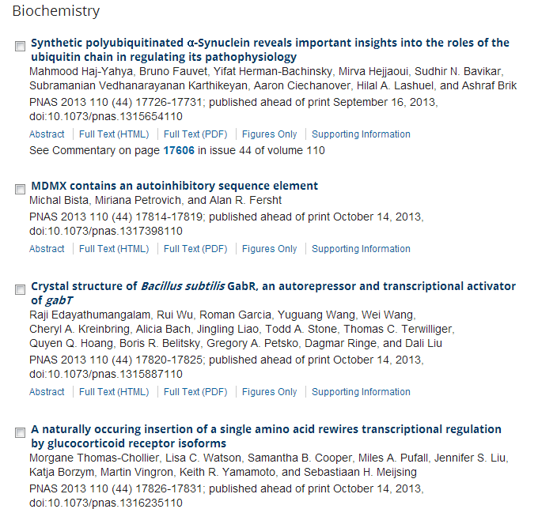

Slide 20
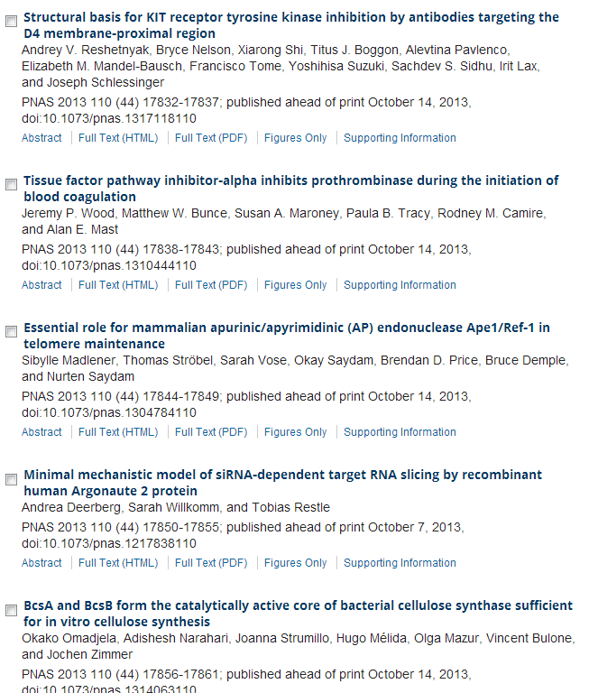

Slide 21
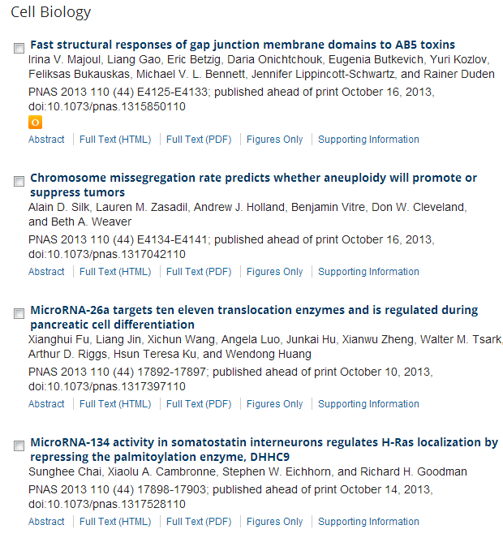

Slide 22
oncogene
HSP-90 inhibitor ganetespib is synergistic with doxorubicin in small cell lung cancer.
Lai CH, Park KS, Lee DH, Alberobello AT, Raffeld M, Pierobon M, Pin E, Petricoin Iii EF, Wang Y, Giaccone G.
Source
1] Medical Oncology Branch, National Cancer Institute, National Institutes of Health, Bethesda, MD, USA [2].
Abstract
Small cell lung cancer (SCLC) at advanced stage is considered an incurable disease. Despite good response to initial chemotherapy, the responses in SCLC patients with metastatic disease are of short duration and resistance inevitably occurs. Although several target-specific drugs have altered the paradigm of treatment for many other cancers, we have yet to witness a revolution of the same magnitude in SCLC treatment. Anthracyclines, such as doxorubicin, have definite activity in this disease, and ganetespib has shown promising activity in preclinical models but underwhelming activity as a single agent in SCLC patients. Using SCLC cell lines, we demonstrated that ganetespib (IC50: 31 nM) was much more potent than 17-allylamino-17-demethoxygeldanamycin (17-AAG), a geldanamycin derivative (IC50: 16 μM). Ganetespib inhibited SCLC cell growth via induction of persistent G2/M arrest and Caspase 3-dependent cell death. MTS assay revealed that ganetespib synergized with both doxorubicin and etoposide, two topoisomerase II inhibitors commonly used in SCLC chemotherapy. Expression of receptor-interacting serine/threonine-protein kinase 1 (RIP1), a protein that may function as a pro-survival scaffold protein or a pro-death kinase in TNFR1-activated cells, was induced by doxorubicin and downregulated by ganetespib. Depletion of RIP1 by either RIP1 small interfering RNA (siRNA) or ganetespib sensitized doxorubicin-induced cell death, suggesting that RIP1 may promote survival in doxorubicin-treated cells and that ganetespib may synergize with doxorubicin in part through the downregulation of RIP1. In comparison to ganetespib or doxorubicin alone, the ganetespib+doxorubicin combination caused significantly more growth regression and death of human SCLC xenografts in immunocompromised mice. We conclude that ganetespib and doxorubicin combination exhibits significant synergy and is efficacious in inhibiting SCLC growth in vitro and in mouse xenograft models. Our preclinical study suggests that ganetespib and doxorubicin combination therapy may be an effective strategy for SCLC treatment, which warrants clinical testing

Slide 23
oncogene
Merlin sumoylation is required for its tumor suppressor activity.
Qi Q, Liu X, Brat DJ, Ye K.
Source
Department of Pathology and Laboratory Medicine, Emory University School of Medicine, Atlanta, GA, USA.
Abstract
Merlin, encoded by the Neurofibromatosis 2 (NF2) gene, is a multifunctional tumor suppressor that integrates and regulates extracellular cues and intracellular signaling pathways, both at the plasma membrane and in the nucleus, to control cell proliferation, migration and invasion. Molecular mechanisms regulating merlin's tumor-suppressive activity have not been clearly defined. Here we report that merlin can be sumoylated on Lysine residue (K76) in vitro and in vivo. Sumoylation mediates merlin's intramolecular and intermolecular binding activities and regulates its cytoplasm/nucleus trafficking. Interestingly, sumoylation of merlin is regulated by its phosphorylation via Akt and PAK2 kinases. Mutation of K76 into arginine (R) abolishes its sumoylation, disrupts merlin cortical cytoskeleton residency and attenuates its stability. Using a K76R mutant merlin in a subcutaneous U87MG xenograft model, we demonstrate that merlin sumoylation is required for tumor-suppressive activity. Taken together, our findings indicate that merlin is sumoylated and that this post-translational modification is essential for tumor suppression.

Slide 24
oncogene
Oncoprotein stabilization in brain tumors.
Hede SM, Savov V, Weishaupt H, Sangfelt O, Swartling FJ.
Source
Department of Immunology, Genetics and Pathology, Rudbeck Laboratory, Uppsala University, Uppsala, Sweden.
Abstract
Proteins involved in promoting cell proliferation and viability need to be timely expressed and carefully controlled for the proper development of the brain but also efficiently degraded in order to prevent cells from becoming brain cancer cells. A major pathway for targeted protein degradation in cells is the ubiquitin-proteasome system (UPS). Oncoproteins that drive tumor development and tumor maintenance are often deregulated and stabilized in malignant cells. This can occur when oncoproteins escape degradation by the UPS because of mutations in either the oncoprotein itself or in the UPS components responsible for recognition and ubiquitylation of the oncoprotein. As the pathogenic accumulation of an oncoprotein can lead to effectively sustained cell growth, viability and tumor progression, it is an indisputable target for cancer treatment. The most common types of malignant brain tumors in children and adults are medulloblastoma and glioma, respectively. Here, we review different ways of how deregulated proteolysis of oncoproteins involved in major signaling cancer pathways contributes to medulloblastoma and glioma development. We also describe means of targeting relevant oncoproteins in brain tumors with treatments affecting their stability or therapeutic strategies directed against the UPS itself.

Slide 25
MicroRNA-106b-5p boosts glioma tumorigensis by targeting multiple tumor suppressor genes.
Liu F, Gong J, Huang W, Wang Z, Wang M, Yang J, Wu C, Wu Z, Han B.
Source
Department of neurosurgery, Changzhou NO.2 People's Hospital, Changzhou, Jiangsu, China.
oncogene
Glucose deprivation increases monocarboxylate transporter 1 (MCT1) expression and MCT1-dependent tumor cell migration.
De Saedeleer CJ, Porporato PE, Copetti T, Pérez-Escuredo J, Payen VL, Brisson L, Feron O, Sonveaux P.
Source
Pole of Pharmacology, Institut de Recherche Expérimentale et Clinique (IREC), Université catholique de Louvain (UCL), Brussels, Belgium.
A comparative survey of functional footprints of EGFR pathway mutations in human cancers.
Lane A, Segura-Cabrera A, Komurov K.
Source
Division of Experimental Hematology and Cancer Biology, Cancer and Blood Diseases Institute, Cincinnati Children's Hospital Medical Center, Cincinnati, OH, USA.
microRNA-18a induces apoptosis in colon cancer cells via the autophagolysosomal degradation of oncogenic heterogeneous nuclear ribonucleoprotein A1.
Fujiya M, Konishi H, Mohamed Kamel MK, Ueno N, Inaba Y, Moriichi K, Tanabe H, Ikuta K, Ohtake T, Kohgo Y.
Source
Division of Gastroenterology and Hematology/Oncology, Department of Medicine, Asahikawa Medical College, Asahikawa, Japan.
Human papillomavirus type 16 E7 perturbs DREAM to promote cellular proliferation and mitotic gene expression.
Decaprio JA.
Source
1] Department of Medical Oncology, Dana-Farber Cancer Institute, Boston, MA, USA [2] Department of Medicine, Brigham and Women's Hospital, Boston, MA, USA [3] Department of Medicine, Harvard Medical School, Boston, MA, USA.
Loss of the desmosomal cadherin desmoglein-2 suppresses colon cancer cell proliferation through EGFR signaling.
Kamekura R, Kolegraff KN, Nava P, Hilgarth RS, Feng M, Parkos CA, Nusrat A.
Source
Epithelial Pathobiology and Mucosal Inflammation Research Unit, Department of Pathology and Laboratory Medicine, Emory University, Atlanta, GA, USA.
Depletion of minichromosome maintenance protein 7 inhibits glioblastoma multiforme tumor growth in vivo.
Erkan EP, Ströbel T, Lewandrowski G, Tannous B, Madlener S, Czech T, Saydam N, Saydam O.
Source
Molecular Neuro-Oncology Research Unit, Department of Pediatrics, Medical University of Vienna, Vienna, Austria.

Slide 26
Aurora-A is a determinant of tamoxifen sensitivity through phosphorylation of ERα in breast cancer.
Zheng XQ, Guo JP, Yang H, Kanai M, He LL, Li YY, Koomen JM, Minton S, Gao M, Ren XB, Coppola D, Cheng JQ.
Source
1] Department of Molecular Oncology, H. Lee Moffitt Cancer Center & Research Institute, Tampa, FL, USA [2] Departments of Thyroid and Neck Tumour, Tianjin Medical University Cancer Institute and Hospital, Oncology Key Laboratory of cancer prevention and therapy, National Clinical Research Center of Cancer, Tianjin, PR China [3] Department of Immunology, Tianjin Medical University Cancer Institute and Hospital, Oncology Key Laboratory of cancer prevention and therapy, National Clinical Research Center of Cancer, Tianjin, PR China.
oncogene
Prohibitin is required for transcriptional repression by the WT1-BASP1 complex.
Toska E, Shandilya J, Goodfellow SJ, Medler KF, Roberts SG.
Source
Department of Biological Sciences, University at Buffalo, Buffalo, NY, USA.
SS18-SSX fusion protein-induced Wnt/β-catenin signaling is a therapeutic target in synovial sarcoma.
Trautmann M, Sievers E, Aretz S, Kindler D, Michels S, Friedrichs N, Renner M, Kirfel J, Steiner S, Huss S, Koch A,Penzel R, Larsson O, Kawai A, Tanaka S, Sonobe H, Waha A, Schirmacher P, Mechtersheimer G, Wardelmann E,Büttner R, Hartmann W.
Source
1] Department of Pathology, University Hospital Cologne, Cologne, Germany [2] Department of Pathology, University Hospital Bonn, Bonn, Germany.
Essential roles of Crk and CrkL in fibroblast structure and motility.
Park TJ, Curran T.
Source
Department of Pathology and Laboratory Medicine, The Children's Hospital of Philadelphia Research Institute, Philadelphia, PA, USA.
MicroRNAs, miR-154, miR-299-5p, miR-376a, miR-376c, miR-377, miR-381, miR-487b, miR-485-3p, miR-495 and miR-654-3p, mapped to the 14q32.31 locus, regulate proliferation, apoptosis, migration and invasion in metastatic prostate cancer cells.
Formosa A, Markert EK, Lena AM, Italiano D, Finazzi-Agro' E, Levine AJ, Bernardini S, Garabadgiu AV, Melino G, Candi E.
Source
1] University of Tor Vergata, Department Experimental Medicine and Surgery, Rome, Italy [2] IDI-IRCCS, Rome, Italy.
A gene signature of bone metastatic colonization sensitizes for tumor-induced osteolysis and predicts survival in lung cancer.
Luis-Ravelo D, Antón I, Zandueta C, Valencia K, Ormazábal C, Martínez-Canarias S, Guruceaga E, Perurena N, Vicent S, De Las Rivas J, Lecanda F.
Source
Division of Oncology, Adhesion and Metastasis Laboratory, University of Navarra, Pamplona, Spain.

Slide 27

EDITORIALS
The nucleolus fine-tunes the orchestration of an early neuroprotection response in neurodegeneration
J D Erickson and N G Bazan
Cell Death Differ 20: 1435-1437; doi:10.1038/cdd.2013.107
p53 talks to PARP: the increasing complexity of p53-induced cell death
K G Wiman
Cell Death Differ 20: 1438-1439; doi:10.1038/cdd.2013.111
Seeking a MCL-1 inhibitor
G Brumatti and P G Ekert
Cell Death Differ 20: 1440-1441; doi:10.1038/cdd.2013.114
In the race for protection, ARF comes second
L Golomb and M Oren
Cell Death Differ 20: 1442-1443; doi:10.1038/cdd.2013.117
REVIEW
Autophagy and genomic integrity
A T Vessoni, E C Filippi-Chiela, C FM Menck and G Lenz
Cell Death Differ 20: 1444-1454; advance online publication, August 9, 2013; doi:10.1038/cdd.2013.103

Slide 28

ORIGINAL PAPERS
A neuroprotective phase precedes striatal degeneration upon nucleolar stress
G Kreiner, H Bierhoff, M Armentano, J Rodriguez-Parkitna, K Sowodniok, J R Naranjo, L Bonfanti, B Liss, G Schütz, I Grummt and R Parlato
Cell Death Differ 20: 1455-1464; advance online publication, June 14, 2013; doi:10.1038/cdd.2013.66
p53 regulates a non-apoptotic death induced by ROS
J Montero, C Dutta, D van Bodegom, D Weinstock and A Letai
Cell Death Differ 20: 1465-1474; advance online publication, May 24, 2013; doi:10.1038/cdd.2013.52
Evaluation and critical assessment of putative MCL-1 inhibitors
S Varadarajan, M Vogler, M Butterworth, D Dinsdale, L D Walensky and G M Cohen
Cell Death Differ 20: 1475-1484; advance online publication, July 5, 2013; doi:10.1038/cdd.2013.79
The DNA damage checkpoint precedes activation of ARF in response to escalating oncogenic stress during tumorigenesis
K Evangelou, J Bartkova, A Kotsinas, I S Pateras, M Liontos, G Velimezi, M Kosar, T Liloglou, I P Trougakos, L Dyrskjot, C L Andersen, M Papaioannou, Y Drosos, G Papafotiou, Z Hodny, B Sosa-Pineda, X-R Wu, A Klinakis, T Ørntoft, J Lukas, J Bartek and V G Gorgoulis
Cell Death Differ 20: 1485-1497; advance online publication, July 12, 2013; doi:10.1038/cdd.2013.76
ATM kinase enables the functional axis of YAP, PML and p53 to ameliorate loss of Werner protein-mediated oncogenic senescence
F Fausti, S Di Agostino, M Cioce, P Bielli, C Sette, P P Pandolfi, M Oren, M Sudol, S Strano and G Blandino
Cell Death Differ 20: 1498-1509; advance online publication, August 9, 2013; doi:10.1038/cdd.2013.101
Apaf1 apoptotic function critically limits Sonic hedgehog signaling during craniofacial development
A B Long, W J Kaiser, E S Mocarski and T Caspary
Cell Death Differ 20: 1510-1520; advance online publication, July 26, 2013; doi:10.1038/cdd.2013.97

Slide 29
Systems analysis of apoptosis protein expression allows the case-specific prediction of cell death responsiveness of melanoma cells
E Passante, M L Würstle, C T Hellwig, M Leverkus and M Rehm
Cell Death Differ 20: 1521-1531; advance online publication, August 9, 2013; doi:10.1038/cdd.2013.106
Characterization of novel MPS1 inhibitors with preclinical anticancer activity
M Jemaà, L Galluzzi, O Kepp, L Senovilla, M Brands, U Boemer, M Koppitz, P Lienau, S Prechtl, V Schulze, G Siemeister, A M Wengner, D Mumberg, K Ziegelbauer, A Abrieu, M Castedo, I Vitale and G Kroemer
Cell Death Differ 20: 1532-1545; advance online publication, August 9, 2013; doi:10.1038/cdd.2013.105
Potent and multiple regulatory actions of microglial glucocorticoid receptors during CNS inflammation
M Á Carrillo-de Sauvage, L Maatouk, I Arnoux, M Pasco, A Sanz Diez, M Delahaye, M T Herrero, T A Newman, C F Calvo, E Audinat, F Tronche and S Vyas
Cell Death Differ 20: 1546-1557; advance online publication, September 6, 2013; doi:10.1038/cdd.2013.108
Negative regulation of lncRNA GAS5 by miR-21
Z Zhang, Z Zhu, K Watabe, X Zhang, C Bai, M Xu, F Wu and Y-Y Mo
Cell Death Differ 20: 1558-1568; advance online publication, August 9, 2013; doi:10.1038/cdd.2013.110
Mechanisms of haptoglobin protection against hemoglobin peroxidation triggered endothelial damage
C A Schaer, J W Deuel, A G Bittermann, I G Rubio, G Schoedon, D R Spahn, R A Wepf, F Vallelian and D J Schaer
Cell Death Differ 20: 1569-1579; advance online publication, August 30, 2013; doi:10.1038/cdd.2013.113
TNFR1 determines progression of chronic liver injury in the IKKγ/Nemo genetic model
F J Cubero, A Singh, E Borkham-Kamphorst, Y A Nevzorova, M Al Masaoudi, U Haas, M V Boekschoten, N Gassler, R Weiskirchen, M Muller, C Liedtke and C Trautwein
Cell Death Differ 20: 1580-1592; advance online publication, August 9, 2013; doi:10.1038/cdd.2013.112

Slide 30
Cell Death and Differentiation (2013) 20, 1465–1474; doi:10.1038/cdd.2013.52; published online 24 May 2013
p53 regulates a non-apoptotic death induced by ROS
J Montero¹, C Dutta¹, D van Bodegom¹, D Weinstock¹ and A Letai^{1,2}
¹Department of Medical Oncology, Dana-Farber Cancer Institute, 450 Brookline Avenue, Boston, MA 02115, USA
²Department of Biological Chemistry and Molecular Pharmacology, Harvard Medical School, Boston, MA 02115, USA
Correspondence: A Letai, Department of Medical Oncology, Dana-Farber Cancer Institute, 450 Brookline Avenue, Boston, MA 02215, USA. Tel: 617 632 2348; Fax: 617 582 8160; E-mail:Anthony_letai@dfci.harvard.edu
Received 1 November 2012; Revised 28 March 2013; Accepted 11 April 2013
Advance online publication 24 May 2013
Abstract
DNA damage induced by reactive oxygen species and several chemotherapeutic agents promotes both p53 and poly (ADP-ribose) polymerase (PARP) activation. p53 activation is well known to regulate apoptotic cell death, whereas robust activation of PARP-1 has been shown to promote a necrotic cell death associated with energetic collapse. Here we identify a novel role for p53 in modulating PARP enzymatic activity to regulate necrotic cell death. In mouse embryonic fibroblasts, human colorectal and human breast cancer cell lines, loss of p53 function promotes resistance to necrotic, PARP-mediated cell death. We therefore demonstrate that p53 can regulate both necrotic and apoptotic cell death, mutations or deletions in this tumor-suppressor protein may be selected by cancer cells to provide not only their resistance to apoptosis but also to necrosis, and explain resistance to chemotherapy and radiation even when it kills via non-apoptotic mechanisms.

