Slide 1
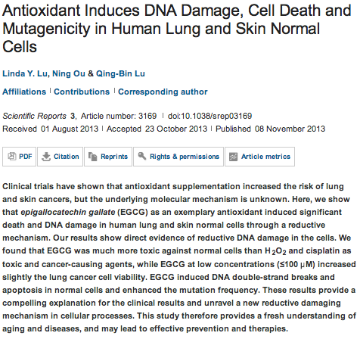
Scientific Reports

Slide 2
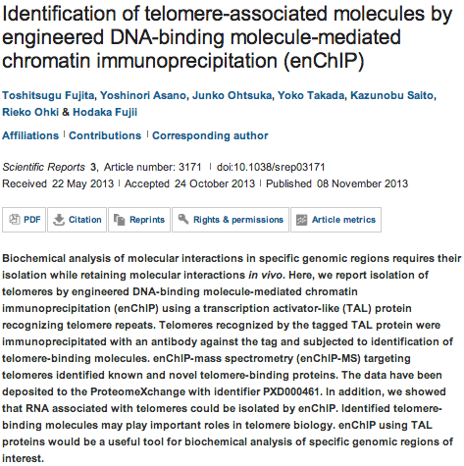

Slide 3
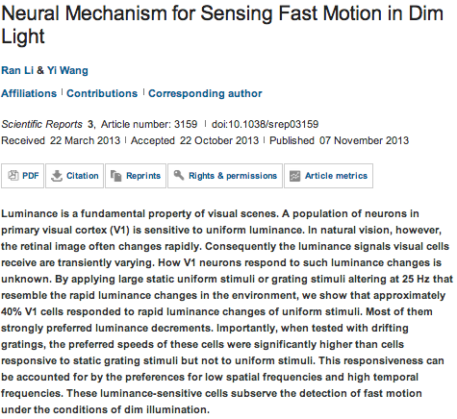

Slide 4
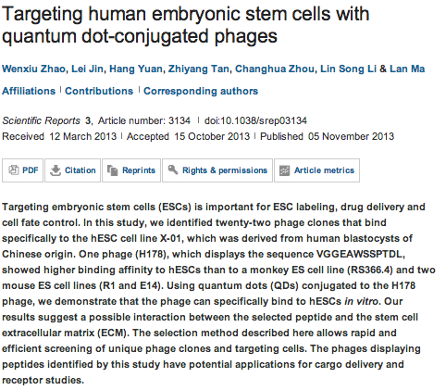

Slide 5
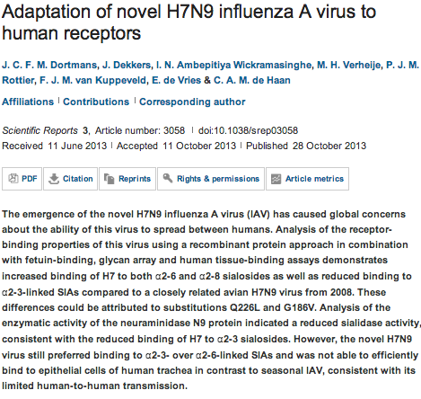

Slide 6
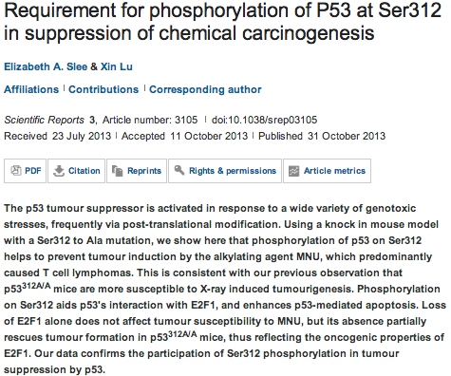

Slide 7

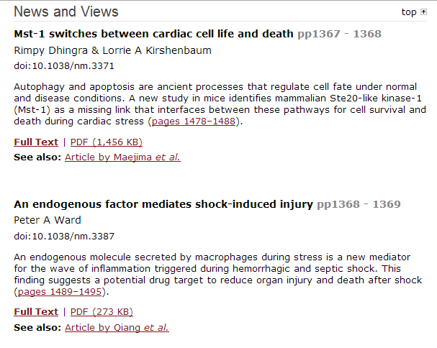
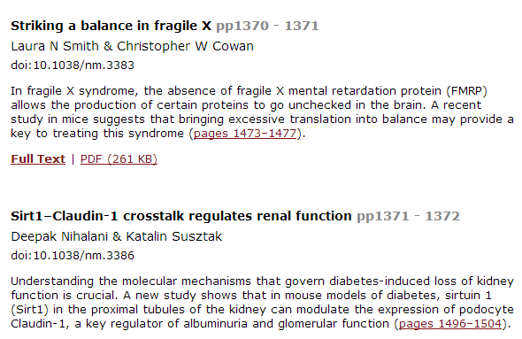

Slide 8
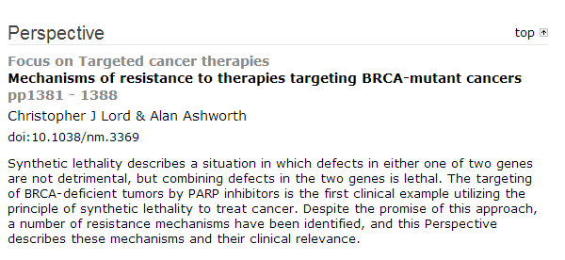

Slide 9
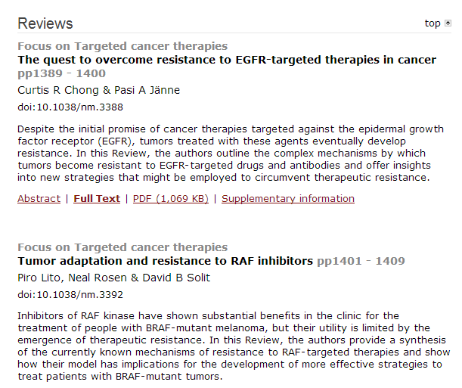

Slide 10
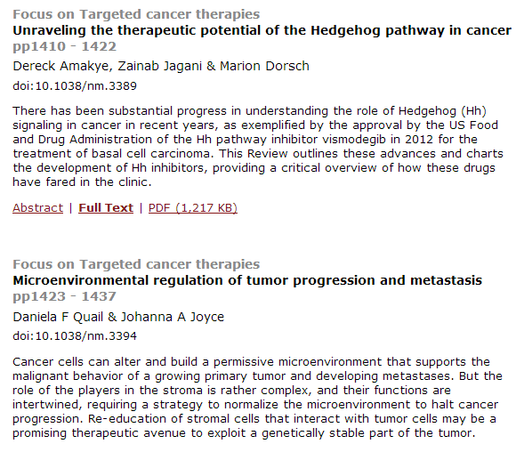

Slide 11
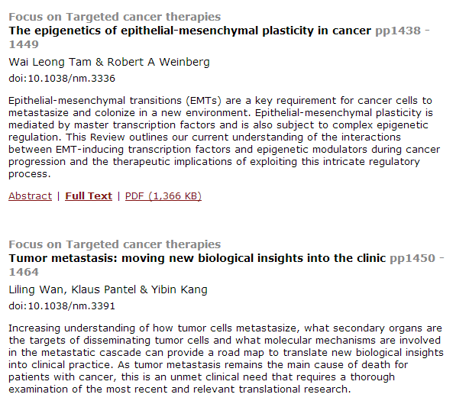

Slide 12
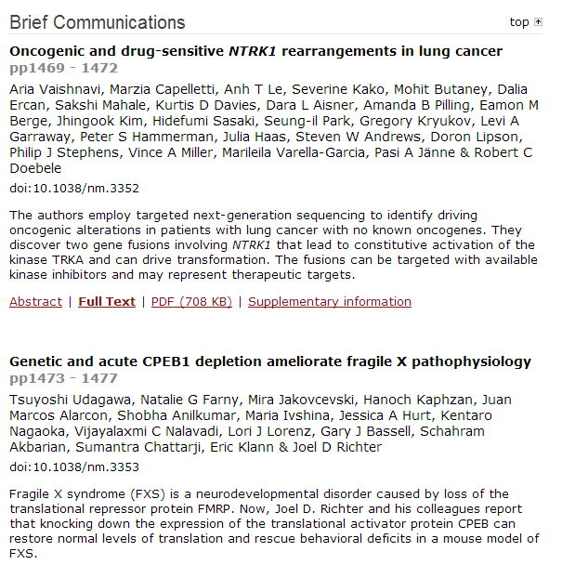
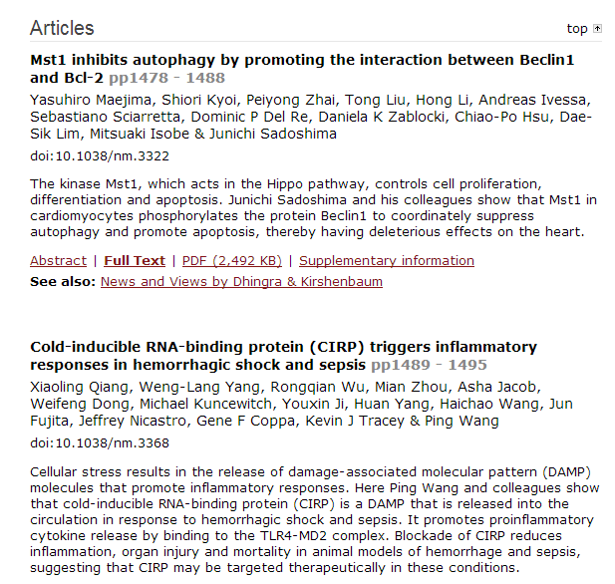

Slide 13
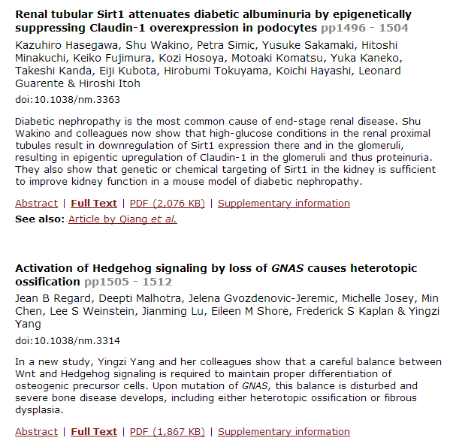
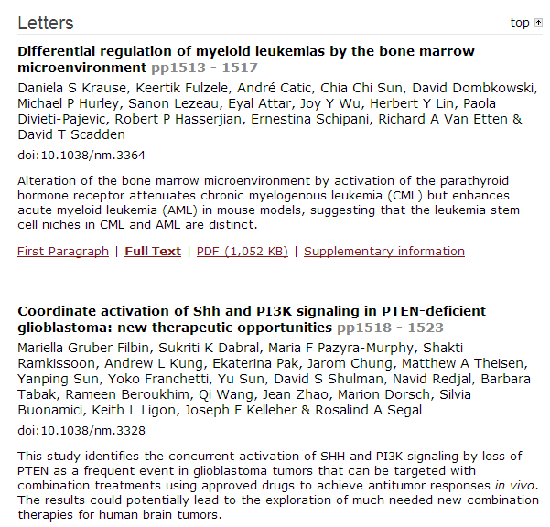

Slide 14
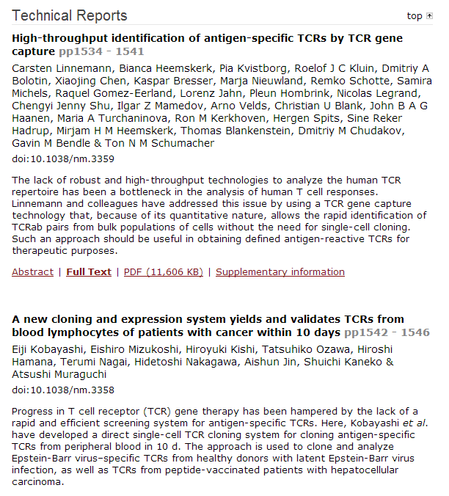

Slide 15
Interferon-α-secreting mesenchymal stem cells exert potent antitumor effect in vivo.
Xu C, Lin L, Cao G, Chen Q, Shou P, Huang Y, Han Y, Wang Y, Shi Y.
Source
Key Laboratory of Stem Cell Biology, Institute of Health Sciences, Shanghai Institutes for Biological Sciences, Chinese Academy of Sciences/Shanghai Jiao Tong University School of Medicine, Shanghai, China.
Abstract
Mesenchymal stem cells (MSCs) are a kind of adult stem cells that can be isolated easily from bone marrow, adipose tissue, umbilical cord and many other tissues. MSCs have been shown to specifically migrate to inflammatory sites, including tumors, and hold great promise as tumor-specific vectors to deliver antitumor agents. Interferon-α (IFNα) has been used in clinic to treat various types of tumors; however, because of its short half-life, significant therapeutic effects require high doses that often results in serious side effects. Here, we tested whether MSCs continuingly secreting IFNα can exert a persistent antitumor effect and eliminate the side effects associated with high clinical doses of recombinant IFNα. We found that even a small number of IFNα-secreting MSCs could potently halt B16 tumor growth in vivo. The antitumor activity of IFNα-secreting MSCs was largely abolished in immunodeficient mice, an effect largely attributed to natural killer cells and CD8⁺ T cells. Therefore, IFNα-secreting MSCs provide an innovative strategy for tumor therapy.

Slide 16
Forkhead transcription factor FOXF1 is a novel target gene of the p53 family and regulates cancer cell migration and invasiveness.
Tamura M, Sasaki Y, Koyama R, Takeda K, Idogawa M, Tokino T.
Source
Department of Medical Genome Sciences, Research Institute for Frontier Medicine, Sapporo Medical University, Sapporo, Japan.
Abstract
p53 is an established tumor suppressor that can activate the transcription of multiple target genes. Recent evidence suggests that p53 may contribute to the regulation of cell invasion and migration. In this study, we show that the forkhead box transcription factor FOXF1 is a novel target of the p53 family because FOXF1 is upregulated by p53, TAp73 and TAp63. We show that FOXF1 is induced upon DNA damage in a p53-dependent manner. Furthermore, we identified a response element located within the FOXF1 gene that is responsive to wild-type p53, TAp73β and TAp63γ. The ectopic expression of FOXF1 inhibited cancer cell invasion and migration, whereas the inactivation of FOXF1 stimulated cell invasion and migration. We also show that FOXF1 regulates the transcriptional activity of E-cadherin (CDH1) by acting on its FOXF1 consensus binding site located upstream of the E-cadherin gene. Collectively, our results show that FOXF1 is a p53 family target gene, and our data suggest that FOXF1 and p53 form a portion of a regulatory transcriptional network that appears to have an important role in cancer cell invasion and migration.

Slide 17
Androgens regulate prostate cancer cell growth via an AMPK-PGC-1α-mediated metabolic switch.
Tennakoon JB, Shi Y, Han JJ, Tsouko E, White MA, Burns AR, Zhang A, Xia X, Ilkayeva OR, Xin L,Ittmann MM, Rick FG, Schally AV, Frigo DE.
Source
Center for Nuclear Receptors and Cell Signaling, Department of Biology and Biochemistry, University of Houston, Houston, TX, USA.
p73 regulates serine biosynthesis in cancer.
Amelio I, Markert EK, Rufini A, Antonov AV, Sayan BS, Tucci P, Agostini M, Mineo TC, Levine AJ,Melino G.
Source
Medical Research Council, Toxicology Unit, Leicester University, Leicester, UK.
PSP94 contributes to chemoresistance and its peptide derivative PCK3145 represses tumor growth in ovarian cancer.
Yan BX, Ma JX, Zhang J, Guo Y, Riedel H, Mueller MD, Remick SC, Yu JJ.
Source
1] Department of Biochemistry, School of Medicine,
IGF-1R inhibition enhances radiosensitivity and delays double-strand break repair by both non-homologous end-joining and homologous recombination.
Chitnis MM, Lodhia KA, Aleksic T, Gao S, Protheroe AS, Macaulay VM.
Source
1] Department of Oncology Laboratories, Weatherall Institute of Molecular Medicine, John Radcliffe Hospital, University of Oxford, Oxford, UK [2] Department of Oncology, Cancer and Haematology Centre, The Churchill Hospital, Oxford, UK.
Alterations in chromatin accessibility and DNA methylation in clear cell renal cell carcinoma.
Buck MJ, Raaijmakers LM, Ramakrishnan S, Wang D, Valiyaparambil S, Liu S, Nowak NJ, Pili R.
Source
1] Department of Biochemistry, Center of Excellence in Bioinformatics and Life Sciences, State University of New York at Buffalo, Buffalo, NY, USA [2] Cancer Genetics, Roswell Park Cancer Institute, Buffalo, NY, USA.
TMPRSS2-ERG gene fusions induce prostate tumorigenesis by modulating microRNA miR-200c.
Kim J, Wu L, Zhao JC, Jin HJ, Yu J.
Source
Division of Hematology/Oncology, Department of Medicine, Feinberg School of Medicine, Northwestern University, Chicago, IL, USA.
MicroRNA-106b-5p boosts glioma tumorigensis by targeting multiple tumor suppressor genes.
Liu F, Gong J, Huang W, Wang Z, Wang M, Yang J, Wu C, Wu Z, Han B.
Source
Department of neurosurgery, Changzhou NO.2 People's Hospital, Changzhou, Jiangsu, China.
Mitochondrial retrograde signaling induces epithelial-mesenchymal transition and generates breast cancer stem cells.
Guha M, Srinivasan S, Ruthel G, Kashina AK, Carstens RP, Mendoza A, Khanna C, Van Winkle T,Avadhani NG.
Source
Department of Animal Biology and Marie Lowe Center for Comparative Oncology, School of Veterinary Medicine, Philadelphia, PA, USA.

Slide 18

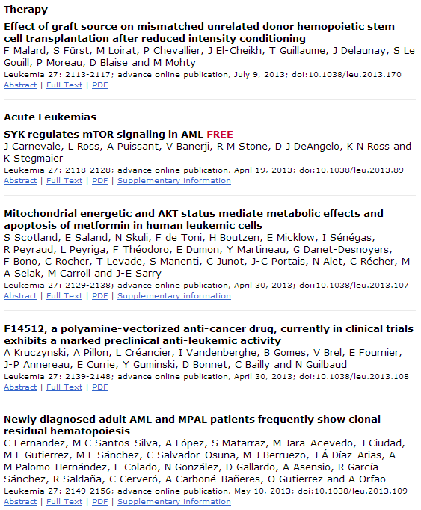
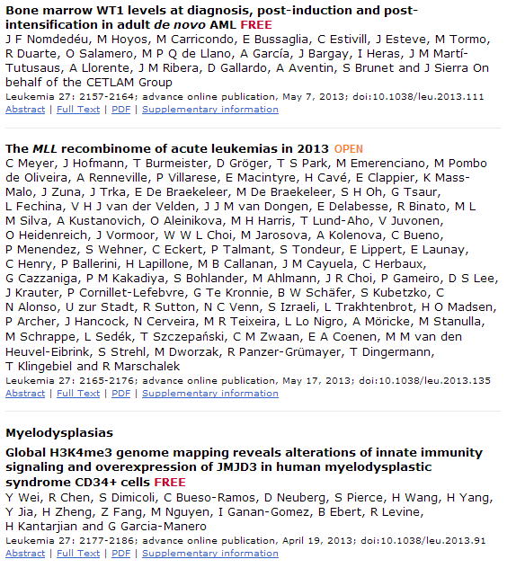

Slide 19
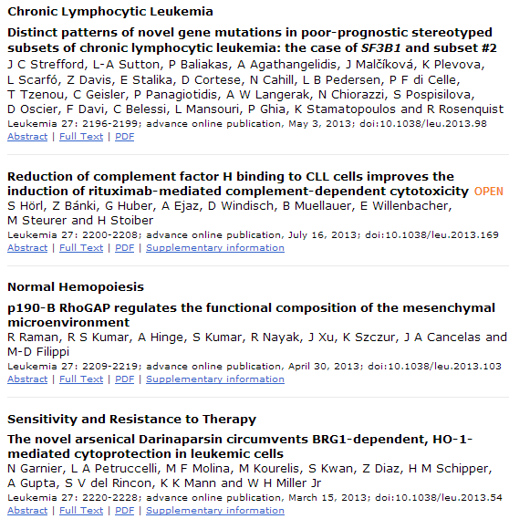
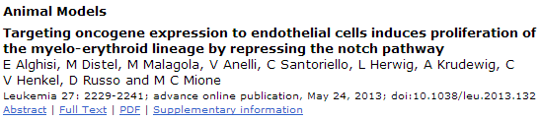

Slide 20
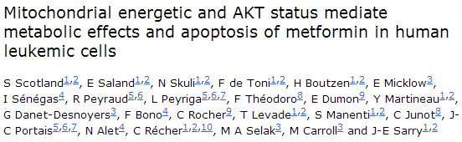
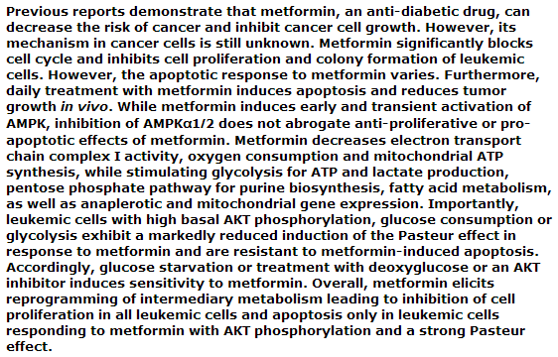

Slide 21

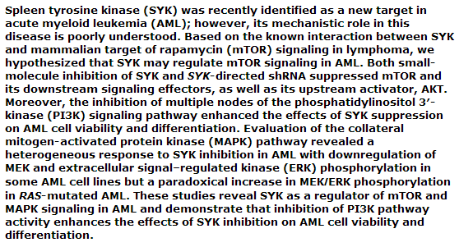

Slide 22
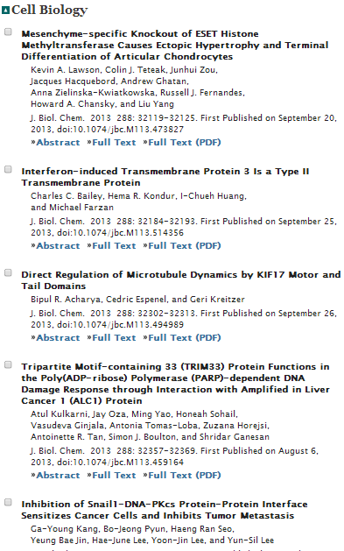
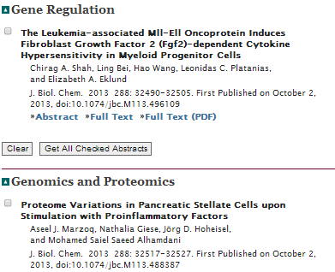
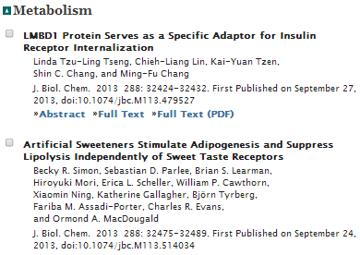

Slide 23
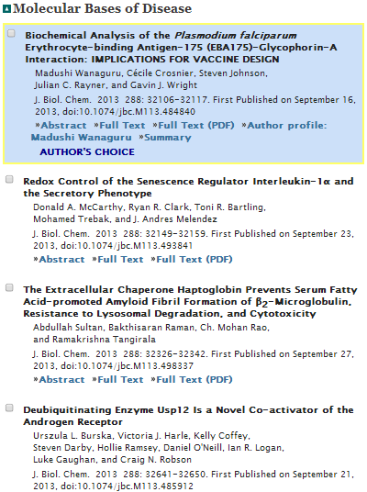
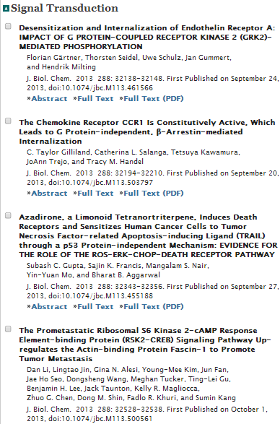
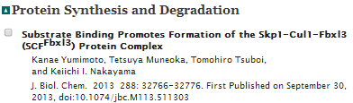

Slide 24
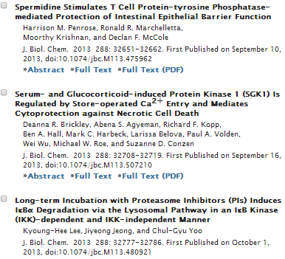

Slide 25
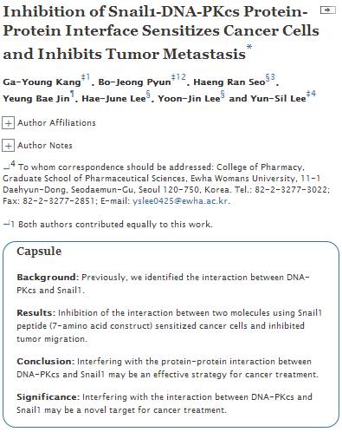
Notes:
Our previous study suggested that the DNA-dependent protein kinase catalytic subunit (DNA-PKcs) interacts with Snail1, which affects genomic instability, sensitivity to DNA-damaging agents, and migration of tumor cells by reciprocal regulation between DNA-PKcs and Snail1. Here, we further investigate that a peptide containing 7-amino acid sequences (amino acids 15–21) of Snail1 (KPNYSEL, SP) inhibits the endogenous interaction between DNA-PKcs and Snail1 through primary interaction with DNA-PKcs. SP restored the inhibited DNA-PKcs repair activity and downstream pathways. On the other hand, DNA-PKcs-mediated phosphorylation of Snail1 was inhibited by SP, which resulted in decreased Snail1 stability and Snail1 functions. However, these phenomena were only shown in p53 wild-type cells, not in p53-defective cells. From these results, it is suggested that interfering with the protein interaction between DNA-PKcs and Snail1 might be an effective strategy for sensitizing cancer cells and inhibiting tumor migration, especially in both Snail1-overexpressing and DNA-PKcs-overexpressing cancer cells with functional p53.

Slide 26
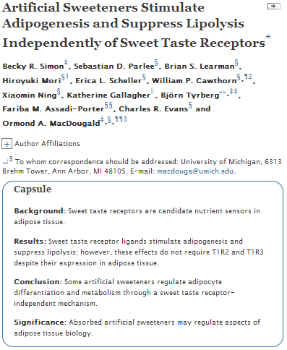
Notes:
G protein-coupled receptors mediate responses to a myriad of ligands, some of which regulate adipocyte differentiation and metabolism. The sweet taste receptors T1R2 and T1R3 are G protein-coupled receptors that function as carbohydrate sensors in taste buds, gut, and pancreas. Here we report that sweet taste receptors T1R2 and T1R3 are expressed throughout adipogenesis and in adipose tissues. Treatment of mouse and human precursor cells with artificial sweeteners, saccharin and acesulfame potassium, enhanced adipogenesis. Saccharin treatment of 3T3-L1 cells and primary mesenchymal stem cells rapidly stimulated phosphorylation of Akt and downstream targets with functions in adipogenesis such as cAMP-response element-binding protein and FOXO1; however, increased expression of peroxisome proliferator-activated receptor γ and CCAAT/enhancer-binding protein α was not observed until relatively late in differentiation. Saccharin-stimulated Akt phosphorylation at Thr-308 occurred within 5 min, was phosphatidylinositol 3-kinase-dependent, and occurred in the presence of high concentrations of insulin and dexamethasone; phosphorylation of Ser-473 occurred more gradually. Surprisingly, neither saccharin-stimulated adipogenesis nor Thr-308 phosphorylation was dependent on expression of T1R2 and/or T1R3, although Ser-473 phosphorylation was impaired in T1R2/T1R3 double knock-out precursors. In mature adipocytes, artificial sweetener treatment suppressed lipolysis even in the presence of forskolin, and lipolytic responses were correlated with phosphorylation of hormone-sensitive lipase. Suppression of lipolysis by saccharin in adipocytes was also independent of T1R2 and T1R3. These results suggest that some artificial sweeteners have previously uncharacterized metabolic effects on adipocyte differentiation and metabolism and that effects of artificial sweeteners on adipose tissue biology may be largely independent of the classical sweet taste receptors, T1R2 and T1R3.

Slide 27
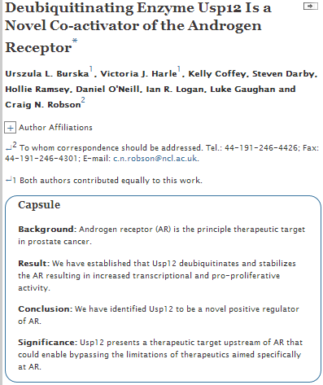
Notes:
The androgen receptor (AR), a member of the nuclear receptor family, is a transcription factor involved in prostate cell growth, homeostasis, and transformation. AR is a key protein in growth and development of both normal and malignant prostate, making it a common therapeutic target in prostate cancer. AR is regulated by an interplay of multiple post-translational modifications including ubiquitination. We and others have shown that the AR is ubiquitinated by a number of E3 ubiquitin ligases, including MDM2, CHIP, and NEDD4, which can result in its proteosomal degradation or enhanced transcriptional activity. As ubiquitination of AR causes a change in AR activity or stability and impacts both survival and growth of prostate cancer cells, deubiquitination of these sites has an equally important role. Hence, deubiquitinating enzymes could offer novel therapeutic targets. We performed an siRNA screen to identify deubiquitinating enzymes that regulate AR; in that screen ubiquitin-specific protease 12 (Usp12) was identified as a novel positive regulator of AR. Usp12 is a poorly characterized protein with few known functions and requires the interaction with two cofactors, Uaf-1 and WDR20, for its enzymatic activity. In this report we demonstrate that Usp12, in complex with Uaf-1 and WDR20, deubiquitinates the AR to enhance receptor stability and transcriptional activity. Our data show that Usp12 acts in a pro-proliferative manner by stabilizing AR and enhancing its cellular function.

Slide 28
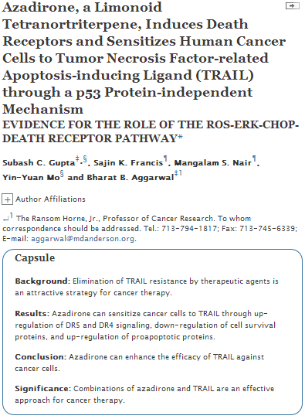
Notes:
Although tumor necrosis factor-related apoptosis-inducing ligand (TRAIL) has shown efficacy in a phase 2 clinical trial, development of resistance to TRAIL by tumor cells is a major roadblock. We investigated whether azadirone, a limonoidal tetranortriterpene, can sensitize human tumor cells to TRAIL. Results indicate that azadirone sensitized cancer cells to TRAIL. The limonoid induced expression of death receptor (DR) 5 and DR4 but did not affect expression of decoy receptors in cancer cells. The induction of DRs was mediated through activation of ERK and through up-regulation of a transcription factor CCAAT enhancer-binding protein homologous protein (CHOP) as silencing of these signaling molecules abrogated the effect of azadirone. These effects of azadirone were cancer cell-specific. The CHOP binding site on the DR5 gene was required for induction of DR5 by azadirone. Up-regulation of DRs was mediated through the generation of reactive oxygen species (ROS) as ROS scavengers reduced the effect of azadirone on ERK activation, CHOP up-regulation, DR induction, and TRAIL sensitization. The induction of DRs by this limonoid was independent of p53, but sensitization to TRAIL was p53-dependent. The limonoid down-regulated the expression of cell survival proteins and up-regulated the proapoptotic proteins. The combination of azadirone with TRAIL was found to be additive at concentrations lower than IC₅₀, whereas at higher concentrations, the combination was synergistic. Overall, this study indicates that azadirone can sensitize cancer cells to TRAIL through ROS-ERK-CHOP-mediated up-regulation of DR5 and DR4 signaling, down-regulation of cell survival proteins, and up-regulation of proapoptotic proteins.

Slide 29
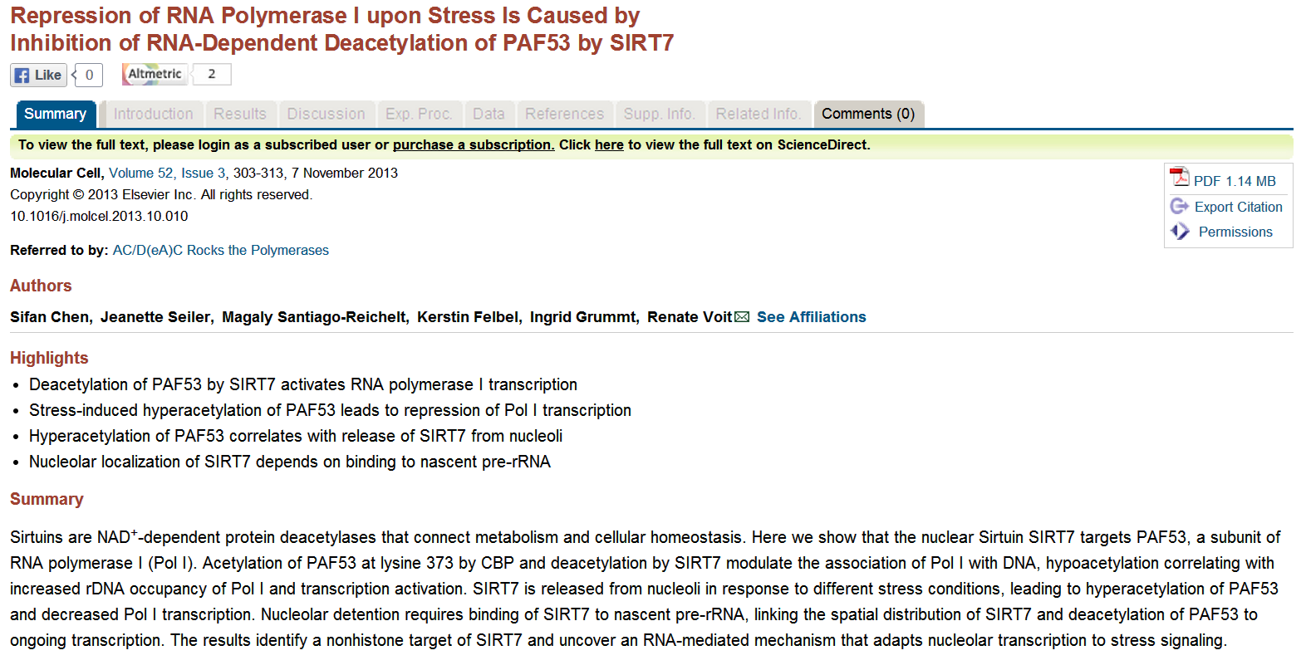


Slide 30
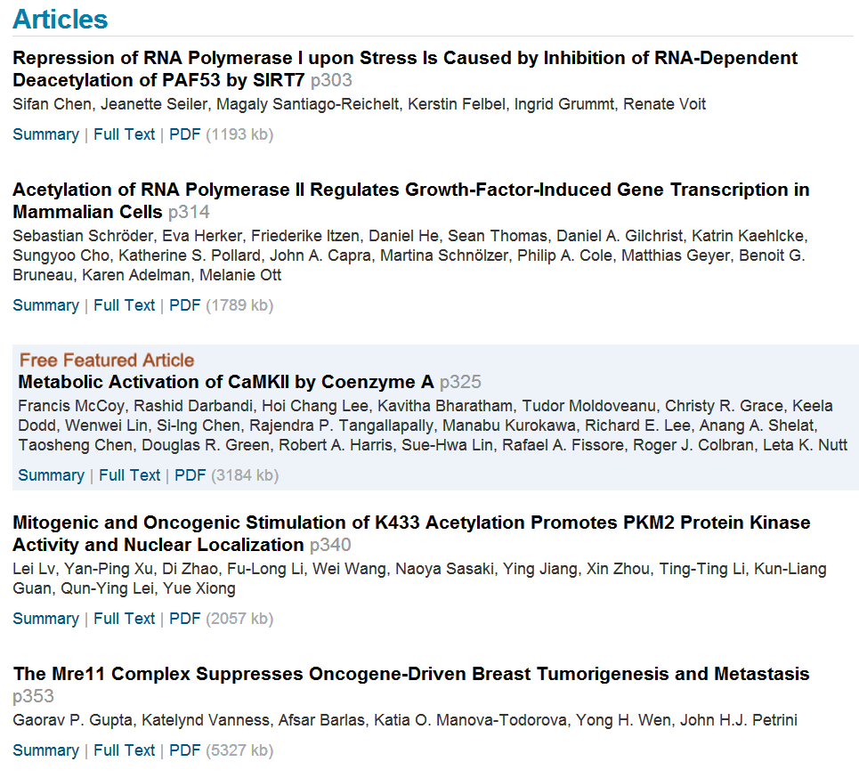

Slide 31


