Slide 1
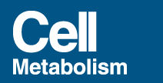
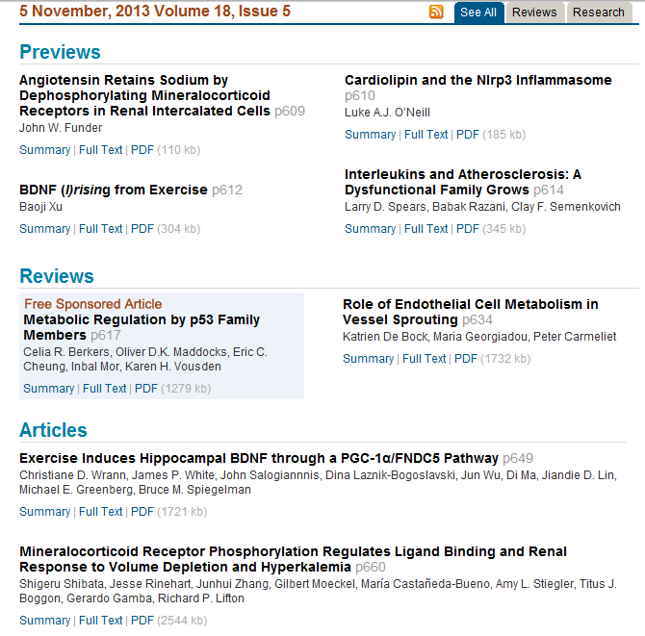

Slide 2
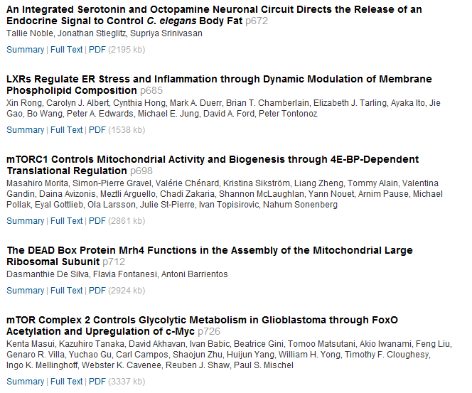

Slide 3
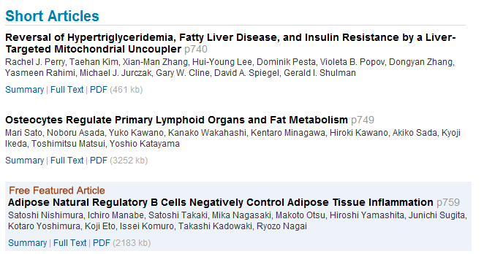

Slide 4
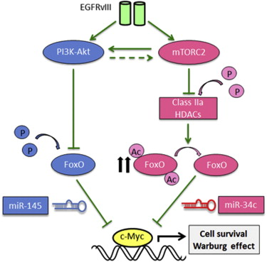
mTOR Complex 2 Controls Glycolytic Metabolism in Glioblastoma through FoxO Acetylation and Upregulation of c-Myc
Authors
Kenta Masui, Kazuhiro Tanaka, David Akhavan, Ivan Babic, Beatrice Gini, Tomoo Matsutani, Akio Iwanami, Feng Liu, Genaro R. Villa, Yuchao Gu, Carl Campos, Shaojun Zhu, Huijun Yang, William H. Yong, Timothy F. Cloughesy, Ingo K. Mellinghoff, Webster K. Cavenee, Reuben J. Shaw, Paul S. Mischel
Ludwig Institute for Cancer Research, University of California, San Diego, La Jolla, CA 92093, USA
Summary
Aerobic glycolysis (the Warburg effect) is a core hallmark of cancer, but the molecular mechanisms underlying it remain unclear. Here, we identify an unexpected central role for mTORC2 in cancer metabolic reprogramming where it controls glycolytic metabolism by ultimately regulating the cellular level of c-Myc. We show that mTORC2 promotes inactivating phosphorylation of class IIa histone deacetylases, which leads to the acetylation of FoxO1 and FoxO3, and this in turn releases c-Myc from a suppressive miR-34c-dependent network. These central features of activated mTORC2 signaling, acetylated FoxO, and c-Myc levels are highly intercorrelated in clinical samples and with shorter survival of GBM patients. These results identify a specific, Akt-independent role for mTORC2 in regulating glycolytic metabolism in cancer.

