Slide 1
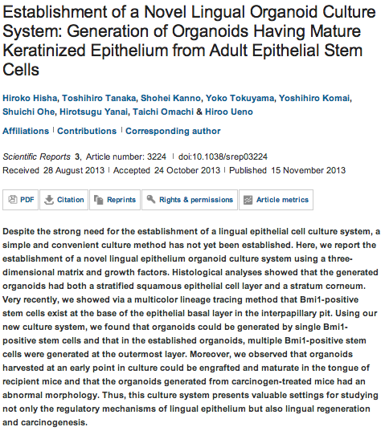
Scientific Reports
SD

Slide 2
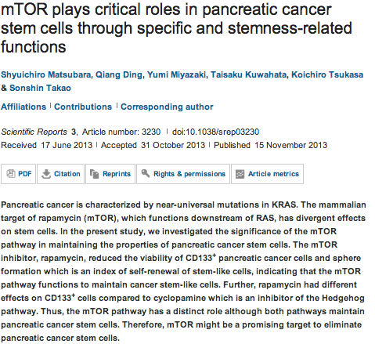
SD

Slide 3
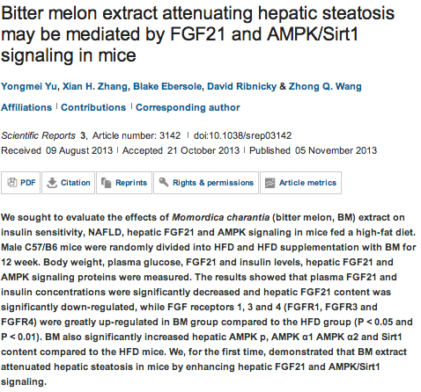
SD

Slide 4
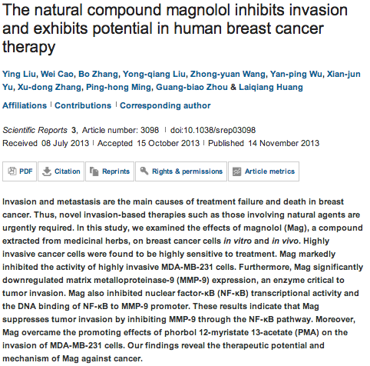
SD

Slide 5
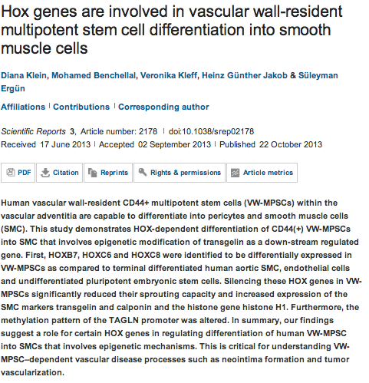
SD

Slide 6
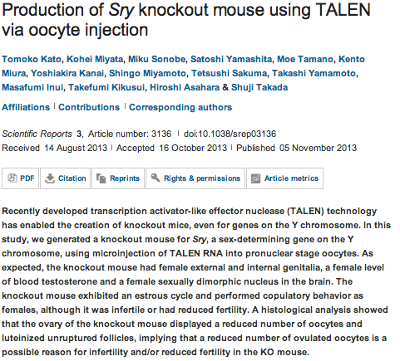
SD

Slide 7

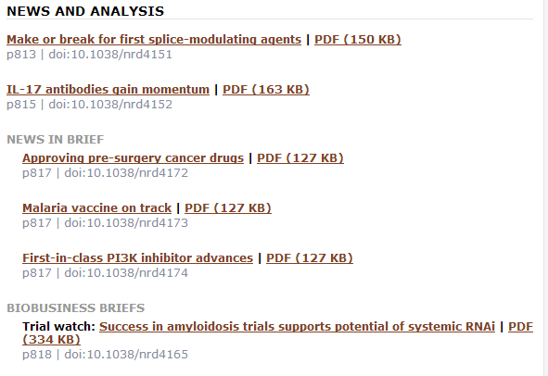
JMC

Slide 8
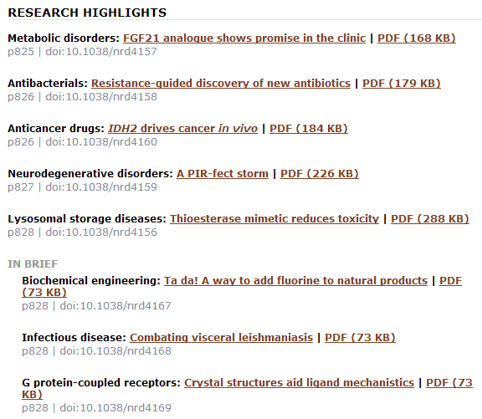
JMC

Slide 9
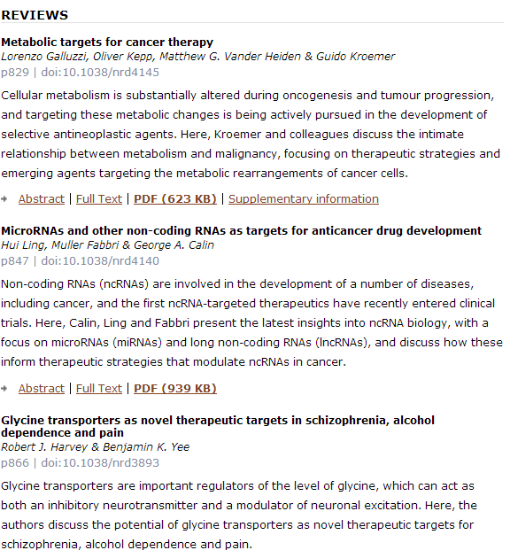
JMC

Slide 10

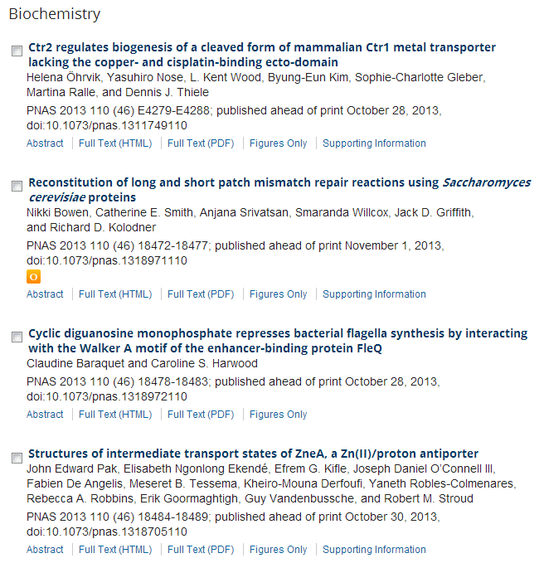
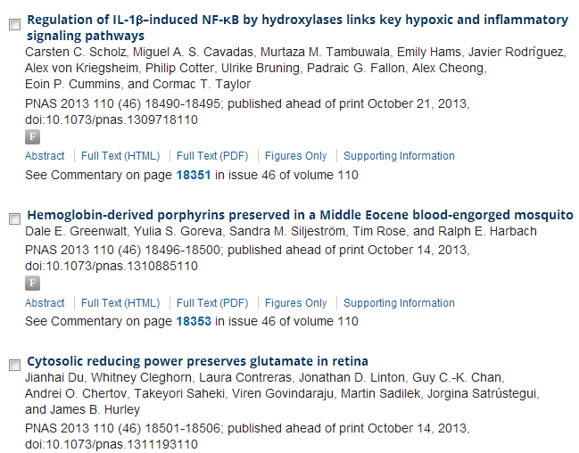
JMC

Slide 11
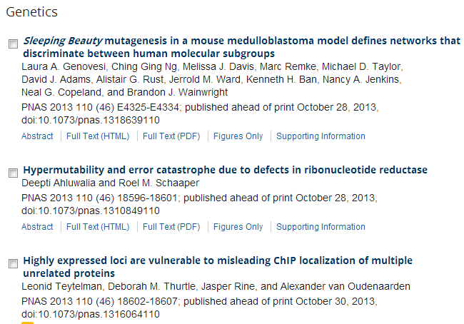
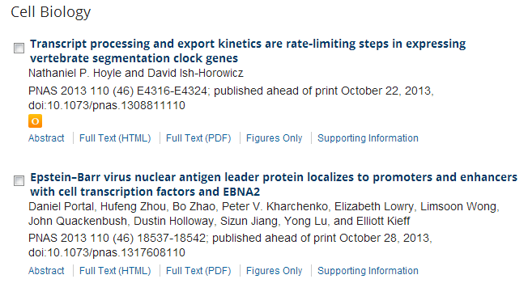
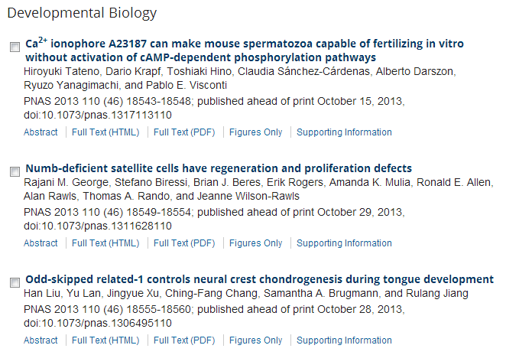
JMC

Slide 12
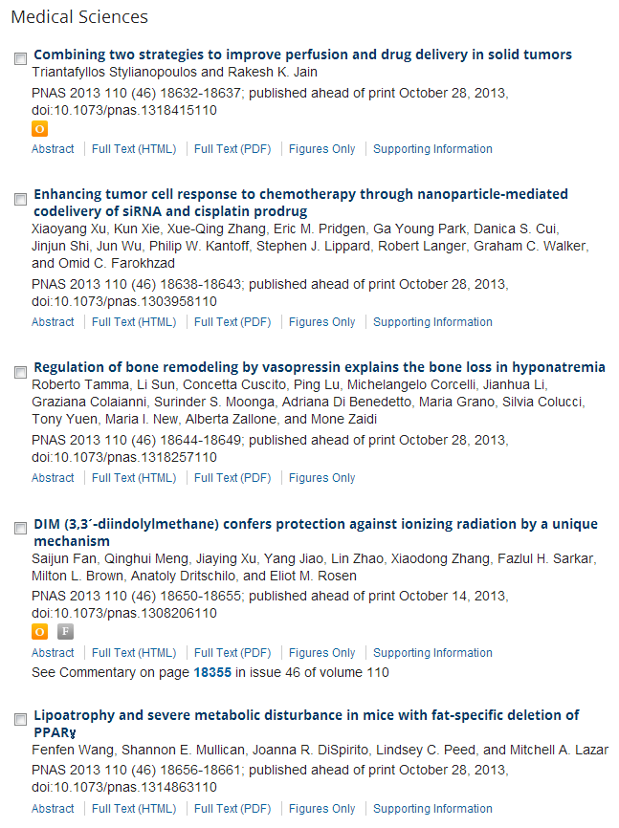
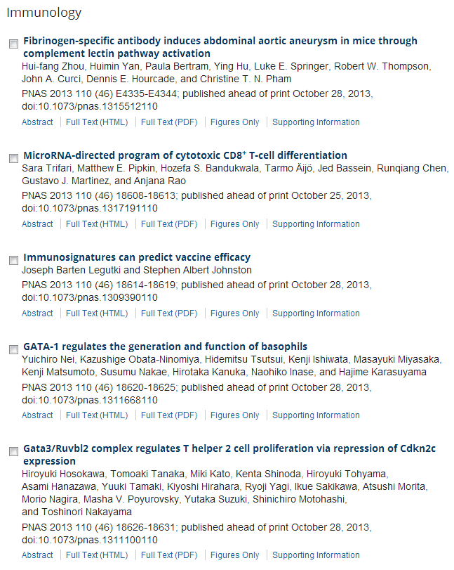
JMC

Slide 13
oncogene
Semaphorin receptors meet receptor tyrosine kinases on the way of tumor progression.
Cagnoni G, Tamagnone L.
Source
1] IRCC-Institute for Cancer Research at Candiolo, Candiolo, Italy [2] University of Torino-Medical School, Candiolo, Italy.
Abstract
Semaphorins are extracellular signals known to guide migrating cells during developmental morphogenesis and in adult tissues. Semaphorin receptors, that is plexins and neuropilins, have been found in association with diverse receptor tyrosine kinases (RTKs), such as Met, ErbB2 and VEGFR2. These receptor complexes are formed in a cell-specific manner and can mediate distinctive signalling cascades, sometimes leading to divergent functional outcomes. This is particularly intriguing in cancer, since the same semaphorin has been found to mediate either tumor-promoting or tumor-suppressing functions, depending on the cancer type and cellular context. We will therefore review the current understanding about the role of RTKs in neuropilin and plexin signalling, putatively accounting for the multifaceted role of semaphorins in cancer.

Slide 14
oncogene
PPARβ/δ promotes HRAS-induced senescence and tumor suppression by potentiating p-ERK and repressing p-AKT signaling.
Zhu B, Ferry CH, Blazanin N, Bility MT, Khozoie C, Kang BH, Glick AB, Gonzalez FJ, Peters JM.
Department of Veterinary and Biomedical Sciences, The Center for Molecular Toxicology and Carcinogenesis, The Pennsylvania State University, University Park, PA, USA.
Peroxisome proliferator-activated receptor-β/δ (PPARβ/δ) inhibits skin tumorigenesis through mechanisms that may be dependent on HRAS signaling. The present study examined the hypothesis that PPARβ/δ promotes HRAS-induced senescence resulting in suppression of tumorigenesis. PPARβ/δ expression increased p-ERK and decreased p-AKT activity. Increased p-ERK activity results from the dampened HRAS-induced negative feedback response mediated in part through transcriptional upregulation of RAS guanyl-releasing protein 1 (RASGRP1) by PPARβ/δ. Decreased p-AKT activity results from repression of integrin-linked kinase (ILK) and phosphoinositide-dependent protein kinase-1 (PDPK1) expression. Decreased p-AKT activity in turn promotes cellular senescence through upregulation of p53 and p27 expression. Both over-expression of RASGRP1 and shRNA-mediated knockdown of ILK partially restore cellular senescence in Pparβ/δ-null cells. Higher PPARβ/δ expression is also correlated with increased senescence observed in human benign neurofibromas and colon adenoma lesions in vivo. These results demonstrate that PPARβ/δ promotes senescence to inhibit tumorigenesis and provide new mechanistic insights into HRAS-induced cellular senescence.

Slide 15
PAX3-NCOA2 fusion gene has a dual role in promoting the proliferation and inhibiting the myogenic differentiation of rhabdomyosarcoma cells.
Yoshida H, Miyachi M, Sakamoto K, Ouchi K, Yagyu S, Kikuchi K, Kuwahara Y, Tsuchiya K, Imamura T, Iehara T,Kakazu N, Hojo H, Hosoi H.
Source
Department of Pediatrics, Graduate School of Medical Science, Kyoto Prefectural University of Medicine, Kyoto, Japan.
oncogene
The Polycomb group (PcG) protein EZH2 supports the survival of PAX3-FOXO1 alveolar rhabdomyosarcoma by repressing FBXO32 (Atrogin1/MAFbx).
Ciarapica R, De Salvo M, Carcarino E, Bracaglia G, Adesso L, Leoncini PP, Dall'agnese A, Walters ZS, Verginelli F,De Sio L, Boldrini R, Inserra A, Bisogno G, Rosolen A, Alaggio R, Ferrari A, Collini P, Locatelli M, Stifani S, Screpanti I,Rutella S, Yu Q, Marquez VE, Shipley J, Valente S, Mai A, Miele L, Puri PL, Locatelli F, Palacios D, Rota R.
Source
Department of Oncohematology, Ospedale Pediatrico Bambino Gesù, IRCCS, Roma, Italy.
Mode of action of trabectedin in myxoid liposarcomas.
Di Giandomenico S, Frapolli R, Bello E, Uboldi S, Licandro SA, Marchini S, Beltrame L, Brich S, Mauro V, Tamborini E,Pilotti S, Casali PG, Grosso F, Sanfilippo R, Gronchi A, Mantovani R, Gatta R, Galmarini CM, Sousa-Faro JM, D'Incalci M.
Source
Department of Oncology, IRCCS-Istituto di Ricerche Farmacologiche 'Mario Negri', Milan, Italy.
Increased leukocyte survival and accelerated onset of lymphoma in the absence of MCL-1 S159-phosphorylation.
Lindner SE, Wissler M, Gründer A, Aumann K, Ottina E, Peintner L, Brauns-Schubert P, Preiss F, Herzog S, Borner C,Charvet C, Villunger A, Pahl HL, Maurer U.
Source
1] Institute of Molecular Medicine and Cell Research, Albert-Ludwigs-University Freiburg, Freiburg, Germany [2] Faculty of Biology, Albert-Ludwigs-University Freiburg, Freiburg, Germany.
PAG - a multipurpose transmembrane adaptor protein.
Hrdinka M, Horejsi V.
Source
Institute of Molecular Genetics, Academy of Sciences of the Czech Republic, Prague, Czech Republic.
The PI3-kinase isoform p110δ is essential for cell transformation induced by the D816V mutant of c-Kit in a lipid-kinase-independent manner.
Sun J, Mohlin S, Lundby A, Kazi JU, Hellman U, Påhlman S, Olsen JV, Rönnstrand L.
Source
Experimental Clinical Chemistry, Department of Laboratory Medicine, Lund University, Skåne University Hospital, Malmö, Sweden.
Synergistic function of Kras mutation and HBx in initiation and progression of hepatocellular carcinoma in mice.
Ye H, Zhang C, Wang BJ, Tan XH, Zhang WP, Teng Y, Yang X.
Source
1] Model Organism Division, E-institutes of Shanghai Universities, Shanghai Jiaotong University School of Medicine, Shanghai, China [2] State Key Laboratory of Proteomics, Genetic Laboratory of Development and Disease, Institute of Biotechnology, Beijing, China

Slide 16
Foxm1 transcription factor is required for the initiation of lung tumorigenesis by oncogenic KrasG12D.
Wang IC, Ustiyan V, Zhang Y, Cai Y, Kalin TV, Kalinichenko VV.
Source
1] Division of Pulmonary Biology, Perinatal Institute of Cincinnati Children's Hospital Research Foundation, Cincinnati, OH, USA [2] Department of Life Sciences, National Tsing Hua University, Hsinchu, Taiwan [3] Institute of Biotechnology, National Tsing Hua University, Hsinchu, Taiwan.
oncogene
MicroRNA-192 suppresses liver metastasis of colon cancer.
Geng L, Chaudhuri A, Talmon G, Wisecarver JL, Are C, Brattain M, Wang J.
Source
Eppley Institute for Research in Cancer and Allied Diseases, Omaha, NE, USA.
High mobility group box 1 promotes tumor cell migration through epigenetic silencing of semaphorin 3A.
Nehil M, Paquette J, Tokuyasu T, McCormick F.
Source
Department of Medical Oncology, Dana-Farber Cancer Institute, Harvard Medical Scool, Boston, MA, USA.
Endothelial deletion of Sag/Rbx2/Roc2 E3 ubiquitin ligase causes embryonic lethality and blocks tumor angiogenesis.
Tan M, Li H, Sun Y.
Division of Radiation and Cancer Biology, Department of Radiation Oncology, University of Michigan, Ann Arbor, MI, USA.
Inhibition of cell migration and invasion mediated by the TAT-RasGAP317-326 peptide requires the DLC1 tumor suppressor.
Barras D, Lorusso G, Rüegg C, Widmann C.
Source
Department of Physiology, University of Lausanne, Lausanne, Switzerland.

