Slide 1
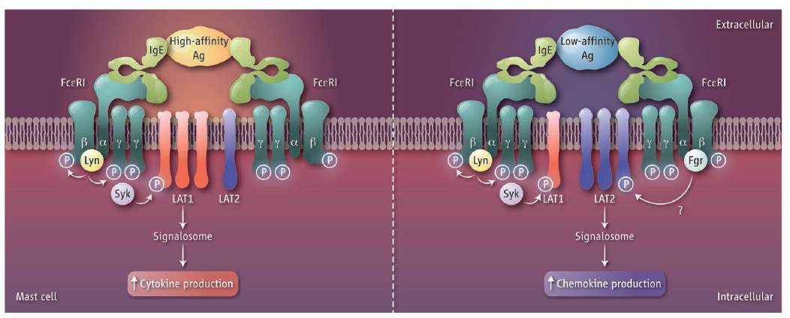
[Science] 28 FEBRUARY 2014 VOL 343, ISSUE 6174, PAGES 941-1048
Science. 2014 Feb 28;343(6174):1021-5. doi: 10.1126/science.1246976. Epub 2014 Feb 6.
Molecular editing of cellular responses by the high-affinity receptor for IgE.
Suzuki R¹, Leach S, Liu W, Ralston E, Scheffel J, Zhang W, Lowell CA, Rivera J.
¹Laboratory of Molecular Immunogenetics, National Institute of Arthritis and Musculoskeletal and Skin Diseases, Bethesda, MD 20892, USA.
Abstract
Cellular responses elicited by cell surface receptors differ according to stimulus strength. We investigated how the high-affinity receptor for immunoglobulin E (IgE) modulates the response of mast cells to a high- or low-affinity stimulus. Both high- and low-affinity stimuli elicited similarreceptor phosphorylation; however, differences were observed in receptor cluster size, mobility, distribution, and the cells' effector responses. Low-affinity stimulation increased receptor association with the Src family kinase Fgr and shifted signals from the adapter LAT1 to the related adapter LAT2. LAT1-dependent calcium signals required for mast cell degranulation were dampened, but the role of LAT2 in chemokine production was enhanced, altering immune cell recruitment at the site of inflammation. These findings uncover how receptor discrimination of stimulus strength can be interpreted as distinct in vivo outcomes.
Perspectives - CELL BIOLOGY
Signaling Shifts in Allergy Responses Marc Daëron
A mechanism that senses antigen affinity shifts cell signaling and leads to qualitatively different inflammatory responses.

Slide 2
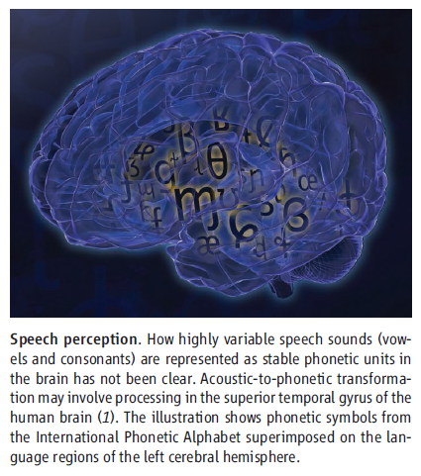
[Science] 28 FEBRUARY 2014 VOL 343, ISSUE 6174, PAGES 941-1048
Science. 2014 Feb 28;343(6174):1006-10. doi: 10.1126/science.1245994. Epub 2014 Jan 30.
Phonetic feature encoding in human superior temporal gyrus.
Mesgarani N¹, Cheung C, Johnson K, Chang EF.
¹Department of Neurological Surgery, Department of Physiology, and Center for Integrative Neuroscience, University of California, San Francisco, CA 94143, USA.
Abstract
During speech perception, linguistic elements such as consonants and vowels are extracted from a complex acoustic speech signal. The superiortemporal gyrus (STG) participates in high-order auditory processing of speech, but how it encodes phonetic information is poorly understood. We used high-density direct cortical surface recordings in humans while they listened to natural, continuous speech to reveal the STG representation of the entire English phonetic inventory. At single electrodes, we found response selectivity to distinct phonetic features. Encoding of acoustic properties was mediated by a distributed population response. Phonetic features could be directly related to tuning for spectrotemporal acoustic cues, some of which were encoded in a nonlinear fashion or by integration of multiple cues. These findings demonstrate the acoustic-phoneticrepresentation of speech in human STG.
Perspectives - NEUROSCIENCE
The Neural Code That Makes Us Human
Yosef Grodzinsky and Israel Nelken
How does a certain pattern of vibration in the air reliably represent a meaningful speech sound?

Slide 3
[Science] 28 FEBRUARY 2014 VOL 343, ISSUE 6174, PAGES 941-1048
Science. 2014 Feb 28;343(6174):1245114. doi: 10.1126/science.1245114. Epub 2014 Jan 16.
Lost in transition: start-up of glycolysis yields subpopulations of nongrowing cells.
van Heerden JH¹, Wortel MT, Bruggeman FJ, Heijnen JJ, Bollen YJ, Planqué R, Hulshof J, O'Toole TG, Wahl SA, Teusink B.
¹Systems Bioinformatics/Amsterdam Institute for Molecules, Medicines and Systems (AIMMS)/Netherlands Institute for Systems Biology, VU University, De Boelelaan 1085, 1081 HV Amsterdam, Netherlands.
Abstract
Cells need to adapt to dynamic environments. Yeast that fail to cope with dynamic changes in the abundance of glucose can undergo growth arrest. We show that this failure is caused by imbalanced reactions in glycolysis, the essential pathway in energy metabolism in most organisms. The imbalance arises largely from the fundamental design of glycolysis, making this state of glycolysis a generic risk. Cells with unbalancedglycolysis coexisted with vital cells. Spontaneous, nongenetic metabolic variability among individual cells determines which state is reached and, consequently, which cells survive. Transient ATP (adenosine 5'-triphosphate) hydrolysis through futile cycling reduces the probability of reaching the imbalanced state. Our results reveal dynamic behavior of glycolysis and indicate that cell fate can be determined by heterogeneity purely at the metabolic level.
Science. 2014 Feb 28;343(6174):1247136. doi: 10.1126/science.1247136. Epub 2014 Jan 30.
ESCRT machinery is required for plasma membrane repair.
Jimenez AJ¹, Maiuri P, Lafaurie-Janvore J, Divoux S, Piel M, Perez F.
¹Institut Curie, 26 rue d'Ulm, 75248 Paris Cedex 05, France.
Abstract
Plasma membrane damage can be triggered by numerous phenomena, and efficient repair is essential for cell survival. Endocytosis, membranepatching, or extracellular budding can be used for plasma membrane repair. We found that endosomal sorting complex required for transport(ESCRT), involved previously in membrane budding and fission, plays a critical role in plasma membrane repair. ESCRT proteins were recruited within seconds to plasma membrane wounds. Quantitative analysis of wound closure kinetics coupled to mathematical modeling suggested that ESCRTs are involved in the repair of small wounds. Real-time imaging and correlative scanning electron microscopy (SEM) identified extracellular buds and shedding at the site of ESCRT recruitment. Thus, the repair of certain wounds is ensured by ESCRT-mediated extracellular shedding of wounded portions.

Slide 4
[Science] 28 FEBRUARY 2014 VOL 343, ISSUE 6174, PAGES 941-1048
Science. 2014 Feb 28;343(6174):1002-5. doi: 10.1126/science.1245831.
Promoter-bound trinucleotide repeat mRNA drives epigenetic silencing in fragile X syndrome.
Colak D¹, Zaninovic N, Cohen MS, Rosenwaks Z, Yang WY, Gerhardt J, Disney MD, Jaffrey SR.
¹Department of Pharmacology, Weill Cornell Medical College, Cornell University, New York, NY 10065, USA.
Abstract
Epigenetic gene silencing is seen in several repeat-expansion diseases. In fragile X syndrome, the most common genetic form of mental retardation, a CGG trinucleotide-repeat expansion adjacent to the fragile X mental retardation 1 (FMR1) gene promoter results in its epigeneticsilencing. Here, we show that FMR1 silencing is mediated by the FMR1 mRNA. The FMR1 mRNA contains the transcribed CGG-repeat tract as part of the 5' untranslated region, which hybridizes to the complementary CGG-repeat portion of the FMR1 gene to form an RNA·DNA duplex. Disrupting the interaction of the mRNA with the CGG-repeat portion of the FMR1 gene prevents promoter silencing. Thus, our data linktrinucleotide-repeat expansion to a form of RNA-directed gene silencing mediated by direct interactions of the trinucleotide-repeat RNA and DNA.
Science. 2014 Feb 28;343(6174):1010-4. doi: 10.1126/science.1249484.
Detection of a recurrent DNAJB1-PRKACA chimeric transcript in fibrolamellar hepatocellular carcinoma.
Honeyman JN¹, Simon EP, Robine N, Chiaroni-Clarke R, Darcy DG, Lim II, Gleason CE, Murphy JM, Rosenberg BR, Teegan L, Takacs CN, Botero S, Belote R, Germer S, Emde AK, Vacic V, Bhanot U, LaQuaglia MP, Simon SM.
¹Laboratory of Cellular Biophysics, Rockefeller University, 1230 York Avenue, New York, NY 10065, USA.
Abstract
Fibrolamellar hepatocellular carcinoma (FL-HCC) is a rare liver tumor affecting adolescents and young adults with no history of primary liver disease or cirrhosis. We identified a chimeric transcript that is expressed in FL-HCC but not in adjacent normal liver and that arises as the result of a ~400-kilobase deletion on chromosome 19. The chimeric RNA is predicted to code for a protein containing the amino-terminal domain of DNAJB1, a homolog of the molecular chaperone DNAJ, fused in frame with PRKACA, the catalytic domain of protein kinase A. Immunoprecipitation and Western blot analyses confirmed that the chimeric protein is expressed in tumor tissue, and a cell culture assay indicated that it retains kinase activity. Evidence supporting the presence of the DNAJB1-PRKACA chimeric transcript in 100% of the FL-HCCs examined (15/15) suggests that this genetic alteration contributes to tumor pathogenesis.

Slide 5
[Science] 28 FEBRUARY 2014 VOL 343, ISSUE 6174, PAGES 941-1048
Resurrecting Surviving Neandertal Lineages from Modern Human Genomes
Benjamin Vernot and Joshua M. Akey
Science 28 February 2014: 1017-1021.
Ancestral Neandertal sequences within extant humans reveal that positive and purifying selection has occurred.
Cell Surface ABP1-TMK Auxin-Sensing Complex Activates ROP GTPase Signaling
Tongda Xu, Ning Dai, Jisheng Chen, Shingo Nagawa, Min Cao, Hongjiang Li, Zimin Zhou, Xu Chen, Riet De Rycke, Hana Rakusová,Wuyi Wang,
Alan M. Jones, Jiří Friml, Sara E. Patterson, Anthony B. Bleecker, and Zhenbiao Yang
Science 28 February 2014: 1025-1028.
An alternate signaling route for the plant hormone auxin goes directly inside from the cell surface.

Slide 6

[Science Signaling] 25 FEBRUARY 2014 VOL 7, ISSUE 314

Slide 7
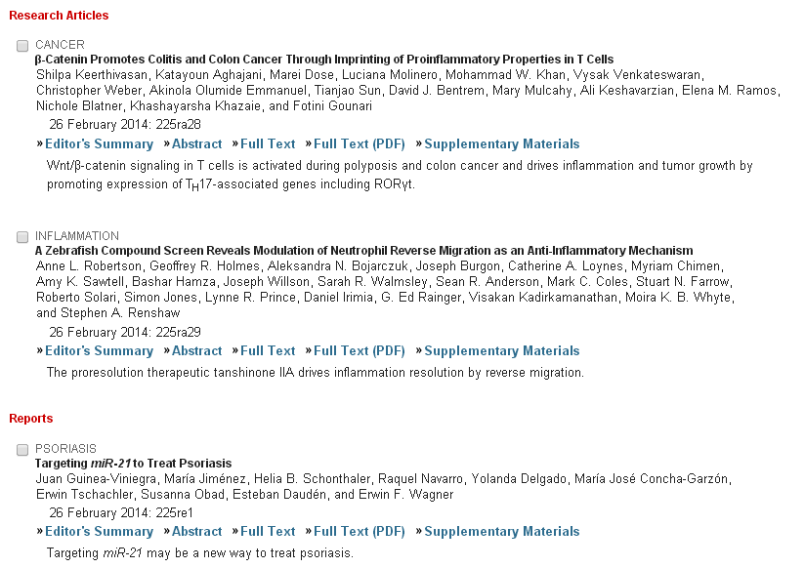
[Science Translational Medicine] 26 FEBRUARY 2014 VOL 6, ISSUE 225

Slide 8

KJ
MiR-592 Regulates the Induction and Cell Death-Promoting Activity of p75NTR in Neuronal Ischemic Injury
Krithi Irmady1, Katherine A. Jackman2, Victoria A. Padow1, Neelam Shahani3, Laura Andres Martin1, Leandro Cerchietti1, Klaus Unsicker3, Costantino Iadecola2, and Barbara L. Hempstead1
1Department of Medicine and
2Brain and Mind Research Institute, Weill Cornell Medical College, New York, New York 10065, and
3Interdisciplinary Center for Neurosciences, Department of Neuroanatomy, University of Heidelberg, INF 307, D69120 Heidelberg, Germany
Abstract
The neurotrophin receptor p75NTR has been implicated in mediating neuronal apoptosis after injury to the CNS. Despite its frequent induction in pathologic states, there is limited understanding of the mechanisms that regulate p75NTR expression after injury. Here, we show that after focal cerebral ischemia in vivo or oxygen–glucose deprivation in organotypic hippocampal slices or neurons, p75NTR is rapidly induced. A concomitant induction of proNGF, a ligand for p75NTR, is also observed. Induction of this ligand/receptor system is pathologically relevant, as a decrease in apoptosis, after oxygen–glucose deprivation, is observed in hippocampal neurons or slices after delivery of function-blocking antibodies to p75NTR or proNGF and in p75NTR and ngf haploinsufficient slices. Furthermore, a significant decrease in infarct volume was noted in p75NTR−/− mice compared with the wild type. We also investigated the regulatory mechanisms that lead to post-ischemic induction of p75NTR. We demonstrate that induction of p75NTR after ischemic injury is independent of transcription but requires active translation. Basal levels of p75NTR in neurons are maintained in part by the expression of microRNA miR-592, and an inverse correlation is seen between miR-592 and p75NTR levels in the adult brain. After cerebral ischemia, miR-592 levels fall, with a corresponding increase in p75NTR levels. Importantly, overexpression of miR-592 in neurons decreases the level of ischemic injury-induced p75NTR and attenuates activation of pro-apoptotic signaling and cell death. These results identify miR-592 as a key regulator of p75NTR expression and point to a potential therapeutic candidate to limit neuronal apoptosis after ischemic injury.

Slide 9

KJ

Slide 10

KJ

Slide 11

KJ

Slide 12

KJ

Slide 13

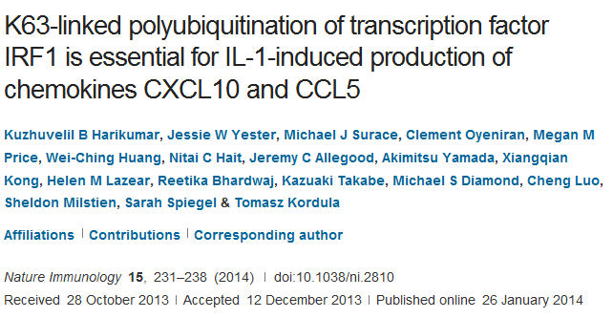
Department of Biochemistry and Molecular Biology and the Massey Cancer Center, Virginia Commonwealth University School of Medicine, Richmond, Virginia, USA.
Although interleukin 1 (IL-1) induces expression of the transcription factor IRF1 (interferon-regulatory factor 1), the roles of IRF1 in immune and inflammatory responses and mechanisms of its activation remain elusive. Here we found that IRF1 was essential for IL-1-induced expression of the chemokines CXCL10 and CCL5, which recruit mononuclear cells into sites of sterile inflammation. Newly synthesized IRF1 acquired Lys63 (K63)-linked polyubiquitination mediated by the apoptosis inhibitor cIAP2 that was enhanced by the bioactive lipid S1P. In response to IL-1, cIAP2 and the sphingosine kinase SphK1 (the enzyme that generates S1P) formed a complex with IRF1, which led to its activation. Thus, IL-1 triggered a hitherto unknown signaling cascade that controlled the induction of IRF1-dependent genes that encode molecules important for sterile inflammation

Slide 14
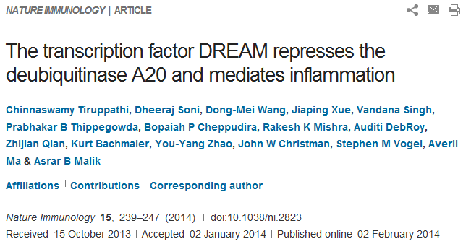
Department of Pharmacology and the Center for Lung and Vascular Biology, University of Illinois, Chicago, Illinois, USA.
Here we found that the transcription repressor DREAM bound to the promoter of the gene encoding A20 to repress expression of this deubiquitinase that suppresses inflammatory NF-κB signaling. DREAM-deficient mice displayed persistent and unchecked A20 expression in response to endotoxin. DREAM functioned by transcriptionally repressing A20 through binding to downstream regulatory elements (DREs). In contrast, binding of the transcription factor USF1 to the DRE-associated E-box domain in the gene encoding A20 activated its expression in response to inflammatory stimuli. Our studies define the critical opposing functions of DREAM and USF1 in inhibiting and inducing A20 expression, respectively, and thereby the strength of NF-κB signaling. Targeting of DREAM to induce USF1-mediated A20 expression is therefore a potential anti-inflammatory strategy for the treatment of diseases associated with unconstrained NF-κB activity, such as acute lung injury.

Slide 15
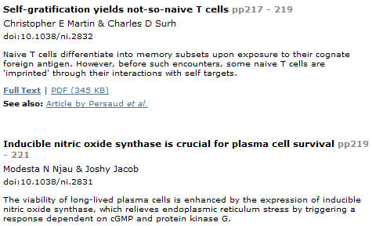

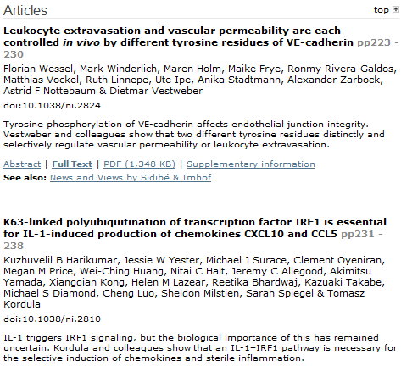
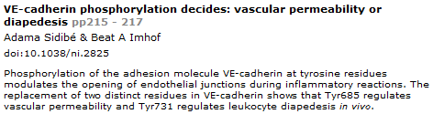

Slide 16


