Slide 1



Slide 2


Slide 3
Cancer: Inflammation lights the way to metastasis
Seth B. Coffelt & Karin E. de Visser
Nature 507, 48–49 (06 March 2014) doi:10.1038/nature13062
Tumour spread is the main cause of death in patients with melanoma. Exposure of melanoma to ultraviolet radiation has now been found to cause an inflammatory response that drives the formation of distant metastases. See Letter p.109
Ultraviolet-radiation-induced inflammation promotes angiotropism and metastasis in melanoma
Tobias Bald, Thomas Quast, Jennifer Landsberg, et al.
Nature 507, 109–113 (06 March 2014) doi:10.1038/nature13111
Intermittent intense ultraviolet (UV) exposure represents an important aetiological factor in the development of malignant melanoma1. The ability of UV radiation to cause tumour-initiating DNA mutations in melanocytes is now firmly established2, but how the microenvironmental effects of UV radiation3, 4 influence melanoma pathogenesis is not fully understood. Here we report that repetitive UV exposure of primary cutaneous melanomas in a genetically engineered mouse model5 promotes metastatic progression, independent of its tumour-initiating effects. UV irradiation enhanced the expansion of tumour cells along abluminal blood vessel surfaces and increased the number of lung metastases. This effect depended on the recruitment and activation of neutrophils, initiated by the release of high mobility group box 1 (HMGB1) from UV-damaged epidermal keratinocytes and driven by Toll-like receptor 4 (TLR4). The UV-induced neutrophilic inflammatory response stimulated angiogenesis and promoted the ability of melanoma cells to migrate towards endothelial cells and use selective motility cues on their surfaces. Our results not only reveal how UV irradiation of epidermal keratinocytes is sensed by the innate immune system, but also show that the resulting inflammatory response catalyses reciprocal melanoma–endothelial cell interactions leading to perivascular invasion, a phenomenon originally described as angiotropism in human melanomas by histopathologists6. Angiotropism represents a hitherto underappreciated mechanism of metastasis7 that also increases the likelihood of intravasation and haematogenous dissemination. Consistent with our findings, ulcerated primary human melanomas with abundant neutrophils and reactive angiogenesis frequently show angiotropism and a high risk for metastases. Our work indicates that targeting the inflammation-induced phenotypic plasticity of melanoma cells and their association with endothelial cells represent rational strategies to specifically interfere with metastatic progression.

Slide 4
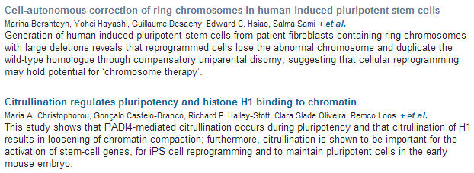
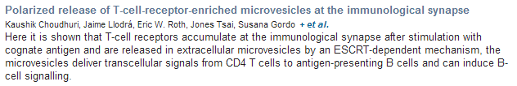

Slide 5



Recent studies indicate that long interspersed nuclear element-1 (L1) are mobilized in the genome of human neural progenitor cells and enhanced in Rett syndrome and ataxia telangiectasia. However, whether aberrant L1 retrotransposition occurs in mental disorders is unknown. Here, we report high L1 copy number in schizophrenia. Increased L1 was demonstrated in neurons from prefrontal cortex of patients and in induced pluripotent stem (iPS) cell-derived neurons containing 22q11 deletions. Whole-genome sequencing revealed brain-specific L1 insertion in patients localized preferentially to synapse- and schizophrenia-related genes. To study the mechanism of L1 transposition, we examined perinatal environmental risk factors for schizophrenia in animal models and observed an increased L1 copy number after immune activation by poly-I:C or epidermal growth factor. These findings suggest that hyperactive retrotransposition of L1 in neurons triggered by environmental and/or genetic risk factors may contribute to the susceptibility and pathophysiology of schizophrenia.

Slide 6

Intestinal epithelial cells: regulators of barrier function and immune homeostasis
Lance W. Peterson & David Artis p141 | doi:10.1038/nri3608
Intestinal epithelial cells (IECs) promote gut homeostasis by coordinating the segregation and regulation of commensal microorganisms and the host immune system. This Review highlights the diverse and multifaceted roles of IECs in barrier function, and in their regulation of innate and adaptive immune cell function and homeostasis in response to microbial colonization.
Homeostatic control of regulatory T cell diversity
Adrian Liston & Daniel H. D. Gray p154 | doi:10.1038/nri3605
Regulatory T (TReg) cells are crucial for maintaining immune homeostasis in the body, with recent data showing that distinct TReg cell subsets become specialized to function in different tissues. Here, Liston and Gray highlight the need to regulate the number and function of the TReg cells themselves, and they describe the dynamic processes that achieve this homeostasis and functional specialization of TReg cell subsets.
Apoptotic cell clearance: basic biology and therapeutic potential
Ivan K. H. Poon, Christopher D. Lucas, Adriano G. Rossi & Kodi S. Ravichandran p166
The removal of apoptotic cells by phagocytes is essential for the maintenance of tissue homeostasis and is usually immunologically silent. However, dysregulation of this process is associated with numerous inflammatory and autoimmune diseases, and thus the therapeutic manipulation of apoptotic cell clearance by phagocytes may be a means to treat these diseases.

Slide 7
Liver fibrosis and repair: immune regulation of wound healing in a solid organ
Antonella Pellicoro, Prakash Ramachandran, John P. Iredale & Jonathan A. Fallowfield p181
The immune regulation of liver fibrosis (particularly the distinct and opposing roles of macrophage subsets) provides an informative model of the endogenous mechanisms that mediate the resolution of fibrosis and the restoration of tissue homeostasis.
Regulation of immune responses by extracellular vesicles
Paul D. Robbins & Adrian E. Morelli p195
Extracellular vesicles, including exosomes, provide a means of intercellular communication for immune regulation. Here, the authors describe how the proteins, nucleic acids and other molecules that they carry influence immune responses, and explore their potential use in the treatment of inflammatory and autoimmune diseases, and cancer.

Slide 8

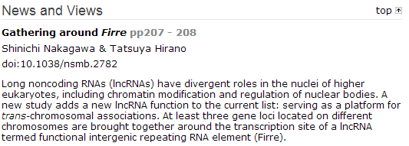
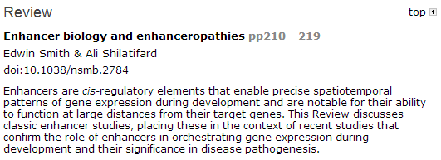

Slide 9

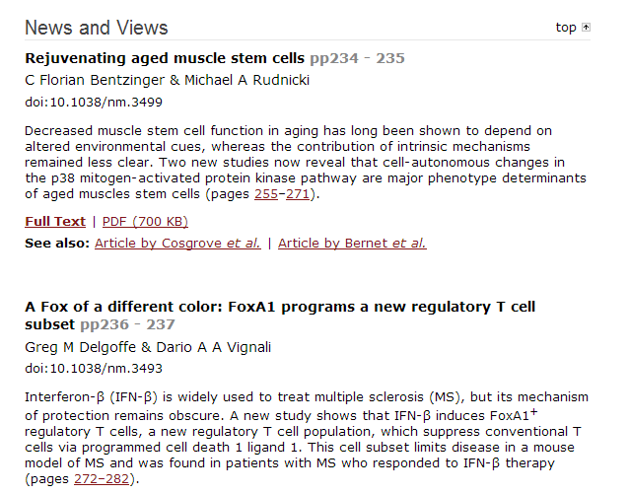

Slide 10
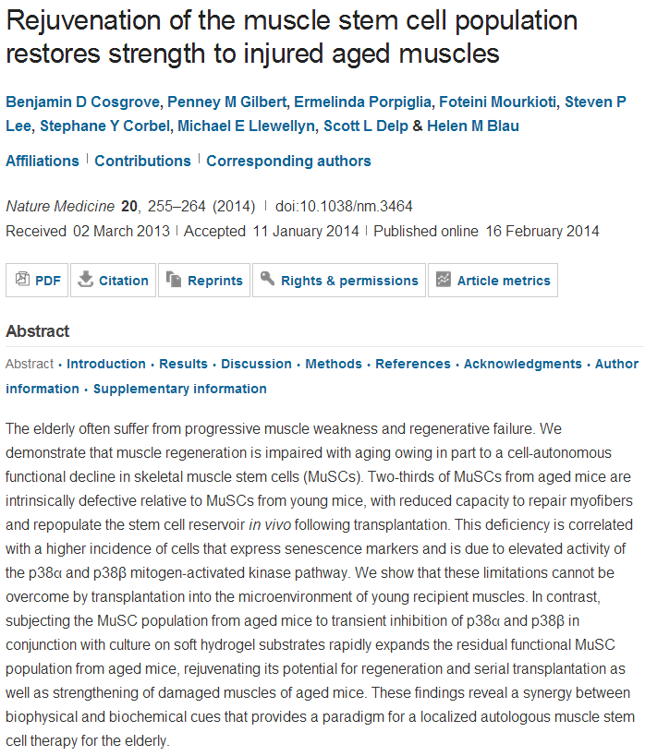

Slide 11
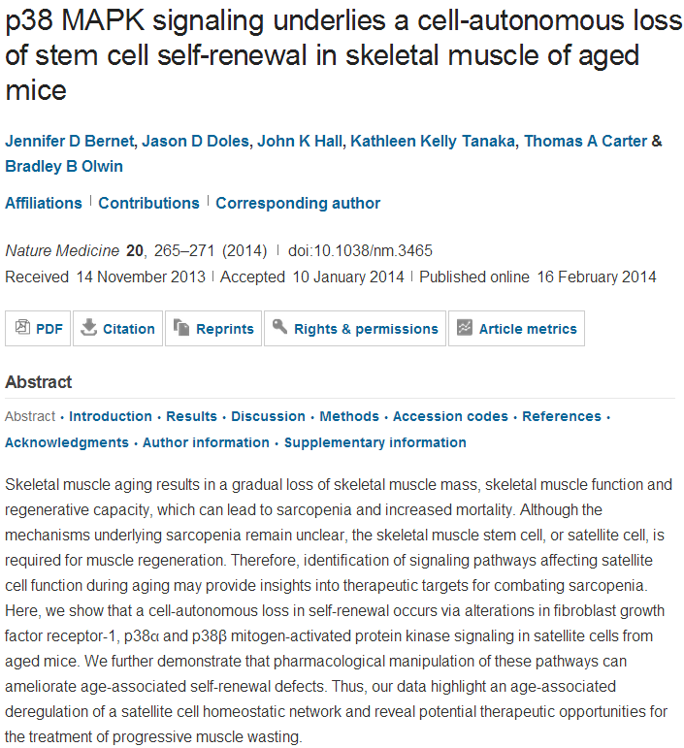

Slide 12
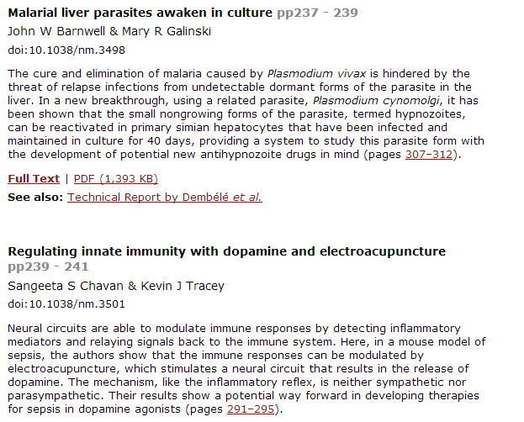

Slide 13
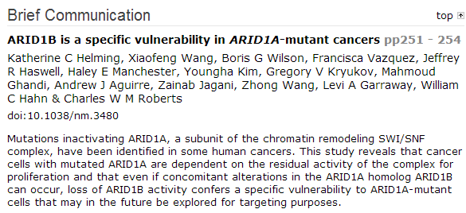
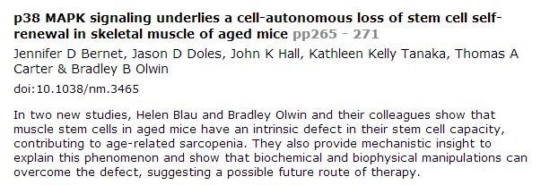

Slide 14
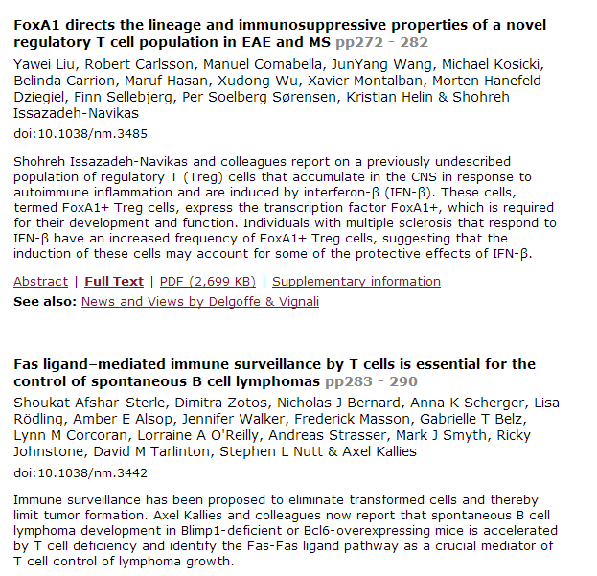

Slide 15
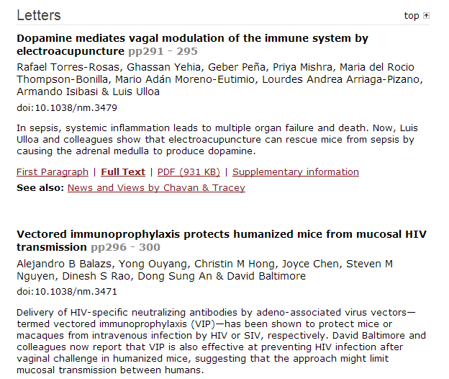

Slide 16
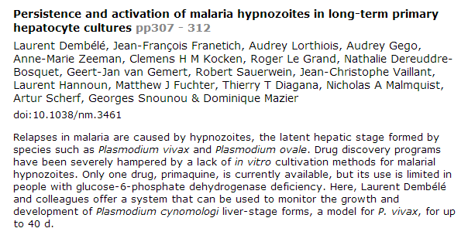
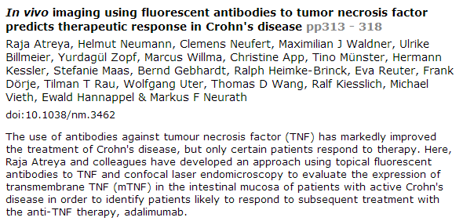

Slide 17
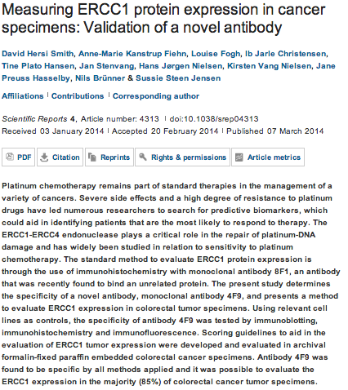
Scientific Reports

Slide 18
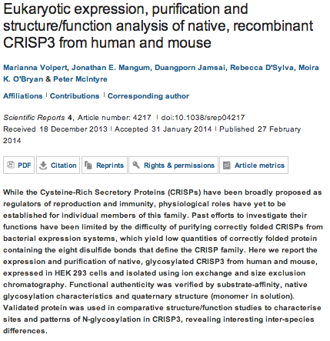

Slide 19
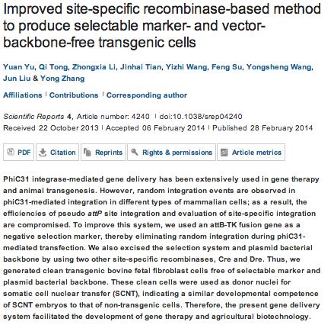

Slide 20
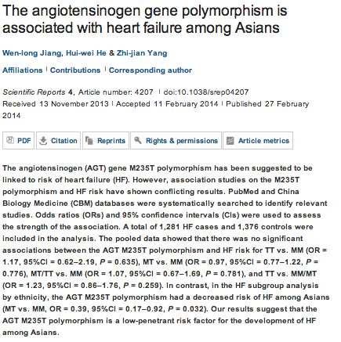

Slide 21
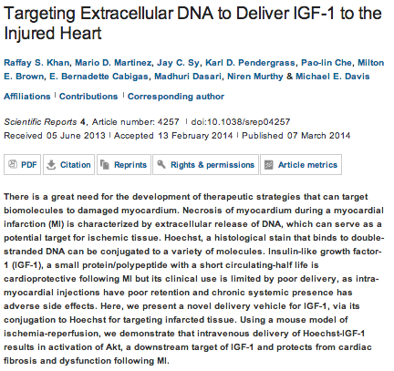

Slide 22

Activation of the Proapoptotic Bcl-2 Protein Bax by a Small
Molecule Induces Tumor Cell Apoptosis
Guoping Zhao, Yanglong Zhu, Colins O. Eno, Yanlong Liu, Lynn DeLeeuw, Joseph A. Burlison,
Jonathan B. Chaires, John O. Trent, and Chi Li
Mol. Cell. Biol. April 2014 34:7 1198-1207; published ahead of print 13 January 2014 , doi:10.1128/MCB.00996-13
Loss of von Hippel-Lindau Protein (VHL) Increases Systemic Cholesterol Levels through Targeting Hypoxia-Inducible Factor 2α and Regulation of Bile Acid Homeostasis
Sadeesh K. Ramakrishnan, Matthew Taylor, Aijuan Qu, Sung-Hoon Ahn, Madathilparambil V. uresh, Krishnan Raghavendran, Frank J. Gonzalez, and Yatrik M. Shah
Mol. Cell. Biol. April 2014 34:7 1208-1220; published ahead of print 13 January 2014 , doi:10.1128/MCB.01441-13
S/T Phosphorylation of DLL1 Is Required for Full Ligand Activity In Vitro but Dispensable for DLL1 Function In Vivo during Embryonic Patterning and Marginal Zone B Cell Development
Eike-Benjamin Braune, Karin Schuster-Gossler, Marcin Lyszkiewicz, Katrin Serth, Kristina Preusse,
Johannes Madlung, Boris Macek, Andreas Krueger, and Achim Gossler
Mol. Cell. Biol. April 2014 34:7 1221-1233; published ahead of print 21 January 2014 , doi:10.1128/MCB.00965-13
Ligand Binding Shifts Highly Mobile Retinoid X Receptor to the Chromatin-Bound State in a Coactivator-Dependent Manner, as Revealed by Single-Cell Imaging
Peter Brazda, Jan Krieger, Bence Daniel, David Jonas, Tibor Szekeres, Katalin Tóth, Laszlo Nagy,
and György Vámosi
Mol. Cell. Biol. April 2014 34:7 1234-1245; published ahead of print 21 January 2014 , doi:10.1128/MCB.01097-13

Slide 23
Activation of p53 Transcriptional Activity by SMRT: a Histone Deacetylase 3-Independent Function of a Transcriptional Corepressor
Anbu Karani Adikesavan, Sudipan Karmakar, Patricia Pardo, Liguo Wang, Shuang Liu, Wei Li,
and Carolyn L. Smith
Mol. Cell. Biol. April 2014 34:7 1246-1261; published ahead of print 21 January 2014 , doi:10.1128/MCB.01216-13
The E3 Ubiquitin Ligase MARCH6 Degrades Squalene Monooxygenase and Affects 3-Hydroxy-3-Methyl-Glutaryl Coenzyme A Reductase and the Cholesterol Synthesis Pathway
Noam Zelcer, Laura J. Sharpe, Anke Loregger, Ika Kristiana, Emma C. L. Cook, Lisa Phan, Julian Stevenson, and Andrew J. Brown
Mol. Cell. Biol. April 2014 34:7 1262-1270; published ahead of print 21 January 2014 , doi:10.1128/MCB.01140-13
Insulin Stimulates Syntaxin4 SNARE Complex Assembly via a Novel Regulatory Mechanism
Dimitrios Kioumourtzoglou, Gwyn W. Gould, and Nia J. Bryant
Mol. Cell. Biol. April 2014 34:7 1271-1279; published ahead of print 27 January 2014 , doi:10.1128/MCB.01203-13
Yin Yang 1 Is a Repressor of Glutamate Transporter EAAT2, and It Mediates Manganese-Induced Decrease of EAAT2 Expression in Astrocytes
Pratap Karki, Anton Webb, Keisha Smith, James Johnson Jr., Kyuwon Lee, Deok-Soo Son,
Michael Aschner, and Eunsook Lee
Mol. Cell. Biol. April 2014 34:7 1280-1289; published ahead of print 27 January 2014 , doi:10.1128/MCB.01176-13
Deregulation of Pancreas-Specific Oxidoreductin ERO1β in the Pathogenesis of Diabetes Mellitus
Motoharu Awazawa, Takashi Futami, Michinori Sakada, Kazuma Kaneko, Mitsuru Ohsugi, Keizo Nakaya, Ai Terai, Ryo Suzuki, Masato Koike, Yasuo Uchiyama, Takashi Kadowaki, and Kohjiro Ueki
Mol. Cell. Biol. April 2014 34:7 1290-1299; published ahead of print 27 January 2014 , doi:10.1128/MCB.01647-13

Slide 24
Cytoplasmic Poly(A) Binding Protein C4 Serves a Critical Role in Erythroid Differentiation
Hemant K. Kini, Jian Kong, and Stephen A. Liebhaber Mol. Cell. Biol. April 2014 34:7 1300-1309; published ahead of print 27 January 2014 , doi:10.1128/MCB.01683-13
Sept6 Is Required for Ciliogenesis in Kupffer's Vesicle, the Pronephros, and the Neural Tube during Early Embryonic Development
Gang Zhai, Qilin Gu, Jiangyan He, Qiyong Lou, Xiaowen Chen, Xia Jin, Erfei Bi, and Zhan Yin
Mol. Cell. Biol. April 2014 34:7 1310-1321; published ahead of print 27 January 2014 , doi:10.1128/MCB.01409-13
Mechanism Underlying IκB Kinase Activation Mediated by the Linear Ubiquitin Chain Assembly Complex
Hiroaki Fujita, Simin Rahighi, Mariko Akita, Ryuichi Kato, Yoshiteru Sasaki, Soichi Wakatsuki,
and Kazuhiro Iwai
Mol. Cell. Biol. April 2014 34:7 1322-1335; published ahead of print 27 January 2014 , doi:10.1128/MCB.01538-13
Proteasome Failure Promotes Positioning of Lysosomes around the Aggresome via Local Block of Microtubule-Dependent Transport
Nava Zaarur, Anatoli B. Meriin, Eloy Bejarano, Xiaobin Xu, Vladimir L. Gabai, Ana Maria Cuervo,
and Michael Y. Sherman
Mol. Cell. Biol. April 2014 34:7 1336-1348; published ahead of print 27 January 2014 , doi:10.1128/MCB.00103-14
TRF2-Tethered TIN2 Can Mediate Telomere Protection by TPP1/POT1
David Frescas and Titia de Lange
Mol. Cell. Biol. April 2014 34:7 1349-1362; published ahead of print 27 January 2014 , doi:10.1128/MCB.01052-13
Stat5 Regulates the Phosphatidylinositol 3-Kinase/Akt1 Pathway during Mammary Gland Development and Tumorigenesis
Jeffrey W. Schmidt, Barbara L. Wehde, Kazuhito Sakamoto, Aleata A. Triplett, Steven M. nderson,
Philip N. Tsichlis, Gustavo Leone, and Kay-Uwe Wagner
Mol. Cell. Biol. April 2014 34:7 1363-1377; published ahead of print 27 January 2014 , doi:10.1128/MCB.01220-13

Slide 25
Activation of the Proapoptotic Bcl-2 Protein Bax by a Small
Molecule Induces Tumor Cell Apoptosis
Guoping Zhaoª,^{c}, Yanglong Zhuª,^{c}, Colins O. Enoª,^{c}*, Yanlong Liu^{c}, Lynn DeLeeuw^{b},^{c},
Joseph A. Burlison^{b},^{c}, Jonathan B. Chaires^{b},^{c}, John O. Trent^{b},^{c} and
Chi Liª,^{c},^{d} +
ABSTRACT
The proapoptotic Bcl-2 protein Bax by itself is sufficient to initiate apoptosis in almost all apoptotic paradigms. Thus, compounds that can facilitate disruptive Bax insertion into mitochondrial membranes have potential as cancer therapeutics. In our study, we have identified small-molecule compounds predicted to associate with the Bax hydrophobic groove by a virtual-screen approach. Among these, one lead compound (compound 106) promotes Bax-dependent but not Bak-dependent apoptosis. Importantly, this compound alters Bax protein stability in vitro and promotes the insertion of Bax into mitochondria, leading to Bax-dependent permeabilization of the mitochondrial outer membrane. Furthermore, as a single agent, compound 106 inhibits the growth of transplanted tumors, probably by inducing apoptosis in tumors. Our study has revealed a compound that activates Bax and induces Bax-dependent apoptosis, which may lead to the development of new therapeutic agents for cancer.

Slide 26
Activation of p53 Transcriptional Activity by SMRT: a Histone Deacetylase 3-Independent Function of a Transcriptional Corepressor
Anbu Karani Adikesavanª, Sudipan Karmakarª*, Patricia Pardoª, Liguo Wang^{b}*,
Shuang Liuª, Wei Li^{b} and Carolyn L. Smithª
ABSTRACT
The silencing mediator of retinoic acid and thyroid hormone receptors (SMRT) is an established histone deacetylase 3 (HDAC3)-dependent transcriptional corepressor. Microarray analyses of MCF-7 cells transfected with control or SMRT small interfering RNA revealed SMRT regulation of genes involved in DNA damage responses, and the levels of the DNA damage marker γH2AX as well as poly(ADP-ribose) polymerase cleavage were elevated in SMRT-depleted cells treated with doxorubicin. A number of these genes are established p53 targets. SMRT knockdown decreased the activity of two p53-dependent reporter genes as well as the expression of p53 target genes, such as CDKN1A (which encodes p21). SMRT bound directly to p53 and was recruited to p53 binding sites within the p21 promoter. Depletion of GPS2 and TBL1, components of the SMRT corepressor complex, but not histone deacetylase 3 (HDAC3) decreased p21-luciferase activity. p53 bound to the SMRT deacetylase activation domain (DAD), which mediates HDAC3 binding and activation, and HDAC3 could attenuate p53 binding to the DAD region of SMRT. Moreover, an HDAC3 binding-deficient SMRT DAD mutant coactivated p53 transcriptional activity. Collectively, these data highlight a biological role for SMRT in mediating DNA damage responses and suggest a model where p53 binding to the DAD limits HDAC3 interaction with this coregulator, thereby facilitating SMRT coactivation of p53-dependent gene expression.

Slide 27
Stat5 Regulates the Phosphatidylinositol 3-Kinase/Akt1 Pathway during Mammary Gland Development and Tumorigenesis
Jeffrey W. Schmidtª, Barbara L. Wehdeª, Kazuhito Sakamotoª, Aleata A. Triplettª,
Steven M. Anderson^{b}, Philip N. Tsichlis^{c}, Gustavo Leone^{d} and Kay-Uwe Wagnerª,^{e}
ABSTRACT
Stat5 (signal transducer and activator of transcription 5) is an essential mediator of cytokine receptor signaling and plays important roles in the proliferation of alveolar progenitors and the survival of functionally differentiated epithelial cells in the mammary gland. A deregulated expression and activation of Stat5 leads to precocious alveolar development in the absence of pregnancy hormones, impaired mammary gland remodeling following the cessation of lactation, and mammary tumor formation. We reported previously that Stat5 induces the transcription of the Akt1 gene from a novel promoter. In this report, we provide experimental evidence that Akt1 is an essential mediator for the biological function of Stat5 as a survival factor. Additionally, Stat5 controls the expression of the regulatory and catalytic subunits of the phosphatidylinositol 3-kinase (PI3K) (p85α and p110α), thereby greatly augmenting signaling through the prosurvival PI3K/Akt pathway. In agreement with this model, we observed that the constitutive activation of Stat5 cooperates with the loss of function of the tumor suppressor PTEN by accelerating the formation of preneoplastic lesions and mammary tumors. The mammary gland-specific ablation of Stat5 is sufficient to prevent mammary carcinogenesis in a genuine mouse model for Cowden syndrome. Therefore, targeting the Jak2/Stat5 pathway might be a suitable strategy to prevent breast cancer in patients that carry a mutant PTEN allele.

Slide 28
Transcriptional regulation of fibronectin by p21-activated kinase-1 modulates pancreatic tumorigenesis.
Jagadeeshan S¹, Krishnamoorthy YR¹, Singhal M¹, Subramanian A¹, Mavuluri J¹, Lakshmi A¹, Roshini A¹, Baskar G², Ravi M², Joseph LD³, Sadasivan K⁴, Krishnan A⁵, Nair AS⁵, Venkatraman G², Rayala SK¹.
¹Department of Biotechnology, Indian Institute of Technology Madras (IITM), Chennai, India.
Pancreatic ductal adenocarcinoma (PDAC) is the eighth largest cause of cancer-related mortality across the world, with a median 5-year survival rate of less than 3.5%. This is partly because the molecules and the molecular mechanisms that contribute to PDAC are not well understood. Our goal is to understand the role of p21-activated kinase 1 (Pak1) signaling axis in the progression of PDAC. Pak1, a serine/threonine kinase, is a well-known regulator of cytoskeletal remodeling, cell motility, cell proliferation and cell survival. Recent reports suggest that Pak1 by itself can have an oncogenic role in a wide variety of cancers. In this study, we analyzed the expression of Pak1 in human pancreatic cancer tissues and found that Pak1 levels are significantly upregulated in PDAC samples as compared with adjacent normals. Further, to study the functional role of Pak1 in pancreatic cancer model systems, we developed stable overexpression and lentiviral short hairpin RNA-mediated knockdown (KD) clones of Pak1 and studied the changes in transforming properties of the cells. We also observed that Pak1 KD clones failed to form tumors in nude mice. By adopting a quantitative PCR array-based approach, we identified fibronectin, a component of the extracellular matrix and a mesenchymal marker, as a transcriptional target of Pak1 signaling. The underlying molecular mechanism of Pak1-mediated transformation includes its nuclear import and recruitment to the fibronectin promoter via interaction with nuclear factor-κB (NF-κB)-p65 complex. To our knowledge, this is the first study illustrating Pak1-NF-κB-p65-mediated fibronectin regulation as a potent tumor-promoting mechanism in KRAS intact model.

Slide 29
Angiogenin promotes tumoral growth and angiogenesis by regulating matrix metallopeptidase-2 expression via the ERK1/2 pathway.
Miyake M¹, Goodison S², Lawton A³, Gomes-Giacoia E¹, Rosser CJ².
Author information
¹Cancer Research Institute, MD Anderson Cancer Center, Orlando, FL, USA.
TMBIM protein family: ancestral regulators of cell death.
Rojas-Rivera D¹, Hetz C².
Author information
¹1] Biomedical Neuroscience Institute, Faculty of Medicine, University of Chile, Santiago, Chile [2] Center for Molecular Studies of the Cell, Institute of Biomedical Sciences, Faculty of Medicine, University of Chile, Santiago, Chile.

Slide 30

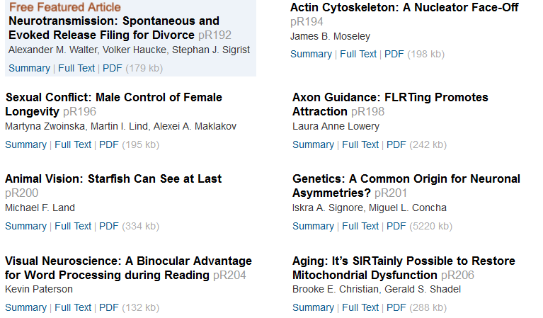
MA

Slide 31
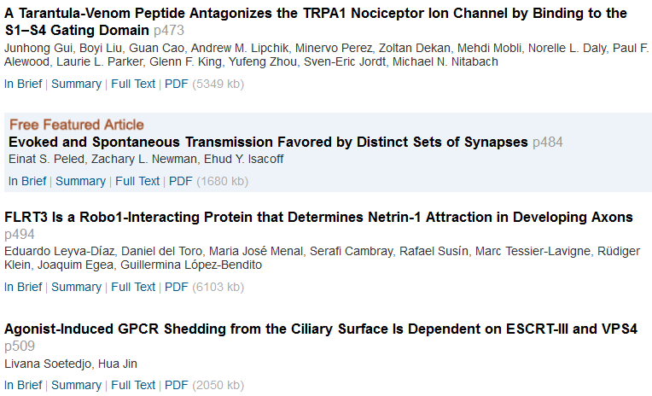
MA

Slide 32
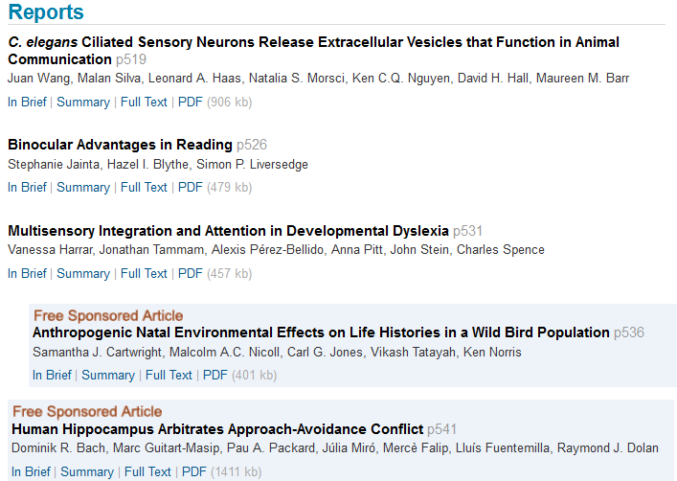
MA

Slide 33
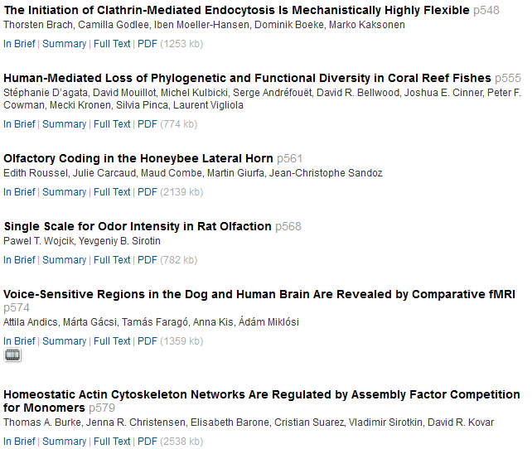
MA

Slide 34
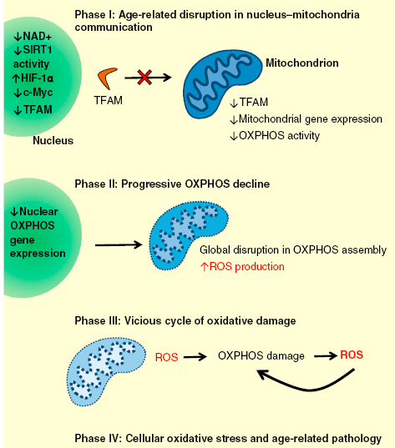
,
,
Aging: It’s SIRTainly Possible to Restore Mitochondrial Dysfunction
Brooke E. Christian, and Gerald S. Shadel1,2
College of Medicine, Biological Sciences and Psychology, Henry Wellcome Building,
University of Leicester, LE1 9HN, UK. E-mail: kbp3@leicester.ac.uk
Summary
Mitochondrial dysfunction is strongly associated with aging. A recent study shows that reduced nuclear SIRT1 activity initiates age-related mitochondrial decline through a signaling pathway that perturbs expression of genes encoded by mitochondrial DNA. This reversible pathway has potential anti-aging therapeutic value.
MA

