Slide 1
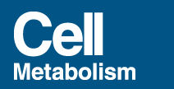


Slide 2
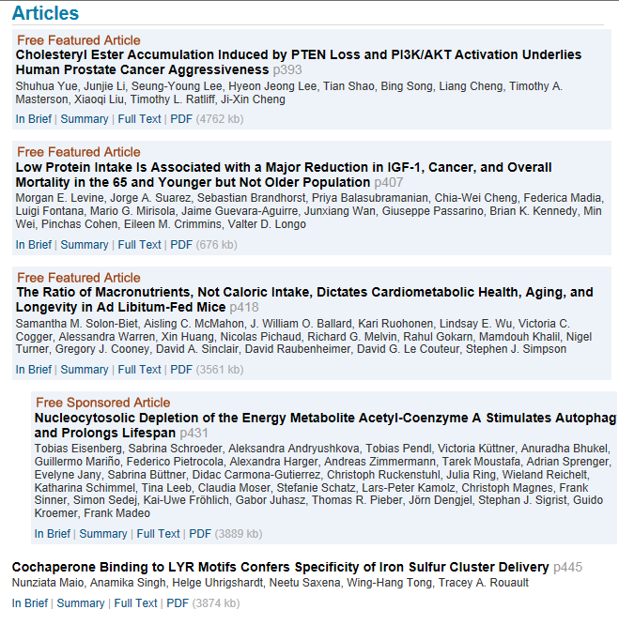

Slide 3
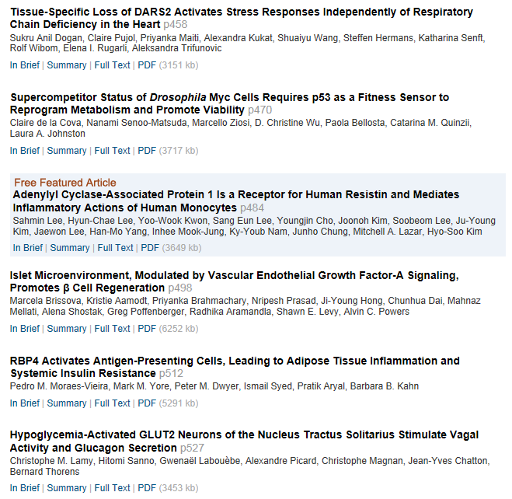

Slide 4


Slide 5
Cholesteryl Ester Accumulation Induced by PTEN Loss and PI3K/AKT Activation Underlies Human Prostate Cancer Aggressiveness
Authors
Shuhua Yue, Junjie Li, Seung-Young Lee, Hyeon Jeong Lee, Tian Shao, Bing Song, Liang Cheng, Timothy A. Masterson, Xiaoqi Liu, Timothy L. Ratliff, Ji-Xin Cheng
Weldon School of Biomedical Engineering, Purdue University, West Lafayette, IN 47907, USA
Summary
Altered lipid metabolism is increasingly recognized as a signature of cancer cells. Enabled by label-free Raman spectromicroscopy, we performed quantitative analysis of lipogenesis at single-cell level in human patient cancerous tissues. Our imaging data revealed an unexpected, aberrant accumulation of esterified cholesterol in lipid droplets of high-grade prostate cancer and metastases. Biochemical study showed that such cholesteryl ester accumulation was a consequence of loss of tumor suppressor PTEN and subsequent activation of PI3K/AKT pathway in prostate cancer cells. Furthermore, we found that such accumulation arose from significantly enhanced uptake of exogenous lipoproteins and required cholesterol esterification. Depletion of cholesteryl ester storage significantly reduced cancer proliferation, impaired cancer invasion capability, and suppressed tumor growth in mouse xenograft models with negligible toxicity. These findings open opportunities for diagnosing and treating prostate cancer by targeting the altered cholesterol metabolism.

Slide 6
Low Protein Intake Is Associated with a Major Reduction in IGF-1, Cancer, and Overall Mortality in the 65 and Younger but Not Older Population
Authors
Morgan E. Levine, Jorge A. Suarez, Sebastian Brandhorst, Priya Balasubramanian, Chia-Wei Cheng, Federica Madia, Luigi Fontana, Mario G. Mirisola, Jaime Guevara-Aguirre, Junxiang Wan, Giuseppe Passarino, Brian K. Kennedy, Min Wei, Pinchas Cohen, Eileen M. Crimmins, Valter D. Longo
Davis School of Gerontology, University of Southern California, Los Angeles, CA 90033, USA
Summary
Mice and humans with growth hormone receptor/IGF-1 deficiencies display major reductions in age-related diseases. Because protein restriction reduces GHR-IGF-1 activity, we examined links between protein intake and mortality. Respondents aged 50–65 reporting high protein intake had a 75% increase in overall mortality and a 4-fold increase in cancer death risk during the following 18 years. These associations were either abolished or attenuated if the proteins were plant derived. Conversely, high protein intake was associated with reduced cancer and overall mortality in respondents over 65, but a 5-fold increase in diabetes mortality across all ages. Mouse studies confirmed the effect of high protein intake and GHR-IGF-1 signaling on the incidence and progression of breast and melanoma tumors, but also the detrimental effects of a low protein diet in the very old. These results suggest that low protein intake during middle age followed by moderate to high protein consumption in old adults may optimize healthspan and longevity.

Slide 7
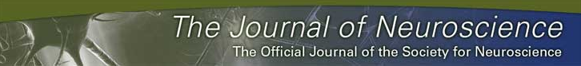
KJ
Chronic Alcohol Disrupts Dopamine Receptor Activity and the Cognitive Function of the Medial Prefrontal Cortex
Heather Trantham-Davidson1, Elizabeth J. Burnett1, Justin T. Gass1, Marcelo F. Lopez1, Patrick J. Mulholland1, Samuel W. Centanni1, Stan B. Floresco2, and L. Judson Chandler1
1Department of Neurosciences, Medical University of South Carolina, Charleston, South Carolina 29425
2Department of Psychology and Brain Research Centre, University of British Columbia, Vancouver, British Columbia, Canada V6T1Z4
Abstract
Dopamine (DA) receptors in the medial prefrontal cortex (mPFC) exert powerful effects on cognition by modulating the balance between excitatory and inhibitory neurotransmission. The present study examined the impact of chronic intermittent ethanol (CIE) exposure on cognitive function and DA receptor-mediated neurotransmission in the rat mPFC. Consistent with alterations in executive function in alcoholics, CIE-exposed rats exhibited deficits in behavioral flexibility in an operant set-shifting task. Since alterations in dopaminergic neurotransmission in the mPFC have been implicated in a number of behavioral disorders including addiction, studies were then performed in the adult acute slice preparation to examine changes in DA receptor function in the mPFC following CIE exposure. In slices obtained from control rats, DA receptor stimulation was observed to exert complex actions on neuronal firing and synaptic neurotransmission that were not only dependent upon the particular receptor subtype but also whether it was a pyramidal cell or a fast-spiking interneuron. In contrast to slices from control rats, there was a near complete loss of the modulatory actions of D2/D4 receptors on cell firing and neurotransmission in slices obtained immediately, 1 and 4 weeks after the last day of CIE exposure. This loss did not appear to be associated with changes in receptor expression. In contrast, CIE exposure did not alter D1 receptor function or mGluR1 modulation of firing. These studies are consistent with the suggestion that chronic alcohol exposure disrupts cognitive function at least in part through disruption of D2 and D4 receptor signaling in mPFC.

Slide 8
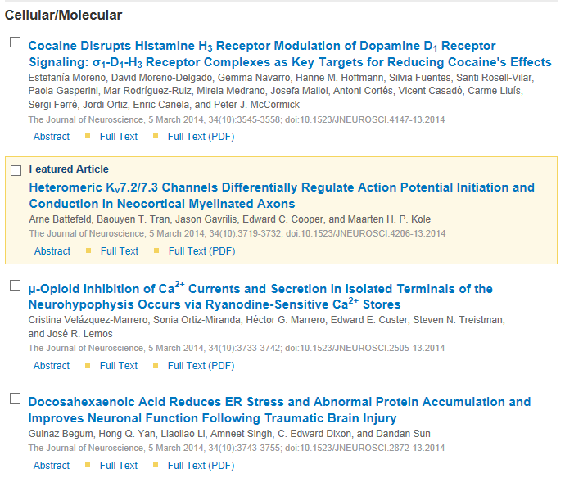
KJ

Slide 9
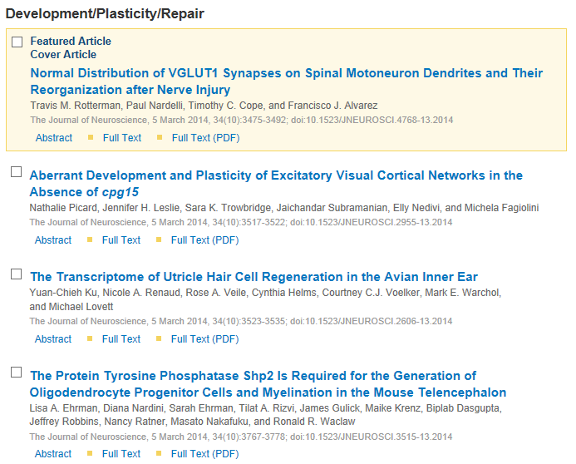
KJ

Slide 10

KJ

Slide 11

KJ

Slide 12
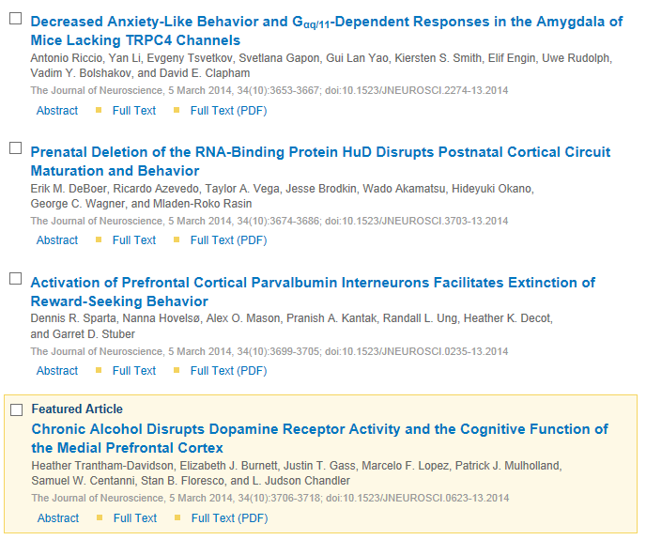
KJ

Slide 13

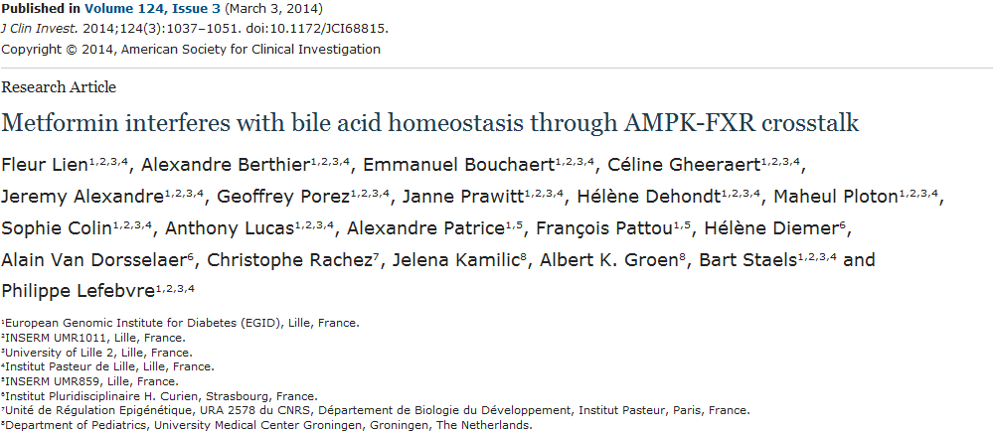
The nuclear bile acid receptor farnesoid X receptor (FXR) is an important transcriptional regulator of bile acid, lipid, and glucose metabolism. FXR is highly expressed in the liver and intestine and controls the synthesis and enterohepatic circulation of bile acids. However, little is known about FXR-associated proteins that contribute to metabolic regulation. Here, we performed a mass spectrometry–based search for FXR-interacting proteins in human hepatoma cells and identified AMPK as a coregulator of FXR. FXR interacted with the nutrient-sensitive kinase AMPK in the cytoplasm of target cells and was phosphorylated in its hinge domain. In cultured human and murine hepatocytes and enterocytes, pharmacological activation of AMPK inhibited FXR transcriptional activity and prevented FXR coactivator recruitment to promoters of FXR-regulated genes. Furthermore, treatment with AMPK activators, including the antidiabetic biguanide metformin, inhibited FXR agonist induction of FXR target genes in mouse liver and intestine. In a mouse model of intrahepatic cholestasis, metformin treatment induced FXR phosphorylation, perturbed bile acid homeostasis, and worsened liver injury. Together, our data indicate that AMPK directly phosphorylates and regulates FXR transcriptional activity to precipitate liver injury under conditions favoring cholestasis.

Slide 14
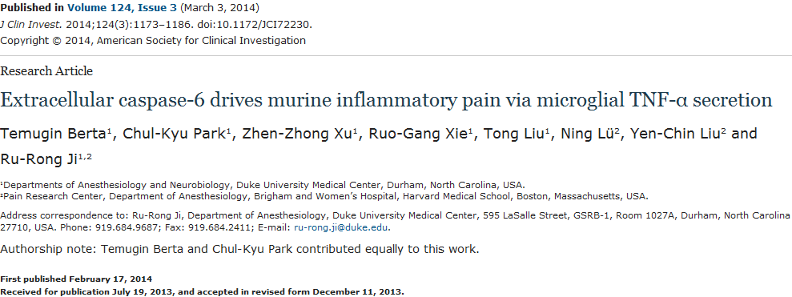
Increasing evidence indicates that the pathogenesis of neuropathic pain is mediated through spinal cord microglia activation. The intracellular protease caspase-6 (CASP6) is known to regulate neuronal apoptosis and axonal degeneration; however, the contribution of microglia and CASP6 in modulating synaptic transmission and pain is unclear. Here, we found that CASP6 is expressed specifically in C-fiber axonal terminals in the superficial spinal cord dorsal horn. Animals exposed to intraplantar formalin or bradykinin injection exhibited CASP6 activation in the dorsal horn. Casp6-null mice had normal baseline pain, but impaired inflammatory pain responses. Furthermore, formalin-induced second-phase pain was suppressed by spinal injection of CASP6 inhibitor or CASP6-neutralizing antibody, as well as perisciatic nerve injection of CASP6 siRNA. Recombinant CASP6 (rCASP6) induced marked TNF-α release in microglial cultures, and most microglia within the spinal cord expressed Tnfa. Spinal injection of rCASP6 elicited TNF-α production and microglia-dependent pain hypersensitivity. Evaluation of excitatory postsynaptic currents (EPSCs) revealed that rCASP6 rapidly increased synaptic transmission in spinal cord slices via TNF-α release. Interestingly, the microglial inhibitor minocycline suppressed rCASP6 but not TNF-α–induced synaptic potentiation. Finally, rCASP6-activated microglial culture medium increased EPSCs in spinal cord slices via TNF-α. Together, these data suggest that CASP6 released from axonal terminals regulates microglial TNF-α secretion, synaptic plasticity, and inflammatory pain.

Slide 15
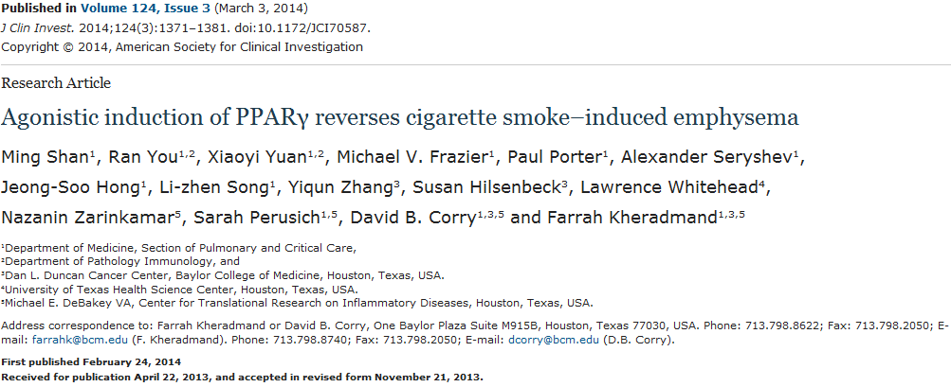
The development of emphysema in humans and mice exposed to cigarette smoke is promoted by activation of an adaptive immune response. Lung myeloid dendritic cells (mDCs) derived from cigarette smokers activate autoreactive Th1 and Th17 cells. mDC-dependent activation of T cell subsets requires expression of the SPP1 gene, which encodes osteopontin (OPN), a pleiotropic cytokine implicated in autoimmune responses. The upstream molecular events that promote SPP1 expression and activate mDCs in response to smoke remain unknown. Here, we show that peroxisome proliferator–activated receptor γ (PPARG/Pparg) expression was downregulated in mDCs of smokers with emphysema and mice exposed to chronic smoke. Conditional knockout of PPARγ in APCs using Cd11c-Cre Pparg^{flox/flox} mice led to spontaneous lung inflammation and emphysema that resembled the phenotype of smoke-exposed mice. The inflammatory phenotype of Cd11c-Cre Pparg^{flox/flox} mice required OPN, suggesting an antiinflammatory mechanism in which PPARγ negatively regulates Spp1 expression in the lung. A 2-month treatment with a PPARγ agonist reversed emphysema in WT mice despite continual smoke exposure. Furthermore, endogenous PPARγ agonists were reduced in the plasma of smokers with emphysema. These findings reveal a proinflammatory pathway, in which reduced PPARγ activity promotes emphysema, and suggest that targeting this pathway in smokers could prevent and reverse emphysema.

Slide 16
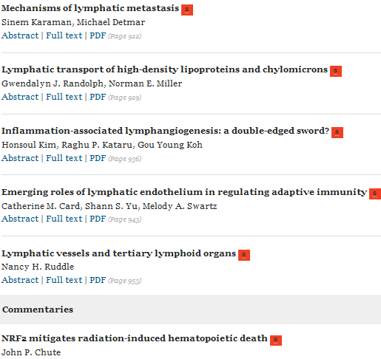

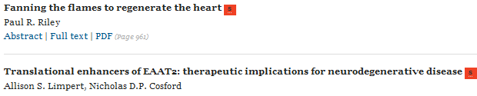

Slide 17
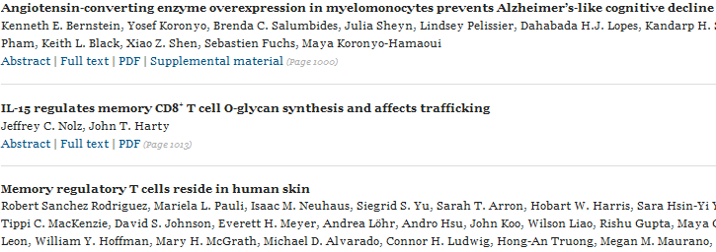
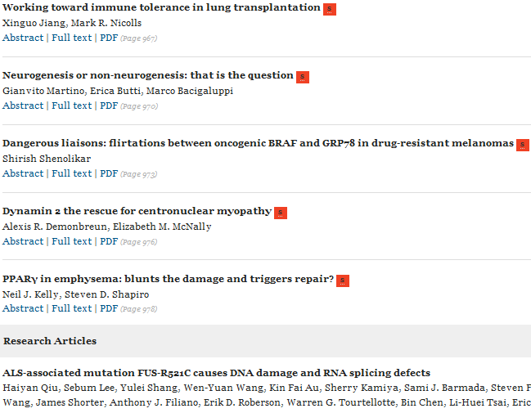
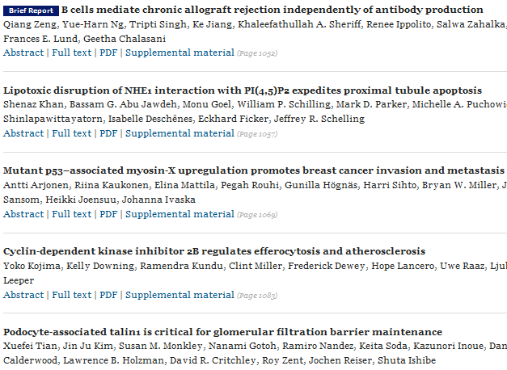


Slide 18
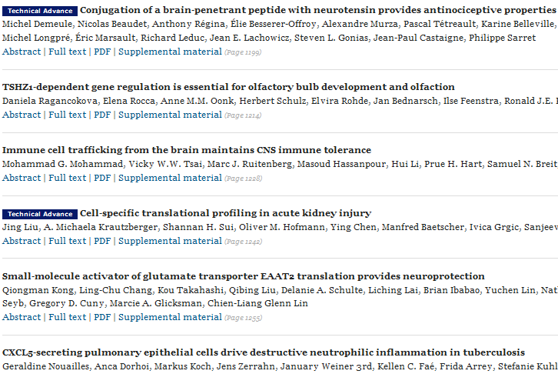
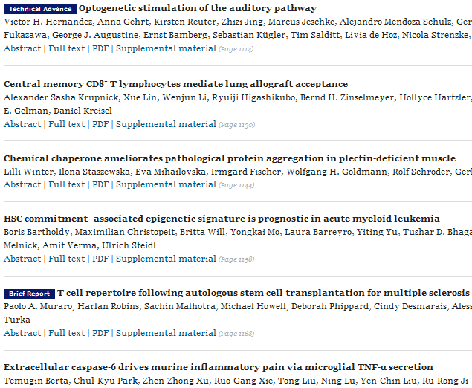
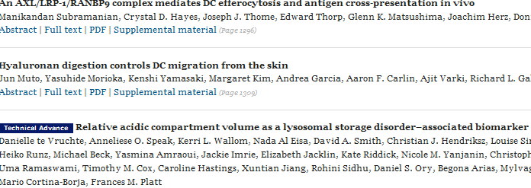
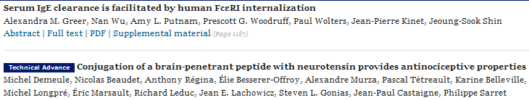

Slide 19
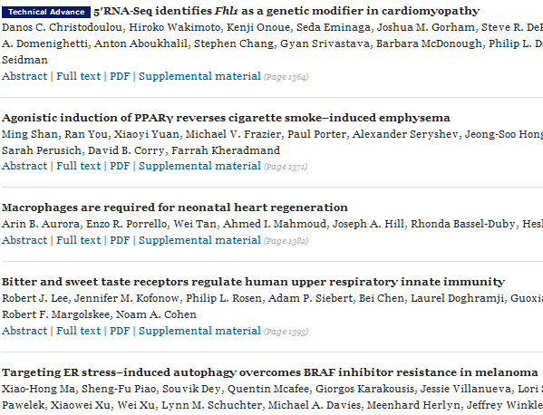
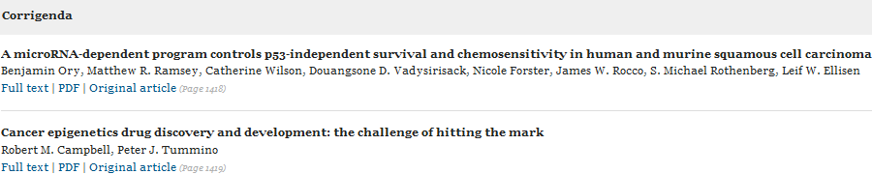

Slide 20
Journal of Immunology
Psychological Stress in Children May Alter the Immune Response
Emma Carlsson, Anneli Frostell, Johnny Ludvigsson, and Maria Faresjö
J Immunol 2014 192:2071-2081; published ahead of print February 5, 2014,doi:10.4049/jimmunol.1301713
IDO2 Is a Critical Mediator of Autoantibody Production and Inflammatory Pathogenesis in a Mouse Model of Autoimmune Arthritis
Lauren M. F. Merlo, Elizabeth Pigott, James B. DuHadaway, Samantha Grabler, Richard Metz, George C. Prendergast, and Laura Mandik-Nayak
J Immunol 2014 192:2082-2090; published ahead of print January 31, 2014,doi:10.4049/jimmunol.1303012
INFECTIOUS DISEASE AND HOST RESPONSE
A Direct and Nonredundant Role for Thymic Stromal Lymphopoietin on Antiviral CD8 T Cell Responses in the Respiratory Mucosa
Hillary L. Shane and Kimberly D. Klonowski
J Immunol 2014 192:2261-2270; published ahead of print January 31, 2014,doi:10.4049/jimmunol.1302085
IRF4 in Dendritic Cells Inhibits IL-12 Production and Controls Th1 Immune Responses against Leishmania major
Masoud Akbari, Kiri Honma, Daisuke Kimura, Mana Miyakoda, Kazumi Kimura, Toshifumi Matsuyama, and Katsuyuki Yui
J Immunol 2014 192:2271-2279; published ahead of print January 31, 2014,doi:10.4049/jimmunol.1301914
BRIEF REVIEWS
True Grit: Programmed Necrosis in Antiviral Host Defense, Inflammation, and Immunogenicity
Edward S. Mocarski, William J. Kaiser, Devon Livingston-Rosanoff, Jason W. Upton, and Lisa P. Daley-Bauer
J Immunol 2014 192:2019-2026; doi:10.4049/jimmunol.1302426
CUTTING EDGE
Cutting Edge: Endoplasmic Reticulum Stress Licenses Macrophages To Produce Mature IL-1β in Response to TLR4 Stimulation through a Caspase-8– and TRIF-Dependent Pathway
Kevin Shenderov, Nicolas Riteau, Ronald Yip, Katrin D. Mayer-Barber, Sandy Oland, Sara Hieny, Pat Fitzgerald, Andrew Oberst, Christopher P. Dillon, Douglas R. Green, Vincenzo Cerundolo, and Alan Sher
J Immunol 2014 192:2029-2033; published ahead of print January 31, 2014,doi:10.4049/jimmunol.1302549
AUTOIMMUNITY
Phosphoinositide 3-Kinase δ Regulates Migration and Invasion of Synoviocytes in Rheumatoid Arthritis
Beatrix Bartok, Deepa Hammaker, and Gary S. Firestein
J Immunol 2014 192:2063-2070; published ahead of print January 27, 2014,doi:10.4049/jimmunol.1300950

Slide 21
All-Trans Retinoic Acid–Triggered Antimicrobial Activity againstMycobacterium tuberculosis Is Dependent on NPC2
Matthew Wheelwright, Elliot W. Kim, Megan S. Inkeles, Avelino De Leon, Matteo Pellegrini, Stephan R. Krutzik, and Philip T. Liu
J Immunol 2014 192:2280-2290; published ahead of print February 5, 2014,doi:10.4049/jimmunol.1301686
INNATE IMMUNITY AND INFLAMMATION
The Transcriptional Repressor BLIMP1 Curbs Host Defenses by Suppressing Expression of the Chemokine CCL8
Martina Severa, Sabina A. Islam, Stephen N. Waggoner, Zhaozhao Jiang, Nancy D. Kim, Glennice Ryan, Evelyn Kurt-Jones, Israel Charo, Daniel R. Caffrey, Victor L. Boyartchuk, Andrew D. Luster, and Katherine A. Fitzgerald
J Immunol 2014 192:2291-2304; published ahead of print January 29, 2014,doi:10.4049/jimmunol.1301799
Upregulation of GRAIL Is Associated with Impaired CD4 T Cell Proliferation in Sepsis
Monowar Aziz, Weng-Lang Yang, Shingo Matsuo, Archna Sharma, Mian Zhou, and Ping Wang
J Immunol 2014 192:2305-2314; published ahead of print January 29, 2014,doi:10.4049/jimmunol.1302160
Decidual Neutrophil Infiltration Is Not Required for Preterm Birth in a Mouse Model of Infection-Induced Preterm Labor
Sara F. Rinaldi, Rob D. Catalano, Jean Wade, Adriano G. Rossi, and Jane E. Norman
J Immunol 2014 192:2315-2325; published ahead of print February 5, 2014,doi:10.4049/jimmunol.1302891
Epigenetic Silencing of the Human NOS2 Gene: Rethinking the Role of Nitric Oxide in Human Macrophage Inflammatory Responses
Thomas J. Gross, Karol Kremens, Linda S. Powers, Brandi Brink, Tina Knutson, Frederick E. Domann, Robert A. Philibert, Mohammed M. Milhem, and Martha M. Monick
J Immunol 2014 192:2326-2338; published ahead of print January 29, 2014,doi:10.4049/jimmunol.1301758
Inhibition of the Membrane Attack Complex of the Complement System Reduces Secondary Neuroaxonal Loss and Promotes Neurologic Recovery after Traumatic Brain Injury in Mice
Kees Fluiter, Anne Loes Opperhuizen, B. Paul Morgan, Frank Baas, and Valeria Ramaglia
J Immunol 2014 192:2339-2348; published ahead of print January 31, 2014,doi:10.4049/jimmunol.1302793
Leukotriene B₄ Enhances the Generation of Proinflammatory MicroRNAs To Promote MyD88-Dependent Macrophage Activation
Zhuo Wang, Luciano Ribeiro Filgueiras, Soujuan Wang, Ana Paula Moreira Serezani, Marc Peters-Golden, Sonia Jancar, and C. Henrique Serezani
J Immunol 2014 192:2349-2356; published ahead of print January 29, 2014,doi:10.4049/jimmunol.1302982
PPAR-γ/IL-10 Axis Inhibits MyD88 Expression and Ameliorates Murine Polymicrobial Sepsis
Ana Elisa Ferreira, Flavia Sisti, Fabiane Sônego, Suojuan Wang, Luciano Ribeiro Filgueiras, Stephanie Brandt, Ana Paula Moreira Serezani, Hong Du, Fernando Q. Cunha, Jose Carlos Alves-Filho, and Carlos Henrique Serezani
J Immunol 2014 192:2357-2365; published ahead of print January 31, 2014,doi:10.4049/jimmunol.1302375

Slide 22
Endothelial Cell–Derived Chemerin Promotes Dendritic Cell Transmigration
Safiye Gonzalvo-Feo, Annalisa Del Prete, Monika Pruenster, Valentina Salvi, Li Wang, Marina Sironi, Susanne Bierschenk, Markus Sperandio, Annunciata Vecchi, and Silvano Sozzani
J Immunol 2014 192:2366-2373; published ahead of print January 27, 2014,doi:10.4049/jimmunol.1302028
IgA Enhances NETosis and Release of Neutrophil Extracellular Traps by Polymorphonuclear Cells via Fcα Receptor I
Esil Aleyd, Miel W. M. van Hout, Sonja H. Ganzevles, Kees A. Hoeben, Vincent Everts, Jantine E. Bakema, and Marjolein van Egmond
J Immunol 2014 192:2374-2383; published ahead of print February 3, 2014,doi:10.4049/jimmunol.1300261
8-Oxoguanine DNA Glycosylase-1 Augments Proinflammatory Gene Expression by Facilitating the Recruitment of Site-Specific Transcription Factors
Xueqing Ba, Attila Bacsi, Jixian Luo, Leopoldo Aguilera-Aguirre, Xianlu Zeng, Zsolt Radak, Allan R. Brasier, and Istvan Boldogh
J Immunol 2014 192:2384-2394; published ahead of print January 31, 2014,doi:10.4049/jimmunol.1302472
Inflammatory Cytokines Break Down Intrinsic Immunological Tolerance of Human Primary Keratinocytes to Cytosolic DNA
Srikanth Chiliveru, Stine H. Rahbek, Simon K. Jensen, Sofie E. Jørgensen, Sara K. Nissen, Stig H. Christiansen, Trine H. Mogensen, Martin R. Jakobsen, Lars Iversen, Claus Johansen, and Søren R. Paludan
J Immunol 2014 192:2395-2404; published ahead of print January 31, 2014,doi:10.4049/jimmunol.1302120
G-CSF Drives a Posttraumatic Immune Program That Protects the Host from Infection
Jason C. Gardner, John G. Noel, Nikolaos M. Nikolaidis, Rebekah Karns, Bruce J. Aronow, Cora K. Ogle, and Francis X. McCormack
J Immunol 2014 192:2405-2417; published ahead of print January 27, 2014,doi:10.4049/jimmunol.1302752
Galectin-9 Signaling through TIM-3 Is Involved in Neutrophil-Mediated Gram-Negative Bacterial Killing: An Effect Abrogated within the Cystic Fibrosis Lung
Isabel Vega-Carrascal, David A. Bergin, Oliver J. McElvaney, Cormac McCarthy, Nessa Banville, Kerstin Pohl, Mitsuomi Hirashima, Vijay K. Kuchroo, Emer P. Reeves, and Noel G. McElvaney
J Immunol 2014 192:2418-2431; published ahead of print January 29, 2014,doi:10.4049/jimmunol.1300711
B-1a Cell Diversity: Nontemplated Addition in B-1a Cell Ig Is Determined by Progenitor Population and Developmental Location
Nichol E. Holodick, Teresa Vizconde, and Thomas L. Rothstein
J Immunol 2014 192:2432-2441; published ahead of print January 29, 2014,doi:10.4049/jimmunol.1300247
Type 2 Innate Lymphoid Cells Drive CD4⁺ Th2 Cell Responses
Ananda S. Mirchandani, Anne-Gaelle Besnard, Edwin Yip, Charlotte Scott, Calum C. Bain, Vuk Cerovic, Robert J. Salmond, and Foo Y. Liew
J Immunol 2014 192:2442-2448; published ahead of print January 27, 2014,doi:10.4049/jimmunol.1300974

Slide 23
CD24-Triggered Caspase-Dependent Apoptosis via Mitochondrial Membrane Depolarization and Reactive Oxygen Species Production of Human Neutrophils Is Impaired in Sepsis
Marianna Parlato, Fernando Souza-Fonseca-Guimaraes, François Philippart, Benoît Misset, Captain Study Group, Minou Adib-Conquy, Jean-Marc Cavaillon, Sébastien Jacqmin, Didier Journois, Alix Lagrange, Gabrielle Pinot de Villechenon, Nadia Aissaoui, Jean-Luc Diehl, Emmanuel Guerot, Marion Venot, Olfa Hamzaoui, Dominique Prat, Benjamin Sztrymf, Djillali Annane, Virginie Maxime, Andrea Polito, Laurence Lecomte, Elsa Bournaud, Etienne Audureau, Laurent Quinquis, Alexandra Rouquette, Cédric Bruel, Julien Fournier, Maïté Garrouste-Orgeas, Charles Gregoire, Nicolas Lau, Adeline Max, Belaïd Bouhemad, Frédéric Ethuin, Jean-Pierre Bedos, Pierrick Crosnier, Virginie Laurent, Sybille Merceron, Alexandre Pachot, Virginie Moucadel, Catherine Fitting, and Virginie Puchois
J Immunol 2014 192:2449-2459; published ahead of print February 5, 2014,doi:10.4049/jimmunol.1301055
MOLECULAR AND STRUCTURAL IMMUNOLOGY
Allelic Exclusion of IgH through Inhibition of E2A in a VDJ Recombination Complex
Jannek Hauser, Christine Grundström, and Thomas Grundström
J Immunol 2014 192:2460-2470; published ahead of print January 27, 2014,doi:10.4049/jimmunol.1302216
Smad and NFAT Pathways Cooperate To Induce CD103 Expression in Human CD8 T Lymphocytes
M’Barka Mokrani, Jihène Klibi, Dominique Bluteau, Georges Bismuth, and Fathia Mami-Chouaib
J Immunol 2014 192:2471-2479; published ahead of print January 29, 2014,doi:10.4049/jimmunol.1302192
Three Tapasin Docking Sites in TAP Cooperate To Facilitate Transporter Stabilization and Heterodimerization
Ralf M. Leonhardt, Parwiz Abrahimi, Susan M. Mitchell, and Peter Cresswell
J Immunol 2014 192:2480-2494; published ahead of print February 5, 2014,doi:10.4049/jimmunol.1302637
TUMOR IMMUNOLOGY
Dynamics of Chemokine, Cytokine, and Growth Factor Serum Levels in BRAF-Mutant Melanoma Patients during BRAF Inhibitor Treatment
James S. Wilmott, Lauren E. Haydu, Alexander M. Menzies, Trina Lum, Jessica Hyman, John F. Thompson, Peter Hersey, Richard F. Kefford, Richard A. Scolyer, and Georgina V. Long
J Immunol 2014 192:2505-2513; published ahead of print January 31, 2014,doi:10.4049/jimmunol.1302616
NK Cells Are Required for Dendritic Cell–Based Immunotherapy at the Time of Tumor Challenge
Anthea L. Bouwer, Sarah C. Saunderson, Felicity J. Caldwell, Tanvi T. Damani, Simon J. Pelham, Amy C. Dunn, Ralph W. Jack, Patrizia Stoitzner, and Alexander D. McLellan
J Immunol 2014 192:2514-2521; published ahead of print January 29, 2014,doi:10.4049/jimmunol.1202797

Slide 24
PPAR-γ/IL-10 Axis Inhibits MyD88 Expression and Ameliorates Murine Polymicrobial Sepsis
Ana Elisa Ferreira*,†, Flavia Sisti*,†, Fabiane Sônego†, Suojuan Wang*, Luciano Ribeiro Filgueiras*,‡, Stephanie Brandt*, Ana Paula Moreira Serezani§, Hong Du¶, Fernando Q. Cunha†, Jose Carlos Alves-Filho† and Carlos Henrique Serezani*
*Department of Microbiology and Immunology, Indiana University School of Medicine, Indianapolis, IN 46202;
Polymicrobial sepsis induces organ failure and is accompanied by overwhelming inflammatory response and impairment of microbial killing. Peroxisome proliferator-activated receptor (PPAR)-γ is a nuclear receptor with pleiotropic effects on lipid metabolism, inflammation, and cell proliferation. The insulin-sensitizing drugs thiazolidinediones (TZDs) are specific PPAR-γ agonists. TZDs exert anti-inflammatory actions in different disease models, including polymicrobial sepsis. The TZD pioglitazone, which has been approved by the U.S. Food and Drug Administration, improves sepsis outcome; however, the molecular programs that mediate its effect have not been determined. In a murine model of sepsis, we now show that pioglitazone treatment improves microbial clearance and enhances neutrophil recruitment to the site of infection. We also observed reduced proinflammatory cytokine production and high IL-10 levels in pioglitazone-treated mice. These effects were associated with a decrease in STAT-1–dependent expression of MyD88 in vivo and in vitro. IL-10R blockage abolished PPAR-γ–mediated inhibition of MyD88 expression. These data demonstrate that the primary mechanism by which pioglitazone protects against polymicrobial sepsis is through the impairment of MyD88 responses. This appears to represent a novel regulatory program. In this regard, pioglitazone provides advantages as a therapeutic tool, because it improves different aspects of host defense during sepsis, ultimately enhancing survival.

Slide 25
Dynamics of Chemokine, Cytokine, and Growth Factor Serum Levels in BRAF-Mutant Melanoma Patients during BRAF Inhibitor Treatment
James S. Wilmott*,†‡, Lauren E. Haydu*,§, Alexander M. Menzies*,†, Trina Lum¶, Jessica Hyman*, John F. Thompson*,§‖#, Peter Hersey*,†,**, Richard F. Kefford*,†††‡‡, Richard A. Scolyer*,‡¶,1 and Georgina V. Long*,†#‡‡,1
*Melanoma Institute Australia, Sydney, New South Wales 2060, Australia;
†Discipline of Medicine, University of Sydney, Sydney, New South Wales 2006, Australia;
‡Discipline of Pathology, University of Sydney, Sydney, New South Wales 2006, Australia;
The purpose of this study is to profile the changes in the serum levels of a range of chemokines, cytokines, and growth and angiogenic factors in MAPK inhibitor–treated metastatic melanoma patients and to correlate these changes with clinical outcome and changes in melanoma tissue biopsies taken from the same patients. Forty-two chemokine, cytokine, angiogenic, and growth factors were measured in the sera of 20 BRAF inhibitor–treated and four combination BRAF and MEK inhibitor–treated metastatic melanoma patients using a multiplex chemokine assay. The changes were correlated with Ki-67 and CD8⁺ tumor-infiltrating lymphocytes in the tumor biopsies taken at the same time points, as well as clinical outcome, including response rate, progression-free survival, and overall survival. Serum levels of IFN-γ, CCL4, and TNF-α were significantly increased, whereas CXCL8 significantly decreased from pretreatment (PRE) to early during treatment (EDT) serum samples. The decrease in serum CXCL8 levels from PRE to EDT significantly correlated with decreases in markers of melanoma proliferation (Ki-67) and increases in cytotoxic tumor-infiltrating T cells in corresponding tumor biopsies. In addition, a greater fold reduction in CXCL8 serum levels from PRE to EDT serum samples was associated with decreased overall survival. These results suggest that BRAF inhibition causes decreased CXCL8 secretion from melanoma cells and induce an immune response against the tumor associated with increased IFN-γ, CCL4, and TNF-α. Further studies are needed to determine if CXCL8 is predictive of response and to confirm the functions of these chemokine and cytokine in BRAF-mutant melanoma under BRAF inhibition.

