Slide 1



Slide 2


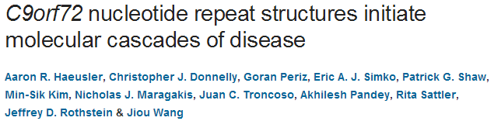
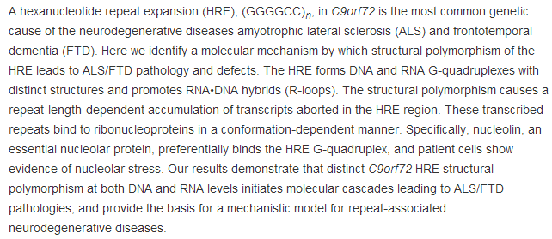

Slide 3

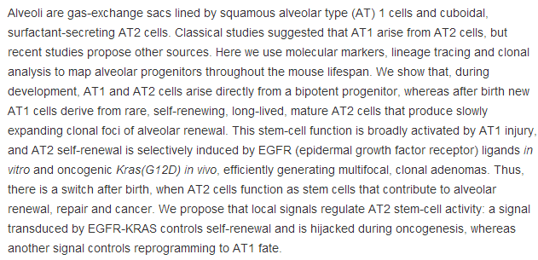

Slide 4
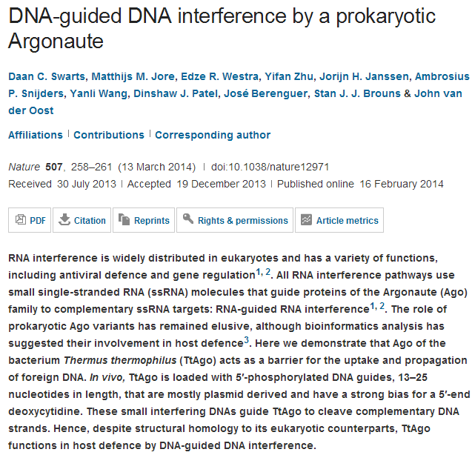

Slide 5
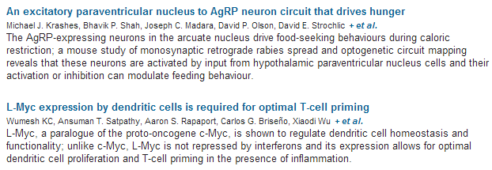

Slide 6
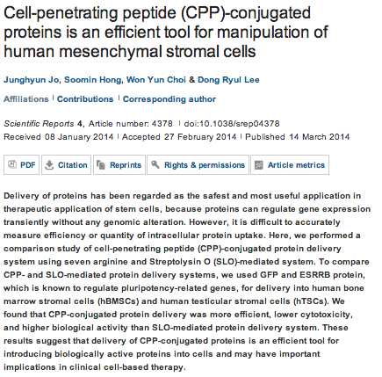

Sushil

Slide 7
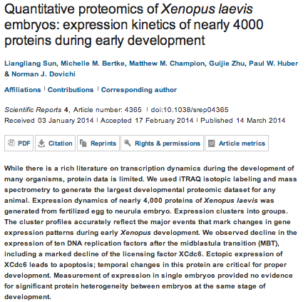
Sushil

Slide 8
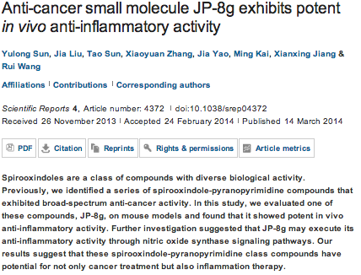
Sushil

Slide 9
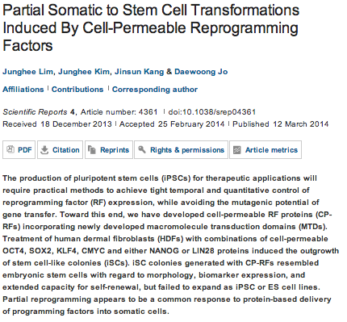
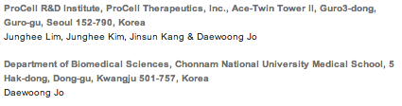
Sushil

Slide 10
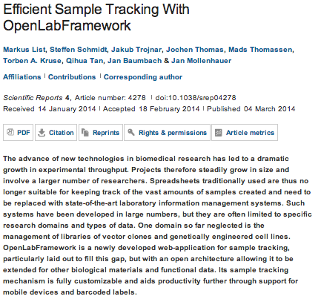
Sushil

Slide 11
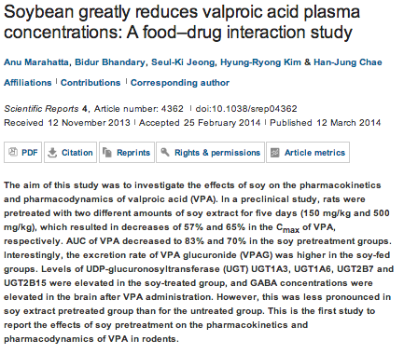
Sushil

Slide 12

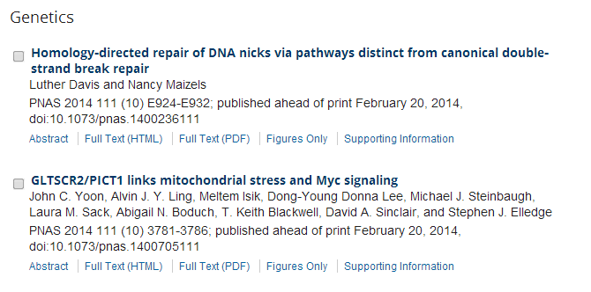
JMC

Slide 13
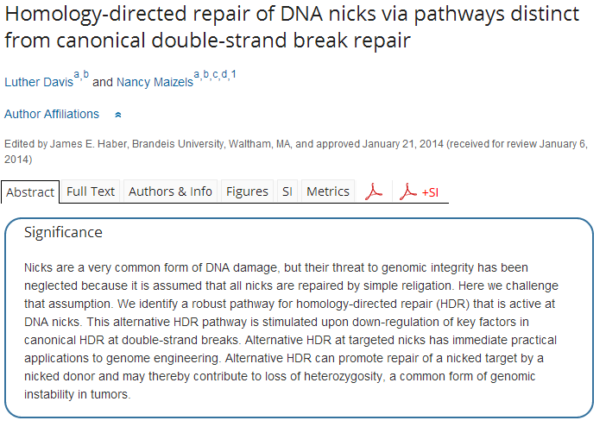
JMC

Slide 14
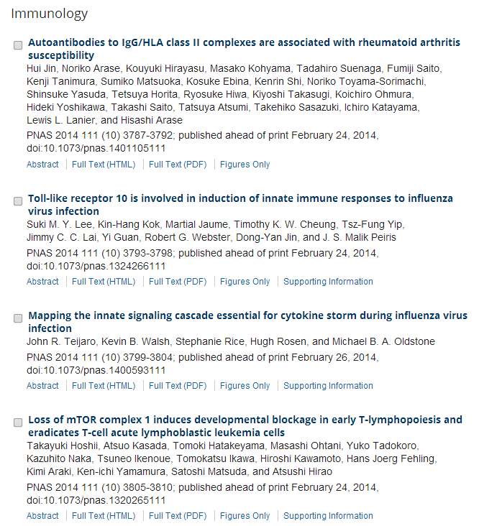
JMC

Slide 15
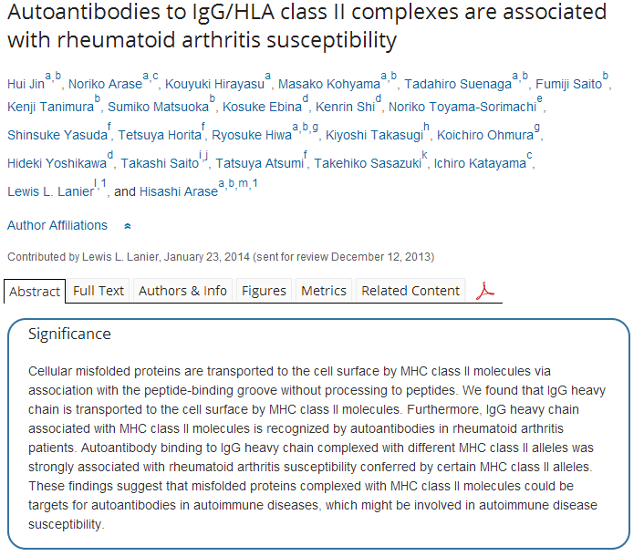
JMC

Slide 16

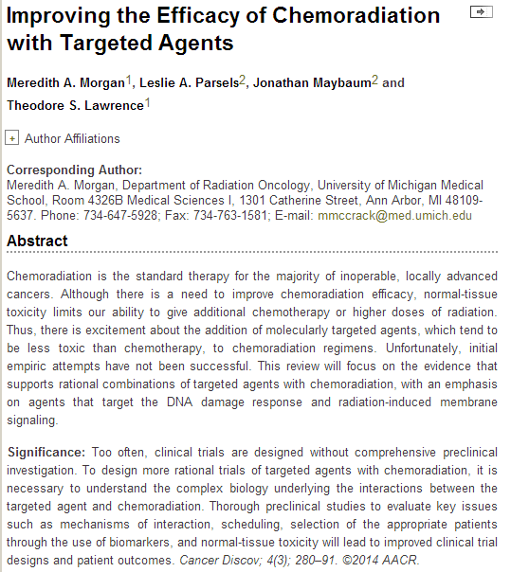
JMC

Slide 17

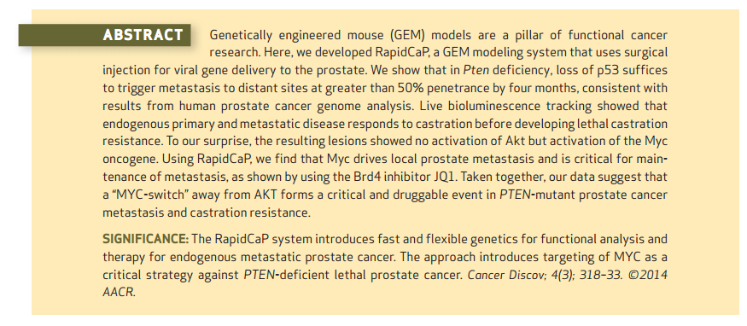
JMC

Slide 18
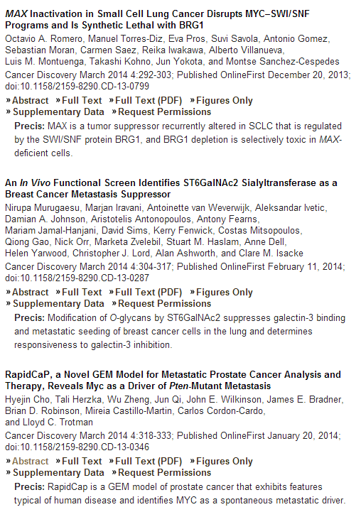
JMC

Slide 19
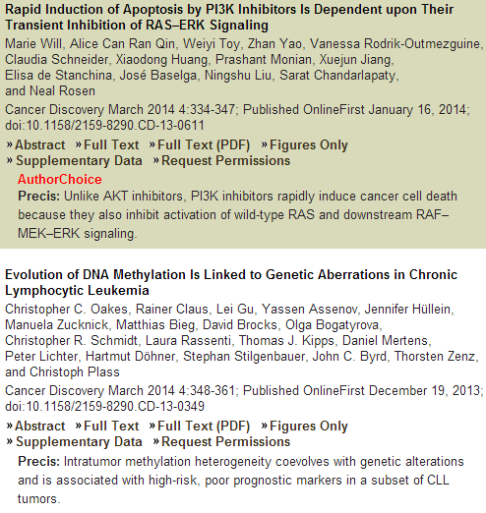
JMC

Slide 20
oncogene
Targeting RNA polymerase I to treat MYC-driven cancer.
Poortinga G¹, Quinn LM², Hannan RD³.
Author information
¹1] Division of Cancer Research, Peter MacCallum Cancer Centre, Melbourne, Victoria, Australia [2] Sir Peter MacCallum Department of Oncology, The University of Melbourne, Melbourne, Victoria, Australia [3] Department of Medicine, St Vincent's Hospital, University of Melbourne, Fitzroy, Victoria, Australia.
The MYC oncoprotein and transcription factor is dysregulated in a majority of human cancers and is considered a major driver of the malignant phenotype. As such, developing drugs for effective inhibition of MYC in a manner selective to malignancies is a 'holy grail' of transcription factor-based cancer therapy. Recent advances in elucidating MYC biology in both normal cells and pathological settings were anticipated to bring inhibition of tumorigenic MYC function closer to the clinic. However, while the extensive array of cellular pathways that MYC impacts present numerous fulcrum points on which to leverage MYC's therapeutic potential, identifying the critical target(s) for MYC-specific cancer therapy has been difficult to achieve. Somewhat unexpectedly, MYC's fundamental role in regulating the 'housekeeping' process of ribosome biogenesis, one of the most ubiquitously required and conserved cell functions, may provide the Achilles' heel for therapeutically targeting MYC-driven tumors.
Jae-Il

Slide 21
oncogene
Application of molecular technologies for phosphoproteomic analysis of clinical samples.
Pierobon M, Wulfkuhle J, Liotta L, Petricoin E.
Author information
Center for Applied Proteomics and Molecular Medicine, George Mason University, Manassas, VA, USA.
Abstract
The integration of small kinase inhibitors and monoclonal antibodies into oncological practice has opened a new paradigm for treating cancer patients. As proteins are the direct targets of the new generations of targeted therapeutics, many of which are kinase/enzymatic inhibitors, there is an increasing interest in developing technologies capable of monitoring post-translational changes of the human proteome for the identification of new predictive, prognostic and therapeutic biomarkers. It is well known that the vast majority of the activation/deactivation of these drug targets is driven by phosphorylation. This review provides a description of the main proteomic platforms (planar and bead array, reverse phase protein microarray, phosphoflow, AQUA and mass spectrometry) that have successfully been used for measuring changes in phosphorylation level of drug targets and downstream substrates using clinical specimens. Major emphasis was given to the strengths and weaknesses of the different platforms and to the major barriers that are associated with the analysis of the phosphoproteome. Finally, a number of examples of application of the above-mentioned technologies in the clinical setting are reported.
Jae-Il

Slide 22
Anti-apoptotic BCL-2 proteins govern cellular outcome following B-RAFV600E inhibition and can be targeted to reduce resistance.
Serasinghe MN¹, Missert DJ², Asciolla JJ¹, Podgrabinska S³, Wieder SY¹, Izadmehr S⁴, Belbin G⁵, Skobe M⁶, Chipuk JE⁷.
Author information
¹1] Department of Oncological Sciences, Icahn School of Medicine at Mount Sinai, New York, NY, USA [2] Department of Dermatology, New York, NY, USA [3] The Tisch Cancer Institute, New York, NY, USA
oncogene
DEK promotes HPV-positive and -negative head and neck cancer cell proliferation.
Adams AK¹, Hallenbeck GE¹, Casper KA², Patil YJ², Wilson KM², Kimple RJ³, Lambert PF³, Witte DP⁴, Xiao W⁵,Gillison ML⁵, Wikenheiser-Brokamp KA⁶, Wise-Draper TM⁷, Wells SI¹.
Author information
¹Cancer and Blood Diseases Institute, Cincinnati Children's Hospital Medical Center, Cincinnati, OH, USA.
MicroRNA-149 targets GIT1 to suppress integrin signaling and breast cancer metastasis.
Chan SH¹, Huang WC², Chang JW¹, Chang KJ³, Kuo WH³, Wang MY³, Lin KY⁴, Uen YH⁴, Hou MF⁵, Lin CM¹, Jang TH¹, Tu CW⁶, Lee YR⁷, Lee YH⁸, Tien MT⁹, Wang LH¹⁰.
Author information
¹Institute of Molecular and Genomic Medicine, National Health Research Institute, Miaoli, Taiwan
The FEN1 E359K germline mutation disrupts the FEN1-WRN interaction and FEN1 GEN activity, causing aneuploidy-associated cancers.
Chung L¹, Onyango D¹, Guo Z², Jia P³, Dai H¹, Liu S⁴, Zhou M¹, Lin W¹, Pang I¹, Li H⁵, Yuan YC⁵, Huang Q⁶, Zheng L¹, Lopes J⁷, Nicolas A⁸, Chai W³, Raz D⁹, Reckamp KL¹⁰, Shen B¹.
Author information
¹Department of Radiation Biology, Beckman Research Institute, City of Hope National Medical Center, Duarte, CA, USA.
Mdmx promotes genomic instability independent of p53 and Mdm2.
Carrillo AM¹, Bouska A², Arrate MP¹, Eischen CM¹.
Author information
¹Department of Pathology, Microbiology and Immunology, Vanderbilt University Medical Center, Nashville, TN, USA.
²Department of Pathology and Microbiology, University of Nebraska Medical Center, Omaha, NE, USA.
Surfactant protein D suppresses lung cancer progression by downregulation of epidermal growth factor signaling.
Hasegawa Y¹, Takahashi M², Ariki S², Asakawa D³, Tajiri M³, Wada Y³, Yamaguchi Y⁴, Nishitani C², Takamiya R²,Saito A¹, Uehara Y¹, Hashimoto J⁵, Kurimura Y⁵, Takahashi H⁶, Kuroki Y².
Author information
¹1] Department of Biochemistry, Sapporo Medical University School of Medicine, Sapporo, Japan [2] Department of Respiratory Medicine and Allergology, Sapporo Medical University School of Medicine, Sapporo, Japan.
miR-219-1-3p is a negative regulator of the mucin MUC4 expression and is a tumor suppressor in pancreatic cancer.
Lahdaoui F¹, Delpu Y², Vincent A¹, Renaud F¹, Messager M¹, Duchêne B¹, Leteurtre E¹, Mariette C¹, Torrisani J²,Jonckheere N¹, Van Seuningen I¹.
Author information
¹1] Inserm, UMR837, Jean Pierre Aubert Research Center (JPARC), Team 5 'Mucins, epithelial differentiation and carcinogenesis', rue Polonovski, Lille Cedex, France [2] Université Lille Nord de France, Lille, France [3] Centre Hospitalier Régional et Universitaire de Lille, Lille, France.
Jae-Il

Slide 23
miR-506 acts as a tumor suppressor by directly targeting the hedgehog pathway transcription factor Gli3 in human cervical cancer.
Wen SY¹, Lin Y², Yu YQ³, Cao SJ⁴, Zhang R⁵, Yang XM⁶, Li J⁶, Zhang YL⁶, Wang YH⁶, Ma MZ⁶, Sun WW⁴, Lou XL⁴,Wang JH⁷, Teng YC⁸, Zhang ZG⁶.
Author information
¹1] Department of Obstetrics & Gynecology, Shanghai Jiao Tong University Affiliated Sixth People's Hospital, Shanghai, PR China [2] Department of Obstetrics & Gynecology, International Peace Maternity & Child Health Hospital of the China Welfare Institute, Shanghai Jiao Tong University School of Medicine, Shanghai, PR China [3] State Key Laboratory of Oncogenes and Related Genes, Shanghai Cancer Institute, Renji Hospital, Shanghai Jiao Tong University School of Medicine, Shanghai, PR China.
oncogene
SAA1 polymorphisms are associated with variation in antiangiogenic and tumor-suppressive activities in nasopharyngeal carcinoma.
Lung HL¹, Man OY¹, Yeung MC¹, Ko JM¹, Cheung AK¹, Law EW¹, Yu Z¹, Shuen WH¹, Tung E², Chan SH¹,Bangarusamy DK³, Cheng Y¹, Yang X¹, Kan R¹, Phoon Y¹, Chan KC¹, Chua D⁴, Kwong DL², Lee AW⁵, Ji MF⁶, Lung ML².
Author information
¹Department of Clinical Oncology and Center for Cancer Research, University of Hong Kong, Pokfulam, Hong Kong (SAR), People's Republic of China.
Jae-Il

Slide 24
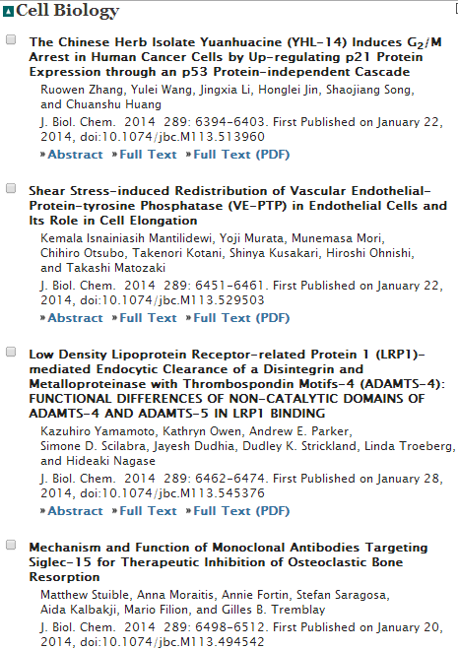
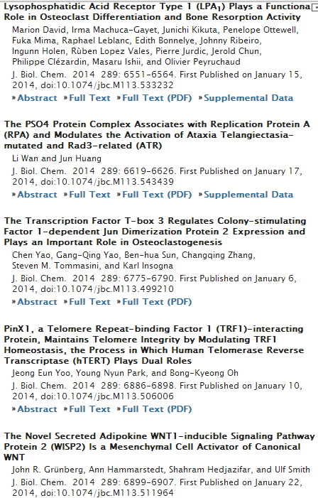
JBC
JH

Slide 25
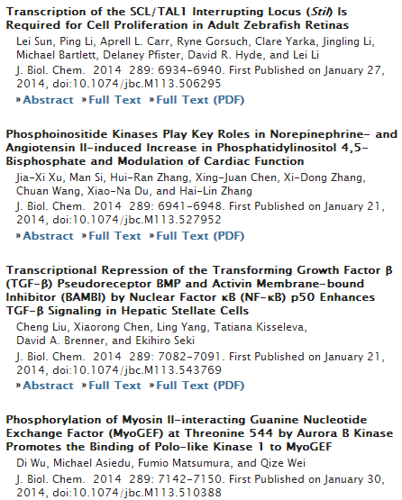
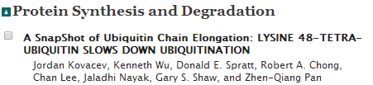
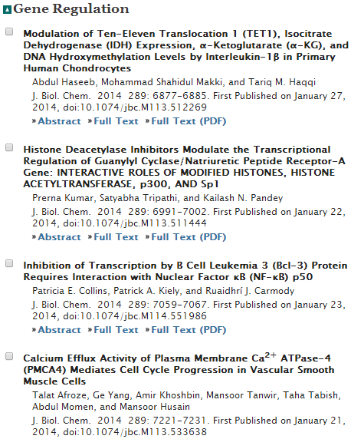
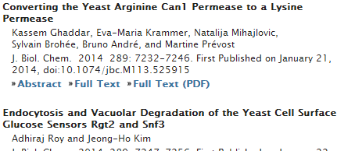
JBC
JH

Slide 26
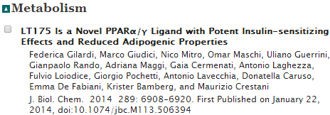
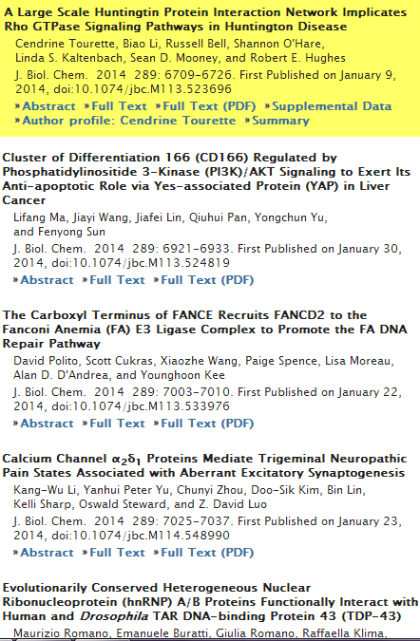
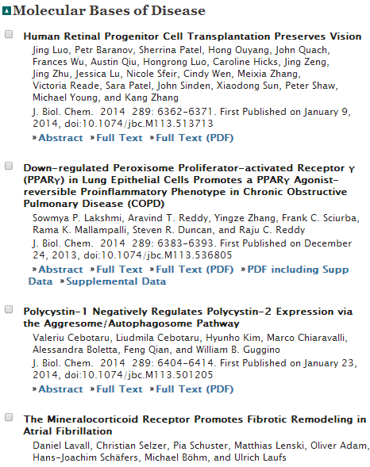
JBC
JH

Slide 27
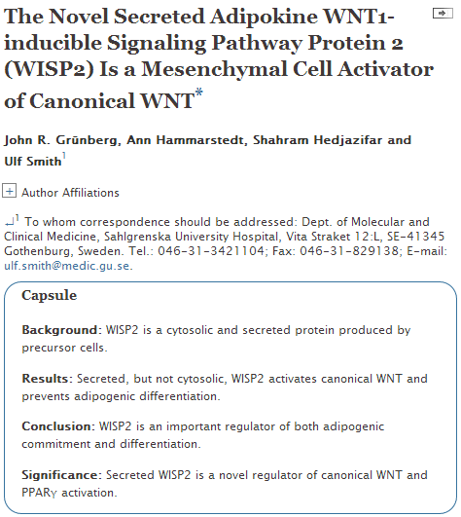
JBC
JH
Notes:
WNT1-inducible-signaling pathway protein 2 (WISP2) is primarily expressed in mesenchymal stem cells, fibroblasts, and adipogenic precursor cells. It is both a secreted and cytosolic protein, the latter regulating precursor cell adipogenic commitment and PPARγ induction by BMP4. To examine the effect of the secreted protein, we expressed a full-length and a truncated, non-secreted WISP2 in NIH3T3 fibroblasts. Secreted, but not truncated WISP2 activated the canonical WNT pathway with increased β-catenin levels, its nuclear targeting phosphorylation, and LRP5/6 phosphorylation. It also inhibited Pparg activation and the effect of secreted WISP2 was reversed by the WNT antagonist DICKKOPF-1. Differentiated 3T3-L1 adipose cells were also target cells where extracellular WISP2 activated the canonical WNT pathway, inhibited Pparg and associated adipose genes and, similar to WNT3a, promoted partial dedifferentiation of the cells and the induction of a myofibroblast phenotype with activation of markers of fibrosis. Thus, WISP2 exerts dual actions in mesenchymal precursor cells; secreted WISP2 activates canonical WNT and maintains the cells in an undifferentiated state, whereas cytosolic WISP2 regulates adipogenic commitment.

Slide 28
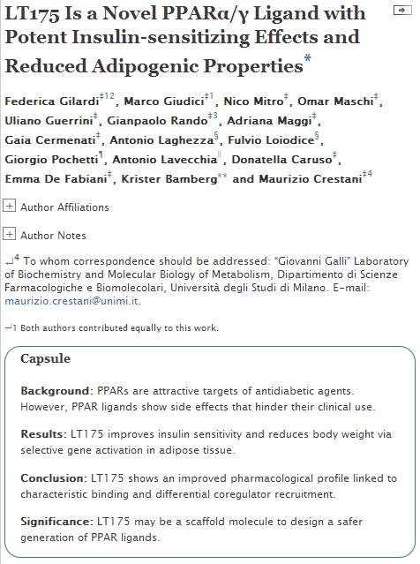
JBC
JH
Notes:
Peroxisome proliferator-activated receptors (PPARs) are ligand-dependent transcription factors regulating lipid and glucose metabolism. Ongoing drug discovery programs aim to develop dual PPARα/γ agonists devoid of the side effects of the marketed antidiabetic agents thiazolidinediones and the dual agonists glitazars. Recently, we described a new dual PPARα/γ ligand, LT175, with a partial agonist profile against PPARγ and interacting with a newly identified region of the PPARγ-ligand binding domain (1). Here we show that LT175 differentially activated PPARγ target genes involved in fatty acid esterification and storage in 3T3-L1-derived adipocytes. This resulted in a less severe lipid accumulation compared with that triggered by rosiglitazone, suggesting that LT175 may have a lower adipogenic activity. Consistent with this hypothesis, in vivo administration of LT175 to mice fed a high-fat diet decreased body weight, adipocyte size, and white adipose tissue mass, as assessed by magnetic resonance imaging. Furthermore, LT175 significantly reduced plasma glucose, insulin, non-esterified fatty acids, triglycerides, and cholesterol and increased circulating adiponectin and fibroblast growth factor 21 levels. Oral glucose and insulin tolerance tests showed that the compound improves glucose homeostasis and insulin sensitivity. Moreover, we demonstrate that the peculiar interaction of LT175 with PPARγ affected the recruitment of the coregulators cyclic-AMP response element-binding protein-binding protein and nuclear corepressor 1 (NCoR1), fundamentals for the PPARγ-mediated adipogenic program. In conclusion, our results describe a new PPAR ligand, modulating lipid and glucose metabolism with reduced adipogenic activity, that may be used as a model for a series of novel molecules with an improved pharmacological profile for the treatment of dyslipidemia and type 2 diabetes.

Slide 29
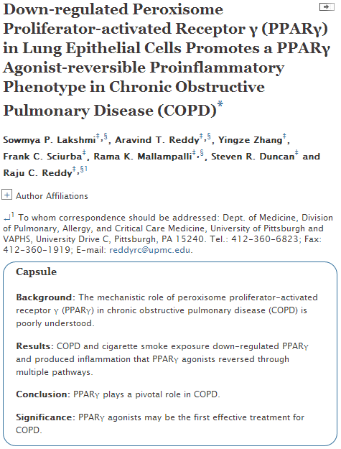
JBC
JH
Notes:
Chronic obstructive pulmonary disease (COPD) is a progressive inflammatory condition and a leading cause of death, with no available cure. We assessed the actions in pulmonary epithelial cells of peroxisome proliferator-activated receptor γ (PPARγ), a nuclear hormone receptor with anti-inflammatory effects, whose role in COPD is largely unknown. We found that PPARγ was down-regulated in lung tissue and epithelial cells of COPD patients, via both reduced expression and phosphorylation-mediated inhibition, whereas pro-inflammatory nuclear factor-κB (NF-κB) activity was increased. Cigarette smoking is the main risk factor for COPD, and exposing airway epithelial cells to cigarette smoke extract (CSE) likewise down-regulated PPARγ and activated NF-κB. CSE also down-regulated and post-translationally inhibited the glucocorticoid receptor (GR-α) and histone deacetylase 2 (HDAC2), a corepressor important for glucocorticoid action and whose down-regulation is thought to cause glucocorticoid insensitivity in COPD. Treating epithelial cells with synthetic (rosiglitazone) or endogenous (10-nitro-oleic acid) PPARγ agonists strongly up-regulated PPARγ expression and activity, suppressed CSE-induced production and secretion of inflammatory cytokines, and reversed its activation of NF-κB by inhibiting the IκB kinase pathway and by promoting direct inhibitory binding of PPARγ to NF-κB. In contrast, PPARγ knockdown via siRNA augmented CSE-induced chemokine release and decreases in HDAC activity, suggesting a potential anti-inflammatory role of endogenous PPARγ. The results imply that down-regulation of pulmonary epithelial PPARγ by cigarette smoke promotes inflammatory pathways and diminishes glucocorticoid responsiveness, thereby contributing to COPD pathogenesis, and further suggest that PPARγ agonists may be useful for COPD treatment.

Slide 30

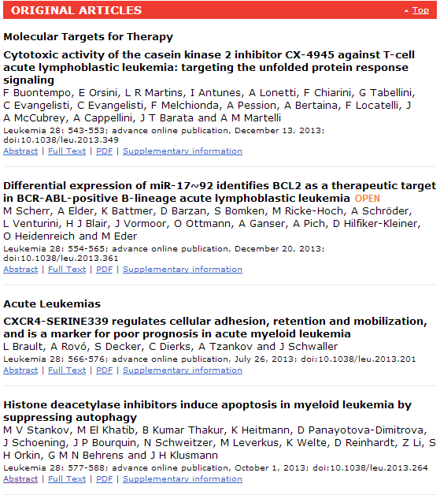
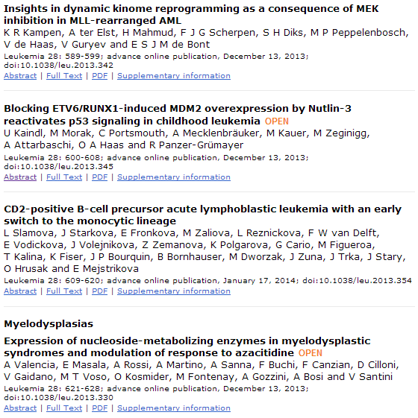
Yu-Ra

Slide 31
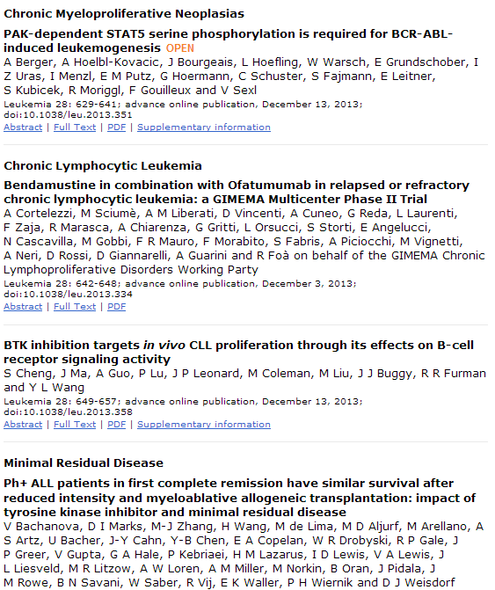
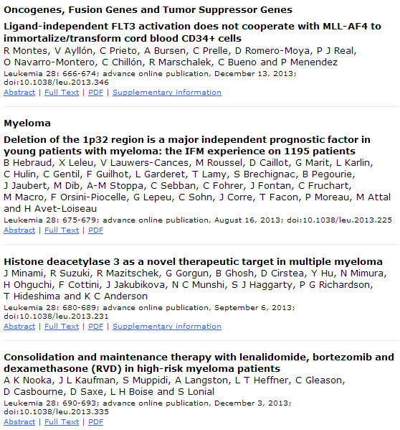
Yu-Ra

Slide 32

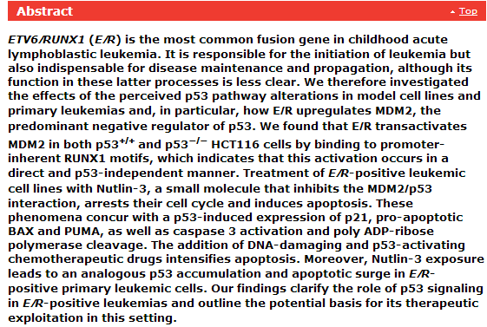
Yu-Ra

Slide 33
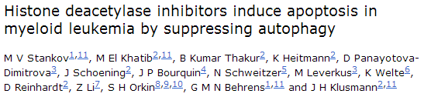
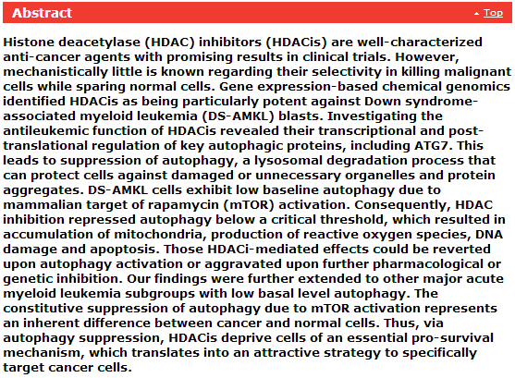
Yu-Ra

Slide 34

Original Papers
Acid sphingomyelinase determines melanoma progression and metastatic behaviour via the microphtalmia-associated transcription factor signalling pathway
L Bizzozero, D Cazzato, D Cervia, E Assi, F Simbari, F Pagni, C De Palma, A Monno, C Verdelli, P R Querini, V Russo, E Clementi and C Perrotta
Cell Death Differ 21: 507-520; advance online publication, December 6, 2013; doi:10.1038/cdd.2013.173
Mapping the p53 transcriptome universe using p53 natural polymorphs FREE
B Wang, D Niu, T H Lam, Z Xiao and E C Ren
Cell Death Differ 21: 521-532; advance online publication, September 27, 2013; doi:10.1038/cdd.2013.132
Phospholipase D-mediated autophagic regulation is a potential target for cancer therapy
Y H Jang, K Y Choi and D S Min
Cell Death Differ 21: 533-546; advance online publication, December 6, 2013; doi:10.1038/cdd.2013.174
Autophagy is required for zebrafish caudal fin regeneration
M Varga, M Sass, D Papp, K Takács-Vellai, J Kobolak, A Dinnyés, D J Klionsky and T Vellai
Cell Death Differ 21: 547-556; advance online publication, December 6, 2013; doi:10.1038/cdd.2013.175
Delayed innocent bystander cell death following hypoxia in Caenorhabditis elegans
C-L Sun, E Kim and C M Crowder
Cell Death Differ 21: 557-567; advance online publication, December 6, 2013; doi:10.1038/cdd.2013.176
Calcium deficiency-induced and TRP channel-regulated IGF1R-PI3K-Akt signaling regulates abnormal epithelial cell proliferation
W Dai, Y Bai, L Hebda, X Zhong, J Liu, J Kao and C Duan
Cell Death Differ 21: 568-581; advance online publication, December 13, 2013; doi:10.1038/cdd.2013.177
JJY

Slide 35
Microglia convert aggregated amyloid-β into neurotoxic forms through the shedding of microvesicles
P Joshi, E Turola, A Ruiz, A Bergami, D D Libera, L Benussi, P Giussani, G Magnani, G Comi, G Legname, R Ghidoni, R Furlan, M Matteoli and C Verderio
Cell Death Differ 21: 582-593; advance online publication, December 13, 2013; doi:10.1038/cdd.2013.180
Suppression of PPARγ through MKRN1-mediated ubiquitination and degradation prevents adipocyte differentiation
J-H Kim, K W Park, E-W Lee, W-S Jang, J Seo, S Shin, K-A Hwang and J Song
Cell Death Differ 21: 594-603; advance online publication, December 13, 2013; doi:10.1038/cdd.2013.181
The deubiquitinating enzyme DUBAI stabilizes DIAP1 to suppress Drosophila apoptosis FREE
C-S Yang, S A Sinenko, M J Thomenius, A C Robeson, C D Freel, S R Horn and S Kornbluth
Cell Death Differ 21: 604-611; advance online publication, December 20, 2013; doi:10.1038/cdd.2013.184
ROS-dependent activation of JNK converts p53 into an efficient inhibitor of oncogenes leading to robust apoptosis Open
Y Shi, F Nikulenkov, J Zawacka-Pankau, H Li, R Gabdoulline, J Xu, S Eriksson, E Hedström, N Issaeva, A Kel, E S J Arnér and G Selivanova
Cell Death Differ 21: 612-623; advance online publication, January 10, 2014; doi:10.1038/cdd.2013.186
Lats2 is critical for the pluripotency and proper differentiation of stem cells FREE
Y Aylon, A Sarver, A Tovy, E Ainbinder and M Oren
Cell Death Differ 21: 624-633; advance online publication, January 10, 2014; doi:10.1038/cdd.2013.188
A novel role for the apoptosis inhibitor ARC in suppressing TNFα-induced regulated necrosis
G Kung, P Dai, L Deng and R N Kitsis
Cell Death Differ 21: 634-644; advance online publication, January 17, 2014; doi:10.1038/cdd.2013.195
p63 is a prosurvival factor in the adult mammary gland during post-lactational involution, affecting PI-MECs and ErbB2 tumorigenesis
A R Yallowitz, E M Alexandrova, F Talos, S Xu, N D Marchenko and U M Moll
Cell Death Differ 21: 645-654; advance online publication, January 17, 2014; doi:10.1038/cdd.2013.199
Fra-2/AP-1 controls adipocyte differentiation and survival by regulating PPARγ and hypoxia
J Luther, K Ubieta, N Hannemann, M Jimenez, M Garcia, C Zech, G Schett, E F Wagner and A Bozec
Cell Death Differ 21: 655-664; advance online publication, January 24, 2014; doi:10.1038/cdd.2013.198
JJY

Slide 36
Cell Death and Differentiation (2014) 21, 533–546; doi:10.1038/cdd.2013.174; published online 6 December 2013
Phospholipase D-mediated autophagic regulation is a potential target for cancer therapy
Y H Jang^{1,3}, K Y Choi² and D S Min^{1,2}
Autophagy is a catabolic process in which cell components are degraded to maintain cellular homeostasis by nutrient limitations. Defects of autophagy are involved in numerous diseases, including cancer. Here, we demonstrate a new role of phospholipase D (PLD) as a regulator of autophagy. PLD inhibition enhances autophagic flux via ATG1 (ULK1), ATG5 and ATG7, which are essential autophagy gene products critical for autophagosome formation. Moreover, PLD suppresses autophagy by differentially modulating phosphorylation of ULK1 mediated by mTOR and adenosine monophosphate-activated protein kinase (AMPK), and by suppressing the interaction of Beclin 1 with vacuolar-sorting protein 34 (Vps34), indicating that PLD coordinates major players of the autophagic pathway, AMPK-mTOR-ULK1 and Vps34/Beclin 1. Ultimately, PLD inhibition significantly sensitized in vitro and in vivo cancer regression via genetic and pharmacological inhibition of autophagy, providing rationale for a new therapeutic approach to enhancing the anticancer efficacy of PLD inhibition. Collectively, we show a novel role for PLD in the molecular machinery regulating autophagy.
JJY

Slide 37
Cell Death and Differentiation (2014) 21, 594–603; doi:10.1038/cdd.2013.181; published online 13 December 2013
Suppression of PPARγ through MKRN1-mediated ubiquitination and degradation prevents adipocyte differentiation
J-H Kim^{1,4}, K W Park^{2,4}, E-W Lee¹, W-S Jang², J Seo¹, S Shin¹, K-A Hwang³ and J Song
The central regulator of adipogenesis, PPARγ, is a nuclear receptor that is linked to obesity and metabolic diseases. Here we report that MKRN1 is an E3 ligase of PPARγ that induces its ubiquitination, followed by proteasome-dependent degradation. Furthermore, we identified two lysine sites at 184 and 185 that appear to be targeted for ubiquitination by MKRN1. Stable overexpression of MKRN1 reduced PPARγ protein levels and suppressed adipocyte differentiation in 3T3-L1 and C3H10T1/2 cells. In contrast, MKRN1 depletion stimulated adipocyte differentiation in these cells. Finally, MKRN1 knockout MEFs showed an increased capacity for adipocyte differentiation compared with wild-type MEFs, with a concomitant increase of PPARγ and adipogenic markers. Together, these data indicate that MKRN1 is an elusive PPARγ E3 ligase that targets PPARγ for proteasomal degradation by ubiquitin-dependent pathways, and further depict MKRN1 as a novel target for diseases involving PPARγ.
JJY

