Slide 1
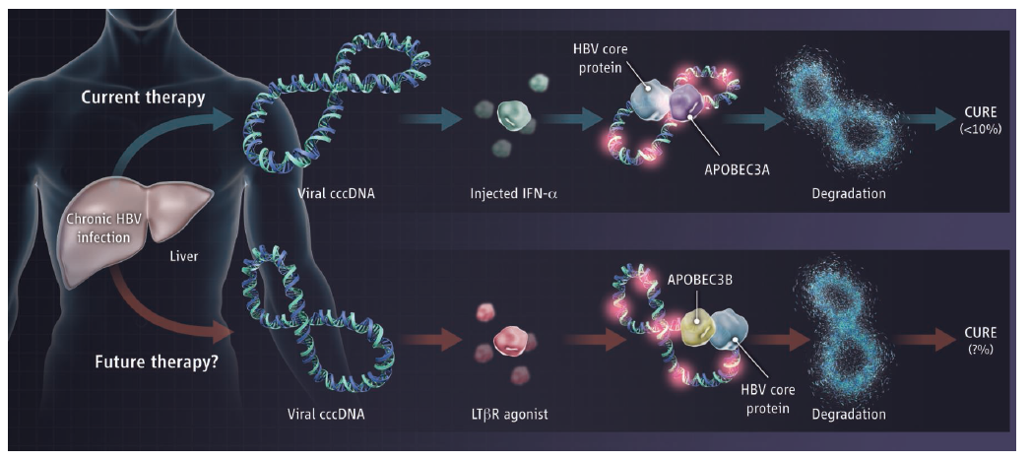
[Science] 14 MARCH 2014 VOL 343, ISSUE 6176, PAGES 1169-1280
Science. 2014 Mar 14;343(6176):1221-8. doi: 10.1126/science.1243462. Epub 2014 Feb 20.
Specific and nonhepatotoxic degradation of nuclear hepatitis B virus cccDNA.
Lucifora J¹, Xia Y, Reisinger F, Zhang K, Stadler D, Cheng X, Sprinzl MF, Koppensteiner H, Makowska Z, Volz T, Remouchamps C, Chou WM, Thasler WE,Hüser N, Durantel D, Liang TJ, Münk C, Heim MH, Browning JL, Dejardin E, Dandri M, Schindler M, Heikenwalder M, Protzer U.
¹Institute of Virology, Technische Universität München-Helmholtz Zentrum München, 81675 Munich, Germany.
Current antiviral agents can control but not eliminate hepatitis B virus (HBV), because HBV establishes a stable nuclear covalently closed circular DNA (cccDNA). Interferon-α treatment can clear HBV but is limited by systemic side effects. We describe how interferon-α can induce specificdegradation of the nuclear viral DNA without hepatotoxicity and propose lymphotoxin-β receptor activation as a therapeutic alternative. Interferon-α and lymphotoxin-β receptor activation up-regulated APOBEC3A and APOBEC3B cytidine deaminases, respectively, in HBV-infected cells, primary hepatocytes, and human liver needle biopsies. HBV core protein mediated the interaction with nuclear cccDNA, resulting in cytidine deamination, apurinic/apyrimidinic site formation, and finally cccDNA degradation that prevented HBV reactivation. Genomic DNA was not affected. Thus, inducing nuclear deaminases-for example, by lymphotoxin-β receptor activation-allows the development of new therapeutics that, in combination with existing antivirals, may cure hepatitis B.
Perspectives – VIROLOGY
Getting Rid of a Persistent Troublemaker to Cure Hepatitis
Amir Shlomai and Charles M. Rice
Eliminating the master genomic template of hepatitis B virus in infected liver cells through cytokine therapy may be a route to help cure chronic infection.

Slide 2
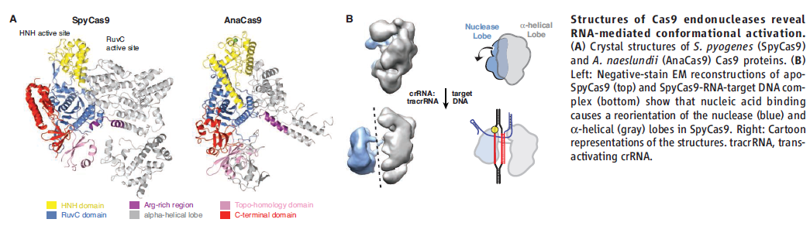
[Science] 14 MARCH 2014 VOL 343, ISSUE 6176, PAGES 1169-1280
Science. 2014 Mar 14;343(6176):1247997. doi: 10.1126/science.1247997. Epub 2014 Feb 6.
Structures of Cas9 endonucleases reveal RNA-mediated conformational activation.
Jinek M¹, Jiang F, Taylor DW, Sternberg SH, Kaya E, Ma E, Anders C, Hauer M, Zhou K, Lin S, Kaplan M, Iavarone AT, Charpentier E, Nogales E, Doudna JA.
¹Department of Biochemistry, University of Zurich, CH-8057 Zurich, Switzerland.
Type II CRISPR (clustered regularly interspaced short palindromic repeats)-Cas (CRISPR-associated) systems use an RNA-guided DNA endonuclease, Cas9, to generate double-strand breaks in invasive DNA during an adaptive bacterial immune response. Cas9 has been harnessed as a powerful tool for genome editing and gene regulation in many eukaryotic organisms. We report 2.6 and 2.2 angstrom resolution crystal structures of two major Cas9 enzyme subtypes, revealing the structural core shared by all Cas9 family members. The architectures ofCas9 enzymes define nucleic acid binding clefts, and single-particle electron microscopy reconstructions show that the two structural lobes harboring these clefts undergo guide RNA-induced reorientation to form a central channel where DNA substrates are bound. The observation that extensive structural rearrangements occur before target DNA duplex binding implicates guide RNA loading as a key step in Cas9 activation.

Slide 3
[Science] 14 MARCH 2014 VOL 343, ISSUE 6176, PAGES 1169-1280
Structure of Human RNase L Reveals the Basis for Regulated RNA Decay in the IFN Response
Yuchen Han, Jesse Donovan, Sneha Rath, Gena Whitney, Alisha Chitrakar, and Alexei Korennykh
The crystal structure of an interferon-induced ribonuclease shows how it selects and shreds its RNA targets.
Selective Methylation of Histone H3 Variant H3.1 Regulates Heterochromatin Replication
Yannick Jacob, Elisa Bergamin, Mark T. A. Donoghue, Vanessa Mongeon, Chantal LeBlanc, Philipp Voigt, Charles J. Underwood,Joseph S. Brunzelle, Scott D. Michaels, Danny Reinberg, Jean-François Couture, and Robert A. Martienssen
The specificity of a histone methyltransferase for a histone variant maintains heterochromatin through cell division.
Vertebrate Limb Bud Formation Is Initiated by Localized Epithelial-to-Mesenchymal Transition
Jerome Gros and Clifford J. Tabin
Cell state change, rather than differential proliferation, initiates limb formation during development.
The stum Gene Is Essential for Mechanical Sensing in Proprioceptive Neurons
Bela S. Desai, Abhishek Chadha, and Boaz Cook
The stumble gene in flies is required in neurons that sense joint angles.
Complement Is Activated by IgG Hexamers Assembled at the Cell Surface
Christoph A. Diebolder, Frank J. Beurskens, Rob N. de Jong, Roman I. Koning, Kristin Strumane, Margaret A. Lindorfer,Marleen Voorhorst, Deniz Ugurlar,
Sara Rosati, Albert J. R. Heck, Jan G. J. van de Winkel, Ian A. Wilson, Abraham J. Koster,Ronald P. Taylor, Erica Ollmann Saphire, Dennis R. Burton,
Janine Schuurman, Piet Gros, and Paul W. H. I. Parren
Hexameric platforms of antibodies on the cell surface trigger the complement cascade.
Dlk1 Promotes a Fast Motor Neuron Biophysical Signature Required for Peak Force Execution
Daniel Müller, Pitchaiah Cherukuri, Kristine Henningfeld, Chor Hoon Poh, Lars Wittler, Phillip Grote, Oliver Schlüter, Jennifer Schmidt,Jorge Laborda,
Steven R. Bauer, Robert M. Brownstone, and Till Marquardt
The fast versus slow profile of motor neurons is controlled by expression of a membrane protein.

Slide 4
[Science] 7 MARCH 2014 VOL 343, ISSUE 6175, PAGES 1049-1168
<Special Issue>Crystallography at 100
INTRODUCTION
Going from Strength to Strength
Robert Coontz, Julia Fahrenkamp-Uppenbrink, Marc Lavine, Valda Vinson
In 1912, the German physicist Max von Laue published the first paper demonstrating x-ray diffraction from a crystal. This discovery, for which he was awarded the Nobel Prize in 1914, provided a window into the regular atomic arrangements within crystals. Today, the Cambridge Structural Database contains more than 600,000 structures of organic and organometallic molecules, many obtained through x-ray crystallography; the Protein Data Bank contains about 100,000 structures. The insights gained from these and other structural studies have revolutionized understanding of chemical and biological systems, leading to the award of 29 Nobel Prizes for scientific achievements related to, or involving the use of, crystallography.
News
Dazzling History
Thomas Sumner
Science 7 March 2014: 1092-1093.
Over the past century, x-ray crystallography has transformed scientists' understanding of the structure and behavior of materials.
Gently Does It
Robert F. Service
Science 7 March 2014: 1094-1097.
A technique for crystallizing fragile biomolecules without disrupting them is helping researchers probe the structures of some of the body's most important but elusive proteins: those that usher other chemicals through the cell membrane.
Reviews
Cutting-Edge Techniques Used for the Structural Investigation of Single Crystals
Judith A. K. Howard and Michael R. Probert
Science 7 March 2014: 1098-1102.
Developments in X-ray Crystallographic Structure Determination of Biological Macromolecules
Elspeth F. Garman
Science 7 March 2014: 1102-1108.
Femtosecond Crystallography with Ultrabright Electrons and X-rays: Capturing Chemistry in Action
R. J. Dwayne Miller
Science 7 March 2014: 1108-1116.

Slide 5
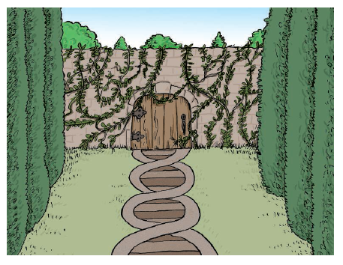
[Science] 7 MARCH 2014 VOL 343, ISSUE 6175, PAGES 1049-1168
Science. 2014 Mar 7;343(6175):1145-8. doi: 10.1126/science.1248127. Epub 2014 Feb 6.
Mapping the epigenetic basis of complex traits.
Cortijo S¹, Wardenaar R, Colomé-Tatché M, Gilly A, Etcheverry M, Labadie K, Caillieux E, Hospital F, Aury JM, Wincker P, Roudier F, Jansen RC, Colot V,Johannes F.
¹Institut de Biologie de l'Ecole Normale Supérieure, Centre National de la Recherche Scientifique (CNRS), UMR 8197, Institut National de la Santé et de la Recherche Médicale (INSERM) U 1024, Paris F-75005, France.
Quantifying the impact of heritable epigenetic variation on complex traits is an emerging challenge in population genetics. Here, we analyze a population of isogenic Arabidopsis lines that segregate experimentally induced DNA methylation changes at hundreds of regions across the genome. We demonstrate that several of these differentially methylated regions (DMRs) act as bona fide epigenetic quantitative trait loci (QTL(epi)), accounting for 60 to 90% of the heritability for two complex traits, flowering time and primary root length. These QTL(epi) are reproducible and can be subjected to artificial selection. Many of the experimentally induced DMRs are also variable in natural populations of this species and may thus provide an epigenetic basis for Darwinian evolution independently of DNA sequence changes.
Perspectives – GENETICS
The Secret Garden
—Epigenetic Alleles Underlie Complex Traits
In the plant Arabidopsis thaliana, epigenetic variation, like genetic change, is potentially a substrate for Darwinian evolution.

Slide 6
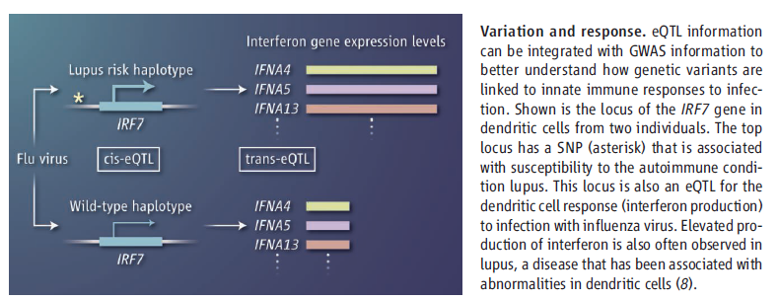
[Science] 7 MARCH 2014 VOL 343, ISSUE 6175, PAGES 1049-1168
Perspectives – GENETICS
A Genomic Road Map for Complex Human Disease
Peter K. Gregersen
Consideration of cell type- and disease-associated environmental conditions is critical to connecting specific genetic variants to immune disorders.

Slide 7
[Science] 7 MARCH 2014 VOL 343, ISSUE 6175, PAGES 1049-1168
Science. 2014 Mar 7;343(6175):1246980. doi: 10.1126/science.1246980.
Common genetic variants modulate pathogen-sensing responses in human dendritic cells.
Lee MN¹, Ye C, Villani AC, Raj T, Li W, Eisenhaure TM, Imboywa SH, Chipendo PI, Ran FA, Slowikowski K, Ward LD, Raddassi K, McCabe C, Lee MH,Frohlich IY, Hafler DA, Kellis M, Raychaudhuri S, Zhang F, Stranger BE, Benoist CO, De Jager PL, Regev A, Hacohen N.
Little is known about how human genetic variation affects the responses to environmental stimuli in the context of complex diseases. Experimental and computational approaches were applied to determine the effects of genetic variation on the induction of pathogen-responsive genes inhuman dendritic cells. We identified 121 common genetic variants associated in cis with variation in expression responses to Escherichia coli lipopolysaccharide, influenza, or interferon-β (IFN-β). We localized and validated causal variants to binding sites of pathogen-activated STAT (signal transducer and activator of transcription) and IRF (IFN-regulatory factor) transcription factors. We also identified a common variant in IRF7 that is associated in trans with type I IFN induction in response to influenza infection. Our results reveal common alleles that explain interindividual variation in pathogen sensing and provide functional annotation for genetic variants that alter susceptibility to inflammatory diseases
Science. 2014 Mar 7;343(6175):1246949. doi: 10.1126/science.1246949.
Innate immune activity conditions the effect of regulatory variants upon monocyte gene expression.
Fairfax BP¹, Humburg P, Makino S, Naranbhai V, Wong D, Lau E, Jostins L, Plant K, Andrews R, McGee C, Knight JC.
¹Wellcome Trust Centre for Human Genetics, University of Oxford, Roosevelt Drive, Oxford OX3 7BN, UK.
To systematically investigate the impact of immune stimulation upon regulatory variant activity, we exposed primary monocytes from 432 healthy Europeans to interferon-γ (IFN-γ) or differing durations of lipopolysaccharide and mapped expression quantitative trait loci (eQTLs). More than half of cis-eQTLs identified, involving hundreds of genes and associated pathways, are detected specifically in stimulated monocytes. Inducedinnate immune activity reveals multiple master regulatory trans-eQTLs including the major histocompatibility complex (MHC), coding variantsaltering enzyme and receptor function, an IFN-β cytokine network showing temporal specificity, and an interferon regulatory factor 2 (IRF2) transcription factor-modulated network. Induced eQTL are significantly enriched for genome-wide association study loci, identifying context-specific associations to putative causal genes including CARD9, ATM, and IRF8. Thus, applying pathophysiologically relevant immune stimuli assists resolution of functional genetic variants.

Slide 8
[Science] 7 MARCH 2014 VOL 343, ISSUE 6175, PAGES 1049-1168
Structural Basis for Heavy Metal Detoxification by an Atm1-Type ABC Exporter
Jonas Y. Lee, Janet G. Yang, Daniel Zhitnitsky, Oded Lewinson, and Douglas C. Rees
Structural and functional studies of ABC exporters provide insight into how glutathione derivatives are translocated.
Crystal Structures of Nucleotide-Free and Glutathione-Bound Mitochondrial ABC Transporter Atm1
Vasundara Srinivasan, Antonio J. Pierik, and Roland Lill
Structural and functional studies of ABC exporters provide insight into how glutathione derivatives are translocated.
Mechanism of the C5 Stereoinversion Reaction in the Biosynthesis of Carbapenem Antibiotics
Wei-chen Chang, Yisong Guo, Chen Wang, Susan E. Butch, Amy C. Rosenzweig, Amie K. Boal, Carsten Krebs, and J. Martin Bollinger Jr.
Crystallography and spectroscopy detail a key mechanistic step in the microbial biosynthesis of an important antibiotic class.
A Single Gene Affects Both Ecological Divergence and Mate Choice in Drosophila
Henry Chung, David W. Loehlin, Héloïse D. Dufour, Kathy Vaccarro, Jocelyn G. Millar, and Sean B. Carroll
A methyl-branched cuticular hydrocarbon affects both desiccation resistance and mate choice in related Drosophila species.
Long-Acting Integrase Inhibitor Protects Macaques from Intrarectal Simian/Human Immunodeficiency Virus
Chasity D. Andrews, William R. Spreen, Hiroshi Mohri, Lee Moss, Susan Ford, Agegnehu Gettie, Kasi Russell-Lodrigue,
Rudolf P. Bohm, Cecilia Cheng-Mayer, Zhi Hong, Martin Markowitz, and David D. Ho
Prolonged protection from repeated SHIV challenges is demonstrated in macaques.
Altitudinal Changes in Malaria Incidence in Highlands of Ethiopia and Colombia
A. S. Siraj, M. Santos-Vega, M. J. Bouma, D. Yadeta, D. Ruiz Carrascal, and M. Pascual
Warmer years promote malaria cases at higher altitudes.

Slide 9

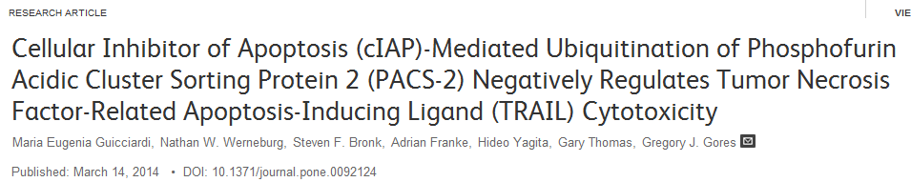
Abstract
Lysosomal membrane permeabilization is an essential step in TRAIL-induced apoptosis of liver cancer cell lines. TRAIL-induced lysosomal membrane permeabilization is mediated by the multifunctional sorting protein PACS-2 and repressed by the E3 ligases cIAP-1 and cIAP-2. Despite the opposing roles for PACS-2 and cIAPs in TRAIL-induced apoptosis, an interaction between these proteins has yet to be examined. Herein, we report that cIAP-1 and cIAP-2 confer TRAIL resistance to hepatobiliary cancer cell lines by reducing PACS-2 levels. Under basal conditions, PACS-2 underwent K48-linked poly-ubiquitination, resulting in PACS-2 proteasomal degradation. Biochemical assays showed cIAP-1 and cIAP-2 interacted with PACS-2 in vitro and co-immunoprecipitation studies demonstrated that the two cIAPs bound PACS-2 in vivo. More importantly, both cIAP-1 and cIAP-2 directly mediated PACS-2 ubiquitination in a cell-free assay. Single c-Iap-1 or c-Iap-2 gene knock-outs in mouse hepatocytes did not lead to PACS-2 accumulation. However, deletion of both cIAP-1 and cIAP-2 reduced PACS-2 ubiquitination, which increased PACS-2 levels and sensitized HuH-7 cells to TRAIL-induced lysosomal membrane permeabilization and apoptosis. Correspondingly, deletion of cIAPs sensitized wild-type, but not PACS-2-deficient hepatocarcinoma cells or Pacs-2^{−/−} mouse hepatocytes to TRAIL-induced apoptosis. Together, these data suggest cIAPs constitutively downregulate PACS-2 by polyubiquitination and proteasomal degradation, thereby restraining TRAIL-induced killing of liver cancer cells.

Slide 10
Nonlinear Analysis of Sensory Organization Test for Subjects with Unilateral Vestibular Dysfunction
Jia-Rong Yeh, Li-Chi Hsu, [...], Men-Tzung Lo
Deregulation of Mitochondria-Shaping Proteins Opa-1 and Drp-1 in Manganese-Induced Apoptosis
Agustina Alaimo, Roxana M. Gorojod, [...], Mónica L. Kotler
Association of Liver Enzymes and Computed Tomography Markers of Liver Steatosis with Familial Longevity
Michiel Sala, Lucia J. M. Kroft, [...], Diana van Heemst
An A91V SNP in the Perforin Gene Is Frequently Found in NK/T-Cell Lymphomas
Rebeca Manso, Socorro María Rodríguez-Pinilla, [...], Miguel Ángel Piris
Metabotropic Glutamate Receptor-1 as a Novel Target for the Antiangiogenic Treatment of Breast Cancer
Cecilia L. Speyer, Ali H. Hachem, [...], David H. Gorski
Specific Reactions of Different Striatal Neuron Types in Morphology Induced by Quinolinic Acid in Rats
Qiqi Feng, Yuxin Ma, [...], Wanlong Lei
P-Selectin-Mediated Platelet Adhesion Promotes the Metastasis of Murine Melanoma Cells
Cui-Ling Qi, Bo Wei, [...], Li-Jing Wang
Autoantibodies to Agrin in Myasthenia Gravis Patients
Bin Zhang, Chengyong Shen, [...], Lin Mei
Facial Motion Engages Predictive Visual Mechanisms
Jordy Kaufman, Patrick J. Johnston
The Toxoplasma Acto-MyoA Motor Complex Is Important but Not Essential for Gliding Motility and Host Cell Invasion
Saskia Egarter, Nicole Andenmatten, [...], Markus Meissner
Correction: CXCR7 Is Highly Expressed in Acute Lymphoblastic Leukemia and Potentiates CXCR4 Response to CXCL12
The PLOS ONE Staff
Overexpressed PKCδ Downregulates the Expression of PKCα in B16F10 Melanoma: Induction of Apoptosis by PKCδ via...
Kuntal Halder, Sayantan Banerjee, [...], Subrata Majumdar
SOCS3 Promoter Hypermethylation Is a Favorable Prognosticator and a Novel Indicator for G-CIMP-Positive GBM Patients
Ying Feng, Zheng Wang, [...], Tao Jiang
Hypoxia-Inducible MiR-210 Is an Independent Prognostic Factor and Contributes to Metastasis in Colorectal Cancer
Ailin Qu, Lutao Du, [...], Chuanxin Wang
Heat-Related Mortality in India: Excess All-Cause Mortality Associated with the 2010 Ahmedabad Heat Wave
Gulrez Shah Azhar, Dileep Mavalankar, [...], on behalf of the Ahmedabad HeatClimate Study Group
DNA Methylation of Heparanase Promoter Influences Its Expression and Associated with the Progression of Human Breast...
Fei Jiao, Shi-yu Bai, [...], Juan Wang
Mathematical Modeling of Interleukin-27 Induction of Anti-Tumor T Cells Response
Kang-Ling Liao, Xue-Feng Bai, Avner Friedman
Cellular Inhibitor of Apoptosis (cIAP)-Mediated Ubiquitination of Phosphofurin Acidic Cluster Sorting Protein 2...
Maria Eugenia Guicciardi, Nathan W. Werneburg, [...], Gregory J. Gores

