Slide 1
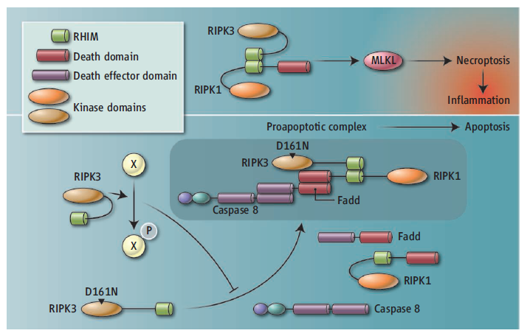
[Science] 21 MARCH 2014 VOL 343, ISSUE 6177
Science. 2014 Mar 21;343(6177):1357-60. doi: 10.1126/science.1249361. Epub 2014 Feb 20.
Activity of protein kinase RIPK3 determines whether cells die by necroptosis or apoptosis.
Newton K¹, Dugger DL, Wickliffe KE, Kapoor N, de Almagro MC, Vucic D, Komuves L, Ferrando RE, French DM, Webster J, Roose-Girma M, Warming S,Dixit VM.
¹Department of Physiological Chemistry, Genentech, 1 DNA Way, South San Francisco, CA 94080, USA.
Abstract
Receptor-interacting protein kinase 1 (RIPK1) and RIPK3 trigger pro-inflammatory cell death termed "necroptosis." Studies with RIPK3-deficient mice or the RIPK1 inhibitor necrostatin-1 suggest that necroptosis exacerbates pathology in many disease models. We engineered mice expressing catalytically inactive RIPK3 D161N or RIPK1 D138N to determine the need for the active kinase in the whole animal. Unexpectedly,RIPK3 D161N promoted lethal RIPK1- and caspase-8-dependent apoptosis. In contrast, mice expressing RIPK1 D138N were viable and, likeRIPK3-deficient mice, resistant to tumor necrosis factor (TNF)-induced hypothermia. Cells expressing RIPK1 D138N were resistant to TNF-induced necroptosis, whereas TNF-induced signaling pathways promoting gene transcription were unperturbed. Our data indicate that the kinase activity of RIPK3 is essential for necroptosis but also governs whether a cell activates caspase-8 and dies by apoptosis.
Perspectives – CELL BIOLOGY
RIPK3 Takes Another Deadly Turn
Jianke Zhang and Francis Ka-Ming Chan
Science 21 March 2014: 1322-1323.
Blocking an enzyme involved in necroptosis may prove toxic by promoting another form of cell death.

Slide 2
[Science] 21 MARCH 2014 VOL 343, ISSUE 6177
Science. 2014 Mar 21;343(6177):1353-6. doi: 10.1126/science.1248373.
β-Catenin activation regulates tissue growth non-cell autonomously in the hair stem cell niche.
Deschene ER¹, Myung P, Rompolas P, Zito G, Sun TY, Taketo MM, Saotome I, Greco V.
¹Department of Genetics, Yale Stem Cell Center, Yale Cancer Center, Yale University School of Medicine, New Haven, CT 06510, USA.
Abstract
Wnt/β-catenin signaling is critical for tissue regeneration. However, it is unclear how β-catenin controls stem cell behaviors to coordinate organized growth. Using live imaging, we show that activation of β-catenin specifically within mouse hair follicle stem cells generates new hairgrowth through oriented cell divisions and cellular displacement. β-Catenin activation is sufficient to induce hair growth independently of mesenchymal dermal papilla niche signals normally required for hair regeneration. Wild-type cells are co-opted into new hair growths by β-catenin mutant cells, which non-cell autonomously activate Wnt signaling within the neighboring wild-type cells via Wnt ligands. This study demonstrates a mechanism by which Wnt/β-catenin signaling controls stem cell-dependent tissue growth non-cell autonomously and advances our understanding of the mechanisms that drive coordinated regeneration.

Slide 3
[Science] 21 MARCH 2014 VOL 343, ISSUE 6177
Review
Virulence and Pathogenesis of HIV-1 Infection: An Evolutionary Perspective
Christophe Fraser, Katrina Lythgoe, Gabriel E. Leventhal, George Shirreff, T. Déirdre Hollingsworth, Samuel Alizon,and Sebastian Bonhoeffer
Reports
Highly Multiplexed Subcellular RNA Sequencing in Situ
Je Hyuk Lee, Evan R. Daugharthy, Jonathan Scheiman, Reza Kalhor, Joyce L. Yang, Thomas C. Ferrante, Richard Terry,Sauveur S. F. Jeanty, Chao Li,
Ryoji Amamoto, Derek T. Peters, Brian M. Turczyk, Adam H. Marblestone, Samuel A. Inverso,Amy Bernard, Prashant Mali, Xavier Rios,
John Aach, and George M. Church
Reads of cellular RNA transcripts demonstrate spatial expression differences during simulated wound healing.
Structure of the Mitochondrial Translocator Protein in Complex with a Diagnostic Ligand
Łukasz Jaremko, Mariusz Jaremko, Karin Giller, Stefan Becker, and Markus Zweckstetter
A ligand stabilizes a mammalian mitochondrial cholesterol transporter, allowing high-resolution structural analysis.
Epistasis and Allele Specificity in the Emergence of a Stable Polymorphism in Escherichia coli
Jessica Plucain, Thomas Hindré, Mickaël Le Gac, Olivier Tenaillon, Stéphane Cruveiller, Claudine Médigue, Nicholas Leiby,William R. Harcombe,
Christopher J. Marx, Richard E. Lenski, and Dominique Schneider
The emergence of a stable polymorphism in bacteria involved a multistep process including three specific mutations.
Humans Can Discriminate More than 1 Trillion Olfactory Stimuli
C. Bushdid, M. O. Magnasco, L. B. Vosshall, and A. Keller
The number of different odor mixtures people can distinguish is several orders of magnitude larger than anticipated.
Control Profiles of Complex Networks
Justin Ruths and Derek Ruths
The control profile is a network statistic that may prove useful in approaching the control of complex networks.
Fossilized Nuclei and Chromosomes Reveal 180 Million Years of Genomic Stasis in Royal Ferns
Benjamin Bomfleur, Stephen McLoughlin, and Vivi Vajda
Fern fossils provide evidence that nuclear shape, size, and chromosomal content have changed little since the Jurassic.

Slide 4

[Science] 21 MARCH 2014 VOL 343, ISSUE 6177

Slide 5

KJ
miR-100 Induces Epithelial-Mesenchymal Transition but Suppresses Tumorigenesis, Migration and Invasion
Dahu Chen, Yutong Sun, Yuan Yuan, Zhenbo Han, Peijing Zhang, Jinsong Zhang, M. James You, Julie Teruya-Feldstein, Min Wang, Sumeet Gupta, Mien-Chie Hung, Han Liang, Li Ma
Affiliation: 1. Department of Experimental Radiation Oncology, The University of Texas MD Anderson Cancer Center, Houston, Texas, United States of America, 2. Department of Pathology, Memorial Sloan-Kettering Cancer Center, New York, New York, United States of America
Abstract
Whether epithelial-mesenchymal transition (EMT) is always linked to increased tumorigenicity is controversial. Through microRNA (miRNA) expression profiling of mammary epithelial cells overexpressing Twist, Snail or ZEB1, we identified miR-100 as a novel EMT inducer. Surprisingly, miR-100 inhibits the tumorigenicity, motility and invasiveness of mammary tumor cells, and is commonly downregulated in human breast cancer due to hypermethylation of its host gene MIR100HG. The EMT-inducing and tumor-suppressing effects of miR-100 are mediated by distinct targets. While miR-100 downregulates E-cadherin by targeting SMARCA5, a regulator of CDH1 promoter methylation, this miRNA suppresses tumorigenesis, cell movement and invasion in vitro and in vivo through direct targeting of HOXA1, a gene that is both oncogenic and pro-invasive, leading to repression of multiple HOXA1 downstream targets involved in oncogenesis and invasiveness. These findings provide a proof-of-principle that EMT and tumorigenicity are not always associated and that certain EMT inducers can inhibit tumorigenesis, migration and invasion.

Slide 6
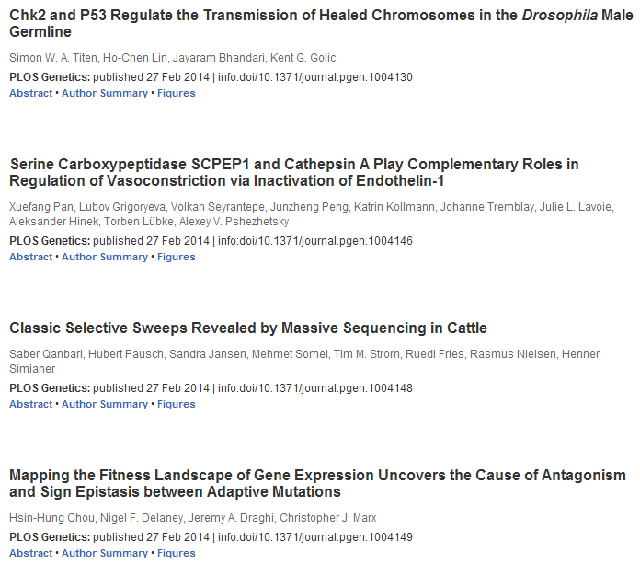
KJ

Slide 7

KJ

Slide 8
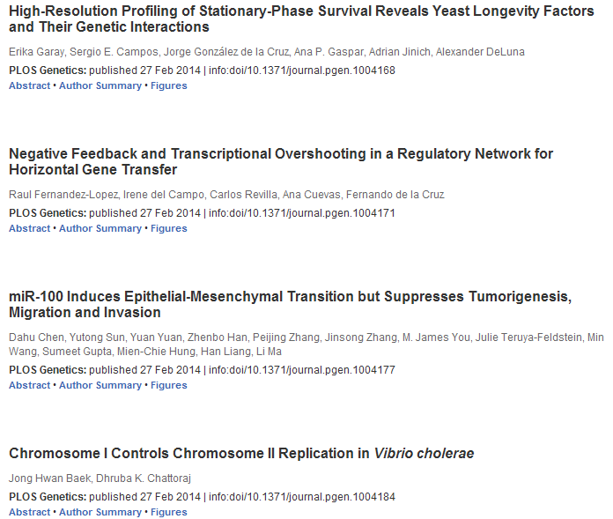
KJ

Slide 9

KJ

Slide 10

KJ

Slide 11

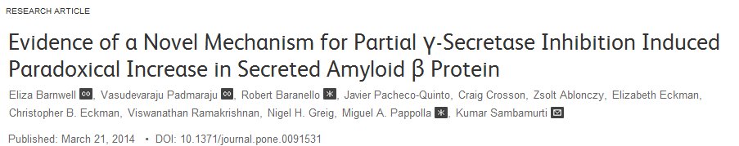
Abstract
BACE1 (β-secretase) and α-secretase cleave the Alzheimer's amyloid β protein (Aβ) precursor (APP) to C-terminal fragments of 99 aa (CTFβ) and 83 aa (CTFα), respectively, which are further cleaved by γ-secretase to eventually secrete Aβ and Aα (a.k.a. P3) that terminate predominantly at residues 40 and 42. A number of γ-secretase inhibitors (GSIs), such as N-[N-(3,5-Difluorophenacetyl-L-alanyl)]-​S-phenylglycinet-butyl ester (DAPT), have been developed with the goal of reducing Aβ to treat Alzheimer's disease (AD). Although most studies show that DAPT inhibits Aβ in a dose-dependent manner several studies have also detected a biphasic effect with an unexpected increase at low doses of DAPT in cell cultures, animal models and clinical trials. In this article, we confirm the increase in Aβ40 and Aβ42 in SH-SY5Y human neuroblastoma cells treated with low doses of DAPT and identify one of the mechanisms for this paradox. We studied the pathway by first demonstrating that stimulation of Aβ, a product of γ-secretase, was accompanied by a parallel increase of its substrate CTFβ, thereby demonstrating that the inhibitor was not anomalously stimulating enzyme activity at low levels. Secondly, we have demonstrated that inhibition of an Aβ degrading activity, endothelin converting enzyme (ECE), yielded more Aβ, but abolished the DAPT-induced stimulation. Finally, we have demonstrated that Aα, which is generated in the secretory pathway before endocytosis, is not subject to the DAPT-mediated stimulation. We therefore conclude that impairment of γ-secretase can paradoxically increase Aβ by transiently skirting Aβ degradation in the endosome. This study adds to the growing body of literature suggesting that preserving γ-secretase activity, rather than inhibiting it, is important for prevention of neurodegeneration.

Slide 12
Protein Catabolism and High Lipid Metabolism Associated with Long-Distance Exercise Are Revealed by Plasma NMR...
Laurence Le Moyec, Céline Robert, [...], Eric Barrey
Prognosis in IgA Nephropathy: 30-Year Analysis of 1,012 Patients at a Single Center in Japan
Takahito Moriyama, Kayu Tanaka, [...], Kosaku Nitta
Widespread FRA1-Dependent Control of Mesenchymal Transdifferentiation Programs in Colorectal Cancer Cells
Jeannine Diesch, Elaine Sanij, [...], Amardeep S. Dhillon
Evidence of a Novel Mechanism for Partial γ-Secretase Inhibition Induced Paradoxical Increase in Secreted Amyloid β...
Eliza Barnwell, Vasudevaraju Padmaraju, [...], Kumar Sambamurti
Wnt5a through Noncanonical Wnt/JNK or Wnt/PKC Signaling Contributes to the Differentiation of Mesenchymal Stem Cells...
Airan Liu, Song Chen, [...], Haibo Qiu
AltitudeOmics: The Integrative Physiology of Human Acclimatization to Hypobaric Hypoxia and Its Retention upon Reascent
Andrew W. Subudhi, Nicolas Bourdillon, [...], Robert C. Roach
Tendon Repair Is Compromised in a High Fat Diet-Induced Mouse Model of Obesity and Type 2 Diabetes
Michael A. David, Khyrie H. Jones, [...], Robert A. Mooney
Brown Fat Determination and Development from Muscle Precursor Cells by Novel Action of Bone Morphogenetic Protein 6
Ankur Sharma, Christine Huard, [...], Robert V. Martinez
Immune Activation Markers in Peripartum Women in Botswana: Association with Feeding Strategy and Maternal Morbidity
Elizabeth S. Russell, Terence Mohammed, [...], Shahin Lockman
The Prognostic Value of CXCR4 in Ovarian Cancer: A Meta-Analysis
Cheng-Fei Liu, Shu-Yan Liu, [...], Ke Li
An Evaluation of Comparability between NEISS and ICD-9-CM Injury Coding
Meghan C. Thompson, Krista K. Wheeler, [...], Huiyun Xiang
The Role of HuR in the Post-Transcriptional Regulation of Interleukin-3 in T Cells
José A. González-Feliciano, Marimar Hernández-Pérez, [...], Carlos I. González
Extensive Microbial and Functional Diversity within the Chicken Cecal Microbiome
Martin J. Sergeant, Chrystala Constantinidou, [...], Mark J. Pallen
Raf Kinase Inhibitor Protein (RKIP) Blocks Signal Transducer and Activator of Transcription 3 (STAT3) Activation in...
Saad Yousuf, MeiLi Duan, [...], Devasis Chatterjee
ntification and Kinetic Analysis of Grb2-EGFR Interaction on Micro-Patterned Surfaces for the Characterization of...
Peter Lanzerstorfer, Daniela Borgmann, [...], Julian Weghuber
Inhibition of Calcineurin Abrogates While Inhibition of mTOR Promotes Regulatory T Cell Expansion and...
Atsushi Satake, Amanda M. Schmidt, [...], Taku Kambayashi
Larval Zebrafish Model for FDA-Approved Drug Repositioning for Tobacco Dependence Treatment
Margot A. Cousin, Jon O. Ebbert, [...], Eric W. Klee
SYBR Green Real-Time PCR for the Detection of All Enterovirus-A71 Genogroups
Audrey Dubot-Pérès, Charlene Y. Q. Tan, [...], Xavier de Lamballerie
Kif4 Interacts with EB1 and Stabilizes Microtubules Downstream of Rho-mDia in Migrating Fibroblasts
Edward J. Morris, Guilherme P. F. Nader, [...], Gregg G. Gundersen

