Slide 1
[Science-Special Issues] 28 MARCH 2014 VOL 343, ISSUE 6178, PAGES 1389-1564
Breast Cancer-INTRODUCTION
A Race Still Unfinished
Paula Kiberstis and Leslie Roberts
<News>
Breast Cancer: A World of Differences
Kelly Servick
Advances in detecting and treating breast cancer offer an ever brightening outlook for women diagnosed in wealthy countries, but the recent progress has been far from uniform, and in poor countries mortality remains disproportionately high.
Dare to Do Less
Eliot Marshall
Scientists are looking for ways to spare women from aggressive treatment of ductal carcinoma in situ, a diagnosis that only sometimes leads to invasive breast cancer.
The 'Other' Breast Cancer Genes
Sam Kean
Since the discovery of BRCA1 and BRCA2, dozens more breast cancer genes have come to light. But what risk they pose—and what to tell women who carry them—remain quandaries.
The Advocate
Jocelyn Kaiser
For more than 2 decades, Fran Visco, president of the National Breast Cancer Coalition, has been a force behind the second biggest U.S. breast cancer research program.
<Perspectives>
“The Race” to Clone BRCA1
Mary-Claire King
Two Decades After BRCA: Setting Paradigms in Personalized Cancer Care and Prevention
Fergus J. Couch, Katherine L. Nathanson, and Kenneth Offit
Cancer Suppression by the Chromosome Custodians, BRCA1 and BRCA2
Ashok R. Venkitaraman

Slide 2
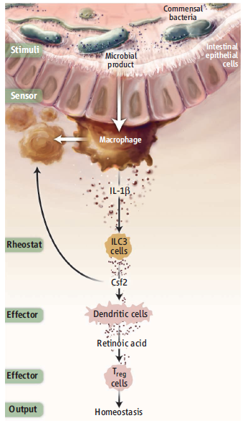
[Science] 28 MARCH 2014 VOL 343, ISSUE 6178, PAGES 1389-1564
Science. 2014 Mar 28;343(6178):1249288.
Microbiota-Dependent Crosstalk Between Macrophages
and ILC3 Promotes Intestinal Homeostasis.
Mortha A¹, Chudnovskiy A, Hashimoto D, Bogunovic M, Spencer SP, Belkaid Y, Merad M.
¹Department of Oncological Sciences, 1470 Madison Avenue, New York, NY 10029, USA.
Abstract
The intestinal microbiota and tissue-resident myeloid cells promote immune responses that maintain intestinal homeostasis in the host. However, the cellular cues that translate microbial signals into intestinal homeostasis
remain unclear. Here, we show that deficient granulocyte-macrophage colony-stimulating factor (GM-CSF) production altered mononuclear phagocyte effector functions and led to reduced regulatory T cell (Treg) numbers and impaired oral tolerance. We observed that RORγt(+) innate lymphoid cells (ILCs) are the primary source of GM-CSF in the gut and that ILC-driven GM-CSF production was dependent on the ability of macrophages
to sense microbial signals and produce interleukin-1β. Our findings reveal that commensal microbes promote a crosstalk between innate myeloid and lymphoid cells that leads to immune homeostasis in the intestine.
Perspectives-IMMUNOLOGY
The Axis of Tolerance
Tegest Aychek and Steffen Jung
Science 28 March 2014: 1439-1440.
Communication between different immune cells of the intestinal mucosa acts as a rheostat that maintains tolerance to gut microbes.

Slide 3
[Science] 28 MARCH 2014 VOL 343, ISSUE 6178, PAGES 1389-1564
Structure of the Yeast Mitochondrial Large Ribosomal Subunit
Alexey Amunts, Alan Brown, Xiao-chen Bai, Jose L. Llácer, Tanweer Hussain, Paul Emsley, Fei Long, Garib Murshudov, Sjors H. W. Scheres, and V. Ramakrishnan
The mitochondrial ribosome structure has substantially diverged from that of bacterial and eukaryotic ribosomes.
Contribution of NAC Transcription Factors to Plant Adaptation to Land
Bo Xu, Misato Ohtani, Masatoshi Yamaguchi, Kiminori Toyooka, Mayumi Wakazaki, Mayuko Sato, Minoru Kubo, Yoshimi Nakano, Ryosuke Sano, Yuji Hiwatashi, Takashi Murata, Tetsuya Kurata, Arata Yoneda, Ko Kato, Mitsuyasu Hasebe, and Taku Demura
Similarities are revealed in the generation of internal water transport systems in moss and Arabidopsis.
A Bacterial Tyrosine Phosphatase Inhibits Plant Pattern Recognition Receptor Activation
Alberto P. Macho, Benjamin Schwessinger, Vardis Ntoukakis, Alexandre Brutus, Cécile Segonzac, Sonali Roy, Yasuhiro Kadota, Man-Ho Oh, Jan Sklenar, Paul Derbyshire, Rosa Lozano-Durán, Frederikke Gro Malinovsky, Jacqueline Monaghan, Frank L. Menke, Steven C. Huber, Sheng Yang He, and Cyril Zipfel
A plant pathogen and its host compete for control over a key phosphorylation site in an innate immune receptor.
A Non–Cell Autonomous Role of E(z) to Prevent Germ Cells from Turning on a Somatic Cell Marker
Suk Ho Eun, Zhen Shi, Kairong Cui, Keji Zhao, and Xin Chen
Somatic cells within the gonad produce a protein that stops Drosophila germ cells from becoming somatic.
The Drosophila Circadian Clock Is a Variably Coupled Network of Multiple Peptidergic Units
Z. Yao and O. T. Shafer
Behavioral rhythms emerge from the interactions of many independent oscillators rather than from a group of master pacemakers.
Quantifying Global International Migration Flows
Guy J. Abel and Nikola Sander
Estimates are provided for the international flow of people over 5-year periods between 1990 and 2010.

Slide 4
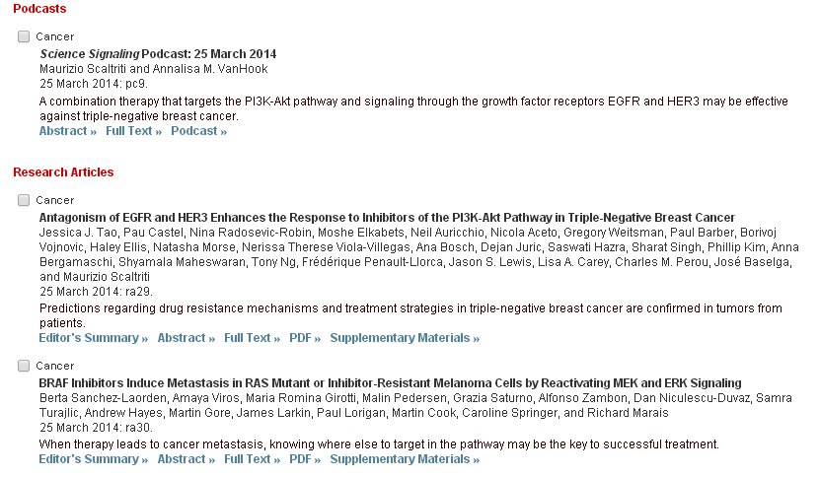
[Science Signaling] 25 MARCH 2014 VOL 7, ISSUE 318

Slide 5
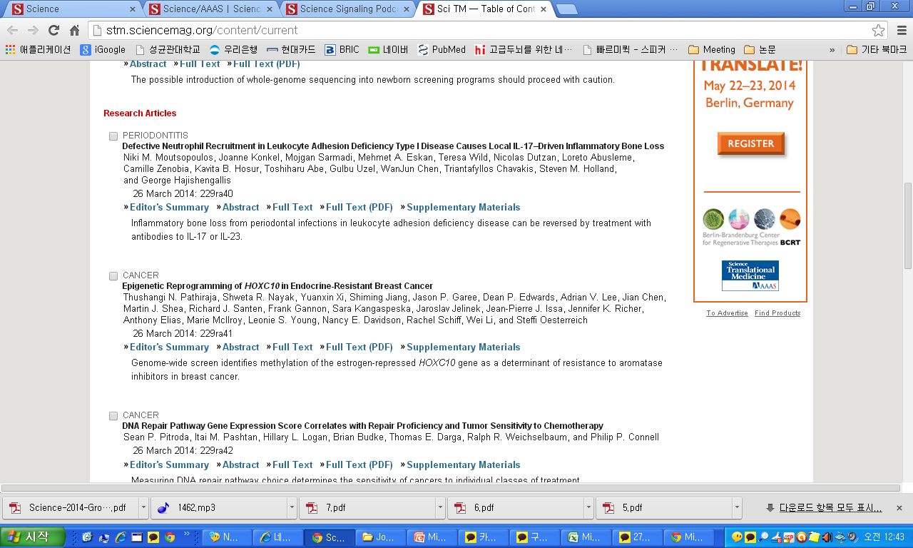
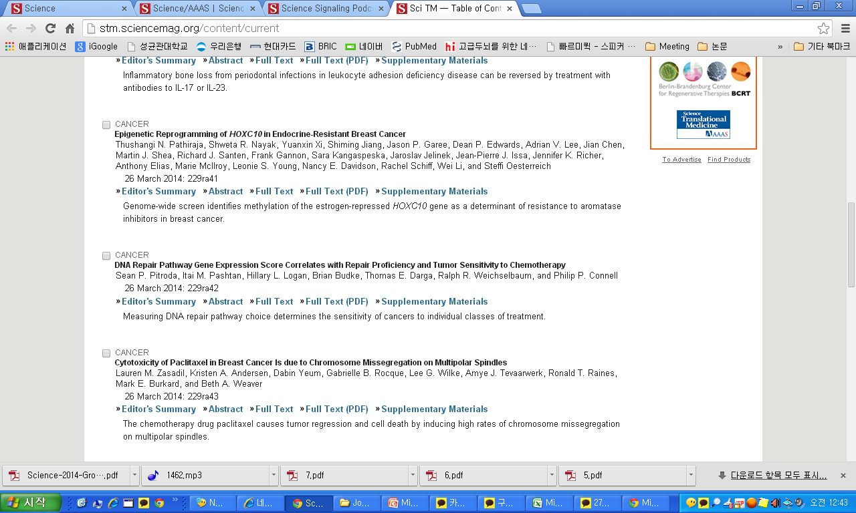
[Science Translational Medicine] 26 MARCH 2014 VOL 6, ISSUE 229

Slide 6
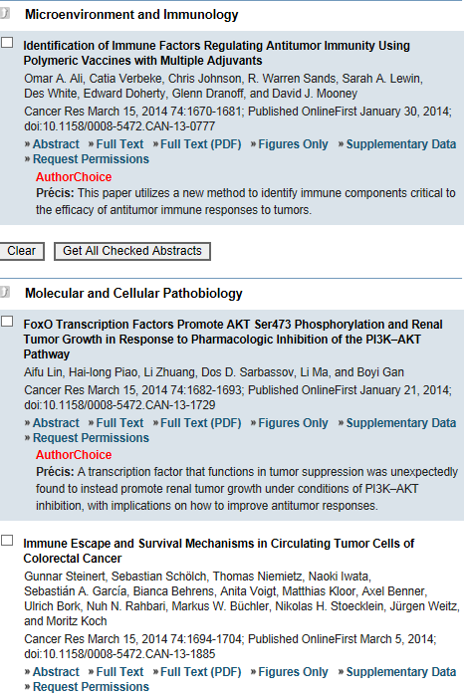
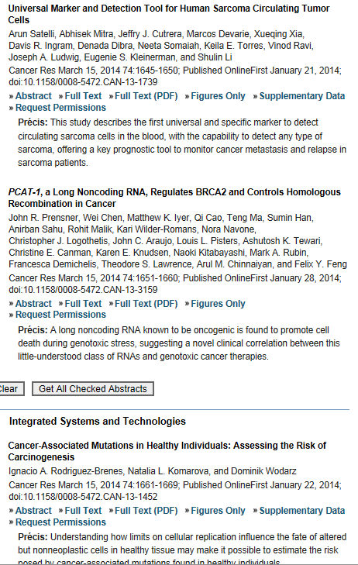

Slide 7
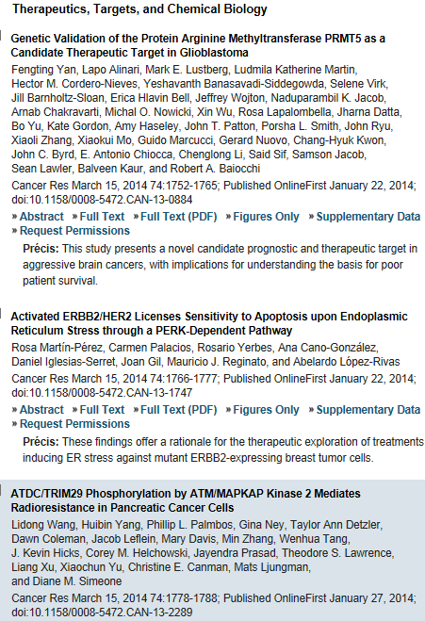

Slide 8
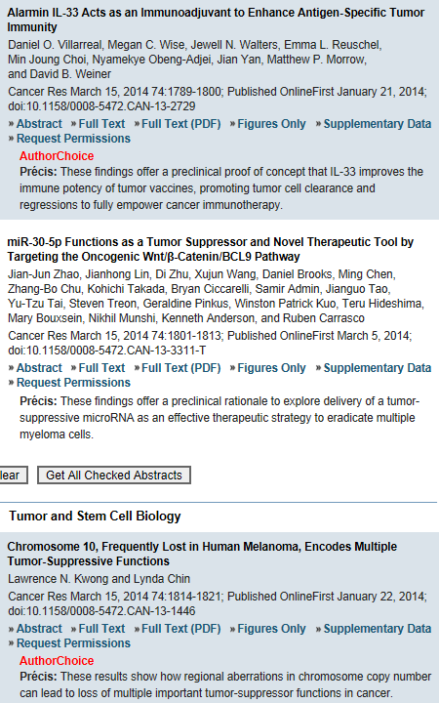


Slide 9
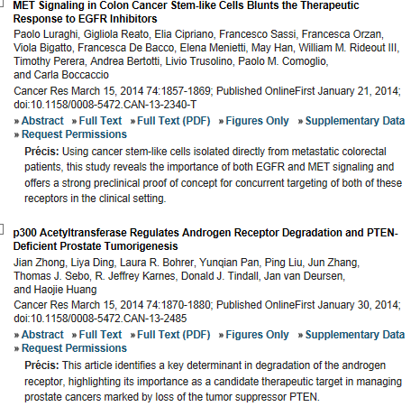

Slide 10
FoxO Transcription Factors Promote AKT Ser473 Phosphorylation and Renal Tumor Growth in Response to Pharmacologic Inhibition of the PI3K–AKT Pathway
Aifu Lin1, Hai-long Piao1, Li Zhuang1, Dos D. Sarbassov2,3, Li Ma1,3, and Boyi Gan
Authors' Affiliations: Departments of ¹Experimental Radiation Oncology and ²Molecular and Cellular Oncology, the University of Texas MD Anderson Cancer Center; and ³Program of Cancer Biology, the University of Texas Graduate School of Biomedical Sciences, Houston, Texas
The PI3K–AKT pathway is hyperactivated in many human cancers, and several drugs to inhibit this pathway, including the PI3K/mTOR dual inhibitor NVP-BEZ235, are currently being tested in various preclinical and clinical trials. It has been shown that pharmacologic inhibition of the PI3K–AKT pathway results in feedback activation of other oncogenic signaling pathways, which likely will limit the clinical utilization of these inhibitors in cancer treatment. However, the underlying mechanisms of such feedback regulation remain incompletely understood. The PI3K–AKT pathway is a validated therapeutic target in renal cell carcinoma (RCC). Here, we show that FoxO transcription factors serve to promote AKT phosphorylation at Ser473 in response to NVP-BEZ235 treatment in renal cancer cells. Inactivation of FoxO attenuated NVP-BEZ235–induced AKT Ser473 phosphorylation and rendered renal cancer cells more susceptible to NVP-BEZ235–mediated cell growth suppression in vitro and tumor shrinkage in vivo. Mechanistically, we showed that FoxOs upregulated the expression of Rictor, an essential component of MTOR complex 2, in response to NVP-BEZ235 treatment and revealed that Rictor is a key downstream target of FoxOs in NVP-BEZ235–mediated feedback regulation. Finally, we show that FoxOs similarly modulate the feedback response on AKT Ser473 phosphorylation and renal tumor growth by other phosphoinositide 3-kinase (PI3K) or AKT inhibitor treatment. Together, our study reveals a novel mechanism of PI3K–AKT inhibition-mediated feedback regulation and may identify FoxO as a novel biomarker to stratify patients with RCC for PI3K or AKT inhibitor treatment, or a novel therapeutic target to synergize with PI3K–AKT inhibition in RCC treatment. Cancer Res; 74(6); 1682–93. ©2014 AACR.

Slide 11
p16INK4a Impairs Homologous Recombination–Mediated DNA Repair in Human Papillomavirus–Positive Head and Neck Tumors
Rüveyda Dok1, Peter Kalev2,5, Evert Jan Van Limbergen1,6, Layka Abbasi Asbagh3, Iria Vázquez2,5, Esther Hauben4,7, Anna Sablina2,5, and Sandra Nuyts1,6
Authors' Affiliations: ¹Department of Oncology, Laboratory of Experimental Radiotherapy; ²Department of Human Genetics, Laboratory for Mechanisms of Cell Transformation; ³Department of Oncology, Molecular and Digestive Oncology; ⁴Department of Imaging and Pathology, Translational Cell and Tissue Research, KU Leuven, University of Leuven; ⁵VIB Center for the Biology of Disease; Departments of ⁶Radiation Oncology; and ⁷Pathology, UZ Leuven, Leuven, Belgium
The p16INK4a protein is a principal cyclin-dependent kinase inhibitor that decelerates the cell cycle. Abnormally high levels of p16INK4a are commonly observed in human papillomavirus (HPV)–positive head and neck squamous cell carcinomas (HNSCC). We and others found that p16INK4a overexpression is associated with improved therapy response and survival of patients with HNSCC treated with radiotherapy. However, the functional role of p16INK4a in HNSCC remains unexplored. Our results implicate p16INK4a in regulation of homologous recombination–mediated DNA damage response independently from its role in control of the cell cycle. We found that expression of p16INK4a dramatically affects radiation sensitivity of HNSCC cells. p16INK4a overexpression impairs the recruitment of RAD51 to the site of DNA damage in HPV-positive cells by downregulating of cyclin D1 protein expression. Consistent with the in vitro findings, immunostaining of HNSCC patient samples revealed that high levels p16INK4a expression significantly correlated with decreased cyclin D1 expression. In summary, these findings reveal an unexpected function of p16INK4a in homologous recombination–mediated DNA repair response and imply p16INK4a status as an independent marker to predict response of patients with HNSCC to radiotherapy. Cancer Res; 74(6); 1739–51. ©2014 AACR.

Slide 12
p300 Acetyltransferase Regulates Androgen Receptor Degradation and PTEN-Deficient Prostate Tumorigenesis
Jian Zhong1,2,4, Liya Ding1,2,4, Laura R. Bohrer5, Yunqian Pan1, Ping Liu5, Jun Zhang3, Thomas J. Sebo3,
R. Jeffrey Karnes2, Donald J. Tindall2,4, Jan van Deursen1,4, and Haojie Huang1,2,4
Authors' Affiliations: ¹Departments of Biochemistry and Molecular Biology, ²Urology, and ³Laboratory Medicine and Pathology; ⁴Mayo Clinic Cancer Center, Mayo Clinic College of Medicine, Rochester; and ⁵Department of Laboratory Medicine and Pathology, University of Minnesota, Minneapolis, Minnesota
Overexpression of the histone acetyltransferase p300 is implicated in the proliferation and progression of prostate cancer, but evidence of a causal role is lacking. In this study, we provide genetic evidence that this generic transcriptional coactivator functions as a positive modifier of prostate tumorigenesis. In a mouse model of PTEN deletion–induced prostate cancer, genetic ablation of p300 attenuated expression of the androgen receptor (AR). This finding was confirmed in human prostate cancer cells in which PTEN expression was abolished by RNA interference–mediated attenuation. These results were consistent with clinical evidence that the expression of p300 and AR correlates positively in human prostate cancer specimens. Mechanistically, PTEN inactivation increased AR phosphorylation at serine 81 (Ser81) to promote p300 binding and acetylation of AR, thereby precluding its polyubiquitination and degradation. In support of these findings, in PTEN-deficient prostate cancer in the mouse, we found that p300 was crucial for AR target gene expression. Taken together, our work identifies p300 as a molecular determinant of AR degradation and highlights p300 as a candidate target to manage prostate cancer, especially in cases marked by PTEN loss. Cancer Res; 74(6); 1870–80. ©2014 AACR.

Slide 13
Journal of immunology
BRIEF REVIEWS
Modulation of T Cell and Innate Immune Responses by Retinoic Acid
Mathilde Raverdeau and Kingston H. G. Mills
J Immunol 2014 192:2953-2958; doi:10.4049/jimmunol.1303245
CUTTING EDGE
Cutting Edge: Resident Memory CD8 T Cells Occupy Frontline Niches in Secondary Lymphoid Organs
Jason M. Schenkel, Kathryn A. Fraser, and David Masopust
J Immunol 2014 192:2961-2964; published ahead of print March 5, 2014, doi:10.4049/jimmunol.1400003
Cutting Edge: Control of Mycobacterium tuberculosis Infection by a Subset of Lung Parenchyma–Homing CD4 T Cells
Shunsuke Sakai, Keith D. Kauffman, Jason M. Schenkel, Cortez C. McBerry, Katrin D. Mayer-Barber, David Masopust, and Daniel L. Barber
J Immunol 2014 192:2965-2969; published ahead of print March 3, 2014, doi:10.4049/jimmunol.1400019
Cutting Edge: Committed Th1 CD4⁺ T Cell Differentiation Blocks Pregnancy-Induced Foxp3 Expression with Antigen-Specific Fetal Loss
Lijun Xin, James M. Ertelt, Jared H. Rowe, Tony T. Jiang, Jeremy M. Kinder, Vandana Chaturvedi, Shokrollah Elahi, and Sing Sing Way
J Immunol 2014 192:2970-2974; published ahead of print March 3, 2014, doi:10.4049/jimmunol.1302678
AUTOIMMUNITY
Siglec-G Deficiency Leads to More Severe Collagen-Induced Arthritis and Earlier Onset of Lupus-like Symptoms in MRL/lpr Mice
Susanne Bökers, Anne Urbat, Christoph Daniel, Kerstin Amann, Kenneth G. C. Smith, Marion Espéli, and Lars Nitschke
J Immunol 2014 192:2994-3002; published ahead of print March 5, 2014, doi:10.4049/jimmunol.1303367
Interaction of Mesenchymal Stem Cells with Fibroblast-like Synoviocytes via Cadherin-11 Promotes Angiogenesis by Enhanced Secretion of Placental Growth Factor
Su-Jung Park, Ki-Jo Kim, Wan-Uk Kim, and Chul-Soo Cho
J Immunol 2014 192:3003-3010; published ahead of print February 26, 2014, doi:10.4049/jimmunol.1302177
Long-Term B Cell Depletion in Murine Lupus Eliminates Autoantibody-Secreting Cells and Is Associated with Alterations in the Kidney Plasma Cell Niche
Wensheng Wang, Javier Rangel-Moreno, Teresa Owen, Jennifer Barnard, Sarah Nevarez, H. Travis Ichikawa, and Jennifer H. Anolik
J Immunol 2014 192:3011-3020; published ahead of print February 26, 2014, doi:10.4049/jimmunol.1302003
Inhibitory Fcγ Receptor Is Required for the Maintenance of Tolerance through Distinct Mechanisms
Fubin Li, Patrick Smith, and Jeffrey V. Ravetch
J Immunol 2014 192:3021-3028; published ahead of print February 21, 2014, doi:10.4049/jimmunol.1302934

Slide 14
Relapsing–Remitting Central Nervous System Autoimmunity Mediated by GFAP-Specific CD8 T Cells
Katsuhiro Sasaki, Angela Bean,
Shivanee Shah, Elizabeth Schutten, Priya G. Huseby, Bjorn Peters, Zu T. Shen, Vijay Vanguri, Denny Liggitt, and Eric S. Huseby
J Immunol 2014 192:3029-3042; published ahead of print March 3, 2014, doi:10.4049/jimmunol.1302911
The Degree of CD4⁺ T Cell Autoreactivity Determines Cellular Pathways Underlying Inflammatory Arthritis
Olivia A. Perng, Malinda Aitken, Andrew L. Rankin, Victoria Garcia, Elizabeth Kropf, Jan Erikson, David S. Garlick, and Andrew J. Caton
J Immunol 2014 192:3043-3056; published ahead of print March 3, 2014, doi:10.4049/jimmunol.1302528
Noncoding RNAs and LRRFIP1 Regulate TNF Expression
Lihua Shi, Li Song, Michael Fitzgerald, Kelly Maurer, Asen Bagashev, and Kathleen E. Sullivan
J Immunol 2014 192:3057-3067; published ahead of print February 24, 2014, doi:10.4049/jimmunol.1302063
Targeting S1P1 Receptor Protects against Murine Immunological Hepatic Injury through Myeloid-Derived Suppressor Cells
Guangwei Liu, Yujing Bi, Ruoning Wang, Hui Yang, Yan Zhang, Xiao Wang, Huanrong Liu, Yun Lu, Zhengguo Zhang, Wanna Chen, Yiwei Chu, and Ruifu Yang
J Immunol 2014 192:3068-3079; published ahead of print February 24, 2014, doi:10.4049/jimmunol.1301193
In Vivo Detection of Peripherin-Specific Autoreactive B Cells during Type 1 Diabetes Pathogenesis
Nahir Garabatos, Raimon Alvarez, Jorge Carrillo, Jorge Carrascal, Cristina Izquierdo, Harold D. Chapman, Maximiliano Presa, Conchi Mora, David V. Serreze, Joan Verdaguer, and Thomas Stratmann
J Immunol 2014 192:3080-3090; published ahead of print March 7, 2014, doi:10.4049/jimmunol.1301053
IMMUNE REGULATION
IκBε Is a Key Regulator of B Cell Expansion by Providing Negative Feedback on cRel and RelA in a Stimulus-Specific Manner
Bryce N. Alves, Rachel Tsui, Jonathan Almaden, Maxim N. Shokhirev, Jeremy Davis-Turak, Jessica Fujimoto, Harry Birnbaum, Julia Ponomarenko, and Alexander Hoffmann
J Immunol 2014 192:3121-3132; published ahead of print March 3, 2014, doi:10.4049/jimmunol.1302351
Tim-3 Directly Enhances CD8 T Cell Responses to Acute Listeria monocytogenes Infection
Jacob V. Gorman, Gabriel Starbeck-Miller, Nhat-Long L. Pham, Geri L. Traver, Paul B. Rothman, John T. Harty, and John D. Colgan
J Immunol 2014 192:3133-3142; published ahead of print February 24, 2014, doi:10.4049/jimmunol.1302290
Identification of Two Forms of TNF Tolerance in Human Monocytes: Differential Inhibition of NF-κB/AP-1– and PP1-Associated Signaling
Johannes Günther, Nico Vogt, Katharina Hampel, Rolf Bikker, Sharon Page, Benjamin Müller, Judith Kandemir, Michael Kracht, Oliver Dittrich-Breiholz, René Huber, and Korbinian Brand
J Immunol 2014 192:3143-3155; published ahead of print February 26, 2014, doi:10.4049/jimmunol.1301610

Slide 15
Protective Immunity and Defects in the Neonatal and Elderly Immune Response to Sepsis
Lori F. Gentile, Dina C. Nacionales, M. Cecilia Lopez, Erin Vanzant, Angela Cuenca, Alex G. Cuenca, Ricardo Ungaro, Ben E. Szpila, Shawn Larson, Anna Joseph, Frederick A. Moore, Christiaan Leeuwenburgh, Henry V. Baker, Lyle L. Moldawer, and Philip A. Efron
J Immunol 2014 192:3156-3165; published ahead of print March 3, 2014, doi:10.4049/jimmunol.1301726
B Cells in T Follicular Helper Cell Development and Function: Separable Roles in Delivery of ICOS Ligand and Antigen
Jason S. Weinstein, Sarah A. Bertino, Sairy G. Hernandez, Amanda C. Poholek, Taylor B. Teplitzky, Heba N. Nowyhed, and Joe Craft
J Immunol 2014 192:3166-3179; published ahead of print March 7, 2014, doi:10.4049/jimmunol.1302617
Modification of T Cell Responses by Stem Cell Mobilization Requires Direct Signaling of the T Cell by G-CSF and IL-10
Kelli P. A. MacDonald, Laetitia Le Texier, Ping Zhang, Helen Morris, Rachel D. Kuns, Katie E. Lineburg, Lucie Leveque, Alistair L. Don, Kate A. Markey, Slavica Vuckovic, Frederik O. Bagger, Glen M. Boyle, Bruce R. Blazar, and Geoffrey R. Hill
J Immunol 2014 192:3180-3189; published ahead of print February 28, 2014, doi:10.4049/jimmunol.1302315
Regulator of Fatty Acid Metabolism, Acetyl Coenzyme A Carboxylase 1, Controls T Cell Immunity
JangEun Lee, Matthew C. Walsh, Kyle L. Hoehn, David E. James, E. John Wherry, and Yongwon Choi
J Immunol 2014 192:3190-3199; published ahead of print February 24, 2014, doi:10.4049/jimmunol.1302985
Transcription Factor IRF4 Regulates Germinal Center Cell Formation through a B Cell–Intrinsic Mechanism
Simon N. Willis, Kim L. Good-Jacobson, Joan Curtis, Amanda Light, Julie Tellier, Wei Shi, Gordon K. Smyth, David M. Tarlinton, Gabrielle T. Belz, Lynn M. Corcoran, Axel Kallies, and Stephen L. Nutt
J Immunol 2014 192:3200-3206; published ahead of print March 3, 2014, doi:10.4049/jimmunol.1303216

Slide 16
Noncoding RNAs and LRRFIP1 Regulate TNF Expression
Lihua Shi, Li Song, Michael Fitzgerald, Kelly Maurer, Asen Bagashev1 and Kathleen E. Sullivan
+ Author Affiliations
Division of Allergy Immunology, Children’s Hospital of Philadelphia, University of Pennsylvania School of Medicine, Philadelphia, PA 19104
Noncoding RNAs have been implicated in the regulation of expression of numerous genes; however, the mechanism is not fully understood. We identified bidirectional, long noncoding RNAs upstream of the TNF gene using five different methods. They arose in a region where the repressors LRRFIP1, EZH2, and SUZ12 were demonstrated to bind, suggesting a role in repression. The noncoding RNAs were polyadenylated, capped, and chromatin associated. Knockdown of the noncoding RNAs was associated with derepression of TNF mRNA and diminished binding of LRRFIP1 to both RNA targets and chromatin. Overexpression of the noncoding RNAs led to diminished expression of TNF and recruitment of repressor proteins to the locus. One repressor protein, LRRFIP1, bound directly to the noncoding RNAs. These data place the noncoding RNAs upstream of TNF gene as central to the transcriptional regulation. They appear to serve as a platform for the assembly of a repressive complex.

