Slide 1
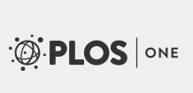
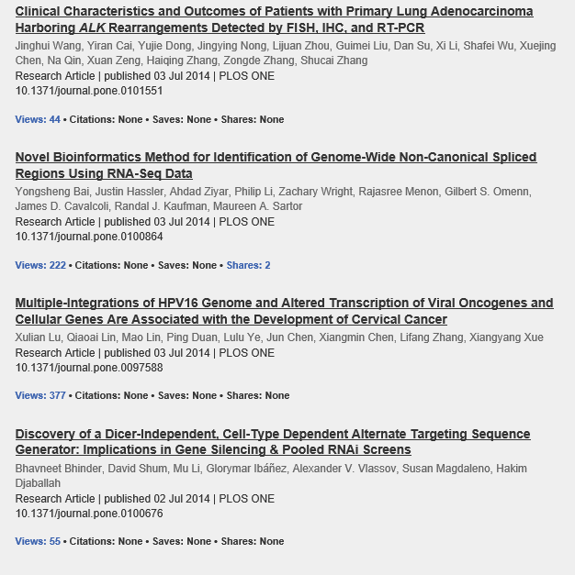
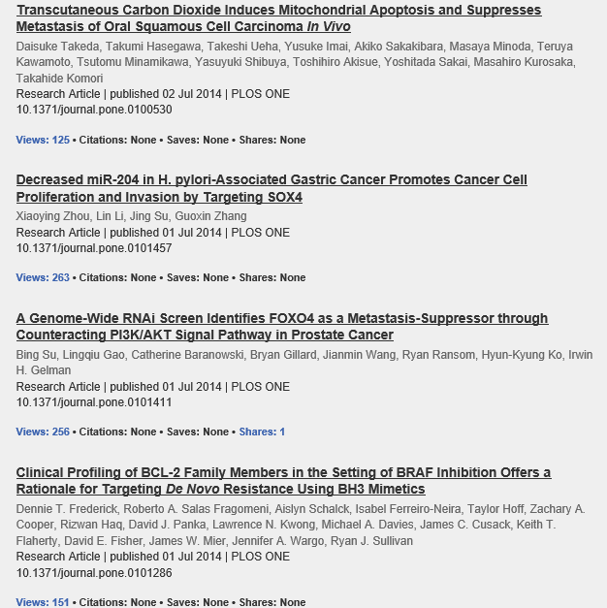

Slide 2
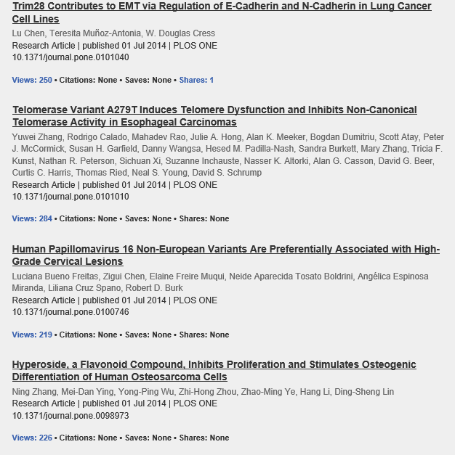
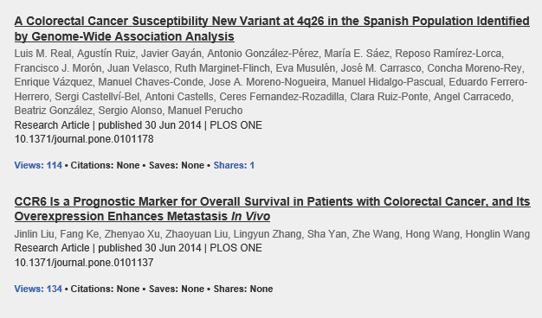

Slide 3
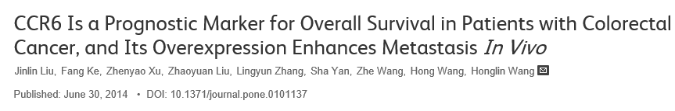
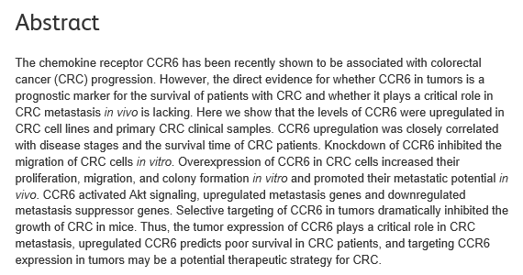

Slide 4

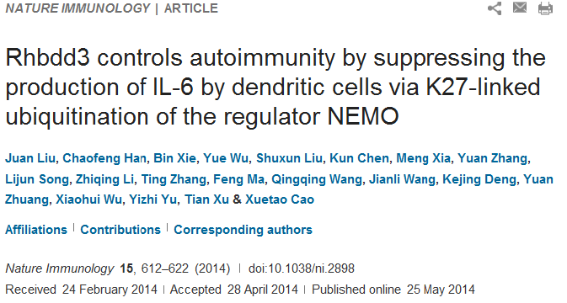
Excessive activation of dendritic cells (DCs) leads to the development of autoimmune and inflammatory diseases, which has prompted a search for regulators of DC activation. Here we report that Rhbdd3, a member of the rhomboid family of proteases, suppressed the activation of DCs and production of interleukin 6 (IL-6) triggered by Toll-like receptors (TLRs). Rhbdd3-deficient mice spontaneously developed autoimmune diseases characterized by an increased abundance of the T_{H}17 subset of helper T cells and decreased number of regulatory T cells due to the increase in IL-6 from DCs. Rhbdd3 directly bound to Lys27 (K27)-linked polyubiquitin chains on Lys302 of the modulator NEMO (IKKγ) via the ubiquitin-binding–association (UBA) domain in endosomes. Rhbdd3 further recruited the deubiquitinase A20 via K27-linked polyubiquitin chains on Lys268 to inhibit K63-linked polyubiquitination of NEMO and thus suppressed activation of the transcription factor NF-κB in DCs. Our data identify Rhbdd3 as a critical regulator of DC activation and indicate K27-linked polyubiquitination is a potent ubiquitin-linked pattern involved in the control of autoimmunity.

Slide 5
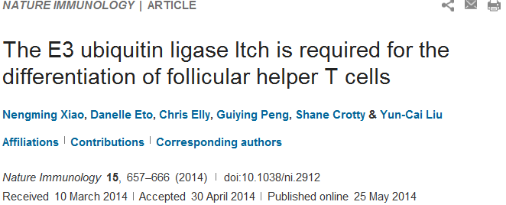
Follicular helper T cells (T_{FH} cells) are responsible for effective B cell–mediated immunity, and Bcl-6 is a central factor for the differentiation of T_{FH} cells. However, the molecular mechanisms that regulate the induction of T_{FH} cells remain unclear. Here we found that the E3 ubiquitin ligase Itch was essential for the differentiation of T_{FH} cells, germinal center responses and immunoglobulin G (IgG) responses to acute viral infection. Itch acted intrinsically in CD4⁺ T cells at early stages of T_{FH} cell development. Itch seemed to act upstream of Bcl-6 expression, as Bcl-6 expression was substantially impaired in Itch^{−/−} cells, and the differentiation of Itch^{−/−} T cells into T_{FH} cells was restored by enforced expression of Bcl-6. Itch associated with the transcription factor Foxo1 and promoted its ubiquitination and degradation. The defective T_{FH} differentiation of Itch^{−/−} T cells was rectified by deletion of Foxo1. Thus, our results indicate that Itch acts as an essential positive regulator in the differentiation of T_{FH} cells.

Slide 6
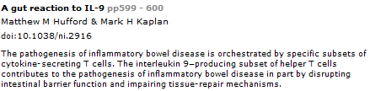
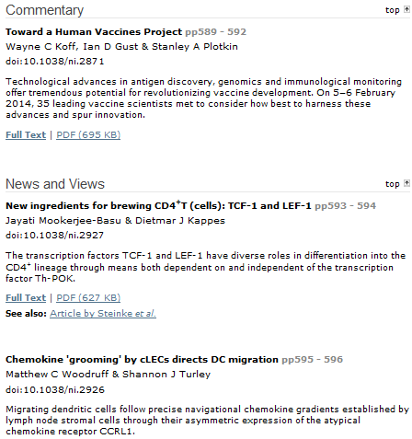
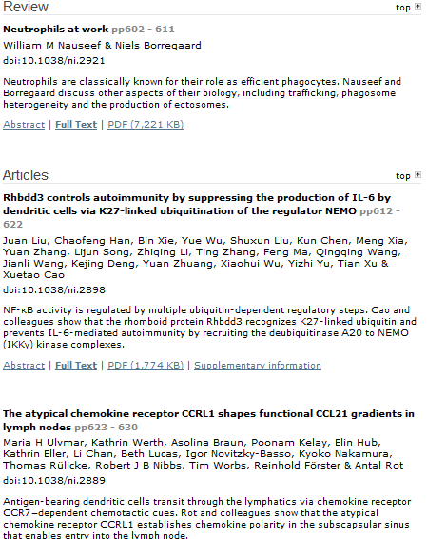
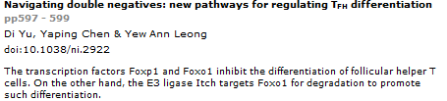

Slide 7
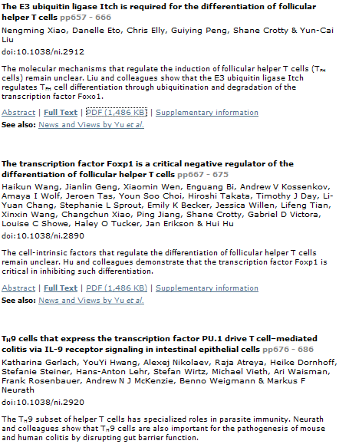
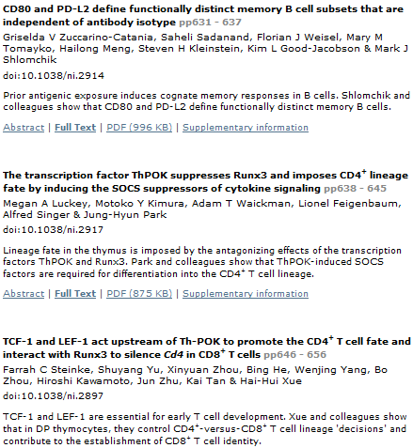
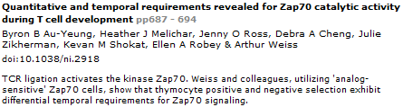

Slide 8
[Science] 4 July 2014 vol 345, issue 6192, pages 1-112
Science. 2014 Jul 4;345(6192):98-101. doi: 10.1126/science.1254312.
Opposing unfolded-protein-response signals converge on death receptor 5 to control apoptosis.
Lu M¹, Lawrence DA¹, Marsters S¹, Acosta-Alvear D², Kimmig P², Mendez AS², Paton AW³, Paton JC³, Walter P⁴, Ashkenazi A⁵.
Abstract
Protein folding by the endoplasmic reticulum (ER) is physiologically critical; its disruption causes ER stress and augments disease. ER stress activates the unfolded protein response (UPR) to restore homeostasis. If stress persists, the UPR induces apoptotic cell death, but the mechanisms remain elusive. Here, we report that unmitigated ER stress promoted apoptosis through cell-autonomous, UPR-controlled activation of death receptor 5 (DR5). ER stressors induced DR5 transcription via the UPR mediator CHOP; however, the UPR sensor IRE1α transiently catalyzed DR5 mRNA decay, which allowed time for adaptation. Persistent ER stress built up intracellular DR5 protein, driving ligand-independent DR5 activation and apoptosis engagement via caspase-8. Thus, DR5 integrates opposing UPR signals to couple ER stress and apoptotic cell fate.
¹Cancer Immunology, Genentech, Inc., 1 DNA Way, South San Francisco, CA 94080, USA.
²Howard Hughes Medical Institute, University of California, San Francisco, CA 94158, USA.Department of Biochemistry and Biophysics, University of California, San Francisco, CA 94158, USA.
³Research Centre for Infectious Diseases, School of Molecular and Biomedical Science, University of Adelaide, South Australia, 5005, Australia.
⁴Howard Hughes Medical Institute, University of California, San Francisco, CA 94158, USA.Department of Biochemistry and Biophysics, University of California, San Francisco, CA 94158, USA. peter@walterlab.ucsf.edu aa@gene.com.
⁵Cancer Immunology, Genentech, Inc., 1 DNA Way, South San Francisco, CA 94080, USA. peter@walterlab.ucsf.edu aa@gene.com.

Slide 9
[Science] 4 July 2014 vol 345, issue 6192, pages 1-112
Science. 2014 Jul 4;345(6192):50-4. doi: 10.1126/science.1250373.
Ras activation by SOS: Allosteric regulation by altered fluctuation dynamics.
Iversen L¹, Tu HL¹, Lin WC¹, Christensen SM¹, Abel SM², Iwig J³, Wu HJ¹, Gureasko J³, Rhodes C⁴, Petit RS¹, Hansen SD¹, Thill P⁵, Yu CH⁶, Stamou D⁷, Chakraborty AK⁸, Kuriyan J⁹, Groves JT¹⁰.
Abstract
Activation of the small guanosine triphosphatase H-Ras by the exchange factor Son of Sevenless (SOS) is an important hub for signal transduction. Multiple layers of regulation, through protein and membrane interactions, govern activity of SOS. We characterized the specific activity of individual SOS molecules catalyzing nucleotide exchange in H-Ras. Single-molecule kinetic traces revealed that SOS samples a broad distribution of turnover rates through stochastic fluctuations between distinct, long-lived (more than 100 seconds), functional states. The expected allosteric activation of SOS by Ras-guanosine triphosphate (GTP) was conspicuously absent in the mean rate. However, fluctuations into highly active states were modulated by Ras-GTP. This reveals a mechanism in which functional output may be determined by the dynamical spectrum of rates sampled by a small number of enzymes, rather than the ensemble average.
¹Howard Hughes Medical Institute, Department of Chemistry, University of California, Berkeley, Berkeley, CA 94720, USA.
²Department of Chemical Engineering, Massachusetts Institute of Technology (MIT), Cambridge, MA 02139, USA.
³Howard Hughes Medical Institute, Department of Molecular and Cell Biology, University of California, Berkeley, Berkeley, CA 94720, USA.
⁴Department of Mechanical Engineering, University of California, Berkeley, Berkeley, CA 94720, USA.
⁵Department of Chemistry, MIT, Cambridge, MA 02139, USA.
⁶Mechanobiology Institute, National University of Singapore, Singapore.
⁷Department of Chemistry and Nano-Science Center, University of Copenhagen, Copenhagen, Denmark.
⁸Department of Chemical Engineering, Massachusetts Institute of Technology (MIT), Cambridge, MA 02139, USA. Department of Chemistry, MIT, Cambridge, MA 02139, USA. Department of Biological Engineering, MIT, Cambridge, MA 02139, USA. Ragon Institute of Massachusetts General Hospital, MIT, and Harvard, Cambridge, MA 02139, USA. Department of Physics, MIT, Cambridge, MA 02139, USA. Institute for Medical Engineering and Science, MIT, Cambridge, MA 02139, USA.
⁹Howard Hughes Medical Institute, Department of Chemistry, University of California, Berkeley, Berkeley, CA 94720, USA. Howard Hughes Medical Institute, Department of Molecular and Cell Biology, University of California, Berkeley, Berkeley, CA 94720, USA. Physical Biosciences and Materials Sciences Divisions, Lawrence Berkeley National Laboratory, Berkeley, CA 94720, USA.
¹⁰Howard Hughes Medical Institute, Department of Chemistry, University of California, Berkeley, Berkeley, CA 94720, USA. Mechanobiology Institute, National University of Singapore, Singapore. Physical Biosciences and Materials Sciences Divisions, Lawrence Berkeley National Laboratory, Berkeley, CA 94720, USA. Berkeley Education Alliance for Research in Singapore, 1 Create Way, CREATE tower level 11, University Town, Singapore 138602. jtgroves@lbl.gov.

Slide 10
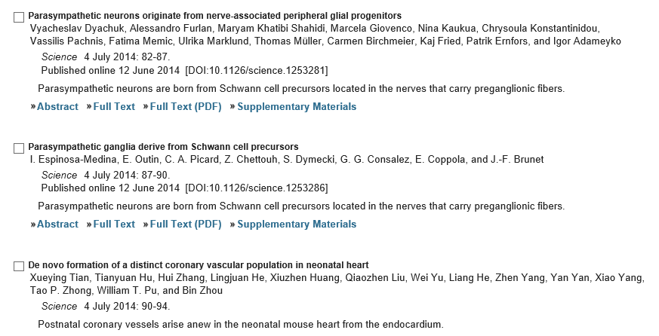
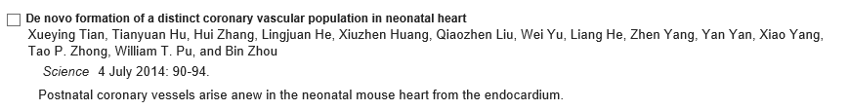
[Science] 4 July 2014 vol 345, issue 6192, pages 1-112

