Slide 1



Slide 2
Sensory systems: The yin and yang of cortical oxytocin
Robert C. Liu
Female mice can learn to respond to distress calls from young mice — an ability that has now been found to be improved through signalling by the hormone oxytocin in the left auditory cortex of the brain. See Article p.499
Nature. 2015 Apr 23;520(7548):499-504. doi: 10.1038/nature14402. Epub 2015 Apr 15.
Oxytocin enables maternal behaviour by balancing cortical inhibition.
Marlin BJ¹, Mitre M², D'amour JA¹, Chao MV³, Froemke RC⁴.
Author information
Abstract
Oxytocin is important for social interactions and maternal behaviour. However, little is known about when, where and how oxytocin modulates neural circuits to improve social cognition. Here we show how oxytocin enables pup retrieval behaviour in female mice by enhancing auditory cortical pup call responses. Retrieval behaviour required the left but not right auditory cortex, was accelerated by oxytocin in the left auditory cortex, and oxytocinreceptors were preferentially expressed in the left auditory cortex. Neural responses to pup calls were lateralized, with co-tuned and temporally precise excitatory and inhibitory responses in the left cortex of maternal but not pup-naive adults. Finally, pairing calls with oxytocin enhanced responses by balancing the magnitude and timing of inhibition with excitation. Our results describe fundamental synaptic mechanisms by whichoxytocin increases the salience of acoustic social stimuli. Furthermore, oxytocin-induced plasticity provides a biological basis for lateralization of auditory cortical processing.

Slide 3
Nature. 2015 Apr 23;520(7548):549-52. doi: 10.1038/nature14131. Epub 2015 Feb 18.
Exit from dormancy provokes DNA-damage-induced attrition in haematopoietic stem cells.
Walter D¹, Lier A¹, Geiselhart A², Thalheimer FB³, Huntscha S¹, Sobotta MC⁴, Moehrle B⁵, Brocks D², Bayindir I², Kaschutnig P², Muedder K⁶, Klein C¹, Jauch A⁷, Schroeder T⁸, Geiger H⁹, Dick TP⁴, Holland-Letz T¹⁰, Schmezer P¹¹, Lane SW¹², Rieger MA³, Essers MA¹³, Williams DA¹⁴, Trumpp A¹⁵, Milsom MD¹⁶.
Author information
Abstract
Haematopoietic stem cells (HSCs) are responsible for the lifelong production of blood cells. The accumulation of DNA damage in HSCs is a hallmark of ageing and is probably a major contributing factor in age-related tissue degeneration and malignant transformation. A number of accelerated ageing syndromes are associated with defective DNA repair and genomic instability, including the most common inherited bone marrow failure syndrome, Fanconi anaemia. However, the physiological source of DNA damage in HSCs from both normal and diseased individuals remains unclear. Here we show in mice that DNA damage is a direct consequence of inducing HSCs to exit their homeostatic quiescent state in response to conditions that model physiological stress, such as infection or chronic blood loss. Repeated activation of HSCs out of their dormant state provoked the attrition of normal HSCs and, in the case of mice with a non-functional Fanconi anaemia DNA repair pathway, led to a complete collapse of the haematopoieticsystem, which phenocopied the highly penetrant bone marrow failure seen in Fanconi anaemia patients. Our findings establish a novel link between physiological stress and DNA damage in normal HSCs and provide a mechanistic explanation for the universal accumulation of DNA damage in HSCs during ageing and the accelerated failure of the haematopoietic system in Fanconi anaemia patients.

Slide 4
Nature. 2015 Apr 23;520(7548):553-7. doi: 10.1038/nature14156. Epub 2015 Feb 2.
Mitochondrial DNA stress primes the antiviral innate immune response.
West AP¹, Khoury-Hanold W², Staron M², Tal MC², Pineda CM¹, Lang SM¹, Bestwick M¹, Duguay BA³, Raimundo N¹, MacDuff DA⁴, Kaech SM⁵, Smiley JR³,Means RE¹, Iwasaki A⁵, Shadel GS⁶.
Author information
Abstract
Mitochondrial DNA (mtDNA) is normally present at thousands of copies per cell and is packaged into several hundred higher-order structures termed nucleoids. The abundant mtDNA-binding protein TFAM (transcription factor A, mitochondrial) regulates nucleoid architecture, abundance and segregation. Complete mtDNA depletion profoundly impairs oxidative phosphorylation, triggering calcium-dependent stress signalling and adaptive metabolic responses. However, the cellular responses to mtDNA instability, a physiologically relevant stress observed in many human diseases and ageing, remain poorly defined. Here we show that moderate mtDNA stress elicited by TFAM deficiency engages cytosolic antiviral signalling to enhance the expression of a subset of interferon-stimulated genes. Mechanistically, we find that aberrant mtDNA packaging promotes escape of mtDNA into the cytosol, where it engages the DNA sensor cGAS (also known as MB21D1) and promotes STING (also known as TMEM173)-IRF3-dependent signalling to elevate interferon-stimulated gene expression, potentiate type I interferon responses and confer broad viral resistance. Furthermore, we demonstrate that herpesviruses induce mtDNA stress, which enhances antiviral signalling and type I interferon responses during infection. Our results further demonstrate that mitochondria are central participants in innate immunity, identify mtDNA stress as a cell-intrinsic trigger of antiviral signalling and suggest that cellular monitoring of mtDNA homeostasis cooperates with canonical virus sensing mechanisms to fully engage antiviral innate immunity.

Slide 5
Nature. 2015 Apr 23;520(7548):563-6. doi: 10.1038/nature14147. Epub 2015 Feb 9.
ATG14 promotes membrane tethering and fusion of autophagosomes to endolysosomes.
Diao J¹, Liu R², Rong Y³, Zhao M¹, Zhang J³, Lai Y¹, Zhou Q¹, Wilz LM⁴, Li J⁴, Vivona S¹, Pfuetzner RA¹, Brunger AT¹, Zhong Q³.
Author information
Abstract
Autophagy, an important catabolic pathway implicated in a broad spectrum of human diseases, begins by forming double membraneautophagosomes that engulf cytosolic cargo and ends by fusing autophagosomes with lysosomes for degradation. Membrane fusion activity is required for early biogenesis of autophagosomes and late degradation in lysosomes. However, the key regulatory mechanisms of autophagicmembrane tethering and fusion remain largely unknown. Here we report that ATG14 (also known as beclin-1-associated autophagy-related key regulator (Barkor) or ATG14L), an essential autophagy-specific regulator of the class III phosphatidylinositol 3-kinase complex, promotes membranetethering of protein-free liposomes, and enhances hemifusion and full fusion of proteoliposomes reconstituted with the target (t)-SNAREs (soluble N-ethylmaleimide-sensitive factor attachment protein receptors) syntaxin 17 (STX17) and SNAP29, and the vesicle (v)-SNARE VAMP8 (vesicle-associated membrane protein 8). ATG14 binds to the SNARE core domain of STX17 through its coiled-coil domain, and stabilizes the STX17-SNAP29 binary t-SNARE complex on autophagosomes. The STX17 binding, membrane tethering and fusion-enhancing activities of ATG14 require its homo-oligomerization by cysteine repeats. In ATG14 homo-oligomerization-defective cells, autophagosomes still efficiently form but their fusionwith endolysosomes is blocked. Recombinant ATG14 homo-oligomerization mutants also completely lose their ability to promote membrane tetheringand to enhance SNARE-mediated fusion in vitro. Taken together, our data suggest an autophagy-specific membrane fusion mechanism in which oligomeric ATG14 directly binds to STX17-SNAP29 binary t-SNARE complex on autophagosomes and primes it for VAMP8 interaction to promote autophagosome-endolysosome fusion.

Slide 6
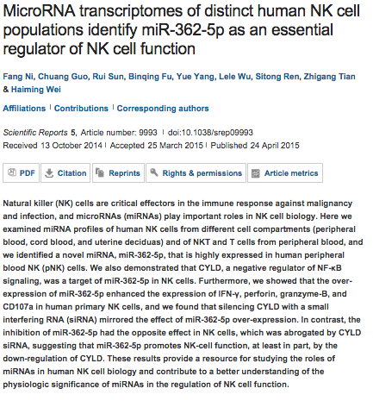
Scientific Reports

Slide 7
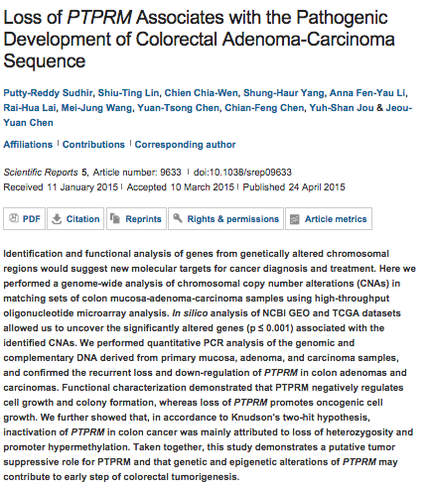

Slide 8
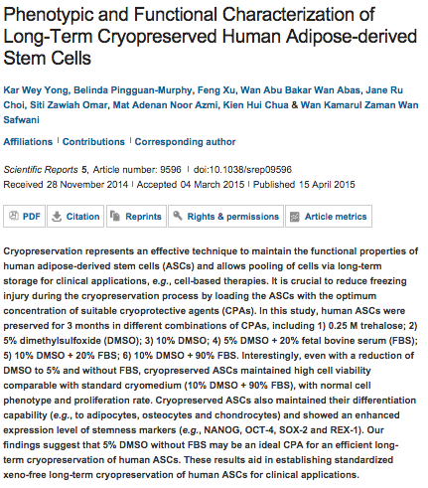

Slide 9
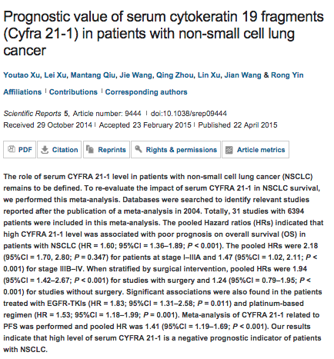

Slide 10

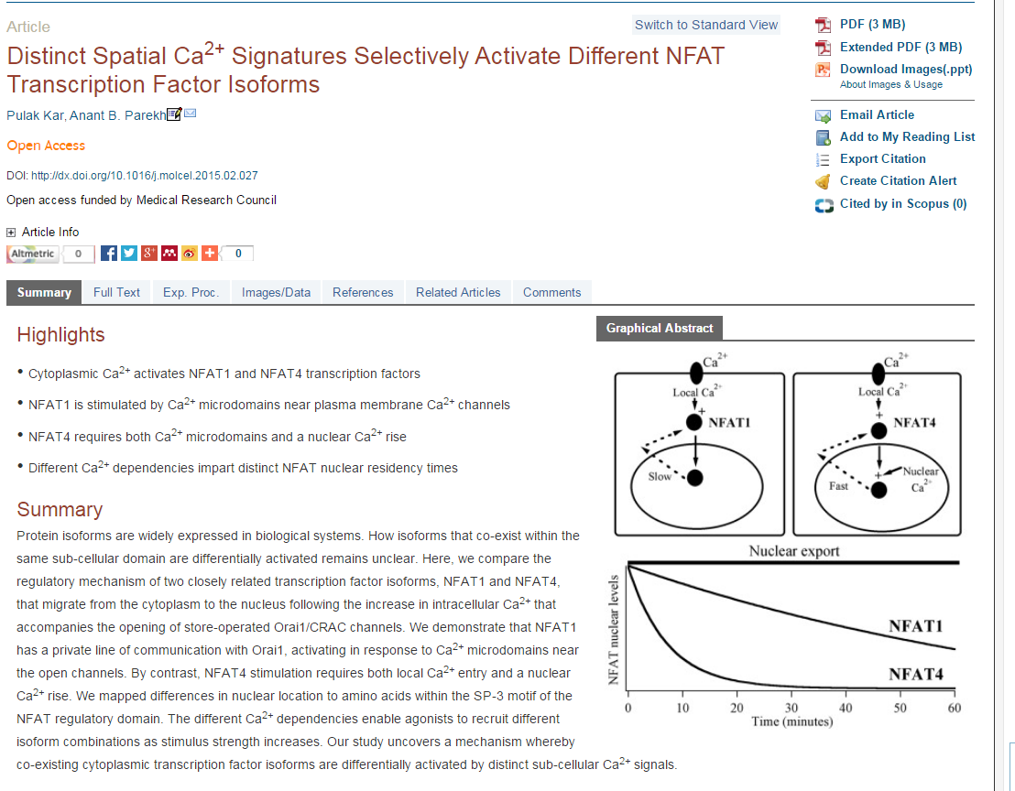

Slide 11
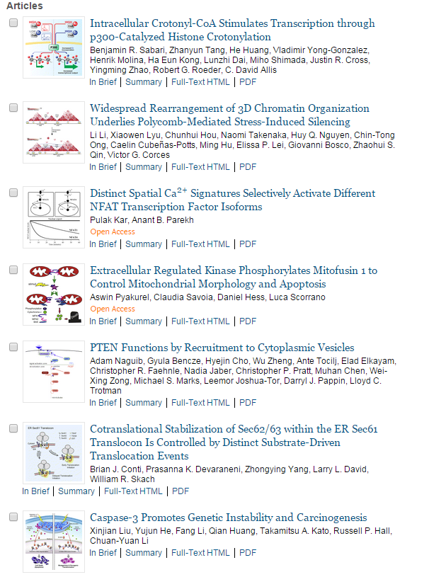

Slide 12
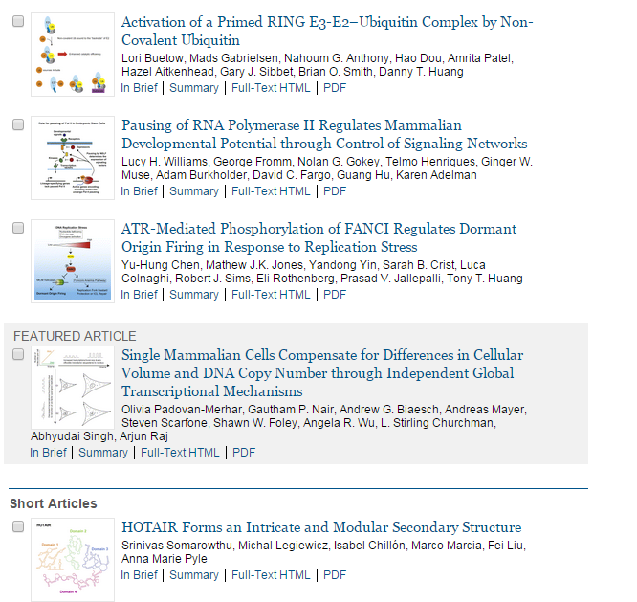

Slide 13
IGFBP2 potentiates nuclear EGFR-STAT3 signaling.
Chua CY¹, Liu Y², Granberg KJ³, Hu L⁴, Haapasalo H⁵, Annala MJ³, Cogdell DE⁴, Verploegen M⁶, Moore LM⁴, Fuller GN⁷, Nykter M⁸, Cavenee WK⁹, Zhang W⁷.
Author information
¹1] Department of Pathology, The University of Texas MD Anderson Cancer Center, Houston, TX, USA
Insulin-like growth factor binding protein 2 (IGFBP2) is a pleiotropic oncogenic protein that has both extracellular and intracellular functions. Despite a clear causal role in cancer development, the tumor-promoting mechanisms of IGFBP2 are poorly understood. The contributions of intracellular IGFBP2 to tumor development and progression are also unclear. Here we present evidence that both exogenous IGFBP2 treatment and cellular IGFBP2 overexpression lead to aberrant activation of epidermal growth factor receptor (EGFR), which subsequently activates signal transducer and activator of transcription factor 3 (STAT3) signaling. Furthermore, we demonstrate that IGFBP2 augments the nuclear accumulation of EGFR to potentiate STAT3 transactivation activities, via activation of the nuclear EGFR signaling pathway. Nuclear IGFBP2 directly influences the invasive and migratory capacities of human glioblastoma cells, providing a direct link between intracellular (and particularly nuclear) IGFBP2 and cancer hallmarks. These activities are also consistent with the strong association between IGFBP2 and STAT3-activated genes derived from The Cancer Genome Atlas database for human glioma. A high level of all three proteins (IGFBP2, EGFR and STAT3) was strongly correlated with poorer survival in an independent patient data set. These results identify a novel tumor-promoting function for IGFBP2 of activating EGFR/STAT3 signaling and facilitating EGFR accumulation in the nucleus, thereby deregulating EGFR signaling by two distinct mechanisms. As targeting EGFR in glioma has been relatively unsuccessful, this study suggests that IGFBP2 may be a novel therapeutic target.Oncogene

Slide 14
Betulinic acid induces a novel cell death pathway that depends on cardiolipin modification.
Potze L¹, Di Franco S², Grandela C¹, Pras-Raves ML³, Picavet DI⁴, van Veen HA⁴, van Lenthe H⁵, Mullauer FB¹, van der Wel NN⁴, Luyf A³, van Kampen AH³, Kemp S⁵, Everts V⁴, Kessler JH¹, Vaz FM⁵, Medema JP¹.
Author information
¹Laboratory for Experimental Oncology and Radiobiology (LEXOR), Center for Experimental and Molecular Medicine, University of Amsterdam, Academic Medical Center (AMC), Amsterdam, The Netherlands.
Cancer is associated with strong changes in lipid metabolism. For instance, normal cells take up fatty acids (FAs) from the circulation, while tumour cells generate their own and become dependent on de novo FA synthesis, which could provide a vulnerability to target tumour cells. Betulinic acid (BetA) is a natural compound that selectively kills tumour cells through an ill-defined mechanism that is independent of BAX and BAK, but depends on mitochondrial permeability transition-pore opening. Here we unravel this pathway and show that BetA inhibits the activity of steroyl-CoA-desaturase (SCD-1). This enzyme is overexpressed in tumour cells and critically important for cells that utilize de novo FA synthesis as it converts newly synthesized saturated FAs to unsaturated FAs. Intriguingly, we find that inhibition of SCD-1 by BetA or, alternatively, with a specific SCD-1 inhibitor directly and rapidly impacts on the saturation level of cardiolipin (CL), a mitochondrial lipid that has important structural and metabolic functions and at the same time regulates mitochondria-dependent cell death. As a result of the enhanced CL saturation mitochondria of cancer cells, but not normal cells that do not depend on de novo FA synthesis, undergo ultrastructural changes, release cytochrome c and quickly induce cell death. Importantly, addition of unsaturated FAs circumvented the need for SCD-1 activity and thereby prevented BetA-induced CL saturation and subsequent cytotoxicity, supporting the importance of this novel pathway in the cytotoxicity induced by BetA.

Slide 15
SCP1 regulates c-Myc stability and functions through dephosphorylating c-Myc Ser62.
Wang W¹, Liao P¹, Shen M², Chen T², Chen Y², Li Y², Lin X³, Ge X⁴, Wang P⁵.
Author information
¹1] Department of Central Laboratory, Shanghai 10th People's Hospital, Tongji University, Shanghai, China [2] Shanghai Key Laboratory of Regulatory Biology, Institute of Biomedical Sciences and School of Life Sciences, East China Normal University, Shanghai, China.
Abstract
Serine 62 (Ser62) phosphorylation affects the c-Myc protein stability in cancer cells. However, the mechanism for dephosphorylating c-Myc is not well understood. In this study, we identified carboxyl-terminal domain RNA polymerase II polypeptide A small phosphatase 1 (SCP1) as a novel phosphatase specifically dephosphorylating c-Myc Ser62. Ectopically expressed SCP1 strongly dephosphorylated c-Myc Ser62, destabilized c-Myc protein and suppressed c-Myc transcriptional activity. Knockdown of SCP1 increased the c-Myc protein levels in liver cancer cells. SCP1 interacted with c-Myc both in vivo and in vitro. In addition, Ser245 at the C-terminus of SCP1 was essential for its phosphatase activity towards c-Myc. Functionally, SCP1 negatively regulated the cancer cell proliferation. Collectively, our findings indicate that SCP1 is a potential tumor suppressor for liver cancers through dephosphorylating c-Myc Ser62.

Slide 16
A novel role for non-ubiquitinated FANCD2 in response to hydroxyurea-induced DNA damage.
Chen X¹, Bosques L¹, Sung P², Kupfer GM¹.
Author information
¹1] Department of Pediatrics, Section of Hematology/Oncology, Yale Cancer Center, Yale School of Medicine, New Haven, CT, USA [2] Department of Pathology, Section of Hematology/Oncology, Yale Cancer Center, Yale School of Medicine, New Haven, CT, USA.
Role of Merlin/NF2 inactivation in tumor biology.
Petrilli AM¹, Fernández-Valle C¹.
Author information
¹Department of Biomedical Sciences, College of Medicine, University of Central Florida, Orlando, FL, USA.
NONO regulates the intra-S-phase checkpoint in response to UV radiation.
Alfano L¹, Costa C¹, Caporaso A², Altieri A¹, Indovina P³, Macaluso M⁴, Giordano A³, Pentimalli F¹.
Author information
¹CROM, Istituto Nazionale Tumori "Fondazione G. Pascale"- IRCCS, Naples, Italy
Smad4 loss promotes lung cancer formation but increases sensitivity to DNA topoisomerase inhibitors.
Haeger SM¹, Thompson JJ¹, Kalra S¹, Cleaver TG¹, Merrick D², Wang XJ², Malkoski SP³.
Author information
¹Division of Pulmonary Sciences and Critical Care Medicine, University of Colorado Denver Anschutz Medical Campus, Aurora, CO, USA.
Lysine-specific demethylase 1 promotes the stemness and chemoresistance of Lgr5+ liver cancer initiating cells by suppressing negative regulators of β-catenin signaling.
Lei ZJ¹, Wang J¹, Xiao HL², Guo Y¹, Wang T¹, Li Q¹, Liu L¹, Luo X¹, Fan LL¹, Lin L², Mao CY², Wang SN³, Wei YL¹, Lan CH¹, Jiang J⁴, Yang XJ⁵, Liu PD⁶, Chen DF¹, Wang B¹.
Author information
¹Department of Gastroenterology, Institute of Surgery Research, Daping Hospital, Third Military Medical University, Chongqing, China
The evolving paradigm of cell-nonautonomous UPR-based regulation of immunity by cancer cells.
Zanetti M¹, Rodvold JJ¹, Mahadevan NR¹.
Author information
¹1] The Laboratory of Immunology, Department of Medicine, University of California, San Diego, La Jolla, CA, USA [2] Moores Cancer Center, University of California, San Diego, La Jolla, CA, USA

Slide 17

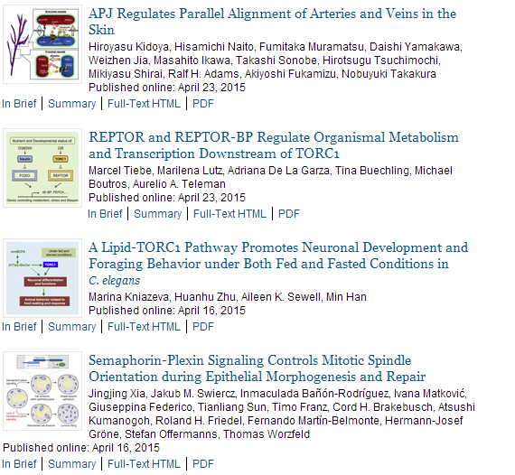

Slide 18

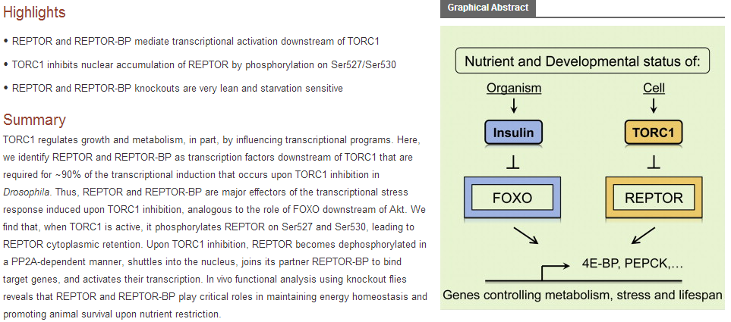

Slide 19
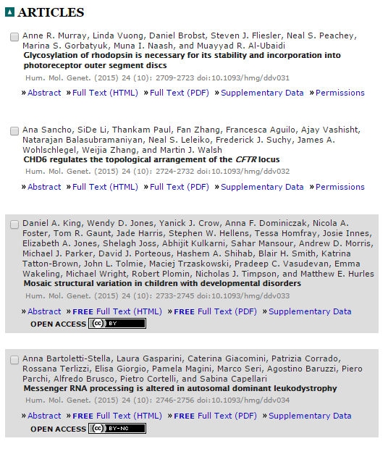
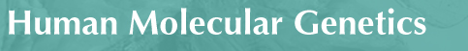

Slide 20
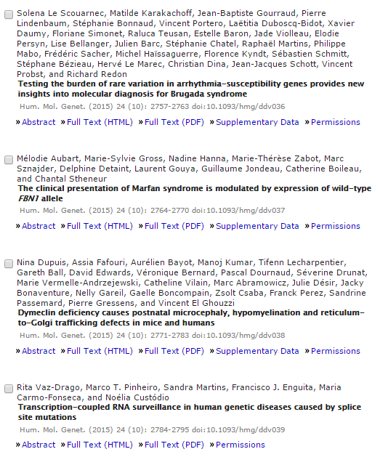

Slide 21
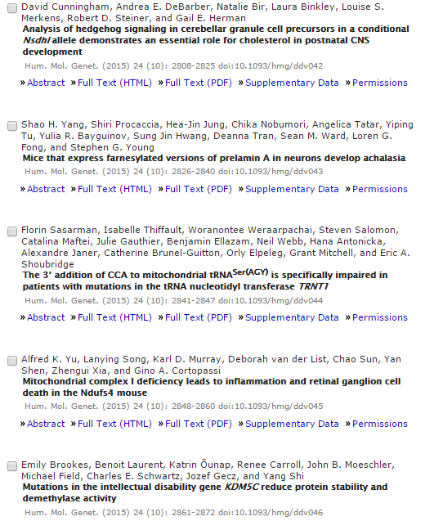

Slide 22
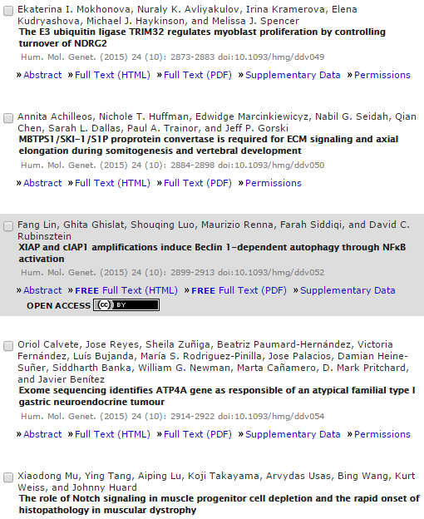

Slide 23
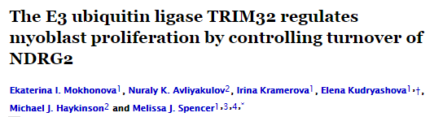
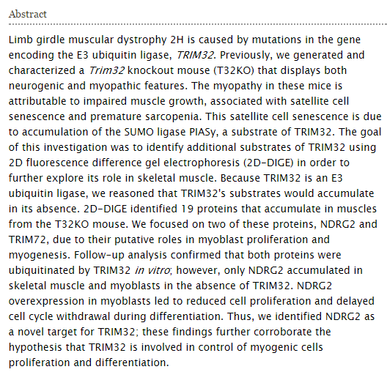

Slide 24

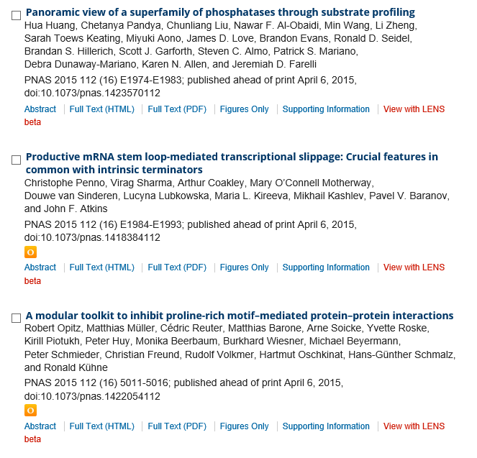

Slide 25
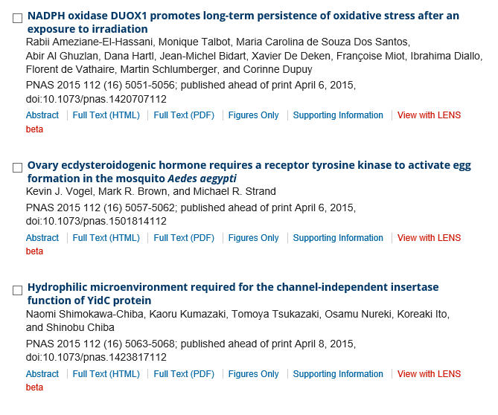
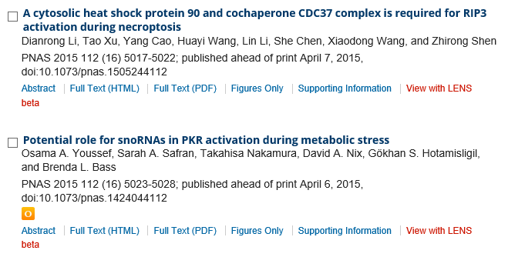

Slide 26
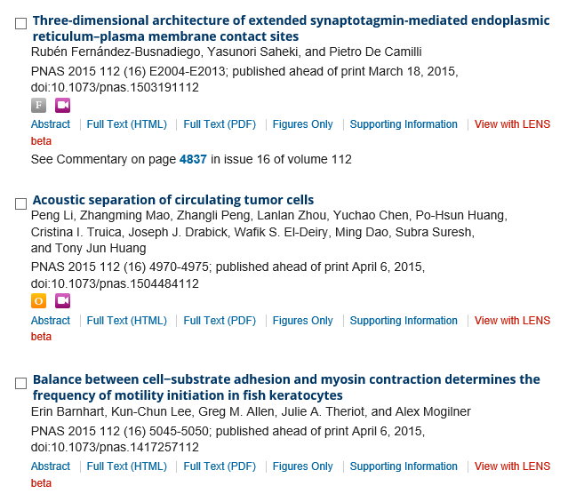

Slide 27
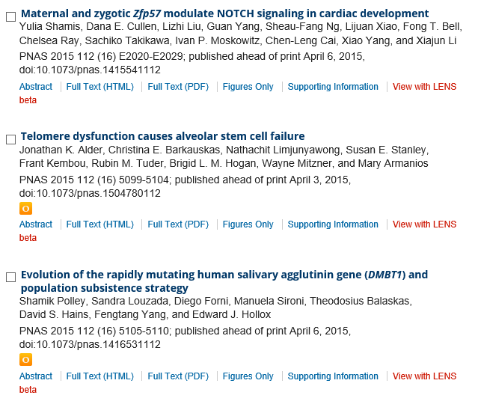

Slide 28


