Slide 1

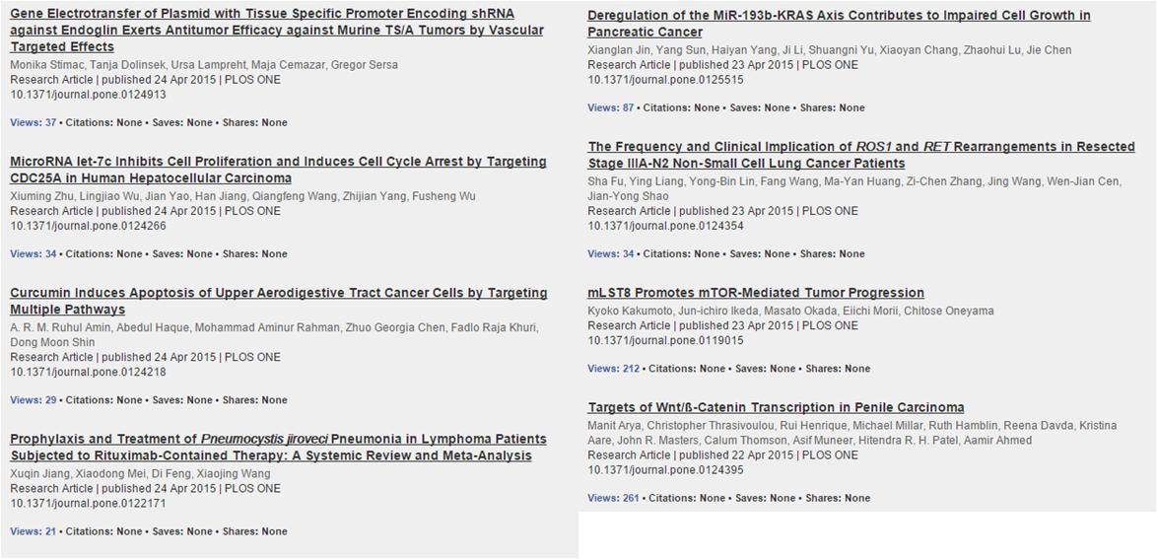

Slide 2
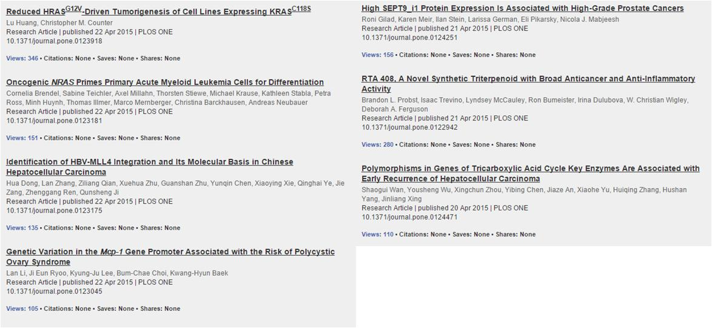

Slide 3
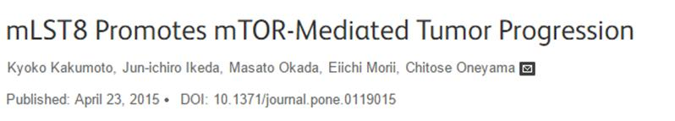
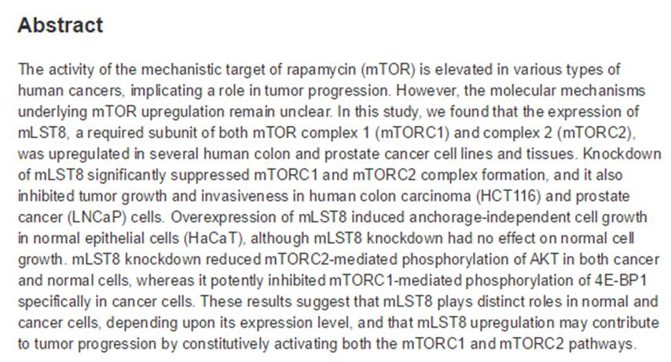

Slide 4

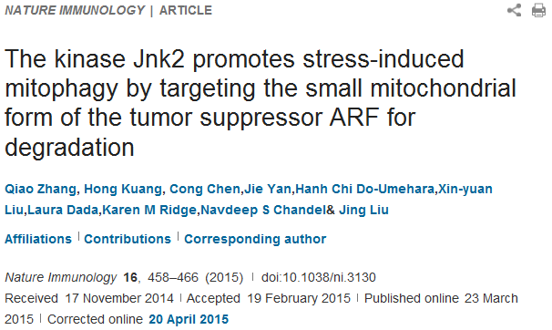
Abstract
Mitophagy is essential for cellular homeostasis, but how mitophagy is regulated is largely unknown. Here we found that the kinase Jnk2 was required for stress-induced mitophagy. Jnk2 promoted ubiquitination and proteasomal degradation of the small mitochondrial form of the tumor suppressor ARF (smARF). Loss of Jnk2 led to the accumulation of smARF, which induced excessive autophagy that resulted in lysosomal degradation of the mitophagy adaptor p62 at steady state. Depletion of p62 prevented Jnk2-deficient cells from mounting mitophagy upon stress. Jnk2-deficient mice displayed defective mitophagy, which resulted in tissue damage under hypoxic stress, as well as hyperactivation of inflammasomes and increased mortality in sepsis. Our findings define a unique mechanism of maintaining immunological homeostasis that protects the host from tissue damage and mortality.

Slide 5
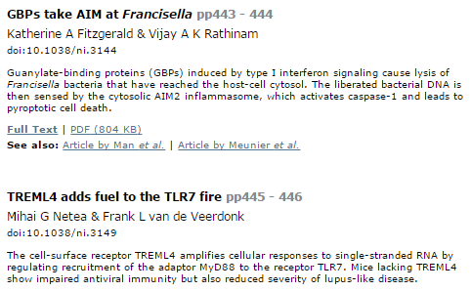
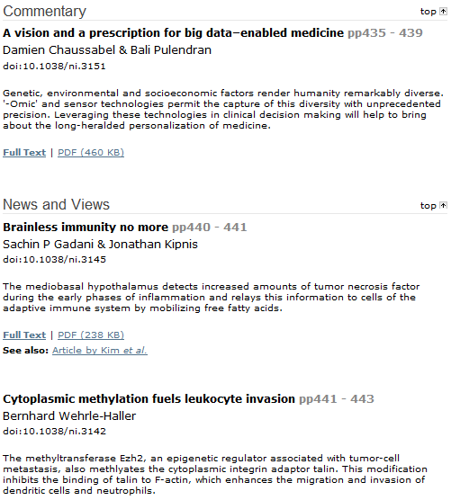
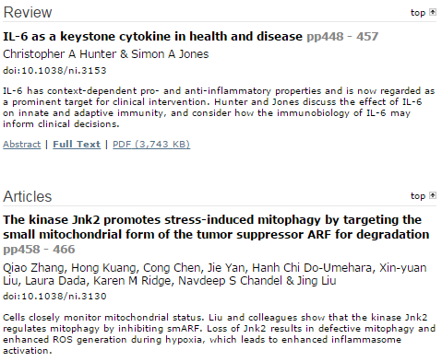

Slide 6
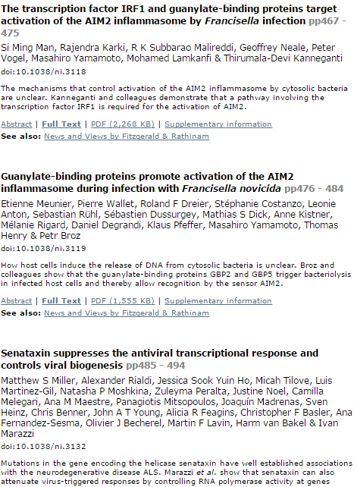
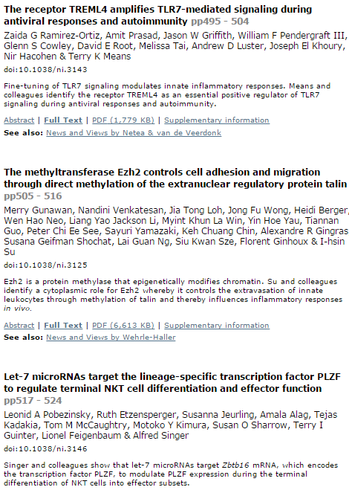

Slide 7
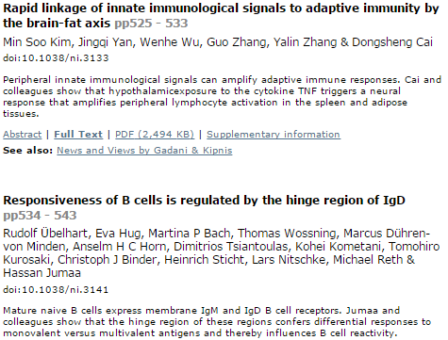
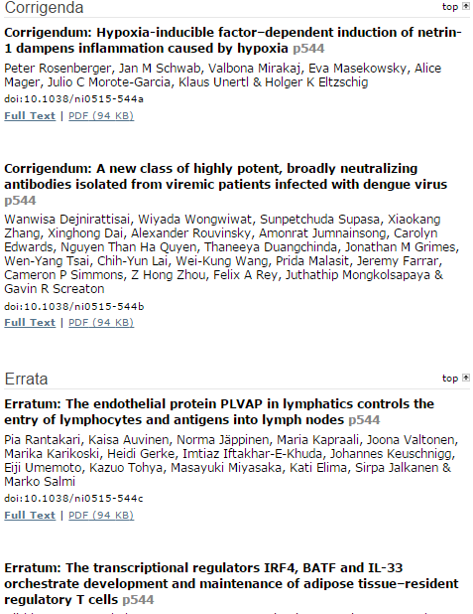

Slide 8

KJ
Science Volume 348, Number 6232, Issue of 17 April 2015
Stem Cells
Stem cells can sort mitochondria by age
L. Bryan Ray
The renewal of tissues in aging organisms requires stem cells, which have the unusual ability to divide asymmetrically into one daughter cell that retains stem cell properties and another that differentiates into a particular tissue type. Katajisto et al. used photoactivated marker proteins to monitor the age of cell organelles in stemlike cells from human breast tissue and their distribution into daughter cells. Most organelles were evenly distributed, but daughter cells that maintained stem-cell properties received more newly produced mitochondria and fewer old ones.
Cancer
Will the real mutation please stand up?
Yevgeniya Nusinovich
When a patient is diagnosed with cancer, tumor samples are analyzed to search for mutations that might guide targeted treatment of the disease. Jones et al. characterized samples from more than 800 patients with 15 different cancer types. For accuracy, this approach requires a matched sample of normal DNA from the same patient. By doing this, mutations present in the patient's normal tissues can be excluded as therapeutic targets, and therapeutically useful new mutations in the tumor are revealed.

Slide 9
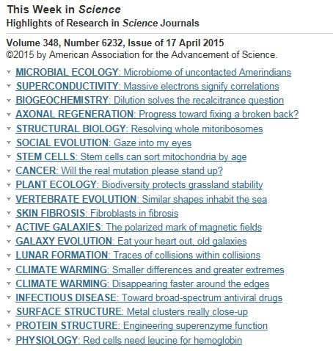
KJ

Slide 10
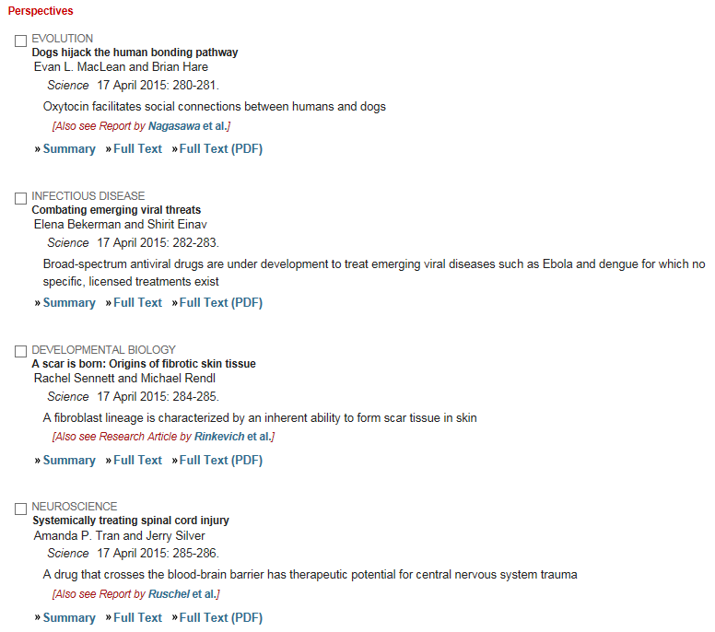
KJ

Slide 11
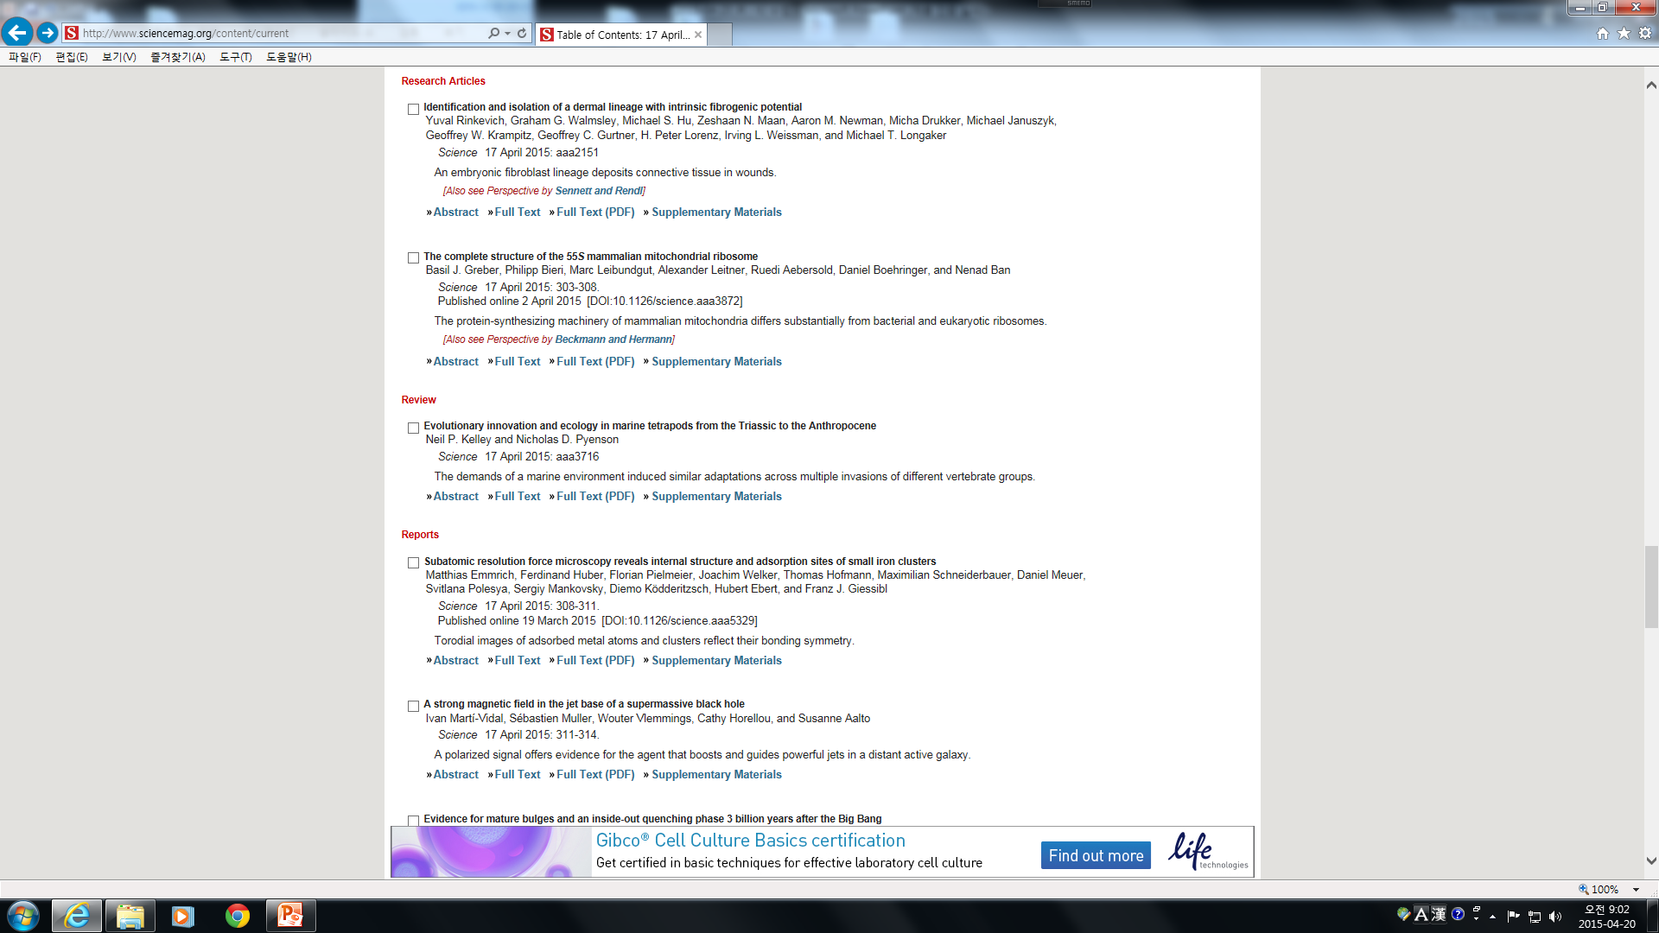
KJ

Slide 12
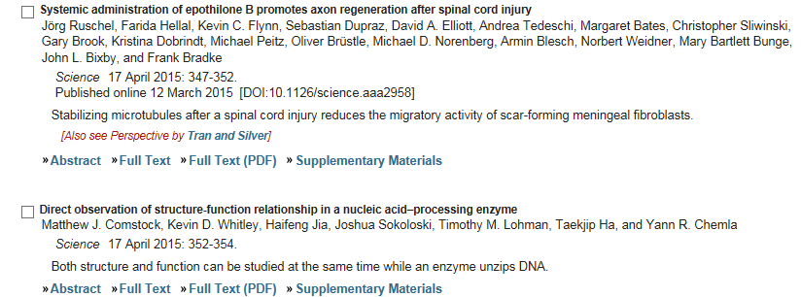
KJ

