Slide 1



Slide 2


Slide 3
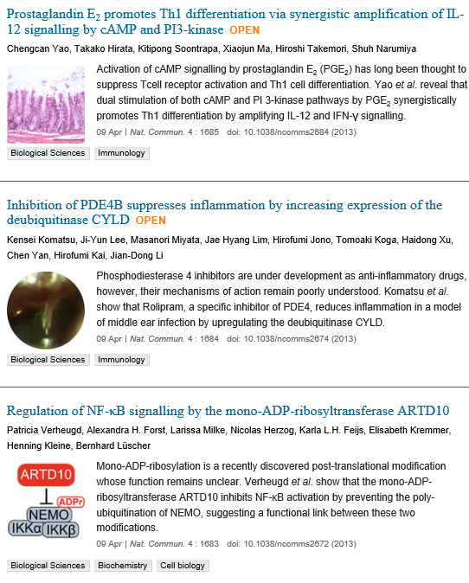

Slide 4
Inhibition of PDE4B suppresses inflammation by increasing expression of the deubiquitinase CYLD
Kensei Komatsu,^{1, 7} Ji-Yun Lee,^{1, 7} Masanori Miyata,¹ Jae Hyang Lim,² Hirofumi Jono,³
Tomoaki Koga,⁴ Haidong Xu,¹ Chen Yan,⁵ Hirofumi Kai⁶ & Jian-Dong Li¹
Center for Inflammation, Immunity & Infection and Department of Biology, Georgia State University, 100 Piedmont Avenue, Atlanta, Georgia 30303, USA
The deubiquitinase CYLD acts as a key negative regulator to tightly control overactive inflammation. Most anti-inflammatory strategies have focused on directly targeting the positive regulator, which often results in significant side effects such as suppression of the host defence response. Here, we show that inhibition of phosphodiesterase 4B (PDE4B) markedly enhances upregulation of CYLD expression in response to bacteria, thereby suggesting that PDE4B acts as a negative regulator for CYLD. Interestingly, in Cyld-deficient mice, inhibition of PDE4B no longer suppresses inflammation. Moreover, PDE4B negatively regulates CYLD via specific activation of JNK2 but not JNK1. Importantly, ototopical post-inoculation administration of a PDE4 inhibitor suppresses inflammation in this animal model, thus demonstrating the therapeutic potential of targeting PDE4. These studies provide insights into how inflammation is tightly regulated via the inhibition of its negative regulator and may also lead to the development of new anti-inflammatory therapeutics that upregulate CYLD expression.

Slide 5
Regulation of NF-κB signalling by the mono-ADP-ribosyltransferase ARTD10
Patricia Verheugd,¹ Alexandra H. Forst,¹ Larissa Milke,^{1, 3} Nicolas Herzog,¹ Karla L.H. Feijs,¹ Elisabeth Kremmer,² Henning Kleine^{1, 3} & Bernhard Lüscher¹
Institute of Biochemistry and Molecular Biology, Medical School, RWTH Aachen University, Aachen 52074, Germany;
Adenosine diphosphate-ribosylation is a post-translational modification mediated by intracellular and membrane-associated extracellular enzymes and many bacterial toxins. The intracellular enzymes modify their substrates either by poly-ADP-ribosylation, exemplified by ARTD1/PARP1, or by mono-ADP-ribosylation. The latter has been discovered only recently, and little is known about its physiological relevance. The founding member of mono-ADP-ribosyltransferases is ARTD10/PARP10. It possesses two ubiquitin-interaction motifs, a unique feature among ARTD/PARP enzymes. Here, we find that the ARTD10 ubiquitin-interaction motifs bind to K63-linked poly-ubiquitin, a modification that is essential for NF-κB signalling. We therefore studied the role of ARTD10 in this pathway. ARTD10 inhibits the activation of NF-κB and downstream target genes in response to interleukin-1β and tumour necrosis factor-α, dependent on catalytic activity and poly-ubiquitin binding of ARTD10. Mechanistically ARTD10 interferes with poly-ubiquitination of NEMO, which interacts with and is a substrate of ARTD10. Our findings identify a novel regulator of NF-κB signalling and provide evidence for cross-talk between K63-linked poly-ubiquitination and mono-ADP-ribosylation.

Slide 6
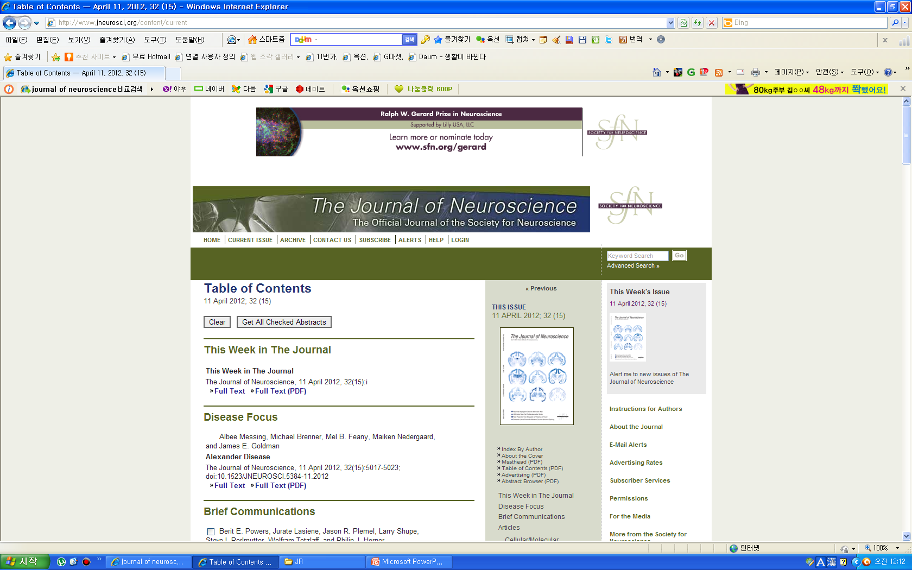
KJ
Increases in cAMP, MAPK Activity, and CREB Phosphorylation during REM Sleep: Implications for REM Sleep and Memory Consolidation
Jie Luo, Trongha X. Phan, Yimei Yang, Michael G. Garelick, and Daniel R. Storm
Abstract
The cyclic adenosine monophosphate (cAMP), mitogen-activated protein kinase (MAPK), and cAMP response element-binding protein (CREB) transcriptional pathway is required for consolidation of hippocampus-dependent memory. In mice, this pathway undergoes a circadian oscillation required for memory persistence that reaches a peak during the daytime. Because mice exhibit polyphasic sleep patterns during the day, this suggested the interesting possibility that cAMP, MAPK activity, and CREB phosphorylation may be elevated during sleep. Here, we report that cAMP, phospho-p44/42 MAPK, and phospho-CREB are higher in rapid eye movement (REM) sleep compared with awake mice but are not elevated in non-REM sleep. This peak of activity during REM sleep does not occur in mice lacking calmodulin-stimulated adenylyl cyclases, a mouse strain that learns but cannot consolidate hippocampus-dependent memory. We conclude that a preferential increase in cAMP, MAPK activity, and CREB phosphorylation during REM sleep may contribute to hippocampus-dependent memory consolidation.

Slide 7


KJ

Slide 8


KJ

Slide 9


KJ

