Slide 1


[Science] 9 AUGUST 2013 VOL 341, ISSUE 6146, PAGES 585-688

Slide 2
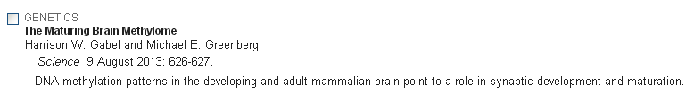
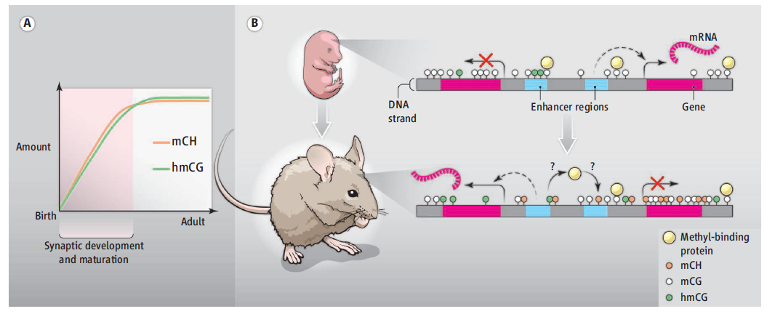
[Science] 9 AUGUST 2013 VOL 341, ISSUE 6146, PAGES 585-688
Science. 2013 Aug 9;341(6146):1237905. doi: 10.1126/science.1237905. Epub 2013 Jul 4.
Global epigenomic reconfiguration during Mammalian brain development.
Lister R, Mukamel EA, Nery JR, Urich M, Puddifoot CA, Johnson ND, Lucero J, Huang Y, Dwork AJ, Schultz MD, Yu M, Tonti-Filippini J, Heyn H, Hu S, Wu JC, Rao A, Esteller M, He C, Haghighi FG, Sejnowski TJ, Behrens MM, Ecker JR.
Genomic Analysis Laboratory, The Salk Institute for Biological Studies, La Jolla, CA 92037, USA.
DNA methylation is implicated in mammalian brain development and plasticity underlying learning and memory. We report the genome-wide composition, patterning, cell specificity, and dynamics of DNA methylation at single-base resolution in human and mouse frontal cortex throughout their lifespan. Widespread methylome reconfiguration occurs during fetal to young adult development, coincident with synaptogenesis. During this period, highly conserved non-CG methylation (mCH) accumulates in neurons, but not glia, to become the dominant form of methylation in the human neuronal genome. Moreover, we found an mCH signature that identifies genes escaping X-chromosome inactivation. Last, whole-genome single-base resolution 5-hydroxymethylcytosine (hmC) maps revealed that hmC marks fetal brain cell genomes at putative regulatory regions that are CG-demethylated and activated in the adult brain and that CG demethylation at these hmC-poised loci depends on Tet2 activity.

Slide 3
[Science] 9 AUGUST 2013 VOL 341, ISSUE 6146, PAGES 585-688
Pluripotent Stem Cells Induced from Mouse Somatic Cells by Small-Molecule Compounds
Pingping Hou, Yanqin Li, Xu Zhang, Chun Liu, Jingyang Guan, Honggang Li, Ting Zhao, Junqing Ye, Weifeng Yang, Kang Liu, Jian Ge,Jun Xu,
Qiang Zhang, Yang Zhao, and Hongkui Deng
Science 9 August 2013: 651-654.
A proof-of-principle study reports somatic reprogramming to the pluripotent state using small-molecule compounds.
Nuclear Pore Scaffold Structure Analyzed by Super-Resolution Microscopy and Particle Averaging
Anna Szymborska, Alex de Marco, Nathalie Daigle, Volker C. Cordes, John A. G. Briggs, and Jan Ellenberg
Science 9 August 2013: 655-658.
The localization of individual components of the nuclear pore complex was dissected using information from thousands of pores.
Polyploids Exhibit Higher Potassium Uptake and Salinity Tolerance in Arabidopsis
Dai-Yin Chao, Brian Dilkes, Hongbing Luo, Alex Douglas, Elena Yakubova, Brett Lahner, and David E. Salt
Science 9 August 2013: 658-659.
Certain thale cress plants collected in the wild contain a duplicated genome and can cope with salty soil.
Spatial Dynamics of Chromosome Translocations in Living Cells
Vassilis Roukos, Ty C. Voss, Christine K. Schmidt, Seungtaek Lee, Darawalee Wangsa, and Tom Misteli
Science 9 August 2013: 660-664.
An experimental system allows the visualization of human cell chromosome translocations in real time.
shared between immune B cell germinal centers.

Slide 4
[Science] 9 AUGUST 2013 VOL 341, ISSUE 6146, PAGES 585-688
Real-Time Dynamics of RNA Polymerase II Clustering in Live Human Cells
Ibrahim I. Cisse, Ignacio Izeddin, Sebastien Z. Causse, Lydia Boudarene, Adrien Senecal, Leila Muresan, Claire Dugast-Darzacq,Bassam Hajj,
Maxime Dahan, and Xavier Darzacq
Science 9 August 2013: 664-667.
A single-cell quantitative method reveals changes in the distribution of proteins with single-molecule sensitivity.
The Hologenomic Basis of Speciation: Gut Bacteria Cause Hybrid Lethality in the Genus Nasonia
Robert M. Brucker and Seth R. Bordenstein
Science 9 August 2013: 667-669.
Speciation may be a collective property of an organism and its microbiota.
Positive Feedback Between PU.1 and the Cell Cycle Controls Myeloid Differentiation
Hao Yuan Kueh, Ameya Champhekhar, Stephen L. Nutt, Michael B. Elowitz, and Ellen V. Rothenberg
Science 9 August 2013: 670-673.
Regulation of cell cycle length is a feedback mechanism that controls cell fate decisions in developing macrophages.
T Follicular Helper Cell Dynamics in Germinal Centers
Ziv Shulman, Alexander D. Gitlin, Sasha Targ, Mila Jankovic, Giulia Pasqual, Michel C. Nussenzweig, and Gabriel D. Victora
Science 9 August 2013: 673-677.
Tracking individual cells reveals that immunological T cell help is shared between immune B cell germinal centers.

Slide 5
[Science Sig] 6 AUGUST 2013 VOL 6, ISSUE 287
Sci Signal. 2013 Aug 6;6(287):ra66. doi: 10.1126/scisignal.2004155.
The Receptor AXL Diversifies EGFR Signaling and Limits the Response to EGFR-Targeted Inhibitors inTriple-Negative Breast Cancer Cells.
Meyer AS, Miller MA, Gertler FB, Lauffenburger DA.
1Department of Biological Engineering, Massachusetts Institute of Technology, Cambridge, MA 02139, USA.
The relationship between drug resistance, changes in signaling, and emergence of an invasive phenotype is well appreciated, but the underlying mechanisms are not well understood. Using machine learning analysis applied to the Cancer Cell Line Encyclopedia database, we identified expression of AXL, the gene that encodes the epithelial-to-mesenchymal transition (EMT)-associated receptor tyrosine kinase (RTK) AXL, as exceptionally predictive of lack of response to ErbB family receptor-targeted inhibitors. Activation of EGFR (epidermal growth factor receptor) transactivated AXL, and this ligand-independent AXL activity diversified EGFR-induced signaling into additional downstream pathways beyond those triggered by EGFR alone. AXL-mediated signaling diversification was required for EGF (epidermal growth factor)-elicited motility responses in AXL-positive TNBC (triple-negative breast cancer) cells. Using cross-linking coimmunoprecipitation assays, we determined that AXL associated with EGFR, other ErbB receptor family members, MET (hepatocyte growth factor receptor), and PDGFR (platelet-derived growth factor receptor) but not IGF1R (insulin-like growth factor 1 receptor) or INSR (insulin receptor). From these AXL interaction data, we predicted AXL-mediatedsignaling synergy for additional RTKs and validated these predictions in cells. This alternative mechanism of receptor activation limits the use of ligand-blocking therapies and indicates against therapy withdrawal after acquired resistance. Further, subadditive interaction between EGFR- andAXL-targeted inhibitors across all AXL-positive TNBC cell lines may indicate that increased abundance of EGFR is principally a means to transactivation-mediated signaling.

Slide 6
[Science Sig] 6 AUGUST 2013 VOL 6, ISSUE 287
Sci Signal. 2013 Aug 6;6(287):ra67. doi: 10.1126/scisignal.2003948.
Interference with akt signaling protects against myocardial infarction and death by limiting theconsequences of oxidative stress.
Kerr BA, Ma L, West XZ, Ding L, Malinin NL, Weber ME, Tischenko M, Goc A, Somanath PR, Penn MS, Podrez EA, Byzova TV.
1Department of Molecular Cardiology, Joseph J. Jacobs Center for Thrombosis and Vascular Biology, Lerner Research Institute, Cleveland Clinic, Cleveland, OH 44195, USA.
The intricacy of multiple feedback loops in the pathways downstream of Akt allows this kinase to control multiple cellular processes in the cardiovascular system and precludes inferring consequences of its activation in specific pathological conditions. Akt1, the major Akt isoform in the heart and vasculature, has a protective role in the endothelium during atherosclerosis. However, Akt1 activation may also have detrimentalconsequences in the cardiovascular system. Mice lacking both the high-density lipoprotein receptor SR-BI (scavenger receptor class B type I) and ApoE (apolipoprotein E), which promotes clearance of remnant lipoproteins, are a model of severe dyslipidemia and spontaneous myocardialinfarction. We found that Akt1 was activated in these mice, and this activation correlated with cardiac dysfunction, hypertrophy, and fibrosis; increased infarct area; cholesterol accumulation in macrophages and atherosclerosis; and reduced life span. Akt1 activation was associated with inflammation, oxidative stress, accumulation of oxidized lipids, and increased abundance of CD36, a major sensor of oxidative stress, and these events created a positive feedback loop that exacerbated the consequences of oxidative stress. Genetic deletion of Akt1 in this mouse model resulted in decreased mortality, alleviation of multiple complications of heart disease, and reduced occurrence of spontaneous myocardialinfarction. Thus, interference with Akt1 signaling in vivo could be protective and improve survival under dyslipidemic conditions by reducingoxidative stress and responses to oxidized lipids.

Slide 7
[Science Translational Medicine] 7 AUGUST 2013 VOL 5, ISSUE 197
Sci Transl Med. 2013 Aug 7;5(197):197ra104. doi: 10.1126/scitranslmed.3006258.
Adenosine receptor antagonists including caffeine alter fetal brain development in mice.
Silva CG, Métin C, Fazeli W, Machado NJ, Darmopil S, Launay PS, Ghestem A, Nesa MP, Bassot E, Szabó E, Baqi Y, Müller CE, Tomé AR, Ivanov A,Isbrandt D, Zilberter Y, Cunha RA, Esclapez M, Bernard C.
Aix Marseille Université, INS, 13005 Marseille, France.
Consumption of certain substances during pregnancy can interfere with brain development, leading to deleterious long-term neurological and cognitive impairments in offspring. To test whether modulators of adenosine receptors affect neural development, we exposed mouse dams to a subtype-selective adenosine type 2A receptor (A2AR) antagonist or to caffeine, a naturally occurring adenosine receptor antagonist, during pregnancy and lactation. We observed delayed migration and insertion of γ-aminobutyric acid (GABA) neurons into the hippocampal circuitry during the first postnatal week in offspring of dams treated with the A2AR antagonist or caffeine. This was associated with increased neuronal network excitability and increased susceptibility to seizures in response to a seizure-inducing agent. Adult offspring of mouse dams exposed to A2AR antagonists during pregnancy and lactation displayed loss of hippocampal GABA neurons and some cognitive deficits. These results demonstrate that exposure to A2AR antagonists including caffeine during pregnancy and lactation in rodents may have adverse effects on the neural development of their offspring.

Slide 8
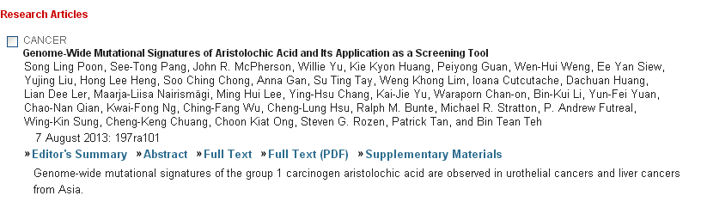
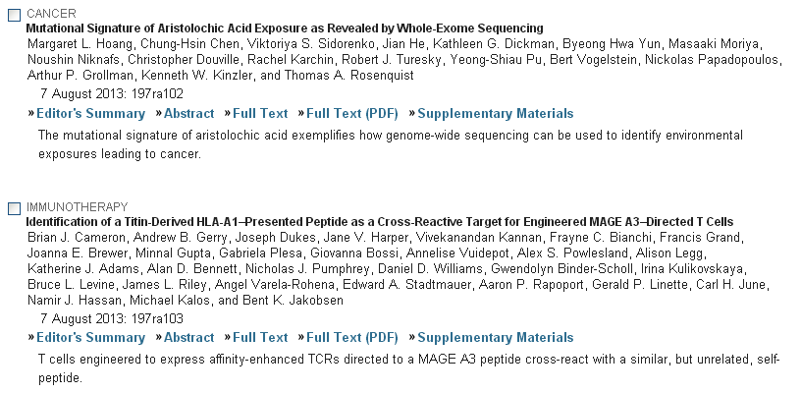
[Science Translational Medicine] 7 AUGUST 2013 VOL 5, ISSUE 197

Slide 9
Journal of Immunology
BRIEF REVIEWS
Immunobiology and Conflicting Roles of the Human NKG2D Lymphocyte Receptor and Its Ligands in Cancer
Ahmed El-Gazzar, Veronika Groh, and Thomas Spies
J Immunol 2013 191:1509-1515; doi:10.4049/jimmunol.1301071
AUTOIMMUNITY
microRNA-17–92 Regulates IL-10 Production by Regulatory T Cells and Control of Experimental Autoimmune Encephalomyelitis
Dimitri de Kouchkovsky, Jonathan H. Esensten, Wendy L. Rosenthal, Malika M. Morar, Jeffrey A. Bluestone, and Lukas T. Jeker
J Immunol 2013 191:1594-1605; published ahead of print July 15, 2013, doi:10.4049/jimmunol.1203567
Notch Signaling Regulates T Cell Accumulation and Function in the Central Nervous System during Experimental Autoimmune Encephalomyelitis
Ashley R. Sandy, Josh Stoolman, Kelli Malott, Prae Pongtornpipat, Benjamin M. Segal, and Ivan Maillard
J Immunol 2013 191:1606-1613; published ahead of print July 3, 2013, doi:10.4049/jimmunol.1301116
IL-17RA Is Essential for Optimal Localization of Follicular Th Cells in the Germinal Center Light Zone To Promote Autoantibody-Producing B Cells
Yanna Ding, Jun Li, Qi Wu, Pingar Yang, Bao Luo, Shutao Xie, Kirk M. Druey, Allan J. Zajac, Hui-Chen Hsu, and John D. Mountz
J Immunol 2013 191:1614-1624; published ahead of print July 15, 2013, doi:10.4049/jimmunol.1300479
IMMUNE REGULATION
The Composite Cytokine p28/Cytokine-Like Factor 1 Sustains B Cell Proliferation and Promotes Plasma Cell Differentiation
Aurélie Jeanne Tormo, Yasmine Meliani, Linda Ann Beaupré, Mukut Sharma, Jörg H. Fritz, Greg Elson, Sandrine Crabé, and Jean-François Gauchat
J Immunol 2013 191:1657-1665; published ahead of print July 8, 2013, doi:10.4049/jimmunol.1201595
Human Invariant NKT Cell Subsets Differentially Promote Differentiation, Antibody Production, and T Cell Stimulation by B Cells In Vitro
Shijuan Grace Zeng, Yasmeen G. Ghnewa, Vincent P. O’Reilly, Victoria G. Lyons, Ann Atzberger, Andrew E. Hogan, Mark A. Exley, and Derek G. Doherty
J Immunol 2013 191:1666-1676; published ahead of print July 12, 2013, doi:10.4049/jimmunol.1202223
Conditional Deletion of PTEN in Peripheral T Cells Augments TCR-Mediated Activation but Does Not Abrogate CD28 Dependency or Prevent Anergy Induction
Frederick L. Locke, Yuan-yuan Zha, Yan Zheng, Gregory Driessens, and Thomas F. Gajewski
J Immunol 2013 191:1677-1685; published ahead of print July 12, 2013, doi:10.4049/jimmunol.1202018
Control of In Vivo Collateral Damage Generated by T Cell Immunity
Govindarajan Thangavelu, Ronald G. Gill, Louis Boon, Kristofor K. Ellestad, and Colin C. Anderson
J Immunol 2013 191:1686-1691; published ahead of print July 12, 2013, doi:10.4049/jimmunol.1203240

Slide 10
B Cell–Specific Deficiencies in mTOR Limit Humoral Immune Responses
Shuling Zhang, Margaret Pruitt, Dena Tran, Wendy Du Bois, Ke Zhang, Rushi Patel, Shelley Hoover, R. Mark Simpson, John Simmons, Joy Gary, Clifford M. Snapper, Rafael Casellas, and Beverly A. Mock
J Immunol 2013 191:1692-1703; published ahead of print July 15, 2013, doi:10.4049/jimmunol.1201767
INNATE IMMUNITY AND INFLAMMATION
Cholinergic Receptors Modulate Immune Complex–Induced Inflammation In Vitro and In Vivo
Milena Vukelic, Xiaoping Qing, Patricia Redecha, Gloria Koo, and Jane E. Salmon
J Immunol 2013 191:1800-1807; published ahead of print July 12, 2013, doi:10.4049/jimmunol.1203467
Differential Regulation of TLR-Dependent MyD88 and TRIF Signaling Pathways by Free Zinc Ions
Anne Brieger, Lothar Rink, and Hajo Haase
J Immunol 2013 191:1808-1817; published ahead of print July 17, 2013, doi:10.4049/jimmunol.1301261
Critical Role of p38 and GATA3 in Natural Helper Cell Function
Jun-ichi Furusawa, Kazuyo Moro, Yasutaka Motomura, Kazuo Okamoto, Jinfang Zhu, Hiroshi Takayanagi, Masato Kubo, and Shigeo Koyasu
J Immunol 2013 191:1818-1826; published ahead of print July 12, 2013, doi:10.4049/jimmunol.1300379
Human Skin Mast Cells Express Complement Factors C3 and C5
Yoshihiro Fukuoka, Michelle R. Hite, Anthony L. Dellinger, and Lawrence B. Schwartz
J Immunol 2013 191:1827-1834; published ahead of print July 5, 2013, doi:10.4049/jimmunol.1202889
IL-17A Plays a Critical Role in the Pathogenesis of Liver Fibrosis through Hepatic Stellate Cell Activation
Zhongming Tan, Xiaofeng Qian, Runqiu Jiang, Qianghui Liu, Youjing Wang, Chen Chen, Xuehao Wang, Bernhard Ryffel, and Beicheng Sun
J Immunol 2013 191:1835-1844; published ahead of print July 10, 2013, doi:10.4049/jimmunol.1203013
IL-22 Regulates Iron Availability In Vivo through the Induction of Hepcidin
Carole L. Smith, Tara L. Arvedson, Keegan S. Cooke, Leslie J. Dickmann, Carla Forte, Hongyan Li, Kimberly L. Merriam, V. Kristina Perry, Linh Tran, James B. Rottman, and Joseph R. Maxwell
J Immunol 2013 191:1845-1855; published ahead of print July 8, 2013, doi:10.4049/jimmunol.1202716
Serum Amyloid A3 Binds MD-2 To Activate p38 and NF-κB Pathways in a MyD88-Dependent Manner
Atsuko Deguchi, Takeshi Tomita, Tsutomu Omori, Akiko Komatsu, Umeharu Ohto, Satoshi Takahashi, Natsuko Tanimura, Sachiko Akashi-Takamura, Kensuke Miyake, and Yoshiro Maru
J Immunol 2013 191:1856-1864; published ahead of print July 15, 2013, doi:10.4049/jimmunol.1201996
Functional Redundancy of MyD88-Dependent Signaling Pathways in a Murine Model of Histidyl-Transfer RNA Synthetase–Induced Myositis
Irina Fernandez, Lisa Harlow, Yunjuan Zang, Ru Liu-Bryan, William M. Ridgway, Paula R. Clemens, and Dana P. Ascherman
J Immunol 2013 191:1865-1872; published ahead of print July 10, 2013, doi:10.4049/jimmunol.1203070

Slide 11
Prototypic Long Pentraxin PTX3 Is Present in Breast Milk, Spreads in Tissues, and Protects Neonate Mice from Pseudomonas aeruginosa Lung Infection
Sébastien Jaillon, Giuseppe Mancuso, Yveline Hamon, Céline Beauvillain, Viorica Cotici, Angelina Midiri, Barbara Bottazzi, Manuela Nebuloni, Cecilia Garlanda, Isabelle Frémaux, Jean-François Gauchat, Philippe Descamps, Concetta Beninati, Alberto Mantovani, Pascale Jeannin, and Yves Delneste
J Immunol 2013 191:1873-1882; published ahead of print July 17, 2013, doi:10.4049/jimmunol.1201642
Membrane-Type 6 Matrix Metalloproteinase Regulates the Activation-Induced Downmodulation of CD16 in Human Primary NK Cells
Giovanna Peruzzi, Laurette Femnou, Aleksandra Gil-Krzewska, Francisco Borrego, Jennifer Weck, Konrad Krzewski, and John E. Coligan
J Immunol 2013 191:1883-1894; published ahead of print July 12, 2013, doi:10.4049/jimmunol.1300313
MOLECULAR AND STRUCTURAL IMMUNOLOGY
Induction of Activation-Induced Cytidine Deaminase–Targeting Adaptor 14-3-3γ Is Mediated by NF-κB–Dependent Recruitment of CFP1 to the 5′-CpG-3′–Rich 14-3-3γ Promoter and Is Sustained by E2A
Thach Mai, Egest J. Pone, Guideng Li, Tonika S. Lam, J’aime Moehlman, Zhenming Xu, and Paolo Casali
J Immunol 2013 191:1895-1906; published ahead of print July 12, 2013, doi:10.4049/jimmunol.1300922
Novel Role for Molecular Transporter Importin 9 in Posttranscriptional Regulation of IFN-ε Expression
Tomoh Matsumiya, Fei Xing, Masayuki Ebina, Ryo Hayakari, Tadaatsu Imaizumi, Hidemi Yoshida, Hideaki Kikuchi, Matthew K. Topham, Kei Satoh, and Diana M. Stafforini
J Immunol 2013 191:1907-1915; published ahead of print July 12, 2013, doi:10.4049/jimmunol.1201925
Regulation of Dendritic Cell Differentiation in Bone Marrow during Emergency Myelopoiesis
Hao Liu, Jie Zhou, Pingyan Cheng, Indu Ramachandran, Yulia Nefedova, and Dmitry I. Gabrilovich
J Immunol 2013 191:1916-1926; published ahead of print July 5, 2013, doi:10.4049/jimmunol.1300714
TUMOR IMMUNOLOGY
Modulation of Regulatory T Cell Function by Monocyte-Derived Dendritic Cells Matured through Electroporation with mRNA Encoding CD40 Ligand, Constitutively Active TLR4, and CD70
Joeri J. Pen, Brenda De Keersmaecker, Sarah K. Maenhout, An M. T. Van Nuffel, Carlo Heirman, Jurgen Corthals, David Escors, Aude Bonehill, Kris Thielemans, Karine Breckpot, and Joeri L. Aerts
J Immunol 2013 191:1976-1983; published ahead of print July 10, 2013, doi:10.4049/jimmunol.1201008
Increased Numbers of Monocyte-Derived Dendritic Cells during Successful Tumor Immunotherapy with Immune-Activating Agents
Sabine Kuhn, Evelyn J. Hyde, Jianping Yang, Fenella J. Rich, Jacquie L. Harper, Joanna R. Kirman, and Franca Ronchese
J Immunol 2013 191:1984-1992; published ahead of print July 15, 2013, doi:10.4049/jimmunol.1301135
Repeated Systemic Administrations of Both Aminobisphosphonates and Human Vγ9Vδ2 T Cells Efficiently Control Tumor Development In Vivo
Thibault Santolaria, Myriam Robard, Alexandra Léger, Véronique Catros, Marc Bonneville, and Emmanuel Scotet
J Immunol 2013 191:1993-2000; published ahead of print July 8, 2013, doi:10.4049/jimmunol.1300255

Slide 12
High Endothelial Venule Blood Vessels for Tumor-Infiltrating Lymphocytes Are Associated with Lymphotoxin β–Producing Dendritic Cells in Human Breast Cancer
Ludovic Martinet, Thomas Filleron, Sophie Le Guellec, Philippe Rochaix, Ignacio Garrido, and Jean-Philippe Girard
J Immunol 2013 191:2001-2008; published ahead of print July 3, 2013, doi:10.4049/jimmunol.1300872
Tumor-Infiltrating Regulatory T Cells Inhibit Endogenous Cytotoxic T Cell Responses to Lung Adenocarcinoma
Anusha-Preethi Ganesan, Magnus Johansson, Brian Ruffell, Adam Beltran, Jonathan Lau, David M. Jablons, and Lisa M. Coussens
J Immunol 2013 191:2009-2017; published ahead of print July 12, 2013, doi:10.4049/jimmunol.1301317

Slide 13
Immunobiology and Conflicting Roles of the Human NKG2D Lymphocyte Receptor and Its Ligands in Cancer
Ahmed El-Gazzar, Veronika Groh and Thomas Spies
Clinical Research Division, Fred Hutchinson Cancer Research Center, Seattle, WA 98109
Address correspondence and reprint requests to Dr. Thomas Spies, Clinical Research Division, Fred Hutchinson Cancer Research Center, 1100 Fairview Avenue North, D1-100, Seattle, WA 98109. E-mail address: tspies@fhcrc.org
Cancers adopt diverse strategies to safeguard their survival, which often involve blinding or incapacitating the immune response, thereby gaining battleground advantage against the host. In immune responses against cancer, an important stimulatory lymphocyte receptor is NKG2D because the tumor-associated expression of its ligands promotes destruction of malignant cells. However, with advanced human cancers profound changes unfold wherein NKG2D and its ligands are targeted or exploited for immune evasion and suppression. This negative imprinting on the immune system may be accompanied by another functional state wherein cancer cells coopt expression of NKG2D to complement the presence of its ligands for self-stimulation of tumor growth and presumably malignant progression. This review emphasizes these conflicting functional dynamics at the immunity–cancer biology interface in humans, within an overview of the immunobiology of NKG2D and mechanisms underlying the regulation of its ligands in cancer, with reference to instructive clinical observations and translational approaches.

Slide 14

Research Article
Lats2 Modulates Adipocyte Proliferation and Differentiation via Hippo Signaling
Affiliation: State Key Laboratory for Agrobiotechnology, College of Biological Sciences, China Agricultural University, Beijing, China
Abstract
First identified in Drosophila and highly conserved in mammals, the Hippo pathway controls organ size. Lats2 is one of the core kinases of the Hippo pathway and plays major roles in cell proliferation by interacting with the downstream transcriptional cofactors YAP and TAZ. Although the function of the Hippo pathway and Lats2 is relatively well understood in several tissues and organs, less is known about the function of Lats2 and Hippo signaling in adipose development. Here, we show that Lats2 is an important modulator of adipocyte proliferation and differentiation via Hippo signaling. Upon activation, Lats2 phosphorylates YAP and TAZ, leading to their retention in the cytoplasm, preventing them from activating the transcription factor TEAD in the nucleus. Because TAZ remains in the cytoplasm, PPARγ regains its transcriptional activity. Furthermore, cytoplasmic TAZ acts as an inhibitor of Wnt signaling by suppressing DVL2, thereby preventing β-catenin from entering the nucleus to stimulate TCF/LEF transcriptional activity. The above effects contribute to the phenotype of repressed proliferation and accelerated differentiation in adipocytes. Thus, Lats2 regulates the balance between proliferation and differentiation during adipose development. Interestingly, our study provides evidence that Lats2 not only negatively modulates cell proliferation but also positively regulates cell differentiation.

Slide 15
Normal CFTR Inhibits Epidermal Growth Factor Receptor-Dependent Pro-Inflammatory Chemokine Production in Human Airway Epithelial Cells Suil Kim, Brittney A. Beyer, Courtney Lewis, Jay A. Nadel Research Article | published 16 Aug 2013 | PLOS ONE 10.1371/journal.pone.0072981
Expression of Galectin-7 Is Induced in Breast Cancer Cells by Mutant p53 Carole G. Campion, Marilyne Labrie, Geneviève Lavoie, Yves St-Pierre Research Article | published 14 Aug 2013 | PLOS ONE 10.1371/journal.pone.0072468
Novel Synthetic Monoketone Transmute Radiation-Triggered NFκB-Dependent TNFα Cross-Signaling Feedback Maintained NFκB and Favors Neuroblastoma Regression Sheeja Aravindan, Mohan Natarajan, Vibhudutta Awasthi, Terence S. Herman, Natarajan Aravindan Research Article | published 14 Aug 2013 | PLOS ONE 10.1371/journal.pone.0072464
Normal CFTR Inhibits Epidermal Growth Factor Receptor-Dependent Pro-Inflammatory Chemokine Production in Human Airway Epithelial Cells Suil Kim, Brittney A. Beyer, Courtney Lewis, Jay A. Nadel Research Article | published 16 Aug 2013 | PLOS ONE 10.1371/journal.pone.0072981
Polo-Like Kinase 1 Inhibits the Activity of Positive Transcription Elongation Factor of RNA Pol II b (P-TEFb) Liangzhen Jiang, Yan Huang, Min Deng, Ting Liu, Wenbin Lai, Xin Ye Research Article | published 16 Aug 2013 | PLOS ONE 10.1371/journal.pone.0072289
IGF-1-Induced Enhancement of PRNP Expression Depends on the Negative Regulation of Transcription Factor FOXO3a Ting Liu, Wenjing Yi, Boya Feng, Zheng Zhou, Gengfu Xiao Research Article | published 14 Aug 2013 | PLOS ONE 10.1371/journal.pone.0071896
Down-Regulation of SIX3 is Associated with Clinical Outcome in Lung Adenocarcinoma Min-Li Mo, Junichi Okamoto, Zhao Chen, Tomomi Hirata, Iwao Mikami, Geneviève Bosco-Clément, Hui Li, Hai-Meng Zhou, David M. Jablons, Biao He Research Article | published 16 Aug 2013 | PLOS ONE 10.1371/journal.pone.0071816
Acute Mechanical Stretch Promotes eNOS Activation in Venous Endothelial Cells Mainly via PKA and Akt Pathways Zhenqian Hu, Yan Xiong, Xiaofan Han, Chenyang Geng, Beibei Jiang, Yingqing Huo, Jincai Luo Research Article | published 14 Aug 2013 | PLOS ONE 10.1371/journal.pone.0071359
PKC Activation in Niemann Pick C1 Cells Restores Subcellular Cholesterol Transport Farshad Tamari, Fannie W. Chen, Chunlei Li, Jagrutiben Chaudhari, Yiannis A. Ioannou Research Article | published 15 Aug 2013 | PLOS ONE 10.1371/journal.pone.0074169 Loading metrics information...
Structure of the HHARI Catalytic Domain Shows Glimpses of a HECT E3 Ligase Donald E. Spratt, Pascal Mercier, Gary S. Shaw Research Article | published 15 Aug 2013 | PLOS ONE 10.1371/journal.pone.0074047
A Yeast-Based Chemical Screen Identifies a PDE Inhibitor That Elevates Steroidogenesis in Mouse Leydig Cells via PDE8 and PDE4 Inhibition Didem Demirbas, Arlene R. Wyman, Masami Shimizu-Albergine, Ozgur Cakici, Joseph A. Beavo, Charles S. Hoffman Research Article | published 14 Aug 2013 | PLOS ONE 10.1371/journal.pone.0071279
Genetic Susceptible Locus in NOTCH2 Interacts with Arsenic in Drinking Water on Risk of Type 2 Diabetes Wen-Chi Pan, Molly L. Kile, Wei Jie Seow, Xihong Lin, Quazi Quamruzzaman, Mahmuder Rahman, Golam Mahiuddin, Golam Mostofa, Quan Lu, David C. Christiani Research Article | published 14 Aug 2013 | PLOS ONE 10.1371/journal.pone.0070792
Enhanced Osteogenesis of Adipose Derived Stem Cells with Noggin Suppression and Delivery of BMP-2 Jiabing Fan, Hyejin Park, Steven Tan, Min Lee Research Article | published 15 Aug 2013 | PLOS ONE 10.1371/journal.pone.0072474

Slide 16

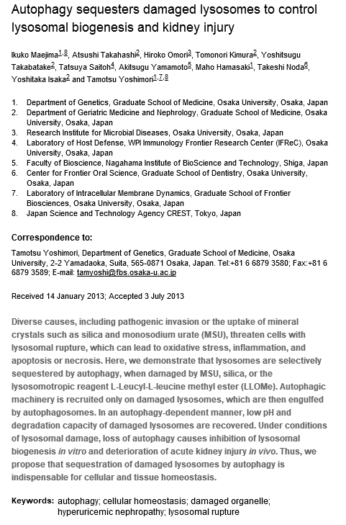

Slide 17
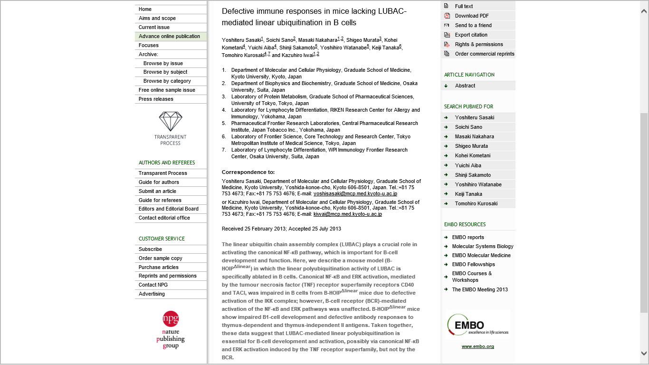

Slide 18
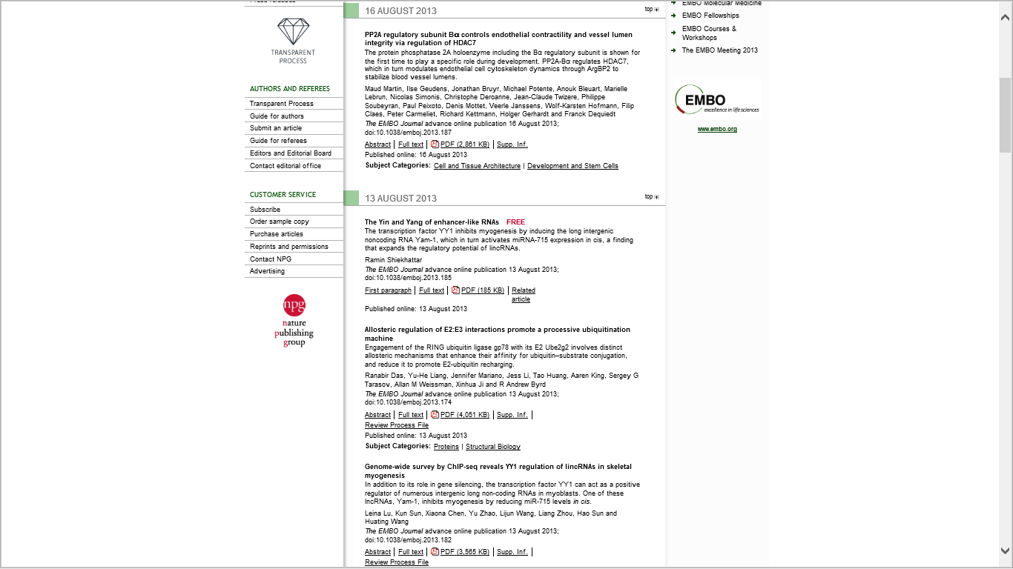
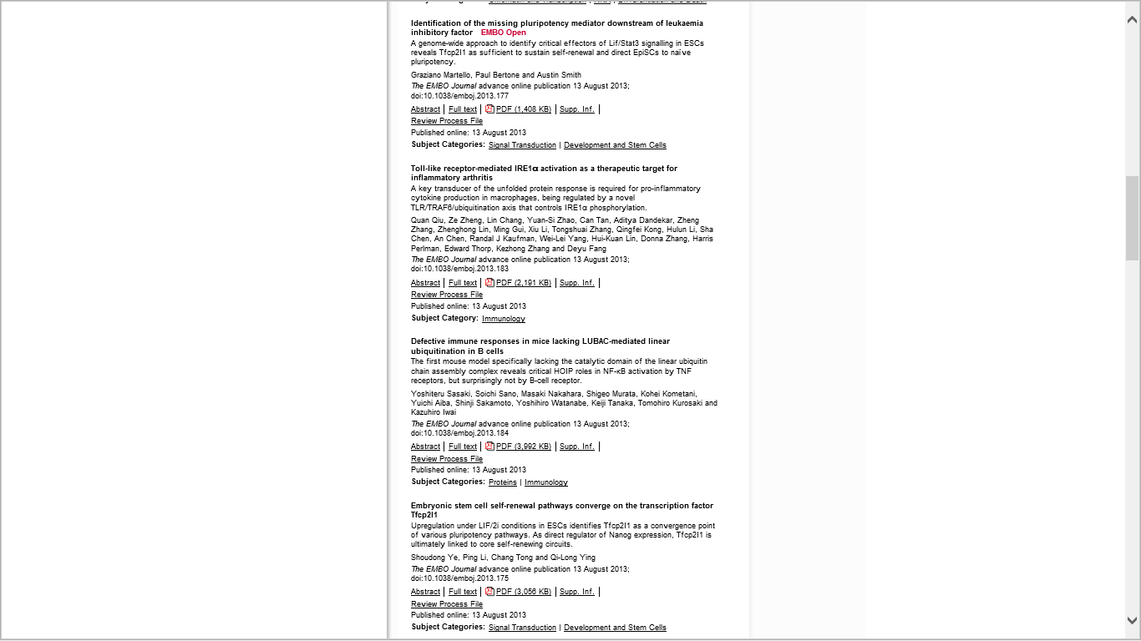

Slide 19


