Slide 1

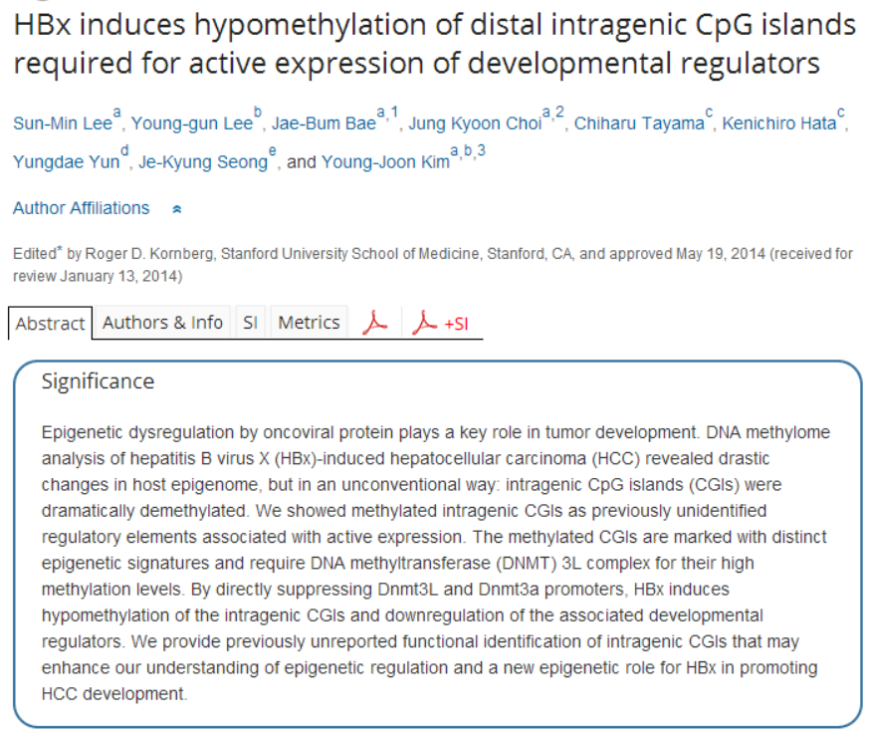

Slide 2
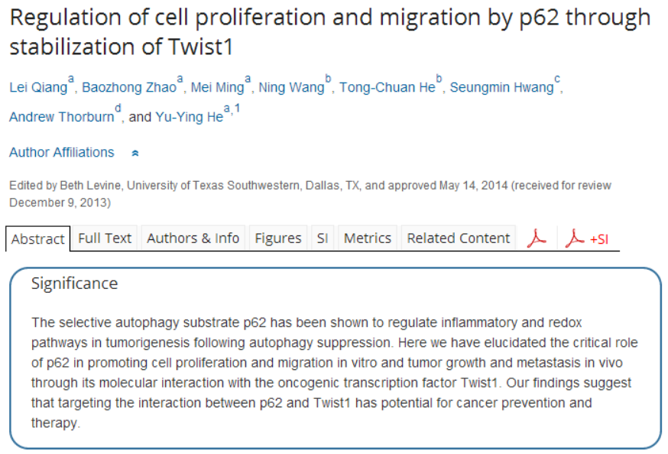

Slide 3
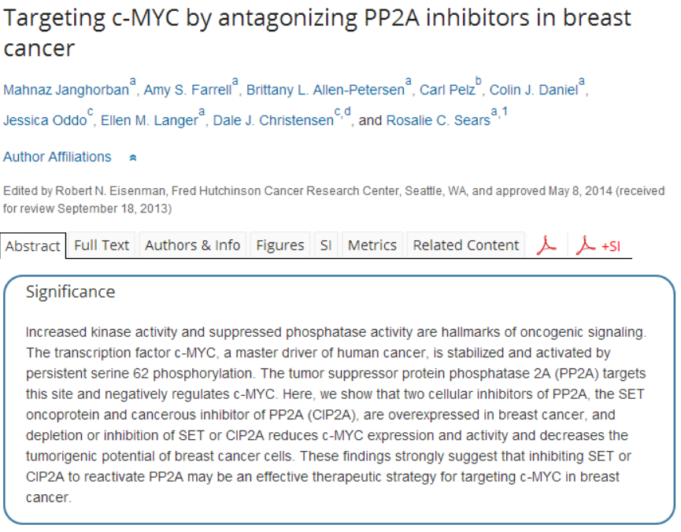

Slide 4
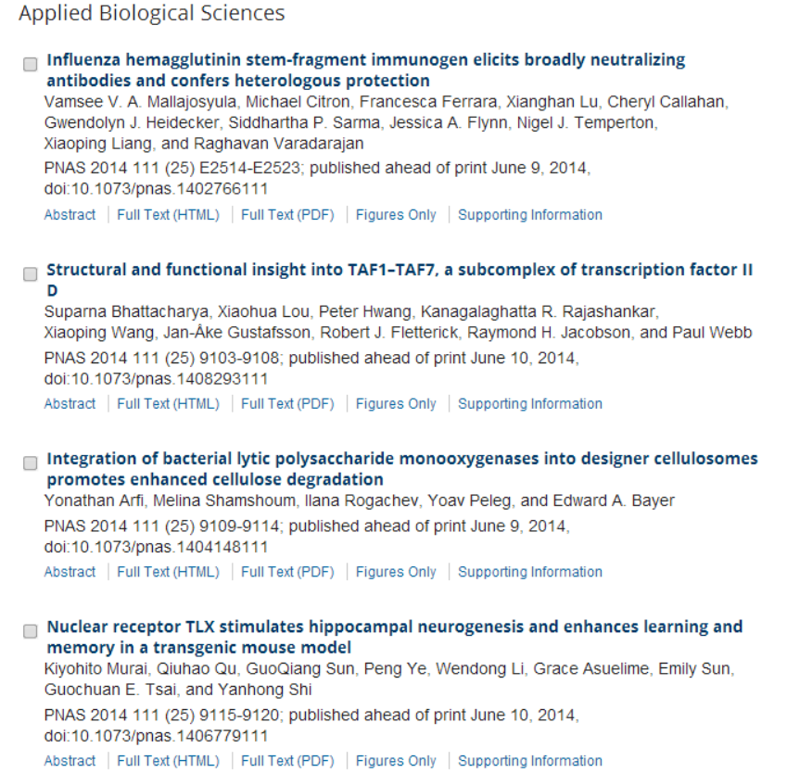

Slide 5
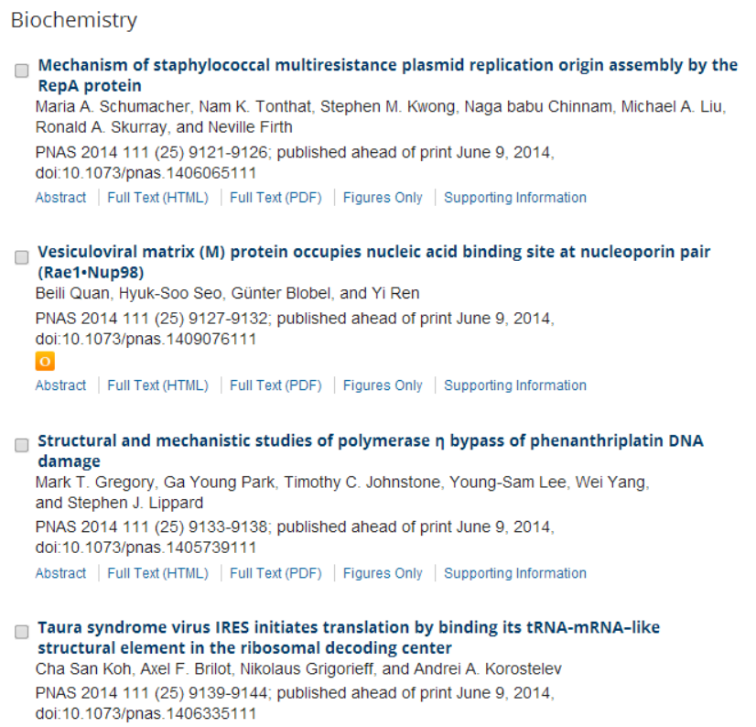

Slide 6
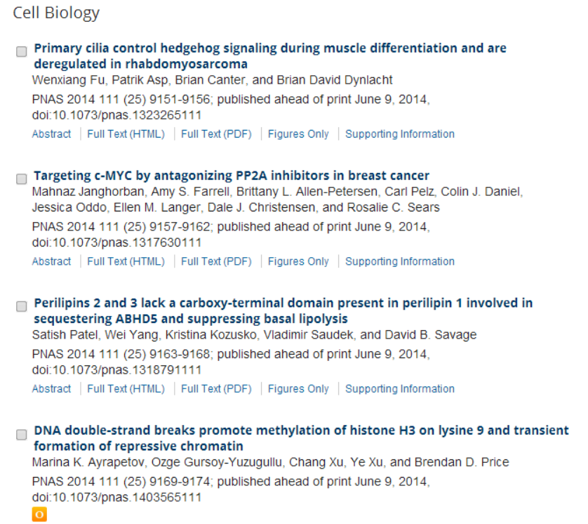

Slide 7
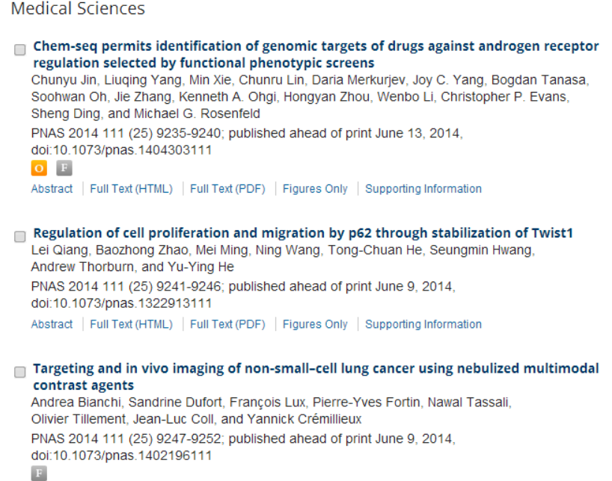

Slide 8
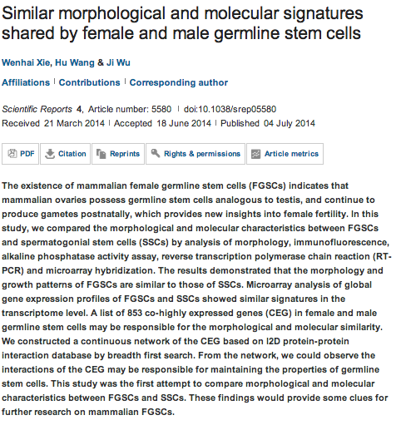
Scientific Reports

Slide 9
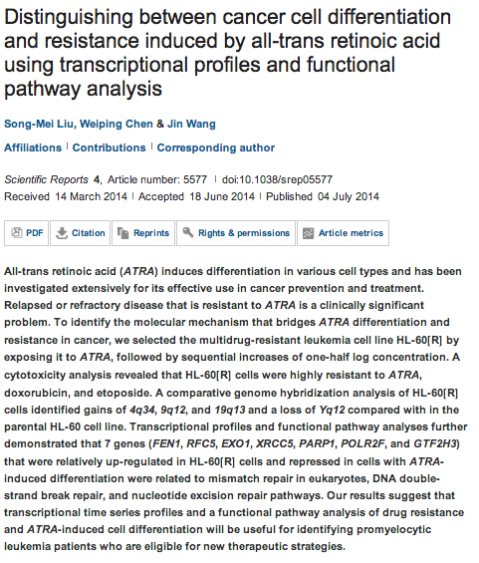

Slide 10
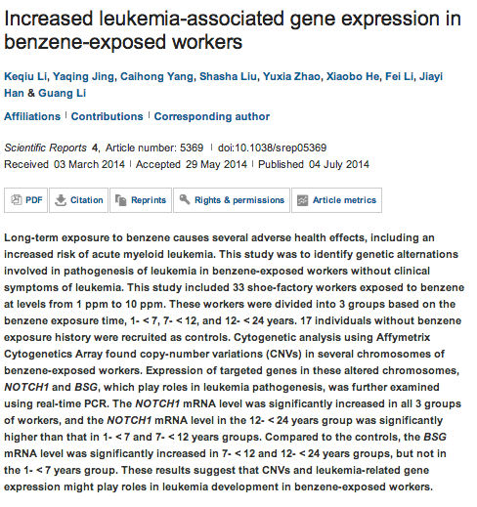

Slide 11
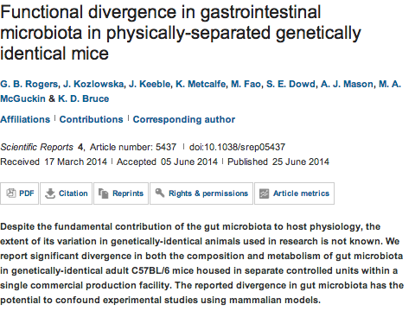

Slide 12
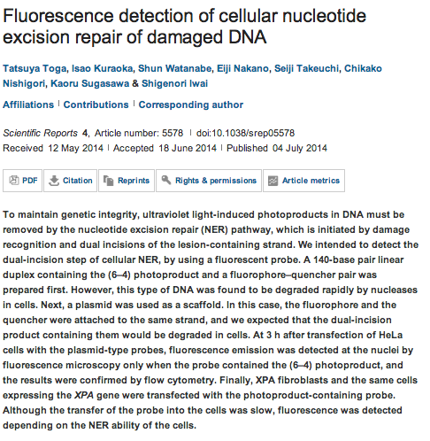

Slide 13
oncogene
Non-conventional functions for NF-κB members: the dark side of NF-κB.
Espinosa L, Margalef P, Bigas A.
Author information
Stem Cells and Cancer Research Laboratory, Institut Hospital del Mar d'Investigacions Mèdiques (IMIM), Barcelona, Spain.
Abstract
NF-κB pathway exerts an essential function in the regulation of the immune response, which has been the nucleus of numerous studies for the past 25 years. Both activation of the pathway and termination of the NF-κB response are tightly regulated events, which is essential to prevent exacerbated inflammatory responses. Thus, alterations in NF-κB regulatory elements might result in tissue damage and cancer in different systems. In addition, several of the proteins involved in NF-κB regulation display additional, and much less studied, functions that connect with specific NF-κB-unrelated pathways. Many of these pathways are in turn regulators of particular physiologic and/or pathologic responses. Which are the principal non-conventional functions that have been identified for specific NF-κB elements, how they connect with other signaling pathways and what is their potential impact on cancer is the focus of this review.

Slide 14
Src kinase function controls progenitor cell pools during regeneration and tumor onset in the Drosophila intestine.
Kohlmaier A, Fassnacht C, Jin Y, Reuter H, Begum J, Dutta D, Edgar BA.
Author information
Deutsches Krebsforschungszentrum (DKFZ), Zentrum für Molekulare Biologie der Universität Heidelberg (ZMBH) Allianz, Im Neuenheimer Feld 282, Heidelberg, Germany.
oncogene
Cables1 controls p21/Cip1 protein stability by antagonizing proteasome subunit alpha type 3.
Shi Z¹, Li Z², Li ZJ³, Cheng K⁴, Du Y⁵, Fu H⁶, Khuri FR⁷.
Author information
¹1] Department of Cell Biology and Institute of Biomedicine, College of Life Science and Technology, Jinan University, Guangzhou, China [2] Department of Pharmacology, Emory University School of Medicine, Atlanta, GA, USA

