Slide 1

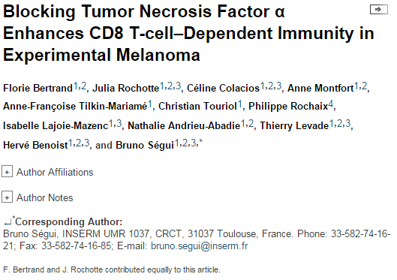
Abstract
TNF plays a dual, still enigmatic role in melanoma, either acting as a cytotoxic cytokine or favoring a tumorigenic inflammatory microenvironment. Herein, the tumor growth of melanoma cell lines expressing major histocompatibility complex class I molecules at high levels (MHC-I^{high}) was dramatically impaired in TNF-deficient mice, and this was associated with enhanced tumor-infiltrating CD8⁺ T lymphocytes. Immunodepletion of CD8 T cells fully restored melanoma growth in TNF^{−/−} mice. Systemic administration of Etanercept inhibited MHC-I^{high} melanoma growth in immunocompetent but not in immunodeficient (IFNγ^{−/−}, nude, or CD8^{−/−}) mice. MHC-I^{high} melanoma growth was also reduced in mice lacking TNF-R1, but not TNF-R2. TNF^{−/−} and TNF-R1^{−/−} mice as well as Etanercept-treated WT mice displayed enhanced intratumor content of high endothelial venules surrounded by high CD8⁺ T-cell density. Adoptive transfer of activated TNF-R1–deficient or –proficient CD8⁺ T cells in CD8-deficient mice bearing B16K1 tumors demonstrated that TNF-R1 deficiency facilitates the accumulation of live CD8⁺ T cells into the tumors. Moreover, in vitro experiments indicated that TNF triggered activated CD8⁺ T cell death in a TNF-R1–dependent manner, likely limiting the accumulation of tumor-infiltrating CD8⁺ T cells in TNF/TNF-R1–proficient animals. Collectively, our observations indicate that TNF-R1–dependent TNF signaling impairs tumor-infiltrating CD8⁺ T-cell accumulation and may serve as a putative target to favor CD8⁺ T-cell–dependent immune response in melanoma. Cancer Res; 75(13); 2619–28. ©2015 AACR.

Slide 2
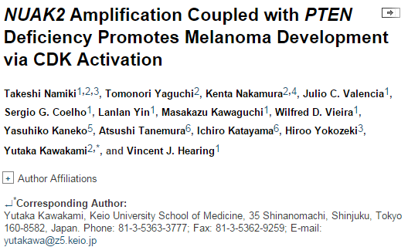
Abstract
The AMPK-related kinase NUAK2 has been implicated in melanoma growth and survival outcomes, but its therapeutic utility has yet to be confirmed. In this study, we show how its genetic amplification in PTEN-deficient melanomas may rationalize the use of CDK2 inhibitors as a therapeutic strategy. Analysis of array-CGH data revealed that PTENdeficiency is coupled tightly with genomic amplification encompassing the NUAK2 locus, a finding strengthened by immunohistochemical evidence that phospho-Akt overexpression was correlated with NUAK2 expression in clinical specimens of acral melanoma. Functional studies in melanoma cells showed that inactivation of the PI3K pathway upregulated p21 expression and reduced the number of cells in S phase. NUAK2 silencing and inactivation of the PI3K pathway efficiently controlled CDK2 expression, whereas CDK2 inactivation specifically abrogated the growth of NUAK2-amplified and PTEN-deficient melanoma cells. Immunohistochemical analyses confirmed an association of CDK2 expression with NUAK2amplification and p-Akt expression in melanomas. Finally, pharmacologic inhibition of CDK2 was sufficient to suppress the growth of NUAK2-amplified and PTEN-deficient melanoma cells in vitro and in vivo. Overall, our results show how CDK2 blockade may offer a promising therapy for genetically defined melanomas, where NUAK2 is amplified and PTEN is deleted. Cancer Res; 75(13); 2708–15. ©2015 AACR.

Slide 3
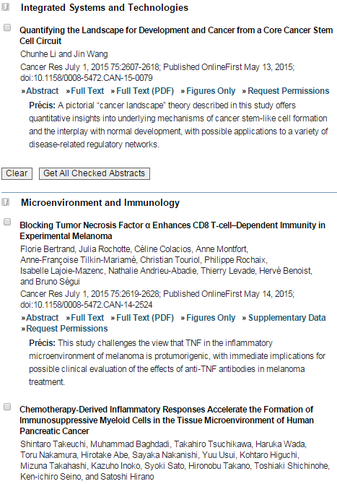
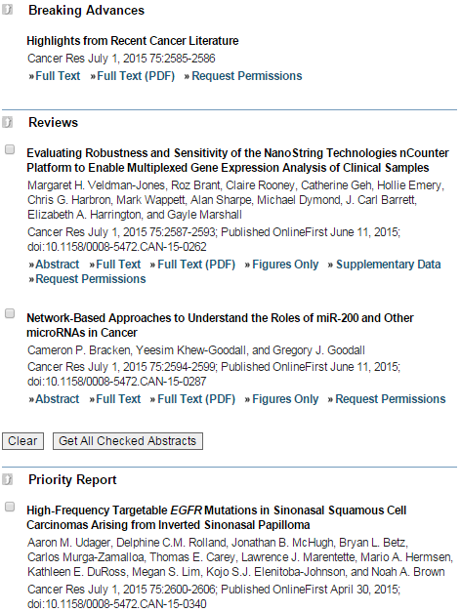

Slide 4
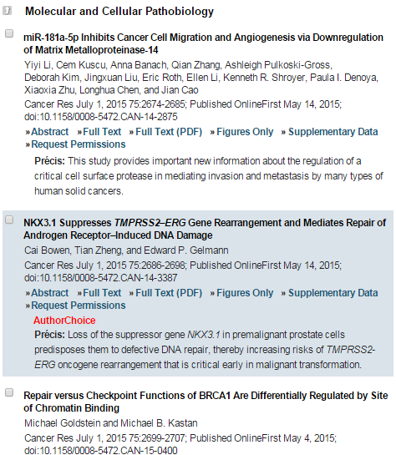
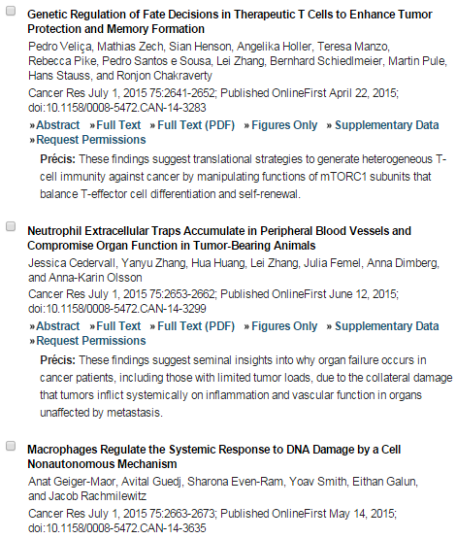
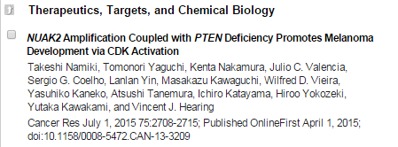

Slide 5
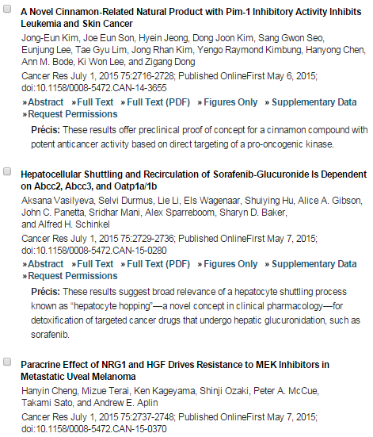
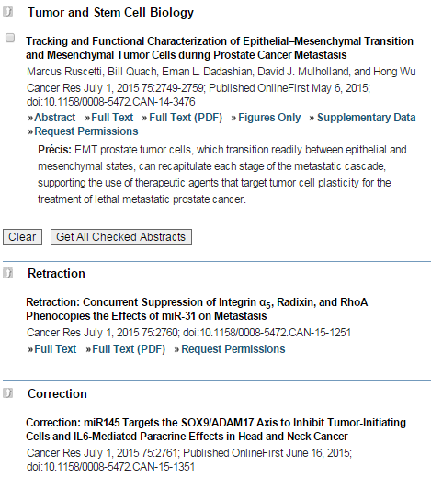

Slide 6

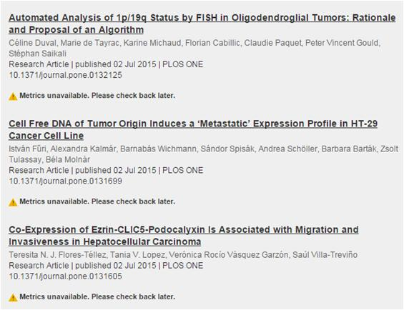

Slide 7
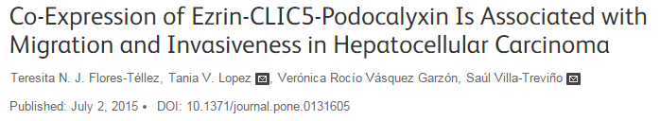
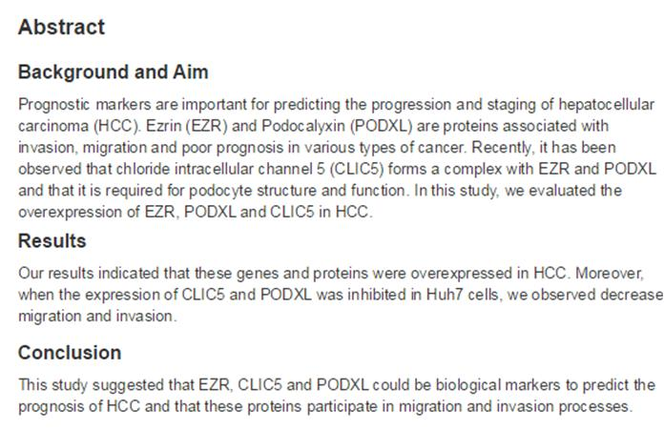

Slide 8

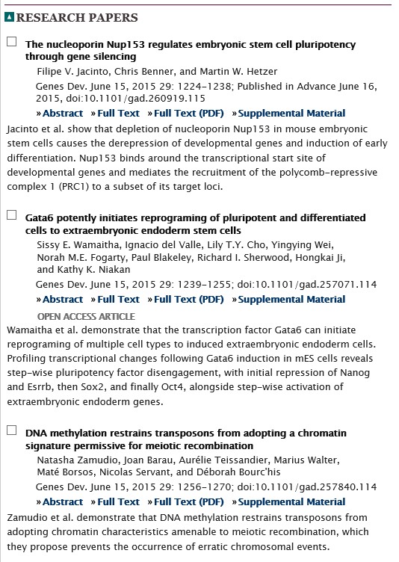
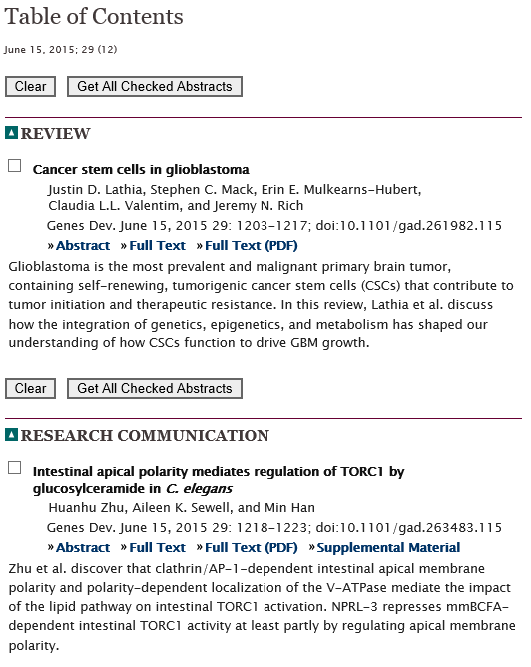

Slide 9
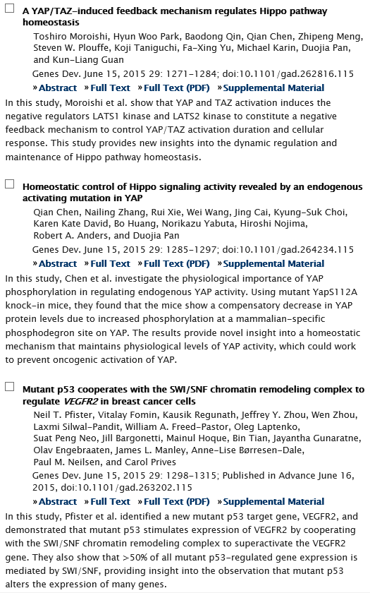
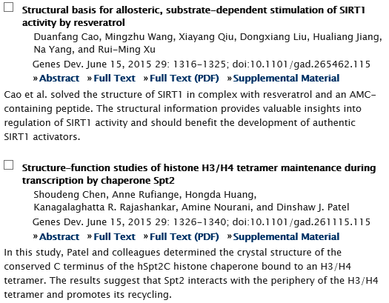

Slide 10
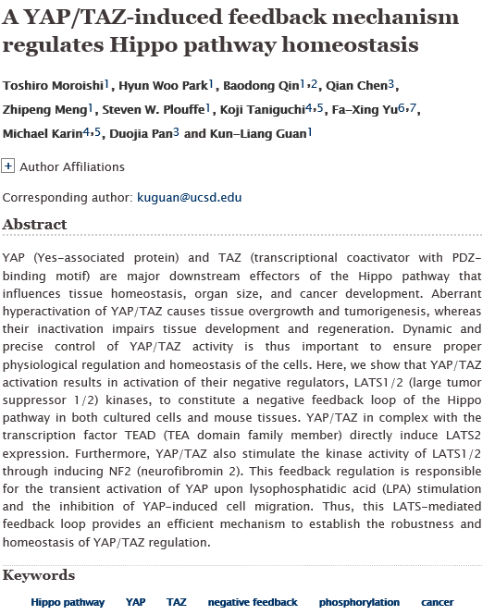

Slide 11
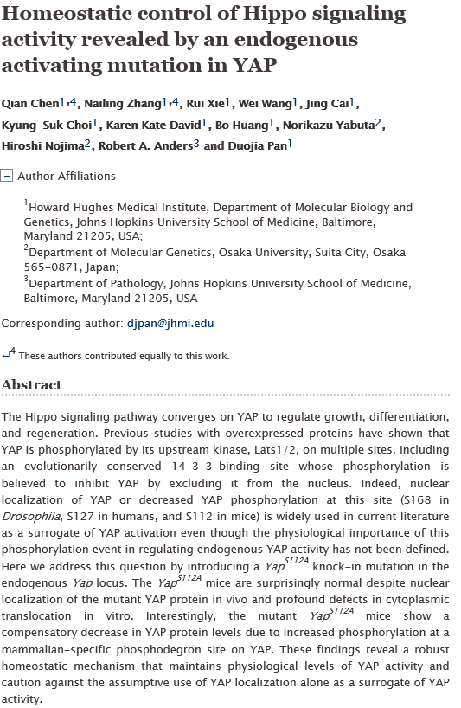

Slide 12

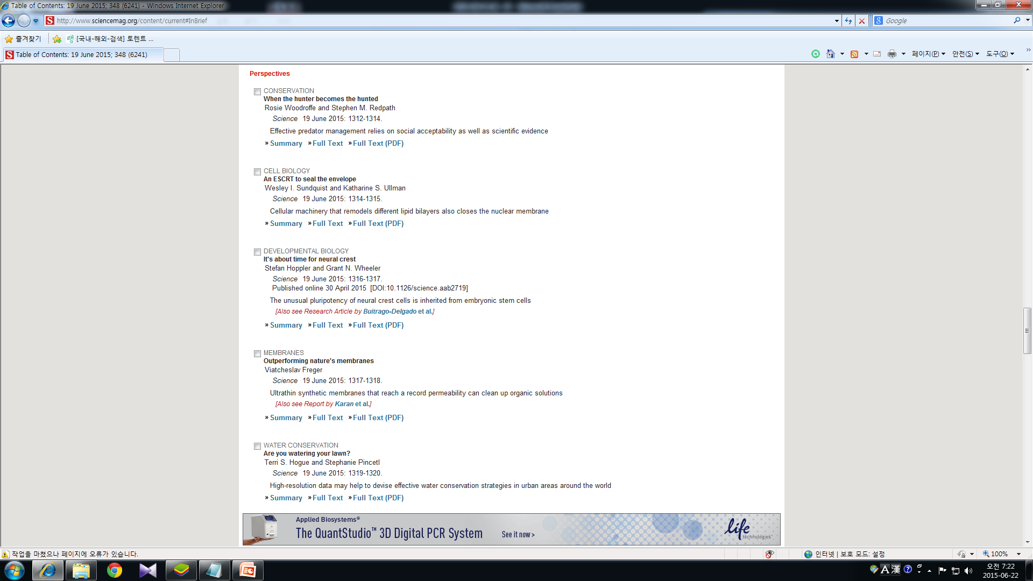
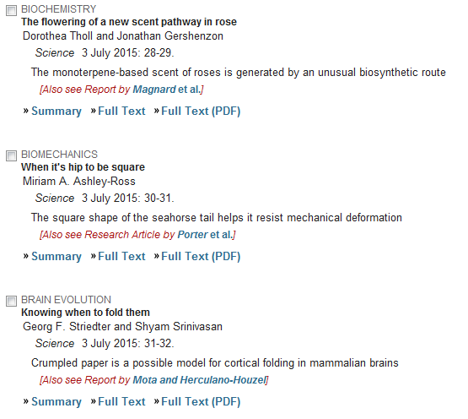
KJ

Slide 13

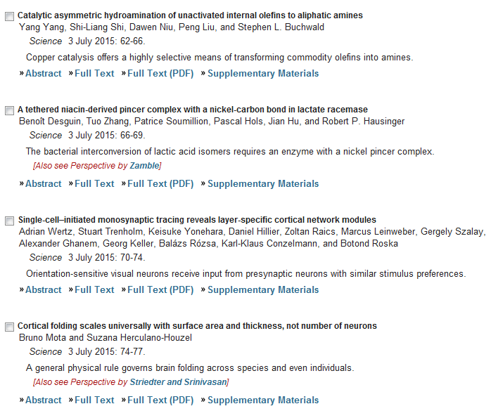
KJ

Slide 14
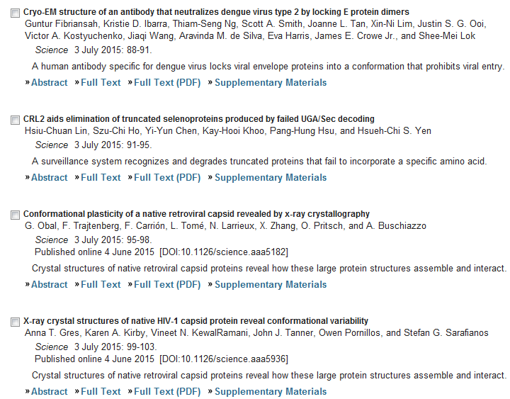
KJ

Slide 15
KJ
Science 3 July 2015: Vol. 349 no. 6243 pp. 99-103
Report
X-ray crystal structures of native HIV-1 capsid protein reveal conformational variability
Anna T. Gres1,2, Karen A. Kirby1,3, Vineet N. KewalRamani4, John J. Tanner2,5, Owen Pornillos6, Stefan G. Sarafianos1,3,5,*
1Christopher S. Bond Life Sciences Center, University of Missouri, Columbia, MO 65211, USA.
2Department of Chemistry, University of Missouri, Columbia, MO 65211, USA.
3Department of Molecular Microbiology and Immunology, University of Missouri School of Medicine, Columbia, MO 65211, USA.
4Basic Research Laboratory, Center for Cancer Research, National Cancer Institute, Frederick, MD 21702, USA.
5Department of Biochemistry, University of Missouri, Columbia, MO 65211, USA.
6Department of Molecular Physiology and Biological Physics, University of Virginia School of Medicine, Charlottesville, VA 22908, USA.
The detailed molecular interactions between native HIV-1 capsid protein (CA) hexamers that shield the viral genome and proteins have been elusive. We report crystal structures describing interactions between CA monomers related by sixfold symmetry within hexamers (intrahexamer) and threefold and twofold symmetry between neighboring hexamers (interhexamer). The structures describe how CA builds hexagonal lattices, the foundation of mature capsids. Lattice structure depends on an adaptable hydration layer modulating interactions among CA molecules. Disruption of this layer alters interhexamer interfaces, highlighting an inherent structural variability. A CA-targeting antiviral affects capsid stability by binding across CA molecules and subtly altering interhexamer interfaces remote to the ligand-binding site. Inherent structural plasticity, hydration layer rearrangement, and effector binding affect capsid stability and have functional implications for the retroviral life cycle.

