Slide 1



Slide 2
Nature. 2015 Jul 2;523(7558):53-8. doi: 10.1038/nature14512. Epub 2015 Jun 24.
The core spliceosome as target and effector of non-canonical ATM signalling.
Tresini M¹, Warmerdam DO², Kolovos P³, Snijder L¹, Vrouwe MG⁴, Demmers JA⁵, van IJcken WF⁶, Grosveld FG³, Medema RH², Hoeijmakers JH¹, Mullenders LH⁴, Vermeulen W¹, Marteijn JA¹.
Author information
Abstract
In response to DNA damage, tissue homoeostasis is ensured by protein networks promoting DNA repair, cell cycle arrest or apoptosis. DNA damage response signalling pathways coordinate these processes, partly by propagating gene-expression-modulating signals. DNA damage influences not only the abundance of messenger RNAs, but also their coding information through alternative splicing. Here we show that transcription-blocking DNA lesions promote chromatin displacement of late-stage spliceosomes and initiate a positive feedback loop centred on the signalling kinase ATM. We propose that initial spliceosome displacement and subsequent R-loop formation is triggered by pausing of RNA polymerase at DNA lesions. In turn, R-loops activate ATM, which signals to impede spliceosome organization further and augment ultraviolet-irradiation-triggered alternative splicing at the genome-wide level. Our findings define R-loop-dependent ATM activation by transcription-blocking lesions as an important event in the DNA damage response of non-replicating cells, and highlight a key role for spliceosome displacement in this process.

Slide 3
Nature. 2015 Jul 2;523(7558):88-91.
Cell-intrinsic adaptation of lipid composition to local crowding drives
social behaviour.
Frechin M¹, Stoeger T², Daetwyler S¹, Gehin C³, Battich N², Damm EM⁴, Stergiou L⁴, Riezman H³, Pelkmans L¹.
Author information
Cells sense the context in which they grow to adapt their phenotype and allow multicellular patterning by mechanisms of autocrine and paracrine signalling. However, patterns also form in cell populations exposed to the same signalling molecules and substratum, which often correlate with specific features of the population context of single cells, such as local cell crowding. Here we reveal a cell-intrinsic molecular mechanism that allows multicellular patterning without requiring specific communication between cells. It acts by sensing the local crowding of a single cell through its ability to spread and activate focal adhesion kinase (FAK, also known as PTK2), resulting in adaptation of genes controlling membrane homeostasis. In cells experiencing low crowding, FAK suppresses transcription of the ABC transporter A1 (ABCA1) by inhibiting FOXO3 and TAL1. Agent-based computational modelling and experimental confirmation identified membrane-based signalling and feedback control as crucial for the emergence of population patterns of ABCA1 expression, which adapts membrane lipid composition to cell crowding and affects multiple signalling activities, including the suppression of ABCA1 expression itself. The simple design of this cell-intrinsic system and its broad impact on the signalling state of mammalian single cells suggests a fundamental role for a tunable membrane lipid composition in collective cell behaviour.

Slide 4
Nature. 2015 Jul 2;523(7558):92-5. doi: 10.1038/nature14329. Epub 2015 May 11.
Mechanical induction of the tumorigenic β-catenin pathway by tumour growth pressure.
Fernández-Sánchez ME¹, Barbier S¹, Whitehead J¹, Béalle G², Michel A², Latorre-Ossa H³, Rey C⁴, Fouassier L⁴, Claperon A⁴, Brullé L⁵, Girard E⁶, Servant N⁶,Rio-Frio T⁷, Marie H⁸, Lesieur S⁸, Housset C⁴, Gennisson JL³, Tanter M³, Ménager C², Fre S⁹, Robine S¹⁰, Farge E¹.
The tumour microenvironment may contribute to tumorigenesis owing to mechanical forces such as fibrotic stiffness or mechanical pressure caused by the expansion of hyper-proliferative cells. Here we explore the contribution of the mechanical pressure exerted by tumour growth onto non-tumorous adjacent epithelium. In the early stage of mouse colon tumour development in the Notch(+)Apc(+/1638N) mouse model, we observed mechanistic pressure stress in the non-tumorous epithelial cells caused by hyper-proliferative adjacent crypts overexpressing active Notch, which is associated with increased Ret and β-catenin signalling. We thus developed a method that allows the delivery of a defined mechanical pressure in vivo, by subcutaneously inserting a magnet close to the mouse colon. The implanted magnet generated a magnetic force on ultra-magnetic liposomes, stabilized in the mesenchymal cells of the connective tissue surrounding colonic crypts after intravenous injection. The magnetically induced pressurequantitatively mimicked the endogenous early tumour growth stress in the order of 1,200 Pa, without affecting tissue stiffness, as monitored by ultrasound strain imaging and shear wave elastography. The exertion of pressure mimicking that of tumour growth led to rapid Ret activation and downstream phosphorylation of β-catenin on Tyr654, imparing its interaction with the E-cadherin in adherens junctions, and which was followed by β-catenin nuclear translocation after 15 days. As a consequence, increased expression of β-catenin-target genes was observed at 1 month, together with crypt enlargement accompanying the formation of early tumorous aberrant crypt foci. Mechanical activation of the tumorigenic β-catenin pathwaysuggests unexplored modes of tumour propagation based on mechanical signalling pathways in healthy epithelial cells surrounding the tumour, which may contribute to tumour heterogeneity.

Slide 5
Nature. 2015 Jul 2;523(7558):96-100. doi: 10.1038/nature14351. Epub 2015 May 11.
MYC regulates the core pre-mRNA splicing machinery as an essential step in lymphomagenesis.
Koh CM¹, Bezzi M², Low DH¹, Ang WX¹, Teo SX¹, Gay FP¹, Al-Haddawi M¹, Tan SY¹, Osato M³, Sabò A⁴, Amati B⁵, Wee KB⁶, Guccione E⁷.
Author information
Abstract
Deregulated expression of the MYC transcription factor occurs in most human cancers and correlates with high proliferation, reprogrammed cellular metabolism and poor prognosis. Overexpressed MYC binds to virtually all active promoters within a cell, although with different binding affinities, and modulates the expression of distinct subsets of genes. However, the critical effectors of MYC in tumorigenesis remain largely unknown. Here we show that during lymphomagenesis in Eµ-myc transgenic mice, MYC directly upregulates the transcription of the core small nuclear ribonucleoprotein particle assembly genes, including Prmt5, an arginine methyltransferase that methylates Sm proteins. This coordinated regulatory effect is critical for the core biogenesis of small nuclear ribonucleoprotein particles, effective pre-messenger-RNA splicing, cell survival and proliferation. Our results demonstrate that MYC maintains the splicing fidelity of exons with a weak 5' donor site. Additionally, we identify pre-messenger-RNAs that are particularly sensitive to the perturbation of the MYC-PRMT5 axis, resulting in either intron retention (for example, Dvl1) or exon skipping (for example, Atr, Ep400). Using antisense oligonucleotides, we demonstrate the contribution of these splicing defects to the anti-proliferative/apoptotic phenotype observed in PRMT5-depleted Eµ-myc B cells. We conclude that, in addition to its well-documented oncogenic functions in transcription and translation, MYC also safeguards proper pre-messenger-RNA splicing as an essential step in lymphomagenesis.

Slide 6
Nature. 2015 Jul 2;523(7558):101-5. doi: 10.1038/nature14357. Epub 2015 May 11.
Cytosolic extensions directly regulate a rhomboid protease by modulating substrate gating.
Baker RP¹, Urban S¹.
Author information
Abstract
Intramembrane proteases catalyse the signal-generating step of various cell signalling pathways, and continue to be implicated in diseases ranging from malaria infection to Parkinsonian neurodegeneration. Despite playing such decisive roles, it remains unclear whether or how these membrane-immersed enzymes might be regulated directly. To address this limitation, here we focus on intramembrane proteases containing domains known to exert regulatory functions in other contexts, and characterize a rhomboid protease that harbours calcium-binding EF-hands. We find calcium potently stimulates proteolysis by endogenous rhomboid-4 in Drosophila cells, and, remarkably, when rhomboid-4 is purified and reconstituted in liposomes. Interestingly, deleting the amino-terminal EF-hands activates proteolysis prematurely, while residues in cytoplasmic loops connecting distal transmembrane segments mediate calcium stimulation. Rhomboid regulation is not orchestrated by either dimerization or substrate interactions. Instead, calcium increases catalytic rate by promoting substrate gating. Substrates with cleavage sites outside the membrane can be cleaved but lose the capacity to be regulated. These observations indicate substrate gating is not an essential step in catalysis, but instead evolved as a mechanism for regulating proteolysis inside the membrane. Moreover, these insights provide new approaches for studying rhomboid functions by investigating upstream inputs that trigger proteolysis.

Slide 7
Nature. 2015 Jul 2;523(7558):106-10. doi: 10.1038/nature14356. Epub 2015 Apr 27.
Structures of actin-like ParM filaments show architecture of plasmid-segregating spindles.
Bharat TA¹, Murshudov GN¹, Sachse C², Löwe J¹.
Author information
Abstract
Active segregation of Escherichia coli low-copy-number plasmid R1 involves formation of a bipolar spindle made of left-handed double-helical actin-like ParM filaments. ParR links the filaments with centromeric parC plasmid DNA, while facilitating the addition of subunits to ParM filaments. Growing ParMRC spindles push sister plasmids to the cell poles. Here, using modern electron cryomicroscopy methods, we investigate the structures and arrangements of ParM filaments in vitro and in cells, revealing at near-atomic resolution how subunits and filaments come together to produce the simplest known mitotic machinery. To understand the mechanism of dynamic instability, we determine structures of ParM filaments in different nucleotide states. The structure of filaments bound to the ATP analogue AMPPNP is determined at 4.3 Å resolution and refined. The ParM filament structure shows strong longitudinal interfaces and weaker lateral interactions. Also using electron cryomicroscopy, we reconstruct ParM doublets forming antiparallel spindles. Finally, with whole-cell electron cryotomography, we show that doublets are abundant in bacterial cells containing low-copy-number plasmids with the ParMRC locus, leading to an asynchronous model of R1 plasmid segregation.

Slide 8
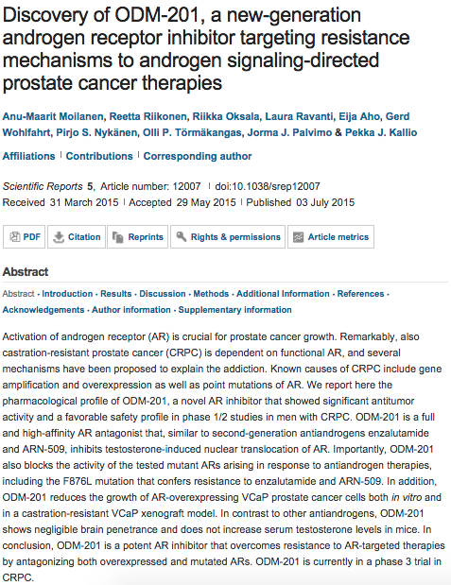
Scientific Reports

Slide 9
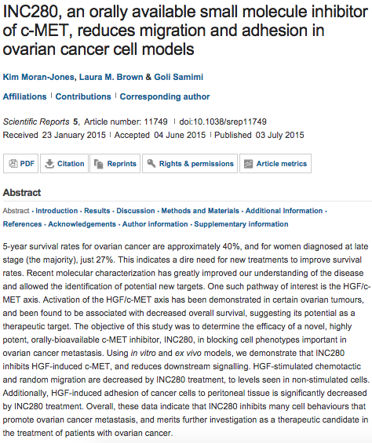

Slide 10
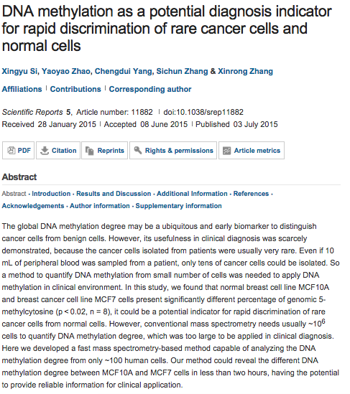

Slide 11
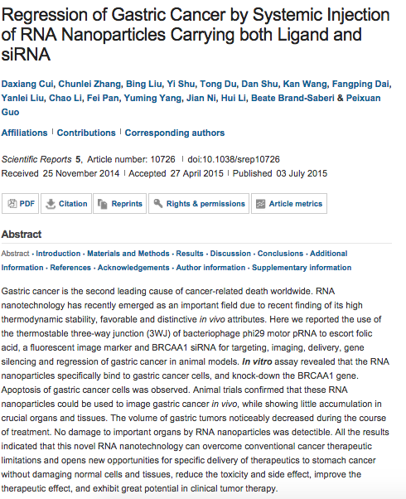

Slide 12
Endothelial CXCR7 regulates breast cancer metastasis.
Stacer AC¹, Fenner J¹, Cavnar SP², Xiao A¹, Zhao S³, Chang SL⁴, Salomonnson A¹, Luker KE¹, Luker GD⁵.
Author information
¹University of Michigan Center for Molecular Imaging, Department of Radiology, University of Michigan Medical School and College of Engineering, Ann Arbor, MI, USA.
oncogene
Comparative genetic study of intratumoral heterogenous MYCN amplified neuroblastoma versus aggressive genetic profile neuroblastic tumors.
Berbegall AP¹, Villamón E¹, Piqueras M¹, Tadeo I¹, Djos A², Ambros PF³, Martinsson T², Ambros IM⁴, Cañete A⁵, Castel V⁵, Navarro S¹, Noguera R¹.
Author information
¹Pathology Department, Medical School, University of Valencia, Medical Research Foundation, INCLIVA, Valencia, Spain.
Heat-shock factor 2 is a suppressor of prostate cancer invasion.
Björk JK¹, Åkerfelt M¹, Joutsen J², Puustinen MC², Cheng F², Sistonen L², Nees M³.
Author information
¹1] Centre for Biotechnology, University of Turku and Åbo Akademi University, Turku, Finland [2] Medical Biotechnology, VTT Technical Research Centre of Finland, Turku, Finland.
PML is required for telomere stability in non-neoplastic human cells.
Marchesini M¹, Matocci R², Tasselli L¹, Cambiaghi V³, OrlethOrleth A³, Furia L³, Marinelli C¹, Lombardi S³, Sammarelli G⁴, Aversa F⁴, Minucci S⁵, Faretta M³, Pelicci PG⁶, Grignani F².
Author information
¹1] General Pathology Section, Department of Experimental Medicine, University of Perugia, Perugia, Italy [2] Department of Experimental Oncology, European Institute of Oncology, Milan, Italy

Slide 13
oncogene
p63 controls cell migration and invasion by transcriptional regulation of MTSS1.
Giacobbe A¹, Compagnone M¹, Bongiorno-Borbone L¹, Antonov A², Markert EK³, Zhou JH⁴, Annicchiarico-Petruzzelli M⁵, Melino G⁶, Peschiaroli A⁷.
Author information
¹Department of Experimental Medicine and Surgery, University of Rome 'Tor Vergata', Rome, Italy.
Abstract
Metastasis is a multistep cell-biological process, which is orchestrated by many factors, including metastasis activators and suppressors. Metastasis Suppressor 1 (MTSS1) was originally identified as a metastasis suppressor protein whose expression is lost in metastatic bladder and prostate carcinomas. However, recent findings indicate that MTSS1 acts as oncogene and pro-migratory factor in melanoma tumors. Here, we identify and characterized a molecular mechanism controlling MTSS1 expression, which impinges on a pro-tumorigenic role of MTSS1 in breast tumors. We found that in normal and in cancer cell lines ΔNp63 is able to drive the expression of MTSS1 by binding to a p63-binding responsive element localized in the MTSS1 locus. We reported that ΔNp63 is able to drive the migration of breast tumor cells by inducing the expression of MTSS1. Notably, in three human breast tumors data sets the MTSS1/p63 co-expression is a negative prognostic factor on patient survival, suggesting that the MTSS1/p63 axis might be functionally important to regulate breast tumor progression.

Slide 14
oncogene
Role of p14ARF-HDM2-p53 axis in SOX6-mediated tumor suppression.
Wang J¹, Ding S¹, Duan Z¹, Xie Q¹, Zhang T¹, Zhang X¹, Wang Y¹, Chen X¹, Zhuang H¹, Lu F¹.
Author information
¹Department of Microbiology and Infectious Disease Center, School of Basic Medicine, Peking University Health Science Center, Beijing, China.
Abstract
Sex-determining region Y box 6 (SOX6) has been described as a tumor-suppressor gene in several cancers. Our previous work has suggested that SOX6 upregulated p21^{Waf1/Cip1}(p21) expression in a p53-dependent manner; however, the underlying mechanism has remained elusive. In this study, we confirmed that SOX6 can suppress cell proliferation in vitro and in vivo by stabilizing p53 protein and subsequently upregulating p21. Co-immunoprecipitation and immunocytofluorescence assays demonstrated that SOX6 can promote formation of the p14ARF-HDM2-p53 ternary complex by promoting translocation of p14ARF (p14 alternate reading frame tumor suppressor) to the nucleoplasm, thereby inhibiting HDM2-mediated p53 nuclear export and degradation. Chromatin immunoprecipitation combined with PCR assay proved that SOX6 can bind to a potential binding site in the regulatory region of the c-Myc gene. Furthermore, we confirmed that SOX6 can downregulate the expression of c-Myc, as well as its direct target gene nucleophosmin 1 (NPM1), and that the SOX6-induced downregulation of NPM1 is linked to translocation of p14ARF to the nucleoplasm. Finally, we showed that the highly conserved high-mobility group (HMG) domain of SOX6 is required for SOX6-mediated p53 stabilization and tumor inhibitory activity. Collectively, these results reveal a new mechanism of SOX6-mediated tumor suppression involving p21 upregulation via the p14ARF-HDM2-p53 axis in an HMG domain-dependent manner.

Slide 15

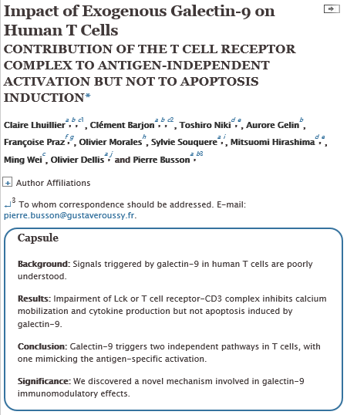

Slide 16

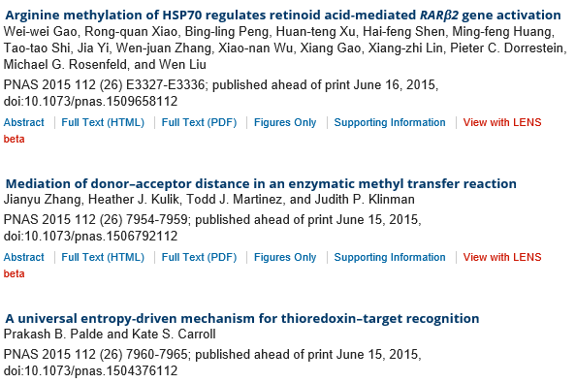
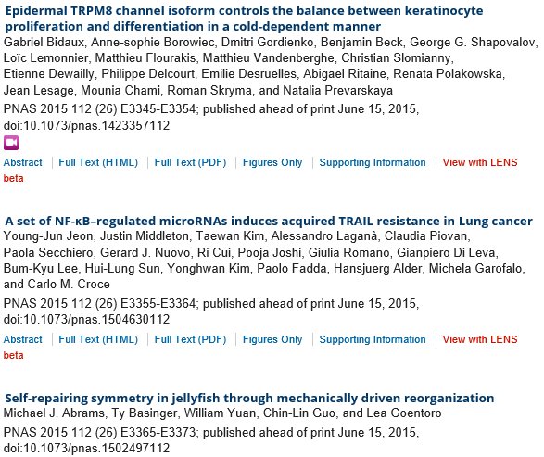
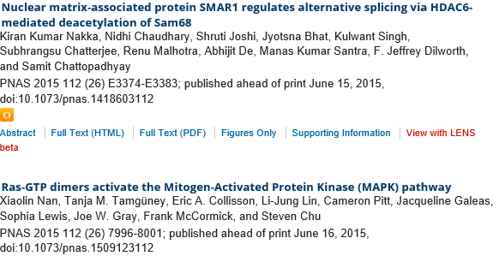

Slide 17



