Slide 1
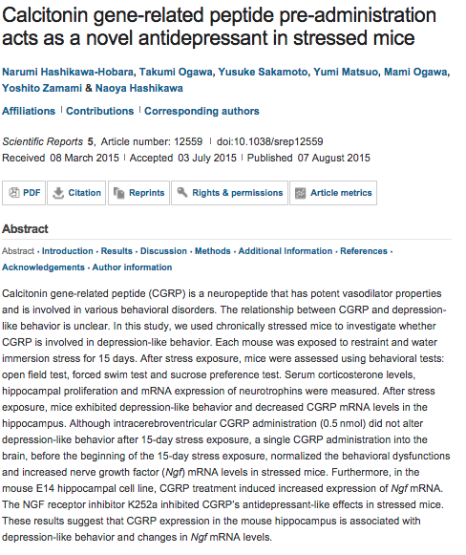
Scientific Reports

Slide 2
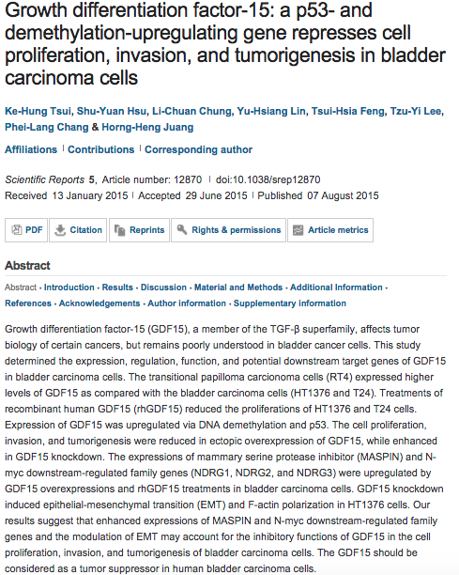

Slide 3
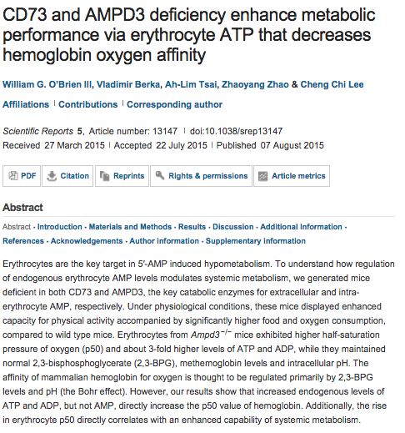

Slide 4
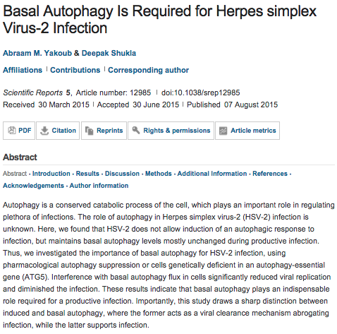

Slide 5
oncogene
Syk-mediated tyrosine phosphorylation of mule promotes TNF-induced JNK activation and cell death.
Lee CK¹, Yang Y², Chen C¹, Liu J¹.
Author information
¹Division of Pulmonary and Critical Care Medicine, Feinberg School of Medicine, Northwestern University, Chicago, IL, USA.
²Institute of Biomedical Sciences, Fudan University, Shanghai, China.
Abstract
The transcription factor Miz1 negatively regulates TNF-induced JNK activation and cell death by suppressing TRAF2 K63-polyubiquitination; upon TNF stimulation, the suppression is relieved by Mule/ARF-BP1-mediated Miz1 ubiquitination and subsequent degradation. It is not known how Mule is activated by TNF. Here we report that TNF activates Mule by inducing the dissociation of Mule from its inhibitor ARF. ARF binds to and thereby inhibits the E3 ligase activity of Mule in the steady state. TNF induces tyrosine phosphorylation of Mule, which subsequently dissociates from ARF and becomes activated. Inhibition of Mule phosphorylation by silencing of the Spleen Tyrosine Kinase (Syk) prevents its dissociation from ARF, thereby inhibiting Mule E3 ligase activity and TNF-induced JNK activation and cell death. Our data provides a missing link in TNF signaling pathway that leads to JNK activation and cell death.

Slide 6
Epigenetic silencing of GDF1 disrupts SMAD signaling to reinforce gastric cancer development.
Yang W¹, Mok MT², Li MS³, Kang W⁴, Wang H⁵, Chan AW⁴, Chou JL⁶, Chen J⁷, Ng EK⁸, To KF⁴, Yu J¹, Chan MW⁶, Chan FK¹, Sung JJ¹, Cheng AS⁹.
Author information
¹1] State Key Laboratory of Digestive Disease, The Chinese University of Hong Kong, Hong Kong SAR, China
oncogene
Stat3 regulates ErbB-2 expression and co-opts ErbB-2 nuclear function to induce miR-21 expression, PDCD4 downregulation and breast cancer metastasis.
Venturutti L¹, Romero LV¹, Urtreger AJ², Chervo MF¹, Cordo Russo RI¹, Mercogliano MF¹, Inurrigarro G³, Pereyra MG¹, Proietti CJ¹, Izzo F¹, Díaz Flaqué MC¹, Sundblad V¹, Roa JC⁴, Guzmán P⁵, Bal de Kier Joffé ED², Charreau EH¹, Schillaci R¹, Elizalde PV¹.
Author information
¹Laboratory of Molecular Mechanisms of Carcinogenesis, Instituto de Biología y Medicina Experimental, CONICET, Buenos Aires, Argentina
Disrupting Na+,HCO3--cotransporter NBCn1 (Slc4a7) delays murine breast cancer development.
Lee S¹, Axelsen TV¹, Andersen AP², Vahl P³, Pedersen SF², Boedtkjer E¹.
Author information
¹Department of Biomedicine, Aarhus University, Aarhus, Denmark
Regulation of sarcoma cell migration, invasion and invadopodia formation by AFAP1L1 through a phosphotyrosine-dependent pathway.
Tie SR¹, McCarthy DJ¹, Kendrick TS¹, Louw A², Le C¹, Satiaputra J¹, Kucera N¹, Phillips M³, Ingley E¹.
Author information
¹Cell Signalling Group, Harry Perkins Institute of Medical Research and Centre for Medical Research, University of Western Australia, Nedlands, Western Australia, Australia
PAK5-mediated E47 phosphorylation promotes epithelial-mesenchymal transition and metastasis of colon cancer.
Zhu G¹, Li X¹, Guo B¹, Ke Q², Dong M³, Li F¹.
Author information
¹Department of Cell Biology, Key Laboratory of Cell Biology, Ministry of Public Health, and Key Laboratory of Medical Cell Biology, Ministry of Education, China Medical University, Shenyang, China
Grb2 depletion under non-stimulated conditions inhibits PTEN, promotes Akt-induced tumor formation and contributes to poor prognosis in ovarian cancer.
Timsah Z¹, Ahmed Z², Ivan C³, Berrout J⁴, Gagea M⁵, Zhou Y⁶, Pena GN⁷, Hu X⁸, Vallien C⁵, Kingsley CV⁹, Lu Y¹⁰, Hancock JF⁶, Liu J¹¹, Gladden AB¹², Mills GB¹⁰, Lopez-Berestein G¹³, Hung MC¹⁴, Sood AK¹⁵, Bogdanov M¹⁶, Ladbury JE¹⁷.
Author information
¹1] Department of Biochemistry and Molecular Biology, The University of Texas MD Anderson Cancer Center, Unit 1000, Houston, TX, USA [2] School of Molecular and Cellular Biology, University of Leeds, Leeds, UK

Slide 7

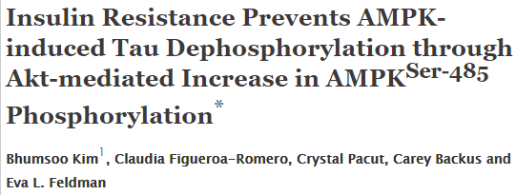
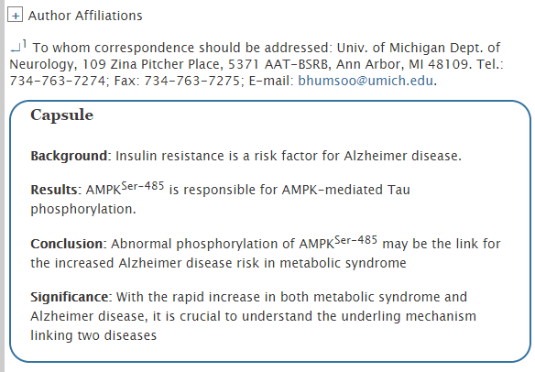

Slide 8
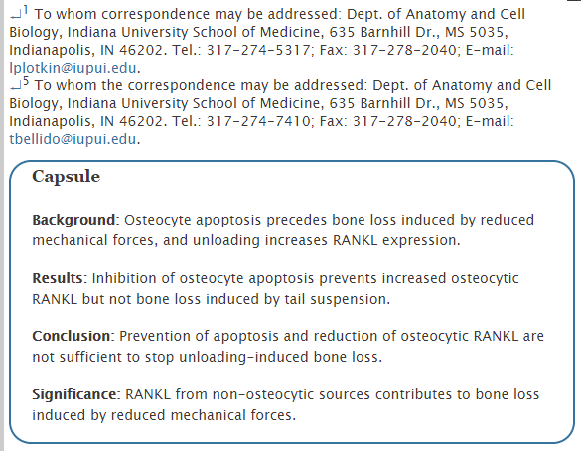
Inhibition of Osteocyte Apoptosis Prevents the Increase in Osteocytic Receptor Activator of Nuclear Factor κB Ligand (RANKL) but Does Not Stop Bone Resorption or the Loss of Bone Induced by Unloading*

Slide 9

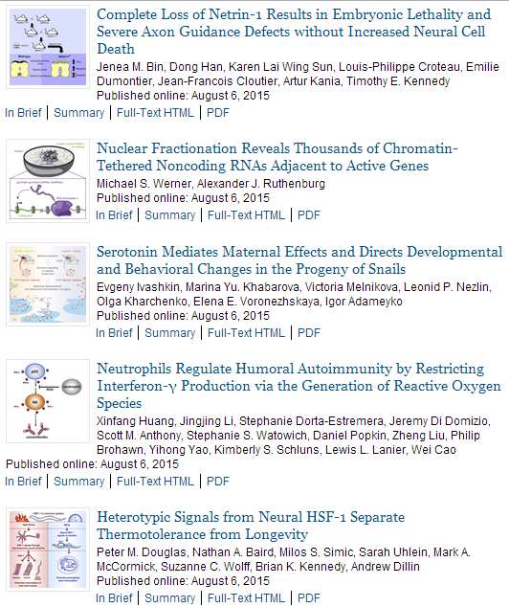

Slide 10
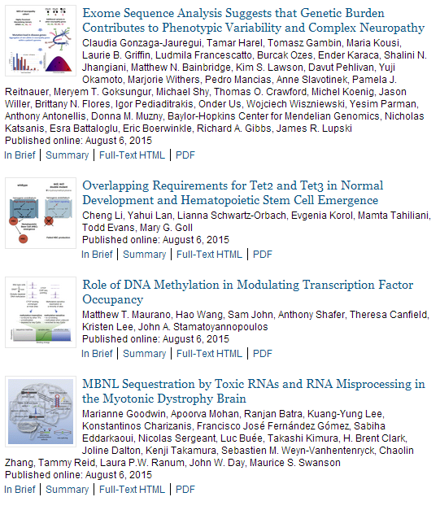

Slide 11
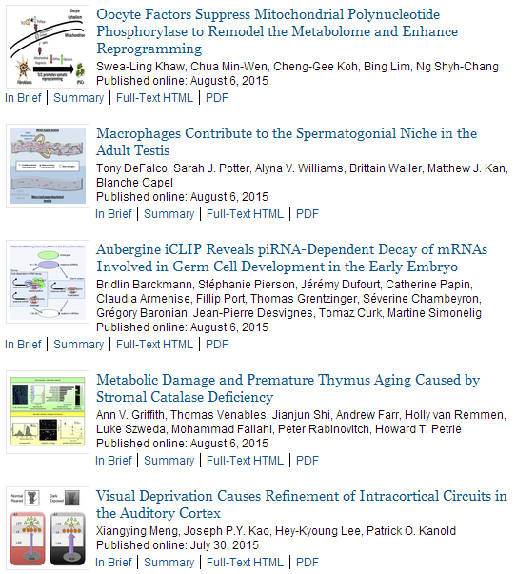

Slide 12

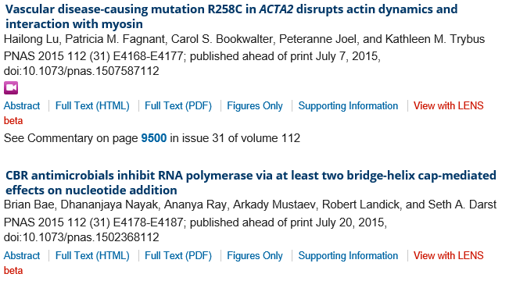
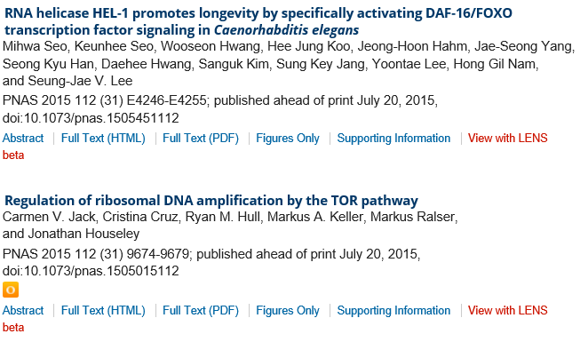
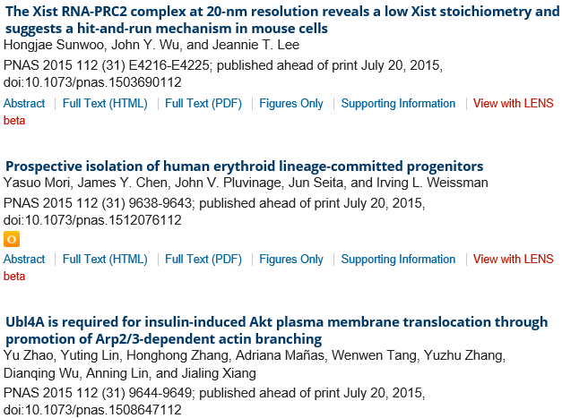

Slide 13

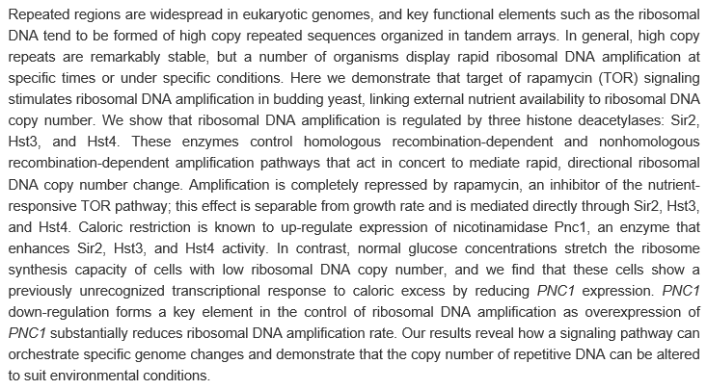

Slide 14

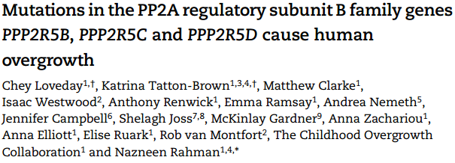
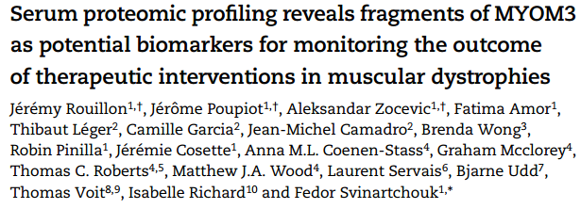
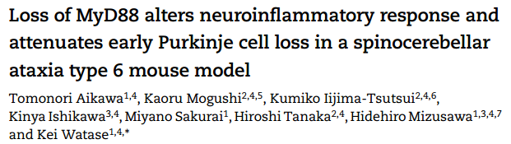
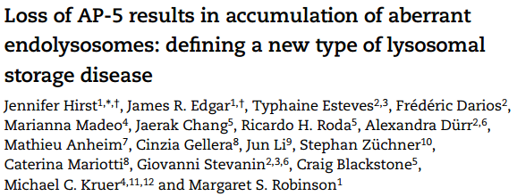
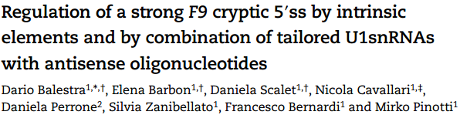
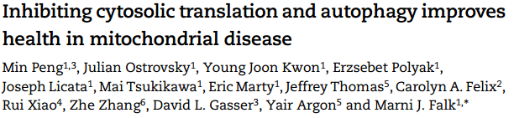
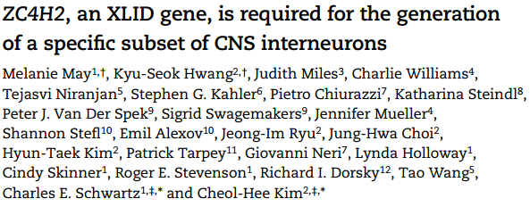
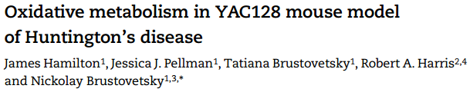

Slide 15


