Slide 1
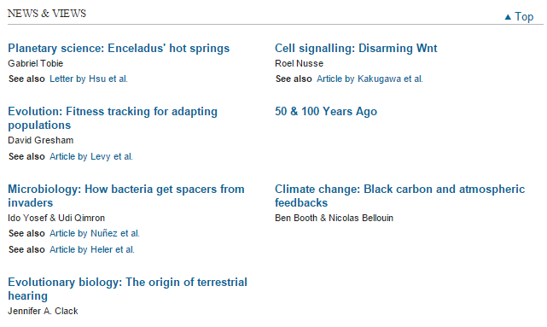


Slide 2
Cell signalling: Disarming Wnt
Roel Nusse
The secreted enzyme Notum has been found to inhibit the Wnt signalling pathway through removal of a lipid that is linked to the Wnt protein and that is required for activation of Wnt receptor proteins.See Article p.187
Nature. 2015 Mar 12;519(7542):187-92. doi: 10.1038/nature14259. Epub 2015 Feb 25.
Notum deacylates Wnt proteins to suppress signalling activity.
Kakugawa S¹, Langton PF¹, Zebisch M², Howell SA¹, Chang TH², Liu Y³, Feizi T³, Bineva G⁴, O'Reilly N⁴, Snijders AP⁵, Jones EY², Vincent JP¹.
Author information
Abstract
Signalling by Wnt proteins is finely balanced to ensure normal development and tissue homeostasis while avoiding diseases such as cancer. This is achieved in part by Notum, a highly conserved secreted feedback antagonist. Notum has been thought to act as a phospholipase, shedding glypicans and associated Wnt proteins from the cell surface. However, this view fails to explain specificity, as glypicans bind many extracellular ligands. Here we provide genetic evidence in Drosophila that Notum requires glypicans to suppress Wnt signalling, but does not cleave their glycophosphatidylinositol anchor. Structural analyses reveal glycosaminoglycan binding sites on Notum, which probably help Notum to co-localize with Wnt proteins. They also identify, at the active site of human and Drosophila Notum, a large hydrophobic pocket that accommodates palmitoleate. Kinetic and mass spectrometric analyses of human proteins show that Notum is a carboxylesterase that removes an essential palmitoleate moiety from Wnt proteins and thus constitutes the first known extracellular protein deacylase.

Slide 3
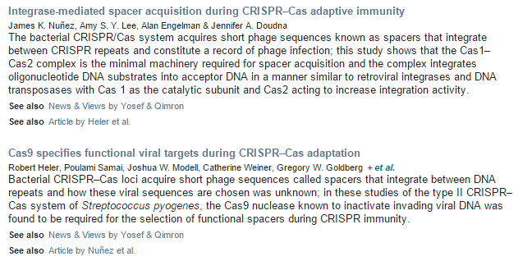
Microbiology: How bacteria get spacers from invaders
Ido Yosef & Udi Qimron
Bacteria use CRISPR–Cas systems to develop immunity to viruses. Details of how these systems select viral DNA fragments and integrate them into bacterial DNA to create a memory of invaders have now been reported. See Articles p.193 & p.199

Slide 4
Nature. 2015 Mar 12;519(7542):223-8. doi: 10.1038/nature14135. Epub 2014 Dec 24.
Large-scale discovery of novel genetic causes of developmental disorders.
Deciphering Developmental Disorders Study.
Collaborators (265)
Abstract
Despite three decades of successful, predominantly phenotype-driven discovery of the genetic causes of monogenic disorders, up to half of children with severe developmental disorders of probable genetic origin remain without a genetic diagnosis. Particularly challenging are those disorders rare enough to have eluded recognition as a discrete clinical entity, those with highly variable clinical manifestations, and those that are difficult to distinguish from other, very similar, disorders. Here we demonstrate the power of using an unbiased genotype-driven approach to identify subsets of patients with similar disorders. By studying 1,133 children with severe, undiagnosed developmental disorders, and their parents, using a combination of exome sequencing and array-based detection of chromosomal rearrangements, we discovered 12 novel genes associated with developmentaldisorders. These newly implicated genes increase by 10% (from 28% to 31%) the proportion of children that could be diagnosed. Clustering of missense mutations in six of these newly implicated genes suggests that normal development is being perturbed by an activating or dominant-negative mechanism. Our findings demonstrate the value of adopting a comprehensive strategy, both genome-wide and nationwide, to elucidate the underlying causes of rare genetic disorders.

Slide 5
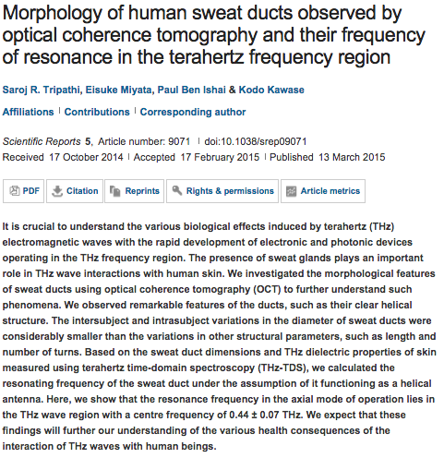
Scientific Reports

Slide 6
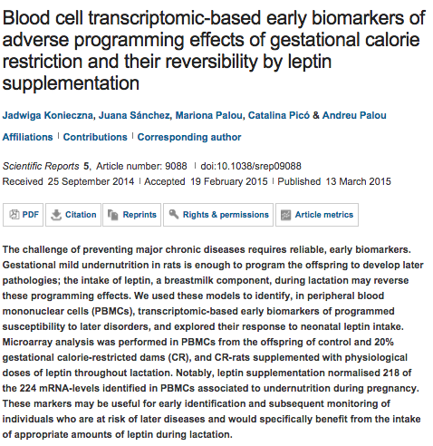

Slide 7
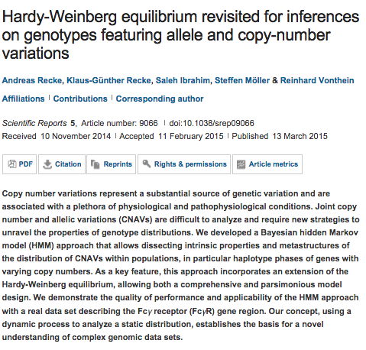

Slide 8
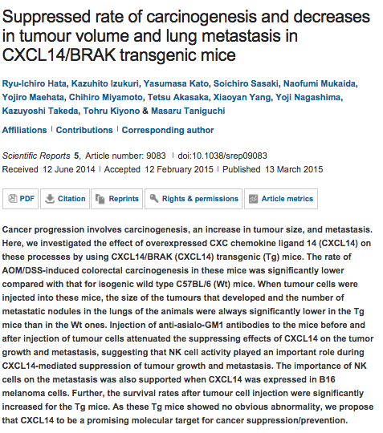

Slide 9



Slide 11

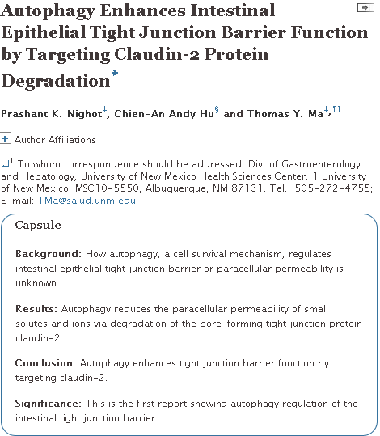

Slide 12
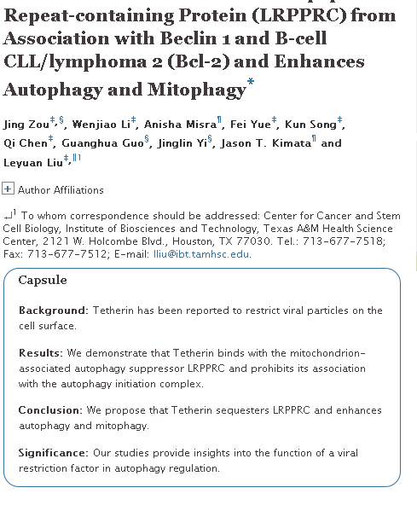

Slide 13
Oncogene
An EGFR/PI3K/AKT axis promotes accumulation of the Rac1-GEF Tiam1 that is critical in EGFR-driven tumorigenesis.
Zhu G¹, Fan Z², Ding M³, Zhang H⁴, Mu L⁵, Ding Y², Zhang Y⁶, Jia B⁷, Chen L⁴, Chang Z⁶, Wu W².
Author information
¹1] MOE Key Laboratory of Protein Science, School of Life Sciences, Tsinghua University, Beijing, China
Epidermal growth factor receptor (EGFR) signaling regulates cell growth and survival, and its overactivation drives cancer development. One important branch of EGFR signaling is through activation of GTPase Rac1, which further promotes cell proliferation, survival and cancer metastasis. Here, we show that EGFR activates Rac1 via inducing the accumulation of its specific guanine nucleotide exchange factor, T-cell lymphoma invasion and metastasis 1 (Tiam1) in non-small-cell lung cancer and colon cancer cells. Conversely, elevated Tiam1 is required for EGFR-induced tumorigenesis. In human lung adenocarcinoma and colon cancer specimens, Tiam1 expression strongly correlates with EGFR expression. We further reveal that AKT, a key downstream protein kinase of EGFR, phosphorylates Tiam1 at several consensus sites, facilitates the interaction of Tiam1 with scaffold proteins 14-3-3 and leads to an increase of Tiam1 stability. Subsequently, Tiam1 is dephosporylated and destabilized by PP2A. Together, our study identifies a bidirectional (phosphorylation and dephosphorylation) regulatory mechanism controlling Tiam1 stability and provides new insights on how EGFR signaling triggers Rac1 activation and cancer development.

Slide 14
DNA methylation in small cell lung cancer defines distinct disease subtypes and correlates with high expression of EZH2.
Poirier JT¹, Gardner EE², Connis N³, Moreira AL⁴, de Stanchina E⁵, Hann CL³, Rudin CM².
Author information
¹Department of Medicine, Memorial Sloan Kettering Cancer Center, New York, NY, USA
Oncogene
ECM1 regulates tumor metastasis and CSC-like property through stabilization of β-catenin.
Lee KM¹, Nam K¹, Oh S¹, Lim J¹, Kim RK¹, Shim D¹, Choi JH¹, Lee SJ¹, Yu JH², Lee JW², Ahn SH², Shin I³.
Author information
¹Department of Life Science, Hanyang University, Seoul, Korea.
Expression of miR-200c in claudin-low breast cancer alters stem cell functionality, enhances chemosensitivity and reduces metastatic potential.
Knezevic J¹, Pfefferle AD², Petrovic I¹, Greene SB³, Perou CM⁴, Rosen JM¹.
Author information
¹Department of Molecular and Cellular Biology, Baylor College of Medicine, Houston, TX, USA
MKL1 potentiates lung cancer cell migration and invasion by epigenetically activating MMP9 transcription.
Cheng X¹, Yang Y², Fan Z³, Yu L³, Bai H³, Zhou B³, Wu X³, Xu H³, Fang M⁴, Shen A⁵, Chen Q³, Xu Y³.
Author information
¹1] Key Laboratory of Cardiovascular Disease and Department of Pathophysiology, Nanjing Medical University, Nanjing, China [2] Jiangsu Institute of Nuclear Medicine, Wuxi, China.
Tumor-specific signaling to p53 is mimicked by Mdm2 inactivation in zebrafish: insights from mdm2 and mdm4 mutant zebrafish.
Chua JS¹, Liew HP¹, Guo L², Lane DP¹.
Author information
¹p53 Laboratory, Biomedical Sciences Institutes, Agency for Science, Technology and Research (A*STAR), Singapore, Singapore.
Nuclear heparanase-1 activity suppresses melanoma progression via its DNA-binding affinity.
Yang Y¹, Gorzelanny C¹, Bauer AT¹, Halter N¹, Komljenovic D², Bäuerle T³, Borsig L⁴, Roblek M⁴, Schneider SW¹.
Author information
¹Department of Dermatology, Experimental Dermatology, Medical Faculty Mannheim, Heidelberg University, Mannheim, Germany.
PKCδ maintains phenotypes of tumor initiating cells through cytokine-mediated autocrine loop with positive feedback.
Kim RK¹, Suh Y¹, Hwang E¹, Yoo KC¹, Choi KS², An S³, Hwang SG⁴, Kim IG⁵, Kim MJ⁶, Lee HJ⁷, Lee SJ¹.
Author information
¹Department of Life Science, Laboratory of Molecular Biochemistry, Research Institute for Natural Sciences, Hanyang University, Seoul, Korea.
The DEAD box protein p68: a crucial regulator of AKT/FOXO3a signaling axis in oncogenesis.
Sarkar M¹, Khare V¹, Guturi KK¹, Das N¹, Ghosh MK¹.
Author information
¹Cancer Biology and Inflammatory Disorder Division, Council of Scientific and Industrial Research-Indian Institute of Chemical Biology, Kolkata, India.

Slide 15
Blocking CLEC14A-MMRN2 binding inhibits sprouting angiogenesis and tumour growth.
Noy PJ¹, Lodhia P¹, Khan K¹, Zhuang X¹, Ward DG², Verissimo AR¹, Bacon A³, Bicknell R¹.
Author information
¹Angiogenesis Laboratory, Institute for Biomedical Research, Schools of Immunity and Infection and Cancer Sciences, College of Medical and Dental Sciences, The Medical School, University of Birmingham, Birmingham, UK
Oncogene
Histone deacetylase inhibitors prevent activation-induced cell death and promote anti-tumor immunity.
Cao K¹, Wang G¹, Li W¹, Zhang L², Wang R³, Huang Y¹, Du L¹, Jiang J⁴, Wu C⁴, He X⁴, Roberts AI⁵, Li F¹, Rabson AB⁵, Wang Y¹, Shi Y⁶.
Author information
¹Key Laboratory of Stem Cell Biology, Institute of Health Sciences, Shanghai Institutes for Biological Sciences, Chinese Academy of Sciences/Shanghai Jiao Tong University of Medicine, Shanghai, China.
Inactivation of the retinoblastoma gene yields a mouse model of malignant colorectal cancer.
Parisi T¹, Bronson RT², Lees JA³.
Author information
¹Koch Institute for Integrative Cancer Research, Cambridge, MA, USA.
Hypoxia upregulates Rab11-family interacting protein 4 through HIF-1α to promote the metastasis of hepatocellular carcinoma.
Hu F¹, Deng X¹, Yang X², Jin H³, Gu D⁴, Lv X⁵, Wang C³, Zhang Y³, Huo X³, Shen Q³, Luo Q³, Zhao F⁵, Ge T¹, Zhao F³, Chu W³, Shu H³, Yao M³, Fan J², Qin W³.
Author information
¹1] Shanghai Medical College of Fudan University, Shanghai, China [2] State Key Laboratory of Oncogenes and Related Genes, Shanghai Cancer Institute, Renji Hospital, Shanghai Jiao Tong University School of Medicine, Shanghai, China.
Repression of Hox genes by LMP1 in nasopharyngeal carcinoma and modulation of glycolytic pathway genes by HoxC8.
Jiang Y¹, Yan B¹, Lai W¹, Shi Y¹, Xiao D², Jia J³, Liu S⁴, Li H¹, Lu J¹, Li Z⁵, Chen L¹, Chen X¹, Sun L⁵, Muegge K⁶, Cao Y¹, Tao Y¹.
Author information
¹1] Cancer Research Institute, Central South University, Changsha, Hunan, China

Slide 16
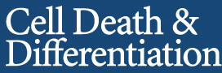
Editorials
Muscle gets stressed? p53 represses and protects
L Latella and P L Puri
Cell Death Differ 22: 519-521; doi:10.1038/cdd.2014.223
JunB and PTEN in prostate cancer: ‘loss is nothing else than change’
P Birner, G Egger, O Merkel and L Kenner
Cell Death Differ 22: 522-523; doi:10.1038/cdd.2014.232
eIF4A1 is a promising new therapeutic target in ER-negative breast cancer
M Stoneley and A E Willis
Cell Death Differ 22: 524-525; advance online publication, January 23, 2015; doi:10.1038/cdd.2014.210
Reviews
Old, new and emerging functions of caspases FREE
S Shalini, L Dorstyn, S Dawar and S Kumar
Cell Death Differ 22: 526-539; advance online publication, December 19, 2014; doi:10.1038/cdd.2014.216
A RING to rule them all? Insights into the Map3k1 PHD motif provide a new mechanistic understanding into the diverse roles of Map3k1 Open
T Suddason and E Gallagher
Cell Death Differ 22: 540-548; advance online publication, January 23, 2015; doi:10.1038/cdd.2014.239
The role of CD95 and CD95 ligand in cancer Open
M E Peter, A Hadji, A E Murmann, S Brockway, W Putzbach, A Pattanayak and P Ceppi
Cell Death Differ 22: 549-559; advance online publication, February 6, 2015; doi:10.1038/cdd.2015.3

Slide 17
Original Papers
p53 suppresses muscle differentiation at the myogenin step in response to genotoxic stress FREE
Z J P Yang, D Kenzelmann Broz, W L Noderer, J P Ferreira, K W Overton, S L Spencer, T Meyer, S J Tapscott, L D Attardi and C L Wang
Cell Death Differ 22: 560-573; advance online publication, December 12, 2014; doi:10.1038/cdd.2014.189
Loss of JUNB/AP-1 promotes invasive prostate cancer FREE
M K Thomsen, L Bakiri, S C Hasenfuss, H Wu, M Morente and E F Wagner
Cell Death Differ 22: 574-582; advance online publication, December 19, 2014; doi:10.1038/cdd.2014.213
The MT2 receptor stimulates axonogenesis and enhances synaptic transmission by activating Akt signaling
D Liu, N Wei, H-Y Man, Y Lu, L-Q Zhu and J-Z Wang
Cell Death Differ 22: 583-596; advance online publication, December 12, 2014; doi:10.1038/cdd.2014.195
Proteasome inhibition and oxidative reactions disrupt cellular homeostasis during heme stress Open
F Vallelian, J W Deuel, L Opitz, C A Schaer, M Puglia, M Lönn, W Engelsberger, S Schauer, E Karnaukhova, D R Spahn, R Stocker, P W Buehler and D J Schaer
Cell Death Differ 22: 597-611; advance online publication, October 10, 2014; doi:10.1038/cdd.2014.154
REDD2-mediated inhibition of mTOR promotes dendrite retraction induced by axonal injury Open
B Morquette, P Morquette, J Agostinone, E Feinstein, R A McKinney, A Kolta and A Di Polo
Cell Death Differ 22: 612-625; advance online publication, September 26, 2014; doi:10.1038/cdd.2014.149

Slide 18
Regulation of neuronal survival and morphology by the E3 ubiquitin ligase RNF157
A Matz, S-J Lee, N Schwedhelm-Domeyer, D Zanini, A Holubowska, M Kannan, M Farnworth, O Jahn, M C Göpfert and J Stegmüller
Cell Death Differ 22: 626-642; advance online publication, October 24, 2014; doi:10.1038/cdd.2014.163
Fas palmitoylation by the palmitoyl acyltransferase DHHC7 regulates Fas stability
A Rossin, J Durivault, T Chakhtoura-Feghali, N Lounnas, L Gagnoux-Palacios and A-O Hueber
Cell Death Differ 22: 643-653; advance online publication, October 10, 2014; doi:10.1038/cdd.2014.153
NRF2-driven miR-125B1 and miR-29B1 transcriptional regulation controls a novel anti-apoptotic miRNA regulatory network for AML survival
N M Shah, L Zaitseva, K M Bowles, D J MacEwan and S A Rushworth
Cell Death Differ 22: 654-664; advance online publication, October 17, 2014; doi:10.1038/cdd.2014.152
Cytokeratin19 induced by HER2/ERK binds and stabilizes HER2 on cell membranes
J-h Ju, S Oh, K-m Lee, W Yang, K S Nam, H-G Moon, D-Y Noh, C G Kim, G Park, J B Park, T Lee, C L Arteaga and I Shin
Cell Death Differ 22: 665-676; advance online publication, October 24, 2014; doi:10.1038/cdd.2014.155
CD44 functions in Wnt signaling by regulating LRP6 localization and activation
M Schmitt, M Metzger, D Gradl, G Davidson and V Orian-Rousseau
Cell Death Differ 22: 677-689; advance online publication, October 10, 2014; doi:10.1038/cdd.2014.156
Disruption of astrocyte-neuron cholesterol cross talk affects neuronal function in Huntington’s disease
M Valenza, M Marullo, E Di Paolo, E Cesana, C Zuccato, G Biella and E Cattaneo
Cell Death Differ 22: 690-702; advance online publication, October 10, 2014; doi:10.1038/cdd.2014.162

Slide 19
p53 suppresses muscle differentiation at the myogenin step in response to genotoxic stress
Z J P Yang¹, D Kenzelmann Broz^{2,6}, W L Noderer¹, J P Ferreira¹, K W Overton¹, S L Spencer³, T Meyer³, S J Tapscott⁴, L D Attardi^{2,5} and C L Wang¹
Abstract
Acute muscle injury and physiological stress from chronic muscle diseases and aging lead to impairment of skeletal muscle function. This raises the question of whether p53, a cellular stress sensor, regulates muscle tissue repair under stress conditions. By investigating muscle differentiation in the presence of genotoxic stress, we discovered that p53 binds directly to the myogenin promoter and represses transcription of myogenin, a member of the MyoD family of transcription factors that plays a critical role in driving terminal muscle differentiation. This reduction of myogenin protein is observed in G1-arrested cells and leads to decreased expression of late but not early differentiation markers. In response to acute genotoxic stress, p53-mediated repression of myogenin reduces post-mitotic nuclear abnormalities in terminally differentiated cells. This study reveals a mechanistic link previously unknown between p53 and muscle differentiation, and suggests new avenues for managing p53-mediated stress responses in chronic muscle diseases or during muscle aging.

