Slide 1
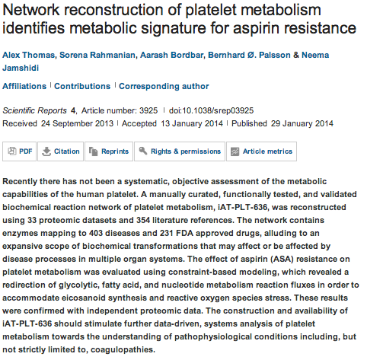
Scientific Reports

Slide 2
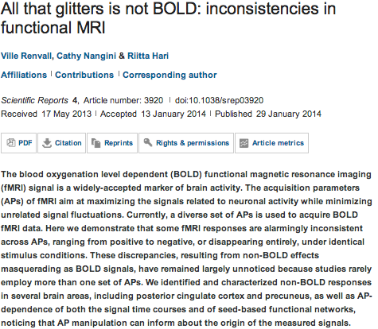

Slide 3
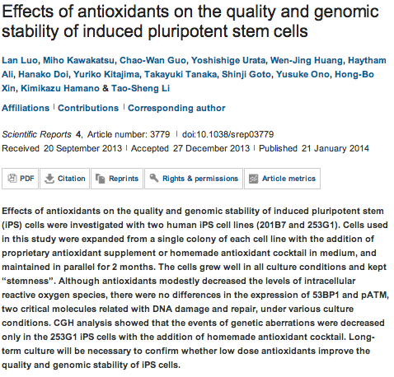

Slide 4
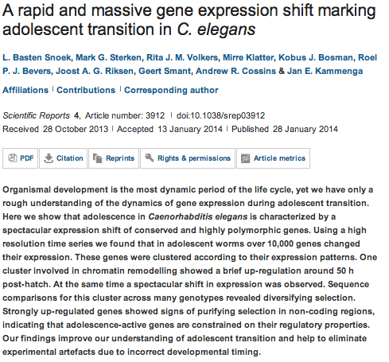

Slide 5
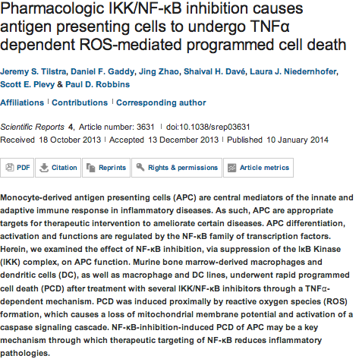

Slide 6
Oncogene
A chromatin modifier genetic screen identifies SIRT2 as a modulator of response to targeted therapies through the regulation of MEK kinase activity.
Bajpe PK¹, Prahallad A¹, Horlings H², Nagtegaal I³, Beijersbergen R¹, Bernards R¹.
Author information
¹Division of Molecular Carcinogenesis, Cancer Genomics Center, The Netherlands Cancer Institute, Amsterdam, The Netherlands.
²1] Division of Molecular Carcinogenesis, Cancer Genomics Center, The Netherlands Cancer Institute, Amsterdam, The Netherlands [2] Department of Pathology, Academisch Medisch Centrum, Amsterdam, The Netherlands.
³Department of Pathology, Radboud University Nijmegen Medical Center, Nijmegen, The Netherlands.
Abstract
Resistance to targeted therapies is a major problem in cancer treatment. The epidermal growth factor receptor (EGFR) antibody drugs are effective in a subset of colorectal cancers, but the molecular mechanisms of resistance are understood poorly. Genes involved in epigenetic regulation are frequently deregulated in cancer, raising the possibility that such genes also contribute to drug resistance. Using a focused RNA interference library for genes involved in epigenetic regulation, we identify sirtuin2 (SIRT2), an NAD⁺-dependent deacetylase, as a modulator of the response to EGFR inhibitors in colon and lung cancer. SIRT2 loss also conferred resistance to BRAF and MEK inhibitors in BRAF mutant melanoma and KRAS mutant colon cancers, respectively. These results warrant further investigation into the potential role of SIRT2 in resistance to drugs that act in the receptor tyrosine kinase-RAS-RAF-MEK-ERK signaling pathway.

Slide 7
Hedgehog acyltransferase as a target in pancreatic ductal adenocarcinoma.
Petrova E¹, Matevossian A², Resh MD³.
¹1] Cell Biology Program, Memorial Sloan-Kettering Cancer Center, New York, NY, USA [2] Graduate Program in Pharmacology, Weill Graduate School of Medical Sciences of Cornell University, New York, NY, USA.
Sonic Hedgehog (Shh) is abnormally expressed in pancreatic cancer and is associated with disease onset and progression. Inhibition of Shh signaling is thus an attractive clinical target for therapeutic intervention. Most efforts to block Shh signaling have focused on inhibitors of Smoothened, which target the canonical Shh signaling pathway. These approaches have met with limited success, in part due to development of resistance-conferring mutations and contributions from non-canonical signaling pathways. Here, we show that Hedgehog acyltransferase (Hhat), the enzyme responsible for the attachment of palmitate onto Shh, is a novel target for inhibition of Shh signaling in pancreatic cancer cells. Depletion of Hhat with lentivirally delivered small hairpin RNA decreased both anchorage-dependent and independent proliferation of human pancreatic cancer cells. In vivo, Hhat knockdown led to reduction of tumor growth in a mouse xenograft model of pancreatic cancer. RU-SKI 43, a small molecule inhibitor of Hhat recently developed by our group, reduced pancreatic cancer cell proliferation and Gli-1 activation through Smoothened-independent non-canonical signaling. In addition, RU-SKI 43 treatment inhibited two key proliferative pathways regulated by Akt and mTOR. This work demonstrates that Hhat has a critical role in pancreatic cancer and that a small molecule inhibitor of Hhat can successfully block pancreatic cancer cell proliferation. It also highlights the importance of developing optimized Hhat inhibitors to be used as therapeutics in pancreatic cancer, as well as in other malignancies characterized by Shh overexpression.
Oncogene

Slide 8
MicroRNA-193a-3p and -5p suppress the metastasis of human non-small-cell lung cancer by downregulating the ERBB4/PIK3R3/mTOR/S6K2 signaling pathway.
Yu T, Li J, Yan M, Liu L, Lin H, Zhao F, Sun L, Zhang Y, Cui Y, Zhang F, Li J, He X, Yao M.
Author information
State Key Laboratory of Oncogenes and Related Genes, Shanghai Cancer Institute, Renji Hospital, Shanghai Jiao Tong University School of Medicine, Shanghai, China.
Oncogene
Oncogenic RIT1 mutations in lung adenocarcinoma.
Berger AH¹, Imielinski M², Duke F³, Wala J⁴, Kaplan N⁵, Shi GX⁶, Andres DA⁶, Meyerson M⁷.
Author information
¹1] Cancer Program, The Broad Institute of Harvard and M.I.T., 7 Cambridge Center, Cambridge, MA, USA [2] Department of Medical Oncology, Dana Farber Cancer Institute, Boston, MA, USA.
The stem cell transcription factor ZFP57 induces IGF2 expression to promote anchorage-independent growth in cancer cells.
Tada Y¹, Yamaguchi Y², Kinjo T¹, Song X¹, Akagi T¹, Takamura H², Ohta T², Yokota T¹, Koide H¹.
Author information
¹Department of Stem Cell Biology, Graduate School of Medical Sciences, Kanazawa University, Ishikawa, Japan.
ASC deficiency suppresses proliferation and prevents medulloblastoma incidence.
Knight ER¹, Patel EY², Flowers CA², Crowther AJ³, Ting JP⁴, Miller CR⁵, Gershon TR⁶, Deshmukh M⁷.
Author information
¹1] Neurobiology Curriculum, University of North Carolina-Chapel Hill, Chapel Hill, NC, USA [2] Neuroscience Center, University of North Carolina-Chapel Hill, Chapel Hill, NC, USA.
Growth factor receptor/steroid receptor cross talk in trastuzumab-treated breast cancer.
Collins DC¹, Cocchiglia S¹, Tibbitts P¹, Solon G¹, Bane FT¹, McBryan J¹, Treumann A², Eustace A³, Hennessy B³,Hill AD¹, Young LS¹.
Author information
¹Endocrine Oncology Research, Department of Surgery, Royal College of Surgeons in Ireland, Dublin, Ireland.
TRIM24 promotes glioma progression and enhances chemoresistance through activation of the PI3K/Akt signaling pathway.
Zhang LH, Yin AA, Cheng JX, Huang HY, Li XM, Zhang YQ, Han N, Zhang X.
Author information
Department of Neurosurgery, Xijing Hospital, Fourth Military Medical University, Xi'an, China
Akt phosphorylates and activates HSF-1 independent of heat shock, leading to Slug overexpression and epithelial-mesenchymal transition (EMT) of HER2-overexpressing breast cancer cells.
Carpenter RL¹, Paw I¹, Dewhirst MW², Lo HW³.
Author information
¹Division of Surgical Sciences, Department of Surgery, Duke University School of Medicine, Durham, NC, USA.
p53 suppresses carcinoma progression by inhibiting mTOR pathway activation.
Akeno N¹, Miller AL¹, Ma X¹, Wikenheiser-Brokamp KA².
Author information
¹Pathology and Laboratory Medicine, Cincinnati Children's Hospital Medical Center, Cincinnati, OH, USA.

Slide 9
Selective killing of lung cancer cells by miRNA-506 molecule through inhibiting NF-κB p65 to evoke reactive oxygen species generation and p53 activation.
Yin M¹, Ren X¹, Zhang X², Luo Y³, Wang G⁴, Huang K³, Feng S³, Bao X⁴, Huang K⁵, He X⁶, Liang P⁷, Wang Z⁴, Tang H², He J², Zhang B¹.
Author information
¹1] The State Key Laboratory of Respiratory Diseases, Guangzhou Institutes of Biomedicine and Health, Chinese Academy of Sciences, Guangzhou, China [2] School of Life Science, University of Science and Technology of China, Hefei, China.
Oncogene
Elafin drives poor outcome in high-grade serous ovarian cancers and basal-like breast tumors.
Labidi-Galy SI¹, Clauss A¹, Ng V², Duraisamy S¹, Elias KM³, Piao HY², Bilal E⁴, Davidowitz RA⁵, Lu Y⁶, Badalian-Very G¹, Györffy B⁷, Kang UB⁸, Ficarro S⁸, Ganesan S⁴, Mills GB⁶, Marto JA⁸, Drapkin R⁹.
Author information
¹1] Department of Medical Oncology, Dana-Farber Cancer Institute, Boston, MA, USA [2] Harvard Medical School, Boston, MA, USA.
Global identification of genes targeted by DNMT3b for epigenetic silencing in lung cancer.
Teneng I, Tellez CS, Picchi MA, Klinge DM, Yingling CM, Snider AM, Liu Y, Belinsky SA.
Author information
Lung Cancer Program, Lovelace Respiratory Research Institute, Albuquerque, NM, USA
Casein kinase 1 regulates Sprouty2 in FGF-ERK signaling.
Yim DG¹, Ghosh S², Guy GR³, Virshup DM⁴.
Author information
¹1] Program in Cancer and Stem Cell Biology, Duke-NUS Graduate Medical School, Singapore, Singapore [2] Signal Transduction Laboratory, Institute for Molecular and Cellular Biology, Biopolis, Singapore [3] Genome Institute of Singapore, Biopolis, Singapore.
TFAP2C governs the luminal epithelial phenotype in mammary development and carcinogenesis.
Cyr AR¹, Kulak MV², Park JM², Bogachek MV², Spanheimer PM², Woodfield GW², White-Baer LS², O'Malley YQ²,Sugg SL², Olivier AK³, Zhang W³, Domann FE⁴, Weigel RJ⁵.
Author information
¹1] Department of Surgery, University of Iowa, Iowa City, IA, USA [2] Department of Radiation Oncology, University of Iowa, Iowa City, IA, USA.
PRC2-independent chromatin compaction and transcriptional repression in cancer.
Vallot C¹, Hérault A¹, Boyle S², Bickmore WA³, Radvanyi F¹.
Author information
¹1] CNRS, UMR 144 - Cell Biology Department, Institut Curie, Paris, France [2] Institut Curie, Centre de Recherche, Paris, France.
The von Hippel-Lindau tumor suppressor regulates programmed cell death 5-mediated degradation of Mdm2.
Essers PB¹, Klasson TD², Pereboom TC¹, Mans DA³, Nicastro M², Boldt K⁴, Giles RH², Macinnes AW¹.
Author information
¹Hubrecht Institute for Developmental Biology and Stem Cell Research, KNAW and University Medical Center Utrecht, Utrecht, The Netherlands
Juvenile myelomonocytic leukaemia-associated mutation in Cbl promotes resistance to apoptosis via the Lyn-PI3K/AKT pathway.
Bunda S, Qin K, Kommaraju K, Heir P, Ohh M.
Author information
Department of Laboratory Medicine and Pathobiology, University of Toronto, Toronto, Ontario, Canada

Slide 10
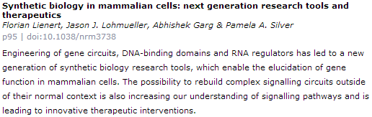
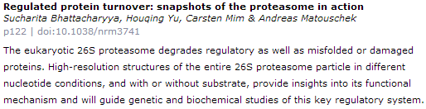
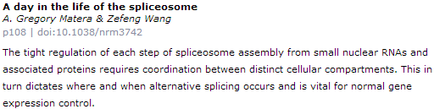
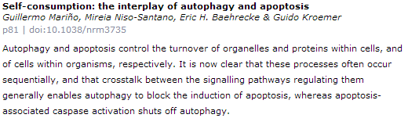
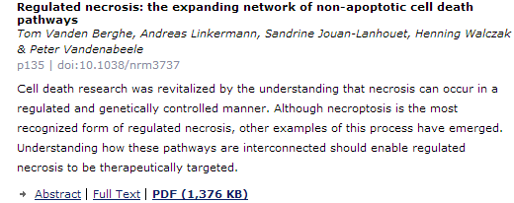
Nature reviews Mol. Cell Biol.

Slide 11
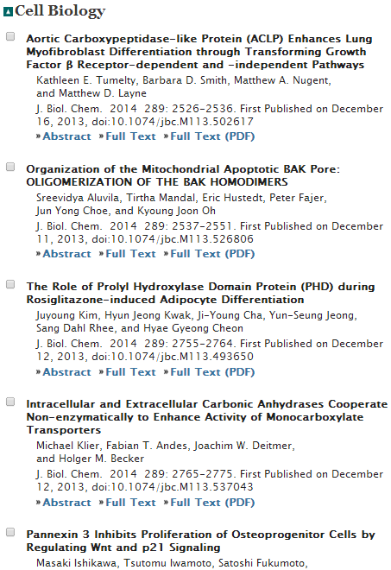

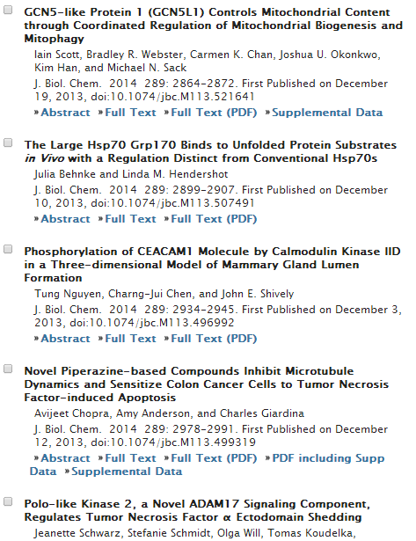

Slide 12
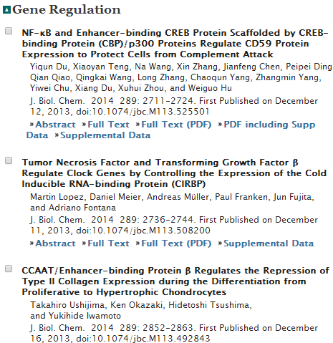
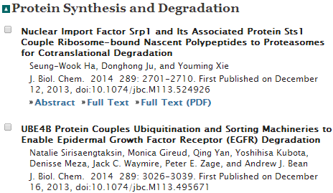
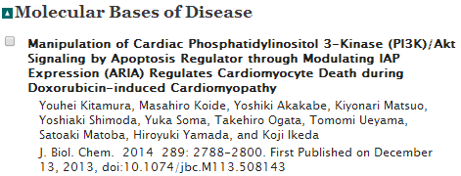

Slide 13
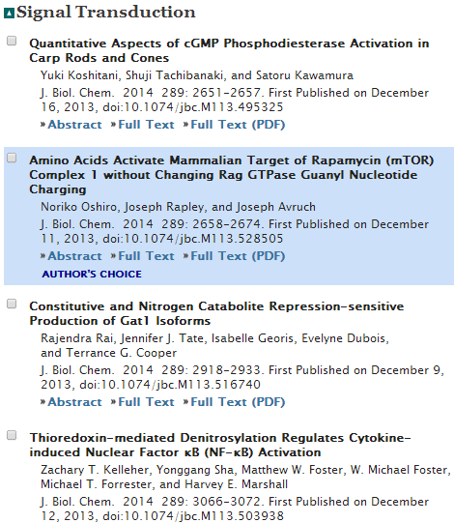

Slide 14


