Slide 1
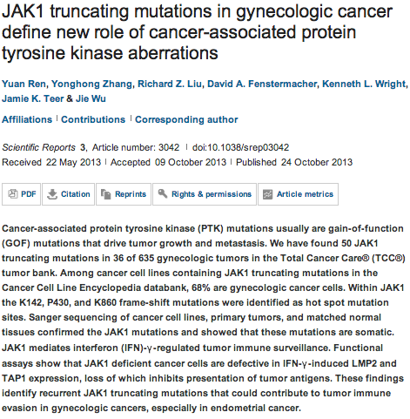
Scientific Reports
SD

Slide 2
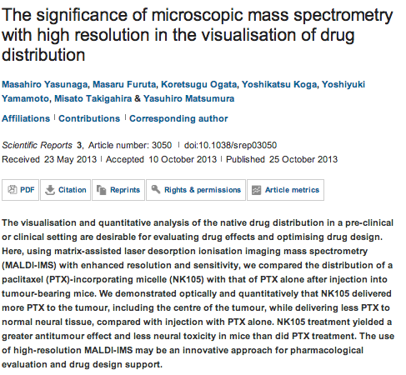
SD

Slide 3
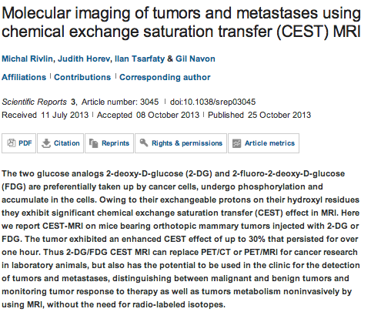
SD

Slide 4
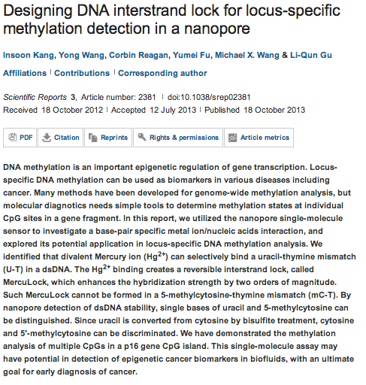
SD

Slide 5

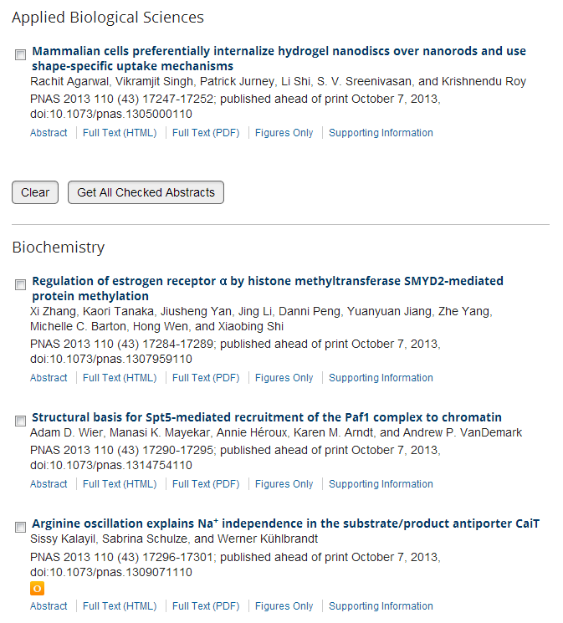
JMC

Slide 6
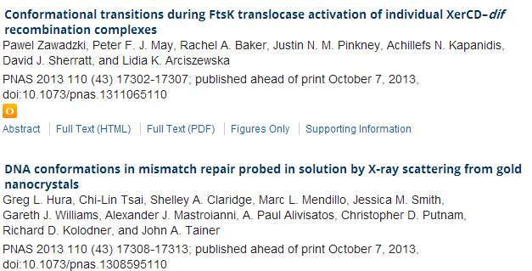
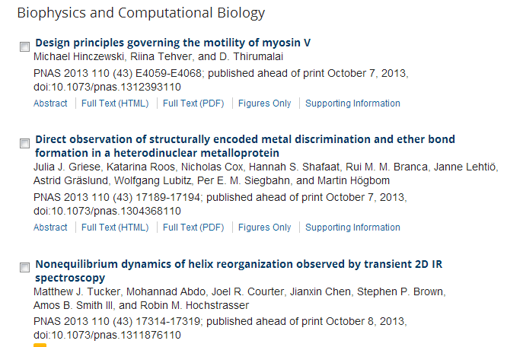
JMC

Slide 7
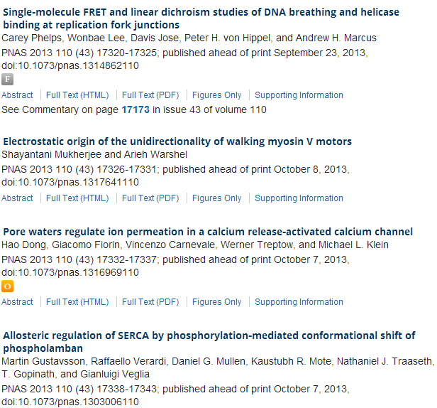
JMC

Slide 8
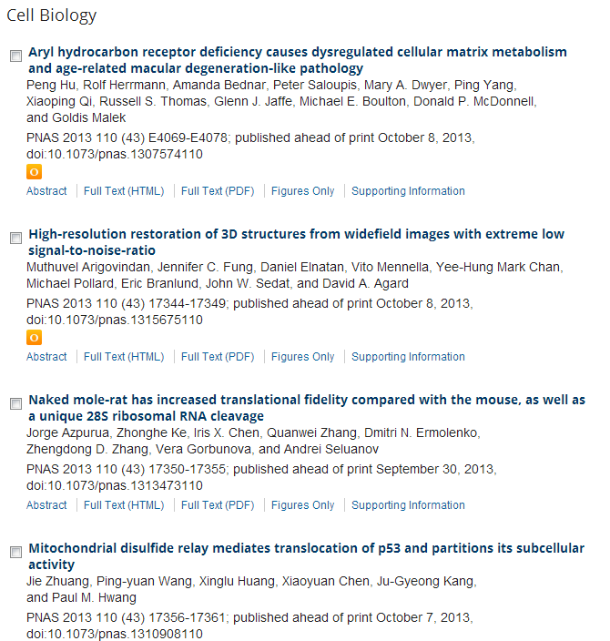
JMC

Slide 9
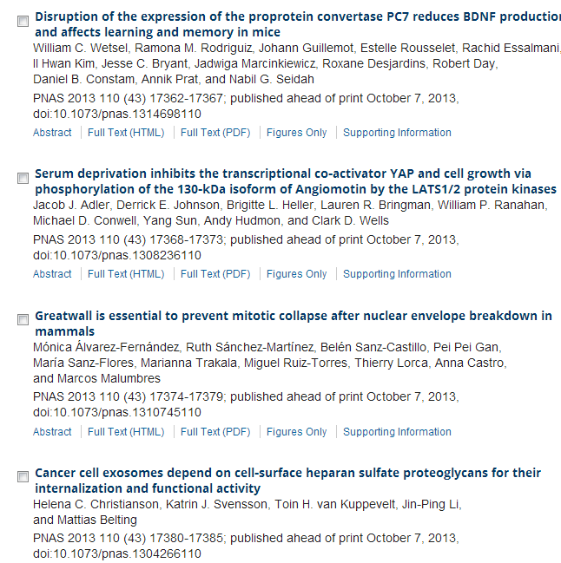
JMC

Slide 10
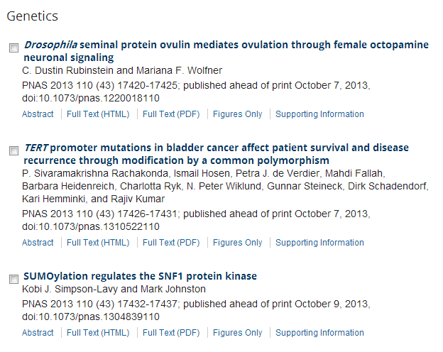
JMC

Slide 11
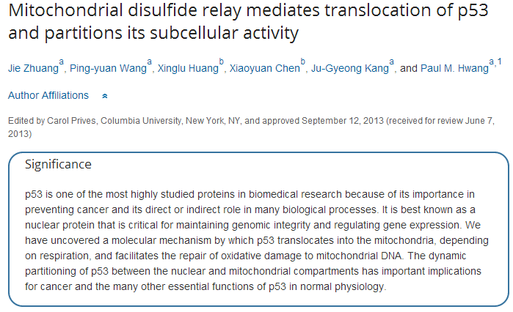
JMC

Slide 12
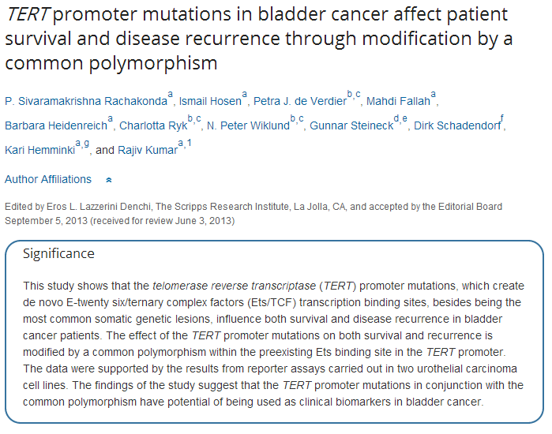
JMC

Slide 13

Rapid Innate Defensive Responses of Mice to Looming Visual Stimuli
Much of brain science is concerned with understanding the neural circuits that underlie specific behaviors. While the mouse has become a favorite experimental subject, the behaviors of this species are still poorly explored. For example, the mouse retina, like that of other mammals, contains ∼20 different circuits that compute distinct features of the visual scene [1,2]. By comparison, only a handful of innate visual behaviors are known in this species—the pupil reflex [3], phototaxis [4], the optomotor response [5], and the cliff response [6]—two of which are simple reflexes that require little visual processing. We explored the behavior of mice under a visual display that simulates an approaching object, which causes defensive reactions in some other species [7,8]. We show that mice respond to this stimulus either by initiating escape within a second or by freezing for an extended period. The probability of these defensive behaviors is strongly dependent on the parameters of the visual stimulus. Directed experiments identify candidate retinal circuits underlying the behavior and lead the way into detailed study of these neural pathways. This response is a new addition to the repertoire of innate defensive behaviors in the mouse that allows the detection and avoidance of aerial predators.
MA

Slide 14
miRNAs Are Required for Generating a Time Delay Critical for the Circadian Oscillator
p1959Rongmin Chen, Matthew D’Alessandro, Choogon Lee
Summary | Full Text | PDF (1718 kb)
An Atypical Tubulin Kinase Mediates Stress-Induced Microtubule Depolymerization in Arabidopsis p1969Satoshi Fujita, Jaromir Pytela, Takashi Hotta, Takehide Kato, Takahiro Hamada, Rie Akamatsu, Yasumasa Ishida, Natsumaro Kutsuna, Seiichiro Hasezawa, Yuko Nomura, Hirofumi Nakagami, Takashi Hashimoto
Summary | Full Text | PDF (2902 kb)
Cytokinin Induces Cell Division in the Quiescent Center of the Arabidopsis Root Apical Meristem p1979Wenjing Zhang, Ranjan Swarup, Malcolm Bennett, G. Eric Schaller, Joseph J. Kieber
Summary | Full Text | PDF (1647 kb)
Dip1 Defines a Class of Arp2/3 Complex Activators that Function without Preformed Actin Filaments p1990Andrew R. Wagner, Qing Luan, Su-Ling Liu, Brad J. Nolen
Summary | Full Text | PDF (1364 kb)
Nuclear Repulsion Enables Division Autonomy in a Single Cytoplasm
p1999Cori A. Anderson, Umut Eser, Therese Korndorf, Mark E. Borsuk, Jan M. Skotheim, Amy S. Gladfelter
Summary | Full Text | PDF (2398 kb)
Reports
Rapid Innate Defensive Responses of Mice to Looming Visual Stimuli
p2011Melis Yilmaz, Markus Meister
Summary | Full Text | PDF (1179 kb)
MA

Slide 15
Striated Rootlet and Nonfilamentous Forms of Rootletin Maintain Ciliary Function
p2016Swetha Mohan, Tiffany A. Timbers, Julie Kennedy, Oliver E. Blacque, Michel R. Leroux
Summary | Full Text | PDF (1689 kb)
Decoding the Brain’s Algorithm for Categorization from Its Neural Implementation
p2023Michael L. Mack, Alison R. Preston, Bradley C. Love
Summary | Full Text | PDF (471 kb)
Negative Emotional Outcomes Attenuate Sense of Agency over Voluntary Actions
p2028Michiko Yoshie, Patrick Haggard
Summary | Full Text | PDF (498 kb)
African Elephants Can Use Human Pointing Cues to Find Hidden Food
p2033Anna F. Smet, Richard W. Byrne
Summary | Full Text | PDF (853 kb)
Chemical Signals Synchronize the Life Cycles of a Plant-Parasitic Nematode and Its Vector Beetle
p2038Lilin Zhao, Shuai Zhang, Wei Wei, Haijun Hao, Bin Zhang, Rebecca A. Butcher, Jianghua Sun
Summary | Full Text | PDF (1073 kb)
Halotropism Is a Response of Plant Roots to Avoid a Saline Environment
p2044Carlos S. Galvan-Ampudia, Magdalena M. Julkowska, Essam Darwish, Jacinto Gandullo, Ruud A. Korver, Geraldine Brunoud, Michel A. Haring, Teun Munnik, Teva Vernoux, Christa Testerink
Summary | Full Text | PDF (2758 kb)
MA

Slide 16
Budding Yeast Escape Commitment to the Phosphate Starvation Program Using Gene Expression Noise p2051Noam Vardi, Sagi Levy, Michael Assaf, Miri Carmi, Naama Barkai
Summary | Full Text | PDF (1076 kb)
Phylogenomics Resolves Evolutionary Relationships among Ants, Bees, and Wasps
p2058Brian R. Johnson, Marek L. Borowiec, Joanna C. Chiu, Ernest K. Lee, Joel Atallah, Philip S. Ward
Summary | Full Text | PDF (735 kb)
Visualization of Neural Activity in Insect Brains Using a Conserved Immediate Early Gene, Hr38 p2063Nozomi Fujita, Yuka Nagata, Takumi Nishiuchi, Makoto Sato, Masafumi Iwami, Taketoshi Kiya
Summary | Full Text | PDF (3271 kb)
WAPL-Mediated Removal of Cohesin Protects against Segregation Errors and Aneuploidy
p2071Judith H.I. Haarhuis, Ahmed M.O. Elbatsh, Bram van den Broek, Daniel Camps, Hasan Erkan, Kees Jalink, René H. Medema, Benjamin D. Rowland
Summary | Full Text | PDF (1012 kb)
MA

Slide 17

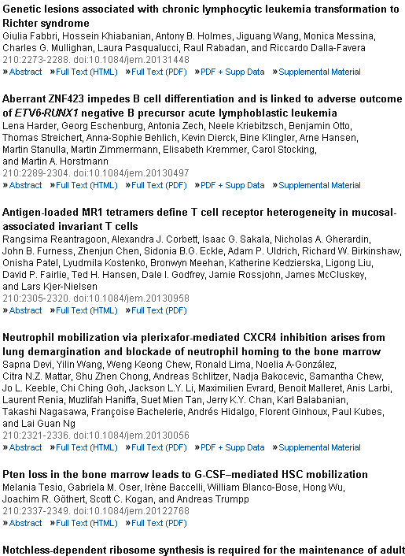
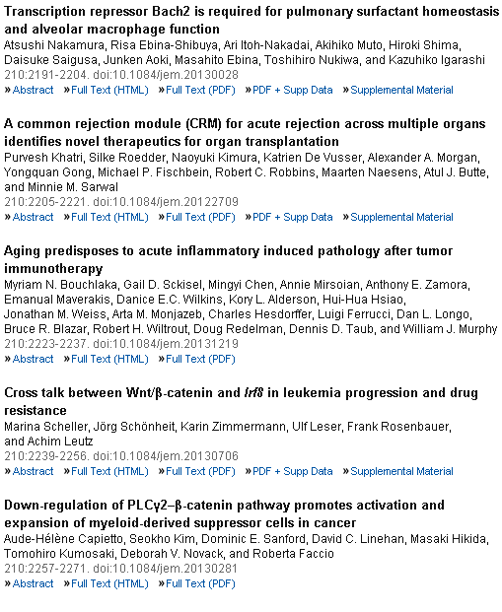

Slide 18
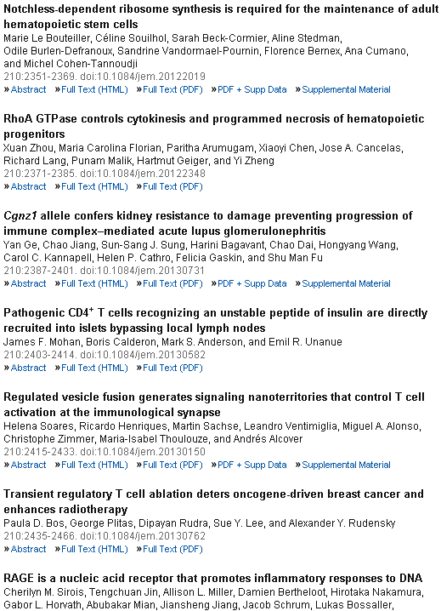
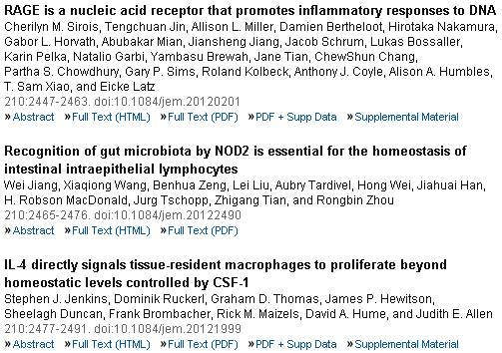

Slide 19
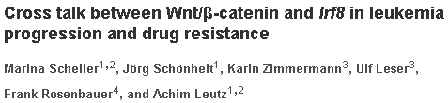
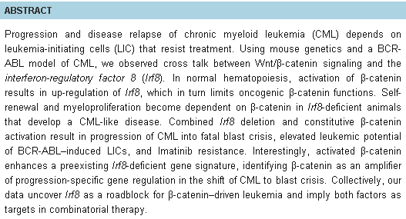

Slide 20
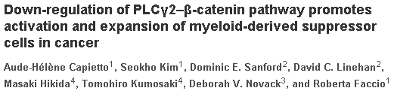
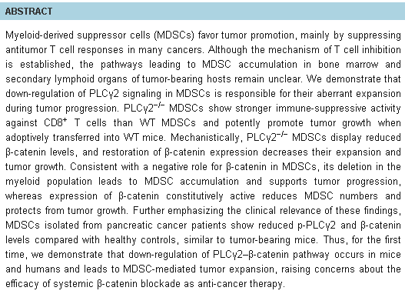

Slide 21
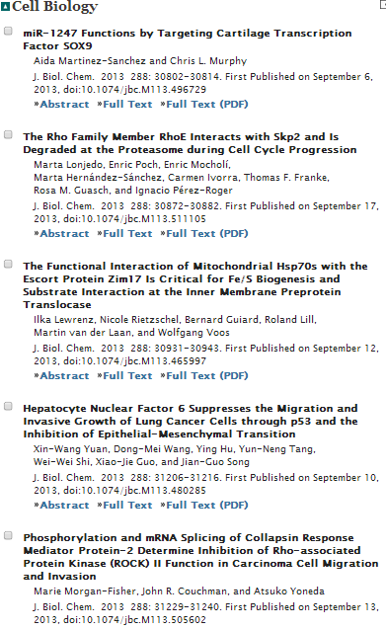

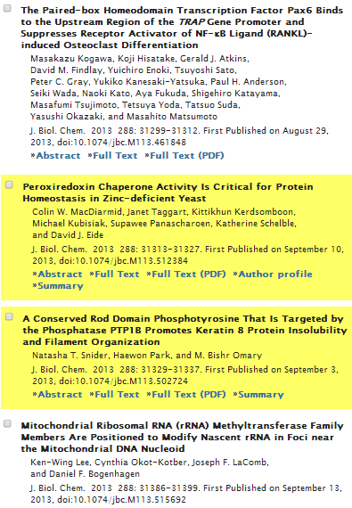

Slide 22
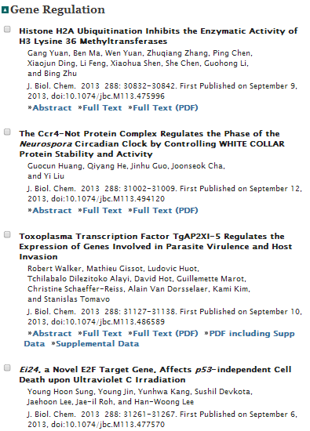
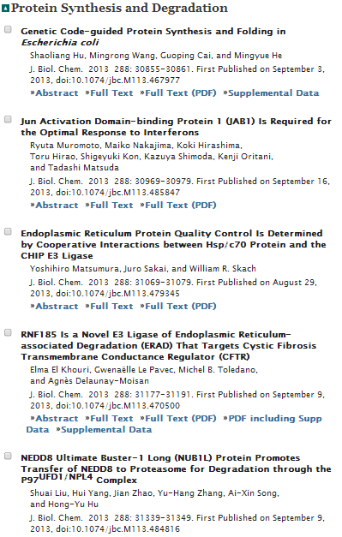

Slide 23
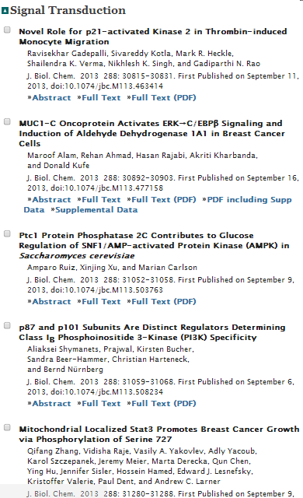

Slide 24
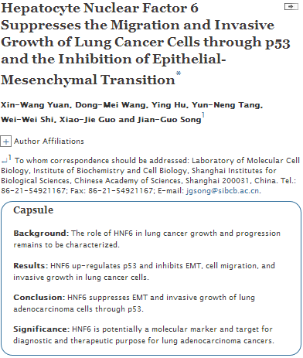

Slide 25
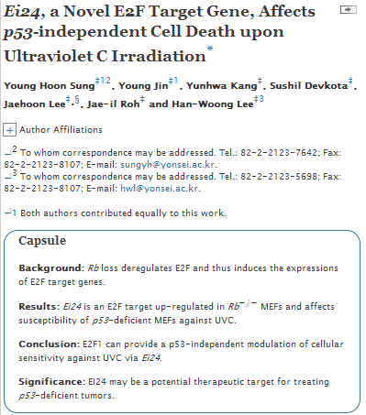

Slide 26
oncogene
Combined PKC and MEK inhibition in uveal melanoma with GNAQ and GNA11 mutations.
Chen X, Wu Q, Tan L, Porter D, Jager MJ, Emery C, Bastian BC.
1] Human Oncology and Pathogenesis Program, Memorial Sloan Kettering Cancer Center, New York, NY, USA [2] Departments of Dermatology and Pathology, and Helen Diller Family Comprehensive Cancer Center, University of California, San Francisco, CA, USA.
Uveal melanoma (UM) is a genetically and biologically distinct type of melanoma, and once metastatic there is no effective treatment currently available. Eighty percent of UMs harbor mutations in the Gα_{q} family members GNAQ and GNA11. Understanding the effector pathways downstream of these oncoproteins is important to identify opportunities for targeted therapy. We report consistent activation of the protein kinase C (PKC) and MAPK pathways as a consequence of GNAQ or GNA11 mutation. PKC inhibition with AEB071 or AHT956 suppressed PKC and MAPK signalling and induced G1 arrest selectively in melanoma cell lines carrying GNAQ or GNA11 mutations. In contrast, treatment with two different MEK inhibitors, PD0325901 and MEK162, inhibited the proliferation of melanoma cell lines irrespective of their mutation status, indicating that in the context of GNAQ or GNA11 mutation MAPK activation can be attributed to activated PKC. AEB071 significantly slowed the growth of tumors in an allograft model of GNAQ^{Q209L}-transduced melanocytes, but did not induce tumor shrinkage. In vivo and in vitro studies showed that PKC inhibitors alone were unable to induce sustained suppression of MAP-kinase signaling. However, combinations of PKC and MEK inhibition, using either PD0325901or MEK162, led to sustained MAP-kinase pathway inhibition and showed a strong synergistic effect in halting proliferation and in inducing apoptosis in vitro. Furthermore, combining PKC and MEK inhibition was efficacious in vivo, causing marked tumor regression in a UM xenograft model. Our data identify PKC as a rational therapeutic target for melanoma patients with GNAQ or GNA11 mutations and demonstrate that combined MEK and PKC inhibition is synergistic, with superior efficacy compared to treatment with either approach alone.

Slide 27
Identification of latent biomarkers in hepatocellular carcinoma by ultra-deep whole-transcriptome sequencing.
Lin KT, Shann YJ, Chau GY, Hsu CN, Huang CY.
Institute of Biomedical Informatics, National Yang-Ming University, Taipei, Taiwan.
There is an urgent need to identify biomarkers for hepatocellular carcinoma due to limited treatment options and the poor prognosis of this common lethal disease. Whole-transcriptome shotgun sequencing (RNA-Seq) provides new possibilities for biomarker identification. We sequenced ∼250 million pair-end reads from a pair of adjacent normal and tumor liver samples. With the aid of bioinformatics tools, we determined the transcriptome landscape and sought novel biomarkers by further empirical validations in 55 pairs of adjacent normal and tumor liver samples with various viral statuses such as HBV(+), HCV(+) and HBV(-)HCV(-). We identified a novel gene with coding regions, termed DUNQU1, which has a tissue-specific expression pattern in tumor liver samples of HCV(+) and HBV(-)HCV(-) hepatocellular carcinomas. Overexpression of DUNQU1 in Huh7 cell lines enhances the ability to form colonies in soft agar. Also, we identified three novel differentially-expressed protein-coding genes (ALG1L, SERPINA11 and TMEM82) that lack documented expression profiles in liver cancer and showed that the level of SREPINA11 is correlated with pathology stages. Moreover, we showed that the alternative splicing event of FGFR2 is associated with virus infection, tumor size, cirrhosis and tumor recurrence. The findings indicate that these new markers of hepatocellular carcinoma may be of value in improving prognosis and could have potential as new targets for developing new treatment options.
oncogene

Slide 28
The age- and shorter telomere-dependent TERT promoter mutation in follicular thyroid cell-derived carcinomas.
Liu T, Wang N, Cao J, Sofiadis A, Dinets A, Zedenius J, Larsson C, Xu D.
Division of Hematology and Center for Molecular Medicine, Department of Medicine, Karolinska Institutet and Karolinska University Hospital Solna, Stockholm, Sweden.
Telomerase activation through induction of its catalytic component telomerase reverse transcriptase (TERT) expression is essential for malignant transformation. TERT promoter mutations namely C228T and C250T that stimulate TERT transcription and telomerase activation have recently been identified in many human malignancies. We thus determined these mutations and their biological and clinical implications in thyroid carcinomas in the present study. The TERT promoter was sequenced in 10 thyroid cancer cell lines and 144 tumors from 20 patients with anaplastic thyroid carcinoma (ATC), 51 with papillary thyroid carcinoma (PTC), 36 with follicular thyroid carcinoma (FTC), and 37 with medullary thyroid carcinoma (MTC). We identified C228T or C250T mutation in 6/8 of ATC cell lines, as well as in tumor tissue from 10/20, 13/51, 8/36 and 0/37 patients with ATC, PTC, FTC and MTC, respectively. In PTC patients, these mutations were exclusively present in the group with age >45 years (P<0.0001), and highly correlated shorter telomeres (P<0.0001) and distant metastasis (P=0.028). The previous radioactivity exposure did not induce the mutation. The presence of C228T or C250T was an independent predictor associated with shorter disease-related survival (DRS) in the entire cohort (P<0.0001), as well as among patients >45 years (P=0.021). ATC patients carrying the mutation survived shorter than those without mutations, although not statistically significant (P=0.129). The TERT promoter mutation was associated with overall survival (P=0.038) and DRS (P=0.058) of FTC patients. Taken together, age- and shorter telomere-dependent TERT promoter mutations occur frequently in follicular cell-derived thyroid carcinoma (ATC, PTC and FTC) but not in parafollicular cell-originated MTC, and may serve as a marker for aggressive disease and poor outcome.
oncogene

Slide 29
FOXM1 targets NBS1 to regulate DNA damage-induced senescence and epirubicin resistance.
Khongkow P, Karunarathna U, Khongkow M, Gong C, Gomes AR, Yagüe E, Monteiro LJ, Kongsema M, Zona S, Man EP, Tsang JW, Coombes RC, Wu KJ, Khoo US, Medema RH, Freire R, Lam EW.
Source
Department of Surgery and Cancer, Imperial College London, Hammersmith Hospital Campus, London, UK.
oncogene
Context-dependent adaption of EpCAM expression in early systemic esophageal cancer.
Driemel C, Kremling H, Schumacher S, Will D, Wolters J, Lindenlauf N, Mack B, Baldus SA, Hoya V, Pietsch JM,Panagiotidou P, Raba K, Vay C, Vallböhmer D, Harréus U, Knoefel WT, Stoecklein NH, Gires O.
Source
Department for General, Visceral und Pediatric Surgery, University Hospital and Medical Faculty of the Heinrich-Heine University Düsseldorf, Düsseldorf, Germany.
YB-1 disrupts mismatch repair complex formation, interferes with MutSα recruitment on mismatch and inhibits mismatch repair through interacting with PCNA.
Chang YW, Mai RT, Fang WH, Lin CC, Chiu CC, Wu Lee YH.
Source
Institute of Biochemistry and Molecular Biology, School of Life Sciences, National Yang-Ming University, Taipei, Taiwan.
Hedgehog signaling induces osteosarcoma development through Yap1 and H19 overexpression.
Chan LH, Wang W, Yeung W, Deng Y, Yuan P, Mak KK.
Breast cancer-associated missense mutants of the PALB2 WD40 domain, which directly binds RAD51C, RAD51 and BRCA2, disrupt DNA repair.
Park JY, Singh TR, Nassar N, Zhang F, Freund M, Hanenberg H, Meetei AR, Andreassen PR.
Source
Division of Experimental Hematology and Cancer Biology, Cincinnati Children's Research Foundation, Cincinnati, OH, USA.
RSK2 regulates endocytosis of FGF receptor 1 by phosphorylation on serine 789.
Nadratowska-Wesolowska B, Haugsten EM, Zakrzewska M, Jakimowicz P, Zhen Y, Pajdzik D, Wesche J, Wiedlocha A.
Source
1] Centre for Cancer Biomedicine, Faculty of Medicine, University of Oslo, Montebello, Oslo, Norway [2] Department of Biochemistry, Institute for Cancer Research, Oslo University Hospital, Montebello, Oslo, Norway.
MicroRNA-9 inhibits the proliferation of oral squamous cell carcinoma cells by suppressing expression of CXCR4 via the Wnt/β-catenin signaling pathway.
Yu T, Liu K, Wu Y, Fan J, Chen J, Li C, Yang Q, Wang Z.
Source
Department of Head and Neck Oncology Surgery, Sichuan Cancer Hospital, Chengdu, People's Republic of China.
Novel role of Engrailed 1 as a prosurvival transcription factor in basal-like breast cancer and engineering of interference peptides block its oncogenic function.
Beltran AS, Graves LM, Blancafort P.
Source
Department of Pharmacology, The University of North Carolina at Chapel Hill, Chapel Hill, NC, USA.

