Slide 1





Slide 2
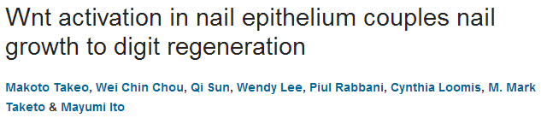
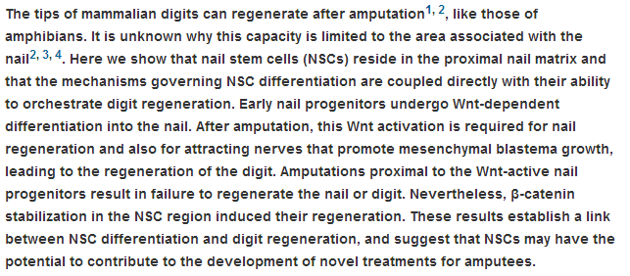

Slide 3
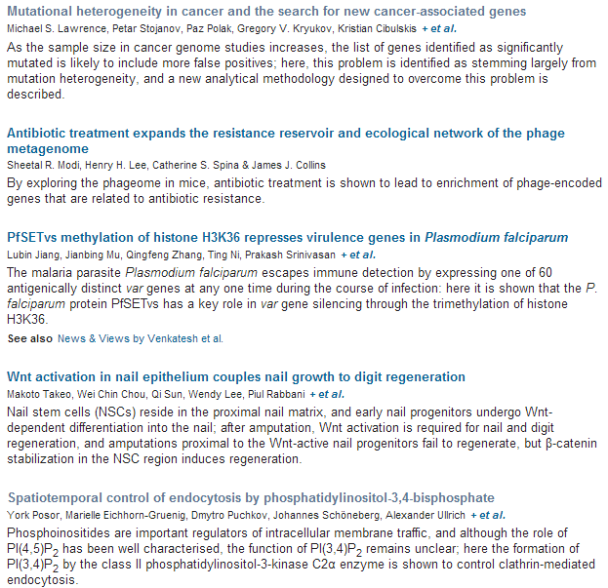

Slide 4
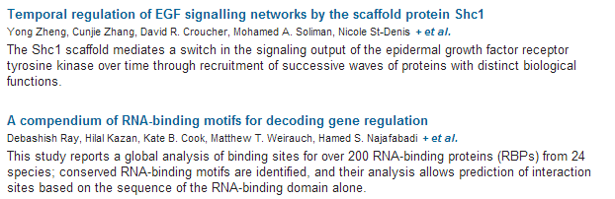
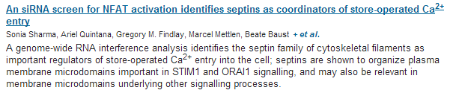

Slide 5

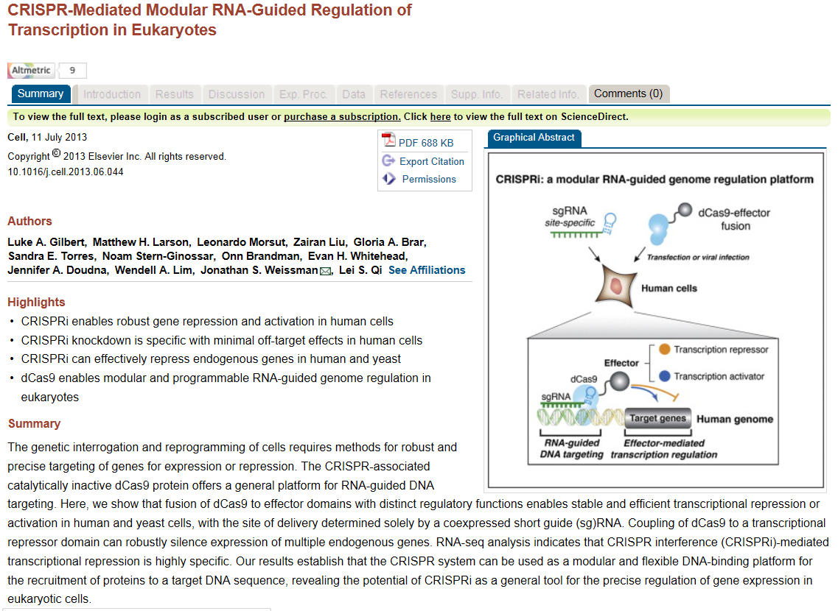

Slide 6
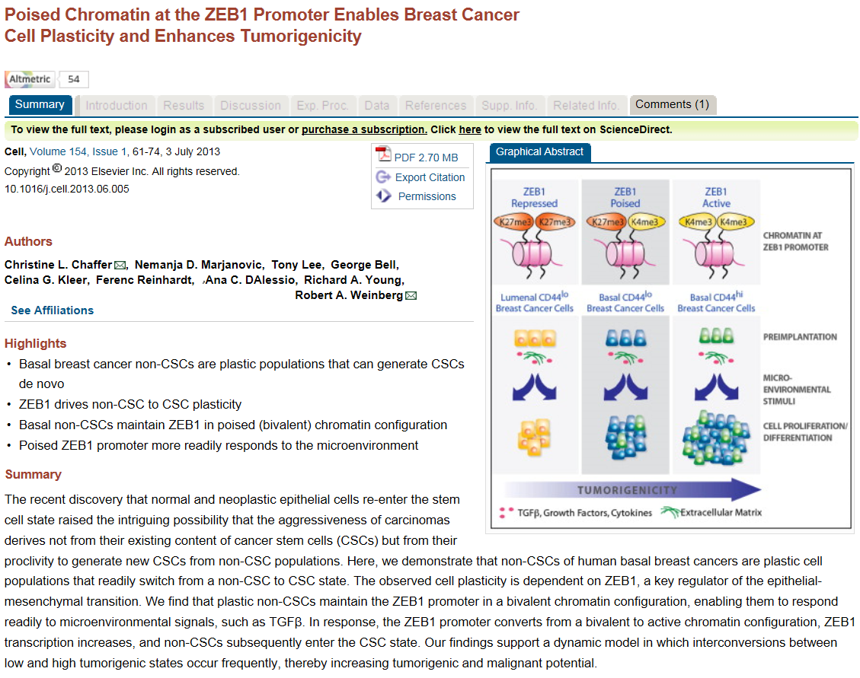

Slide 7
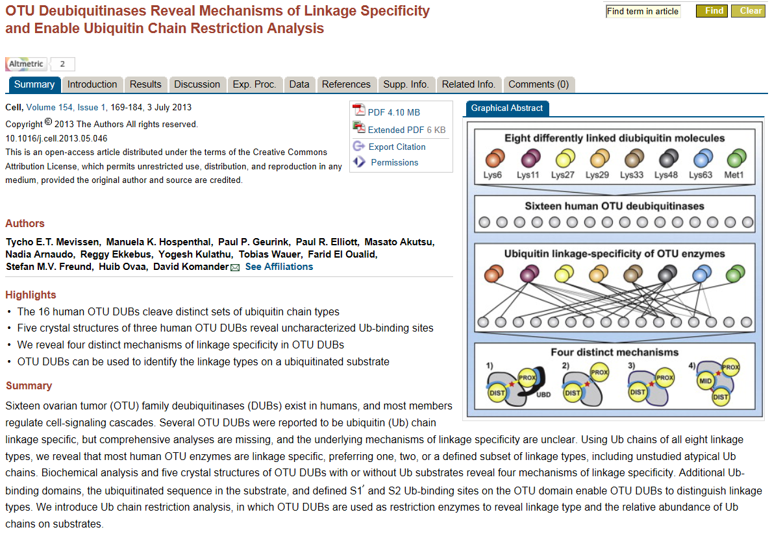

Slide 8

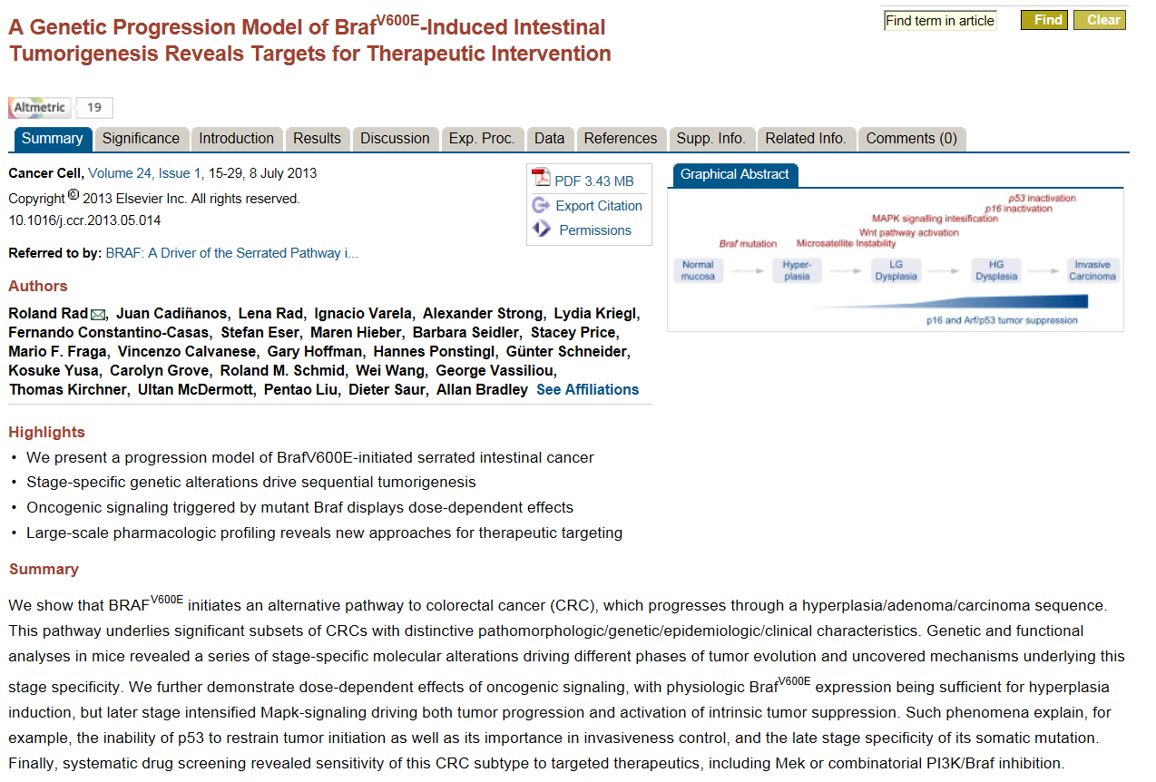

Slide 9
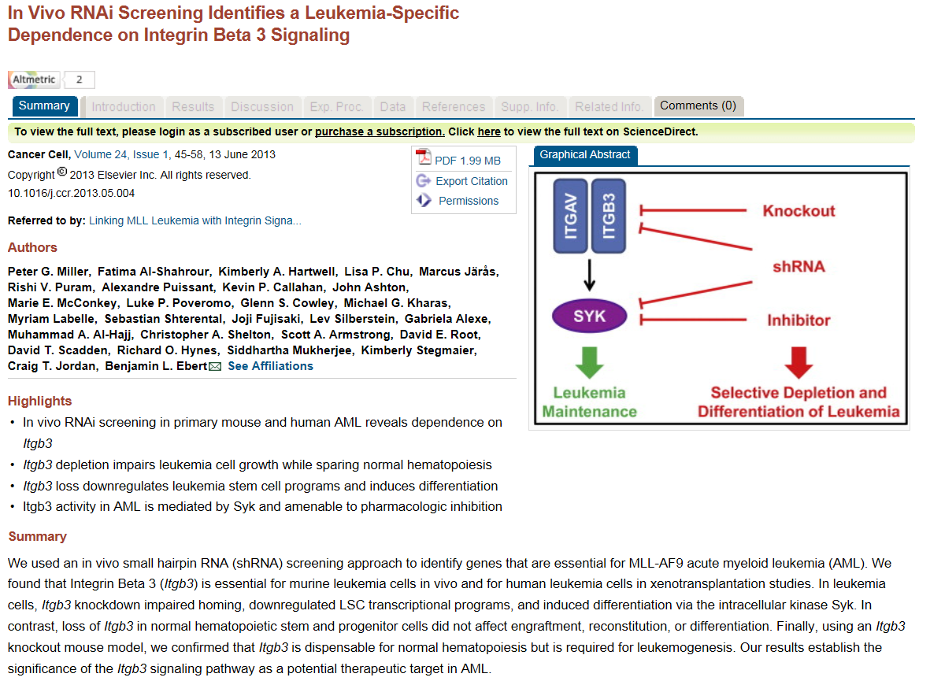

Slide 10
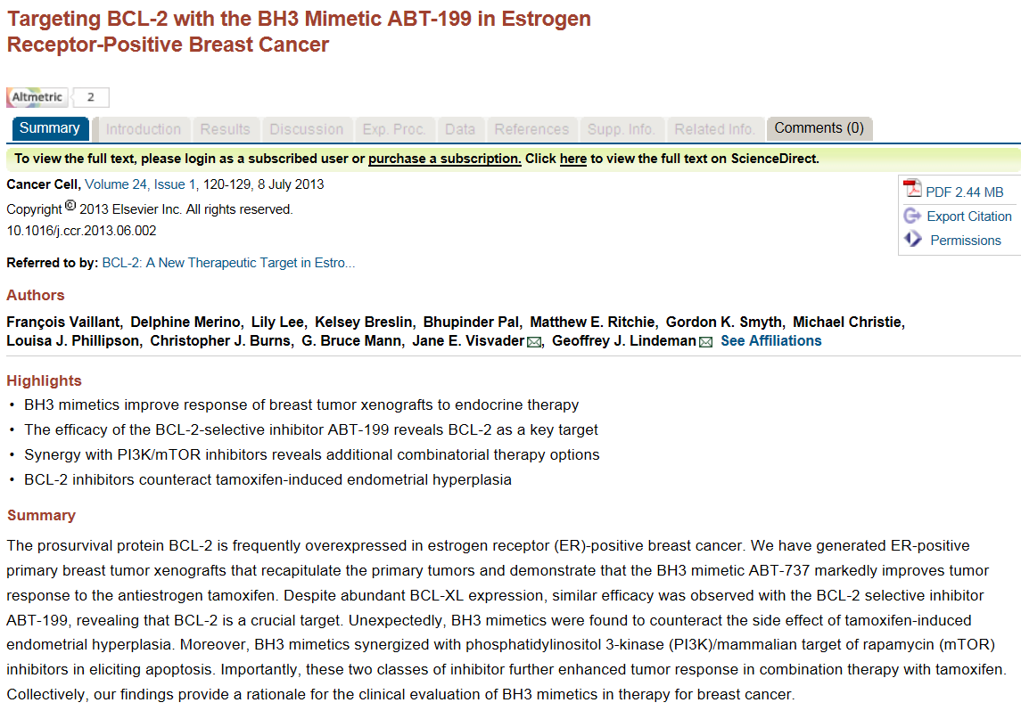

Slide 11
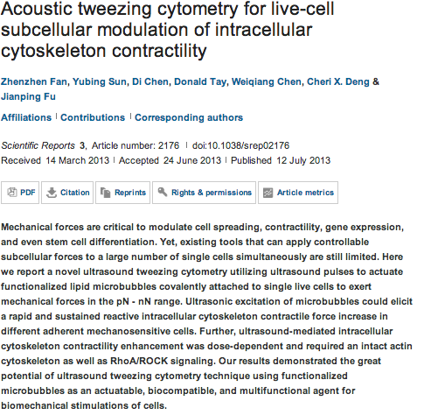
Scientific Reports

Slide 12
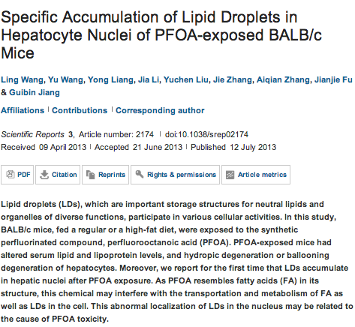

Slide 13
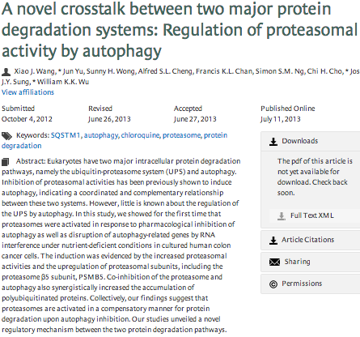
Autophagy

Slide 14
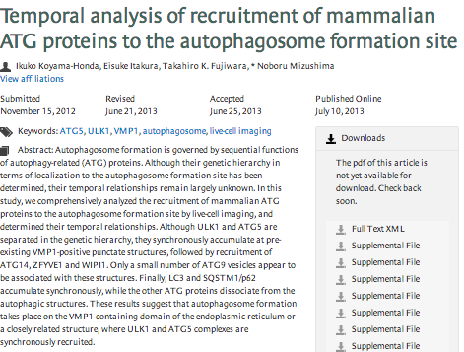

Slide 15

The Hippo Pathway Member Nf2 Is Required for Inner Cell Mass Specification p1195
Summary | Full Text | PDF (1949 kb)
Transient and Specific Inactivation of Drosophila Neurons In Vivo Using a Native Ligand-Gated Ion Channel p1202
Summary | Full Text | PDF (1124 kb)
Three MYB Transcription Factors Control Pollen Tube Differentiation Required for Sperm Release p1209
Summary | Full Text | PDF (1610 kb)
Polarity in Migrating Neurons Is Related to a Mechanism Analogous to Cytokinesis p1215
Summary | Full Text | PDF (1936 kb)
An Injury-Responsive Gata4 Program Shapes the Zebrafish Cardiac Ventricle p1221
Summary | Full Text | PDF (3130 kb)
Essential Role of the Mushroom Body in Context-Dependent CO₂ Avoidance in Drosophilap1228
Summary | Full Text | PDF (2104 kb)
Postharvest Circadian Entrainment Enhances Crop Pest Resistance and Phytochemical Cycling p1235
Summary | Full Text | PDF (1661 kb)
Metabolic Regulation of Cellular Plasticity in the Pancreas p1242
Summary | Full Text | PDF (3088 kb)
Diffusion Dynamics of Socially Learned Foraging Techniques in Squirrel Monkeys p1251
Summary | Full Text | PDF (901 kb)
New Transitional Fleas from China Highlighting Diversity of Early Cretaceous Ectoparasitic Insects p1261
Summary | Full Text | PDF (3343 kb)
Development: Hippo Signalling Turns the Embryo Inside Out pR559
Summary | Full Text | PDF (98 kb)

Slide 16
Cytokinins: Determinants of Sink Storage Ability pR561
Summary | Full Text | PDF (66 kb)
Microtubule Motors: Doin’ It without Dynactin pR563
Summary | Full Text | PDF (80 kb)
Tumor Angiogenesis: A New Source of Pericytes pR565
Summary | Full Text | PDF (288 kb)
Animal Behavior: The Truman Show for Ants pR568
Summary | Full Text | PDF (1731 kb)
Mitophagy: Mitofusin Recruits a Mitochondrial Killer pR570
Summary | Full Text | PDF (735 kb)
Sex Determination: How Worms Count to Two pR573
Summary | Full Text | PDF (76 kb)
Axon Outgrowth: Motor Protein Moonlights in Microtubule Sliding pR575
Summary | Full Text | PDF (53 kb)
Asynchronous Broadband Signals Are the Principal Source of the BOLD Response in Human Visual Cortex p1145
Summary | Full Text | PDF (1368 kb)
Actin Filament Severing by Cofilin Dismantles Actin Patches and Produces Mother Filaments for New Patches p1154
Summary | Full Text | PDF (2259 kb)
Specific Kinematics and Motor-Related Neurons for Aversive Chemotaxis in Drosophilap1163
Summary | Full Text | PDF (3081 kb)
Local Cytoskeletal and Organelle Interactions Impact Molecular-Motor- Driven Early Endosomal Trafficking p1173
Summary | Full Text | PDF (2979 kb)

Slide 17
Metabolic Regulation of Cellular Plasticity in the Pancreas
Highlights:
β cells transition from quiescence to proliferation in response to nutrient intake
Nutrient intake induces β cell differentiation from progenitors in the pancreatic duct
Constitutive β cell ablation triggers a regenerative response in the pancreatic duct
Nutrient intake and mTOR signaling are required to trigger this regenerative response
Summary
Obese individuals exhibit an increase in pancreatic β cell mass; conversely, scarce nutrition during pregnancy has been linked to β cell insufficiency in the offspring. These phenomena are thought to be mediated mainly through effects on β cell proliferation, given that a nutrient-sensitive β cell progenitor population in the pancreas has not been identified. Here, we employed the fluorescent ubiquitination-based cell-cycle indicator system to investigate β cell replication in real time and found that high nutrient concentrations induce rapid β cell proliferation. Importantly, we found that high nutrient concentrations also stimulate β cell differentiation from progenitors in the intrapancreatic duct (IPD). Furthermore, using a new zebrafish line where β cells are constitutively ablated, we show that β cell loss and high nutrient intake synergistically activate these progenitors. At the cellular level, this activation process causes ductal cell reorganization as it stimulates their proliferation and differentiation. Notably, we link the nutrient-dependent activation of these progenitors to a downregulation of Notch signaling specifically within the IPD. Furthermore, we show that the nutrient sensor mechanistic target of rapamycin (mTOR) is required for endocrine differentiation from the IPD under physiological conditions as well as in the diabetic state. Thus, this study reveals critical insights into how cells modulate their plasticity in response to metabolic cues and identifies nutrient-sensitive progenitors in the mature pancreas.

Slide 18
Oncogene
Ras signaling is essential for skin development.
Drosten M, Lechuga CG, Barbacid M.
Source
Molecular Oncology Programme, Centro Nacional de Investigaciones Oncológicas (CNIO), Spanish National Cancer Research Center, Madrid, Spain.
Abstract
Proliferation in the epidermis is a tightly controlled process. During skin development, epidermis formation and hair follicle morphogenesis crucially depend on the regulated balance between proliferation and differentiation. Here we deleted all three Ras loci (H-Ras, N-Ras and K-Ras) from keratinocytes in vitro as well as specifically from the epidermis in mice using a K5Cre strain. Upon Ras elimination, keratinocytes ceased proliferation and entered into senescence without any signs of apoptosis induction. Constitutive activation of the mitogen-activated protein kinase pathway was able to partially rescue the proliferative defects. In mice, Ras signaling was essential for proper development of the epidermis and hair follicles. Deletion of the three Ras loci during epidermis formation in mouse embryos caused a dramatic decrease in proliferation, resulting in a substantially thinner epidermis and delayed appearance of differentiation markers. We could not detect apoptotic or senescent cells in these embryos suggesting that loss of Ras protein expression only leads to severe hypoproliferation. These observations provide genetic evidence for an essential role of Ras proteins in the control of keratinocyte and epidermal proliferation.

Slide 19
Oncogene
A JNK-mediated autophagy pathway that triggers c-IAP degradation and necroptosis for anticancer chemotherapy.
He W, Wang Q, Srinivasan B, Xu J, Padilla MT, Li Z, Wang X, Liu Y, Gou X, Shen HM, Xing C, Lin Y.
Source
1] Molecular Biology and Lung Cancer Program, Lovelace Respiratory Research Institute, Albuquerque, NM, USA [2] Department of Urology, The First Affiliated Hospital, Chongqing Medical University, Chongqing, China.
Abstract
Killing cancer cells through the induction of apoptosis is one of the main mechanisms of chemotherapy. However, numerous cancer cells have primary or acquired apoptosis resistance, resulting in chemoresistance. In this study, using a novel chalcone derivative chalcone-24 (Chal-24), we identified a novel anticancer mechanism through autophagy-mediated necroptosis (RIP1- and RIP3-dependent necrosis). Chal-24 potently killed different cancer cells with induction of necrotic cellular morphology while causing no detectable caspase activation. Blocking the necroptosis pathway with either necrostatin-1 or by knockdown of RIP1 and RIP3 effectively blocked the cytotoxicity of Chal-24, suggesting that Chal-24-induced cell death is associated with necroptosis. Chal-24 robustly activated JNK and ERK and blockage of which effectively suppressed Chal-24-induced cytotoxicity. In addition, Chal-24 strongly induced autophagy that is dependent on JNK-mediated phosphorylation of Bcl-2 and Bcl-xL and dissociation of Bcl-2 or Bcl-xL from Beclin-1. Importantly, suppression of autophagy, with either pharmacological inhibitors or small interfering RNAs targeting the essential autophagy components ATG7 and Beclin-1, effectively attenuated Chal-24-induced cell death. Furthermore, we found that autophagy activation resulted in c-IAP1 and c-IAP2 degradation and formation of the Ripoptosome that contributes to necroptosis. These results thus establish a novel mechanism for killing cancer cells that involves autophagy-mediated necroptosis, which may be employed for overcoming chemoresistance

Slide 20
Oncogene
A Jnk-Rho-Actin remodeling positive feedback network directs Src-driven invasion.
Rudrapatna VA, Bangi E, Cagan RL.
Source
Department of Developmental and Regenerative Biology, Mount Sinai School of Medicine, New York, NY, USA.
Abstract
Current models of tumor cell invasion propose that oncogenic signaling converges upon key orchestrators of cytoskeletal dynamics, including c-Jun N-terminal kinase (Jnk) and RhoGTPase family members; these signals dynamically direct Actin remodeling proteins (ARPs) to catalyze the cytoskeletal changes required for migration. Src is a key driver of tumor aggression, metastasis and patient mortality. To clarify how Src regulates Actin dynamics to promote invasive migration, we performed a genetic modifier screen in a Drosophila model of invasion. Nine genes linked to Actin dynamics were identified that mediate invasion in situ. We found that ARPs were required for many oncogenic effects of Src including Mmp1 expression and initiation of apoptosis. Surprisingly, they were also regulators of Jnk pathway activity: both Src and the small GTPase Rho1 activated Jnk in a manner dependent on ARPs during invasion. Our results suggest that ARPs are not simply downstream executors of signal transduction pathways. Rather, they participate in a positive feedback network involving canonical oncogenic signaling pathways that promote tumor invasion.

Slide 21
Functional regulation of the apurinic/apyrimidinic endonuclease 1 by nucleophosmin: impact on tumor biology.
Vascotto C, Lirussi L, Poletto M, Tiribelli M, Damiani D, Fabbro D, Damante G, Demple B, Colombo E, Tell G.
Source
Department of Medical and Biological Sciences, University of Udine, Udine, Italy.
Oncogene
Alternative CD44 splicing in intestinal stem cells and tumorigenesis.
Guo W, Frenette PS.
Source
Department of Cell Biology, Albert Einstein College of Medicine, Ruth L. and David S. Gottesman Institute for Stem Cell and Regenerative Medicine, Bronx, NY, USA.
The variety of leukemic stem cells in myeloid malignancy.
Wiseman DH, Greystoke BF, Somervaille TC.
Source
Cancer Research UK Leukaemia Biology Laboratory, Paterson Institute for Cancer Research, The University of Manchester, Manchester, UK.
PPM1A is a RelA phosphatase with tumor suppressor-like activity.
Lu X, An H, Jin R, Zou M, Guo Y, Su PF, Liu D, Shyr Y, Yarbrough WG.
Source
Department of Cancer Biology, Vanderbilt University, Nashville, TN, USA.
MicroRNA-19a-3p inhibits breast cancer progression and metastasis by inducing macrophage polarization through downregulated expression of Fra-1 proto-oncogene.
Yang J, Zhang Z, Chen C, Liu Y, Si Q, Chuang TH, Li N, Gomez-Cabrero A, Reisfeld RA, Xiang R, Luo Y.
Source
1] Department of Immunology, Institute of Basic Medical Science, Chinese Academy of Medical Science and Peking Union Medical College, Beijing, China [2] Department of Immunology, Nankai University, Tianjin, China.
Expression of the antimicrobial peptide cathelicidin in myeloid cells is required for lung tumor growth.
Li D, Beisswenger C, Herr C, Schmid RM, Gallo RL, Han G, Zakharkina T, Bals R.
Source
Department of Internal Medicine V-Pulmonology, Allergology, Respiratory Intensive Care Medicine, Saarland University Hospital, Homburg, Germany.
EWS represses cofilin 1 expression by inducing nuclear retention of cofilin 1 mRNA.
Huang L, Kuwahara I, Matsumoto K.
Source
1] Molecular Entomology Laboratory, RIKEN, Wako, Japan [2] Department of Pathophysiology, Dalian Medical University, Dalian, China.
Rare insights into cancer biology.
Adam J, Yang M, Soga T, Pollard PJ.
Source
Cancer biology and Metabolism Group, Nuffield Department of Medicine, Henry Wellcome Building for Molecular Physiology, University of Oxford, Oxford, UK.

Slide 22
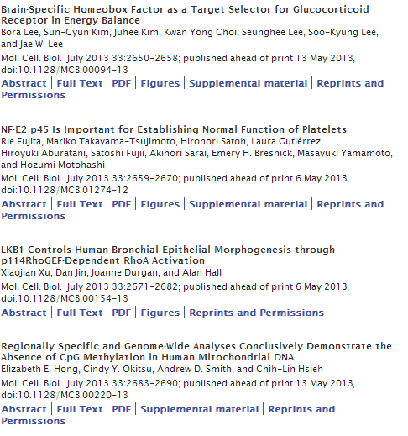


Slide 23
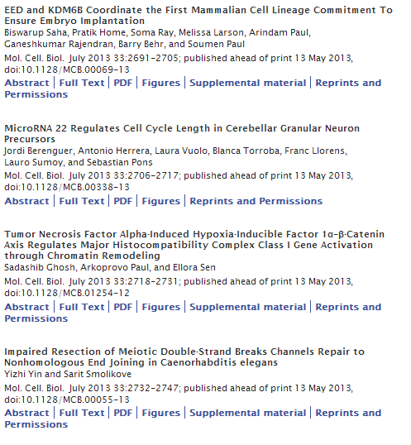

Slide 24
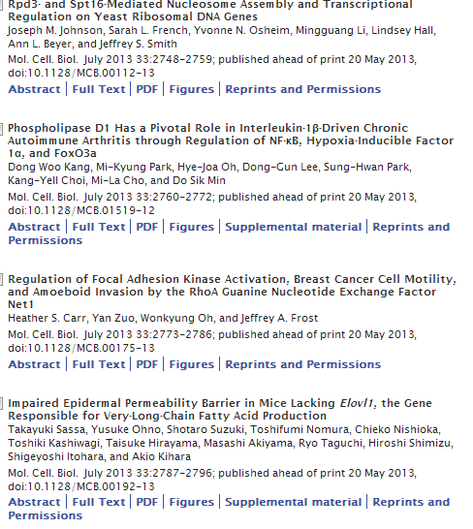

Slide 25
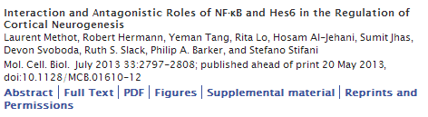

Slide 26
Tumor Necrosis Factor Alpha-Induced Hypoxia-Inducible Factor 1α–β-Catenin Axis Regulates Major Histocompatibility Complex Class I Gene Activation through Chromatin Remodeling
Sadashib Ghosh, Arkoprovo Paul and Ellora Sen
National Brain Research Centre, Manesar, Haryana, India
ABSTRACT
Hypoxia-inducible factor 1α (HIF-1α) plays a crucial role in the progression of glioblastoma multiforme tumors, which are characterized by their effective immune escape mechanisms. As major histocompatibility complex class I (MHC-I) is involved in glioma immune evasion and since HIF-1α is a pivotal link between inflammation and glioma progression, the role of tumor necrosis factor alpha (TNF-α)-induced inflammation in MHC-I gene regulation was investigated. A TNF-α-induced increase in MHC-I expression and transcriptional activation was concurrent with increased HIF-1α, ΝF-κΒ, and β-catenin activities. While knockdown of HIF-1α and β-catenin abrogated TNF-α-induced MHC-I activation, NF-κB had no effect. β-Catenin inhibition abrogated HIF-1α activation and vice versa, and this HIF-1α–β-catenin axis positively regulated CREB phosphorylation. Increased CREB activation was accompanied by its increased association with β-catenin and CBP. Chromatin immunoprecipitation revealed increased CREB enrichment at CRE/site α on the MHC-I promoter in a β-catenin-dependent manner. β-Catenin replaced human Brahma (hBrm) with Brg1 as the binding partner for CREB at the CRE site. The hBrm-to-Brg1 switch is crucial for MHC-I regulation, as ATPase-deficient Brg1 abolished TNF-α-induced MHC-I expression. β-Catenin also increased the association of MHC-I enhanceosome components RFX5 and NF-YB at the SXY module. CREB acts as a platform for assembling coactivators and chromatin remodelers required for MHC-I activation in a HIF-1α/β-catenin-dependent manner.

Slide 27

The human squamous epithelial cell envelope: the structural model by Peter M Steinert
E Candi and G Melino
Cell Death Differ 20: 965-966; doi:10.1038/cdd.2013.58
How to best preserve oocytes in female cancer patients exposed to DNA damage inducing therapeutics
K Hutt, J B Kerr, C L Scott, J K Findlay and A Strasser
Cell Death Differ 20: 967-968; doi:10.1038/cdd.2013.54
Guarding effector T-cell survival: all for one, Mcl-1 for all?
E Ottina, M Pellegrini and A Villunger
Cell Death Differ 20: 969-971; doi:10.1038/cdd.2013.55
p73 – constitutively open for business
M A Seeliger and U M Moll
Cell Death Differ 20: 972-973; doi:10.1038/cdd.2013.56
Another twist in the on and off affair between cell suicide and inflammation
D L Vaux
Cell Death Differ 20: 974-975; doi:10.1038/cdd.2013.57

Slide 28
Glycobiology of cell death: when glycans and lectins govern cell fate
R G Lichtenstein and G A Rabinovich
Cell Death Differ 20: 976-986; advance online publication, May 24, 2013; doi:10.1038/cdd.2013.50
Rescue of platinum-damaged oocytes from programmed cell death through inactivation of the p53 family signaling network
S-Y Kim, M H Cordeiro, V A Serna, K Ebbert, L M Butler, S Sinha, A A Mills, T K Woodruff and T Kurita
Cell Death Differ 20: 987-997; advance online publication, April 19, 2013; doi:10.1038/cdd.2013.31
Mcl-1 antagonizes Bax/Bak to promote effector CD4⁺ and CD8⁺ T-cell responses
P Tripathi, B Koss, J T Opferman and D A Hildeman
Cell Death Differ 20: 998-1007; advance online publication, April 5, 2013; doi:10.1038/cdd.2013.25
Analysis of the oligomeric state and transactivation potential of TAp73α
L M Luh, S Kehrloesser, G B Deutsch, J Gebel, D Coutandin, B Schäfer, M Agostini, G Melino and V Dötsch
Cell Death Differ 20: 1008-1016; advance online publication, March 29, 2013; doi:10.1038/cdd.2013.23
ProNGF/NGF imbalance triggers learning and memory deficits, neurodegeneration and spontaneous epileptic-like discharges in transgenic mice
C Tiveron, L Fasulo, S Capsoni, F Malerba, S Marinelli, F Paoletti, S Piccinin, R Scardigli, G Amato, R Brandi, P Capelli, S D'Aguanno, F Florenzano, F La Regina, A Lecci, A Manca, G Meli, L Pistillo, N Berretta, R Nisticò, F Pavone and A Cattaneo
Cell Death Differ 20: 1017-1030; advance online publication, March 29, 2013; doi:10.1038/cdd.2013.22

Slide 29
Foxc2 induces Wnt4 and Bmp4 expression during muscle regeneration and osteogenesis
M C Gozo, P-J Aspuria, D-J Cheon, A E Walts, D Berel, N Miura, B Y Karlan and S Orsulic
Cell Death Differ 20: 1031-1042; advance online publication, May 3, 2013; doi:10.1038/cdd.2013.34
GAPDH binds to active Akt, leading to Bcl-xL increase and escape from caspase-independent cell death
M A Jacquin, J Chiche, B Zunino, M Bénéteau, O Meynet, L A Pradelli, S Marchetti, A Cornille, M Carles and J-E Ricci
Cell Death Differ 20: 1043-1054; advance online publication, May 3, 2013; doi:10.1038/cdd.2013.32
ZNF313 is a novel cell cycle activator with an E3 ligase activity inhibiting cellular senescence by destabilizing p21^{WAF1}
J Han, Y-L Kim, K-W Lee, N-G Her, T-K Ha, S Yoon, S-I Jeong, J-H Lee, M-J Kang, M-G Lee, B-K Ryu, J-H Baik and S-G Chi
Cell Death Differ 20: 1055-1067; advance online publication, May 3, 2013; doi:10.1038/cdd.2013.33
Survival and differentiation defects contribute to neutropenia in glucose-6-phosphatase-β (G6PC3) deficiency in a model of mouse neutrophil granulocyte differentiation
S Gautam, S Kirschnek, I E Gentle, C Kopiniok, P Henneke, H Häcker, L Malleret, A Belaaouaj and G Häcker
Cell Death Differ 20: 1068-1079; advance online publication, May 17, 2013; doi:10.1038/cdd.2013.39
Interaction between the TP63 and SHH pathways is an important determinant of epidermal homeostasis
N S Chari, R A Romano, M I Koster, V Jaks, D Roop, E R Flores, S Teglund, S Sinha, W Gruber, F Aberger, L J Medeiros, R Toftgard and T J McDonnell
Cell Death Differ 20: 1080-1088; advance online publication, May 17, 2013; doi:10.1038/cdd.2013.4

Slide 30
A human iPSC model of Ligase IV deficiency reveals an important role for NHEJ-mediated-DSB repair in the survival and genomic stability of induced pluripotent stem cells and emerging haematopoietic progenitors
K Tilgner, I Neganova, I Moreno-Gimeno, J Y AL-Aama, D Burks, S Yung, C Singhapol, G Saretzki, J Evans, V Gorbunova, A Gennery, S Przyborski, M Stojkovic, L Armstrong, P Jeggo and M Lako
Cell Death Differ 20: 1089-1100; advance online publication, May 31, 2013; doi:10.1038/cdd.2013.44
Disease-relevant proteostasis regulation of cystic fibrosis transmembrane conductance regulator
V R Villella, S Esposito, E M Bruscia, M Vicinanza, S Cenci, S Guido, M Pettoello-Mantovani, R Carnuccio, M A De Matteis, A Luini, M C Maiuri, V Raia, G Kroemer and L Maiuri
Cell Death Differ 20: 1101-1115; advance online publication, May 17, 2013; doi:10.1038/cdd.2013.46
Evidence for a common progenitor of epithelial and mesenchymal components of the liver
A Conigliaro, L Amicone, V Costa, M De Santis Puzzonia, C Mancone, B Sacchetti, C Cicchini, F Garibaldi, D A Brenner, T Kisseleva, P Bianco and M Tripodi
Cell Death Differ 20: 1116-1123; advance online publication, May 17, 2013; doi:10.1038/cdd.2013.49

Slide 31
Original Paper
Cell Death and Differentiation (2013) 20, 1043–1054; doi:10.1038/cdd.2013.32; published online 3 May 2013
GAPDH binds to active Akt, leading to Bcl-xL increase and escape from caspase-independent cell death
M A Jacquin^{1,2}, J Chiche^{1,2}, B Zunino^{1,2,3}, M Bénéteau^{1,2}, O Meynet^{1,2}, L A Pradelli^{1,2}, S Marchetti^{2,4}, A Cornille^{1,2}, M Carles^{1,3} and J-E Ricci^{1,2,3}
¹Inserm, U1065, Centre Méditerranéen de Médecine Moléculaire (C3M), équipe ‘contrôle métabolique des morts cellulaires’, Nice, France
²Faculté de Médecine, Université de Nice-Sophia-Antipolis, Nice, France
³Département d’Anesthésie Réanimation, Centre Hospitalier Universitaire de Nice, Nice, France
⁴Inserm, U1065, Centre Méditerranéen de Médecine Moléculaire (C3M), équipe ‘mort cellulaire, différentiation et cancer’, Nice, France
Abstract
Increased glucose catabolism and resistance to cell death are hallmarks of cancers, but the link between them remains elusive. Remarkably, under conditions where caspases are inhibited, the process of cell death is delayed but rarely blocked, leading to the occurrence of caspase-independent cell death (CICD). Escape from CICD is particularly relevant in the context of cancer as apoptosis inhibition only is often not sufficient to allow oncogenic transformation. While most glycolytic enzymes are overexpressed in tumors, glyceraldehyde-3-phosphate dehydrogenase (GAPDH) is of particular interest as it can allow cells to recover from CICD. Here, we show that GAPDH, but no other glycolytic enzymes tested, when overexpressed could bind to active Akt and limit its dephosphorylation. Active Akt prevents FoxO nuclear localization, which precludes Bcl-6 expression and leads to Bcl-xL overexpression. The GAPDH-dependent Bcl-xL overexpression is able to protect a subset of mitochondria from permeabilization that are required for cellular survival from CICD. Thus, our work suggests that GAPDH overexpression could induce Bcl-xL overexpression and protect cells from CICD-induced chemotherapy through preservation of intact mitochondria that may facilitate tumor survival and chemotherapeutic resistance.
Keywords:
bcl-2 family; cell death; glycolysis; mitochondria; Warburg effect
Abbreviations:
CICD, Caspase-independent cell death; GAPDH, Glyceraldehyde-3-phosphate dehydrogenase; KA, koningic acid; MOMP, Mitochondrial outer membrane permeabilization

Slide 32
Original Paper
Cell Death and Differentiation (2013) 20, 1116–1123; doi:10.1038/cdd.2013.49; published online 17 May 2013
Evidence for a common progenitor of epithelial and mesenchymal components of the liver
A Conigliaro^{1,5}, L Amicone^{1,5}, V Costa², M De Santis Puzzonia¹, C Mancone², B Sacchetti³, C Cicchini¹, F Garibaldi¹, D A Brenner⁴, T Kisseleva⁴, P Bianco³ and M Tripodi^{1,2}
Received 31 October 2012; Revised 22 March 2013; Accepted 8 April 2013
Abstract
Tissues of the adult organism maintain the homeostasis and respond to injury by means of progenitor/stem cell compartments capable to give rise to appropriate progeny. In organs composed by histotypes of different embryological origins (e.g. the liver), the tissue turnover may in theory involve different stem/precursor cells able to respond coordinately to physiological or pathological stimuli. In the liver, a progenitor cell compartment, giving rise to hepatocytes and cholangiocytes, can be activated by chronic injury inhibiting hepatocyte proliferation. The precursor compartment guaranteeing turnover of hepatic stellate cells (HSCs) (perisinusoidal cells implicated with the origin of the liver fibrosis) in adult organ is yet unveiled. We show here that epithelial and mesenchymal liver cells (hepatocytes and HSCs) may arise from a common progenitor. Sca+ murine progenitor cells were found to coexpress markers of epithelial and mesenchymal lineages and to give rise, within few generations, to cells that segregate the lineage-specific markers into two distinct subpopulations. Notably, these progenitor cells, clonally derived, when transplanted in healthy livers, were found to generate epithelial and mesenchymal liver-specific derivatives (i.e. hepatocytes and HSCs) properly integrated in the liver architecture. These evidences suggest the existence of a ‘bona fide’ organ-specific meso-endodermal precursor cell, thus profoundly modifying current models of adult progenitor commitment believed, so far, to be lineage-restricted. Heterotopic transplantations, which confirm the dual differentiation potentiality of those cells, indicates as tissue local cues are necessary to drive a full hepatic differentiation. These data provide first evidences for an adult stem/precursor cell capable to differentiate in both parenchymal and non-parenchymal organ-specific components and candidate the liver as the instructive site for the reservoir compartment of HSC precursors as yet non-localized in the adult.

Slide 33

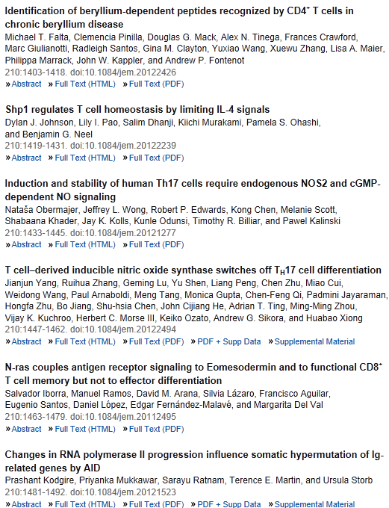
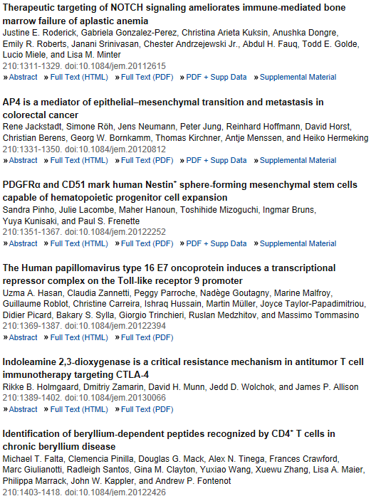

Slide 34

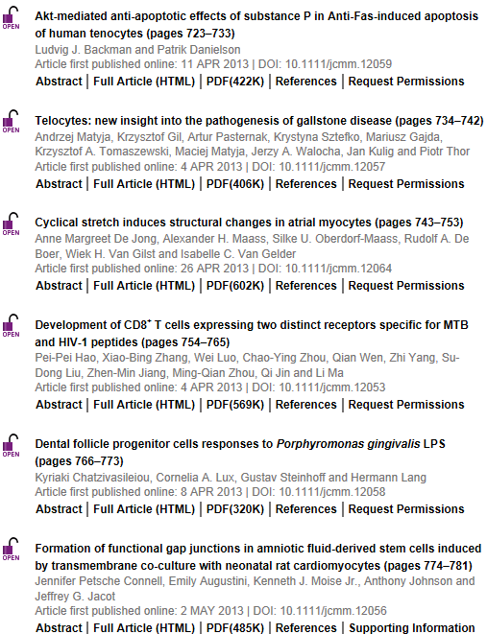
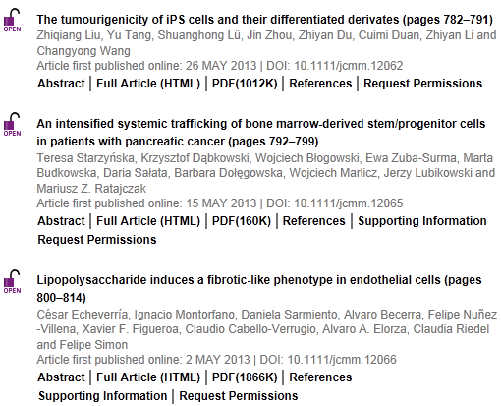

Slide 35


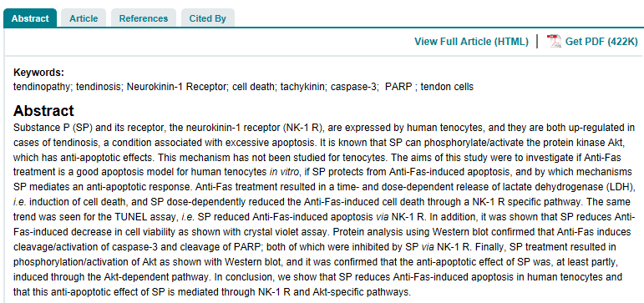

Slide 36

Public accessibility of biomedical articles from PubMed Central reduces journal readership—retrospective cohort analysis
Philip M. Davis
Source
FASEB J July 2013 27:2536-2541; published ahead of print April 3, 2013, doi:10.1096/fj.13-229922
Signaling mechanism of tumor cell-induced up-regulation of E3 ubiquitin ligase UBR2
hua Zhang, Ren-Kuo Lin, Yong Tae Kwon, and Yi-Ping Li
Source
FASEB J July 2013 27:2893-2901; published ahead of print April 8, 2013, doi:10.1096/fj.12-222711
Low dystrophin levels increase survival and improve muscle pathology and function in dystrophin/utrophin double-knockout mice
Maaike van Putten, Margriet Hulsker, Courtney Young, Vishna D. Nadarajah, Hans Heemskerk, Louise van der Weerd, Peter A. C. 't Hoen, Gert-Jan B. van Ommen, and Annemieke M. Aartsma-Rus
Source
FASEB J June 2013 27:2484-2495; published ahead of print March 4, 2013, doi:10.1096/fj.12-224170
Diaphragm and ventilatory dysfunction during cancer cachexia
Brandon M. Roberts, Bumsoo Ahn, Ashley J. Smuder, Monsour Al-Rajhi, Luther C. Gill, Adam W. Beharry, Scott K. Powers, David D. Fuller, Leonardo F. Ferreira, and Andrew R. Judge
Source
FASEB J July 2013 27:2600-2610; published ahead of print March 20, 2013, doi:10.1096/fj.12-222844
SCF E3 ligase F-box protein complex SCF^{FBXL19} regulates cell migration by mediating Rac1 ubiquitination and degradation
Jing Zhao, Rachel K. Mialki, Jianxin Wei, Tiffany A. Coon, Chunbin Zou, Bill B. Chen, Rama K. Mallampalli, and Yutong Zhao
Source
FASEB J July 2013 27:2611-2619; published ahead of print March 19, 2013, doi:10.1096/fj.12-223099
Signal transducer and activator of transcription-3 (Stat3) plays a critical role in implantation via progesterone receptor in uterus
Jae Hee Lee, Tae Hoon Kim, Seo Jin Oh, Jung-Yoon Yoo,
Shizuo Akira, Bon Jeong Ku, John P. Lydon, and Jae-Wook Jeong
Source
FASEB J July 2013 27:2553-2563; published ahead of print March 26, 2013, doi:10.1096/fj.12-225664

Slide 37
Passage-dependent cancerous transformation of human mesenchymal stem cells under carcinogenic hypoxia
Spencer W. Crowder, Linda W. Horton, Sue Hyun Lee, Colt M. McClain, Oriana E. Hawkins,
Amanda M. Palmer, Hojae Bae, Ann Richmond, and Hak-Joon Sung1
Abstract
Bone marrow-derived human mesenchymal stem cells (hMSCs) either promote or inhibit cancer progression, depending on factors that heretofore have been undefined. Here we have utilized extreme hypoxia (0.5% O₂) and concurrent treatment with metal carcinogen (nickel) to evaluate the passage-dependent response of hMSCs toward cancerous transformation. Effects of hypoxia and nickel treatment on hMSC proliferation, apoptosis, gene and protein expression, replicative senescence, reactive oxygen species (ROS), redox mechanisms, and in vivo tumor growth were analyzed. The behavior of late passage hMSCs in a carcinogenic hypoxia environment follows a profile similar to that of transformed cancer cells (i.e., increased expression of oncogenic proteins, decreased expression of tumor suppressor protein, increased proliferation, decreased apoptosis, and aberrant redox mechanisms), but this effect was not observed in earlier passage control cells. These events resulted in accumulated intracellular ROS in vitro and excessive proliferation in vivo. We suggest a mechanism by which carcinogenic hypoxia modulates the activity of three critical transcription factors (c-MYC, p53, and HIF1), resulting in accumulated ROS and causing hMSCs to undergo cancer-like behavioral changes. This is the first study to utilize carcinogenic hypoxia as an environmentally relevant experimental model for studying the age-dependent cancerous transformation of hMSCs.

Slide 38

Up-regulation of sarcoplasmic reticulum Ca²⁺ uptake leads to cardiac hypertrophy, contractile dysfunction and early mortality in mice deficient in CASQ2
Anuradha Kalyanasundaram, Véronique A. Lacombe, Andriy E. Belevych, Lucia Brunello, Cynthia A. Carnes, Paul M.L. Janssen,
Bjørn C. Knollmann, Muthu Periasamy, and Sandor Gyørke
Source
Cardiovasc Res (2013) 98(2): 297-306 first published online November 6, 2012 doi:10.1093/cvr/cvs334
Over-expression of calpastatin aggravates cardiotoxicity induced by doxorubicin
Yanpeng Wang, Dong Zheng, Meng Wei, Jian Ma, Yong Yu,
Ruizhen Chen, James C. Lacefield, Huaxi Xu, and Tianqing Peng
Source
Cardiovasc Res (2013) 98(3): 381-390 first published online March 1, 2013 doi:10.1093/cvr/cvt048
Extracellular matrix protein CCN1 regulates cardiomyocyte apoptosis in mice with stress-induced cardiac injury
Pei-Ling Hsu, Bor-Chyuan Su, Qian-Yu Kuok, and Fan-E Mo
Source
Cardiovasc Res (2013) 98(1): 64-72 first published online January 16, 2013 doi:10.1093/cvr/cvt001
Editor's choice: Protective role of vascular smooth muscle cell PPARγ in angiotensin II-induced vascular disease
Chiara Marchesi, Asia Rehman, Yohann Rautureau, Daniel A. Kasal, Marie Briet, Avshalom Leibowitz, Stefania M.C. Simeone,
Talin Ebrahimian, Mario F. Neves, Stefan Offermanns, Frank J. Gonzalez, Pierre Paradis, and Ernesto L. Schiffrin
Source
Cardiovasc Res (2013) 97(3): 562-570 first published online December 17, 2012 doi:10.1093/cvr/cvs362
AICAR inhibits PPARγ during monocyte differentiation to attenuate inflammatory responses to atherogenic lipids
Dmitry Namgaladze, Marina Kemmerer, Andreas von Knethen,
and Bernhard Brüne
Source
Cardiovasc Res (2013) 98(3): 479-487 first published online March 25, 2013 doi:10.1093/cvr/cvt073
Extracellular HSP60 induces inflammation through activating and up-regulating TLRs in cardiomyocytes
Jing Tian, Xin Guo, Xue-Mei Liu, Li Liu, Qi-Fang Weng, Shu-Juan Dong, Anne A. Knowlton, Wen-Jun Yuan, and Li Lin
Source
Cardiovasc Res (2013) 98(3): 391-401 first published online February 27, 2013 doi:10.1093/cvr/cvt047

Slide 39

IL-1β Production through the NLRP3 Inflammasome by Hepatic Macrophages Links Hepatitis C Virus Infection with Liver Inflammation and Disease
Amina A. Negash, Hilario J. Ramos, Nanette Crochet, Daryl T. Y. Lau, Brian Doehle, Neven Papic, Don A. Delker, Juandy Jo, Antonio Bertoletti, Curt H. Hagedorn, Michael Gale Jr
Source
published 25 Apr 2013 | info:doi/10.1371/journal.ppat.1003330
CYLD Enhances Severe Listeriosis by Impairing IL-6/STAT3-Dependent Fibrin Production
Gopala Nishanth, Martina Deckert, Katharina Wex, Ramin Massoumi, Katrin Schweitzer, Michael Naumann, Dirk Schlüter
Source
published 27 Jun 2013 | info:doi/10.1371/journal.ppat.1003455
Shigella IpaH0722 E3 Ubiquitin Ligase Effector Targets TRAF2 to Inhibit PKC–NF-κB Activity in Invaded Epithelial Cells
Hiroshi Ashida, Hiroyasu Nakano, Chihiro Sasakawa
Source
published 06 Jun 2013 | info:doi/10.1371/journal.ppat.1003409
The Serine Phosphatase SerB of Porphyromonas gingivalis Suppresses IL-8 Production by Dephosphorylation of NF-κB RelA/p65
Hiroki Takeuchi, Takanori Hirano, Sarah E. Whitmore, Ichijiro Morisaki, Atsuo Amano, Richard J. Lamont
Source
published 18 Apr 2013 | info:doi/10.1371/journal.ppat.1003326
The JAK-STAT Transcriptional Regulator, STAT-5, Activates the ATM DNA Damage Pathway to Induce HPV 31 Genome Amplification upon Epithelial Differentiation
Shiyuan Hong, Laimonis A. Laimins
Source
published 04 Apr 2013 | info:doi/10.1371/journal.ppat.1003295
Cell Death Control: The Interplay of Apoptosis and Autophagy in the Pathogenicity of Sclerotinia sclerotiorum
Mehdi Kabbage, Brett Williams, Martin B. Dickman
Source
published 11 Apr 2013 | info:doi/10.1371/journal.ppat.1003287

Slide 40

Understanding, recognizing, and managing toxicities of targeted anticancer therapies
Grace K. Dy and Alex A. Adjei
Source
Article first published online: 28 MAY 2013 | DOI: 10.3322/caac.21184
Recent developments in esophageal adenocarcinoma
  Jesper Lagergren and Pernilla Lagergren
Grace K. Dy and Alex A. Adjei
Source
Article first published online: 1 JUL 2013 | DOI: 10.3322/caac.21185
Strategies for expanding colorectal cancer screening at community health centers
Mona Sarfaty, Mary Doroshenk, James Hotz, Durado Brooks, Seiji Hayashi, Terry C. Davis, Djenaba Joseph, David Stevens, Donald L. Weaver, Michael B. Potter and Richard Wender
Source
Article first published online: 1 JUL 2013 | DOI: 10.3322/caac.21191

Slide 41

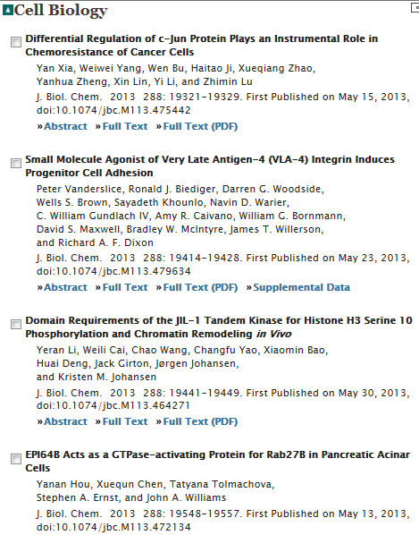
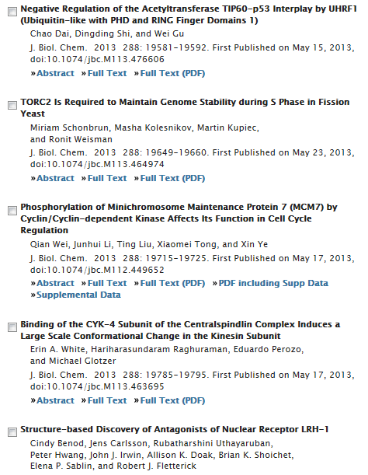

Slide 42
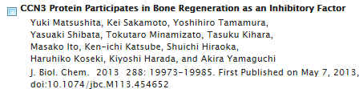
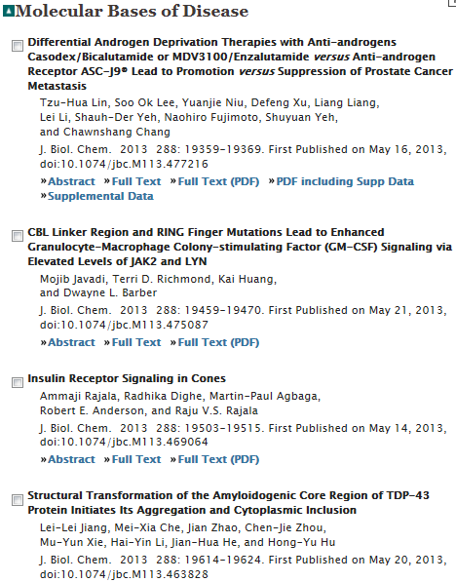
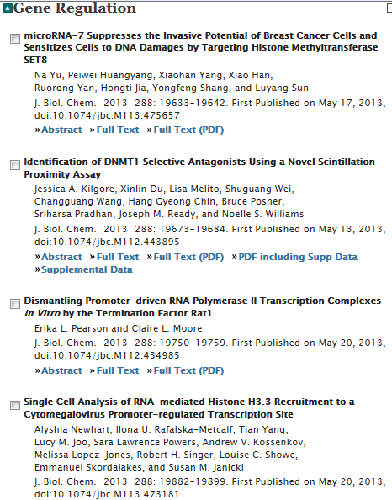

Slide 43
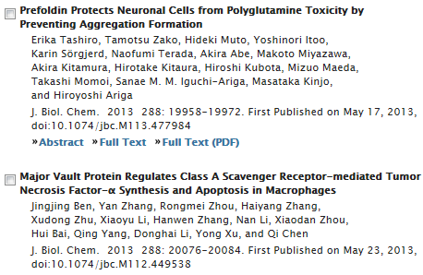
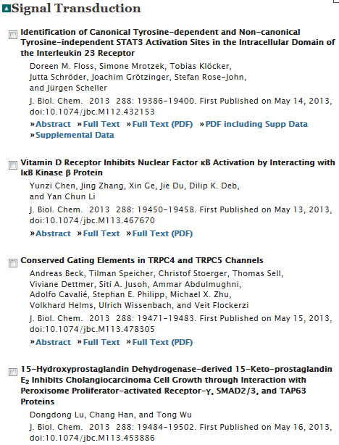
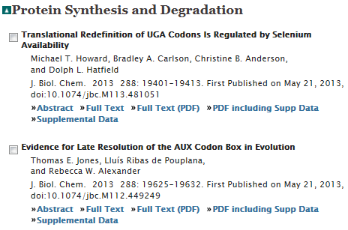

Slide 44
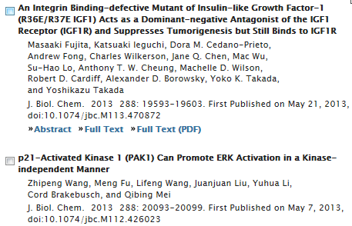

Slide 45
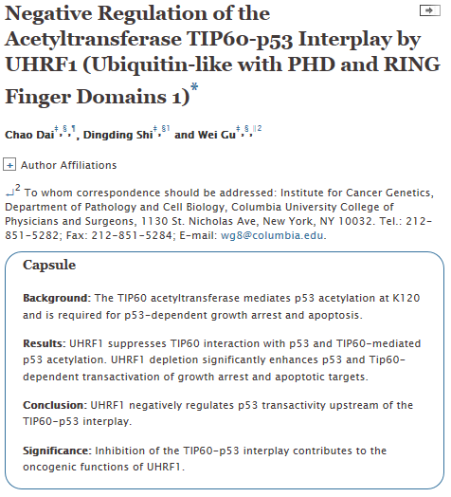
Notes:
Abstract
Numerous studies indicate the importance of acetylation in p53-mediated stress responses upon DNA damage. We and others previously showed that TIP60 (Tat-interacting protein of 60 kDa)-mediated acetylation of p53 at K120 is crucial for p53-dependent apoptotic responses. Nevertheless, it remains unclear how TIP60-mediated effects on p53 are dynamically regulated in vivo. Here, we report that UHRF1 (ubiquitin-like with PHD and RING finger domains 1) interacts with TIP60 both in vitro and in vivo and induces degradation-independent ubiquitination of TIP60. Moreover, UHRF1 expression markedly suppresses the ability of TIP60 to acetylate p53. In contrast, RNAi-mediated knockdown of UHRF1 increases the endogenous levels of p53 acetylation at K120 and p53-mediated apoptosis is significantly enhanced in UHRF1-depleted cells. To elucidate the mechanisms of this regulation, we found that the interaction between TIP60 and p53 is severely inhibited in the presence of UHRF1, suggesting that UHRF1 modulates TIP60-mediated functions in both K120 acetylation-dependent and -independent manners. Consistent with this notion, UHRF1 knockdown promotes activation of p21 and PUMA but not MDM2. These findings demonstrate that UHRF1 is a critical negative regulator of TIP60 and suggest that UHRF1-mediated effects on p53 may contribute, at least in part, to its role in tumorigenesis.

