Slide 1

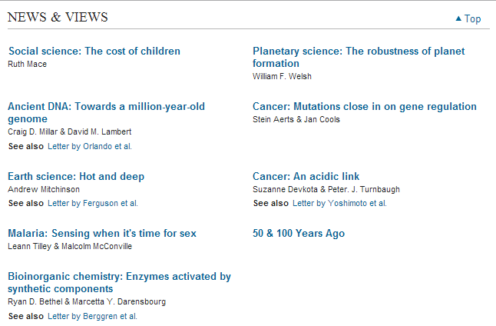

Slide 2


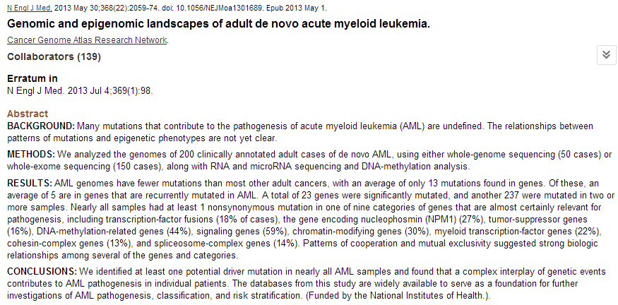

Slide 3


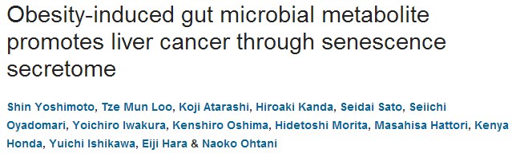
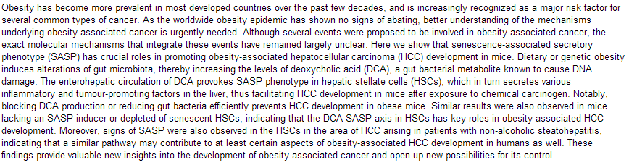

Slide 4
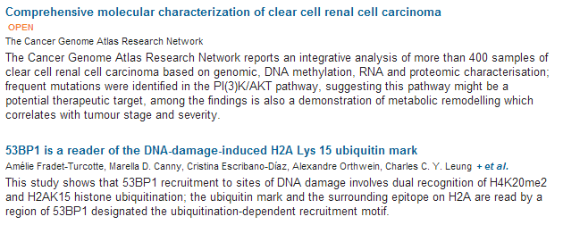
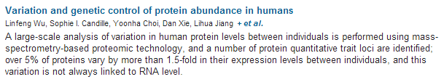
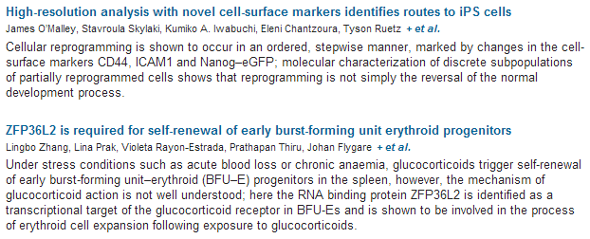

Slide 5
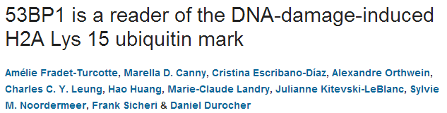
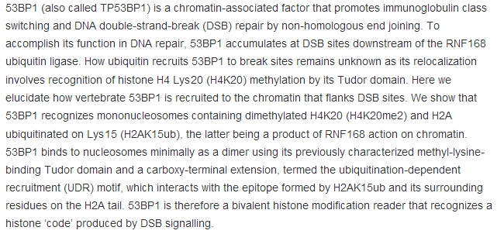

Slide 6

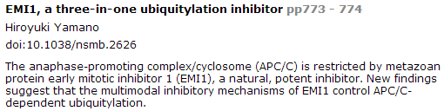
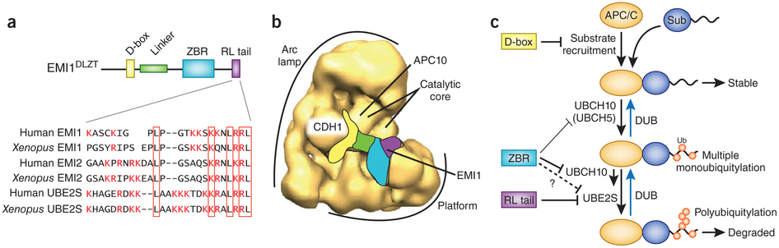
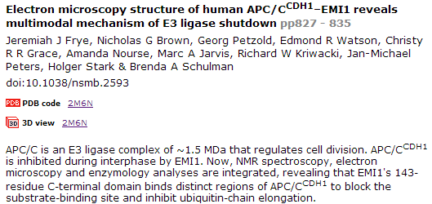

Slide 7
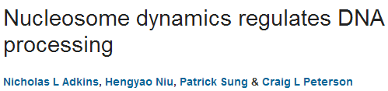
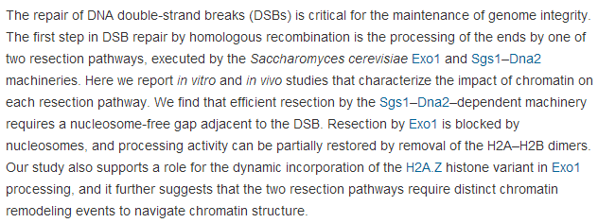
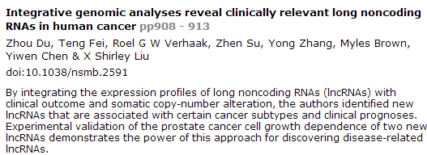

Slide 8

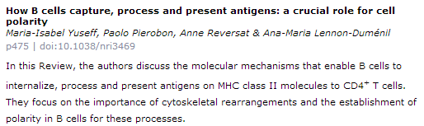
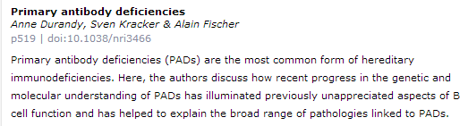

Slide 9

Public accessibility of biomedical articles from PubMed Central reduces journal readership—retrospective cohort analysis
Philip M. Davis
Source
FASEB J July 2013 27:2536-2541; published ahead of print April 3, 2013, doi:10.1096/fj.13-229922
Signaling mechanism of tumor cell-induced up-regulation of E3 ubiquitin ligase UBR2
hua Zhang, Ren-Kuo Lin, Yong Tae Kwon, and Yi-Ping Li
Source
FASEB J July 2013 27:2893-2901; published ahead of print April 8, 2013, doi:10.1096/fj.12-222711
Low dystrophin levels increase survival and improve muscle pathology and function in dystrophin/utrophin double-knockout mice
Maaike van Putten, Margriet Hulsker, Courtney Young, Vishna D. Nadarajah, Hans Heemskerk, Louise van der Weerd, Peter A. C. 't Hoen, Gert-Jan B. van Ommen, and Annemieke M. Aartsma-Rus
Source
FASEB J June 2013 27:2484-2495; published ahead of print March 4, 2013, doi:10.1096/fj.12-224170
Diaphragm and ventilatory dysfunction during cancer cachexia
Brandon M. Roberts, Bumsoo Ahn, Ashley J. Smuder, Monsour Al-Rajhi, Luther C. Gill, Adam W. Beharry, Scott K. Powers, David D. Fuller, Leonardo F. Ferreira, and Andrew R. Judge
Source
FASEB J July 2013 27:2600-2610; published ahead of print March 20, 2013, doi:10.1096/fj.12-222844
SCF E3 ligase F-box protein complex SCF^{FBXL19} regulates cell migration by mediating Rac1 ubiquitination and degradation
Jing Zhao, Rachel K. Mialki, Jianxin Wei, Tiffany A. Coon, Chunbin Zou, Bill B. Chen, Rama K. Mallampalli, and Yutong Zhao
Source
FASEB J July 2013 27:2611-2619; published ahead of print March 19, 2013, doi:10.1096/fj.12-223099
Signal transducer and activator of transcription-3 (Stat3) plays a critical role in implantation via progesterone receptor in uterus
Jae Hee Lee, Tae Hoon Kim, Seo Jin Oh, Jung-Yoon Yoo,
Shizuo Akira, Bon Jeong Ku, John P. Lydon, and Jae-Wook Jeong
Source
FASEB J July 2013 27:2553-2563; published ahead of print March 26, 2013, doi:10.1096/fj.12-225664

Slide 10
Passage-dependent cancerous transformation of human mesenchymal stem cells under carcinogenic hypoxia
Spencer W. Crowder, Linda W. Horton, Sue Hyun Lee, Colt M. McClain, Oriana E. Hawkins,
Amanda M. Palmer, Hojae Bae, Ann Richmond, and Hak-Joon Sung1
Abstract
Bone marrow-derived human mesenchymal stem cells (hMSCs) either promote or inhibit cancer progression, depending on factors that heretofore have been undefined. Here we have utilized extreme hypoxia (0.5% O₂) and concurrent treatment with metal carcinogen (nickel) to evaluate the passage-dependent response of hMSCs toward cancerous transformation. Effects of hypoxia and nickel treatment on hMSC proliferation, apoptosis, gene and protein expression, replicative senescence, reactive oxygen species (ROS), redox mechanisms, and in vivo tumor growth were analyzed. The behavior of late passage hMSCs in a carcinogenic hypoxia environment follows a profile similar to that of transformed cancer cells (i.e., increased expression of oncogenic proteins, decreased expression of tumor suppressor protein, increased proliferation, decreased apoptosis, and aberrant redox mechanisms), but this effect was not observed in earlier passage control cells. These events resulted in accumulated intracellular ROS in vitro and excessive proliferation in vivo. We suggest a mechanism by which carcinogenic hypoxia modulates the activity of three critical transcription factors (c-MYC, p53, and HIF1), resulting in accumulated ROS and causing hMSCs to undergo cancer-like behavioral changes. This is the first study to utilize carcinogenic hypoxia as an environmentally relevant experimental model for studying the age-dependent cancerous transformation of hMSCs.

Slide 11

Up-regulation of sarcoplasmic reticulum Ca²⁺ uptake leads to cardiac hypertrophy, contractile dysfunction and early mortality in mice deficient in CASQ2
Anuradha Kalyanasundaram, Véronique A. Lacombe, Andriy E. Belevych, Lucia Brunello, Cynthia A. Carnes, Paul M.L. Janssen,
Bjørn C. Knollmann, Muthu Periasamy, and Sandor Gyørke
Source
Cardiovasc Res (2013) 98(2): 297-306 first published online November 6, 2012 doi:10.1093/cvr/cvs334
Over-expression of calpastatin aggravates cardiotoxicity induced by doxorubicin
Yanpeng Wang, Dong Zheng, Meng Wei, Jian Ma, Yong Yu,
Ruizhen Chen, James C. Lacefield, Huaxi Xu, and Tianqing Peng
Source
Cardiovasc Res (2013) 98(3): 381-390 first published online March 1, 2013 doi:10.1093/cvr/cvt048
Extracellular matrix protein CCN1 regulates cardiomyocyte apoptosis in mice with stress-induced cardiac injury
Pei-Ling Hsu, Bor-Chyuan Su, Qian-Yu Kuok, and Fan-E Mo
Source
Cardiovasc Res (2013) 98(1): 64-72 first published online January 16, 2013 doi:10.1093/cvr/cvt001
Editor's choice: Protective role of vascular smooth muscle cell PPARγ in angiotensin II-induced vascular disease
Chiara Marchesi, Asia Rehman, Yohann Rautureau, Daniel A. Kasal, Marie Briet, Avshalom Leibowitz, Stefania M.C. Simeone,
Talin Ebrahimian, Mario F. Neves, Stefan Offermanns, Frank J. Gonzalez, Pierre Paradis, and Ernesto L. Schiffrin
Source
Cardiovasc Res (2013) 97(3): 562-570 first published online December 17, 2012 doi:10.1093/cvr/cvs362
AICAR inhibits PPARγ during monocyte differentiation to attenuate inflammatory responses to atherogenic lipids
Dmitry Namgaladze, Marina Kemmerer, Andreas von Knethen,
and Bernhard Brüne
Source
Cardiovasc Res (2013) 98(3): 479-487 first published online March 25, 2013 doi:10.1093/cvr/cvt073
Extracellular HSP60 induces inflammation through activating and up-regulating TLRs in cardiomyocytes
Jing Tian, Xin Guo, Xue-Mei Liu, Li Liu, Qi-Fang Weng, Shu-Juan Dong, Anne A. Knowlton, Wen-Jun Yuan, and Li Lin
Source
Cardiovasc Res (2013) 98(3): 391-401 first published online February 27, 2013 doi:10.1093/cvr/cvt047

Slide 12

IL-1β Production through the NLRP3 Inflammasome by Hepatic Macrophages Links Hepatitis C Virus Infection with Liver Inflammation and Disease
Amina A. Negash, Hilario J. Ramos, Nanette Crochet, Daryl T. Y. Lau, Brian Doehle, Neven Papic, Don A. Delker, Juandy Jo, Antonio Bertoletti, Curt H. Hagedorn, Michael Gale Jr
Source
published 25 Apr 2013 | info:doi/10.1371/journal.ppat.1003330
CYLD Enhances Severe Listeriosis by Impairing IL-6/STAT3-Dependent Fibrin Production
Gopala Nishanth, Martina Deckert, Katharina Wex, Ramin Massoumi, Katrin Schweitzer, Michael Naumann, Dirk Schlüter
Source
published 27 Jun 2013 | info:doi/10.1371/journal.ppat.1003455
Shigella IpaH0722 E3 Ubiquitin Ligase Effector Targets TRAF2 to Inhibit PKC–NF-κB Activity in Invaded Epithelial Cells
Hiroshi Ashida, Hiroyasu Nakano, Chihiro Sasakawa
Source
published 06 Jun 2013 | info:doi/10.1371/journal.ppat.1003409
The Serine Phosphatase SerB of Porphyromonas gingivalis Suppresses IL-8 Production by Dephosphorylation of NF-κB RelA/p65
Hiroki Takeuchi, Takanori Hirano, Sarah E. Whitmore, Ichijiro Morisaki, Atsuo Amano, Richard J. Lamont
Source
published 18 Apr 2013 | info:doi/10.1371/journal.ppat.1003326
The JAK-STAT Transcriptional Regulator, STAT-5, Activates the ATM DNA Damage Pathway to Induce HPV 31 Genome Amplification upon Epithelial Differentiation
Shiyuan Hong, Laimonis A. Laimins
Source
published 04 Apr 2013 | info:doi/10.1371/journal.ppat.1003295
Cell Death Control: The Interplay of Apoptosis and Autophagy in the Pathogenicity of Sclerotinia sclerotiorum
Mehdi Kabbage, Brett Williams, Martin B. Dickman
Source
published 11 Apr 2013 | info:doi/10.1371/journal.ppat.1003287

Slide 13

Understanding, recognizing, and managing toxicities of targeted anticancer therapies
Grace K. Dy and Alex A. Adjei
Source
Article first published online: 28 MAY 2013 | DOI: 10.3322/caac.21184
Recent developments in esophageal adenocarcinoma
  Jesper Lagergren and Pernilla Lagergren
Grace K. Dy and Alex A. Adjei
Source
Article first published online: 1 JUL 2013 | DOI: 10.3322/caac.21185
Strategies for expanding colorectal cancer screening at community health centers
Mona Sarfaty, Mary Doroshenk, James Hotz, Durado Brooks, Seiji Hayashi, Terry C. Davis, Djenaba Joseph, David Stevens, Donald L. Weaver, Michael B. Potter and Richard Wender
Source
Article first published online: 1 JUL 2013 | DOI: 10.3322/caac.21191

Slide 14
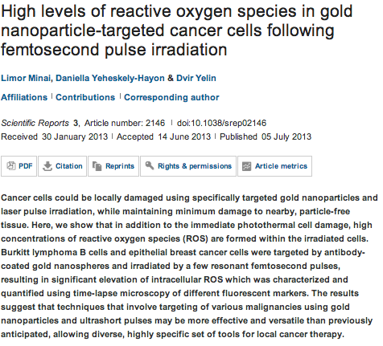
Scientific Reports

Slide 15
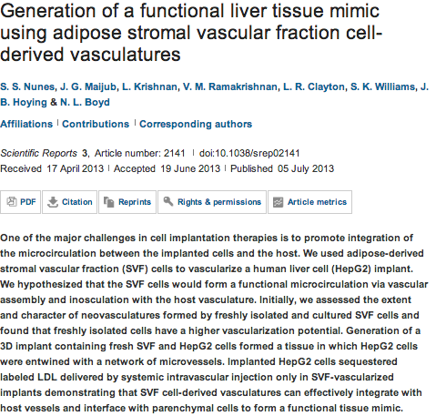

Slide 16
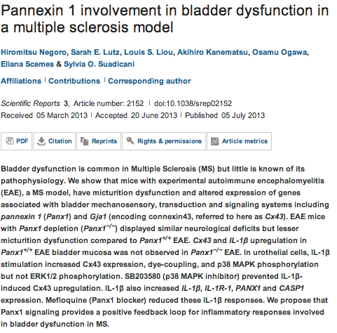

Slide 17
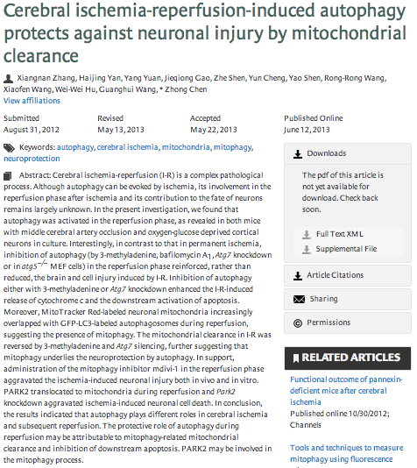
Autophagy

Slide 18
Oncogene
Rare insights into cancer biology.
Adam J, Yang M, Soga T, Pollard PJ.
Cancer biology and Metabolism Group, Nuffield Department of Medicine, Henry Wellcome Building for Molecular Physiology, University of Oxford, Oxford, UK.
Cancer-associated mutations have been identified in the metabolic genes succinate dehydrogenase (SDH), fumarate hydratase (FH) and isocitrate dehydrogenase (IDH), advancing and challenging our understanding of cellular function and disease mechanisms and providing direct links between dysregulated metabolism and cancer. Some striking parallels exist in the cellular consequences of the genetic mutations within this triad of cancer syndromes, including accumulation of oncometabolites and competitive inhibition of 2-oxoglutarate-dependent dioxygenases, particularly, hypoxia-inducible factor (HIF) prolyl hydroxylases, JmjC domain-containing histone demethylases (part of the JMJD family) and the ten-eleven translocation (TET) family of 5methyl cytosine (5mC) DNA hydroxylases. These lead to activation of HIF-dependent oncogenic pathways and inhibition of histone and DNA demethylation. Mutations in FH, resulting in loss of enzyme activity, predispose affected individuals to a rare cancer, hereditary leiomyomatosis and renal cell cancer (HLRCC), characterised by benign smooth muscle cutaneous and uterine tumours (leiomyomata) and an aggressive form of collecting duct and type 2 papillary renal cancer. Interestingly, loss of FH activity results in the accumulation of high levels of fumarate that can lead to the non-enzymatic modification of cysteine residues in multiple proteins (succination) and in some cases to their disrupted function. Here we consider that the study of rare diseases such as HLRCC, combining analyses of human tumours and cell lines with in vitro and in vivo murine models has provided novel insights into cancer biology associated with dysregulated metabolism and represents a useful paradigm for cancer research.

Slide 19
Oncogene
Snail1-dependent transcriptional repression of Cezanne2 in hepatocellular carcinoma.
Xu Z, Pei L, Wang L, Zhang F, Hu X, Gui Y.
Source
Department of molecular diagnosis, ZhongCheng Translational-Medicine Inc, Shanghai, China.
Abstract
High malignancy and early metastasis are the hallmarks of hepatocellular carcinoma (HCC). Here, we report that Cezanne2 expression is downregulated in HCC cells and in HCC patients' tumorous tissues and that Cezanne2 is inversely associated with Snail1 expression in HCC patients' tumorous tissues. Chromatin immunoprecipitation assays and the reporter gene assay showed that Snail1 binds to the promoter of the Cezanne2 gene and mediates the direct consequence of Cezanne2 repression. Enhanced expression of Cezanne2 could suppress proliferation, migration and invasion in HCC cells. Further, Cezanne2 could regulate MMP (matrix metalloproteinase)2, MMP9 and ICAM1 (intercellular adhesion molecule) levels through modulation of the NF-κB (nuclear factor kappa-light-chain-enhancer of activated B cell) signaling cascade. Co-immunoprecipitation and in vivo deubiquitination assay indicated that Cezanne2 interacts with TNF receptor-associated factor (TRAF)6 and cleaves the polyubiquitin from TRAF6 substrates. Our data reveal that Snail1-mediated suppression of Cezanne2 may have a key role in HCC malignancy.

Slide 20
PPM1A is a RelA phosphatase with tumor suppressor-like activity.
Lu X, An H, Jin R, Zou M, Guo Y, Su PF, Liu D, Shyr Y, Yarbrough WG.
Source
Department of Cancer Biology, Vanderbilt University, Nashville, TN, USA.
Oncogene
Post-transcriptional regulation of cyclins D1, D3 and G1 and proliferation of human cancer cells depend on IMP-3 nuclear localization.
Rivera Vargas T, Boudoukha S, Simon A, Souidi M, Cuvellier S, Pinna G, Polesskaya A.
Source
1] CNRS, FRE 3377, Gif-sur-Yvette, France [2] Univ Paris-Sud, FRE 3377, Gif-sur-Yvette, France [3] CEA, FRE 3377, Gif-sur-Yvette, France.
Expression of the antimicrobial peptide cathelicidin in myeloid cells is required for lung tumor growth.
Li D, Beisswenger C, Herr C, Schmid RM, Gallo RL, Han G, Zakharkina T, Bals R.
Source
Department of Internal Medicine V-Pulmonology, Allergology, Respiratory Intensive Care Medicine, Saarland University Hospital, Homburg, Germany.
KLF8 and FAK cooperatively enrich the active MMP14 on the cell surface required for the metastatic progression of breast cancer.
Lu H, Hu L, Yu L, Wang X, Urvalek AM, Li T, Shen C, Mukherjee D, Lahiri SK, Wason MS, Zhao J.
Source
Burnett School of Biomedical Sciences, College of Medicine, University of Central Florida, Orlando, FL, USA
As an independent prognostic factor, FAT10 promotes hepatitis B virus-related hepatocellular carcinoma progression via Akt/GSK3β pathway.
Liu L, Dong Z, Liang J, Cao C, Sun J, Ding Y, Wu D.
Source
Hepatology Unit and Department of Infectious Diseases, Nanfang Hospital, Southern Medical University, Guangzhou, China.
LXRα-mediated downregulation of FOXM1 suppresses the proliferation of hepatocellular carcinoma cells.
Hu C, Liu D, Zhang Y, Lou G, Huang G, Chen B, Shen X, Gao M, Gong W, Zhou P, Dai S, Zeng Y, He F.
Source
Department of Biochemistry and Molecular Biology, College of Basic Medical Sciences, Third Military Medical University, Chongqing, China.
Histone deacetylase 5 blocks neuroblastoma cell differentiation by interacting with N-Myc.
Sun Y, Liu PY, Scarlett CJ, Malyukova A, Liu B, Marshall GM, Mackenzie KL, Biankin AV, Liu T.
Source
Children's Cancer Institute Australia for Medical Research, Randwick, New South Wales, Australia.
Crosstalk of Ras and Rho: activation of RhoA abates Kras-induced liver tumorigenesis in transgenic zebrafish models.
Chew TW, Liu XJ, Liu L, Spitsbergen JM, Gong Z, Low BC.
Source
1] Cell Signaling and Developmental Biology Laboratory, Department of Biological Sciences, National University of Singapore, Singapore, Singapore [2] Mechanobiology Institute, National University of Singapore, Singapore, Singapore.

Slide 21
A novel bispecific EGFR/Met antibody blocks tumor-promoting phenotypic effects induced by resistance to EGFR inhibition and has potent antitumor activity.
Castoldi R, Ecker V, Wiehle L, Majety M, Busl-Schuller R, Asmussen M, Nopora A, Jucknischke U, Osl F, Kobold S,Scheuer W, Venturi M, Klein C, Niederfellner G, Sustmann C.
Source
Pharma Research and Early Development (pRED), Roche Diagnostics GmbH, Penzberg, Germany
Oncogene
Infiltrating bone marrow mesenchymal stem cells increase prostate cancer stem cell population and metastatic ability via secreting cytokines to suppress androgen receptor signaling.
Luo J, Ok Lee S, Liang L, Huang CK, Li L, Wen S, Chang C.
Source
George Whipple Lab for Cancer Research, Departments of Pathology, Urology, Radiation Oncology, and The Wilmot Cancer Center, University of Rochester Medical Center, Rochester, NY, USA.
Discovery of colorectal cancer PIK3CA mutation as potential predictive biomarker: power and promise of molecular pathological epidemiology.
Ogino S, Lochhead P, Giovannucci E, Meyerhardt JA, Fuchs CS, Chan AT.
Source
1] Department of Pathology, Brigham and Women's Hospital, Harvard Medical School, Boston, MA, USA [2] Department of Medical Oncology, Dana-Farber Cancer Institute, Boston, MA, USA [3] Department of Epidemiology, Harvard School of Public Health, Boston, MA, USA.
Targeting Myc in KSHV-associated primary effusion lymphoma with BET bromodomain inhibitors.
Tolani B, Gopalakrishnan R, Punj V, Matta H, Chaudhary PM.
Source
Jane Anne Nohl Division of Hematology and Center for the Study of Blood Diseases, University of Southern California Keck School of Medicine, Los Angeles, CA, USA
Integrin α3β1-CD151 complex regulates dimerization of ErbB2 via RhoA.
Novitskaya V, Romanska H, Kordek R, Potemski P, Kusińska R, Parsons M, Odintsova E, Berditchevski F.
Source
School of Cancer Sciences, The University of Birmingham, Edgbaston, Birmingham, UK.
Whole chromosome instability resulting from the synergistic effects of pRB and p53 inactivation.
Manning AL, Benes C, Dyson NJ.
Source
Center for Cancer Research, Massachusetts General Hospital Cancer Center, Harvard Medical School, Harvard University, Charlestown, MA, USA

Slide 22

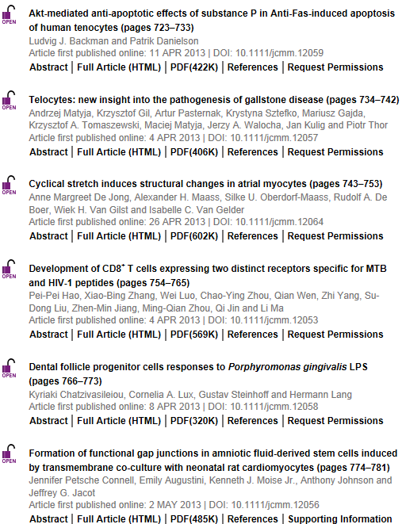
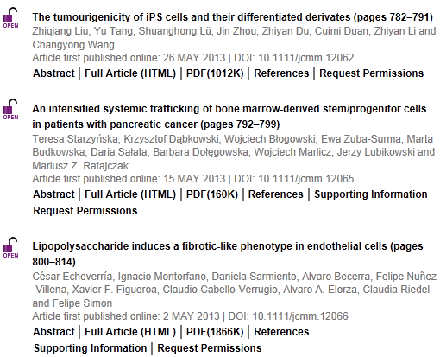

Slide 23


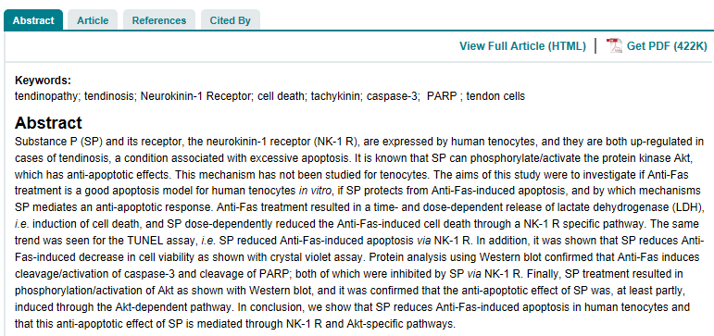

Slide 24

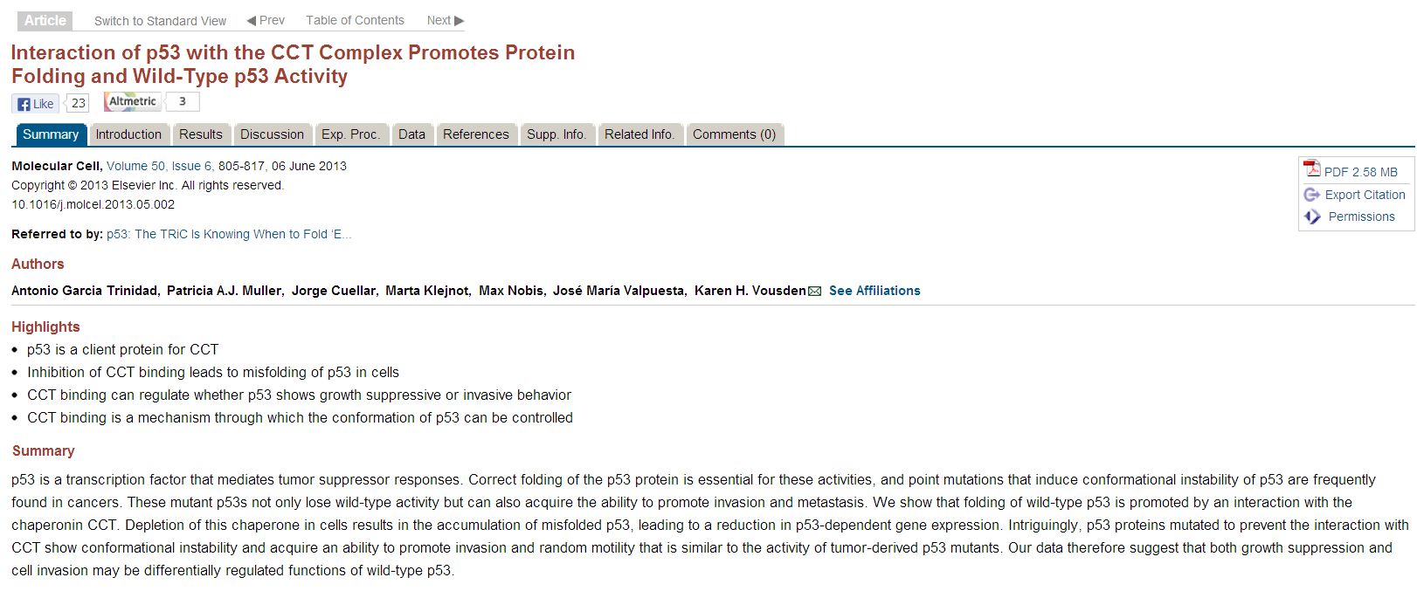

Slide 25
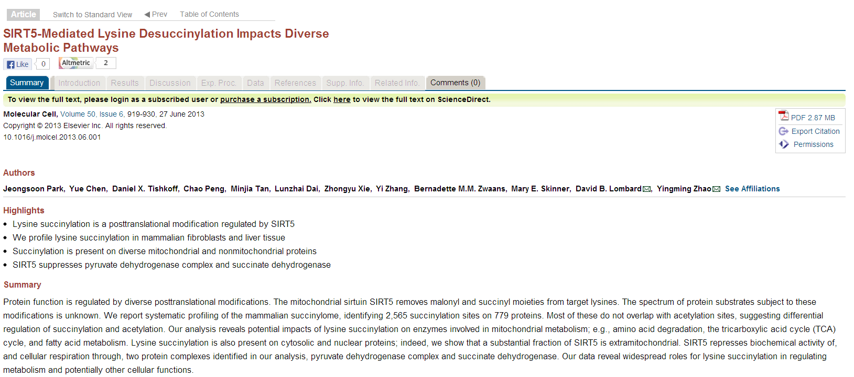

Slide 26
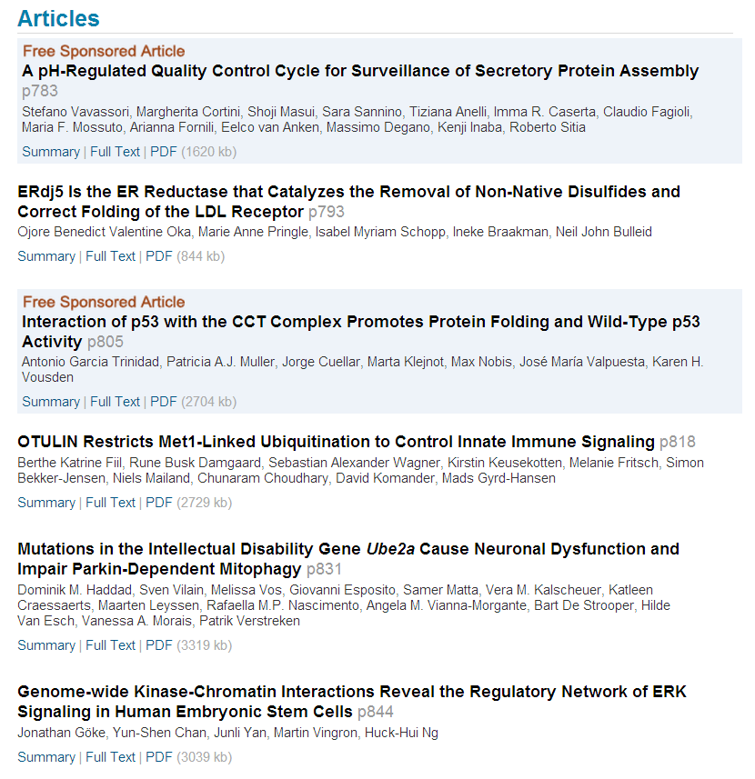

Slide 27
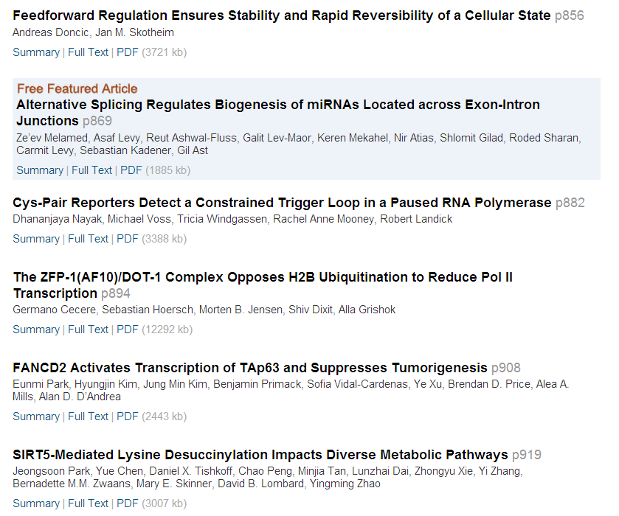

Slide 28
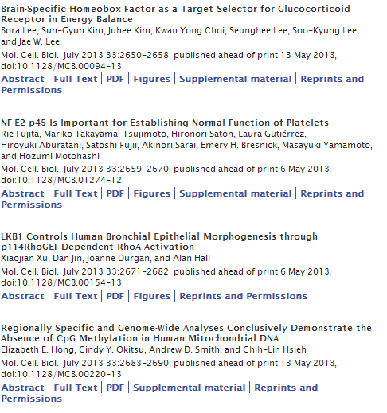


Slide 29
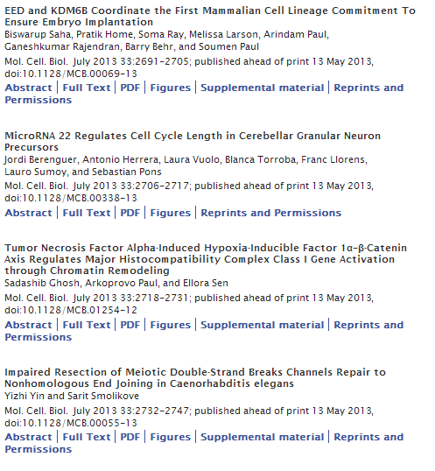

Slide 30
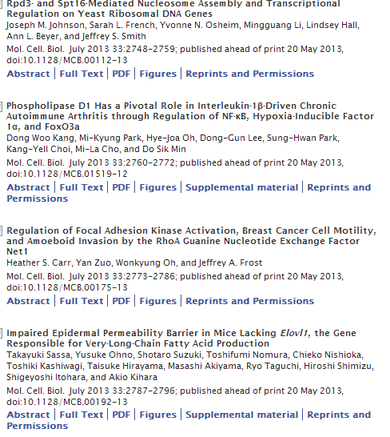

Slide 31
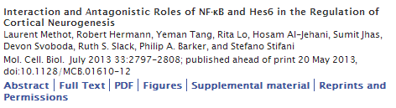

Slide 32
Tumor Necrosis Factor Alpha-Induced Hypoxia-Inducible Factor 1α–β-Catenin Axis Regulates Major Histocompatibility Complex Class I Gene Activation through Chromatin Remodeling
Sadashib Ghosh, Arkoprovo Paul and Ellora Sen
National Brain Research Centre, Manesar, Haryana, India
ABSTRACT
Hypoxia-inducible factor 1α (HIF-1α) plays a crucial role in the progression of glioblastoma multiforme tumors, which are characterized by their effective immune escape mechanisms. As major histocompatibility complex class I (MHC-I) is involved in glioma immune evasion and since HIF-1α is a pivotal link between inflammation and glioma progression, the role of tumor necrosis factor alpha (TNF-α)-induced inflammation in MHC-I gene regulation was investigated. A TNF-α-induced increase in MHC-I expression and transcriptional activation was concurrent with increased HIF-1α, ΝF-κΒ, and β-catenin activities. While knockdown of HIF-1α and β-catenin abrogated TNF-α-induced MHC-I activation, NF-κB had no effect. β-Catenin inhibition abrogated HIF-1α activation and vice versa, and this HIF-1α–β-catenin axis positively regulated CREB phosphorylation. Increased CREB activation was accompanied by its increased association with β-catenin and CBP. Chromatin immunoprecipitation revealed increased CREB enrichment at CRE/site α on the MHC-I promoter in a β-catenin-dependent manner. β-Catenin replaced human Brahma (hBrm) with Brg1 as the binding partner for CREB at the CRE site. The hBrm-to-Brg1 switch is crucial for MHC-I regulation, as ATPase-deficient Brg1 abolished TNF-α-induced MHC-I expression. β-Catenin also increased the association of MHC-I enhanceosome components RFX5 and NF-YB at the SXY module. CREB acts as a platform for assembling coactivators and chromatin remodelers required for MHC-I activation in a HIF-1α/β-catenin-dependent manner.

