Slide 1

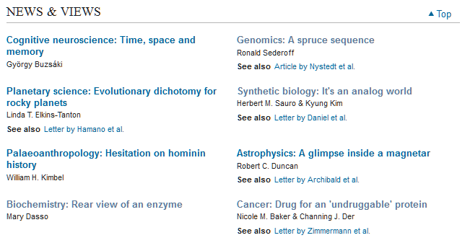

Slide 2
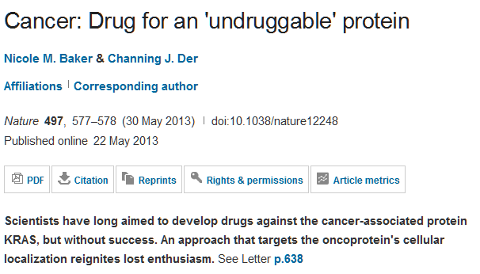

Slide 3
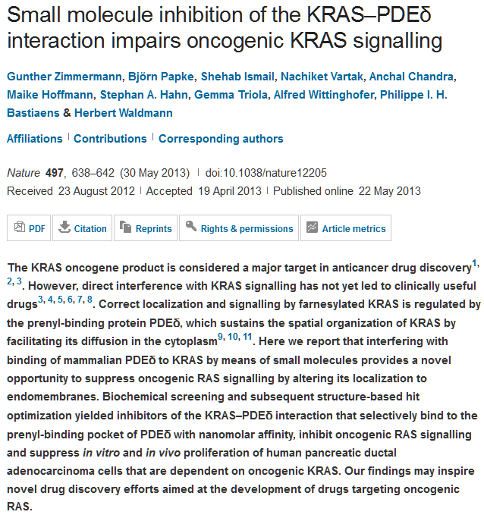

Slide 4
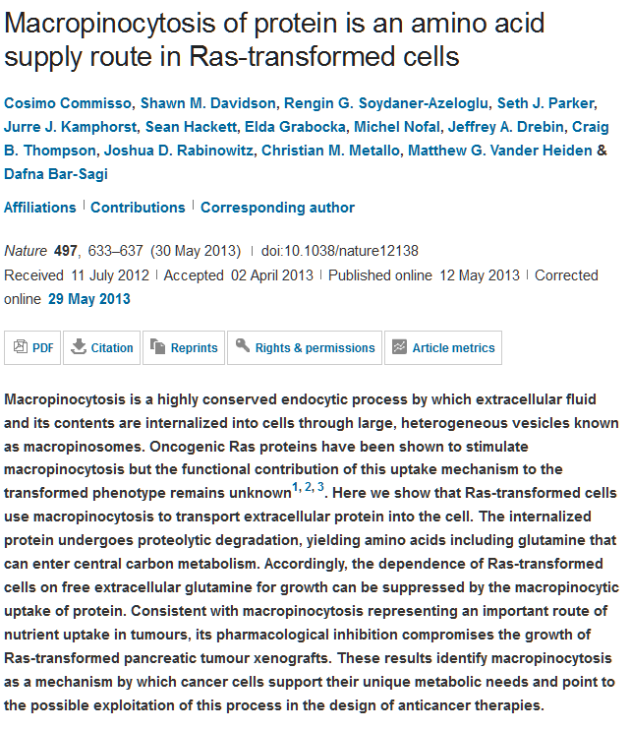

Slide 5
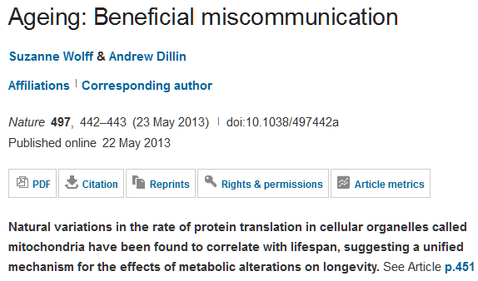

Slide 6
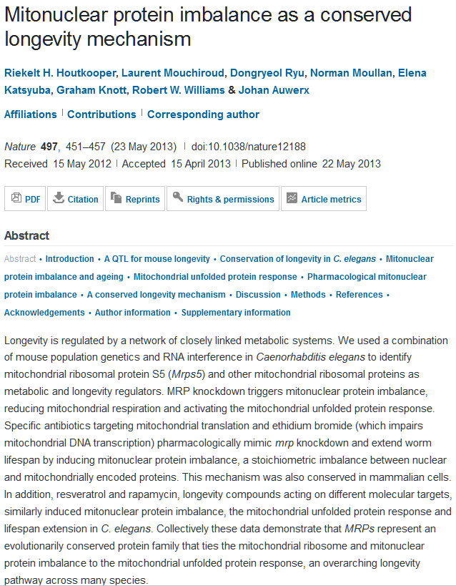

Slide 7
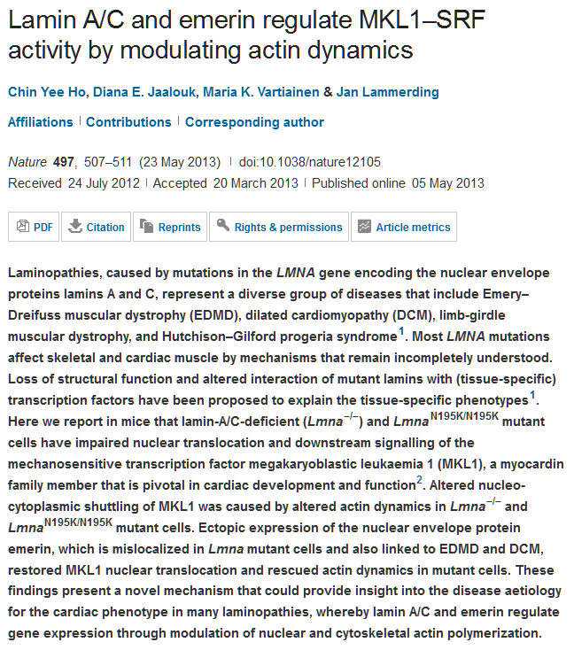

Slide 8
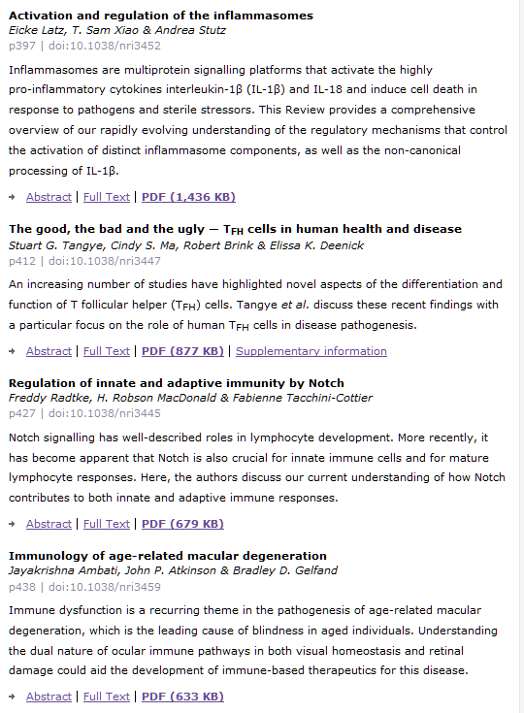


Slide 9
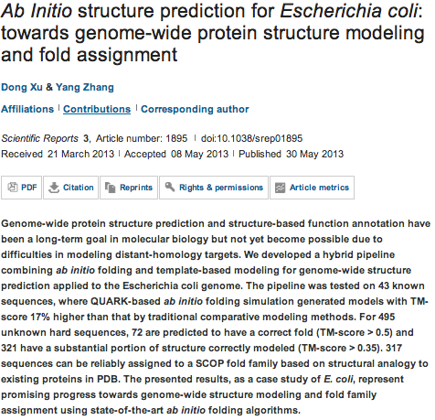
Scientific Reports

Slide 10
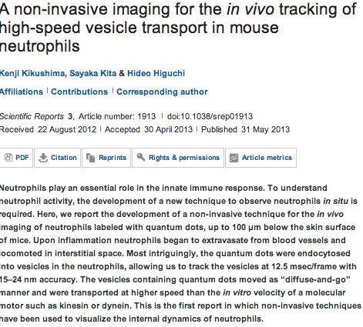

Slide 11
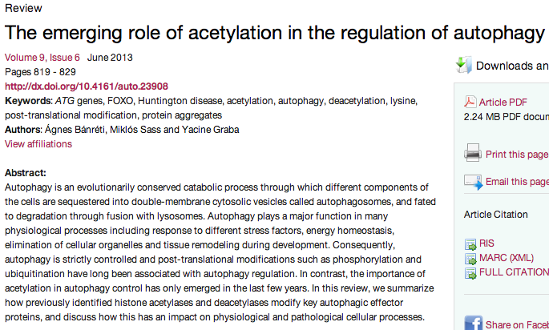
Autophagy

Slide 12
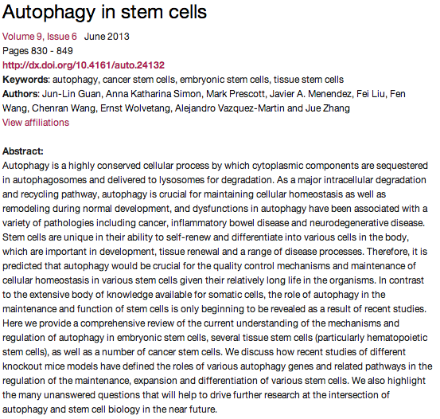

Slide 13

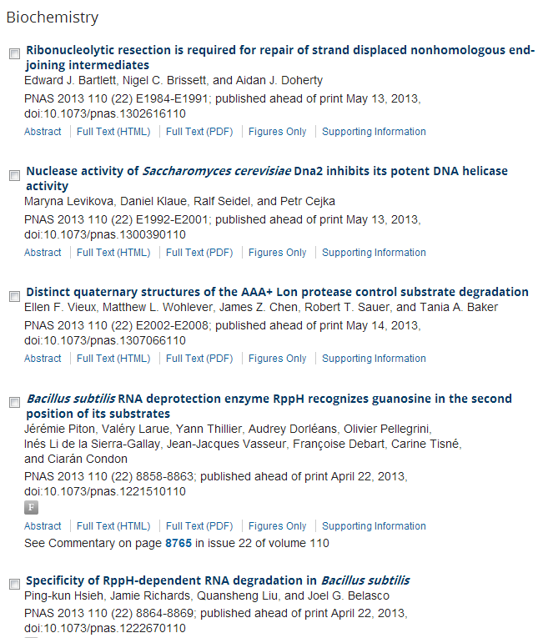
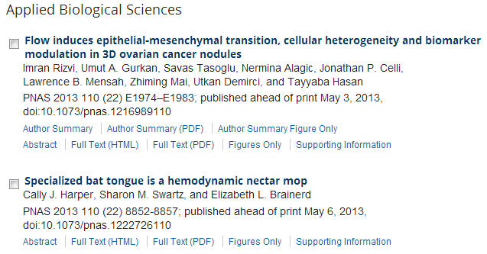
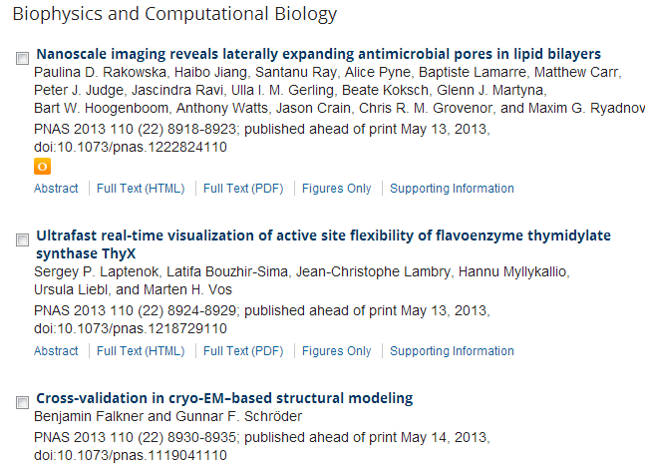

Slide 14
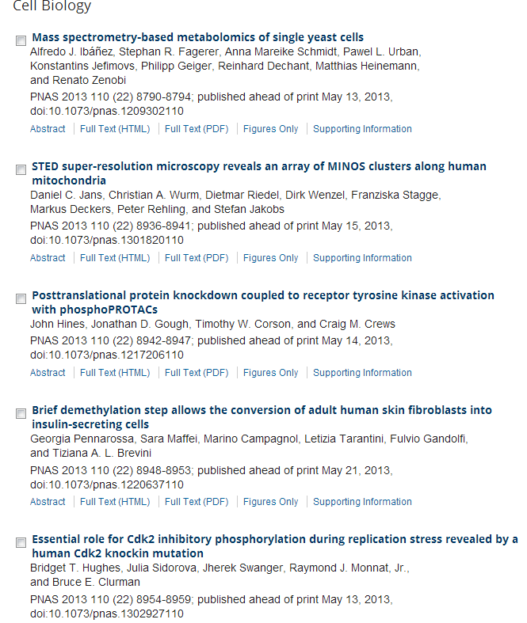
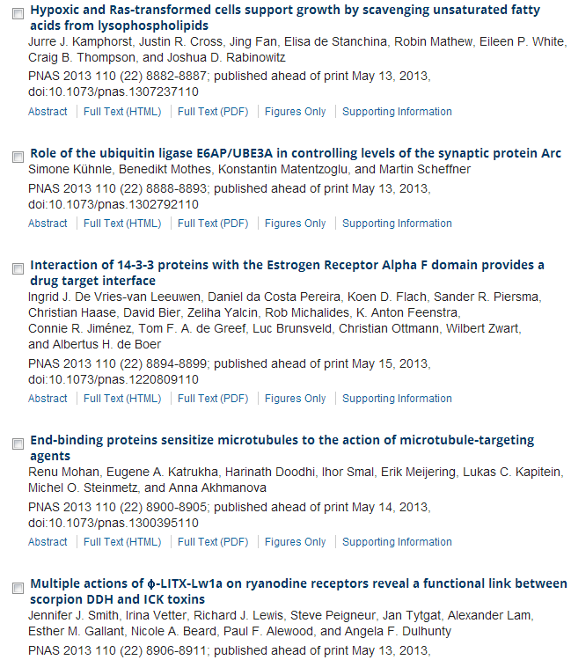

Slide 15
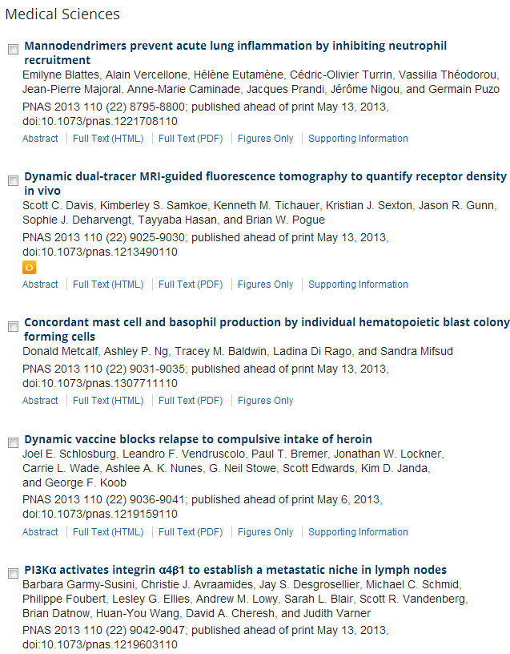

Slide 16
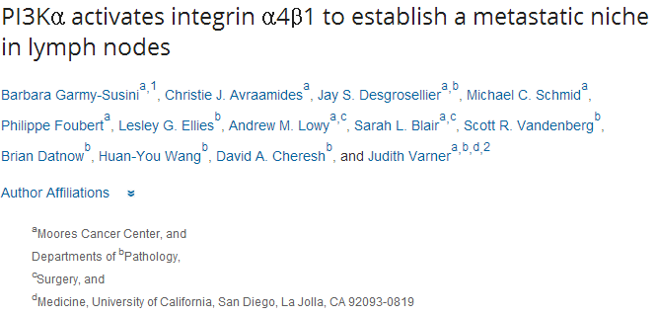
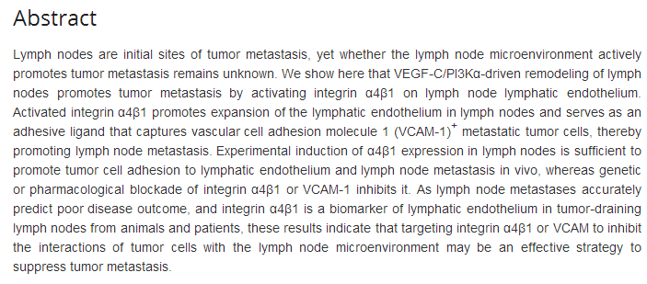

Slide 17

Differential regulation of proteasome functionality in reproductive vs. somatic tissues of Drosophila during aging or oxidative stress
Eleni N. Tsakiri, Gerasimos P. Sykiotis, Issidora S. Papassideri,
Vassilis G. Gorgoulis, Dirk Bohmann, and Ioannis P. Trougakos
Source
FASEB J June 2013 27:2407-2420; published ahead of print March 1, 2013, doi:10.1096/fj.12-221408
The hydrolase DDAH2 enhances pancreatic insulin secretion by transcriptional regulation of secretagogin through a Sirt1-dependent mechanism in mice
Kazuhiro Hasegawa, Shu Wakino, Masumi Kimoto, Hitoshi Minakuchi, Keiko Fujimura, Koji Hosoya, Motoaki Komatsu,
Yuka Kaneko, Takeshi Kanda, Hirobumi Tokuyama, Koichi Hayashi,
and Hiroshi Itoh
Source
FASEB J June 2013 27:2301-2315; published ahead of print February 21, 2013, doi:10.1096/fj.12-226092
Low dystrophin levels increase survival and improve muscle pathology and function in dystrophin/utrophin double-knockout mice
Maaike van Putten, Margriet Hulsker, Courtney Young, Vishna D. Nadarajah, Hans Heemskerk, Louise van der Weerd, Peter A. C. 't Hoen, Gert-Jan B. van Ommen, and Annemieke M. Aartsma-Rus
Source
FASEB J June 2013 27:2484-2495; published ahead of print March 4, 2013, doi:10.1096/fj.12-224170
Early methyl donor deficiency produces severe gastritis in mothers and offspring through N-homocysteinylation of cytoskeleton proteins, cellular stress, and inflammation
Carine Bossenmeyer-Pourié, Grégory Pourié, Violette Koziel,
Deborah Helle, Elise Jeannesson, Jean-Louis Guéant,
and Bernard Beck
Source
FASEB J June 2013 27:2185-2197; published ahead of print February 11, 2013, doi:10.1096/fj.12-224642
Interleukin-10 promoter variants predict HPV-positive tumors and survival of squamous cell carcinoma of the oropharynx
Lei Jin, Erich M. Sturgis, Xiaolin Cao, Xicheng Song, Taufiq Salahuddin, Qingyi Wei, and Guojun Li
Source
FASEB J June 2013 27:2496-2503; published ahead of print February 21, 2013, doi:10.1096/fj.12-226803
Intracellular signaling in ER stress-induced autophagy in skeletal muscle cells
Luca Madaro, Valeria Marrocco, Silvia Carnio, Marco Sandri,
and Marina Bouché
Source
FASEB J May 2013 27:1990-2000; published ahead of print February 6, 2013, doi:10.1096/fj.12-215475

Slide 18
Regulation of Wnt4 in chronic obstructive pulmonary disease
Correspondence: Airways Disease Section, National Heart and Lung Institute, Dovehouse St., London SW3 6LY, UK. E-mail: a.durham@imperial.ac.uk
Abstract
Chronic obstructive pulmonary disease (COPD) is associated with persistent inflammation and oxidative stress in susceptible individuals. Using microarray analysis of bronchial biopsy samples from patients with COPD and controls, we identified Wnt4 as being up-regulated in COPD. Analysis of bronchial biopsy samples showed a very strong correlation between Wnt4 and IL8 gene expression, suggesting that Wnt4 plays a role in chronic lung inflammation. In vitro, Wnt4 induced proliferation and inflammation in human epithelial cells (BEAS-2B) and normal primary human bronchial epithelial cells in a concentration-dependent manner. This effect was enhanced in the presence of interleukin-1β (IL-1β) as a result of activation of the p38 and c-Jun NH₂-terminal kinase mitogen-activated protein kinase pathways. Hydrogen peroxide, but not proinflammatory stimuli, up-regulated Wnt4 expression in epithelial cells. In monocytic THP-1 and primary airway smooth muscle cells, Wnt4 induced inflammation and enhanced the inflammatory response to lipopolysaccharide and IL-1β but did not induce proliferation. In addition, these other cell types did not have enhanced Wnt4 expression in response to hydrogen peroxide. Our results indicate that airway epithelial activation, due to oxidative stress, may lead to Wnt4 induction. Wnt4, in turn, acts through the noncanonical pathway to activate epithelial cell remodeling and IL8 gene expression, leading to neutrophil infiltration and inflammation.

Slide 19

Up-regulation of sarcoplasmic reticulum Ca²⁺ uptake leads to cardiac hypertrophy, contractile dysfunction and early mortality in mice deficient in CASQ2
Anuradha Kalyanasundaram, Véronique A. Lacombe, Andriy E. Belevych, Lucia Brunello, Cynthia A. Carnes, Paul M.L. Janssen,
Bjørn C. Knollmann, Muthu Periasamy, and Sandor Gyørke
Source
Cardiovasc Res (2013) 98(2): 297-306 first published online November 6, 2012 doi:10.1093/cvr/cvs334
Over-expression of calpastatin aggravates cardiotoxicity induced by doxorubicin
Yanpeng Wang, Dong Zheng, Meng Wei, Jian Ma, Yong Yu,
Ruizhen Chen, James C. Lacefield, Huaxi Xu, and Tianqing Peng
Source
Cardiovasc Res (2013) 98(3): 381-390 first published online March 1, 2013 doi:10.1093/cvr/cvt048
Extracellular matrix protein CCN1 regulates cardiomyocyte apoptosis in mice with stress-induced cardiac injury
Pei-Ling Hsu, Bor-Chyuan Su, Qian-Yu Kuok, and Fan-E Mo
Source
Cardiovasc Res (2013) 98(1): 64-72 first published online January 16, 2013 doi:10.1093/cvr/cvt001
Editor's choice: Protective role of vascular smooth muscle cell PPARγ in angiotensin II-induced vascular disease
Chiara Marchesi, Asia Rehman, Yohann Rautureau, Daniel A. Kasal, Marie Briet, Avshalom Leibowitz, Stefania M.C. Simeone,
Talin Ebrahimian, Mario F. Neves, Stefan Offermanns, Frank J. Gonzalez, Pierre Paradis, and Ernesto L. Schiffrin
Source
Cardiovasc Res (2013) 97(3): 562-570 first published online December 17, 2012 doi:10.1093/cvr/cvs362
Cardiomyocyte ryanodine receptor degradation by chaperone-mediated autophagy
Zully Pedrozo, Natalia Torrealba, Carolina Fernández, Damian Gatica, Barbra Toro, Clara Quiroga, Andrea E. Rodriguez, Gina Sanchez, Thomas G. Gillette, Joseph A. Hill, Paulina Donoso,
and Sergio Lavandero
Source
Cardiovasc Res (2013) 98(2): 277-285 first published online February 11, 2013 doi:10.1093/cvr/cvt029

Slide 20

p53 Protein Isoforms: Key Regulators in the Front Line of Pathogen Infections?
Olivier Terrier, Jean-Christophe Bourdon, Manuel Rosa-Calatrava
Source
published 04 Apr 2013 | info:doi/10.1371/journal.ppat.1003246
IL-1β Production through the NLRP3 Inflammasome by Hepatic Macrophages Links Hepatitis C Virus Infection with Liver Inflammation and Disease
Amina A. Negash, Hilario J. Ramos, Nanette Crochet, Daryl T. Y. Lau, Brian Doehle, Neven Papic, Don A. Delker, Juandy Jo, Antonio Bertoletti, Curt H. Hagedorn, Michael Gale Jr
Source
published 25 Apr 2013 | info:doi/10.1371/journal.ppat.1003330
Early Apoptosis of Macrophages Modulated by Injection of Yersinia pestis YopK Promotes Progression of Primary Pneumonic Plague
Kristen N. Peters, Miqdad O. Dhariwala, Jennifer M. Hughes Hanks, Charles R. Brown, Deborah M. Anderson
Source
published 25 Apr 2013 | info:doi/10.1371/journal.ppat.1003324
The Serine Phosphatase SerB of Porphyromonas gingivalis Suppresses IL-8 Production by Dephosphorylation of NF-κB RelA/p65
Hiroki Takeuchi, Takanori Hirano, Sarah E. Whitmore, Ichijiro Morisaki, Atsuo Amano, Richard J. Lamont
Source
published 18 Apr 2013 | info:doi/10.1371/journal.ppat.1003326
The JAK-STAT Transcriptional Regulator, STAT-5, Activates the ATM DNA Damage Pathway to Induce HPV 31 Genome Amplification upon Epithelial Differentiation
Shiyuan Hong, Laimonis A. Laimins
Source
published 04 Apr 2013 | info:doi/10.1371/journal.ppat.1003295
Cell Death Control: The Interplay of Apoptosis and Autophagy in the Pathogenicity of Sclerotinia sclerotiorum
Mehdi Kabbage, Brett Williams, Martin B. Dickman
Source
published 11 Apr 2013 | info:doi/10.1371/journal.ppat.1003287

Slide 21
Oncogene
Telomere dysfunction and activation of alternative lengthening of telomeres in B-lymphocytes infected by Epstein-Barr virus.
Kamranvar SA, Chen X, Masucci MG.
Source
Department of Cell and Molecular Biology, Karolinska Institute, Stockholm, Sweden.
Abstract
Malignant cells achieve replicative immortality by two alternative mechanisms, a common one dependent on de novo synthesis of telomeric DNA by telomerase, and a rare one based on telomere recombination known as alternative lengthening of telomeres (ALT). Epstein-Barr virus (EBV) transforms human B-lymphocytes into lymphoblastoid cell lines with unlimited growth potential in vitro and in vivo. Here we show that newly EBV-infected cells exhibit multiple signs of telomere dysfunction, including the occurrence of extra-chromosomal telomeres, telomere fusion and telomere length heterogeneity, and undergo progressive increase in telomere length without a parallel increase in telomerase activity. This phenotype is accompanied by the accumulation of telomere-associated promyelocytic leukemia nuclear bodies and telomeric-sister chromatid exchange, suggesting that EBV infection promotes the activation of ALT. Newly infected cells also display a significant reduction of telomere-associated TRF2 and express low levels of TRF1, TRF2, POT1 and ATRX, pointing to telomere de-protection as an important correlate of ALT activation. Collectively, these findings highlight the involvement of recombination-dependent mechanisms for maintenance of telomere homeostasis in EBV-induced B-cell immortalization.

Slide 22
Oncogene
PIK3CA and APC mutations are synergistic in the development of intestinal cancers.
Deming DA, Leystra AA, Nettekoven L, Sievers C, Miller D, Middlebrooks M, Clipson L, Albrecht D, Bacher J,Washington MK, Weichert J, Halberg RB.
Source
Division of Hematology and Oncology, Department of Medicine, University of Wisconsin, Madison, WI, USA.
Abstract
Human colorectal cancers are known to possess multiple mutations, though how these mutations interact in tumor development and progression has not been fully investigated. We have previously described the FCPIK3ca* murine colon cancer model, which expresses a constitutively activated phosphoinositide-3 kinase (PI3K) in the intestinal epithelium. The expression of this dominantly active form of PI3K results in hyperplasia and invasive mucinous adenocarcinomas. These cancers form via a non-canonical mechanism of tumor initiation that is mediated through activation of PI3K and not through aberrations in WNT signaling. Since the Adenomatous Polyposis Coli (APC) gene is mutated in the majority of human colon cancers and often occurs simultaneously with PIK3CA mutations, we sought to better understand the interaction between APC and PIK3CA mutations in the mammalian intestine. In this study, we have generated mice in which the expression of a constitutively active PI3K and the loss of APC occur simultaneously in the distal small intestine and colon. Here, we demonstrate that expression of a dominant active PI3K synergizes with loss of APC activity resulting in a dramatic change in tumor multiplicity, size, morphology and invasiveness. Activation of the PI3K pathway is not able to directly activate WNT signaling through the nuclear localization of CTNNB1 (β-catenin) in the absence of aberrant WNT signaling. Alterations at the transcriptional level, including increased CCND1, may be the etiology of synergy between these activated pathways

Slide 23
The NuRD complex cooperates with DNMTs to maintain silencing of key colorectal tumor suppressor genes.
Cai Y, Geutjes EJ, de Lint K, Roepman P, Bruurs L, Yu LR, Wang W, van Blijswijk J, Mohammad H, de Rink I,Bernards R, Baylin SB.
Source
Department of Oncology and The Sidney Kimmel Comprehensive Cancer Center at Johns Hopkins University, Baltimore, MD, USA
Oncogene
Concomitant loss of EAF2/U19 and Pten synergistically promotes prostate carcinogenesis in the mouse model.
Ai J, Pascal LE, O'Malley KJ, Dar JA, Isharwal S, Qiao Z, Ren B, Rigatti LH, Dhir R, Xiao W, Nelson JB, Wang Z.
Source
Department of Urology, University of Pittsburgh School of Medicine, Pittsburgh, PA, USA.
Prolactin suppresses a progestin-induced CK5-positive cell population in luminal breast cancer through inhibition of progestin-driven BCL6 expression.
Sato T, Tran TH, Peck AR, Girondo MA, Liu C, Goodman CR, Neilson LM, Freydin B, Chervoneva I, Hyslop T, Kovatich AJ, Hooke JA, Shriver CD, Fuchs SY, Rui H.
Source
Department of Cancer Biology, Kimmel Cancer Center, Thomas Jefferson University, Philadelphia, PA, USA.
LPLUNC1 suppresses IL-6-induced nasopharyngeal carcinoma cell proliferation via inhibiting the Stat3 activation.
Liao Q, Zeng Z, Guo X, Li X, Wei F, Zhang W, Li X, Chen P, Liang F, Xiang B, Ma J, Wu M, Tang H, Deng M, Zeng X,Tang K, Xiong W, Li G.
Source
1] Hunan Provincial Tumor Hospital and the Affiliated Tumor Hospital of Xiangya School of Medicine, Central South University, Changsha, Hunan, China.
Role of Nek2 on centrosome duplication and aneuploidy in breast cancer cells.
Cappello P, Blaser H, Gorrini C, Lin DC, Elia AJ, Wakeham A, Haider S, Boutros PC, Mason JM, Miller NA, Youngson B, Done SJ, Mak TW.
1] The Campbell Family Institute for Breast Cancer Research, University Health Network, Toronto, Ontario, Canada [2] Department of Molecular Biotechnology and Health Sciences, University of Turin, Turin, Italy.
Matrix metalloprotease 1a deficiency suppresses tumor growth and angiogenesis.
Foley CJ, Fanjul-Fernández M, Bohm A, Nguyen N, Agarwal A, Austin K, Koukos G, Covic L, López-Otín C, Kuliopulos A.
Source
1] Molecular Oncology Research Institute, Division of Hematology-Oncology, Tufts Medical Center, Tufts University School of Medicine, Boston, MA, USA [2] Program in Genetics at the Sackler School of Graduate Biomedical Sciences, Departments of Biochemistry and Medicine, Tufts University School of Medicine, Boston, MA, USA.
Accumulation of dephosphorylated 4EBP after mTOR inhibition with rapamycin is sufficient to disrupt paracrine transformation by the KSHV vGPCR oncogene.
Martin D, Nguyen Q, Molinolo A, Gutkind JS.
Oral and Pharyngeal Cancer Branch; National Institute of Dental and Craniofacial Research, National Institutes of Health, Bethesda, MD, USA.

Slide 24
RSK promotes G2/M transition through activating phosphorylation of Cdc25A and Cdc25B.
Wu CF, Liu S, Lee YC, Wang R, Sun S, Yin F, Bornmann WG, Yu-Lee LY, Gallick GE, Zhang W, Lin SH, Kuang J.
Source
Department of Experimental Therapeutics, The University of Texas MD Anderson Cancer Center, Houston, TX, USA.
Oncogene
HTLV-1 HBZ positively regulates the mTOR signaling pathway via inhibition of GADD34 activity in the cytoplasm.
Mukai R, Ohshima T.
Source
Faculty of Engineering, Tokushima Bunri University, Sanuki, Kagawa, Japan.
Phosphorylation of Nanog is essential to regulate Bmi1 and promote tumorigenesis.
Xie X, Piao L, Cavey GS, Old M, Teknos TN, Mapp AK, Pan Q.
Source
1] Department of Otolaryngology-Head and Neck Surgery, The Ohio State University Wexner Medical Center, Columbus, OH, USA [2] Arthur G. James Cancer Hospital and Richard J. Solove Research Institute, The Ohio State University Comprehensive Cancer Center, Columbus, OH, USA.
HOX-mediated LMO2 expression in embryonic mesoderm is recapitulated in acute leukaemias.
Calero-Nieto FJ, Joshi A, Bonadies N, Kinston S, Chan WI, Gudgin E, Pridans C, Landry JR, Kikuchi J, Huntly BJ,Gottgens B.
Source
Department of Haematology, Wellcome Trust and MRC Cambridge Stem Cell Institute, Cambridge Institute for Medical Research, Cambridge University, Cambridge, UK.
Identification of novel TMPRSS2:ERG mechanisms in prostate cancer metastasis: involvement of MMP9 and PLXNA2.
Tian TV, Tomavo N, Huot L, Flourens A, Bonnelye E, Flajollet S, Hot D, Leroy X, de Launoit Y, Duterque-Coquillaud M.
1] Institut de Biologie de Lille, CNRS UMR8161, Lille, France [2] Institut Pasteur de Lille/IFR142, Lille, France [3] Université de Lille Nord de France, Lille, France [4] Faculté de Médecine Henri Warembourg, Université du Droit et de la Santé Lille II, Lille, France.
Targeting cell cycle and hormone receptor pathways in cancer.
Comstock CE, Augello MA, Goodwin JF, de Leeuw R, Schiewer MJ, Ostrander WF Jr, Burkhart RA, McClendon AK,McCue PA, Trabulsi EJ, Lallas CD, Gomella LG, Centenera MM, Brody JR, Butler LM, Tilley WD, Knudsen KE.
Department of Cancer Biology, Kimmel Cancer Center, Thomas Jefferson University, Philadelphia, PA, USA

Slide 25

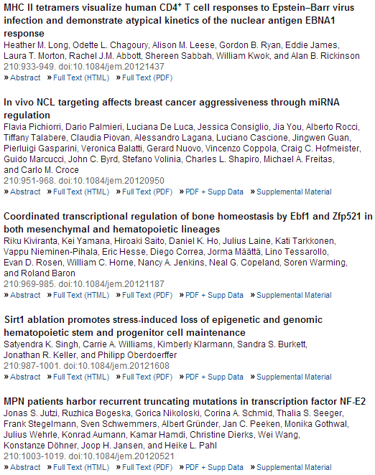
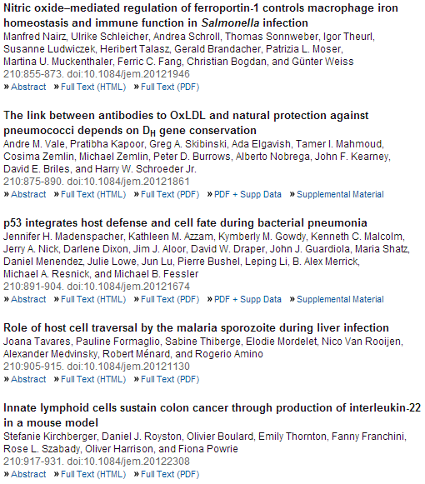

Slide 26
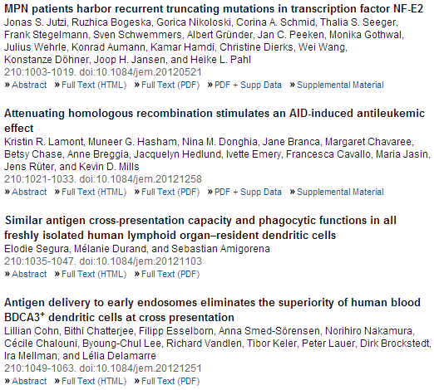

Slide 27
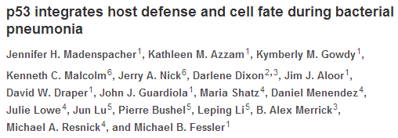
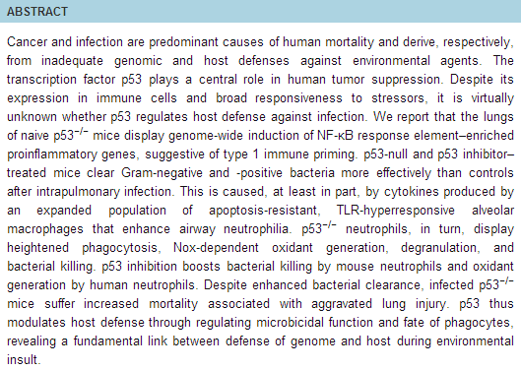

Slide 28

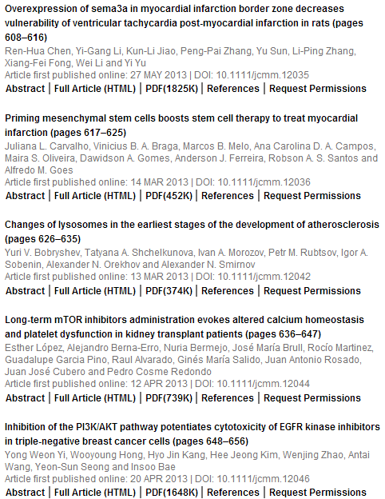
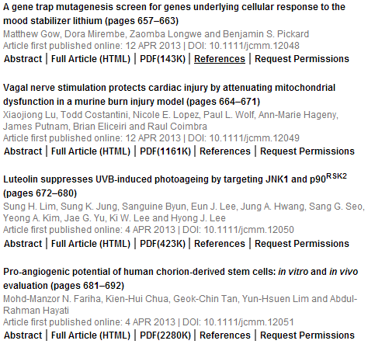

Slide 29

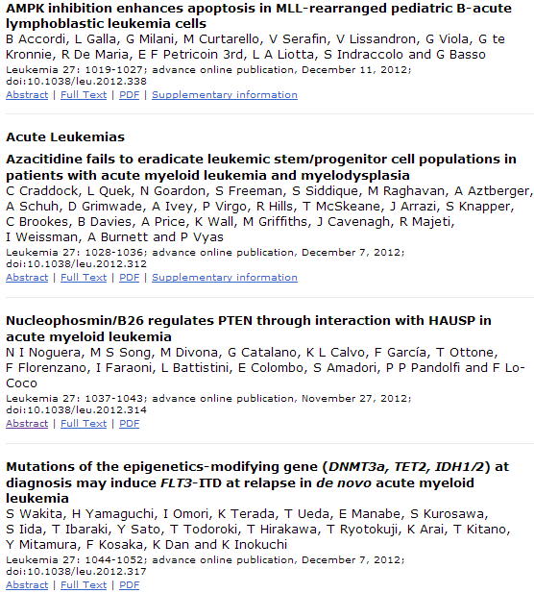
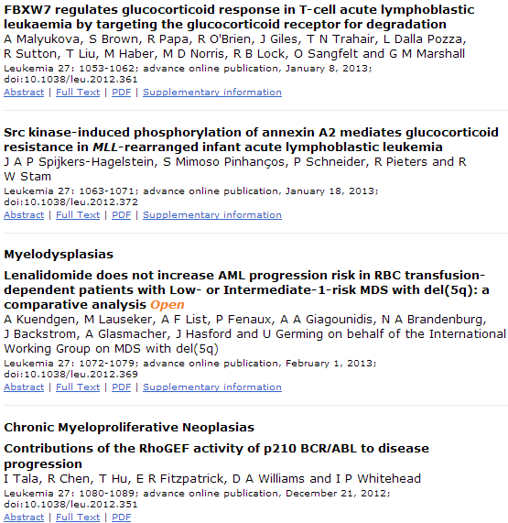

Slide 30
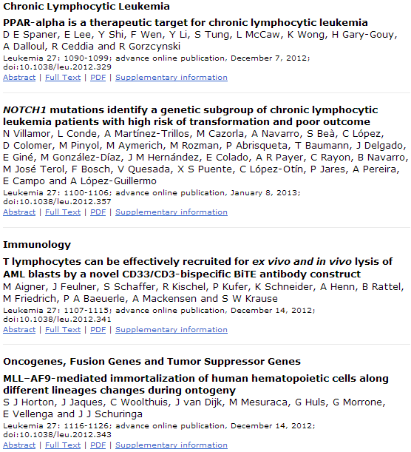
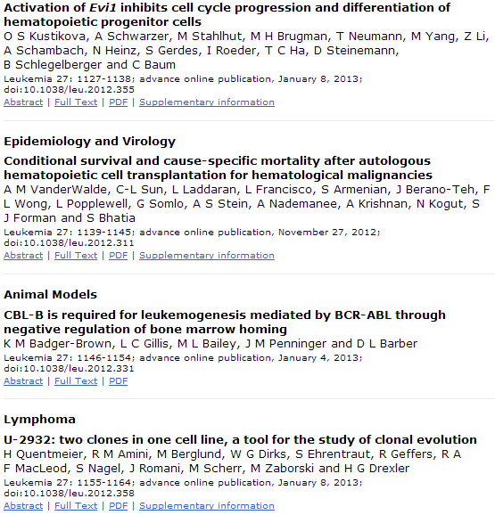

Slide 31
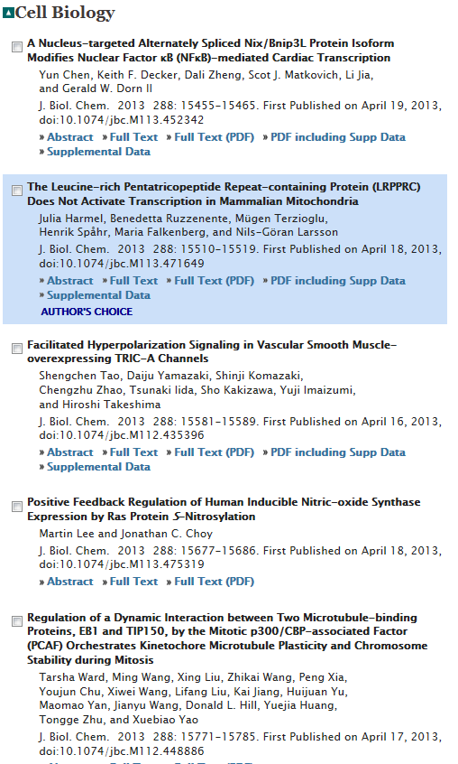
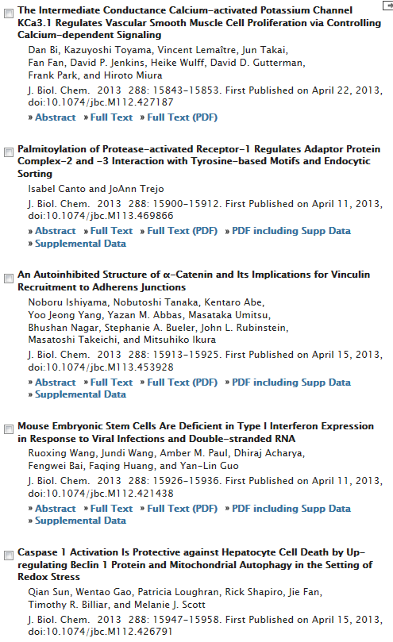

Slide 32
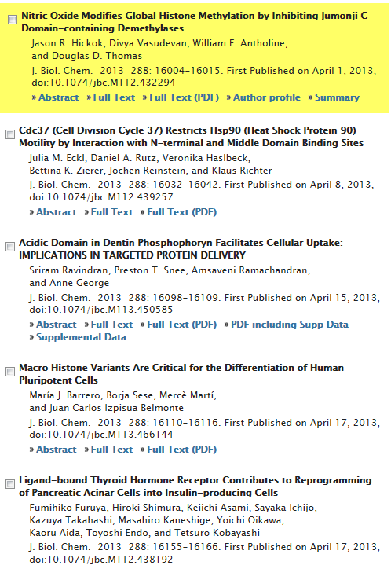
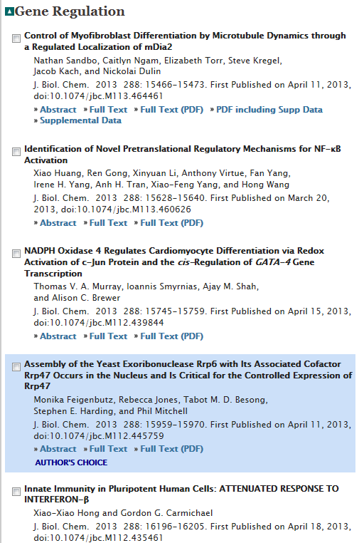

Slide 33
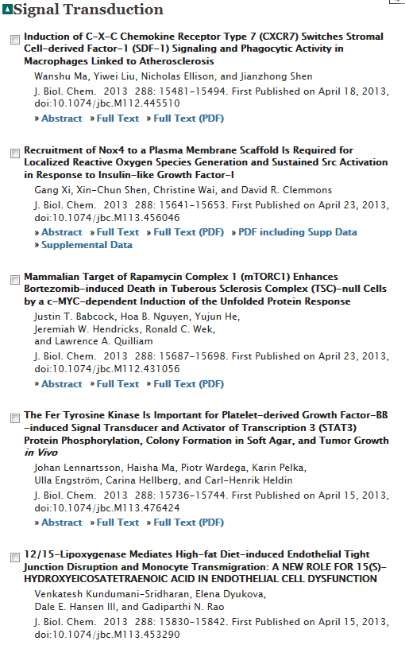
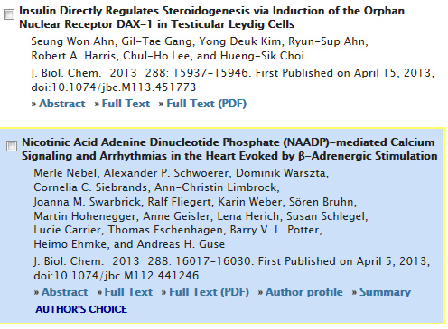

Slide 34


