Slide 1

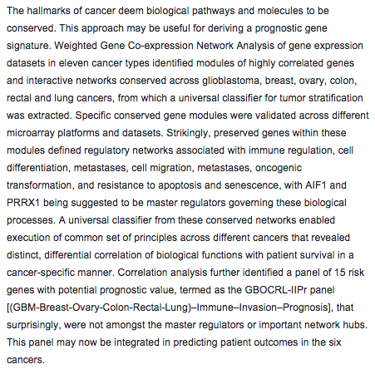
Scientific Reports

Slide 2
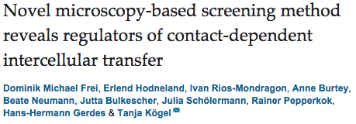
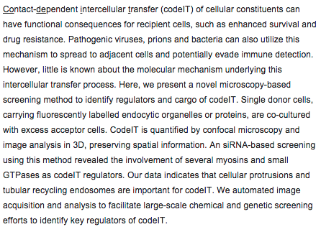

Slide 3
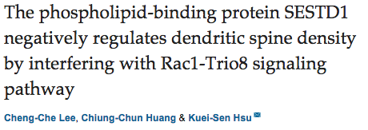
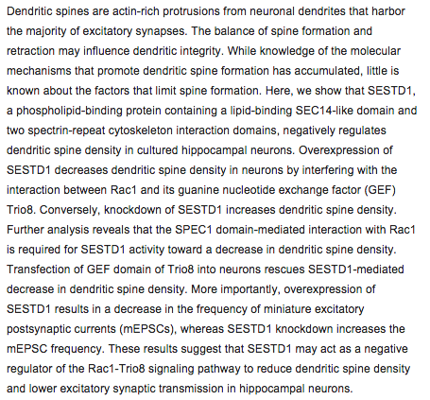

Slide 4
oncogene
PIAS1 is a determinant of poor survival and acts as a positive feedback regulator of AR signaling through enhanced AR stabilization in prostate cancer.
Puhr M¹, Hoefer J¹, Eigentler A¹, Dietrich D², van Leenders G³, Uhl B², Hoogland M³, Handle F¹, Schlick B¹, Neuwirt H⁴, Sailer V², Kristiansen G², Klocker H¹, Culig Z¹.
¹Department of Urology, Medical University of Innsbruck, Innsbruck, Austria.
Novel drugs like Abiraterone or Enzalutamide, which target androgen receptor (AR) signaling to improve androgen deprivation therapy (ADT), have been developed during the past years. However, the application of these drugs is limited because of occurrence of inherent or acquired therapy resistances during the treatment. Thus, identification of new molecular targets is urgently required to improve current therapeutic prostate cancer (PCa) treatment strategies. PIAS1 (protein inhibitor of activated STAT1 (signal transducer and activator of transcription-1)) is known to be an important cell cycle regulator and PIAS1-mediated SUMOylation is essential for DNA repair. In this context, elevated PIAS1 expression has already been associated with cancer initiation. Thus, in the present study, we addressed the question of whether PIAS1 targeting can be used as a basis for an improved PCa therapy in combination with anti-androgens. We show that PIAS1 significantly correlates with AR expression in PCa tissue and in cell lines and demonstrate that high PIAS1 levels predict shorter relapse-free survival. Our patient data are complemented by mechanistic and functional in vitro experiments that identify PIAS1 as an androgen-responsive gene and a crucial factor for AR signaling via prevention of AR degradation. Furthermore, PIAS1 knockdown is sufficient to decrease cell proliferation as well as cell viability. Strikingly, Abiraterone or Enzalutamide treatment in combination with PIAS1 depletion is even more effective than single-drug treatment in multiple PCa cell models, rendering PIAS1 as a promising target protein for a combined treatment approach to improve future PCa therapies.

Slide 5
Genome-wide lentiviral shRNA screen identifies serine/arginine-rich splicing factor 2 as a determinant of oncolytic virus activity in breast cancer cells.
Workenhe ST¹, Ketela T², Moffat J², Cuddington BP¹, Mossman KL¹.
Author information
¹Department of Pathology and Molecular Medicine, McMaster Immunology Research Centre, Institute for Infectious Disease Research, McMaster University, Hamilton, ON, Canada
oncogene
Somatic gene copy number alterations in colorectal cancer: new quest for cancer drivers and biomarkers.
Wang H¹, Liang L¹, Fang JY¹, Xu J¹.
Author information
¹State Key Laboratory for Oncogenes and Related Genes; Key Laboratory of Gastroenterology & Hepatology, Ministry of Health; Division of Gastroenterology and Hepatology, Renji Hospital, School of Medicine, Shanghai Jiao Tong University; Shanghai Cancer Institute, Shanghai Institute of Digestive Disease, Shanghai, China.
Sustained adrenergic signaling leads to increased metastasis in ovarian cancer via increased PGE2 synthesis.
Nagaraja AS¹, Dorniak PL¹, Sadaoui NC¹, Kang Y¹, Lin T², Armaiz-Pena G¹, Wu SY¹, Rupaimoole R¹, Allen JK¹, Gharpure KM¹, Pradeep S¹, Zand B¹, Previs RA¹, Hansen JM¹, Ivan C³, Rodriguez-Aguayo C³, Yang P², Lopez-Berestein G³, Lutgendorf SK⁴, Cole SW⁵, Sood AK⁶.
Author information
¹Department of Gynecologic Oncology and Reproductive Medicine, University of Texas MD Anderson Cancer Center, Houston, TX, USA
Imipramine blue halts head and neck cancer invasion through promoting F-box and leucine-rich repeat protein 14-mediated Twist1 degradation.
Yang WH¹, Su YH¹, Hsu WH¹, Wang CC², Arbiser JL³, Yang MH⁴.
Author information
¹Institute of Clinical Medicine, National Yang-Ming University, Taipei, Taiwan

Slide 6

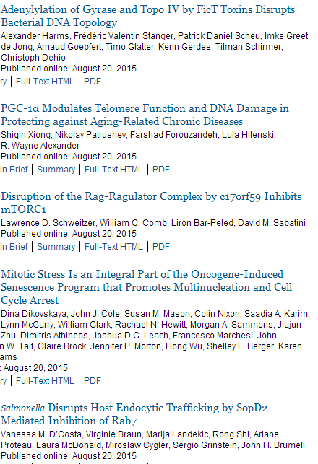
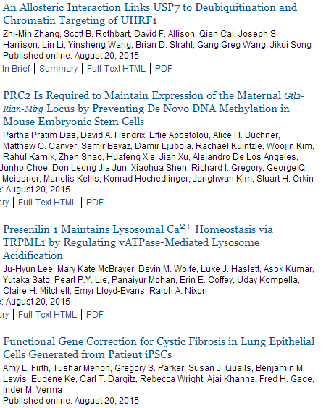

Slide 7
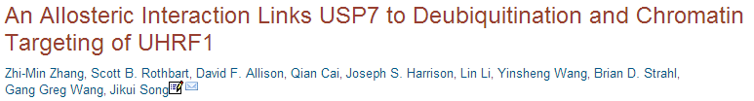
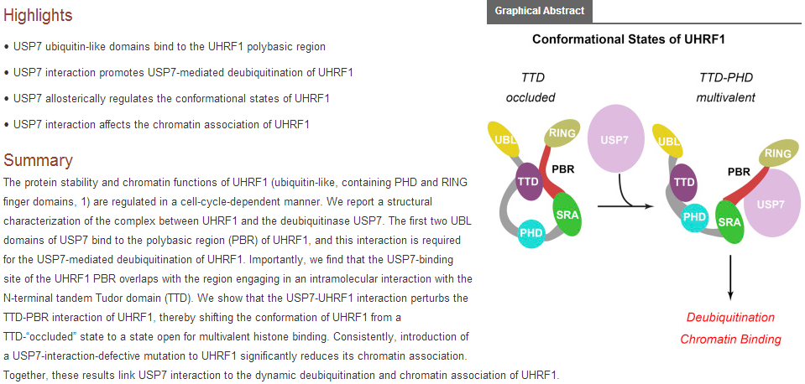

Slide 8

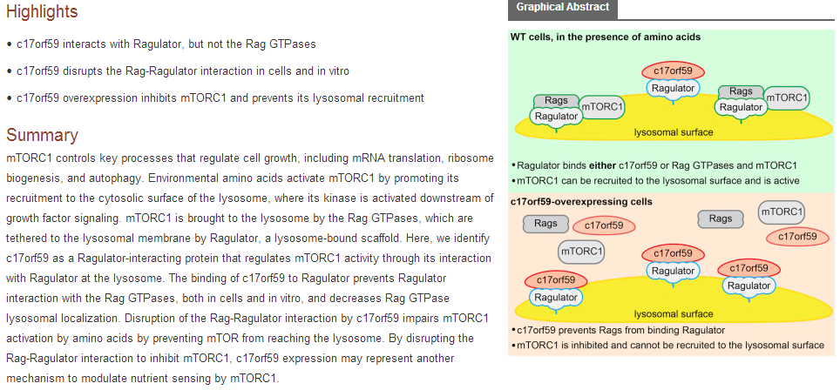

Slide 9

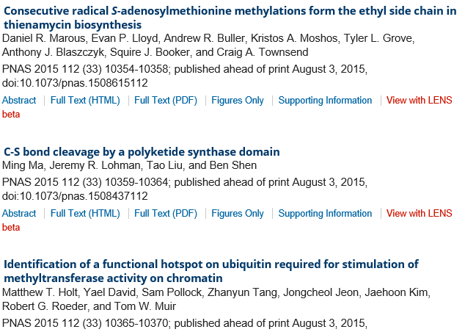
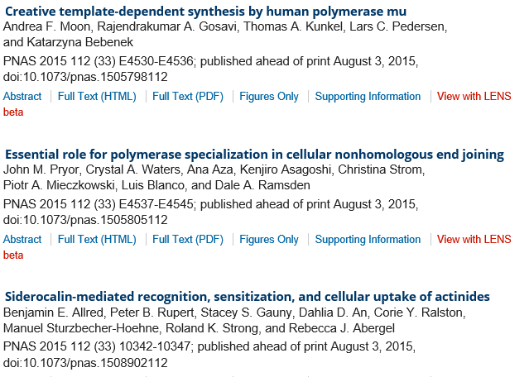
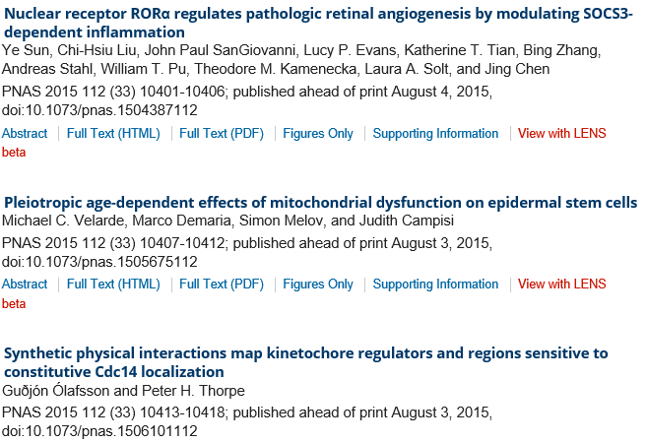
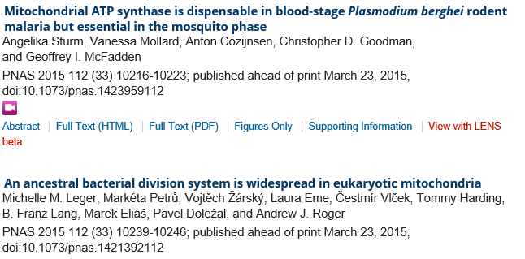

Slide 10
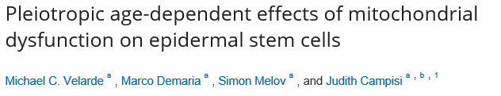
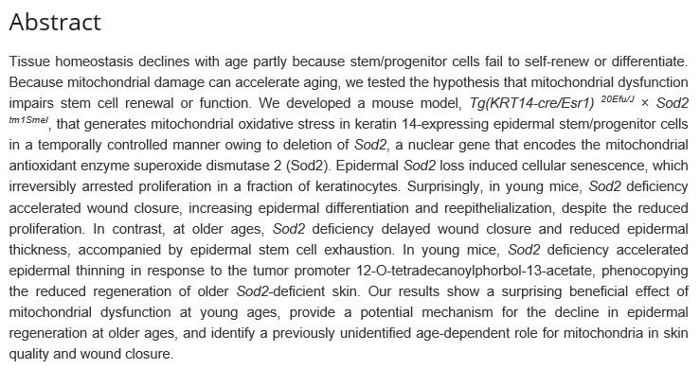

Slide 11

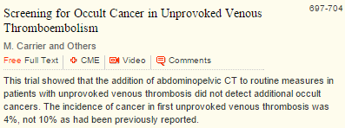
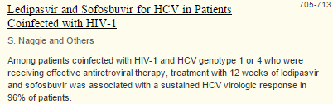
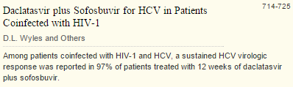
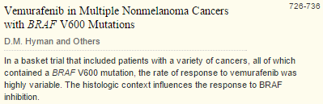
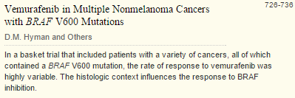

Slide 12

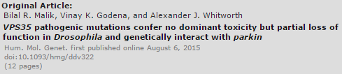
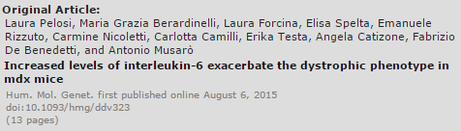
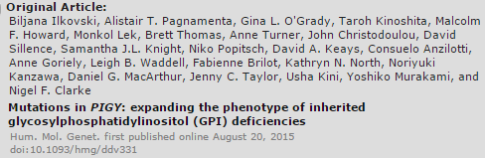
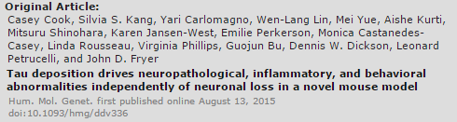
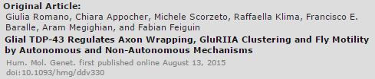

Slide 13
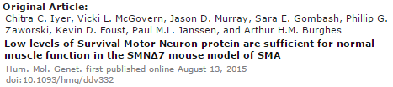
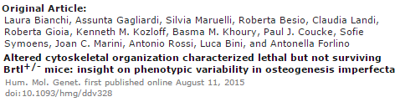
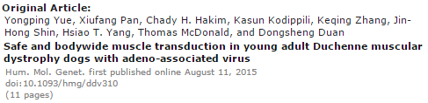
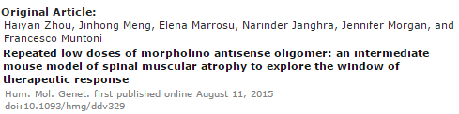
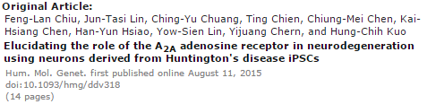
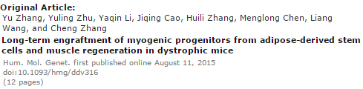

Slide 14

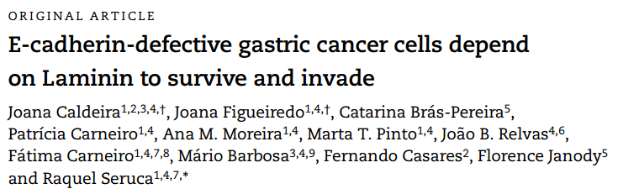
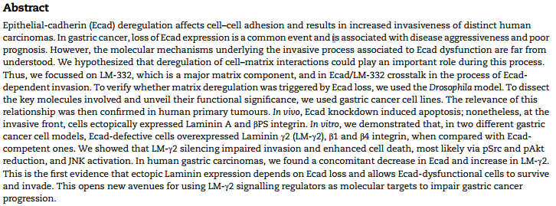
Notes:
These are the list of The NEW ENGLAND JOURNAR of MEDICINE, and Human Molecular Genetics. And I chose the 1paper.
The title is E-cadherin-defective gastric cancer cells depend on Laminin to survive and invade.
They showed that LM-γ2 silencing impaired invasion and enhanced cell death, most likely via pSrc and pAkt reduction, and JNK activation.

