Slide 1


Institute of Pathology, University of Munich, Munich, Germany
Abstract
Tumor cells are stressed by unfavorable environmental conditions like hypoxia or starvation. Driven by the resulting cellular stress tumor cells undergo epithelial-mesenchymal transition. Additionally, cellular stress is accompanied by endoplasmic reticulum-stress which induces an unfolded protein response. It is unknown if epithelial-mesenchymal transition and endoplasmic reticulum-stress are occurring as independent parallel events or if an interrelationship exists between both of them. Here, we show that in colorectal cancer cells endoplasmic reticulum-stress depends on the induction of ZEB-1, which is a main factor of epithelial-mesenchymal transition. In the absence of ZEB-1 colorectal cancer cells cannot mount endoplasmic reticulum-stress as a reaction on cellular stress situations like hypoxia or starvation. Thus, our data suggest that there is a hierarchy in the development of cellular stress which starts with the presence of environmental stress that induces epithelial-mesenchymal transition which allows finally endoplasmic reticulum-stress. This finding highlights the central role of epithelial-mesenchymal transition during the process of tumorigenesis as epithelial-mesenchymal transition is also associated with chemoresistance and cancer stemness. Consequently, endoplasmic reticulum-stress might be a well suited target for chemotherapy of colorectal cancers.

Slide 2
Galectin-1 in Early Acute Myocardial Infarction
Suhail Al-Salam, Satwat Hashmi
Rho1 GTPase and PKC Ortholog Pck1 Are Upstream Activators of the Cell Integrity MAPK Pathway in Fission Yeast
Laura Sánchez-Mir, Teresa Soto, [...], José Cansado
Evaluating the X Chromosome-Specific Diversity of Colombian Populations Using Insertion/Deletion Polymorphisms
Adriana Ibarra, Tomás Restrepo, [...], Leonor Gusmão
Global Gene Expression Analysis Reveals a Link between NDRG1 and Vesicle Transport
Hanne A. Askautrud, Elisabet Gjernes, [...], Eirik Frengen
Transcriptional Profiling of ParA and ParB Mutants in Actively Dividing Cells of an Opportunistic...
Aneta A. Bartosik, Krzysztof Glabski, [...], Grazyna Jagura-Burdzy
Fluphenazine Reduces Proteotoxicity in C. elegans and Mammalian Models of Alpha-1-Antitrypsin Deficiency
Jie Li, Stephen C. Pak, [...], David H. Perlmutter
Lysosome Transport as a Function of Lysosome Diameter
Debjyoti Bandyopadhyay, Austin Cyphersmith, [...], Christine K. Payne
Air Exposure Induced Characteristics of Dry Eye in Conjunctival Tissue Culture
Hui Lin, Yangluowa Qu, [...], Wei Li
Cell Surface Area and Membrane Folding in Glioblastoma Cell Lines Differing in PTEN and p53 Status
Simon Memmel, Vladimir L. Sukhorukov, [...], Cholpon S. Djuzenova
Epithelial-Mesenchymal Transition Induces Endoplasmic-Reticulum-Stress Response in Human Colorectal Tumor Cells
Evelyn Zeindl-Eberhart, Lydia Brandl, [...], Andreas Jung
Opposite Modulation of Brain Functional Networks Implicated at Low vs. High Demand of Attention and Working Memory
Jiansong Xu, Vince D. Calhoun, [...], Marc N. Potenza
New Insights into the In Silico Prediction of HIV Protease Resistance to Nelfinavir
Dinler A. Antunes, Maurício M. Rigo, [...], Gustavo F. Vieira
Enhanced HBsAg Synthesis Correlates with Increased Severity of Fibrosis in Chronic Hepatitis B Patients
Mei-Zhu Hong, Wen-Qi Huang, [...], Jin-Shui Pan
Diagnosis of Breast Masses from Dynamic Contrast-Enhanced and Diffusion-Weighted MR: A Machine Learning Approach
Hongmin Cai, Yanxia Peng, [...], Li Li
Using Highly Detailed Administrative Data to Predict Pneumonia Mortality
Michael B. Rothberg, Penelope S. Pekow, [...], Peter K. Lindenauer
Association of HLA-DPB1 with Scleroderma and Its Clinical Features in Chinese Population
Jiucun Wang, Xinjian Guo, [...], Xiaodong Zhou
β-Hairpin-Mediated Formation of Structurally Distinct Multimers of Neurotoxic Prion Peptides
Andrew C. Gill
Small Changes in Climate Can Profoundly Alter the Dynamics and Ecosystem Services of Tropical Crater Lakes
Émilie Saulnier-Talbot, Irene Gregory-Eaves, [...], Lauren J. Chapman
Sex Differences in Thermogenesis Structure Behavior and Contact within Huddles of Infant Mice
Christopher Harshaw, Jay J. Culligan, Jeffrey R. Alberts
Integrative Gene Network Construction to Analyze Cancer Recurrence Using Semi-Supervised Learning
Chihyun Park, Jaegyoon Ahn, [...], Sanghyun Park

Slide 3
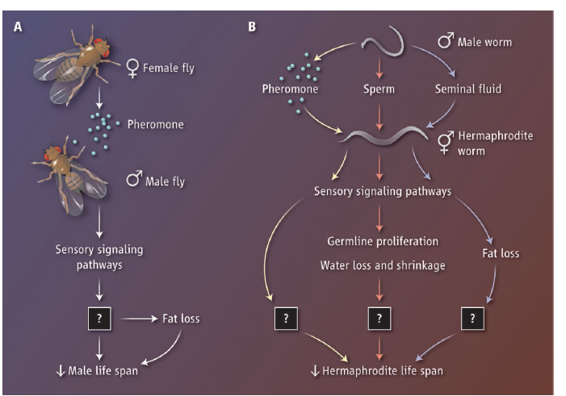
[Science] 31 JANUARY 2014 VOL 343, ISSUE 6170
Perspectives – DEVELOPMENT
Chemical Warfare in the Battle of the Sexes
Daniel E. L. Promislow and Matt Kaeberlein
Merely perceiving the opposite sex can shorten an animal's life span.
Mating Induces Shrinking and Death in Caenorhabditis Mothers
Cheng Shi and Coleen T. Murphy
Sperm and seminal fluid cause Caenorhabditis mothers to die shortly after they produce offspring.
Males Shorten the Life Span of C. elegans Hermaphrodites via Secreted Compounds
Travis J. Maures, Lauren N. Booth, Bérénice A. Benayoun, Yevgeniy Izrayelit, Frank C. Schroeder, and Anne Brunet
Male nematodes produce a soluble signal that shortens the life span of worms of the opposite sex.
Drosophila Life Span and Physiology Are Modulated by Sexual Perception and Reward
Christi M. Gendron, Tsung-Han Kuo, Zachary M. Harvanek, Brian Y. Chung, Joanne Y. Yew, Herman A. Dierick, and Scott D. Pletcher
Female pheromones are bad for male flies.
Mating and mortality.
(A) Female fruit flies can shorten the life span of males through a pheromone pathway and unknown downstream mechanisms.
(B) Signals from male worms can shorten the life span of
recipient hermaphroditic worms through various pathways that are not yet fully understood

Slide 4
[Science] 31 JANUARY 2014 VOL 343, ISSUE 6170
Perspectives-GENETICS
A Unified Process for Neurological Disease
Andrew B. Singleton
The discovery of mutations associated with disease pathogenesis does not have to rest solely on genetic evidence
Science. 2014 Jan 31;343(6170):506-11. doi: 10.1126/science.1247363.
Exome sequencing links corticospinal motor neuron disease to common neurodegenerative disorders.
Novarino G, Fenstermaker AG, Zaki MS, Hofree M, Silhavy JL, Heiberg AD, Abdellateef M, Rosti B, Scott E, Mansour L, Masri A, Kayserili H, Al-Aama JY,Abdel-Salam GM, Karminejad A, Kara M, Kara B, Bozorgmehri B, Ben-Omran T, Mojahedi F, Mahmoud IG, Bouslam N, Bouhouche A, Benomar A, Hanein S,Raymond L, Forlani S, Mascaro M, Selim L, Shehata N, Al-Allawi N, Bindu PS, Azam M, Gunel M, Caglayan A, Bilguvar K, Tolun A, Issa MY, Schroth J,Spencer EG, Rosti RO, Akizu N, Vaux KK, Johansen A, Koh AA, Megahed H, Durr A, Brice A, Stevanin G, Gabriel SB, Ideker T, Gleeson JG.
Howard Hughes Medical Institute, University of California, San Diego, La Jolla, CA 92093, USA.
Abstract
Hereditary spastic paraplegias (HSPs) are neurodegenerative motor neuron diseases characterized by progressive age-dependent loss ofcorticospinal motor tract function. Although the genetic basis is partly understood, only a fraction of cases can receive a genetic diagnosis, and a global view of HSP is lacking. By using whole-exome sequencing in combination with network analysis, we identified 18 previously unknown putative HSP genes and validated nearly all of these genes functionally or genetically. The pathways highlighted by these mutations link HSP to cellular transport, nucleotide metabolism, and synapse and axon development. Network analysis revealed a host of further candidate genes, of which three were mutated in our cohort. Our analysis links HSP to other neurodegenerative disorders and can facilitate gene discovery and mechanistic understanding of disease.

Slide 5
[Science] 31 JANUARY 2014 VOL 343, ISSUE 6170
Perspectives-PLANT SCIENCE
Delayed Gratification—Waiting to Terminate Stem Cell Identity
Xiaoyu Zhang
A cell-cycle timing mechanism in Arabidopsis is critical for flower development through the staggered expression of two transcription factors.
Science. 2014 Jan 31;343(6170):1248559. doi: 10.1126/science.1248559.
Timing mechanism dependent on cell division is invoked by Polycomb eviction in plant stem cells.
Sun B, Looi LS, Guo S, He Z, Gan ES, Huang J, Xu Y, Wee WY, Ito T.
Temasek Life Sciences Laboratory, 1 Research Link, National University of Singapore, Singapore 117604, Republic of Singapore.
Abstract
Plant floral stem cells divide a limited number of times before they stop and terminally differentiate, but the mechanisms that control this timingremain unclear. The precise temporal induction of the Arabidopsis zinc finger repressor KNUCKLES (KNU) is essential for the coordinated growth and differentiation of floral stem cells. We identify an epigenetic mechanism in which the floral homeotic protein AGAMOUS (AG) induces KNU at ~2 days of delay. AG binding sites colocalize with a Polycomb response element in the KNU upstream region. AG binding to the KNU promoter causes the eviction of the Polycomb group proteins from the locus, leading to cell division-dependent induction. These analyses demonstrate that floral stem cells measure developmental timing by a division-dependent epigenetic timer triggered by Polycomb eviction.

Slide 6
[Science] 31 JANUARY 2014 VOL 343, ISSUE 6170
Science. 2014 Jan 31;343(6170):533-6. doi: 10.1126/science.1247671.
Reversal of female infertility by Chk2 ablation reveals the oocyte DNA damage checkpoint pathway.
Bolcun-Filas E, Rinaldi VD, White ME, Schimenti JC.
Department of Biomedical Sciences, Cornell University, Ithaca, NY 14850, USA.
Abstract
Genetic errors in meiosis can lead to birth defects and spontaneous abortions. Checkpoint mechanisms of hitherto unknown nature eliminate oocytes with unrepaired DNA damage, causing recombination-defective mutant mice to be sterile. Here, we report that checkpoint kinase 2 (Chk2or Chek2), is essential for culling mouse oocytes bearing unrepaired meiotic or induced DNA double-strand breaks (DSBs). Female infertilitycaused by a meiotic recombination mutation or irradiation was reversed by mutation of Chk2. Both meiotically programmed and induced DSBs trigger CHK2-dependent activation of TRP53 (p53) and TRP63 (p63), effecting oocyte elimination. These data establish CHK2 as essential forDNA damage surveillance in female meiosis and indicate that the oocyte DSB damage response primarily involves a pathway hierarchy in which ataxia telangiectasia and Rad3-related (ATR) signals to CHK2, which then activates p53 and p63.
Science. 2014 Jan 31;343(6170):1239882. doi: 10.1126/science.1239882.
Development-inspired reprogramming of the mammalian central nervous system.
Amamoto R, Arlotta P.
Department of Stem Cell and Regenerative Biology, Sherman Fairchild Building, 7 Divinity Avenue, Harvard University, Cambridge, MA 02138, USA.
Abstract
In 2012, John Gurdon and Shinya Yamanaka shared the Nobel Prize for the demonstration that the identity of differentiated cells is not irreversibly determined but can be changed back to a pluripotent state under appropriate instructive signals. The principle that differentiated cells can revert to an embryonic state and even be converted directly from one cell type into another not only turns fundamental principles of development on their heads but also has profound implications for regenerative medicine. Replacement of diseased tissue with newly reprogrammed cells and modeling of human disease are concrete opportunities. Here, we focus on the central nervous system to consider whether and how reprogramming of cell identity may affect regeneration and modeling of a system historically considered immutable and hardwired.

Slide 7
[Science] 31 JANUARY 2014 VOL 343, ISSUE 6170
A Mechanosensory Pathway to the Drosophila Circadian Clock
Alekos Simoni, Werner Wolfgang, Matthew P. Topping, Ryan G. Kavlie, Ralf Stanewsky, and Joerg T. Albert
Flies use a mechanosensory organ to sense a low-frequency vibration and reset the brain’s biological clock.
Marine Tubeworm Metamorphosis Induced by Arrays of Bacterial Phage Tail–Like Structures
Nicholas J. Shikuma, Martin Pilhofer, Gregor L. Weiss, Michael G. Hadfield, Grant J. Jensen, and Dianne K. Newman
Benthic marine larval development is triggered by a bacterially expressed structure of phage origin.
Savanna Vegetation-Fire-Climate Relationships Differ Among Continents
Caroline E. R. Lehmann, T. Michael Anderson, Mahesh Sankaran, Steven I. Higgins, Sally Archibald, William A. Hoffmann,Niall P. anan, Richard J. Williams, Roderick J. Fensham, Jeanine Felfili, Lindsay B. Hutley, Jayashree Ratnam, Jose San Jose,Ruben ontes, Don Franklin, Jeremy Russell-Smith, Casey M. Ryan, Giselda Durigan, Pierre Hiernaux, Ricardo Haidar,David M. J. S. owman, and William J. Bond
Evolution cannot be overlooked when aiming to predict the potential global impacts on savanna dynamics in a warming world.
Effector Specialization in a Lineage of the Irish Potato Famine Pathogen
Suomeng Dong, Remco Stam, Liliana M. Cano, Jing Song, Jan Sklenar, Kentaro Yoshida, Tolga O. Bozkurt, Ricardo Oliva,Zhenyu iu, Miaoying Tian, Joe Win, Mark J. Banfield, Alexandra M. E. Jones, Renier A. L. van der Hoorn, and Sophien Kamoun
A potato pathogen has changed one of its protease inhibitors that targets its new host plant protease.

Slide 8
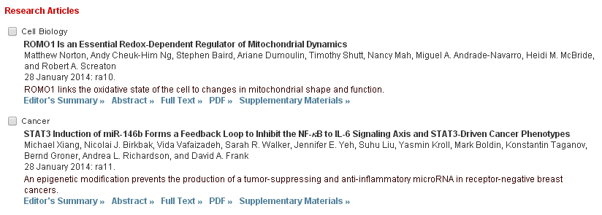
[Science Signaling] 28 JANUARY 2014 VOL 7, ISSUE 310

Slide 9
[Science Translational Medicine] 29 JANUARY 2014 VOL 6, ISSUE 221
Sci Transl Med. 2014 Jan 29;6(221):221ra15. doi: 10.1126/scitranslmed.3007653.
Antioxidants accelerate lung cancer progression in mice.
Sayin VI, Ibrahim MX, Larsson E, Nilsson JA, Lindahl P, Bergo MO.
Sahlgrenska Cancer Center, Department of Molecular and Clinical Medicine, Institute of Medicine, University of Gothenburg, SE-405 30 Gothenburg, Sweden.
Abstract
Antioxidants are widely used to protect cells from damage induced by reactive oxygen species (ROS). The concept that antioxidants can help fightcancer is deeply rooted in the general population, promoted by the food supplement industry, and supported by some scientific studies. However, clinical trials have reported inconsistent results. We show that supplementing the diet with the antioxidants N-acetylcysteine (NAC) and vitamin E markedly increases tumor progression and reduces survival in mouse models of B-RAF- and K-RAS-induced lung cancer. RNA sequencing revealed that NAC and vitamin E, which are structurally unrelated, produce highly coordinated changes in tumor transcriptome profiles, dominated by reduced expression of endogenous antioxidant genes. NAC and vitamin E increase tumor cell proliferation by reducing ROS, DNA damage, and p53 expression in mouse and human lung tumor cells. Inactivation of p53 increases tumor growth to a similar degree as antioxidants and abolishes the antioxidant effect. Thus, antioxidants accelerate tumor growth by disrupting the ROS-p53 axis. Because somatic mutations in p53 occur late in tumor progression, antioxidants may accelerate the growth of early tumors or precancerous lesions in high-risk populations such as smokers and patients with chronic obstructive pulmonary disease who receive NAC to relieve mucus production.

Slide 10
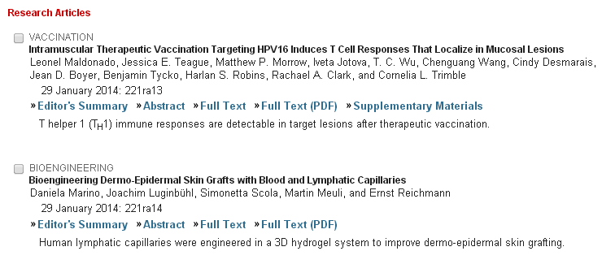
[Science Translational Medicine] 29 JANUARY 2014 VOL 6, ISSUE 221

Slide 11
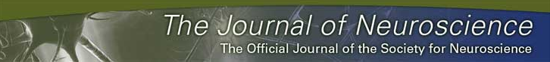
KJ
HSF1 Protects Neurons through a Novel Trimerization- and HSP-Independent Mechanism
Pragya Verma, Jason A. Pfister, Sathi Mallick, and Santosh R. D'Mello
Department of Molecular and Cell Biology, University of Texas at Dallas, Richardson, Texas
Abstract
Heat shock factor 1 (HSF1) protects neurons from death caused by the accumulation of misfolded proteins. It is believed that this protective effect is mediated by the transcriptional stimulation of genes encoding heat shock proteins (HSPs), a family of chaperones that refold or degrade misfolded proteins. Whether HSF1 is protective when neuronal death is not caused by protein misfolding has not been studied. Here, we report that HSF1 expression is necessary for the survival of rat neurons and that HSF1 mRNA and protein expression is reduced in neurons primed to die. Knock-down of HSF1 induces death of otherwise healthy neurons, whereas reestablishment of elevated levels of HSF1 protects neurons even when death is not due to accumulation of misfolded proteins. Neuroprotection by HSF1 does not require its trimerization, an event obligatory for the binding of HSF1 to heat shock elements within HSP gene promoters. Moreover, knock-down of HSP70 or blockade of HSP90 signaling does not reduce neuroprotection by HSF1. Although several neuroprotective molecules and signaling pathways, including CaMK, PKA, Casein kinase-II, and the Raf-MEK-ERK and PI-3K-Akt pathways, are not required for HSF1-mediated neuroprotection, protection is abrogated by inhibition of classical histone deacetylases (HDACs). We report that the novel mechanism of neuroprotection by HSF1 involves cooperation with SIRT1, an HDAC with well documented neuroprotective effects. Using a cell culture model of Huntington's disease, we show that HSF1 trimerization is not required for protection against mutant huntingtin-induced neurotoxicity, suggesting that HSF1 can protect neurons against both proteinopathic and nonproteinopathic death through a noncanonical pathway.

Slide 12

KJ

Slide 13

KJ

Slide 14

KJ

Slide 15

KJ

