Slide 1
[Science] 7 FEBRUARY 2014 VOL 343, ISSUE 6171,
Perspectives – NEUROSCIENCE
Could Autism Be Treated Prenatally?
Andrew W. Zimmerman and Susan L. Connors
Treatment of rodent models of autism spectrum disorder with a drug that alters the function of a neurotransmitter ameliorates autistic-like behavior in offspring.
Oxytocin-Mediated GABA Inhibition During Delivery Attenuates Autism Pathogenesis in Rodent Offspring
Roman Tyzio, Romain Nardou, Diana C. Ferrari, Timur Tsintsadze, Amene Shahrokhi, Sanaz Eftekhari, Ilgam Khalilov,
Vera Tsintsadze, Corinne Brouchoud, Genevieve Chazal, Eric Lemonnier, Natalia Lozovaya, Nail Burnashev,
and Yehezkel Ben-Ari
Maternal administration of bumetanide before delivery reduces the autistic phenotype in rodent models of autism.
Perspectives – EVOLUTION
There Can Be Only One
Jeffery D. Kovach and Rebecca S. Lamb
How can a single-copy transcription factor evolve new DNA binding specificities without loss of function?
A Promiscuous Intermediate Underlies the Evolution of LEAFY DNA Binding Specificity
Camille Sayou, Marie Monniaux, Max H. Nanao, Edwige Moyroud, Samuel F. Brockington, Emmanuel Thévenon, Hicham Chahtane, Norman Warthmann, Michael Melkonian, Yong Zhang, Gane Ka-Shu Wong, Detlef Weigel, François Parcy,
and Renaud Dumas
Comparative and structural studies reveal how an essential plant transcription factor evolved different specificities.
Perspectives – CELL BIOLOGY
Cells Listen to Their Inner Voice
Anna Jisu Lee and Lingchong You
A signaling circuit that controls the release and detection of the same signaling molecule can trigger diverse behaviors in a cell population.
Secreting and Sensing the Same Molecule Allows Cells to Achieve Versatile Social Behaviors
Hyun Youk and Wendell A. Lim
The etiquette of yeast cells that secrete signals that influence themselves and their neighbors is explored.

Slide 2
[Science] 7 FEBRUARY 2014 VOL 343, ISSUE 6171,
PCP and Septins Compartmentalize Cortical Actomyosin to Direct Collective Cell Movement
Asako Shindo and John B. Wallingford
Science 7 February 2014: 649-652.
A mechanism is revealed for orchestrated cell movement during gastrulation in Xenopus.
Distribution of ESCRT Machinery at HIV Assembly Sites Reveals Virus Scaffolding of ESCRT Subunits
Schuyler B. Van Engelenburg, Gleb Shtengel, Prabuddha Sengupta, Kayoko Waki, Michal Jarnik, Sherimay D. Ablan,
Eric O. Freed,Harald F. Hess, and Jennifer Lippincott-Schwartz
Science 7 February 2014: 653-656.
ESCRT-III proteins scaffold within assembling HIV particles to mediate viral membrane abscission.
A Structurally Distinct Human Mycoplasma Protein that Generically Blocks Antigen-Antibody Union
Rajesh K. Grover, Xueyong Zhu, Travis Nieusma, Teresa Jones, Isabel Boero, Amanda S. MacLeod, Adam Mark, Sherry Niessen,
Helen J. Kim, Leopold Kong, Nacyra Assad-Garcia, Keehwan Kwon, Marta Chesi, Vaughn V. Smider, Daniel R. Salomon, Diane F. Jelinek, Robert A. Kyle, Richard B. Pyles, John I. Glass, Andrew B. Ward, Ian A. Wilson, and Richard A. Lerner
Science 7 February 2014: 656-661.
High-affinity binding of Protein M to a very broad range of human antibodies may find widespread immunochemical applications.
Interchromosomal Communication Coordinates Intrinsically Stochastic Expression Between Alleles
Robert J. Johnston Jr. and Claude Desplan
Science 7 February 2014: 661-665.
A stochastic, cell-autonomous decision to express a particular transcription factor is nevertheless coordinated.
Loose Coupling Between Ca²⁺ Channels and Release Sensors at a Plastic Hippocampal Synapse
Nicholas P. Vyleta and Peter Jonas
Science 7 February 2014: 665-670.
The mossy fiber to the CA3 synapse operates via loose calcium microdomains established by local calcium buffering.
Local Impermeant Anions Establish the Neuronal Chloride Concentration
J. Glykys, V. Dzhala, K. Egawa, T Balena, Y. Saponjian, K. V. Kuchibhotla, B. J. Bacskai, K. T. Kahle, T. Zeuthen, and K. J. Staley
Science 7 February 2014: 670-675.
Imaging of a fluorescent chloride indicator reveals a role for impermeant anions in setting intraneuronal chloride levels.

Slide 3
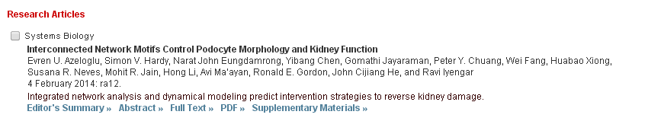
[Science Signaling] 4 FEBRUARY 2014 VOL 7, ISSUE 311
Sci Signal. 2014 Feb 4;7(311):ra13. doi: 10.1126/scisignal.2004557.
Noncanonical NF-κB Signaling Is Limited by Classical NF-κB Activity.
Gray CM, Remouchamps C, McCorkell KA, Solt LA, Dejardin E, Orange JS, May MJ.
Author information
Abstract
Precise regulation of nuclear factor κB (NF-κB) signaling is crucial for normal immune responses, and defective NF-κB activity underlies a range of immunodeficiencies. NF-κB is activated through two signaling cascades: the classical and noncanonical pathways. The classical pathway requires inhibitor of κB kinase β (IKKβ) and NF-κB essential modulator (NEMO), and hypomorphic mutations in the gene encoding NEMO (ikbkg) lead to inherited immunodeficiencies, collectively termed NEMO-ID. Noncanonical NF-κB activation requires NF-κB-inducing kinase (NIK) and IKKα, but not NEMO. We found that noncanonical NF-κB was basally active in peripheral blood mononuclear cells from NEMO-ID patients and that noncanonical NF-κB signaling was similarly enhanced in cell lines lacking functional NEMO. NIK, which normally undergoes constitutive degradation, was aberrantly present in resting NEMO-deficient cells, and regulation of its abundance was rescued by reconstitution with full-length NEMO, but not a mutant NEMO protein unable to physically associate with IKKα or IKKβ. Binding of NEMO to IKKα was not required for ligand-dependent stabilization of NIK or noncanonical NF-κB signaling. Rather, an intact and functional IKK complex was essential to suppress basal NIK activity in unstimulated cells. Despite interacting with IKKα and IKKβ to form an IKK complex, NEMO mutants associated with immunodeficiency failed to rescue classical NF-κB signaling or reverse the accumulation of NIK. Together, these findings identify a crucial role for classical NF-κB activity in the suppression of basal noncanonical NF-κB signaling.

Slide 4
[Science Translational Medicine] 5 FEBRUARY 2014 VOL 6, ISSUE 222
Research Articles
ENDOMETRIOSIS
Molecular Network Analysis of Endometriosis Reveals a Role for c-Jun–Regulated Macrophage Activation
Michael T. Beste, Nicole Pfäffle-Doyle, Emily A. Prentice, Stephanie N. Morris, Douglas A. Lauffenburger,
Keith B. Isaacson, and Linda G. Griffith
The molecular correlates of heterogeneous endometriosis symptoms support a role for innate inflammatory responses converging upon c-Jun and NFκB signaling cascades.
CARDIOVASCULAR DISEASE
A Factor XIIa Inhibitory Antibody Provides Thromboprotection in Extracorporeal Circulation Without Increasing Bleeding Risk
Magnus Larsson, Veronika Rayzman, Marc W. Nolte, Katrin F. Nickel, Jenny Björkqvist, Anne Jämsä, Matthew P. Hardy,Marion Fries, Stefan Schmidbauer, Patricia Hedenqvist, Michael Broomé, Ingo Pragst, Gerhard Dickneite, Michael J. Wilson,Andrew D. Nash, Con Panousis, and Thomas Renné
Blocking the enzyme that initiates the intrinsic coagulation pathway protects against thrombosis in bypass systems and does not cause excess bleeding in vivo.
CANCER
High-Dose Parenteral Ascorbate Enhanced Chemosensitivity of Ovarian Cancer and Reduced Toxicity of Chemotherapy
Yan Ma, Julia Chapman, Mark Levine, Kishore Polireddy, Jeanne Drisko, and Qi Chen5
Pharmacological use of ascorbate (vitamin C) enhanced chemosensitivity of ovarian cancer in preclinical models and reduced chemotherapy-associated toxicity in patients.
BIOENGINEERING
Restoring Natural Sensory Feedback in Real-Time Bidirectional Hand Prostheses
Stanisa Raspopovic, Marco Capogrosso, Francesco Maria Petrini, Marco Bonizzato, Jacopo Rigosa, Giovanni Di Pino,Jacopo arpaneto, Marco Controzzi, Tim Boretius, Eduardo Fernandez, Giuseppe Granata, Calogero Maria Oddo, Luca Citi,
Anna Lisa Ciancio, Christian Cipriani, Maria Chiara Carrozza, Winnie Jensen, Eugenio Guglielmelli, Thomas Stieglitz,
Paolo Maria Rossini, and Silvestro Micera
A multigrasp, bidirectional hand prosthesis delivers dynamic sensory feedback, allowing a user with a hand amputation to achieve fine grasping force control and realistic object sensing.

Slide 5
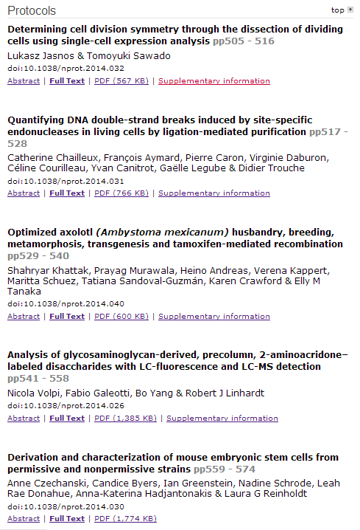

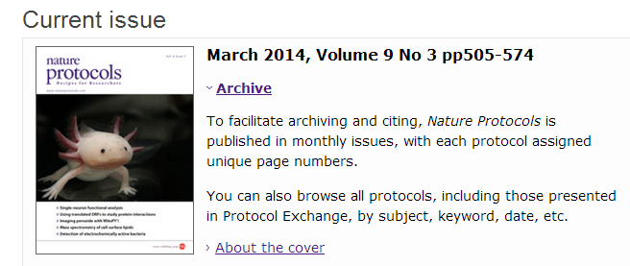

Slide 6
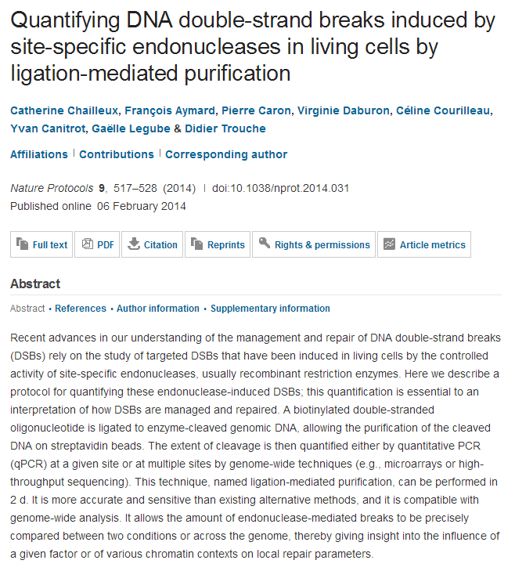

Slide 7
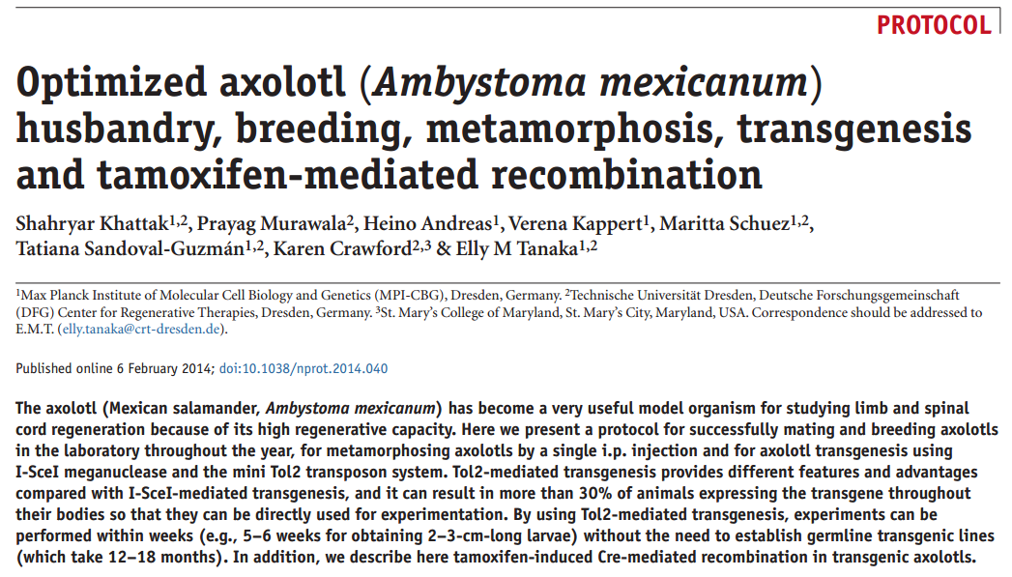
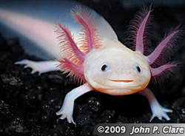

Slide 8
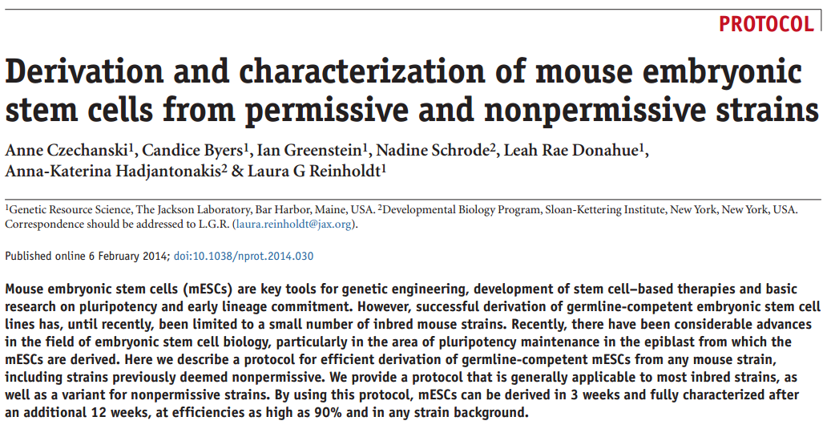
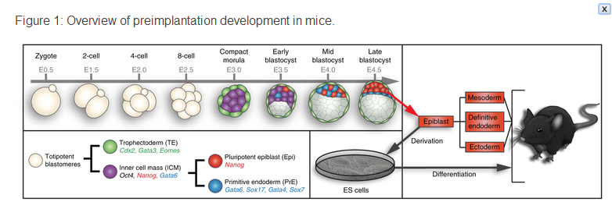

Slide 9
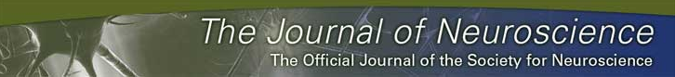
KJ
In vivo Activation of Wnt Signaling Pathway Enhances Cognitive Function of Adult Mice and Reverses Cognitive Deficits in an Alzheimer's Disease Model
Jessica Y. Vargas1, Marco Fuenzalida2, and Nibaldo C. Inestrosa1
1Centro de Envejecimiento y Regeneración, Departamento de Biología Celular y Molecular, Facultad de Ciencias Biológicas, Pontificia Universidad Católica de Chile, Santiago 8331150, Chile, and
2Centro de Neurobiología y Plasticidad Cerebral, Departamento de Fisiología, Facultad de Ciencias, Universidad de Valparaíso, Valparaíso 2360102, Chile
Abstract
The role of the Wnt signaling pathway during synaptic development has been well established. In the adult brain, different components of Wnt signaling are expressed, but little is known about its role in mature synapses. Emerging in vitro studies have implicated Wnt signaling in synaptic plasticity. Furthermore, activation of Wnt signaling has shown to protect against amyloid-β-induced synaptic impairment. The present study provides the first evidence that in vivo activation of Wnt signaling improves episodic memory, increases excitatory synaptic transmission, and enhances long-term potentiation in adult wild-type mice. Moreover, the activation of Wnt signaling also rescues memory loss and improves synaptic dysfunction in APP/PS1-transgenic mice that model the amyloid pathology of Alzheimer's diseases. These findings indicate that Wnt signaling modulates cognitive function in the adult brain and could be a novel promising target for Alzheimer's disease therapy.

Slide 10

KJ

Slide 11

KJ

Slide 12
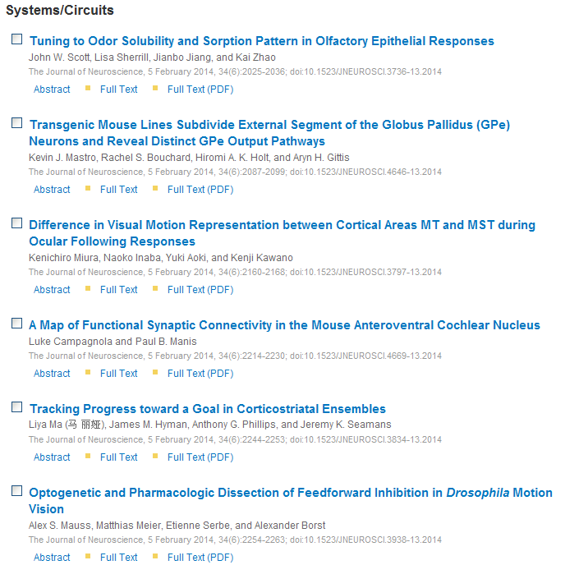
KJ

Slide 13

KJ

Slide 14

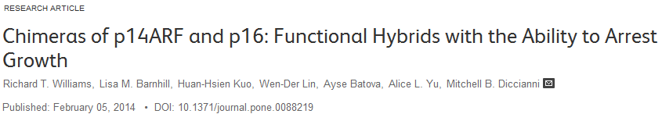
Affiliation: Department of Pediatric Hematology/Oncology, University of California San Diego, San Diego, California, United States of America
Abstract
The INK4A locus codes for two independent tumor suppressors, p14ARF and p16/CDKN2A, and is frequently mutated in many cancers. Here we report a novel deletion/substitution from CC to T in the shared exon 2 of p14ARF/p16 in a melanoma cell line. This mutation aligns the reading frames of p14ARF and p16 mid-transcript, producing one protein which is half p14ARF and half p16, chimera ARF (chARF), and another which is half p16 and half non-p14ARF/non-p16 amino acids, p16-Alternate Carboxyl Terminal (p16-ACT). In an effort to understand the cellular impact of this novel mutation and others like it, we expressed the two protein products in a tumor cell line and analyzed common p14ARF and p16 pathways, including the p53/p21 and CDK4/cyclin D1 pathways, as well as the influence of the two proteins on growth and the cell cycle. We report that chARF mimicked wild-type p14ARF by inducing the p53/p21 pathway, inhibiting cell growth through G2/M arrest and maintaining a certain percentage of cells in G1 during nocodazole-induced G2 arrest. chARF also demonstrated p16 activity by binding CDK4. However, rather than preventing cyclin D1 from binding CDK4, chARF stabilized this interaction through p21 which bound CDK4. p16-ACT had no p16-related function as it was unable to inhibit cyclin D1/CDK4 complex formation and was unable to arrest the cell cycle, though it did inhibit colony formation. We conclude that these novel chimeric proteins, which are very similar to predicted p16/p14ARF chimeric proteins found in other primary cancers, result in maintained p14ARF-p53-p21 signaling while p16-dependent CDK4 inhibition is lost

Slide 15
Disease and Predation: Sorting out Causes of a Bighorn Sheep (Ovis canadensis) Decline
Joshua B. Smith, Jonathan A. Jenks, [...], Robert W. Klaver
Exploring the Use of Sensors to Measure Behavioral Interactions: An Experimental Evaluation of Using Hand Trajectories
Jeroen H. M. Bergmann, Patrick M. Langdon, [...], Newton Howard
DISC1 (Disrupted-in-Schizophrenia-1) Regulates Differentiation of Oligodendrocytes
Tsuyoshi Hattori, Shoko Shimizu, [...], Akira Ito
Comparative Variation within the Genome of Campylobacter jejuni NCTC 11168 in Human and Murine Hosts
Dallas K. Thomas, Abdul G. Lone, [...], G. Douglas Inglis
Structural Properties of Prokaryotic Promoter Regions Correlate with Functional Features
Pieter Meysman, Julio Collado-Vides, [...], Kris Laukens
Significant Improvement of Thermal Stability for CeZrPrNd Oxides Simply by Supercritical CO₂ Drying
Yunzhao Fan, Zizi Wang, [...], Yingxia Wang
Short Term Effects of Particle Exposure on Hospital Admissions in the Mid-Atlantic States: A Population Estimate
Itai Kloog, Francesco Nordio, [...], Joel D. Schwartz
Initial Effects of the National PCV7 Childhood Immunization Program on Adult Invasive Pneumococcal Disease in Israel
Gili Regev-Yochay, Galia Rahav, [...], for the IAIPD study group
Significant Improvement of Thermal Stability for CeZrPrNd Oxides Simply by Supercritical CO₂ Drying
Yunzhao Fan, Zizi Wang, [...], Yingxia Wang
Immunohistochemical Localization of Key Arachidonic Acid Metabolism Enzymes during Fracture Healing in Mice
Hsuan-Ni Lin, J. Patrick O’Connor
Initial Effects of the National PCV7 Childhood Immunization Program on Adult Invasive Pneumococcal Disease in Israel
Gili Regev-Yochay, Galia Rahav, [...], for the IAIPD study group
No Major Role for Insulin-Degrading Enzyme in Antigen Presentation by MHC Molecules
Slobodan Culina, François-Xavier Mauvais, [...], Peter van Endert
Immunohistochemical Localization of Key Arachidonic Acid Metabolism Enzymes during Fracture Healing in Mice
Hsuan-Ni Lin, J. Patrick O’Connor
A Gene Expression and Pre-mRNA Splicing Signature That Marks the Adenoma-Adenocarcinoma Progression in Colorectal Cancer
Marine Pesson, Alain Volant, [...], Laurent Corcos
Id Proteins Regulate Capillary Repair and Perivascular Cell Proliferation following Ischemia-Reperfusion Injury
David Lee, Shantheri Shenoy, [...], Matt Plotkin
Discriminant Features and Temporal Structure of Nonmanuals in American Sign Language
C. Fabian Benitez-Quiroz, Kadir Gökgöz, [...], Aleix M. Martinez
Using the PfEMP1 Head Structure Binding Motif to Deal a Blow at Severe Malaria
Manuel E. Patarroyo, Martha Patricia Alba, [...], Manuel A. Patarroyo
Genomic Plasticity Enables Phenotypic Variation of Pseudomonas syringae pv. tomato DC3000
Zhongmeng Bao, Paul V. Stodghill, [...], Bryan Swingle
Structural Properties of Prokaryotic Promoter Regions Correlate with Functional Features
Pieter Meysman, Julio Collado-Vides, [...], Kris Laukens
HIV-1 Coinfection Profoundly Alters Intrahepatic Chemokine but Not Inflammatory Cytokine Profiles in HCV-Infected...
Sishun Hu, Marwan Ghabril, [...], Qigui Yu

