Slide 1
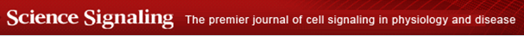
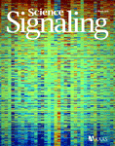
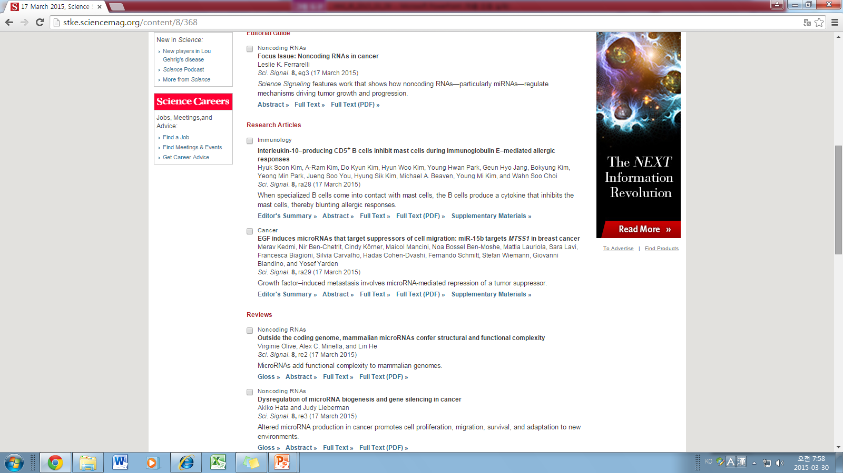

Slide 2
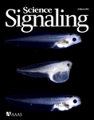
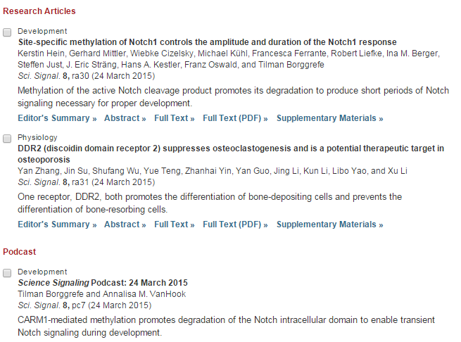

Slide 3
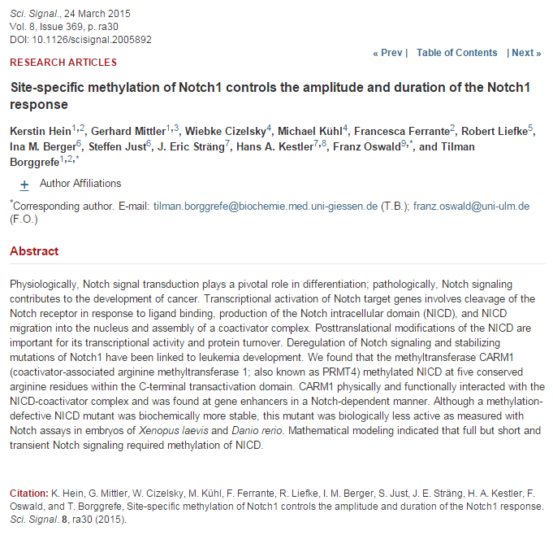

Slide 4

KJ
Spring-loaded unraveling of a single SNARE complex by NSF in one round of ATP turnover
Je-Kyung Ryu1,2,*, Duyoung Min1,2,*, Sang-Hyun Rah1,2,*, Soo Jin Kim3, Yongsoo Park4, Haesoo Kim3, Changbong Hyeon5, Ho Min Kim3, Reinhard Jahn4,†, Tae-Young Yoon1,2,
1National Creative Research Initiative Center for Single-Molecule Systems Biology, Korea Advanced Institute of Science and Technology (KAIST), Daejeon 305-701, South Korea.
2Department of Physics, KAIST, Daejeon 305-701, South Korea.
3Graduate School of Medical Science and Engineering, KAIST, Daejeon 305-701, South Korea.
4Department of Neurobiology, Max-Planck-Institute for Biophysical Chemistry, 37077 Göttingen, Germany.
5Korea Institute for Advanced Study, Seoul 130-722, South Korea.
Abstract
During intracellular membrane trafficking, N-ethylmaleimide-sensitive factor (NSF) and alpha-soluble NSF attachment protein (α-SNAP) disassemble the soluble NSF attachment protein receptor (SNARE) complex for recycling of the SNARE proteins. The molecular mechanism by which NSF disassembles the SNARE complex is largely unknown. Using single-molecule fluorescence spectroscopy and magnetic tweezers, we found that NSF disassembled a single SNARE complex in only one round of adenosine triphosphate (ATP) turnover. Upon ATP cleavage, the NSF hexamer developed internal tension with dissociation of phosphate ions. After latent time measuring tens of seconds, NSF released the built-up tension in a burst within 20 milliseconds, resulting in disassembly followed by immediate release of the SNARE proteins. Thus, NSF appears to use a “spring-loaded” mechanism to couple ATP hydrolysis and unfolding of substrate proteins.

Slide 5
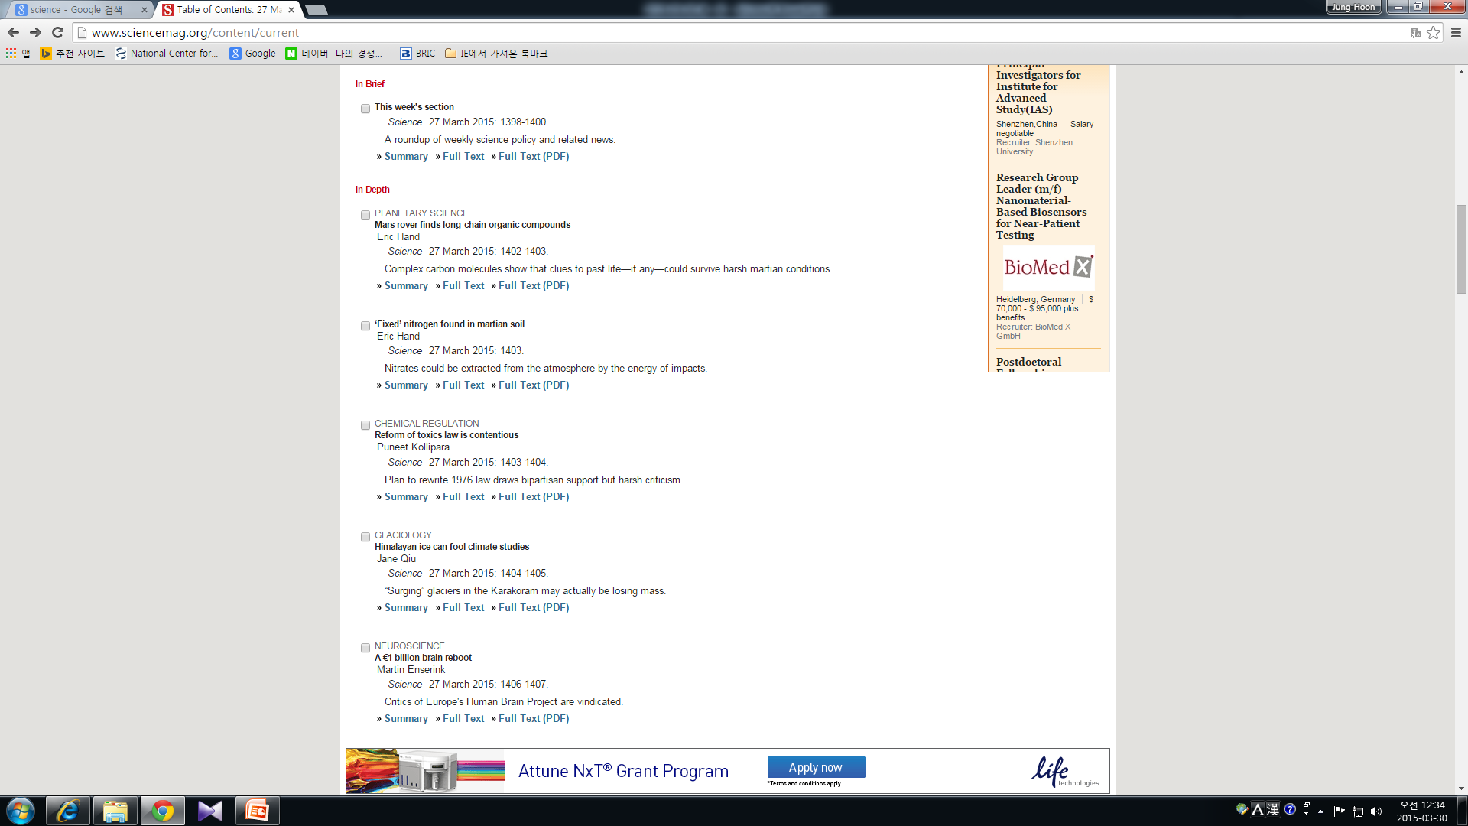
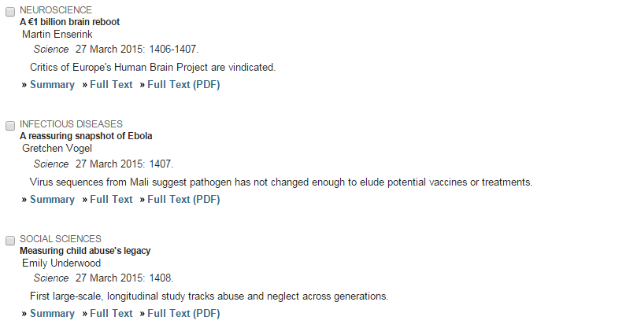
KJ

Slide 6
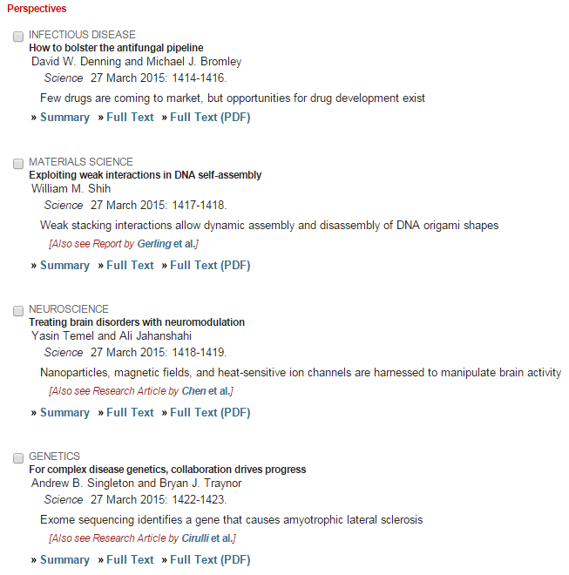
KJ

Slide 7
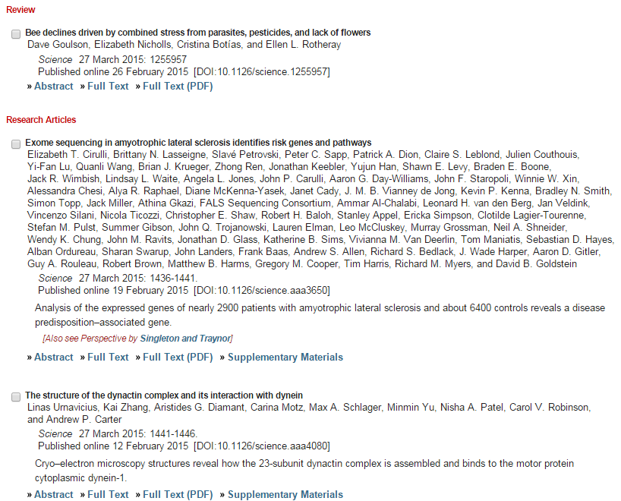
KJ

Slide 8
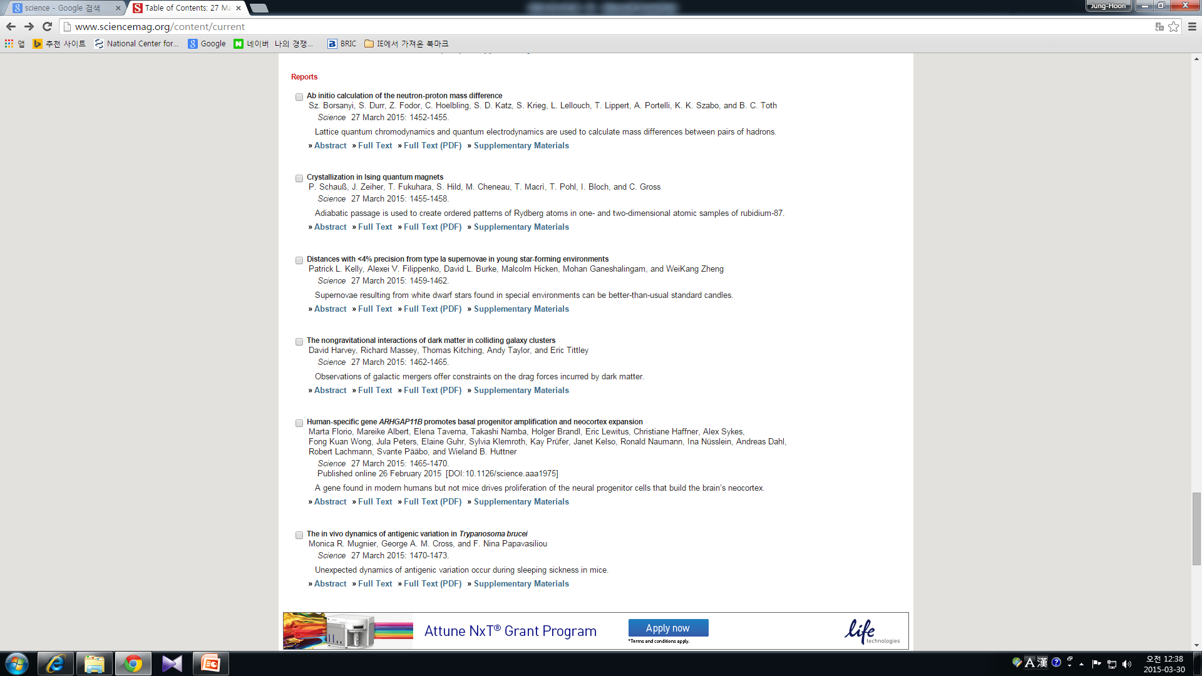
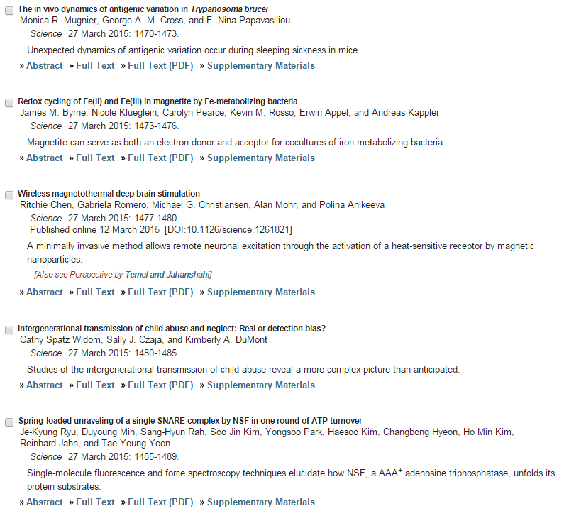
KJ

