Slide 1
[Science] Special Issue | 29 March 2013 Cancer Genomics
<Introduction>
A Medical Renaissance?
Laura M. Zahn and John Travis
With the completion of the human genome in 2001, many researchers immediately set their sights on using this information to better understand the genetics and, more recently, epigenetic effects identified during the initiation, development, and progression of cancer. Moving from the pre–genome-era identification of single gene variants associated with hereditary cancers, advances in sequencing technology have enabled the use of a whole-genome approach to examine the differences between the genomes, and epigenetic regulation, of tumor and patient DNA. This issue of Science examines how these advances are shaping our current understanding of cancer at the genomic level.
<News>
Steering Cancer Genomics Into the Fast Lane
Elizabeth Pennisi
With her passion for DNA sequencing technology, Elaine Mardis now hopes to help cancer patients.
The Downside of Diversity
Jocelyn Kaiser
Increasing genetic evidence that tumors contain a heterogeneous mix of cells may explain why cancer treatments often fail.
<Reviews>
Cancer Genome Landscapes
Bert Vogelstein, Nickolas Papadopoulos, Victor E. Velculescu, Shibin Zhou, Luis A. Diaz Jr., and Kenneth W. Kinzler
Diagnostic Cancer Genome Sequencing and the Contribution of Germline Variants
O. Kilpivaara and L. A. Aaltonen
Cancer Pharmacogenomics: Early Promise, But Concerted Effort Needed
Howard L. McLeod
Epigenetic Reprogramming in Cancer
Mario L. Suvà, Nicolo Riggi, and Bradley E. Bernstein Podcast Interview

Slide 2
[Science] 29 March 2013 vol 339, issue 6127, pages 1477-1648
Perspectives-Biochemistry
A Protease for the Ages
Susan Michaelis and Christine A. Hrycyna
Science 29 March 2013: 1529-1530.[DOI:10.1126/science.1236764]
Structures of membrane metalloproteases provide the basis for understanding mutations associated with premature aging.
Structure of the Integral Membrane Protein CAAX Protease Ste24p
Edward E. Pryor Jr., Peter S. Horanyi, Kathleen M. Clark, Nadia Fedoriw, Sara M. Connelly, Mary Koszelak-Rosenblum, Guangyu Zhu,
Michael G. Malkowski, Michael C. Wiener, and Mark E. Dumont
Science 29 March 2013: 1600-1604.[DOI:10.1126/science.1232048]
Structures of two transmembrane zinc proteases reveal a barrel of seven helices surrounding a large cavity
The Structural Basis of ZMPSTE24-Dependent Laminopathies
Andrew Quigley, Yin Yao Dong, Ashley C. W. Pike, Liang Dong, Leela Shrestha, Georgina Berridge, Phillip J. Stansfeld, Mark S. P. Sansom,
Aled M. Edwards, Chas Bountra, Frank von Delft, Alex N. Bullock, Nicola A. Burgess-Brown, and Elisabeth P. Carpenter
Science 29 March 2013: 1604-1607.[DOI:10.1126/science.1231513]
Structures of two transmembrane zinc proteases reveal a barrel of seven helices surrounding a large cavity.
Science. 2013 Mar 29;339(6127):1621-5. doi: 10.1126/science.1231677. Epub 2013 Feb 7.
(R)-2-hydroxyglutarate is sufficient to promote leukemogenesis and its effects are reversible.
Losman JA, Looper RE, Koivunen P, Lee S, Schneider RK, McMahon C, Cowley GS, Root DE, Ebert BL, Kaelin WG Jr.
Department of Medical Oncology, Dana-Farber Cancer Institute, Boston, MA 02215, USA.
Mutations in IDH1 and IDH2, the genes coding for isocitrate dehydrogenases 1 and 2, are common in several human cancers, including leukemias, and result in overproduction of the (R)-enantiomer of 2-hydroxyglutarate [(R)-2HG]. Elucidation of the role of IDH mutations and (R)-2HG in leukemogenesis has been hampered by a lack of appropriate cell-based models. Here, we show that a canonical IDH1 mutant, IDH1 R132H, promotes cytokine independence and blocks differentiation in hematopoietic cells. These effects can be recapitulated by (R)-2HG, but not (S)-2HG, despite the fact that (S)-2HG more potently inhibits enzymes, such as the 5'-methylcytosine hydroxylase TET2, that have previously been linked to the pathogenesis of IDH mutant tumors. We provide evidence that this paradox relates to the ability of (S)-2HG, but not (R)-2HG, to inhibit the EglN prolyl hydroxylases. Additionally, we show that transformation by (R)-2HG is reversible.

Slide 3
[Science] 29 March 2013 vol 339, issue 6127, pages 1477-1648
Roots and Associated Fungi Drive Long-Term Carbon Sequestration in Boreal Forest
K. E. Clemmensen, A. Bahr, O. Ovaskainen, A. Dahlberg, A. Ekblad, H. Wallander, J. Stenlid, R. D. Finlay, D. A. Wardle, and B. D. Lindahl
Science 29 March 2013: 1615-1618.[DOI:10.1126/science.1231923]
Reservoirs of carbon in boreal forest soils are revisited in an island chronosequence, using modeling and molecular approaches.
The Biological Underpinnings of Namib Desert Fairy Circles
Norbert Juergens
Science 29 March 2013: 1618-1621.[DOI:10.1126/science.1222999]
Termites alter local soil conditions to facilitate the growth of grasses, generating patterns in the desert.
ESCRT-III Assembly and Cytokinetic Abscission Are Induced by Tension Release in the Intercellular Bridge
Julie Lafaurie-Janvore, Paolo Maiuri, Irène Wang, Mathieu Pinot, Jean-Baptiste Manneville, Timo Betz, Martial Balland, and Matthieu Piel
Science 29 March 2013: 1625-1629.[DOI:10.1126/science.1233866]
When a daughter cell lets go, the mother cell cuts it loose.

Slide 4
[Science Sig] 26 March 2013 Vol 6, Issue 268
Sci Signal. 2013 Mar 26;6(268):ra20. doi: 10.1126/scisignal.2003483.
PUMA and BIM Are Required for Oncogene Inactivation-Induced Apoptosis.
Bean GR, Ganesan YT, Dong Y, Takeda S, Liu H, Chan PM, Huang Y, Chodosh LA, Zambetti GP, Hsieh JJ, Cheng EH.
1Human Oncology and Pathogenesis Program, Memorial Sloan-Kettering Cancer Center, New York, NY 10065, USA.
Abstract
The clinical efficacy of tyrosine kinase inhibitors supports the dependence of distinct subsets of cancers on specific driver mutations for survival, a phenomenon called "oncogene addiction." We demonstrate that PUMA and BIM are the key apoptotic effectors of tyrosine kinase inhibitors in breast cancers with amplification of the gene encoding human epidermal growth factor receptor 2 (HER2) and lung cancers with epidermal growth factor receptor (EGFR) mutants. The BH3 domain containing proteins BIM and PUMA can directly activate the proapoptotic proteins BAX and BAK to permeabilize mitochondria, leading to caspase activation and apoptosis. We delineated the signal transduction pathways leading to the induction of BIM and PUMA by tyrosine kinase inhibitors. Inhibition of the mitogen-activated or extracellular signal-regulated protein kinase kinase (MEK)-extracellular signal-regulated kinase (ERK) pathway caused increased abundance of BIM, whereas antagonizing the phosphoinositide 3-kinase (PI3K)-AKT pathway triggered nuclear translocation of the FOXO transcription factors, which directly activated thePUMA promoter. In a mouse breast tumor model, the abundance of PUMA and BIM was increased after inactivation of HER2. Moreover, deficiency of Bim or Puma impaired caspase activation and reduced tumor regression caused by inactivation of HER2. Similarly, deficiency ofPuma impeded the regression of EGFR(L858R)-driven mouse lung tumors upon inactivation of the EGFR-activating mutant. Overall, our study identified PUMA and BIM as the sentinels that interconnect kinase signaling networks and the mitochondrion-dependent apoptotic program, which offers therapeutic insights for designing novel cell death mechanism-based anticancer strategies.

Slide 5
[Science Sig] 26 March 2013 Vol 6, Issue 268
Sci Signal. 2013 Mar 26;6(268):ra21. doi: 10.1126/scisignal.2003848.
Dysregulated RasGRP1 Responds to Cytokine Receptor Input in T Cell Leukemogenesis.
Hartzell C, Ksionda O, Lemmens E, Coakley K, Yang M, Dail M, Harvey RC, Govern C, Bakker J, Lenstra TL, Ammon K, Boeter A, Winter SS, Loh M,Shannon K, Chakraborty AK, Wabl M, Roose JP.
1Department of Anatomy, University of California, San Francisco, San Francisco, CA 94143, USA.
Abstract
Enhanced signaling by the small guanosine triphosphatase Ras is common in T cell acute lymphoblastic leukemia/lymphoma (T-ALL), but the underlying mechanisms are unclear. We identified the guanine nucleotide exchange factor RasGRP1 (Rasgrp1 in mice) as a Ras activator that contributes to leukemogenesis. We found increased RasGRP1 expression in many pediatric T-ALL patients, which is not observed in rare earlyT cell precursor T-ALL patients with KRAS and NRAS mutations, such as K-Ras(G12D). Leukemia screens in wild-type mice, but not in mice expressing the mutant K-Ras(G12D) that encodes a constitutively active Ras, yielded frequent retroviral insertions that led to increasedRasgrp1 expression. Rasgrp1 and oncogenic K-Ras(G12D) promoted T-ALL through distinct mechanisms. In K-Ras(G12D) T-ALLs, enhanced Ras activation had to be uncoupled from cell cycle arrest to promote cell proliferation. In mouse T-ALL cells with increased Rasgrp1 expression, we found that Rasgrp1 contributed to a previously uncharacterized cytokine receptor-activated Ras pathway that stimulated the proliferation ofT-ALL cells in vivo, which was accompanied by dynamic patterns of activation of effector kinases downstream of Ras in individual T-ALLs. Reduction of Rasgrp1 abundance reduced cytokine-stimulated Ras signaling and decreased the proliferation of T-ALL in vivo. The position ofRasGRP1 downstream of cytokine receptors as well as the different clinical outcomes that we observed as a function of RasGRP1 abundance make RasGRP1 an attractive future stratification marker for T-ALL.

Slide 6

KJ
The Role of ATM in the Deficiency in Nonhomologous End-Joining near Telomeres in a Human Cancer Cell Line
Keiko Muraki, Limei Han, Douglas Miller, John P. Murnane
Abstract
Telomeres distinguish chromosome ends from double-strand breaks (DSBs) and prevent chromosome fusion. However, telomeres can also interfere with DNA repair, as shown by a deficiency in nonhomologous end joining (NHEJ) and an increase in large deletions at telomeric DSBs. The sensitivity of telomeric regions to DSBs is important in the cellular response to ionizing radiation and oncogene-induced replication stress, either by preventing cell division in normal cells, or by promoting chromosome instability in cancer cells. We have previously proposed that the telomeric protein TRF2 causes the sensitivity of telomeric regions to DSBs, either through its inhibition of ATM, or by promoting the processing of DSBs as though they are telomeres, which is independent of ATM. Our current study addresses the mechanism responsible for the deficiency in repair of DSBs near telomeres by combining assays for large deletions, NHEJ, small deletions, and gross chromosome rearrangements (GCRs) to compare the types of events resulting from DSBs at interstitial and telomeric DSBs. Our results confirm the sensitivity of telomeric regions to DSBs by demonstrating that the frequency of GCRs is greatly increased at DSBs near telomeres and that the role of ATM in DSB repair is very different at interstitial and telomeric DSBs. Unlike at interstitial DSBs, a deficiency in ATM decreases NHEJ and small deletions at telomeric DSBs, while it increases large deletions. These results strongly suggest that ATM is functional near telomeres and is involved in end protection at telomeric DSBs, but is not required for the extensive resection at telomeric DSBs. The results support our model in which the deficiency in DSB repair near telomeres is a result of ATM-independent processing of DSBs as though they are telomeres, leading to extensive resection, telomere loss, and GCRs involving alternative NHEJ.

Slide 7

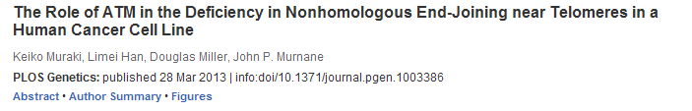
KJ

Slide 8


KJ

Slide 9



KJ

Slide 10

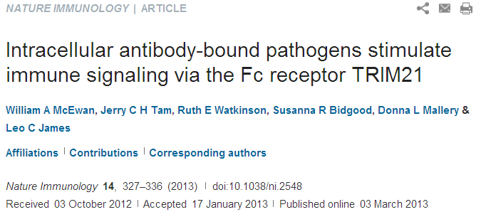
Division of Protein and Nucleic Acid Chemistry, Medical Research Council Laboratory of Molecular Biology, Cambridge, UK.
Abstract
During pathogen infection, antibodies can be carried into the infected cell, where they are detected by the ubiquitously expressed cytosolic antibody receptor TRIM21. Here we found that recognition of intracellular antibodies by TRIM21 activated immune signaling. TRIM21 catalyzed the formation of Lys63 (K63)-linked ubiquitin chains and stimulated the transcription factor pathways of NF-κB, AP-1, IRF3, IRF5 and IRF7. Activation resulted in the production of proinflammatory cytokines, modulation of natural killer stress ligands and induction of an antiviral state. Intracellular antibody signaling was abrogated by genetic deletion of TRIM21 and was restored by ectopic expression of TRIM21. The sensing of antibodies by TRIM21 was stimulated after infection by DNA or RNA nonenveloped viruses or intracellular bacteria. Thus, the antibody-TRIM21 detection system provides potent, comprehensive activation of the innate immune system independently of known pattern-recognition receptors.

Slide 11
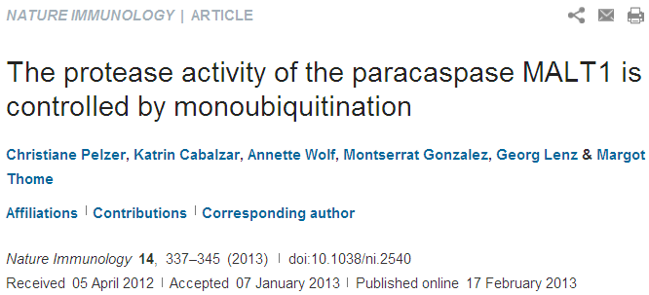
Department of Biochemistry, Center of Immunity and Infection, University of Lausanne, Epalinges, Switzerland.
Abstract
The protease activity of the paracaspase MALT1 is central to lymphocyte activation and lymphomagenesis, but how this activity is controlled remains unknown. Here we identify a monoubiquitination of MALT1 on Lys644 that activated the protease function of MALT1. Monoubiquitinated MALT1 had enhanced protease activity, whereas a ubiquitination-deficient MALT1 mutant with replacement of that lysine with arginine (MALT1(K644R)) had less protease activity, which correlated with impaired induction of interleukin 2 (IL-2) via the T cell antigen receptor in activated T cells. Expression of MALT1(K644R) diminished the survival of cells derived from diffuse large B cell lymphoma of the activated B cell–like subtype (ABC DLBCL), which require constitutive protease activity of MALT1 for survival. Thus, monoubiquitination of MALT1 is essential for its catalytic activation and is therefore a potential target for the treatment of ABC-DLBCL and for immunomodulation.

Slide 12
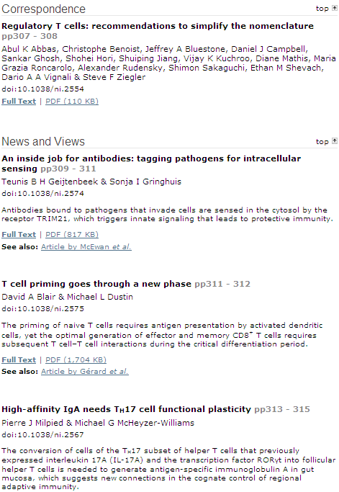


Slide 13


