Slide 1
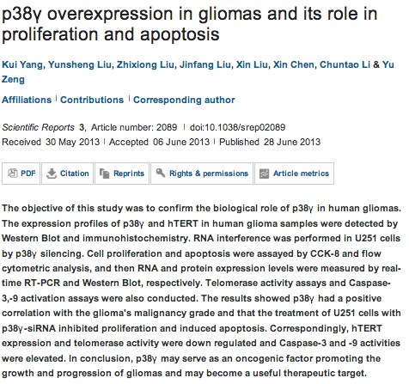
Scientific Reports

Slide 2
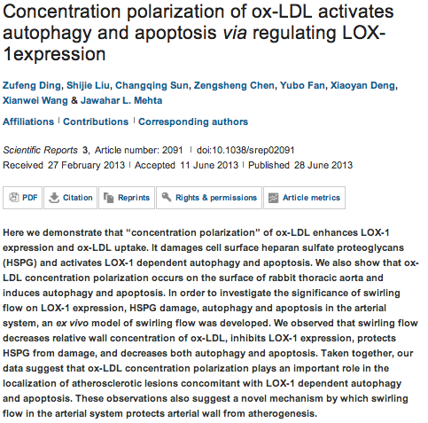

Slide 3
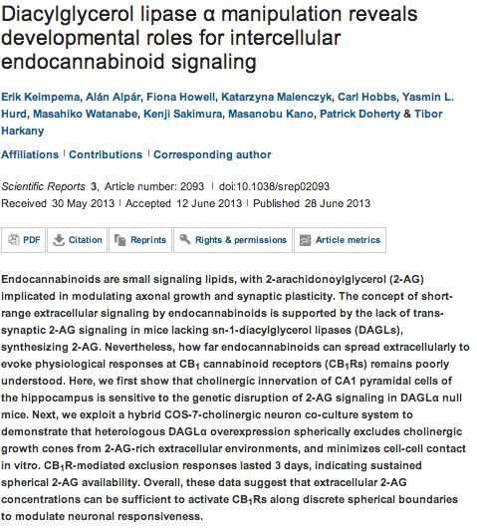

Slide 4
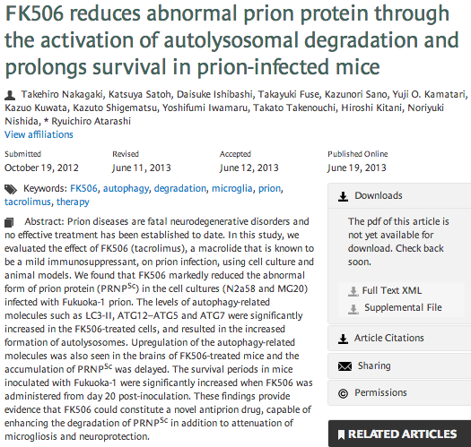
Autophagy

Slide 5
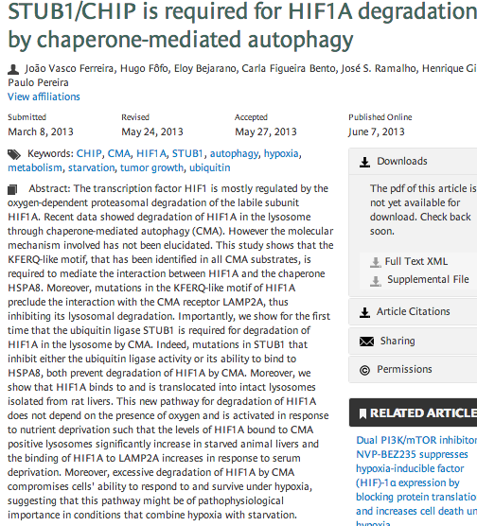

Slide 6

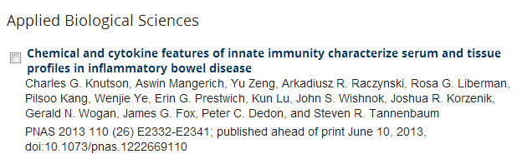
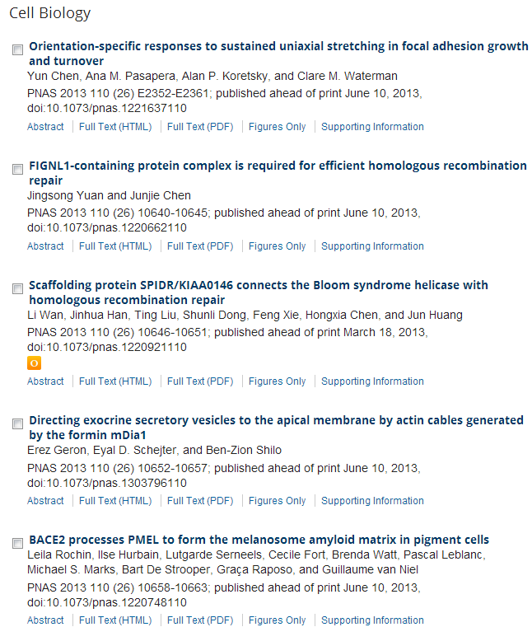
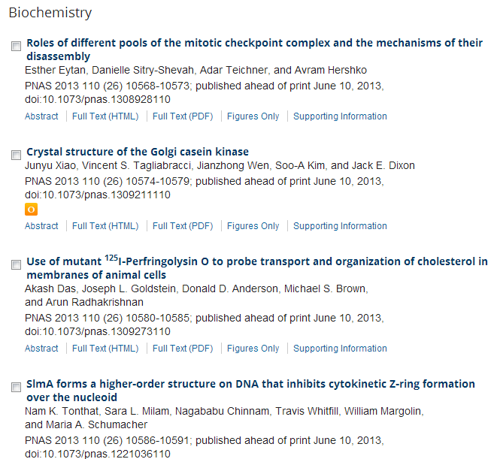

Slide 7
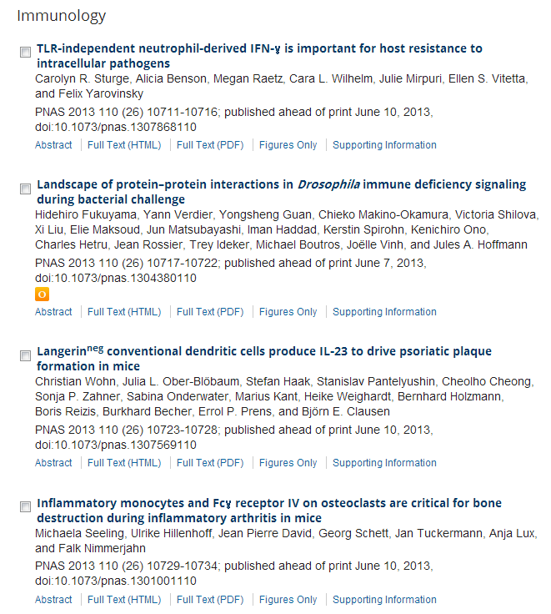
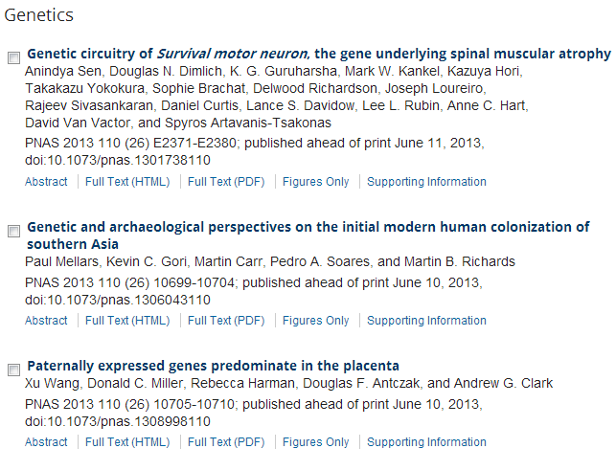

Slide 8
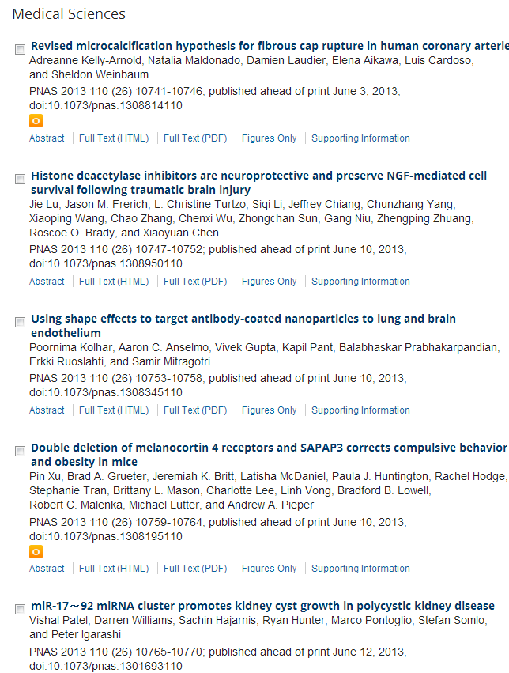
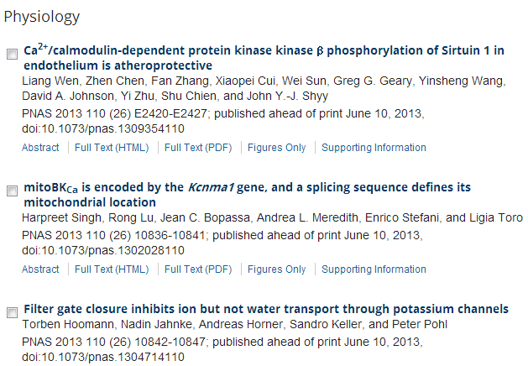

Slide 9
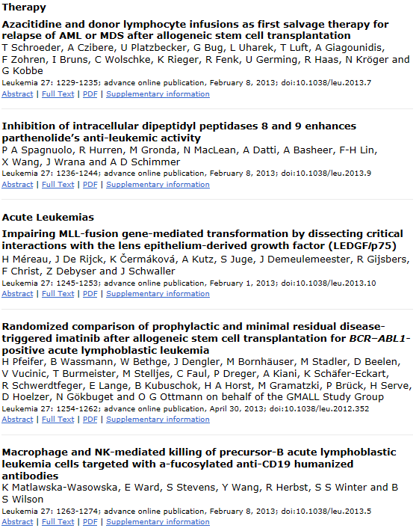

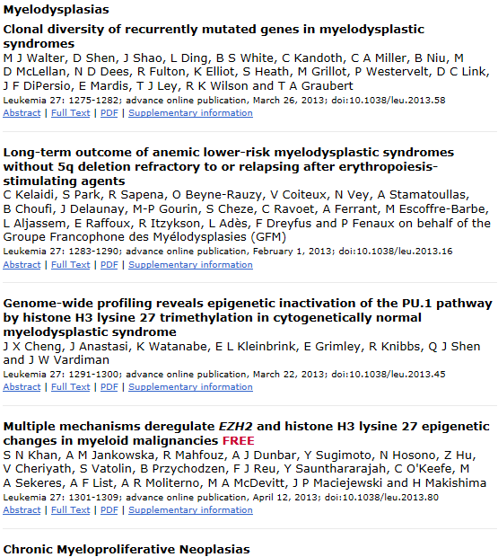

Slide 10
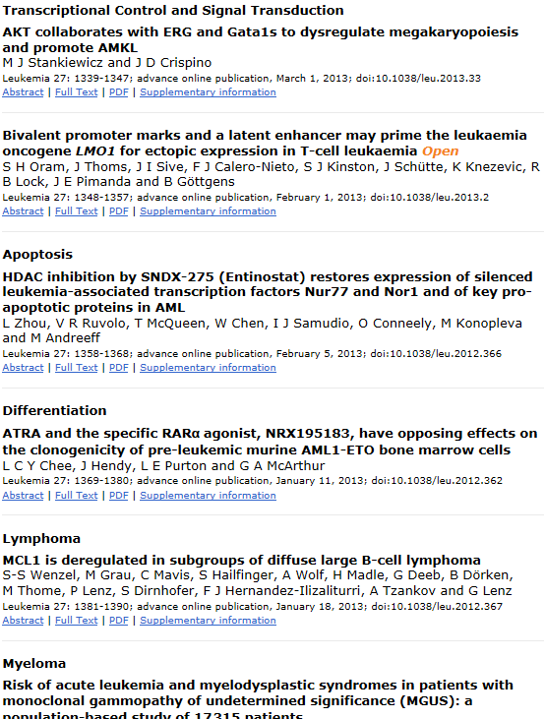
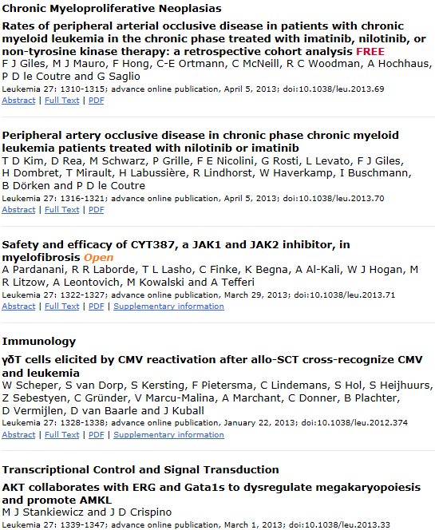

Slide 11

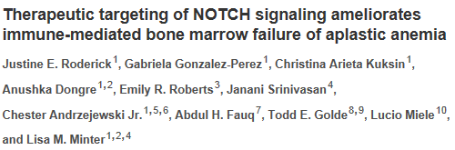
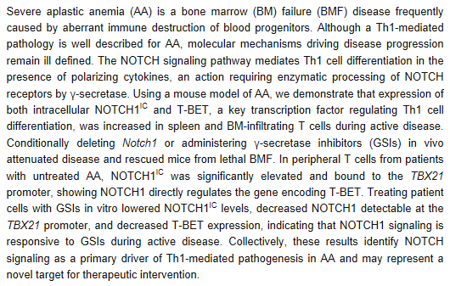

Slide 12
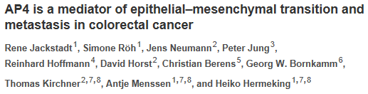
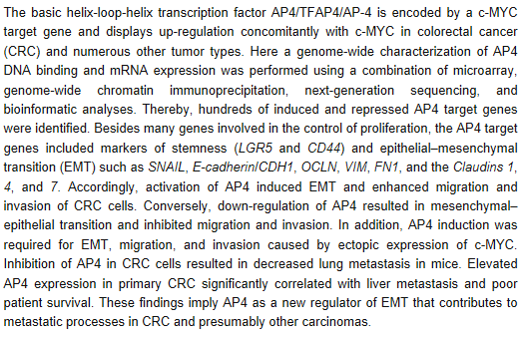

Slide 13
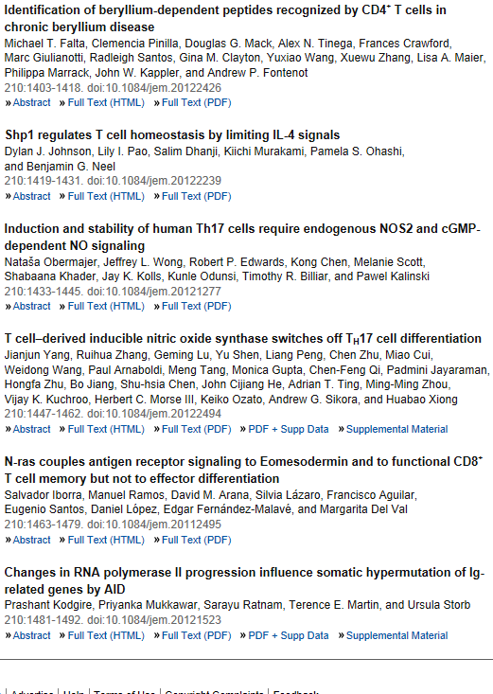
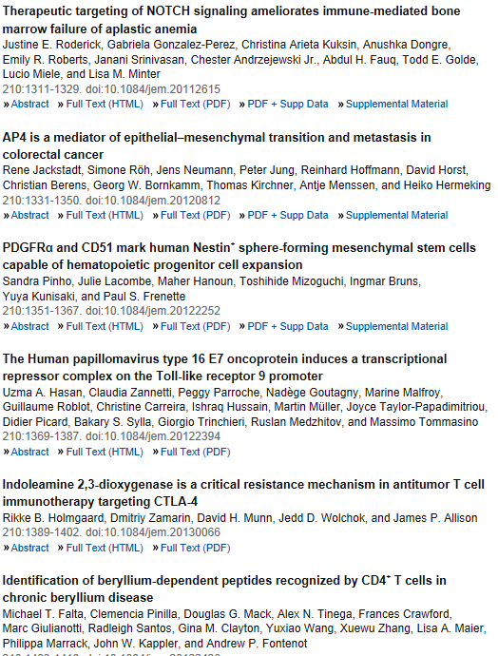

Slide 14
Infiltrating bone marrow mesenchymal stem cells increase prostate cancer stem cell population and metastatic ability via secreting cytokines to suppress androgen receptor signaling.
Luo J, Ok Lee S, Liang L, Huang CK, Li L, Wen S, Chang C.
George Whipple Lab for Cancer Research, Departments of Pathology, Urology, Radiation Oncology, and The Wilmot Cancer Center, University of Rochester Medical Center, Rochester, NY, USA.
Although the contribution of the bone marrow mesenchymal stem cells (BM-MSCs) in cancer progression is emerging, their potential roles in prostate cancer (PCa) remain unclear. Here, we showed that PCa cells could recruit BM-MSCs and consequently the metastatic ability of PCa cells was increased. We also found that the increased metastatic ability of PCa cells could be due to the increased PCa stem cell population. Mechanism dissection studies found that the upregulation of Chemokine ligand 5 (CCL5) expression in BM-MSCs and PCa cells, after MSCs infiltrated into the PCa cells, subsequently downregulated androgen receptor (AR) signaling, which was due to inhibition of AR nuclear translocation. Interruption of such signaling led to suppression of the BM-MSCs-induced PCa stem cell population increase and thereby inhibited the metastatic ability of PCa cells. The PCa stem cell increase then led to the upregulation of matrix metalloproteinase 9, ZEB-1, CD133 and CXCR4 molecules, and enhanced the metastatic ability of PCa cells. Therefore, we conclude that the BM-MSCs-mediated increased metastatic ability of PCa cells can be due to the PCa stem cell increase via alteration of the CCL5-AR signaling pathway. Together, these results uncover the important roles of BM-MSCs as key components in the prostate tumor microenvironment to promote PCa metastasis and may provide a new potential target to suppress PCa metastasis by blocking BM-MSCs infiltration into PCa.

Slide 15
Snail1-dependent transcriptional repression of Cezanne2 in hepatocellular carcinoma.
Xu Z, Pei L, Wang L, Zhang F, Hu X, Gui Y.
Source
Department of molecular diagnosis, ZhongCheng Translational-Medicine Inc, Shanghai, China.
Abstract
High malignancy and early metastasis are the hallmarks of hepatocellular carcinoma (HCC). Here, we report that Cezanne2 expression is downregulated in HCC cells and in HCC patients' tumorous tissues and that Cezanne2 is inversely associated with Snail1 expression in HCC patients' tumorous tissues. Chromatin immunoprecipitation assays and the reporter gene assay showed that Snail1 binds to the promoter of the Cezanne2 gene and mediates the direct consequence of Cezanne2 repression. Enhanced expression of Cezanne2 could suppress proliferation, migration and invasion in HCC cells. Further, Cezanne2 could regulate MMP (matrix metalloproteinase)2, MMP9 and ICAM1 (intercellular adhesion molecule) levels through modulation of the NF-κB (nuclear factor kappa-light-chain-enhancer of activated B cell) signaling cascade. Co-immunoprecipitation and in vivo deubiquitination assay indicated that Cezanne2 interacts with TNF receptor-associated factor (TRAF)6 and cleaves the polyubiquitin from TRAF6 substrates. Our data reveal that Snail1-mediated suppression of Cezanne2 may have a key role in HCC malignancy.

Slide 16
Whole chromosome instability resulting from the synergistic effects of pRB and p53 inactivation.
Manning AL, Benes C, Dyson NJ.
Source
Center for Cancer Research, Massachusetts General Hospital Cancer Center, Harvard Medical School, Harvard University, Charlestown, MA, USA.
Abstract
Whole chromosome instability (CIN) is a common feature of cancer cells and has been linked to increased tumor evolution and metastasis. Several studies have shown that the loss of the pRB tumor suppressor causes mitotic defects and chromosome mis-segregation. pRB is inactivated in many types of cancer and this raises the possibility that the loss of pRB may be a general cause of CIN in tumors. Paradoxically, retinoblastoma tumor cells have a relatively stable karyotype and currently the circumstances in which pRB inactivation causes CIN in human cancers are unclear. Here we utilize a fluorescence in situ hybridization-based approach to score numerical heterogeneity in chromosome copy number as a readout of CIN. Using this technique, we show that high levels of CIN correlate with the combined inactivation of pRB and p53 and that this association is evident in two independent panels of cancer cell lines. Retinoblastoma cell lines characteristically retain a wild-type TP53 gene, providing an opportunity to test the relevance of this functional relationship. We show that retinoblastoma cell lines display mitotic defects similar to those seen when pRB is depleted from non-transformed cells, but that the presence of wild-type p53 suppresses the accumulation of aneuploid cells. A similar synergy between pRB and p53 inactivation was observed in HCT116 cells. These results suggest that the loss of pRB promotes segregation errors, whereas loss of p53 allows tolerance and continued proliferation of the resulting, genomically unstable cancer cells. Hence, it is the cooperative effect of inactivation of both pRB and p53 tumor suppressor pathways that promotes CIN.

Slide 17
Discovery of colorectal cancer PIK3CA mutation as potential predictive biomarker: power and promise of molecular pathological epidemiology.
Ogino S, Lochhead P, Giovannucci E, Meyerhardt JA, Fuchs CS, Chan AT.
Source
1] Department of Pathology, Brigham and Women's Hospital, Harvard Medical School, Boston, MA, USA [2] Department of Medical Oncology, Dana-Farber Cancer Institute, Boston, MA, USA [3] Department of Epidemiology, Harvard School of Public Health, Boston, MA, USA.
Annexin A2 depletion delays EGFR endocytic trafficking via cofilin activation and enhances EGFR signaling and metastasis formation.
de Graauw M, Cao L, Winkel L, van Miltenburg MH, le Dévédec SE, Klop M, Yan K, Pont C, Rogkoti VM, Tijsma A,Chaudhuri A, Lalai R, Price L, Verbeek F, van de Water B.
Source
Division of Toxicology, LACDR, Leiden University, Leiden, The Netherlands.
The oncogenic GLI transcription factors facilitate keratinocyte survival and transformation upon exposure to genotoxic agents.
Harrison W, Cochrane B, Neill G, Philpott M.
Source
Centre for Cutaneous Research, Blizard Institute, Barts and The London School of Medicine and Dentistry, Queen Mary University of London, London, UK.
Integrin α3β1-CD151 complex regulates dimerization of ErbB2 via RhoA.
Novitskaya V, Romanska H, Kordek R, Potemski P, Kusińska R, Parsons M, Odintsova E, Berditchevski F.
Source
School of Cancer Sciences, The University of Birmingham, Edgbaston, Birmingham, UK.
Infiltrating bone marrow mesenchymal stem cells increase prostate cancer stem cell population and metastatic ability via secreting cytokines to suppress androgen receptor signaling.
Luo J, Ok Lee S, Liang L, Huang CK, Li L, Wen S, Chang C.
Source
George Whipple Lab for Cancer Research, Departments of Pathology, Urology, Radiation Oncology, and The Wilmot Cancer Center, University of Rochester Medical Center, Rochester, NY, USA.
Targeting Myc in KSHV-associated primary effusion lymphoma with BET bromodomain inhibitors.
Tolani B, Gopalakrishnan R, Punj V, Matta H, Chaudhary PM.
Source
Jane Anne Nohl Division of Hematology and Center for the Study of Blood Diseases, University of Southern California Keck School of Medicine, Los Angeles, CA, USA.

Slide 18
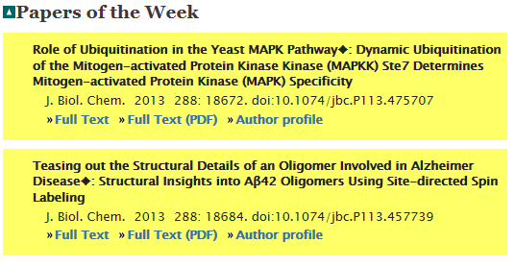
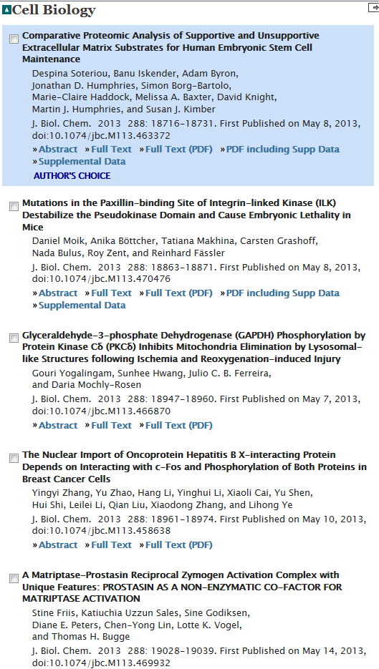

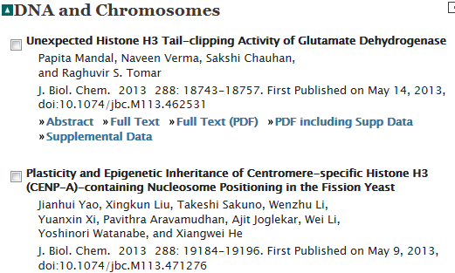
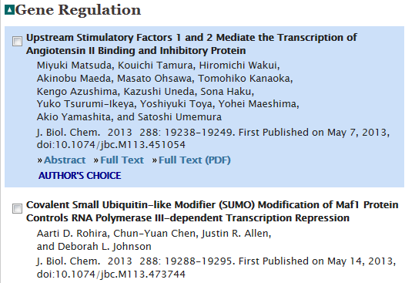

Slide 19
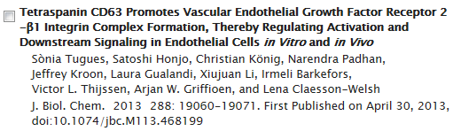
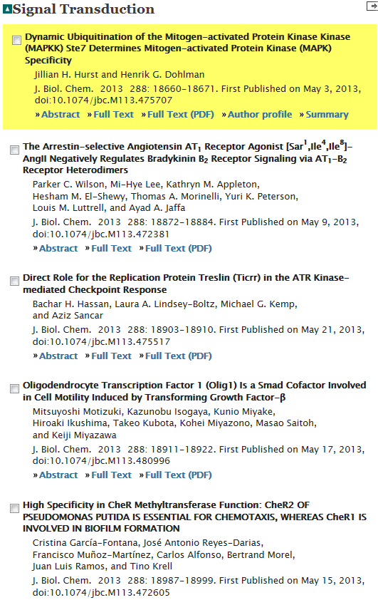
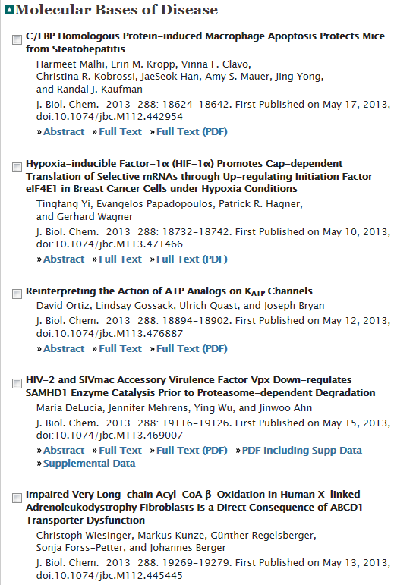

Slide 20
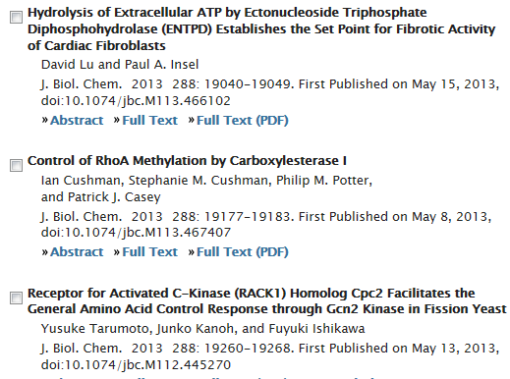

Slide 21
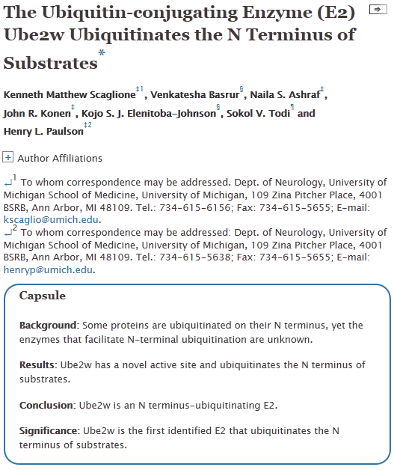

Slide 22
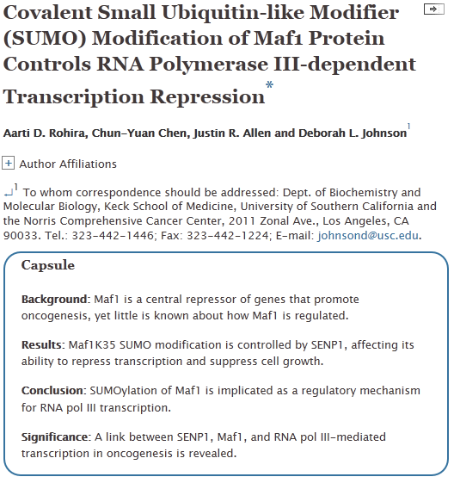

Slide 23
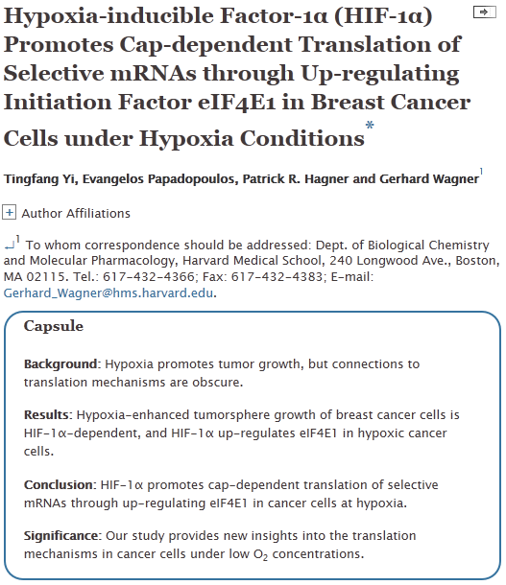

Slide 24
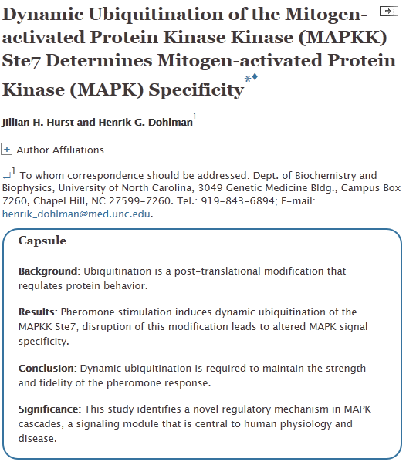

Slide 25

Genital Evolution: Cock-a-Doodle-Don’tpR523Patricia L.R. Brennan
Summary | Full Text | PDF (173 kb)
.
Evolutionary Genetics: Inheritance of a Complex Pollination Syndrome pR525Kevin M. Wright, Kirsten Bomblies
Summary | Full Text | PDF (223 kb)
Tumor Suppression: p53 Alters Immune Surveillance to Restrain Liver CancerpR527Nitin Raj, Laura D. Attardi
Summary | Full Text | PDF (449 kb)
Cells inside Cells: Symbiosis and Continuing Phagotrophy pR530John A. Raven
Summary | Full Text | PDF (136 kb)
GMF Severs Actin-Arp2/3 Complex Branch Junctions by a Cofilin-like Mechanism p1037Casey A. Ydenberg, Shae B. Padrick, Meredith O. Sweeney, Meghal Gandhi, Olga Sokolova, Bruce L. Goode
Summary | Full Text | PDF (1679 kb)
Dynamic Localization of G-Actin during Membrane Protrusion in Neuronal Motility p1046Chi Wai Lee, Eric A. Vitriol, Sangwoo Shim, Ariel L. Wise, Radhi P. Velayutham, James Q. Zheng
Summary | Full Text | PDF (4497 kb)
A Cytokinin-Activating Enzyme Promotes Tuber Formation in Tomato p1057Tamar Eviatar-Ribak, Akiva Shalit-Kaneh, Louise Chappell-Maor, Ziva Amsellem, Yuval Eshed, Eliezer Lifschitz
Summary | Full Text | PDF (2143 kb)
Developmental Basis of Phallus Reduction during Bird Evolution p1065Ana M. Herrera, Simone G. Shuster, Claire L. Perriton, Martin J. Cohn
Summary | Full Text | PDF (1528 kb)
Anthocyanins Double the Shelf Life of Tomatoes by Delaying Overripening and Reducing Susceptibility to Gray Mold p1094Yang Zhang, Eugenio Butelli, Rosalba De Stefano, Henk-jan Schoonbeek, Andreas Magusin, Chiara Pagliarani, Nikolaus Wellner, Lionel Hill, Diego Orzaez, Antonio Granell, Jonathan D.G. Jones, Cathie Martin
Summary | Full Text | PDF (1523 kb)

Slide 26
Theta Oscillations at Encoding Mediate the Context-Dependent Nature of Human Episodic Memory p1101Tobias Staudigl, Simon Hanslmayr
Summary | Full Text | PDF (1771 kb)
Context-Dependent Decay of Motor Memories during Skill Acquisition p1107James N. Ingram, J. Randall Flanagan, Daniel M. Wolpert
Summary | Full Text | PDF (845 kb)
Evolutionary Origin of the Turtle Shell p1113Tyler R. Lyson, Gabe S. Bever, Torsten M. Scheyer, Allison Y. Hsiang, Jacques A. Gauthier
Summary | Full Text | PDF (2828 kb)
Group Formation, Relatedness, and the Evolution of Multicellularity p1120Roberta M. Fisher, Charlie K. Cornwallis, Stuart A. West
Summary | Full Text | PDF (397 kb)
Cloning and Characterization of Four Novel Coral Acid-Rich Proteins that Precipitate Carbonates In Vitro p1126Tali Mass, Jeana L. Drake, Liti Haramaty, J. Dongun Kim, Ehud Zelzion, Debashish Bhattacharya, Paul G. Falkowski
Summary | Full Text | PDF (1118 kb)
Dance Choreography Is Coordinated with Song Repertoire in a Complex Avian Displayp1132Anastasia H. Dalziell, Richard A. Peters, Andrew Cockburn, Alexandra D. Dorland, Alex C. Maisey, Robert D. Magrath
Summary | Full Text | PDF (560 kb)

